Slide 1
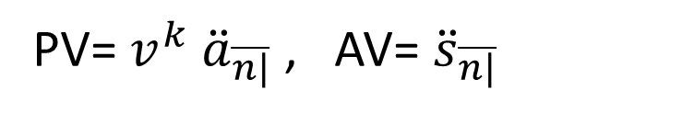
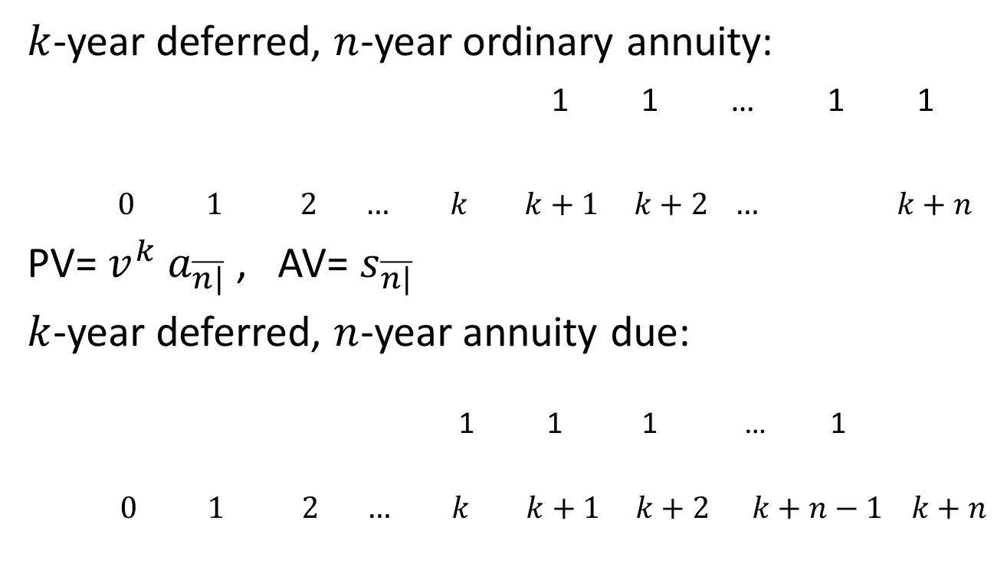
Deferred annuities
$k$-year deferred, $n$-year ordinary annuity:
1 1 … 1 1
$0 1 2 … k k+1 k+2 … k+n$
PV= $v^{k} a_{\overline{n|}}$ , AV= $s_{\overline{n|}}$
$k$-year deferred, $n$-year annuity due:
1 1 1 … 1
$$0 1 2 … k k+1 k+2 k+n−1 k+n$$
PV= $v^{k} {\ddot{a}}_{\overline{n|}}$ , AV= ${\ddot{s}}_{\overline{n|}}$

Slide 2
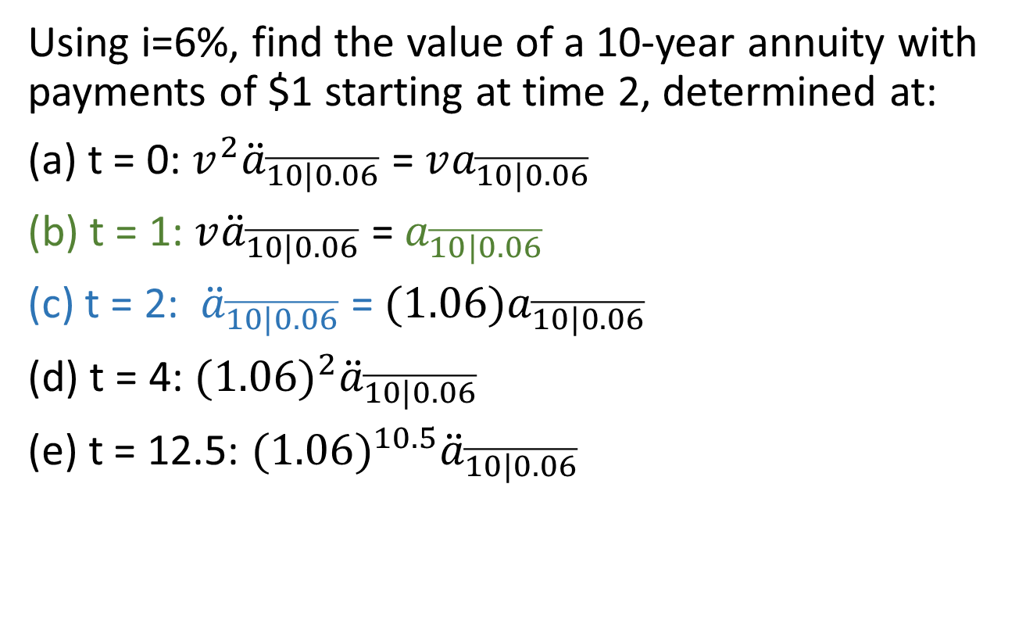
Annuity recap/example
Using i=6%, find the value of a 10-year annuity with payments of $1 starting at time 2, determined at:
(a) t = 0: ${v^{2}\ddot{a}}_{\overline{10|0.06}}$ = $va_{\overline{10|0.06}}$
(b) t = 1: ${v\ddot{a}}_{\overline{10|0.06}}$ = $a_{\overline{10|0.06}}$
(c) t = 2: ${\ddot{a}}_{\overline{10|0.06}}$ = ${(1.06)a}_{\overline{10|0.06}}$
(d) t = 4: $(1.06)^{2}{\ddot{a}}_{\overline{10|0.06}}$
(e) t = 12.5: $(1.06)^{10.5}{\ddot{a}}_{\overline{10|0.06}}$

Slide 3
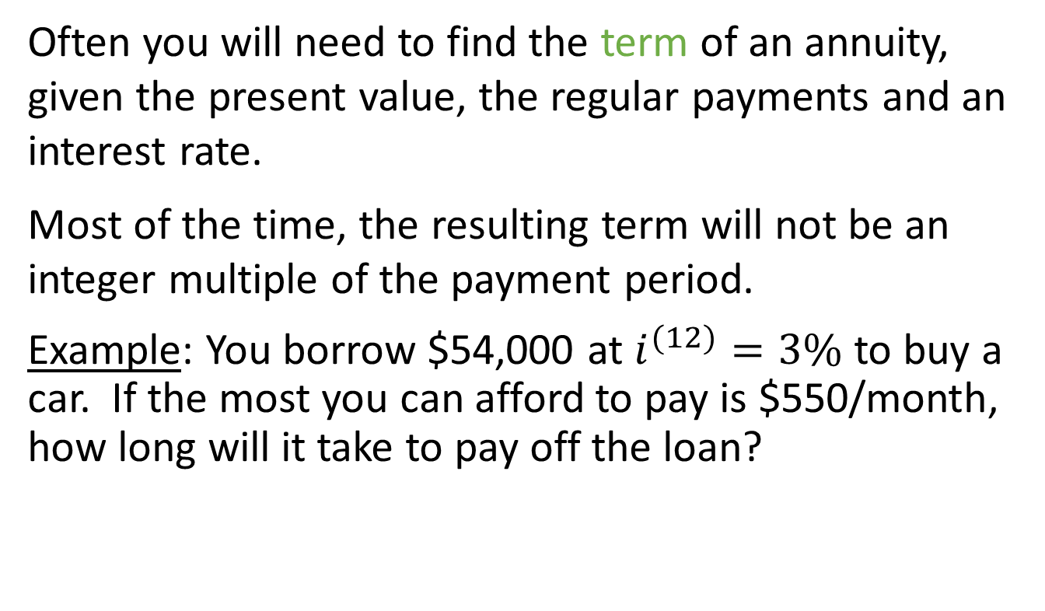
3.5 Finding the term of an annuity
Often you will need to find the term of an annuity, given the present value, the regular payments and an interest rate.
Most of the time, the resulting term will not be an integer multiple of the payment period.
Example: You borrow $54,000 at $i^{(12)}=3\%$ to buy a car. If the most you can afford to pay is $550/month, how long will it take to pay off the loan?

Slide 4
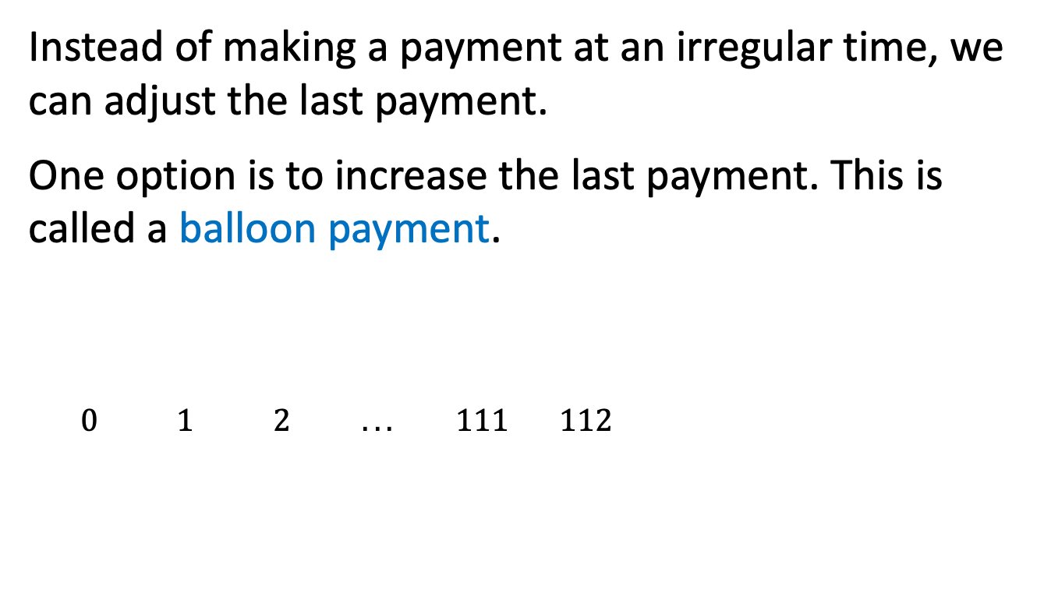
Balloon payments
Instead of making a payment at an irregular time, we can adjust the last payment.
One option is to increase the last payment. This is called a balloon payment.
$0 1 2 ... 111 112$

Slide 5
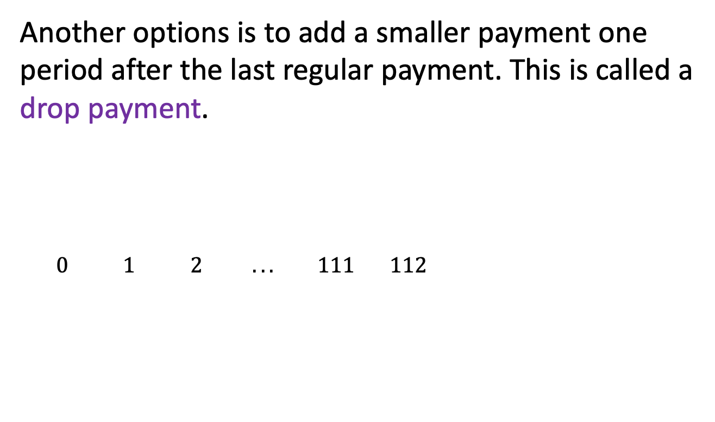
Drop payments
Another options is to add a smaller payment one period after the last regular payment. This is called a drop payment.
$0 1 2 ... 111 112$

Slide 6
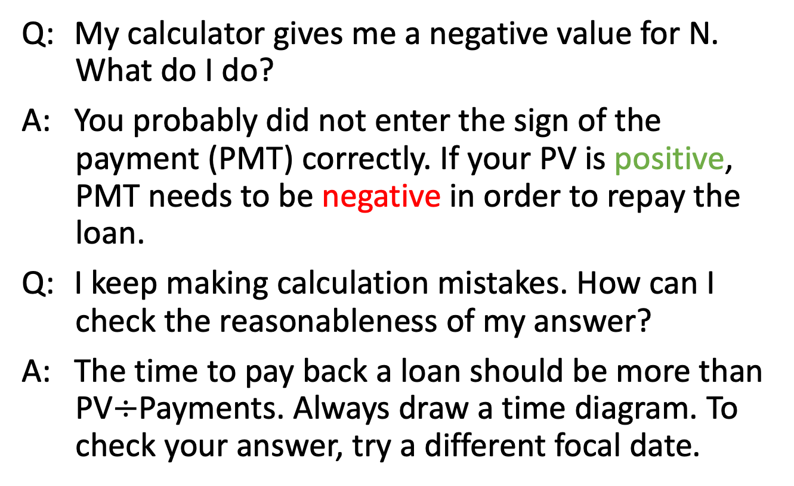
Common mistakes
Q: My calculator gives me a negative value for N. What do I do?
A: You probably did not enter the sign of the payment (PMT) correctly. If your PV is positive, PMT needs to be negative in order to repay the loan.
Q: I keep making calculation mistakes. How can I check the reasonableness of my answer?
A: The time to pay back a loan should be more than PV$÷$Payments. Always draw a time diagram. To check your answer, try a different focal date.

Slide 7
3.6 Finding the interest rate
Sometimes you know the PV (loan amount) or FV (the desired savings at some future date), as well as the payments and the term, so what you need to find is the interest rate.
This is easy if you have a financial calculator.
Your calculator actually runs an approximation algorithm to find the interest rate that satisfies your equation of value.
You can do this too.

Slide 8
Approximation methods
Consider rates in 1% increments, use linear approximation between closest rates
Proper root-finding algorithms
  Bisection
  Newton–Raphson method
In Excel, you can use the RATE function or the Goal Seek feature (under Tools menu)
In R, the NLRoot package has both bisection and Newton-Raphson methods

Slide 9
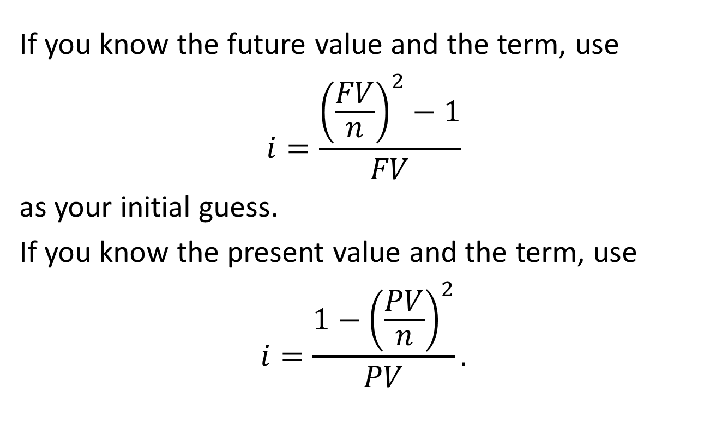
Starting values
If you know the future value and the term, use
$$i=\frac{{\left(\frac{FV}{n}\right)}^{2}−1}{FV}$$
as your initial guess.
If you know the present value and the term, use
$$i=\frac{{1−\left(\frac{PV}{n}\right)}^{2}}{PV}.$$

Slide 10
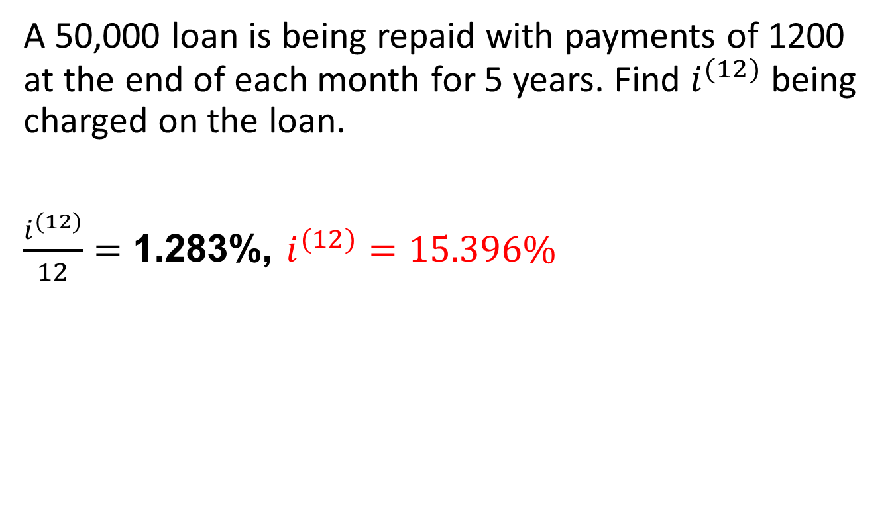
Example
A 50,000 loan is being repaid with payments of 1200 at the end of each month for 5 years. Find $i^{(12)}$ being charged on the loan.
$\frac{i^{(12)}}{12}=$ 1.283%, $i^{(12)}=15.396\%$

Slide 11
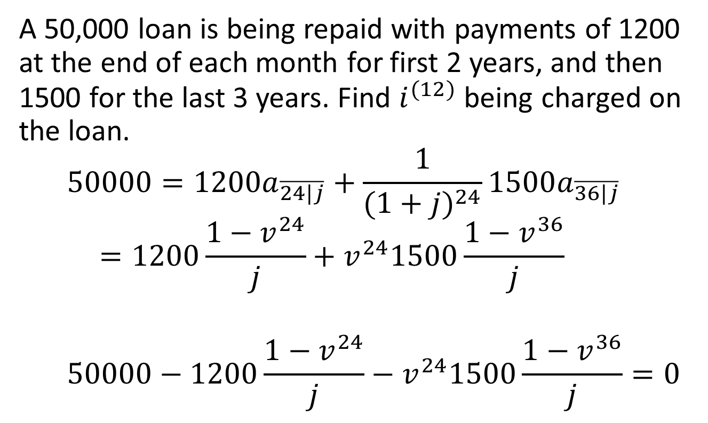
Example
A 50,000 loan is being repaid with payments of 1200 at the end of each month for first 2 years, and then 1500 for the last 3 years. Find $i^{(12)}$ being charged on the loan.
$${50000=1200a}_{\overline{24|j}}+\frac{1}{(1+j)^{24}}1500a_{\overline{36|j}}$$
$$=1200\frac{1−v^{24}}{j}+v^{24}1500\frac{1−v^{36}}{j}$$
$$50000−1200\frac{1−v^{24}}{j}−v^{24}1500\frac{1−v^{36}}{j}=0$$

