Slide 1
CHAPTER 4
General and Other Annuities

Slide 2
4.1 General annuities
An annuity for which payments are made more or less frequently than interest is compounded is called a general annuity.
The simplest technique to solve problems involving general annuities is to replace the given interest rate with an equivalent rate whose compounding period matches the payment periods.

Slide 3
Example 4.1
Payments of $500 are made for two years at the beginning of each month. Find the present value of these payments if the effective annual rate is 6%.
0 1 2 11 12 23 24

Slide 4
Alternative approach
An alternative approach is to replace the payments with equivalent payments whose frequency matches the interest compounding period.
Example 4.1, continued
500 500 500 … 500 500 … 500
0 1 2 … 11 12 … 23 24

Slide 5
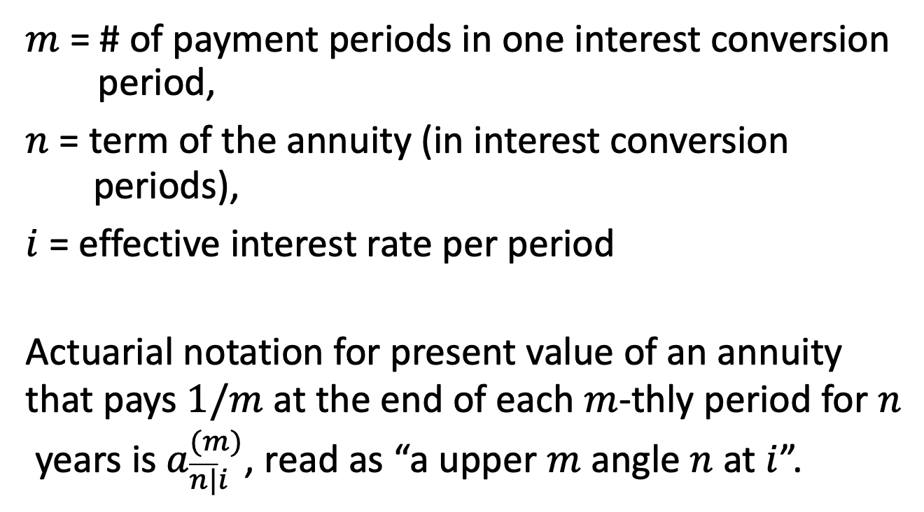
Ordinary annuity payable m-thly
$m$ = # of payment periods in one interest conversion period,
$n$ = term of the annuity (in interest conversion periods),
$i$ = effective interest rate per period
Actuarial notation for present value of an annuity
that pays $1/m$ at the end of each $m$-thly period for $n$
years is $a_{\overline{n|}i}^{(m)}$, read as “a upper $m$ angle $n$ at $i$”.

Slide 6
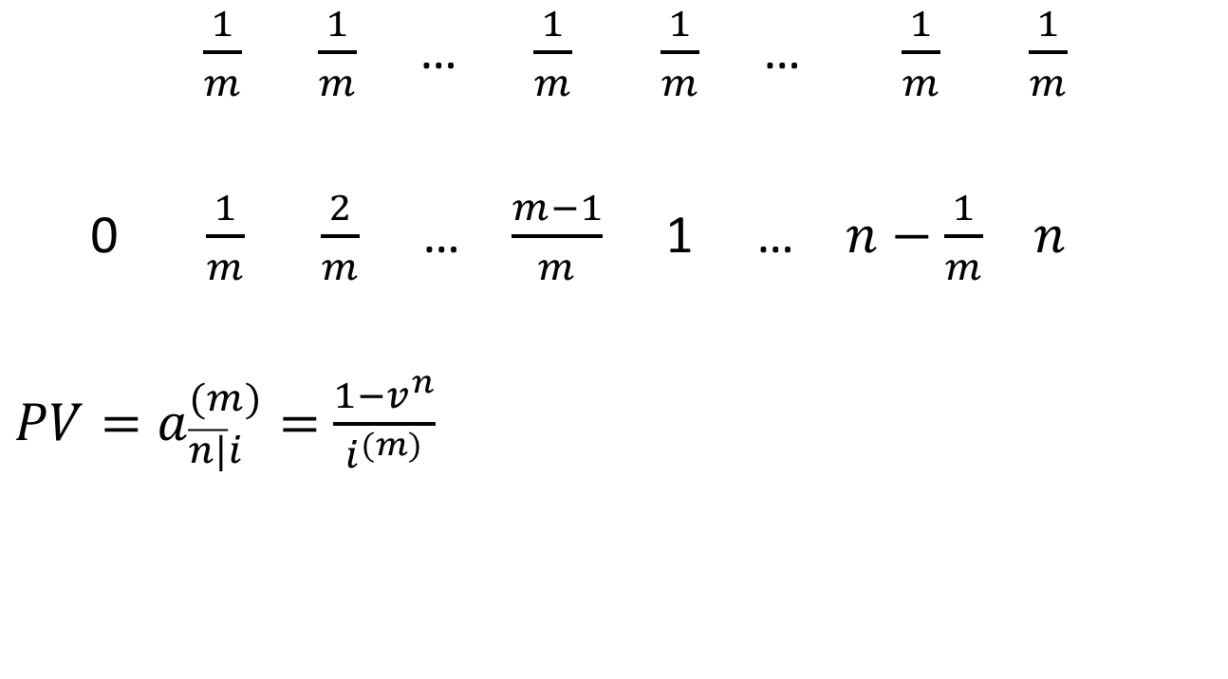
PV of annuity payable m-thly
$\frac{1}{m}$ $\frac{1}{m}$ … $\frac{1}{m}$ $\frac{1}{m}$ … $\frac{1}{m}$ $\frac{1}{m}$
0 $\frac{1}{m}$ $\frac{2}{m}$ … $\frac{m−1}{m}$ 1 … $n−\frac{1}{m}$ $n$
${PV=a}_{\overline{n|}i}^{(m)}=$ $\frac{1−v^{n}}{i^{(m)}}$

Slide 7
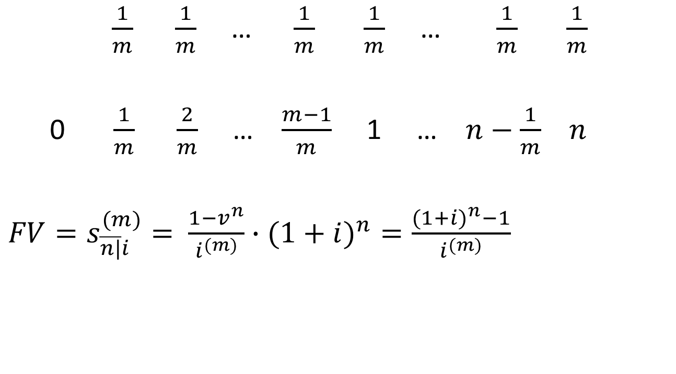
FV of annuity payable m-thly
$\frac{1}{m}$ $\frac{1}{m}$ … $\frac{1}{m}$ $\frac{1}{m}$ … $\frac{1}{m}$ $\frac{1}{m}$
0 $\frac{1}{m}$ $\frac{2}{m}$ … $\frac{m−1}{m}$ 1 … $n−\frac{1}{m}$ $n$
${FV=s}_{\overline{n|}i}^{(m)}=$ $\frac{1−v^{n}}{i^{(m)}}∙(1+i)^{n}=\frac{(1+i)^{n}−1}{i^{(m)}}$

Slide 8
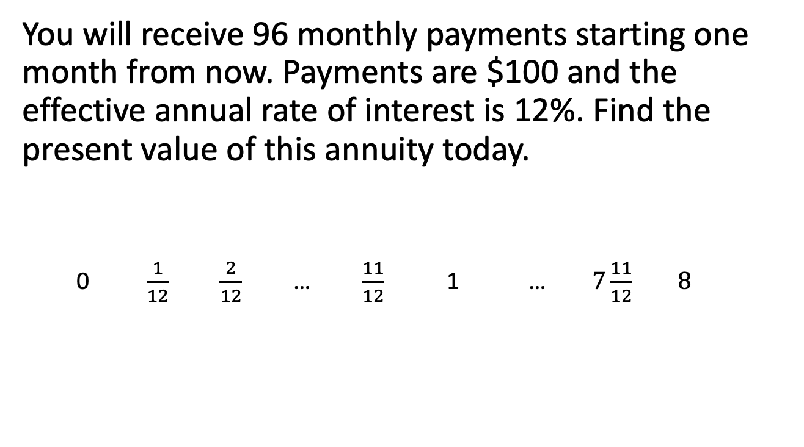
Example 4.2
You will receive 96 monthly payments starting one month from now. Payments are $100 and the effective annual rate of interest is 12%. Find the present value of this annuity today.
0 $\frac{1}{12}$ $\frac{2}{12}$ … $\frac{11}{12}$ 1 … $7\frac{11}{12}$ $8$

Slide 9
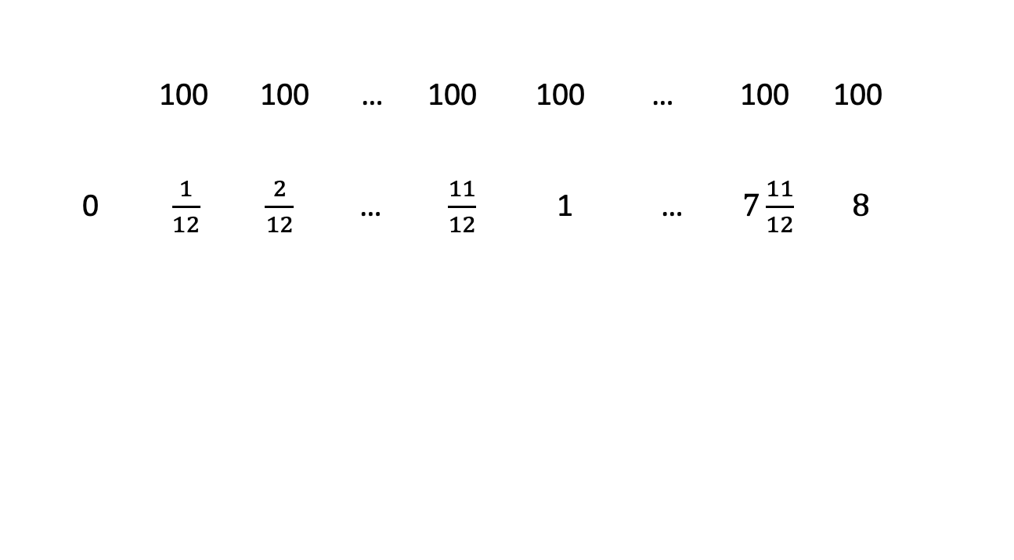
Example 4.2, continued
100 100 … 100 100 … 100 100
0 $\frac{1}{12}$ $\frac{2}{12}$ … $\frac{11}{12}$ 1 … $7\frac{11}{12}$ $8$

Slide 10
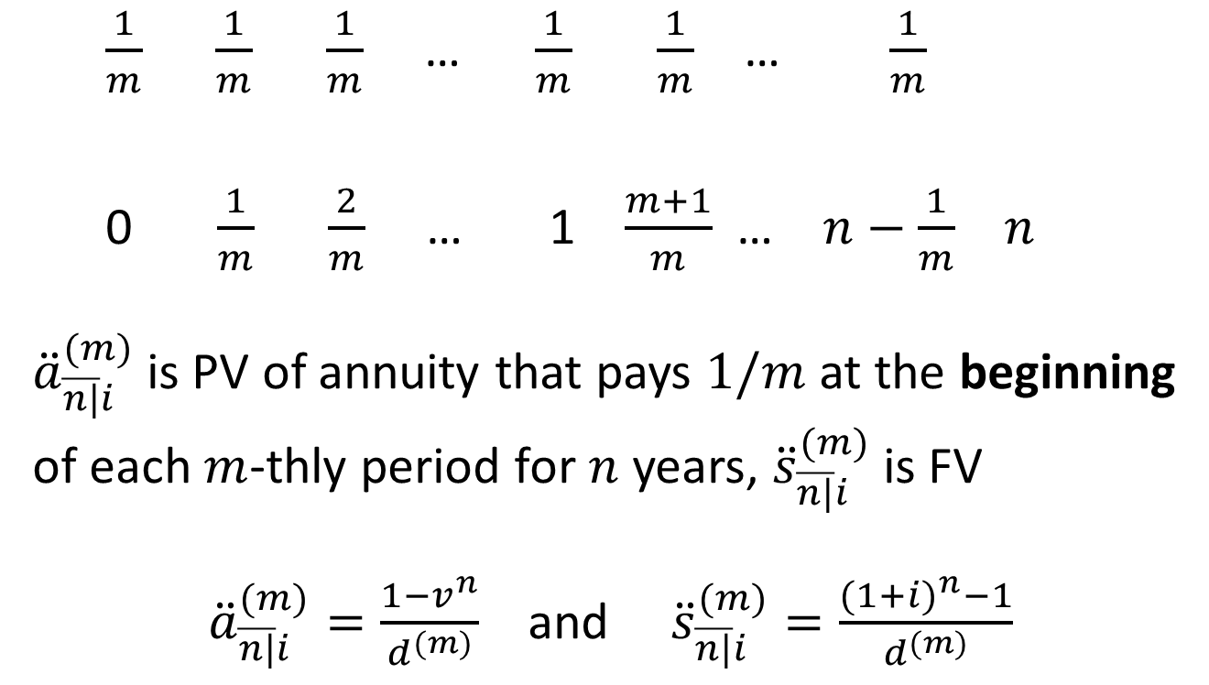
Annuity-due payable m-thly
$\frac{1}{m}$ $\frac{1}{m}$ $\frac{1}{m}$ … $\frac{1}{m}$ $\frac{1}{m}$ … $\frac{1}{m}$
0 $\frac{1}{m}$ $\frac{2}{m}$ … 1 $\frac{m+1}{m}$ … $n−\frac{1}{m}$ $n$
${\ddot{a}}_{\overline{n|}i}^{(m)}$is PV of annuity that pays $1/m$ at the beginning of each $m$-thly period for $n$ years, ${\ddot{s}}_{\overline{n|}i}^{(m)}$is FV
${\ddot{a}}_{\overline{n|}i}^{(m)}=\frac{1−v^{n}}{d^{(m)}}$ and ${\ddot{s}}_{\overline{n|}i}^{(m)}=\frac{{(1+i)}^{n}−1}{d^{(m)}}$

Slide 11
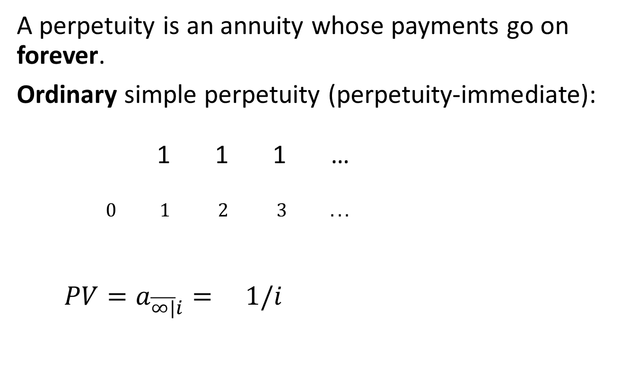
4.3 Perpetuities
A perpetuity is an annuity whose payments go on forever.
Ordinary simple perpetuity (perpetuity-immediate):
1 1 1 …
$0 1 2 3 ...$
$${PV=a}_{\overline{∞|}i}^{ }= 1/i$$

Slide 12
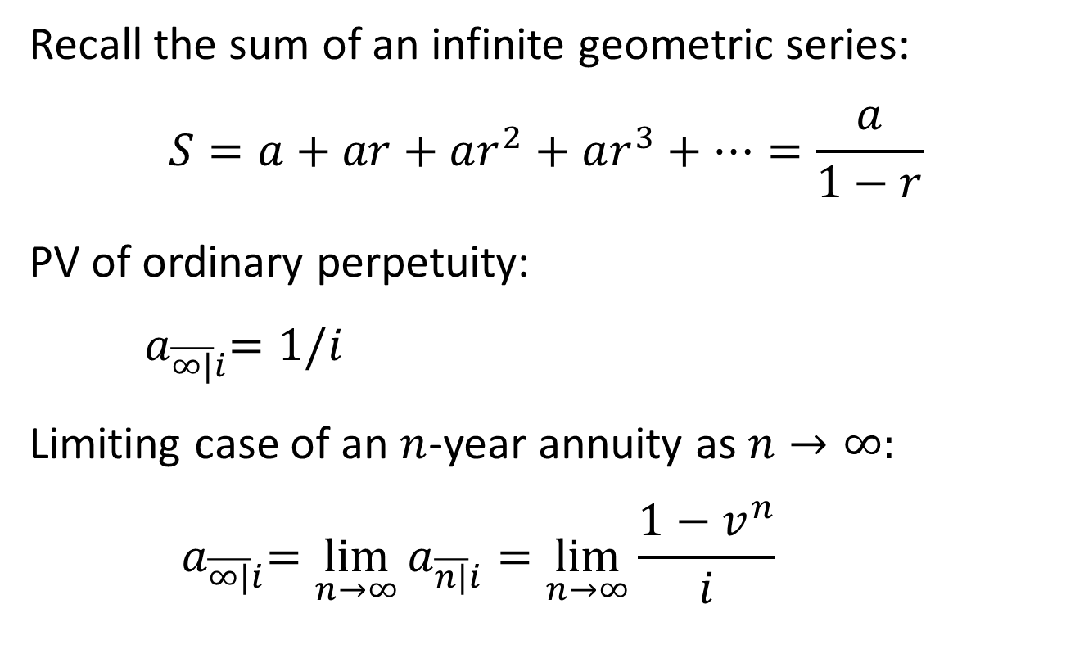
PV of ordinary perpetuity
Recall the sum of an infinite geometric series:
$$S=a+ar+ar^{2}+ar^{3}+…=\frac{a}{1−r}$$
PV of ordinary perpetuity:
$${ a}_{\overline{∞|}i}^{ }=1/i$$
Limiting case of an $n$-year annuity as $n→∞:$
$${ a}_{\overline{∞|}i}^{ }=\lim_{n→∞}{a_{\overline{n|}i}^{ }}=\lim_{n→∞}\frac{1−v^{n}}{i}$$

Slide 13
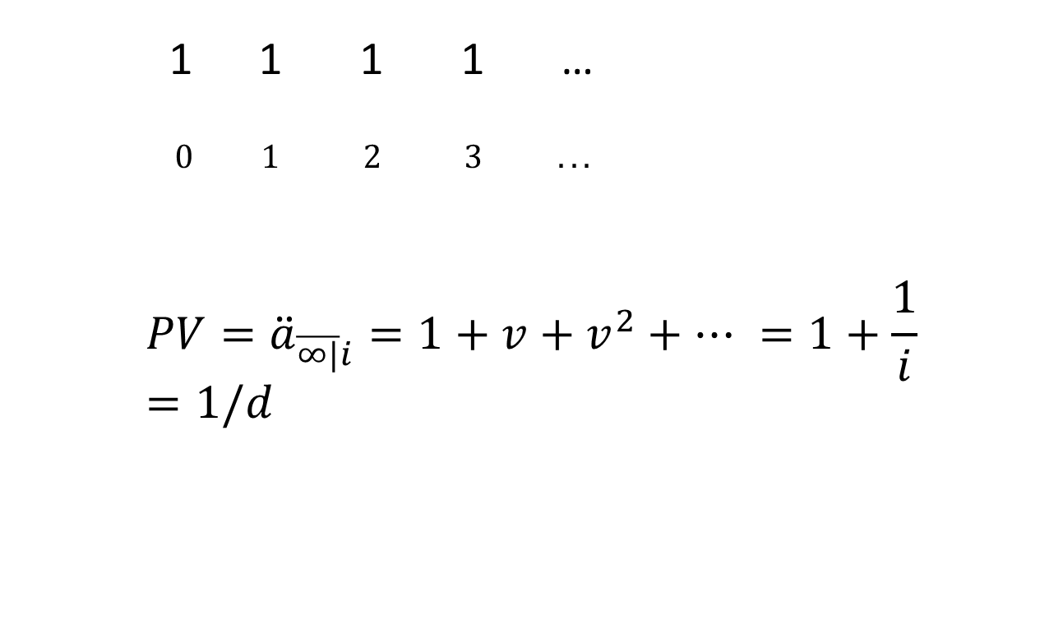
Perpetuity due
1 1 1 1 …
$0 1 2 3 ...$
$${PV=\ddot{a}}_{\overline{∞|}i}^{ }=1+v+v^{2}+… =1+\frac{1}{i}=1/d$$

Slide 14
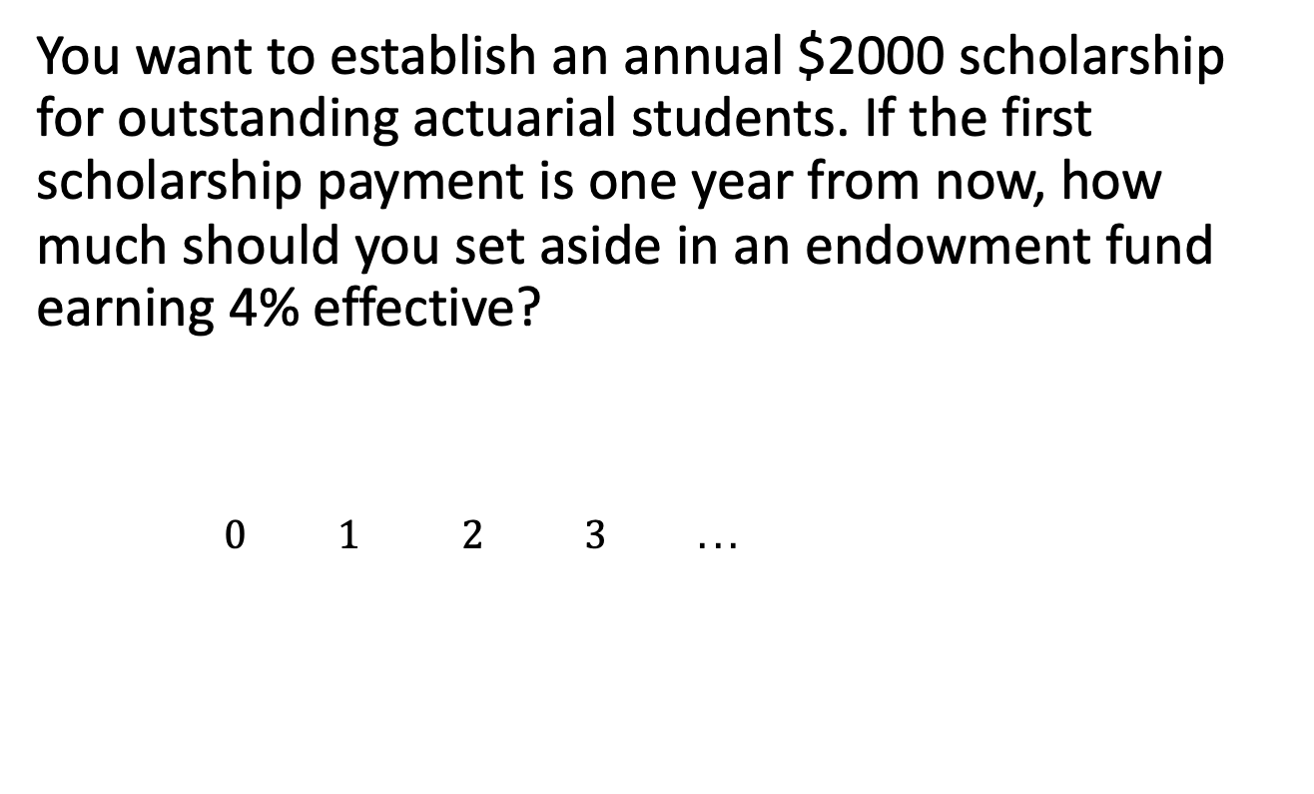
Example 4.3
You want to establish an annual $2000 scholarship for outstanding actuarial students. If the first scholarship payment is one year from now, how much should you set aside in an endowment fund earning 4% effective?
$0 1 2 3 ...$

Slide 15
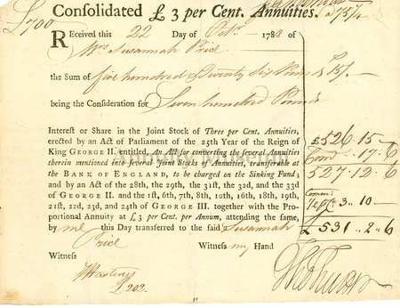
Practical examples of perpetuities
Endowment funds
  Scholarships and bursaries
  Institutional funding
  Sovereign wealth funds
‘Consol’ bonds (UK, US)
  Short for ‘consolidated annuities’
  Borrowing by government, promise to pay fixed % of initial principal each year (coupon) to investor, to be redeemed when government chooses
  UK consol first issued in 1752, final redemption in 2015
Preferred shares
Rental income

