Slide 1
4.2 Mortgages
Mortgages are a special type of loan where the property is pledged as security in case of default (non-payment) by the borrower.
In Canada, mortgages are offered by various banks, credit unions and private lenders.
We distinguish between residential mortgages (for properties where the owners will live) and commercial mortgages (for properties purchased as investment). The processes and rules for issuing commercial mortgages are different from residential mortgages.

Slide 2
Lenders
“A” lenders: Mortgage lenders with strict criteria about who they lend to, heavily regulated
  The “Big Five” and their various brands
  Some smaller banks
  Credit unions
“B” lenders: mortgage lenders with less strict criteria but still regulated
“C” lenders: private lenders, not directly regulated

Slide 3
Regulation
Banks are regulated federally under the Bank Act and supervised by the Office of the Superintendent of Financial Institutions (OSFI)
Most credit unions are regulated provincially
Interest Act also applies: sets rules about rates and how to communicate/quote them

Slide 4
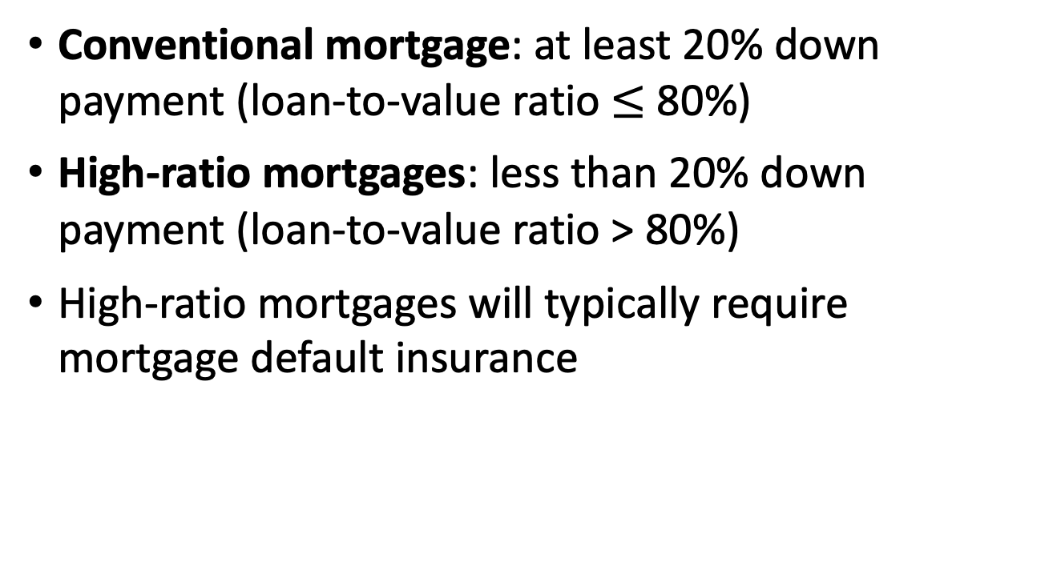
Down payment
Conventional mortgage: at least 20% down payment (loan-to-value ratio $≤$ 80%)
High-ratio mortgages: less than 20% down payment (loan-to-value ratio > 80%)
High-ratio mortgages will typically require mortgage default insurance

Slide 5
Mortgage default insurance
Mortgage default insurance (aka mortgage loan insurance) protects the lender in case of default by borrower
Issued by Canada Mortgage and Housing Corporation (CMHC) and a few others
Only mortgages with a big enough down payment are insured by CMHC

Slide 6
Mortgage default insurance, cont’d
Minimum down payment to qualify for mortgage insurance through CMHC: 5% of first $500,000 of property value, 10% of rest
CMHC does not insure mortgages on properties valued over $1.5 / 1 million (homeowner / rental)
Insurance premium is charged at issue as a % of the mortgage amount, can be paid in cash or rolled into mortgage
Typical premium is 2.4%-4.0%, depending on LTV

Slide 7
Amortization period
The period over which the mortgage loan is assumed to be paid back
Maximum amortization period in Canada:
  For CMHC-insured mortgages: 30 years
  For other mortgages: 35 years
A longer amortization period will:
  Reduce the amount of mortgage payments
  Increase the total interest paid over the life of the mortgage

Slide 8
Mortgage rates
Interest rates payable on mortgages vary widely depending on the type of lender, the credit-worthiness of borrower, and whether the rate is fixed or variable
Expressed as a nominal rate compounded semi-annually
Annual Percentage Rate (APR) also includes fees charged to issue the mortgage
Posted rate vs discounted rate

Slide 9
Fixed vs. variable rates
Fixed mortgage rates are locked in for the length of the mortgage term
Variable rate floats with the lender’s prime rate
Variable rates on mortgages are generally lower than fixed rates, but borrower takes on more risk

Slide 10
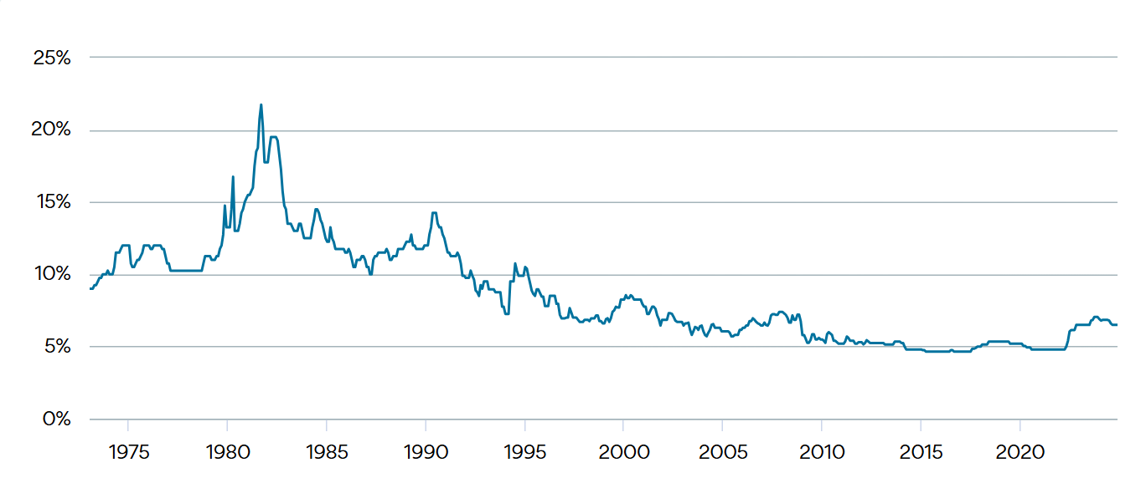
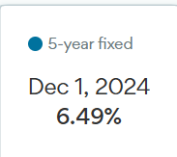
5-year fixed rates - posted
Source: https://www.ratehub.ca/5-year-fixed-mortgage-rate-history

Slide 11
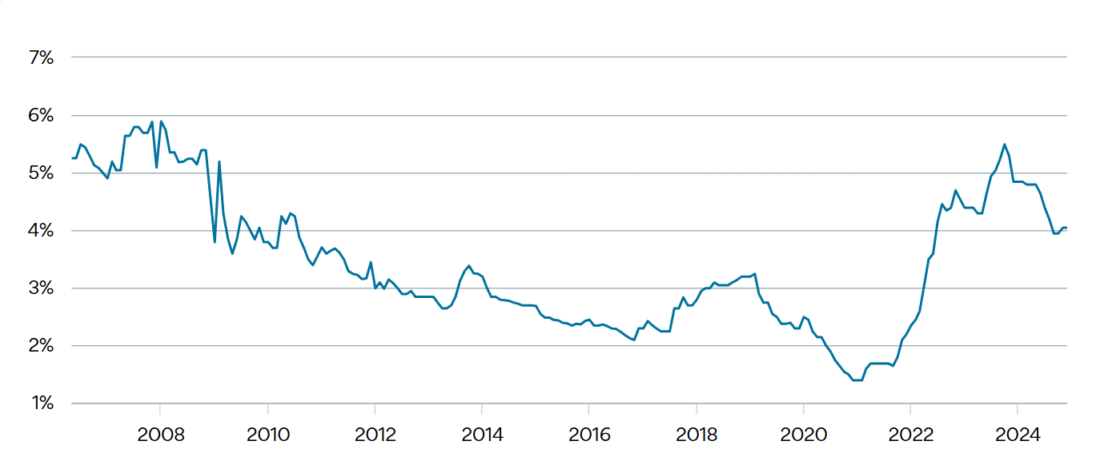
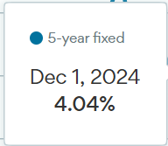
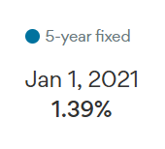
5-year fixed rates - discounted
Source: https://www.ratehub.ca/5-year-fixed-mortgage-rate-history

Slide 12
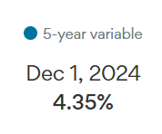
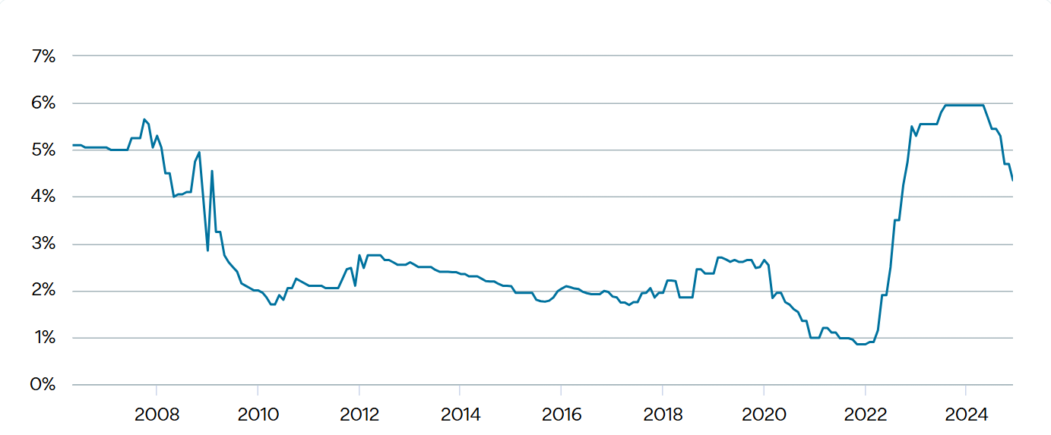
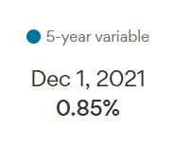
5-year variable rates - discounted
Source: https://www.ratehub.ca/5-year-variable-mortgage-rate-history

Slide 13
Qualifying for a mortgage
Credit score
Loan-to-value ratio
Income and debt service ratios:
  Gross debt service ratio (GDS) = PITH/gross income
  PITH= Principal, Interest, Taxes, Heat
  Total debt service ratio (TDS) includes all debt payments in numerator, not just the PITH associated with the mortgage

Slide 14
Mortgage stress testing
Introduced by OSFI & Dept of Finance in 2012, last updated in June 2021
Protects stability of financial system in case of rising interest rates
Calculate GDS and TDS using a qualifying interest rate, not the contract rate
Current qualifying rate is 5.25%
Maximum GDS = 39%, maximum TDS = 44%

Slide 15
Impact of stress test on borrowing
As the qualifying rate increases, the monthly mortgage payment that is deemed affordable decreases → reduces ability to borrow
Example: Consider a borrower with annual household income of $100,000 and a down payment of $50,000, wanting a mortgage with a 25-year amortization. Ignore taxes and heating costs for simplicity.

Slide 16
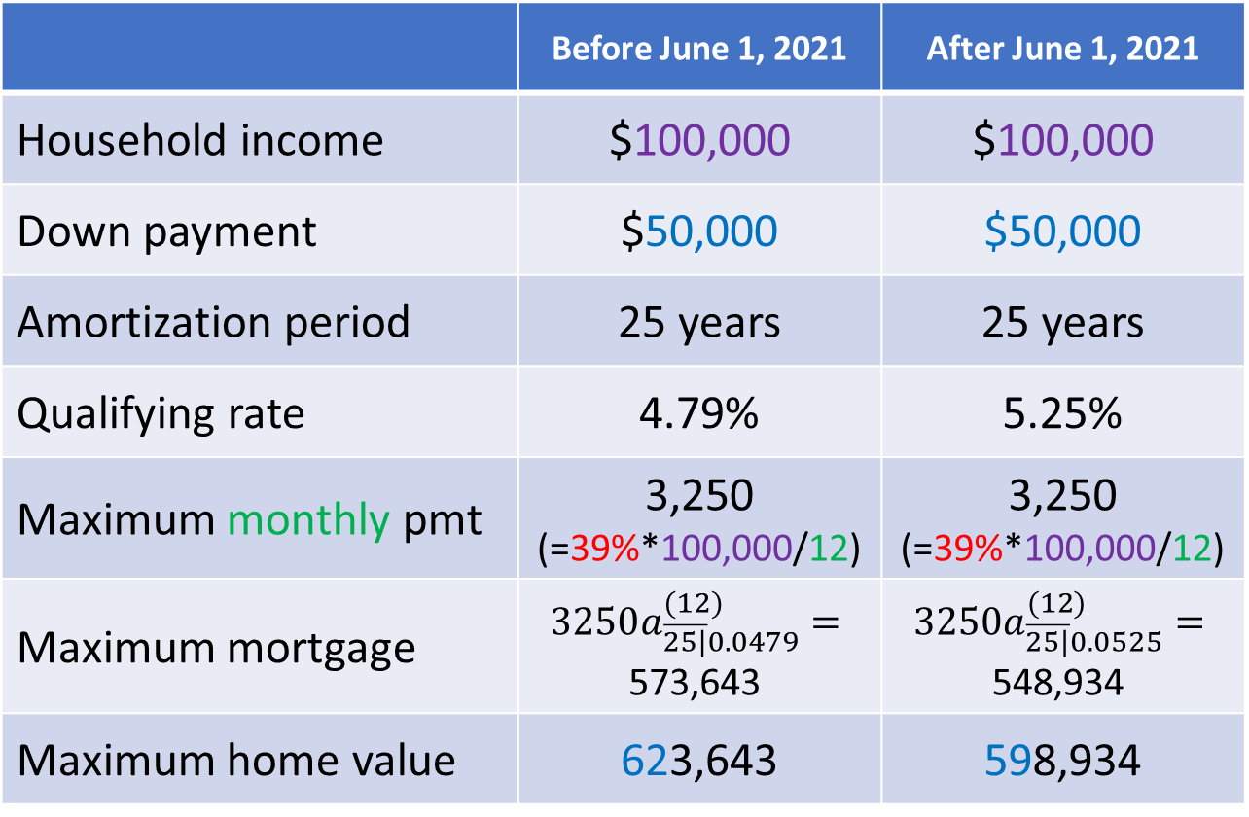
Stress test impact - example
 | Before June 1, 2021 | After June 1, 2021
Household income | $100,000 | $100,000
Down payment | $50,000 | $50,000
Amortization period | 25 years | 25 years
Qualifying rate | 4.79% | 5.25%
Maximum monthly pmt | 3,250 (=39%*100,000/12) | 3,250 (=39%*100,000/12)
Maximum mortgage | $$3250a_{\overline{25|}0.0479}^{(12)}=$$ 573,643 | $$3250a_{\overline{25|}0.0525}^{(12)}=$$ 548,934
Maximum home value | 623,643 | 598,934

Slide 17
Prepayments
The borrower may wish to pay more than required under the mortgage terms → prepayment
Prepayments accelerate the rate at which principal is repaid and reduce the amount of interest paid during the life of the mortgage
Lenders put limits on prepayments and charge penalties for prepayments in excess of these limits
  Fixed rate, closed mortgages have strictest limits
  Variable rate, open mortgages have no limits

Slide 18
Mortgage-backed securities (MBS)
The steady stream of payments from mortgage loans makes for a good investment
Default risk is a potential problem → pool many loans together to reduce impact of default by any one borrower
Lenders sell loans to organizations who will then use these as collateral for a bond issue
Investors who buy the bond receive monthly payments, secured by the underlying stream of mortgage payments

Slide 19
Types of MBS
Pass-through MBS: payments of interest and principal are passed on to investors directly through a trust
Collateralized Debt Obligations (CDOs): the loan pool is divided into slices (“tranches”) based on characteristics such as time to maturity, credit risk
Credit rating of CDOs varies widely, depending on characteristics of underlying mortgage pool
CDOs with bigger risk pay higher rate to investors

Slide 20
CDO-squared
A CDO-squared is a CDO backed by a pool of CDOs
A way for banks that issue CDOs to spread around their credit risk
Underlying CDOs divided into tranches (again); priority of different tranches varies in case of default
Very opaque investment, difficult to assess actual credit risk

Slide 21
“Underwater” mortgages
When the value of the property is lower than the outstanding balance of the mortgage, the mortgage is said to be underwater
Can occur in overheated/volatile housing markets following a substantial dip in home values
Borrowers have incentive to default on obligations and walk away from mortgage
  “Jingle mail” phenomenon during US subprime mortgage crisis

Slide 22
The US subprime lending crisis
Low standards for underwriting, increase in housing speculation, mortgage fraud → lots of subprime mortgages being issued and packaged into MBS
Inflated credit ratings assigned to these MBSs by ratings agencies
When housing bubble burst, borrowers with underwater mortgages defaulted
Large number of defaults weakened the MBSs written on these pools

Slide 23
Subprime lending crisis, cont’d
MBS values declined → banks/investors losing $
Banks unable to issue more loans
  Credit spreads widened
  Lending ground to a halt
Defaults pushed housing prices further down, throwing more fuel on the fire
Several US banks teetering on brink of insolvency, eventually bailed out by US government and US Federal Reserve Bank

Slide 24
Global financial crisis (2007-2008)
Losses on MBSs and CDOs and CDO² were spread around globally
Many banks both issuers of CDOs and holders of other banks’ CDOs
Trouble at a small number of banks in the US led to contagion throughout global banking system
Highlighted interconnectedness of global financial system and led to regulatory focus on Systematically Important Financial Institutions (SIFI)

