Slide 1
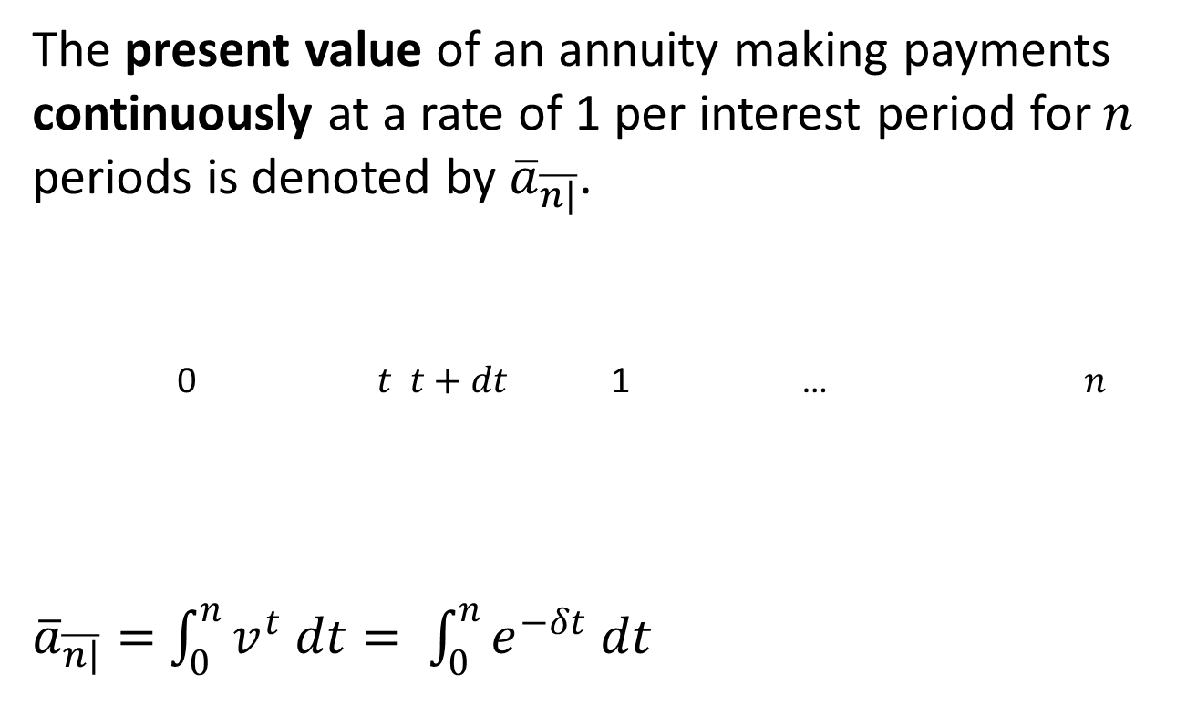
4.4 Continuous Annuities
The present value of an annuity making payments continuously at a rate of 1 per interest period for $n$ periods is denoted by ${\overline{a}}_{\overline{n|}}$.
0 $t$ $t+dt$ 1 … $n$
${\overline{a}}_{\overline{n|}}=$ $\int_{0}^{n}{v^{t} dt}= \int_{0}^{n}{e^{−δt} dt}$

Slide 2
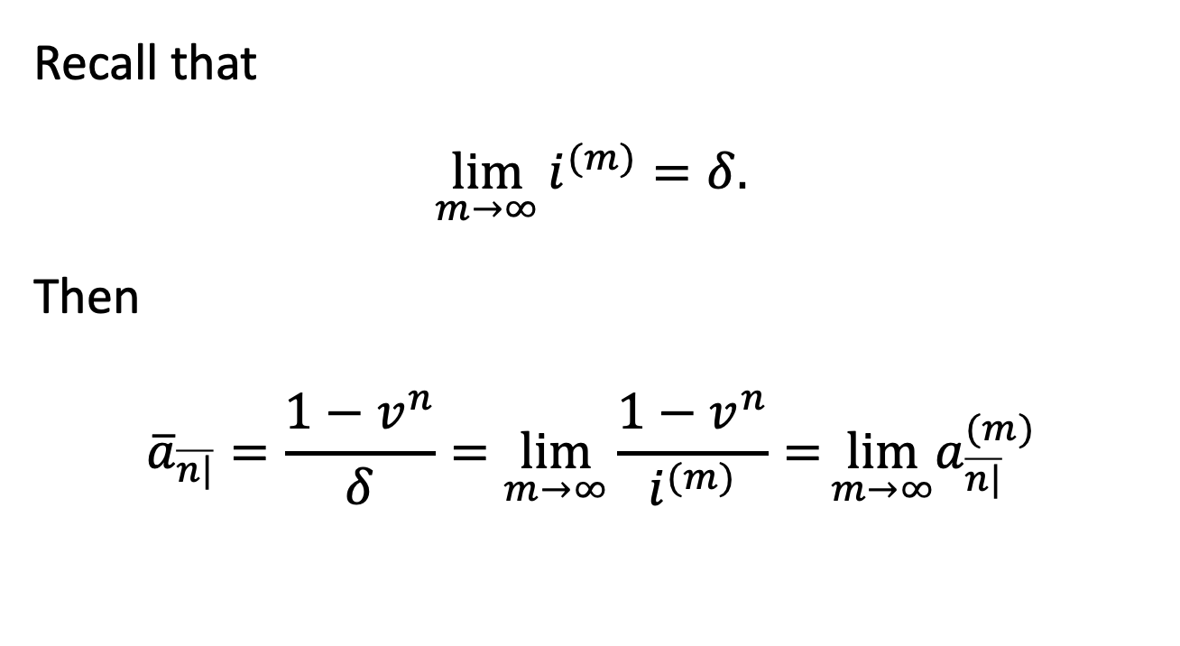
Limit of m-thly ordinary annuity
  Recall that
  $$\lim_{m→∞}{i^{(m)}=δ.}$$
  Then
  $${\overline{a}}_{\overline{n|}}=\frac{1−v^{n}}{δ}=\lim_{m→∞}{\frac{1−v^{n}}{i^{(m)}}=}\lim_{m→∞}a_{\overline{n|}}^{(m)}$$

Slide 3
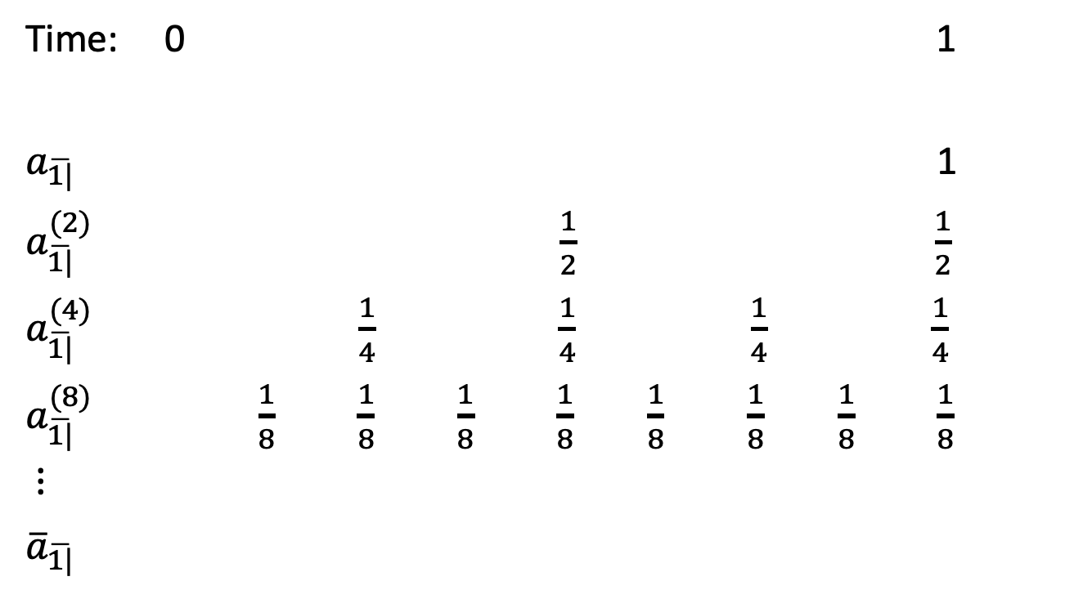
Interpretation (n=1)
  Time: 0 1
  $a_{\overline{1|}}$ 1
  $a_{\overline{1|}}^{(2)}$ $\frac{1}{2}$ $\frac{1}{2}$
  $a_{\overline{1|}}^{(4)}$ $\frac{1}{4}$ $\frac{1}{4}$ $\frac{1}{4}$ $\frac{1}{4}$
  $a_{\overline{1|}}^{(8)}$ $\frac{1}{8}$ $\frac{1}{8}$ $\frac{1}{8}$ $\frac{1}{8}$ $\frac{1}{8}$ $\frac{1}{8}$ $\frac{1}{8}$ $\frac{1}{8}$
  $⋮$
  ${\overline{a}}_{\overline{1|}}$

Slide 4
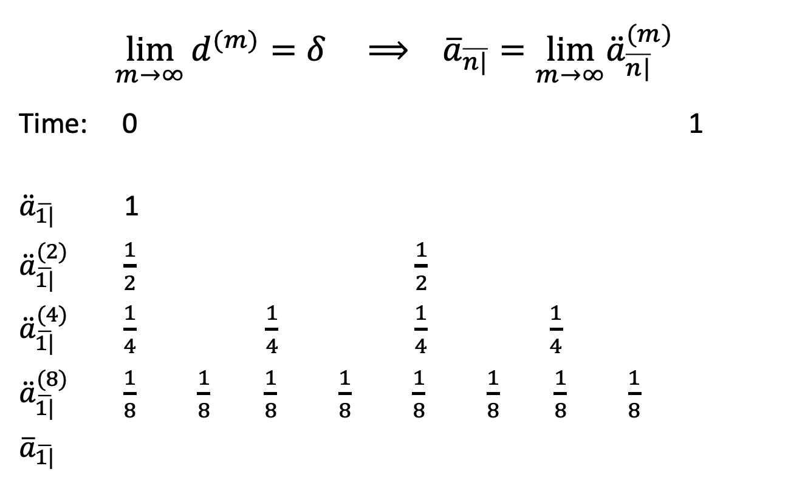
Limit of m-thly annuity-due
  $$\lim_{m→∞}{d^{(m)}=δ} ⟹ {\overline{a}}_{\overline{n|}}=\lim_{m→∞}{\ddot{a}}_{\overline{n|}}^{(m)}$$
  Time: 0 1
  ${\ddot{a}}_{\overline{1|}}$ 1
  ${\ddot{a}}_{\overline{1|}}^{(2)}$ $\frac{1}{2}$ $\frac{1}{2}$
  ${\ddot{a}}_{\overline{1|}}^{(4)}$ $\frac{1}{4}$ $\frac{1}{4}$ $\frac{1}{4}$ $\frac{1}{4}$
  ${\ddot{a}}_{\overline{1|}}^{(8)}$ $\frac{1}{8}$ $\frac{1}{8}$ $\frac{1}{8}$ $\frac{1}{8}$ $\frac{1}{8}$ $\frac{1}{8}$ $\frac{1}{8}$ $\frac{1}{8}$
  ${\overline{a}}_{\overline{1|}}$

Slide 5
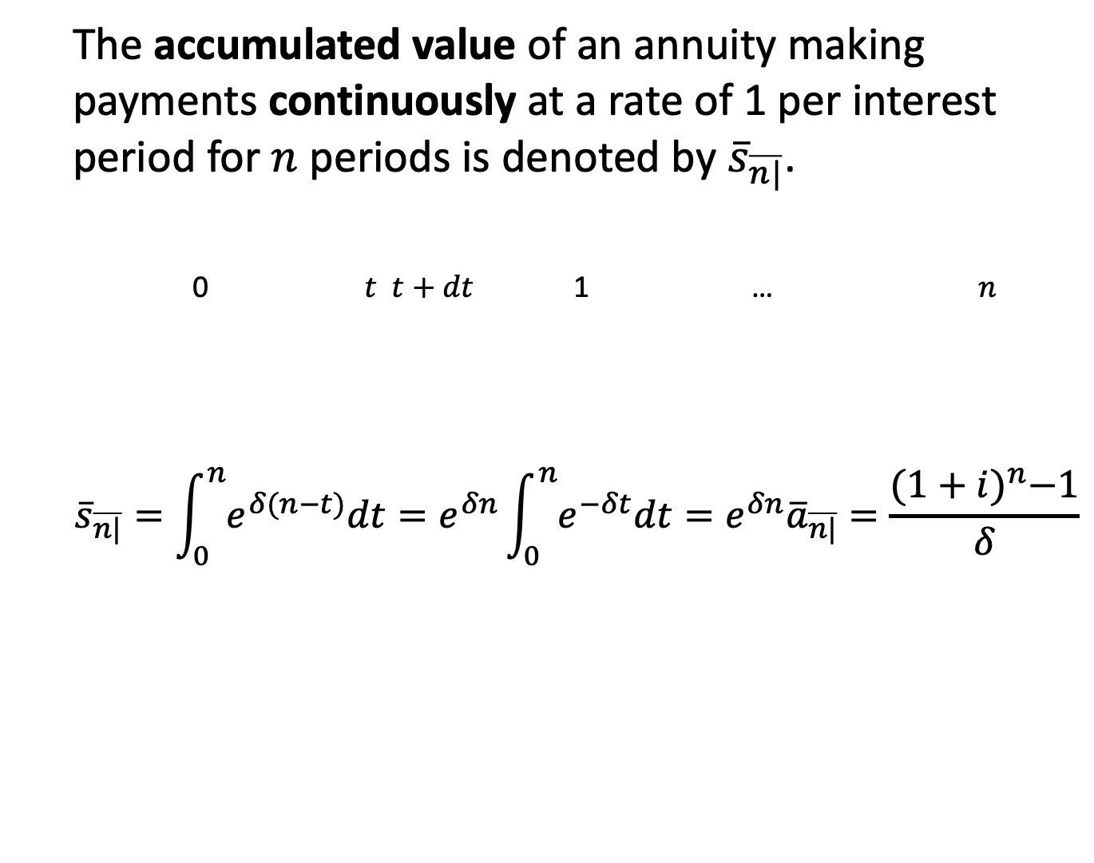
Accumulated value
The accumulated value of an annuity making payments continuously at a rate of 1 per interest period for $n$ periods is denoted by ${\overline{s}}_{\overline{n|}}$.
0 $t$ $t+dt$ 1 … $n$
$${\overline{s}}_{\overline{n|}}=\int_{0}^{n}{e^{δ(n−t)}dt}=e^{δn}\int_{0}^{n}{e^{−δt}dt}=e^{δn}{\overline{a}}_{\overline{n|}}=\frac{{(1+i)}^{n}−1}{δ}$$

Slide 6
Example 1
In 2021 and 2022 Daisy deposits $12/day into an account.
The account earns interest from the exact time of the deposit, with interest quoted as an annual effective rate.
The rates are 9% in 2021 and 2022.
Find the amount in the account, including interest, on December 31, 2022 in two ways:
(a) exactly based on the daily deposits, and
(b) using the approximation that deposits are made continuously.

Slide 7
Example 1
Please see the Excel spreadsheet ‘daily, monthly, continuous annuities’ file on Canvas.
I also recommend you try quarterly / bi-annually / usual annuities and compare their future values with given ones.

Slide 8
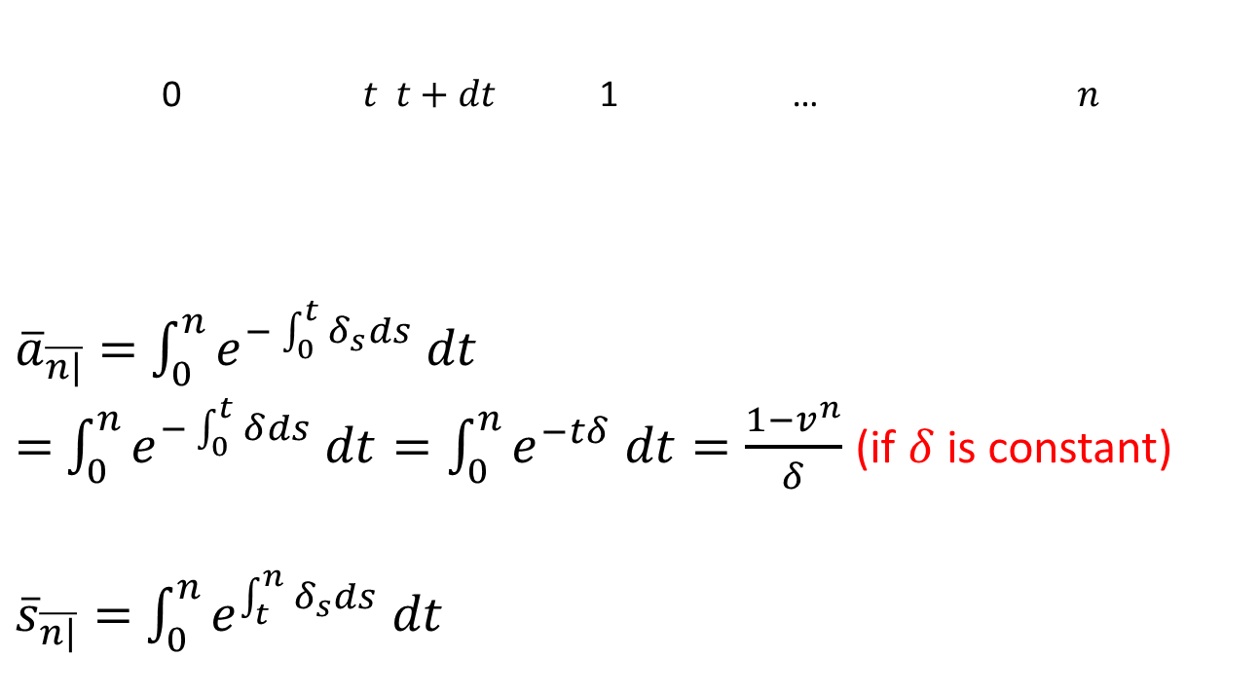
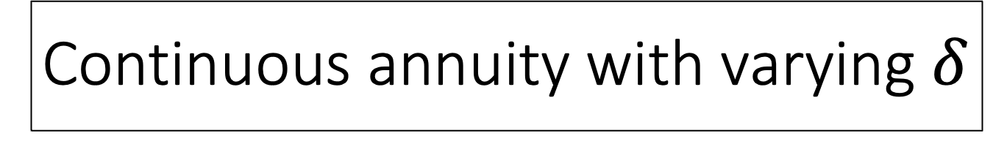
Continuous annuity with varying $δ$
0 $t$ $t+dt$ 1 … $n$
${\overline{a}}_{\overline{n|}}=$ $\int_{0}^{n}{e^{−\int_{0}^{t}{δ_{s}}ds} dt}$
$=$ $\int_{0}^{n}{e^{−\int_{0}^{t}{δ}ds} dt}=\int_{0}^{n}{e^{−tδ} dt}=\frac{1−v^{n}}{δ}$ (if $δ$ is constant)
${\overline{s}}_{\overline{n|}}=$ $\int_{0}^{n}{e^{\int_{t}^{n}{δ_{s}}ds} dt}$

Slide 9
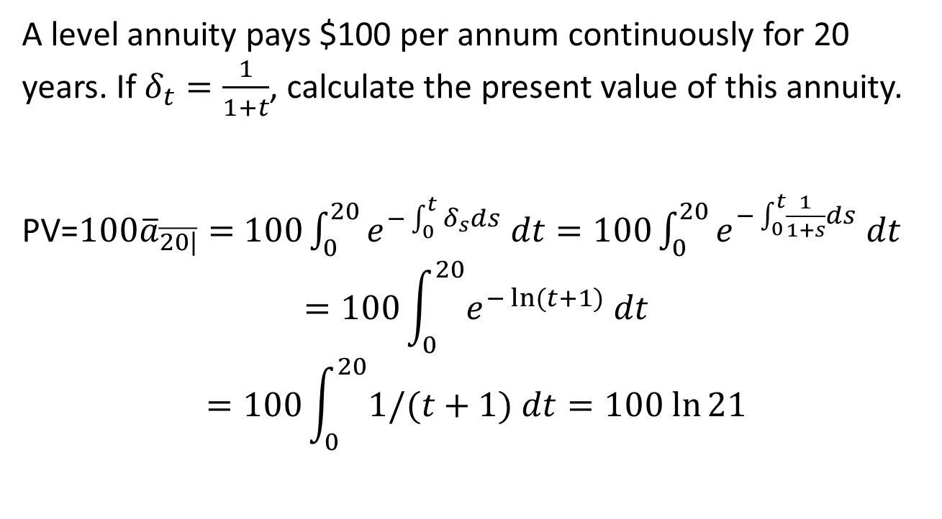
Example 2 (Brown & Kopp 4.4.A7)
A level annuity pays $100 per annum continuously for 20 years. If $δ_{t}=\frac{1}{1+t}$, calculate the present value of this annuity.
PV=${100\overline{a}}_{\overline{20|}}=$ $100\int_{0}^{20}{e^{−\int_{0}^{t}{δ_{s}}ds} dt}=100\int_{0}^{20}{e^{−\int_{0}^{t}{\frac{1}{1+s}}ds} dt}$
$$=100\int_{0}^{20}{e^{−\ln{(t+1)}} dt}$$
$$=100\int_{0}^{20}{1/(t+1) dt}=100 ln⁡21$$

