Slide 1
4.5 Varying annuities
In many practical situations, we have a payment stream that varies deterministically over time.
We will consider three ”patterns”:
Discrete payments that vary by a constant %
→ payments form a geometric progression
Discrete payments that vary by a constant $
→ payments form an arithmetic progression
Continuous payments that vary with time

Slide 2
Geometric progressions
  In many situations, payments are adjusted by a fixed percentage:
  pensions adjusted for inflation,
  wages increased according to a negotiated agreement.
  The adjustments can happen:
  at the same frequency as the payments, or
  at a different frequency.

Slide 3
Example 1
A pension plan will make annual payments starting one year from now and continuing for a total of 20 payments. The first payment will be $24,000, with cost-of-living adjustments of 5% per year applied to each payment thereafter. Find the present value of this pension arrangement today at an effective rate of 10%.
  0 1 2 3

Slide 4
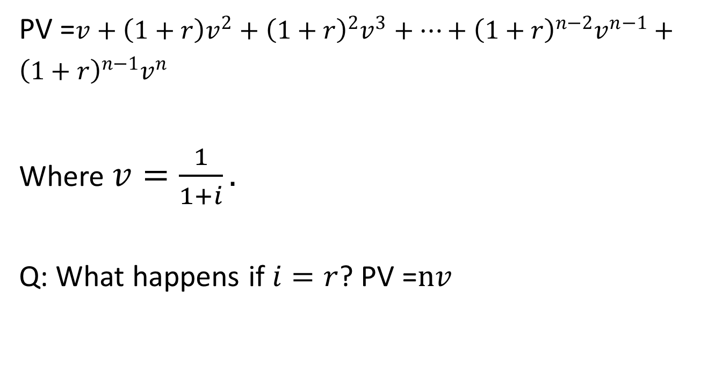
Example 1, continued
  PV =$v+\left(1+r\right)v^{2}+{\left(1+r\right)}^{2}v^{3}+…+{\left(1+r\right)}^{n−2}v^{n−1}+{\left(1+r\right)}^{n−1}v^{n}$
  Where $v=\frac{1}{1+i}.$
  Q: What happens if $i=r$? PV =$nv$

Slide 5
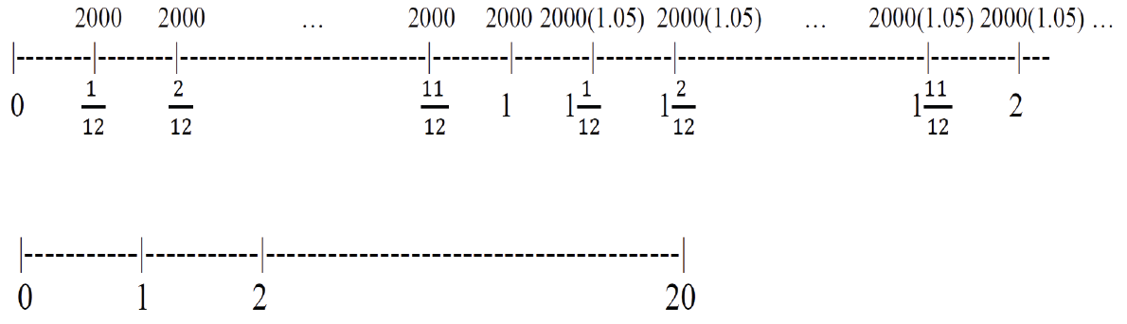
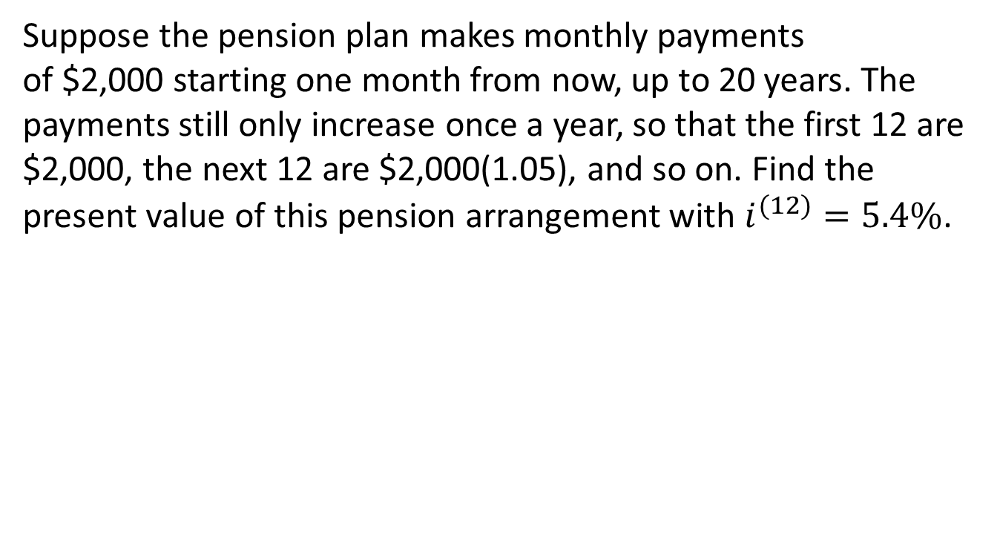
Example 2
Suppose the pension plan makes monthly payments
of $2,000 starting one month from now, up to 20 years. The payments still only increase once a year, so that the first 12 are $2,000, the next 12 are $2,000(1.05), and so on. Find the present value of this pension arrangement with $i^{(12)}=5.4\%$.

Slide 6
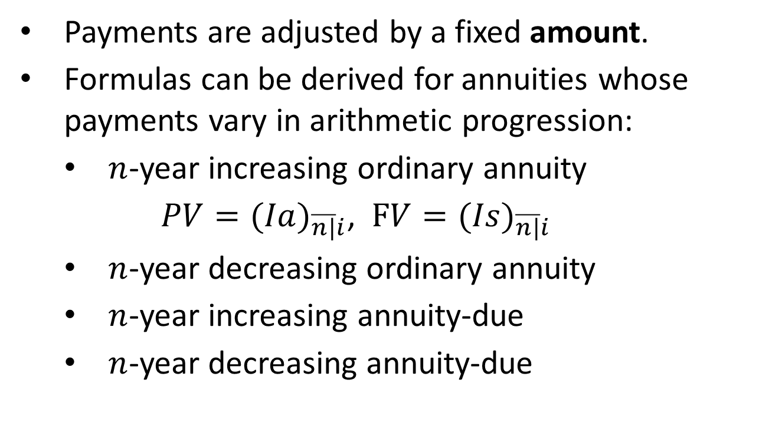
Arithmetic progressions
  Payments are adjusted by a fixed amount.
  Formulas can be derived for annuities whose payments vary in arithmetic progression:
    $n$-year increasing ordinary annuity
    $PV={(Ia)}_{\overline{n|}i}$, $FV={(Is)}_{\overline{n|}i}$
    $n$-year decreasing ordinary annuity
    $n$-year increasing annuity-due
    $n$-year decreasing annuity-due

Slide 7
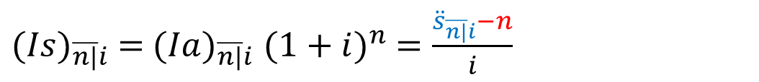
n-year increasing ordinary annuity
  Pmt: 1 2 3 4 … n
  Time: 0 1 2 3 4 … n
${(Ia)}_{\overline{n|}i}$ $=1v+2v^{2}+3v^{3}+4v^{4}+…+nv^{n}$
${v(Ia)}_{\overline{n|}i}=$ $1v^{2}+2v^{3}+3v^{4}+…+(n−1)v^{n}+nv^{n+1}$
$$\left(1−v\right){\left(Ia\right)}_{\overline{n|}i}={v+v}^{2}+v^{3}+…+v^{n}−nv^{n+1}=a_{\overline{n|}i}−nv^{n+1}$$
$∴{(Ia)}_{\overline{n|}i}$ $=\frac{a_{\overline{n|}i}−nv^{n+1}}{1−v}=\frac{(a_{\overline{n|}i}−nv^{n+1})(1+i)}{(1−v)(1+i)}=\frac{{\ddot{a}}_{\overline{n|}i}−nv^{n}}{i}$
${(Is)}_{\overline{n|}i}$ $=$ ${(Ia)}_{\overline{n|}i}$ ${(1+i)}^{n}$ $=\frac{{\ddot{s}}_{\overline{n|}i}−n}{i}$

Slide 8
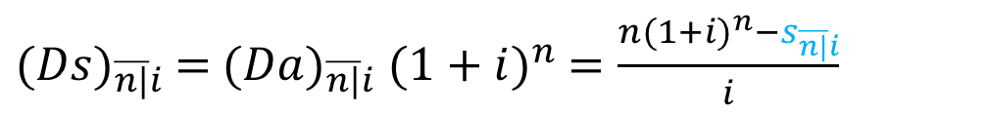
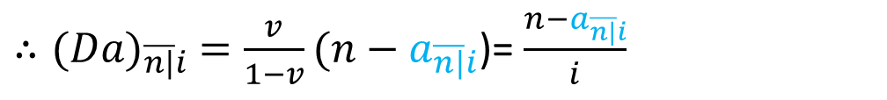
n-year decreasing ordinary annuity
  Pmt: n n-1 n-2 n-3 … 1
  Time: 0 1 2 3 4 … n
${(Da)}_{\overline{n|}i}$ $= nv+(n−1)v^{2}+(n−2)v^{3}+…+1v^{n}$
$\frac{1}{v}{ (Da)}_{\overline{n|}i}=$ $n+(n−1)v+(n−2)v^{2}+…+1v^{n−1}$
$$\frac{1−v}{v}{ (Da)}_{\overline{n|}i}=n−\left(v+v^{2}+…+v^{n−1}+v^{n}\right)=n−a_{\overline{n|}i}$$
$∴{(Da)}_{\overline{n|}i}$ $=\frac{v}{1−v}(n−a_{\overline{n|}i}$)= $\frac{n−a_{\overline{n|}i}}{i}$
${(Ds)}_{\overline{n|}i}$ $=$ ${(Da)}_{\overline{n|}i}$ ${(1+i)}^{n}$ $=\frac{n{(1+i)}^{n}−s_{\overline{n|}i}}{i}$

Slide 9
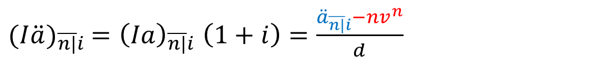
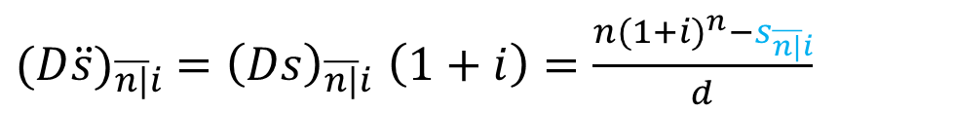
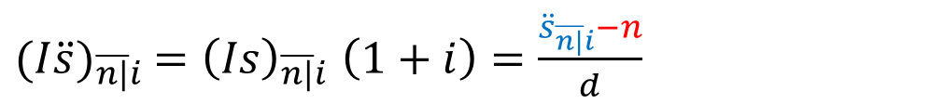
Increasing/decreasing annuity-due
  1 2 3 4 … n-1 n
  1 2 3 4 5 … n
  Time: 0 1 2 3 4 … n-1 n
${(I\ddot{a})}_{\overline{n|}i}$ ${=\left(Ia\right)}_{\overline{n|}i}\left(1+i\right)=\frac{{\ddot{a}}_{\overline{n|}i}−nv^{n}}{d}$
${(I\ddot{s})}_{\overline{n|}i}$ ${=\left(Is\right)}_{\overline{n|}i}\left(1+i\right)=\frac{{\ddot{s}}_{\overline{n|}i}−n}{d}$
${(D\ddot{a})}_{\overline{n|}i}$ ${=\left(Da\right)}_{\overline{n|}i}\left(1+i\right)=\frac{n−a_{\overline{n|}i}}{d}$
${(D\ddot{s})}_{\overline{n|}i}$ ${=\left(Ds\right)}_{\overline{n|}i}\left(1+i\right)=\frac{n{(1+i)}^{n}−s_{\overline{n|}i}}{d}$

Slide 10
Example 3
You bought a perpetuity-due with annual payments starting at $50 and increasing by $50 each year until the payment amount reaches $1000. The payments stay at $1000 thereafter. The effective annual interest rate is 7.5%. Find the PV of this perpetuity.
0 1 2 3 …

Slide 11
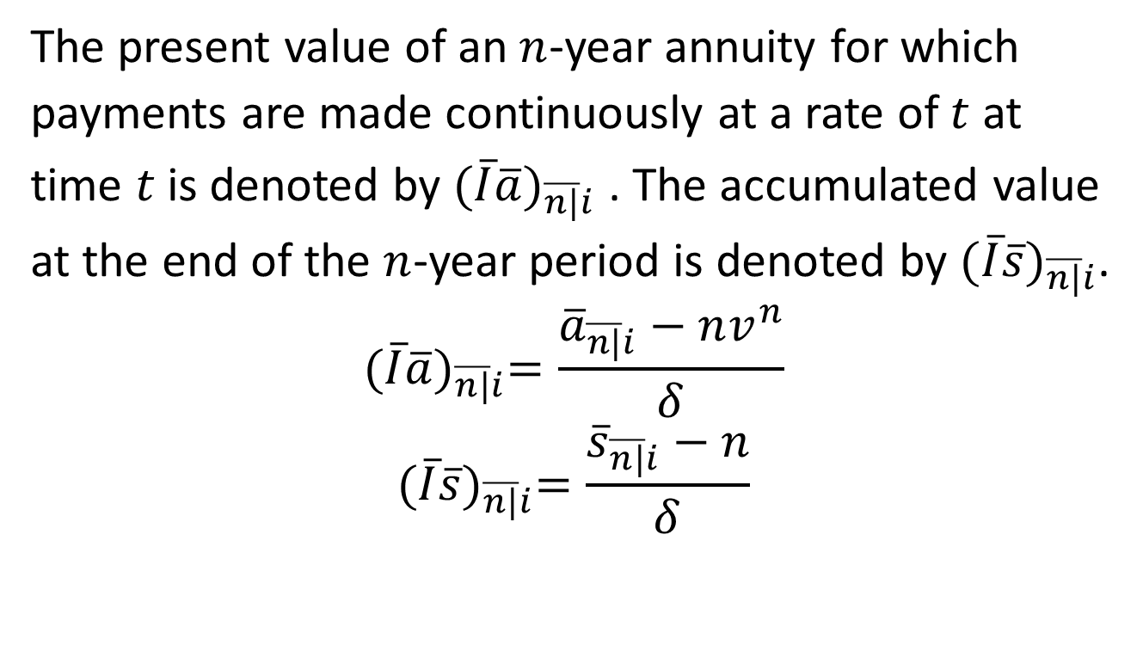
Continuously varying annuities
The present value of an $n$-year annuity for which payments are made continuously at a rate of $t$ at time $t$ is denoted by ${(\overline{I}\overline{a})}_{\overline{n|}i}$ . The accumulated value at the end of the $n$-year period is denoted by ${(\overline{I}\overline{s})}_{\overline{n|}i}$.
$${(\overline{I}\overline{a})}_{\overline{n|}i}=\frac{{\overline{a}}_{\overline{n|}i}−nv^{n}}{δ}$$
$${(\overline{I}\overline{s})}_{\overline{n|}i}=\frac{{\overline{s}}_{\overline{n|}i}−n}{δ}$$

Slide 12
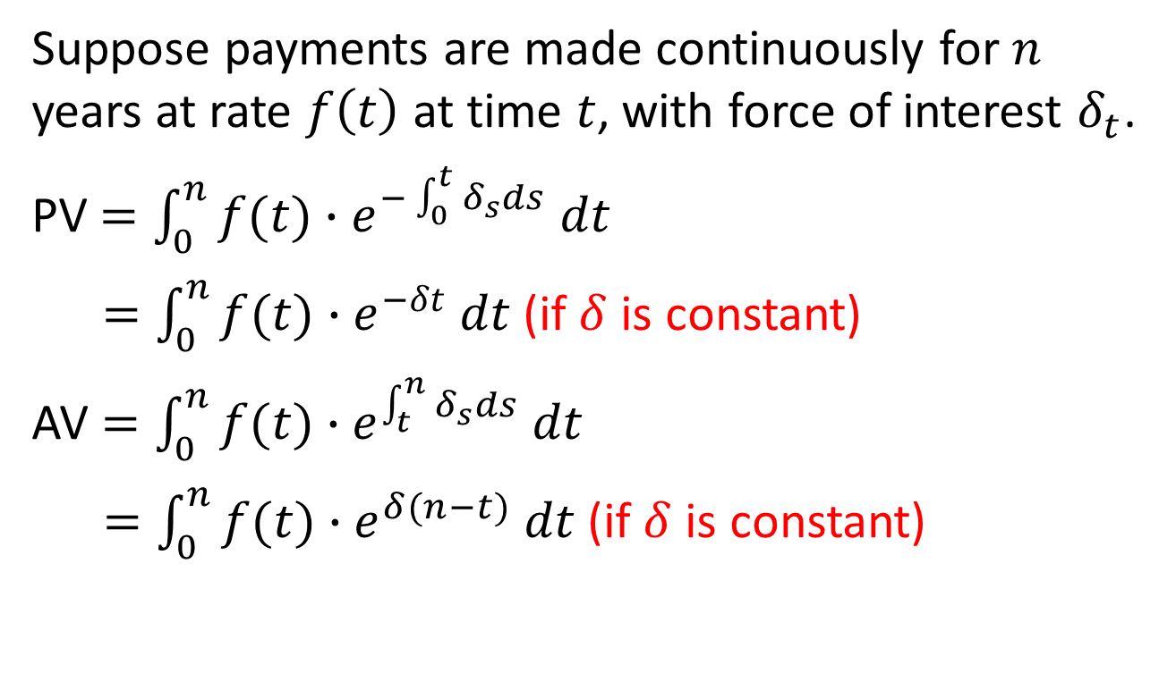
General continuous annuities
Suppose payments are made continuously for $n$ years at rate $f\left(t\right)$ at time $t$, with force of interest $δ_{t}$.
PV$=\int_{0}^{n}{{f(t)∙e}^{−\int_{0}^{t}{δ_{s}}ds} dt}$
$=\int_{0}^{n}{{f(t)∙e}^{−δt} dt}$ (if $δ$ is constant)
AV $=\int_{0}^{n}{{f(t)∙e}^{\int_{t}^{n}{δ_{s}}ds} dt}$
$=\int_{0}^{n}{{f(t)∙e}^{δ(n−t)} dt}$ (if $δ$ is constant)

Slide 13
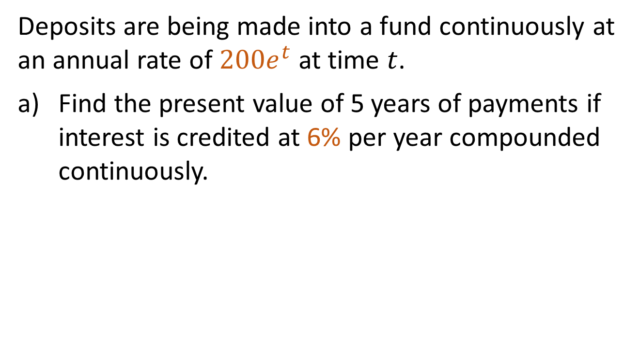
Example 4
Deposits are being made into a fund continuously at an annual rate of $200e^{t}$ at time $t$.
Find the present value of 5 years of payments if interest is credited at 6% per year compounded continuously.
$$f\left(t\right)=200e^{t},δ=6\%$$

Slide 14
Example 4, continued
What is the accumulated value of the fund at the end of the third year?

