Slide 1
CHAPTER 5
Repayment of Debts

Slide 2
5.1 Amortization of a debt
When the amortization method is used to repay a loan, the borrower makes installment payments to the lender at regular intervals.
Each installment payment is used:
  to pay the interest on the outstanding loan balance since the last payment, AND
  to repay part of the principal borrowed.
We will be interested in finding the outstanding balance, and the interest/principal portion of each payment.

Slide 3
Amortization schedule
An amortization schedule for a loan identifies the corresponding portions of each payment.
Dividing each payment into principal and interest is often required in practice. For example, the two may be treated differently for income tax purposes.
Amortization schedules are easiest to build in a spreadsheet. See the textbook for instructions.

Slide 4
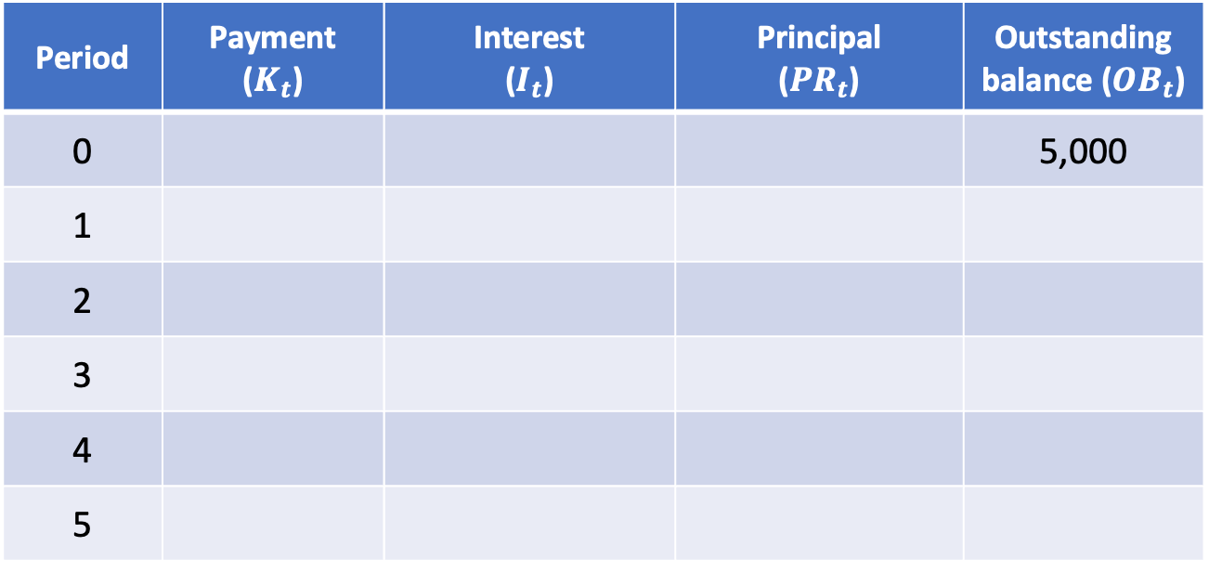
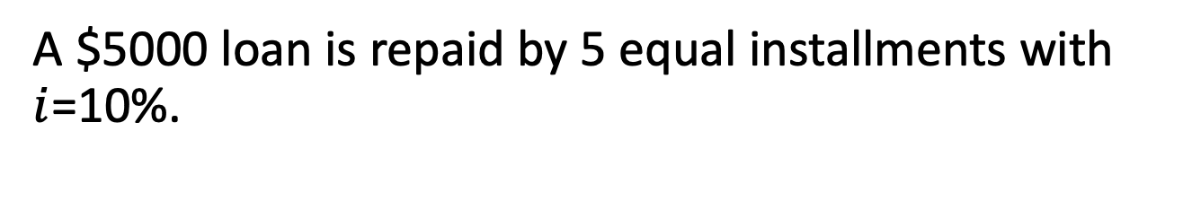
Example 5.1
A $5000 loan is repaid by 5 equal installments with $i$=10%.
Period | Payment ($K_{t}$) | Interest ($I_{t}$) | Principal (${PR}_{t}$) | Outstanding balance (${OB}_{t}$)
0 |  |  |  | 5,000
1
2
3
4
5

Slide 5
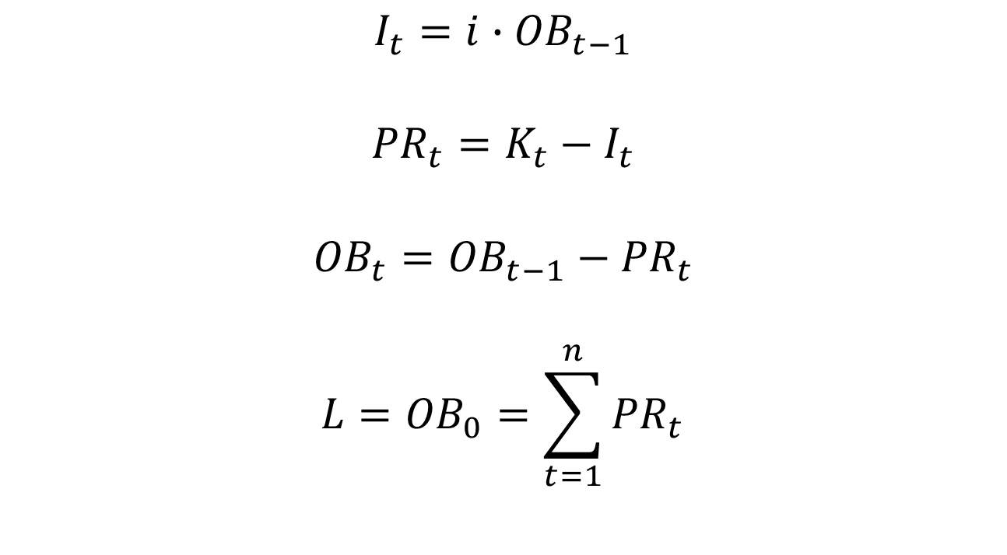
General relationships
$$I_{t}=i∙{OB}_{t−1}$$
$${PR}_{t}=K_{t}−I_{t}$$
$${OB}_{t}={OB}_{t−1}−{PR}_{t}$$
$${L=OB}_{0}=\sum_{t=1}^{n}{{PR}_{t}}$$

Slide 6
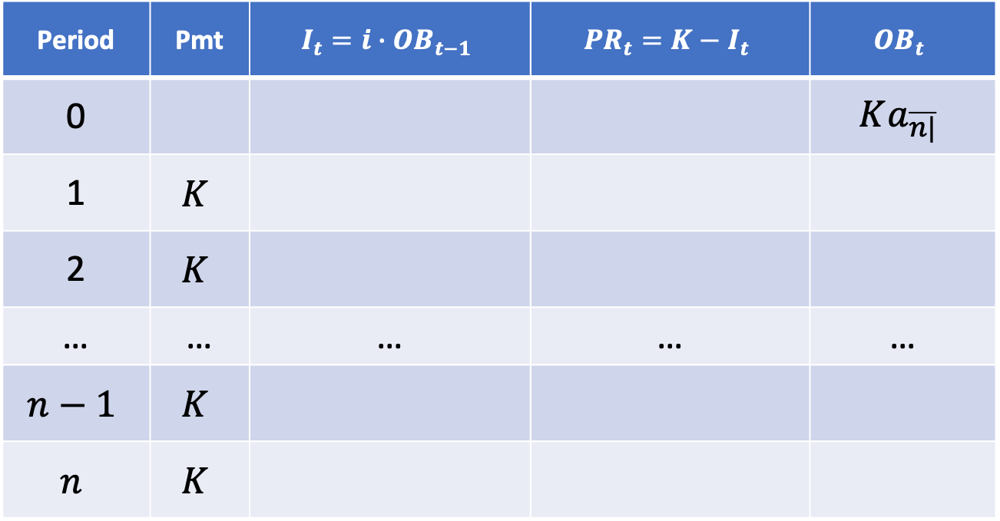
General case (level payments)
Consider a loan to be repaid by $n$ installments of $K$.
Period | Pmt | $$I_{t}={i∙OB}_{t−1}$$ | $${PR}_{t}=K−I_{t}$$ | $${OB}_{t}$$
0 |  |  |  | $$Ka_{\overline{n|}}$$
1 | $$K$$
2 | $$K$$
… | … | … | … | …
$$n−1$$ | $$K$$
$$n$$ | $$K$$

Slide 7
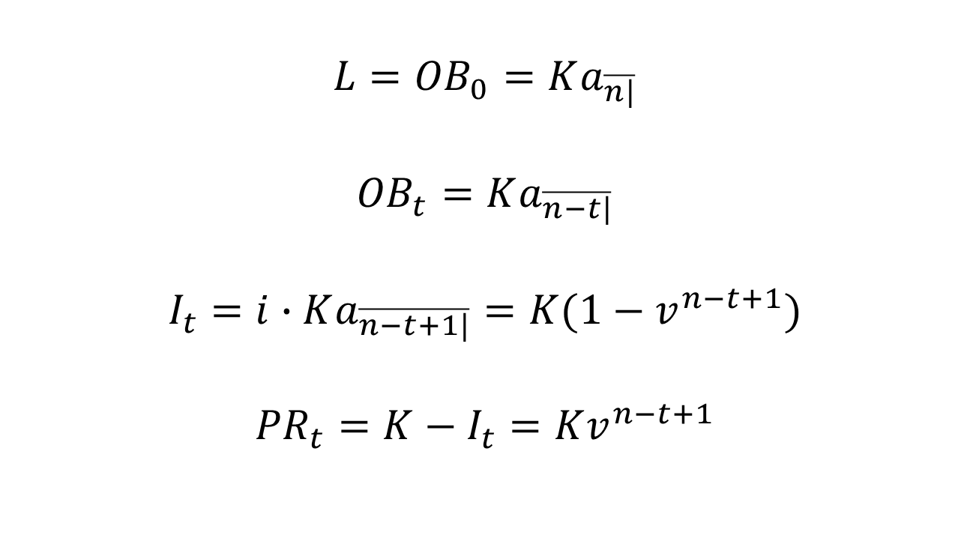
Special relationships (level pmts)
$${L=OB}_{0}=Ka_{\overline{n|}}$$
$${OB}_{t}=Ka_{\overline{n−t|}}$$
$$I_{t}=i∙Ka_{\overline{n−t+1|}}=K(1−v^{n−t+1})$$
$${PR}_{t}=K−I_{t}=Kv^{n−t+1}$$

Slide 8
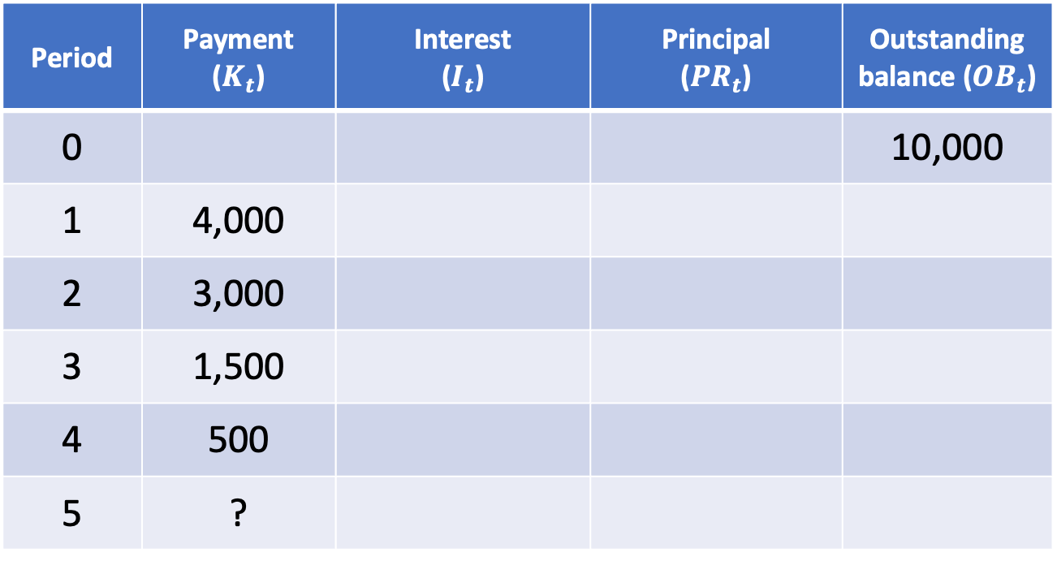
Example 5.2 (non-level payments)
A $10,000 loan is repaid by unequal installments ($i=10\%)$.
Period | Payment ($K_{t}$) | Interest ($I_{t}$) | Principal (${PR}_{t}$) | Outstanding balance (${OB}_{t}$)
0 |  |  |  | 10,000
1 | 4,000
2 | 3,000
3 | 1,500
4 | 500
5 | ?

Slide 9
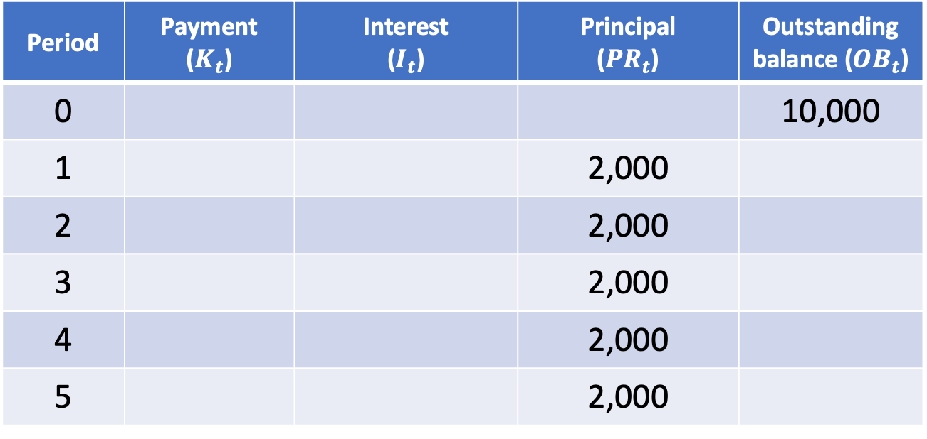
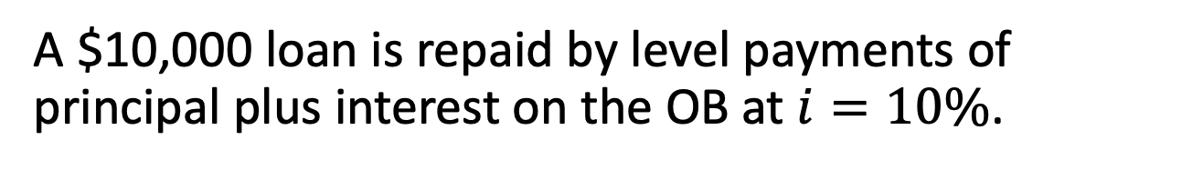
Example 5.3 (level principal repayment)
A $10,000 loan is repaid by level payments of principal plus interest on the OB at $i=10\%$.
Period | Payment ($K_{t}$) | Interest ($I_{t}$) | Principal (${PR}_{t}$) | Outstanding balance (${OB}_{t}$)
0 |  |  |  | 10,000
1 |  |  | 2,000
2 |  |  | 2,000
3 |  |  | 2,000
4 |  |  | 2,000
5 |  |  | 2,000

Slide 10
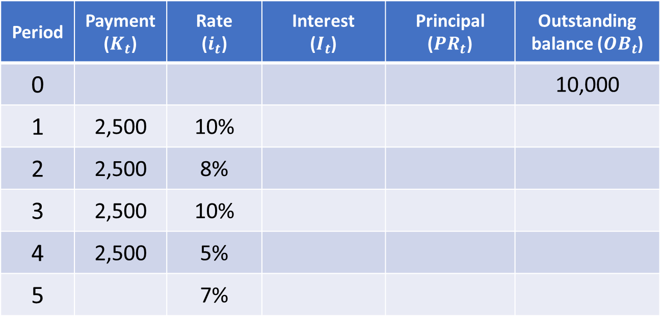

Example 5.4 (non-level rates)
Consider Example 5.2 again. Let the interest rate applicable during period $t$ be $i_{t}$.
Period | Payment ($K_{t}$) | Rate ($i_{t}$) | Interest ($I_{t}$) | Principal (${PR}_{t}$) | Outstanding balance (${OB}_{t}$)
0 |  |  |  |  | 10,000
1 | 2,500 | 10%
2 | 2,500 | 8%
3 | 2,500 | 10%
4 | 2,500 | 5%
5 |  | 7%

