Slide 1
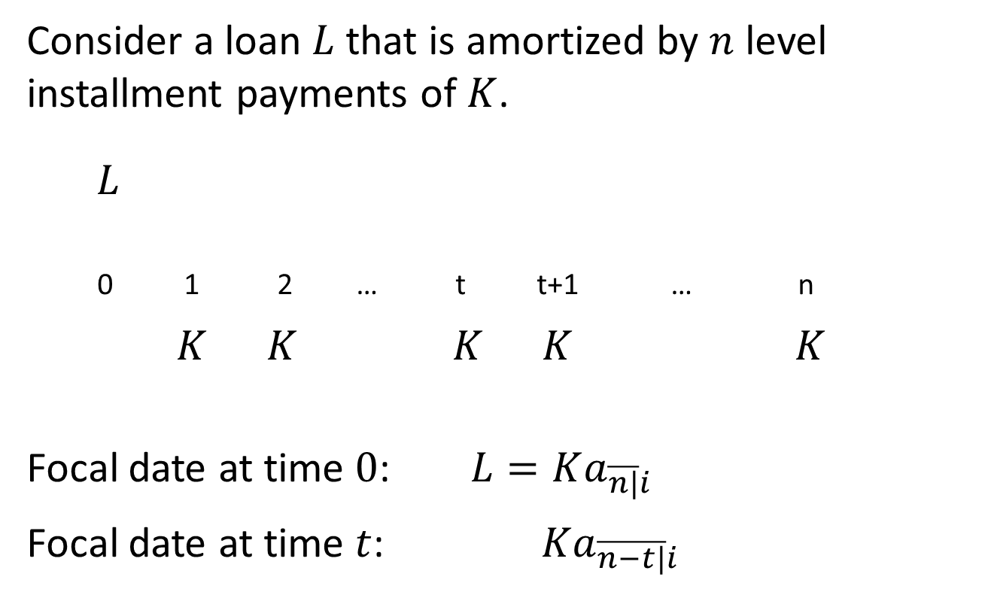
5.2 Outstanding balance
Consider a loan $L$that is amortized by $n$ level installment payments of $K$.
$L$
0 1 2 … t t+1 … n
$K K K K K$
Focal date at time $0$: $L=Ka_{\overline{n|}i}$
Focal date at time $t$: $Ka_{\overline{n−t|}i}$

Slide 2
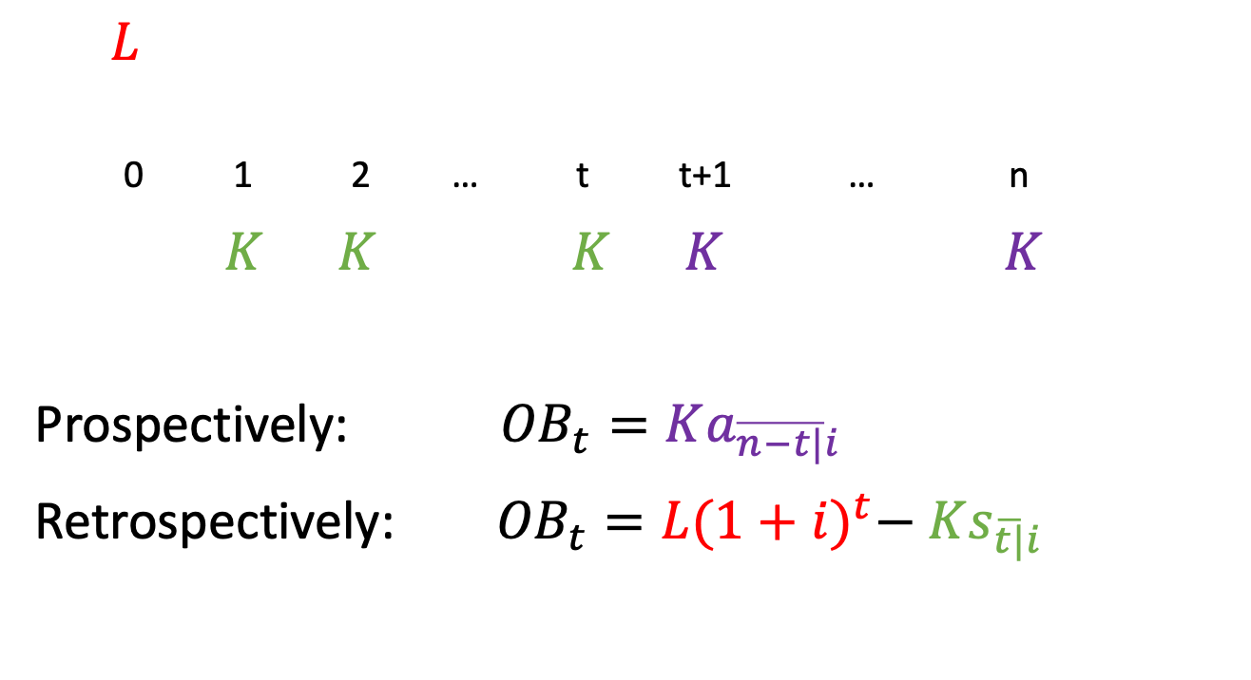
Outstanding balance (level pmts)
$L$
0 1 2 … t t+1 … n
$K K K K K$
Prospectively: ${OB}_{t}=Ka_{\overline{n−t|}i}$
Retrospectively: ${OB}_{t}=L{(1+i)}^{t}− Ks_{\overline{t|}i}$

Slide 3
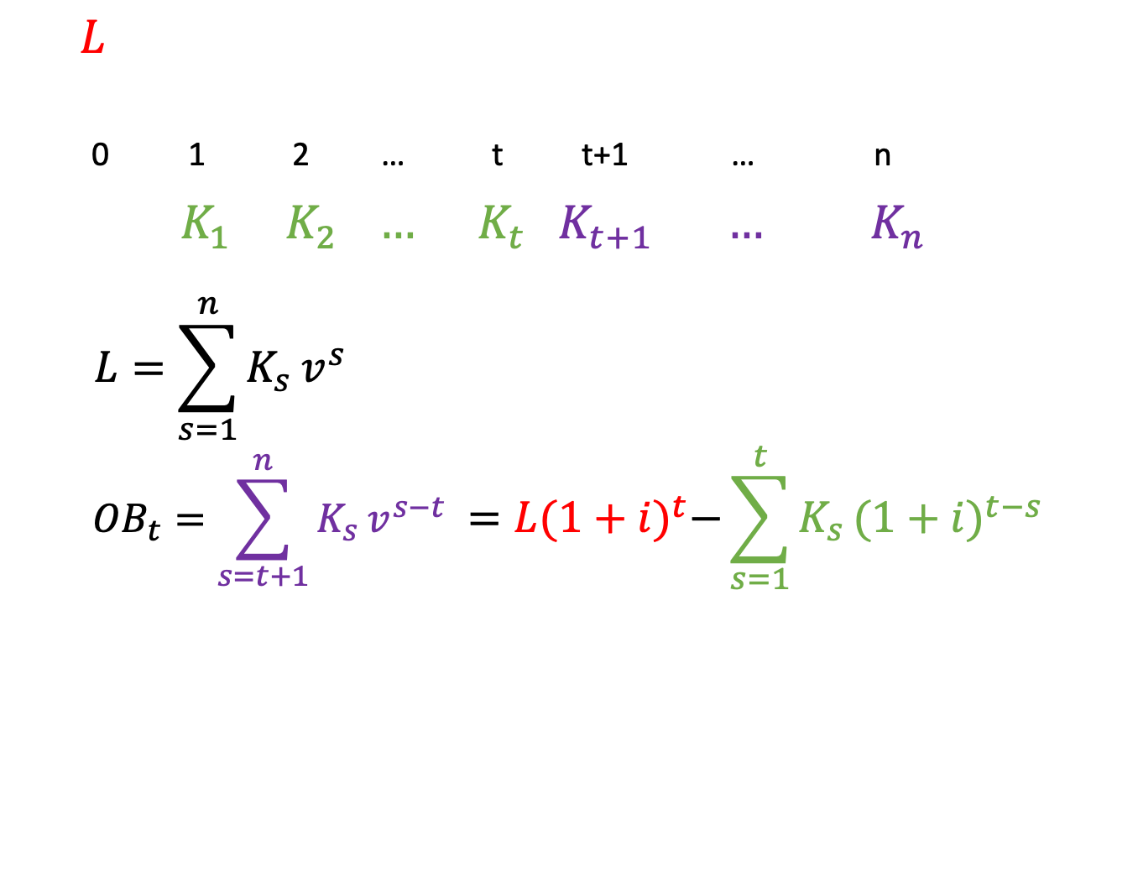
Outstanding balance (general)
$L$
0 1 2 … t t+1 … n
$K_{1} K_{2} … K_{t} K_{t+1} …{ K}_{n}$
$$L=\sum_{s=1}^{n}{K_{s}}v^{s}$$
$${OB}_{t}=\sum_{s=t+1}^{n}{K_{s}}v^{s−t} =L{(1+i)}^{t}−\sum_{s=1}^{t}{K_{s}}{(1+i)}^{t−s}$$

Slide 4
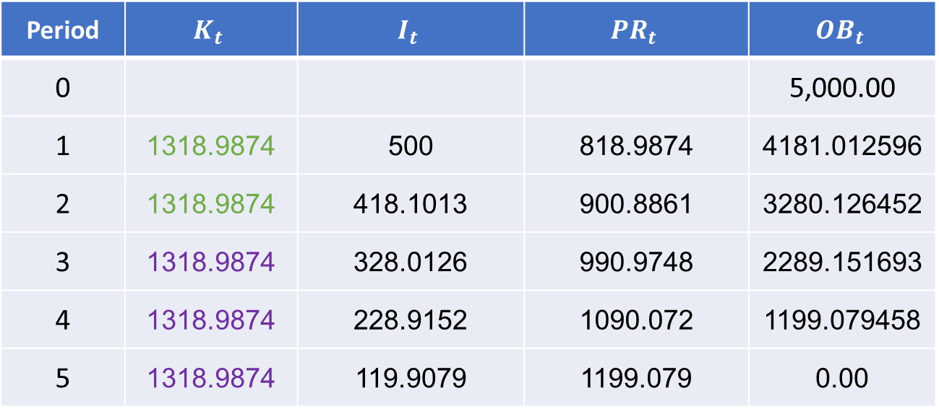
Example 5.1 revisited
Period | $$K_{t}$$ | $$I_{t}$$ | $${PR}_{t}$$ | $${OB}_{t}$$
0 |  |  |  | 5,000.00
1 | 1318.9874 | 500 | 818.9874 | 4181.012596
2 | 1318.9874 | 418.1013 | 900.8861 | 3280.126452
3 | 1318.9874 | 328.0126 | 990.9748 | 2289.151693
4 | 1318.9874 | 228.9152 | 1090.072 | 1199.079458
5 | 1318.9874 | 119.9079 | 1199.079 | 0.00
$${OB}_{2}=5000{(1.1)}^{2}− 1318.9874s_{\overline{2|}10\%}≈1318.9874{ a}_{\overline{3|}10\%}$$

Slide 5
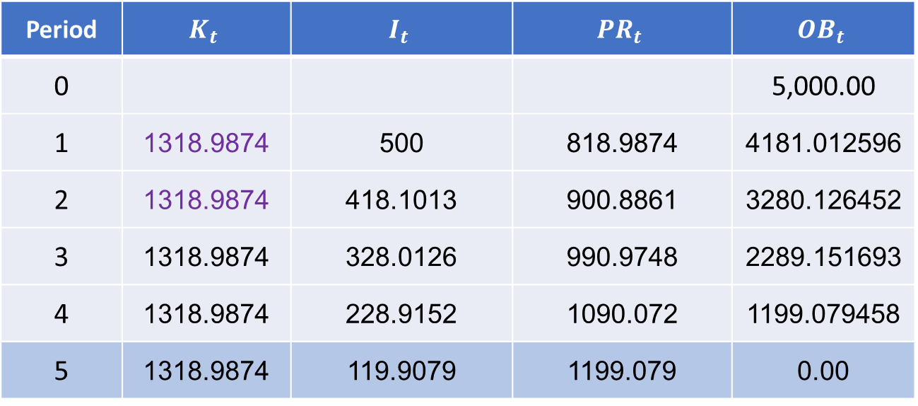
Example 5.1 revisited
Period | $$K_{t}$$ | $$I_{t}$$ | $${PR}_{t}$$ | $${OB}_{t}$$
0 |  |  |  | 5,000.00
1 | 1318.9874 | 500 | 818.9874 | 4181.012596
2 | 1318.9874 | 418.1013 | 900.8861 | 3280.126452
3 | 1318.9874 | 328.0126 | 990.9748 | 2289.151693
4 | 1318.9874 | 228.9152 | 1090.072 | 1199.079458
5 | 1318.9874 | 119.9079 | 1199.079 | 0.00
$${OB}_{2}=1318.9874{ a}_{\overline{3|}10\%}$$

Slide 6
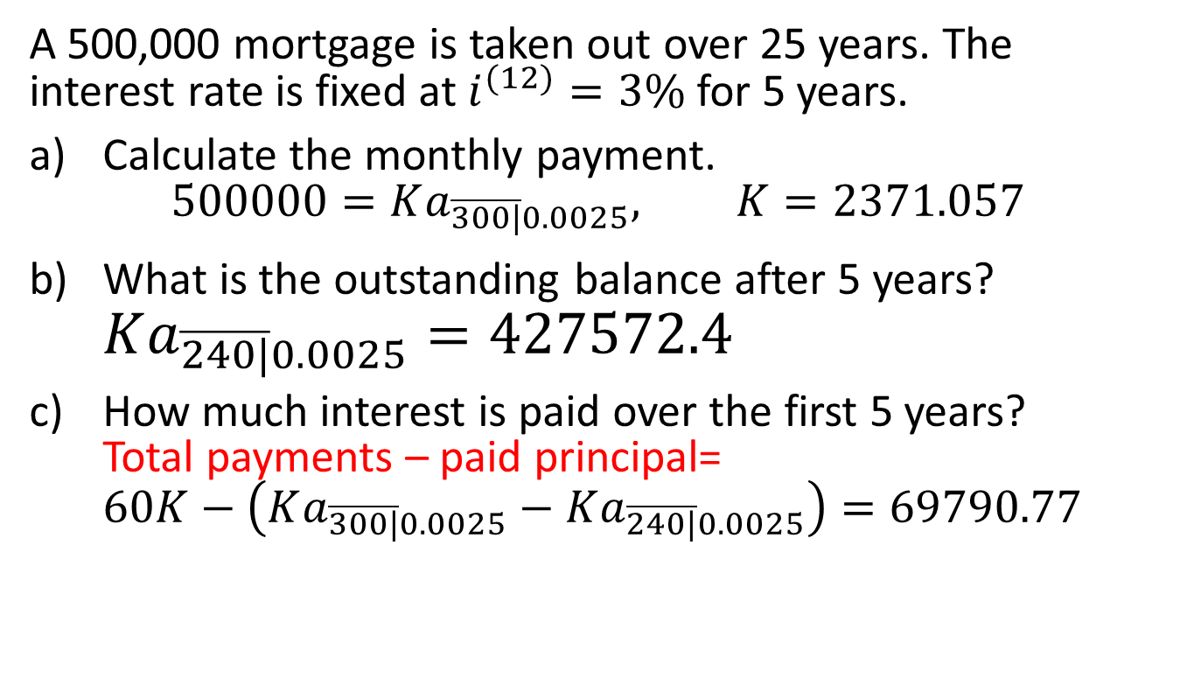
Example 5.5
A 500,000 mortgage is taken out over 25 years. The interest rate is fixed at $i^{(12)}=3\%$ for 5 years.
Calculate the monthly payment.
$500000=Ka_{\overline{300|}0.0025}, K=2371.057$
What is the outstanding balance after 5 years? $Ka_{\overline{240|}0.0025}=427572.4$
How much interest is paid over the first 5 years?
Total payments – paid principal=
$60K−\left(Ka_{\overline{300|}0.0025}−Ka_{\overline{240|}0.0025}\right)=69790.77$

Slide 7
5.3 Refinancing a loan
Mortgage loans are long-term commitments, but even on a fixed-rate mortgage the interest rate is only guaranteed for a portion of the amortization period.
When rates change, it may be advantageous for the borrower to refinance to loan. This means getting a new loan that pays off the outstanding balance on the original loan and establishes new periodic payments.

Slide 8
Penalties
Borrowers can usually refinance a mortgage at the end of the term without penalty.
If a borrower wishes to refinance a mortgage during the term, there may be a penalty to compensate the lender for lost interest.
A common penalty is 3 times the monthly interest on the outstanding balance.
Borrowers must take this penalty into account when deciding whether to refinance.

Slide 9
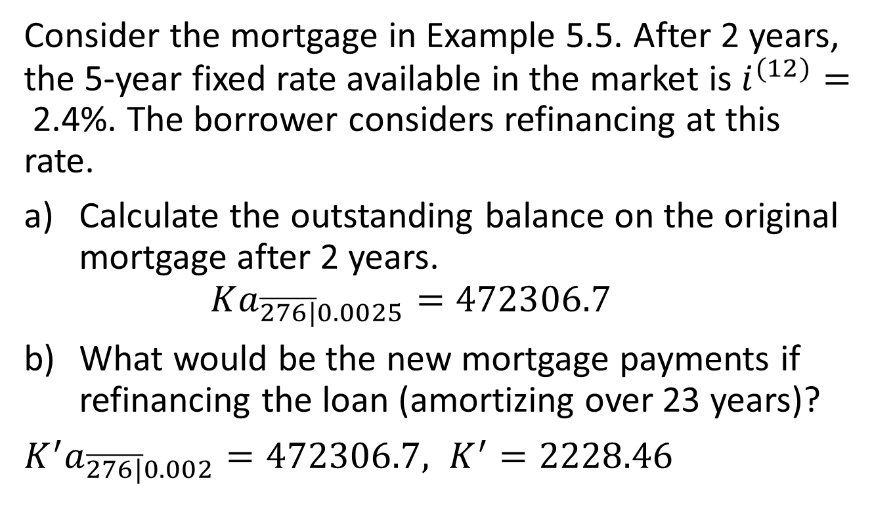
Example 5.6
Consider the mortgage in Example 5.5. After 2 years, the 5-year fixed rate available in the market is $i^{(12)}=$2.4%. The borrower considers refinancing at this rate.
Calculate the outstanding balance on the original mortgage after 2 years.
$Ka_{\overline{276|}0.0025}=472306.7$
What would be the new mortgage payments if refinancing the loan (amortizing over 23 years)?
$K^{′}a_{\overline{276|}0.002}=472306.7, K^{′}=2228.46$

Slide 10

Example 5.6, continued
What is the outstanding balance at the end of the first 5 years if the mortgage is refinanced?
$$K^{′}a_{\overline{240|}0.002}=424433.2$$

Slide 11
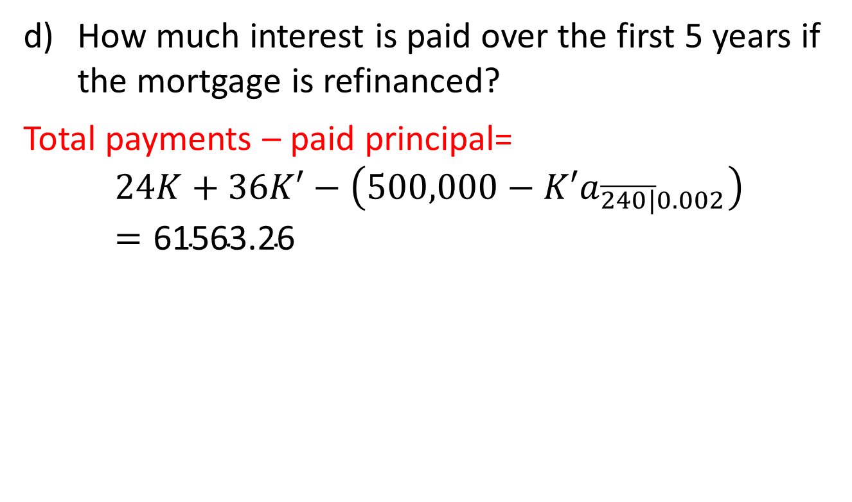
Example 5.6, continued
How much interest is paid over the first 5 years if the mortgage is refinanced?
Total payments – paid principal=
$$24K+36K′−\left(500,000−K′a_{\overline{240|}0.002}\right)=\text{61563.26}$$

Slide 12
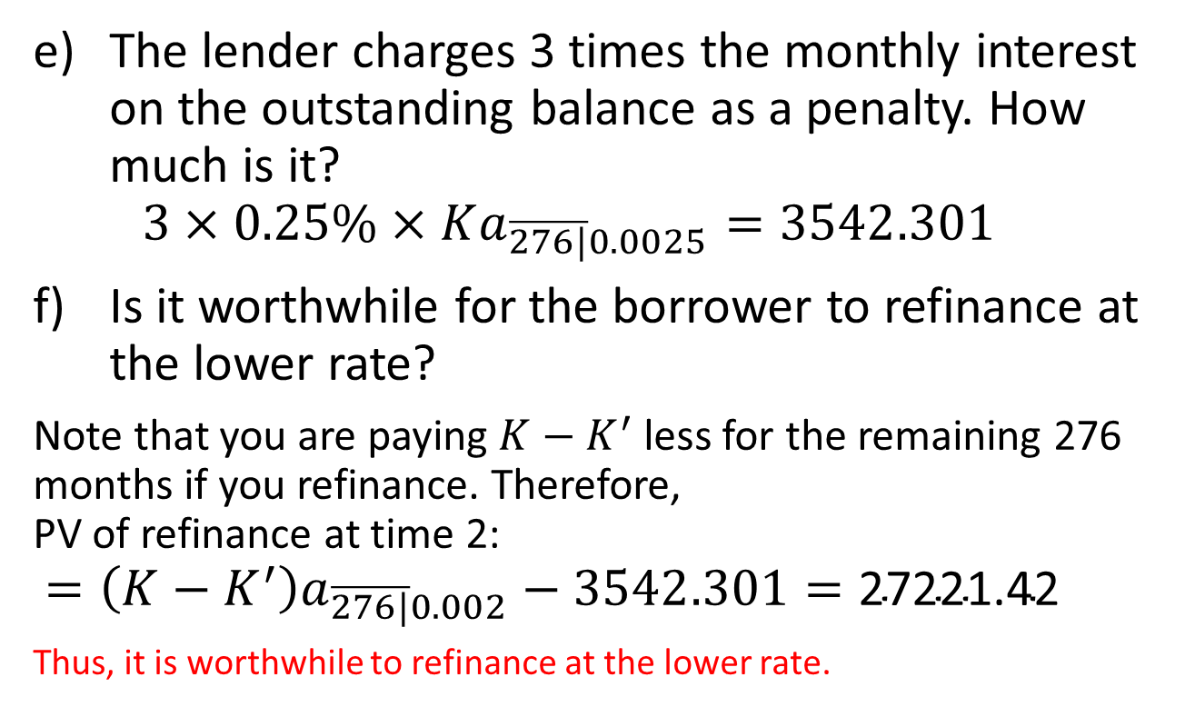
Example 5.6, continued
The lender charges 3 times the monthly interest on the outstanding balance as a penalty. How much is it?
$3×0.25\%×Ka_{\overline{276|}0.0025}=3542.301$
Is it worthwhile for the borrower to refinance at the lower rate?
Note that you are paying $K−K^{′}$ less for the remaining 276 months if you refinance. Therefore,
PV of refinance at time 2:
$=\left(K−K^{′}\right)a_{\overline{276|}0.002}−3542.301=\text{27221.42}$
Thus, it is worthwhile to refinance at the lower rate.

