Slide 1
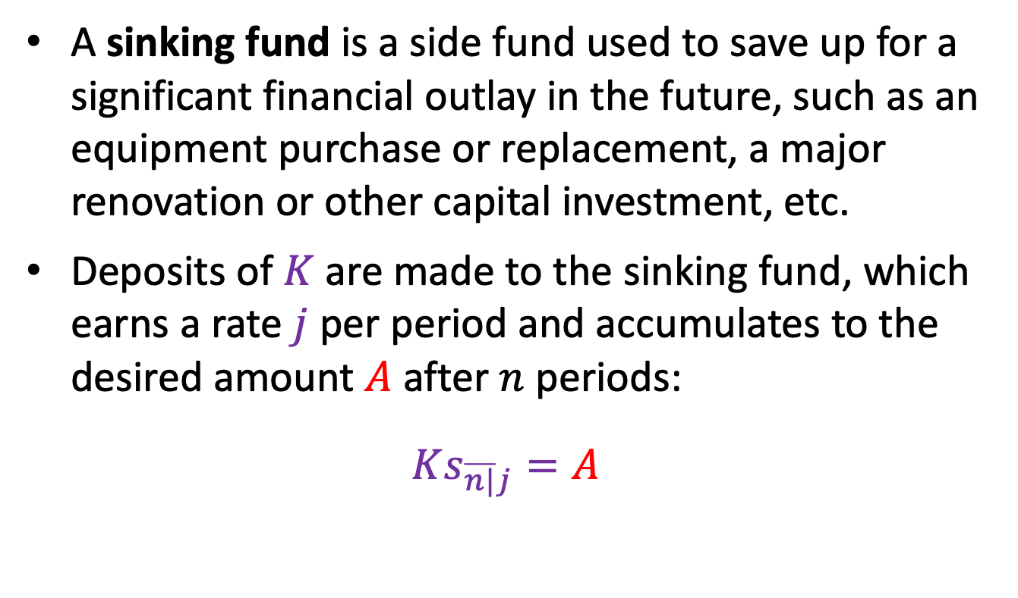
5.4 Sinking funds
A sinking fund is a side fund used to save up for a significant financial outlay in the future, such as an equipment purchase or replacement, a major renovation or other capital investment, etc.
Deposits of $K$ are made to the sinking fund, which earns a rate $j$ per period and accumulates to the desired amount $A$ after $n$ periods:
$$Ks_{\overline{n|}j}=A$$

Slide 2
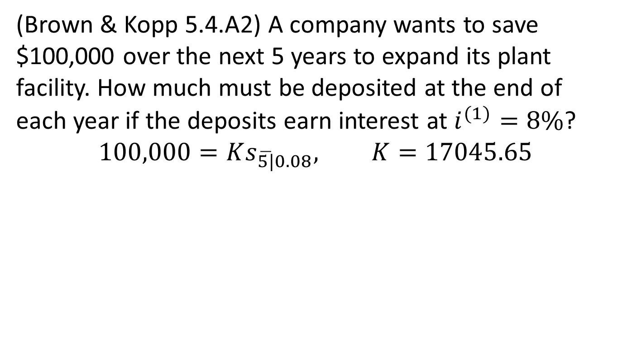
Example 5.7
(Brown & Kopp 5.4.A2) A company wants to save $100,000 over the next 5 years to expand its plant facility. How much must be deposited at the end of each year if the deposits earn interest at $i^{(1)}=8\%$?
$$100,000=Ks_{\overline{5|}0.08}, K=17045.65$$

Slide 3
Sinking fund schedule (savings)
Time | Interest on SF | Deposit (EOY) | Amount in fund
1 | -- | 17,045.65 | 17,045.65
2 | 1,363.65 | 17,045.65
3 |  | 17,045.65
4 |  | 17,045.65
5 |  | 17,045.65
$$t$$ |  | $$K=A/s_{\overline{n|}j}$$ | $$Ks_{\overline{t|}j}$$

Slide 4
SF method of loan repayment
Under the amortization method, the borrower makes periodic installment payments to the lender which cover both principal and interest.
An alternative is to make only interest payments during the term of the loan and repay the original principal in one lump sum at the end. If the borrower “saves up” for the principal payment in a sinking fund, this is known as the sinking fund method of repaying a loan.

Slide 5
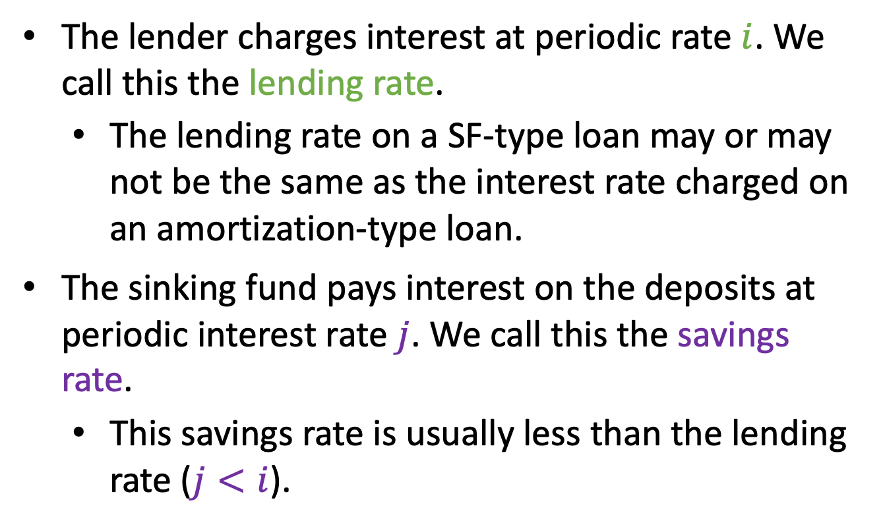
SF method: key interest rates
The lender charges interest at periodic rate $i$. We call this the lending rate.
  The lending rate on a SF-type loan may or may not be the same as the interest rate charged on an amortization-type loan.
The sinking fund pays interest on the deposits at periodic interest rate $j$. We call this the savings rate.
  This savings rate is usually less than the lending rate ($j<i$).

Slide 6
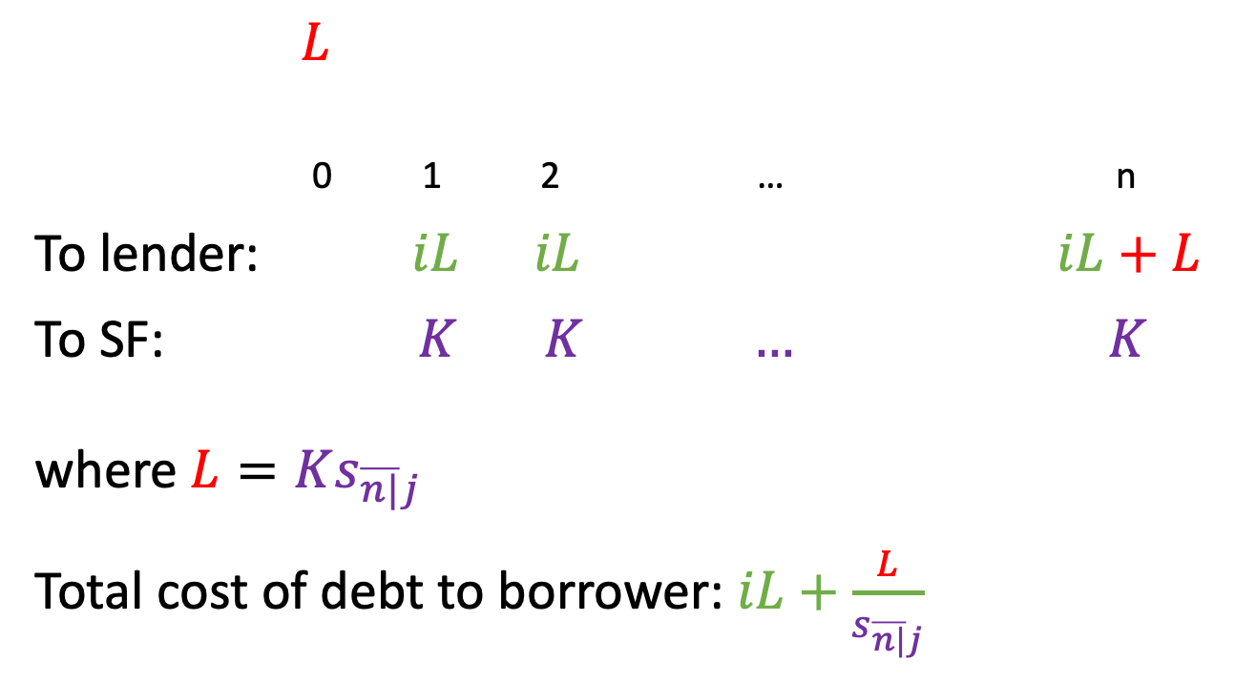
Cash flows under SF method
$L$
0 1 2 … n
To lender: $iL iL iL+L$
To SF: $K K … K$
where $L=Ks_{\overline{n|}j}$
Total cost of debt to borrower: $iL+\frac{L}{s_{\overline{n|}j}}$

Slide 7
Example 5.8
A loan of 100,000 is to be repaid by 10 annual payments beginning one year after issue.
The lender wants annual payments of interest at a rate of 10% and repayment of the principal in a single lump sum at the end of 10 years.
The borrower can accumulate the principal in a sinking fund earning an annual interest rate of 8%, and decides to do this by means of 10 level deposits starting one year after the loan is made.

Slide 8
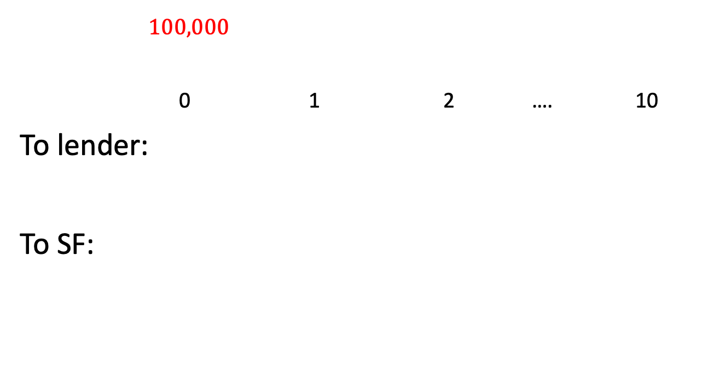
Example 5.8: cash flows
$100,000$
0 1 2 …. 10
To lender:
To SF:

Slide 9
Example 5.8: sinking fund schedule
t | Original loan |  | Sinking fund |  |  | Periodic cost of debt | Book value of loan
 | Interest | OB | Deposit | Interest | AV
1 | 10,000 | 100,000 | 6,902.95 | 0 | 6,902.95 | 16,902.95 | 93,097.05
2 | 10,000 | 100,000 | 6,902.95 | 552.24 | 14,358.13 | 16,902.95 | 85,641.87
.. | … | … | … | … | … | … | …
9 | 10,000 | 100,000 | 6,902.95 | 5,873.93 | 86,200.97 | 16,902.95 | 13,799.03
10 | 10,000 | 100,000 | 6,902.95 | 6,896.08 | 100,000 | 16,902.95 | 0

Slide 10
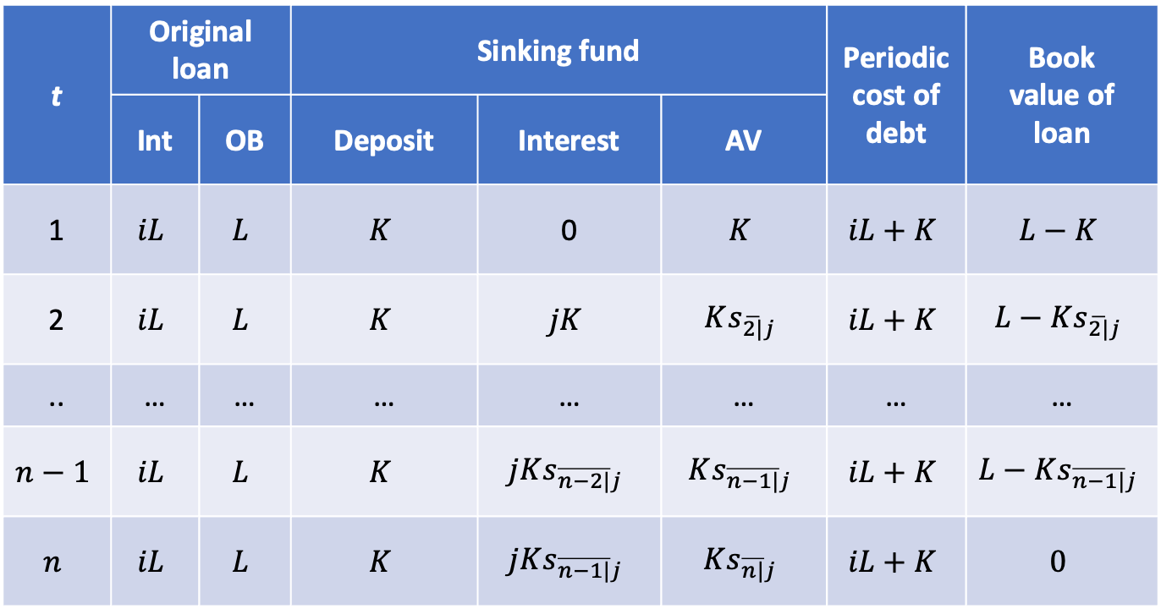
General sinking fund schedule
t | Original loan |  | Sinking fund |  |  | Periodic cost of debt | Book value of loan
 | Int | OB | Deposit | Interest | AV
1 | $$iL$$ | $$L$$ | $$K$$ | 0 | $$K$$ | $$iL+K$$ | $$L−K$$
2 | $$iL$$ | $$L$$ | $$K$$ | $$jK$$ | $$Ks_{\overline{2|}j}$$ | $$iL+K$$ | $$L−Ks_{\overline{2|}j}$$
.. | … | … | … | … | … | … | …
$$n−1$$ | $$iL$$ | $$L$$ | $$K$$ | $$jKs_{\overline{n−2|}j}$$ | $$Ks_{\overline{n−1|}j}$$ | $$iL+K$$ | $$L−Ks_{\overline{n−1|}j}$$
$$n$$ | $$iL$$ | $$L$$ | $$K$$ | $$jKs_{\overline{n−1|}j}$$ | $$Ks_{\overline{n|}j}$$ | $$iL+K$$ | $$0$$

Slide 11
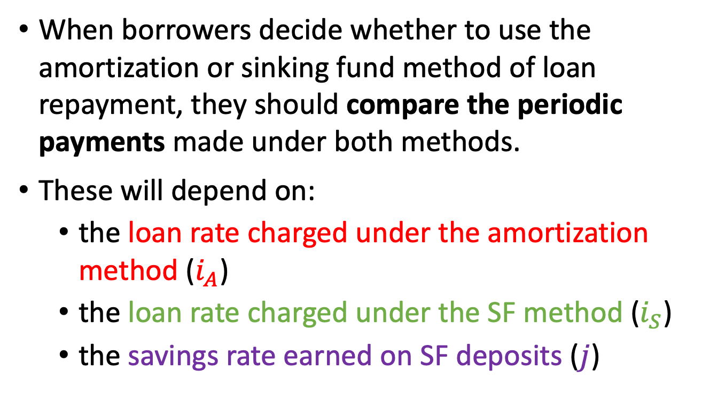
5.5 Comparison of amortization and sinking-fund methods
When borrowers decide whether to use the amortization or sinking fund method of loan repayment, they should compare the periodic payments made under both methods.
These will depend on:
  the loan rate charged under the amortization method ($i_{A}$)
  the loan rate charged under the SF method ($i_{S}$)
  the savings rate earned on SF deposits ($j$)

Slide 12
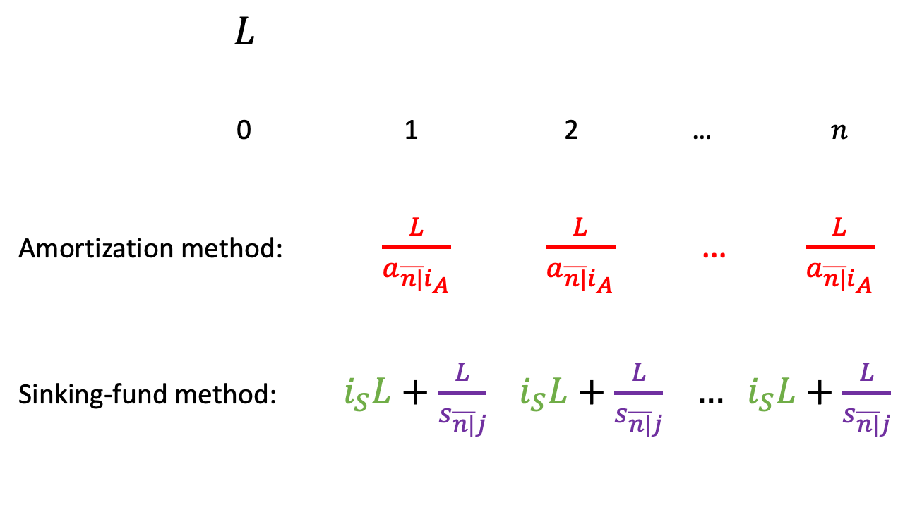
Cash flow comparison
$L$
0 1 2 … $n$
Amortization method: $\frac{L}{a_{\overline{n|}i_{A}}}$ $\frac{L}{a_{\overline{n|}i_{A}}}$ … $\frac{L}{a_{\overline{n|}i_{A}}}$
Sinking-fund method: $i_{S}L+\frac{L}{s_{\overline{n|}j}} i_{S}L+\frac{L}{s_{\overline{n|}j}} … i_{S}L+\frac{L}{s_{\overline{n|}j}}$

Slide 13
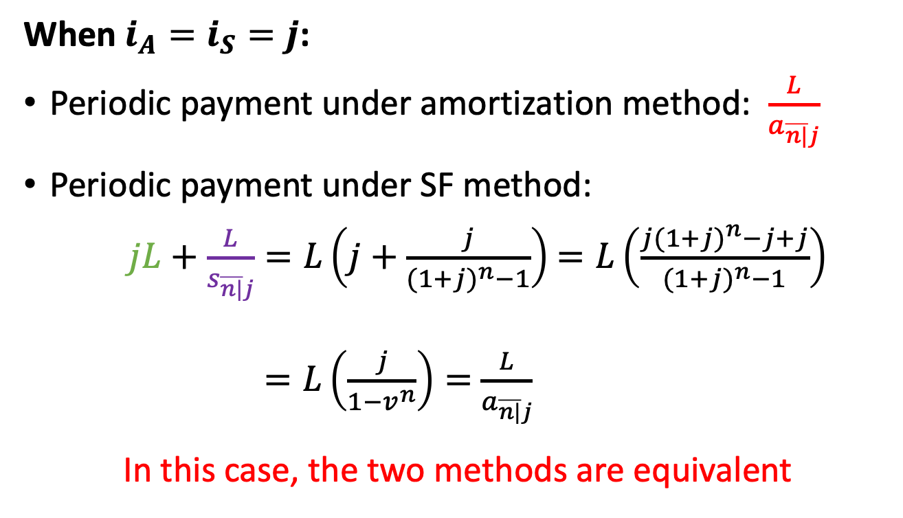
Cash flow comparison, continued
When $i_{A}=i_{S}=j$:
Periodic payment under amortization method: $\frac{L}{a_{\overline{n|}j}}$
Periodic payment under SF method:
$jL+$ $\frac{L}{s_{\overline{n|}j}}=L\left(j+\frac{j}{{(1+j)}^{n}−1}\right)$ $=L\left(\frac{j{(1+j)}^{n}−j+j}{{(1+j)}^{n}−1}\right)$
$=L\left(\frac{j}{1−v^{n}}\right)=$ $\frac{L}{a_{\overline{n|}j}}$
In this case, the two methods are equivalent

Slide 14
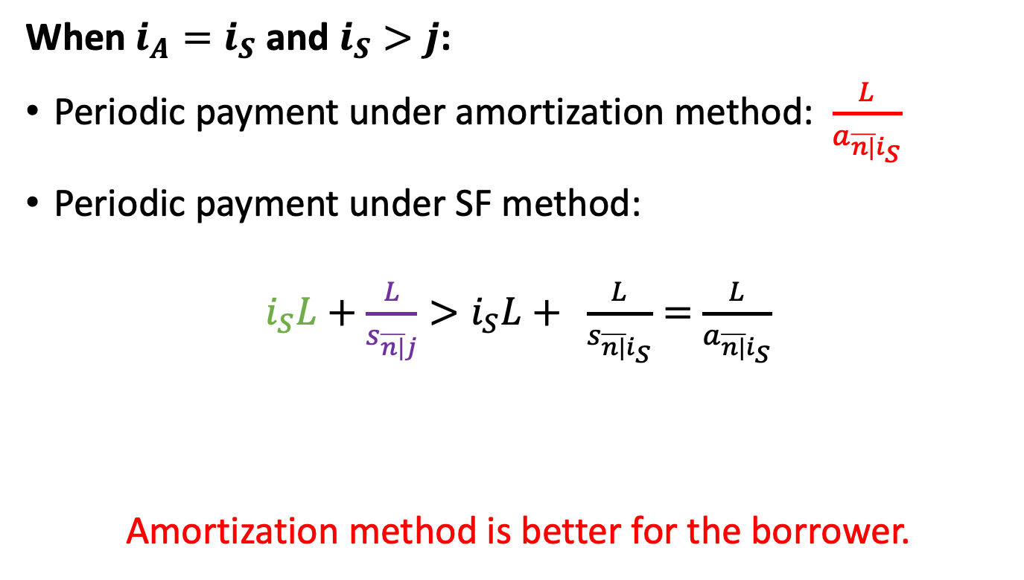
Cash flow comparison, continued
When $i_{A}=i_{S}$ and $i_{S}>j$:
Periodic payment under amortization method: $\frac{L}{a_{\overline{n|}i_{S}}}$
Periodic payment under SF method:
$i_{S}L+$ $\frac{L}{s_{\overline{n|}j}}>i_{S}L+ \frac{L}{s_{\overline{n|}i_{S}}}=$ $\frac{L}{a_{\overline{n|}i_{S}}}$
Amortization method is better for the borrower.

Slide 15
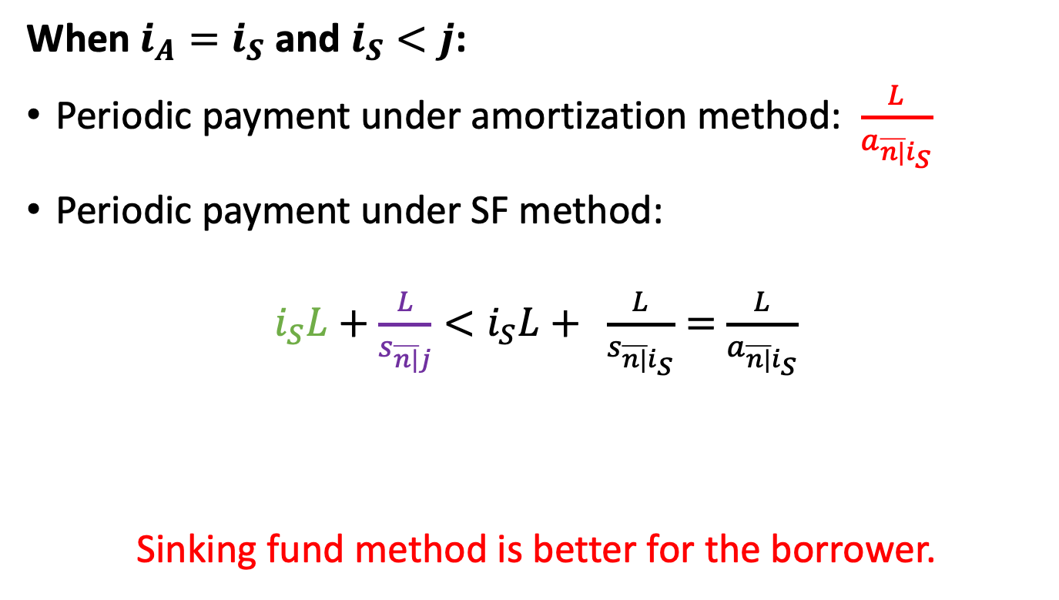
Cash flow comparison, continued
When $i_{A}=i_{S}$ and $i_{S}<j$:
Periodic payment under amortization method: $\frac{L}{a_{\overline{n|}i_{S}}}$
Periodic payment under SF method:
$i_{S}L+$ $\frac{L}{s_{\overline{n|}j}}<i_{S}L+ \frac{L}{s_{\overline{n|}i_{S}}}=$ $\frac{L}{a_{\overline{n|}i_{S}}}$
Sinking fund method is better for the borrower.

Slide 16
Other considerations
A borrower may still choose the sinking fund method even if the periodic cost of payment is higher than under the amortization method because:
The borrower controls the SF deposit amount. If it needs to reduce payments for a while, it can catch up later.
The borrower can take risk in investing the deposits and maybe earn a higher return.
The borrower can usually negotiate a lower loan rate than with amortization.

Slide 17
Example 5.9
A loan of 100,000 is to be repaid by 10 payments beginning one year after the loan is made.
If the borrower chooses the amortization method, the lender charges a loan rate of 11%.
If the borrower chooses to pay interest only on the loan, the lender is willing to reduce the loan rate to 10%. The borrower can get a savings rate of 8%.
Which one should the borrower choose?

Slide 18
Example 5.9, continued

Slide 19
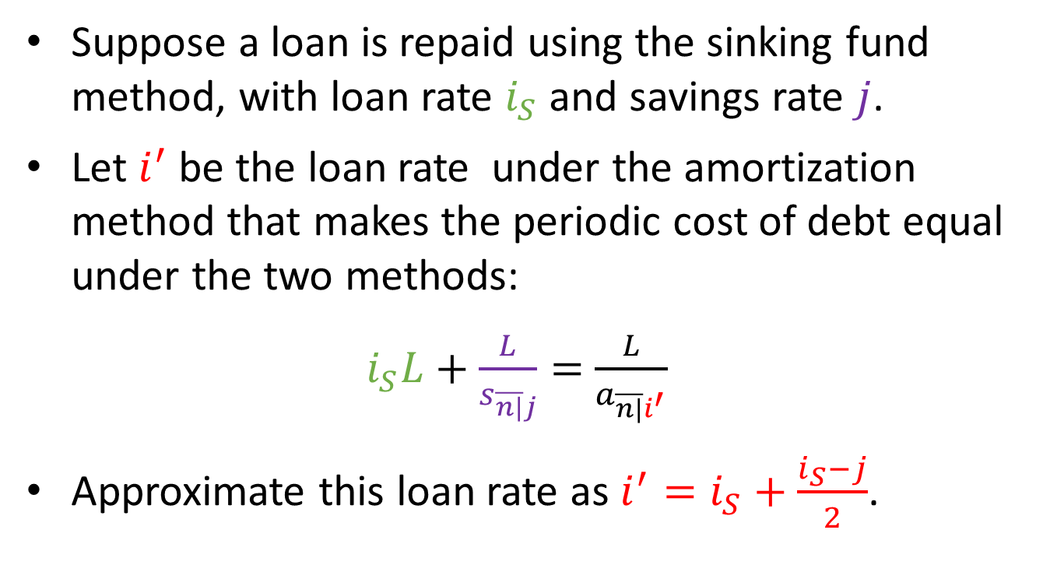
General equivalence
Suppose a loan is repaid using the sinking fund method, with loan rate $i_{S}$ and savings rate $j$.
Let $i^{′}$ be the loan rate under the amortization method that makes the periodic cost of debt equal under the two methods:
$i_{S}L+$ $\frac{L}{s_{\overline{n|}j}}=$ $\frac{L}{a_{\overline{n|}i^{′}}}$
Approximate this loan rate as $i^{′}=i_{S}+\frac{i_{S}−j}{2}$.

