Slide 1
CHAPTER 6
Bonds

Slide 2
6.1 Introduction and terminology
Bonds are financial instruments that corporations and governments use to raise capital
They are debt instruments:
  The bond issuer is the borrower: gets cash at issue, and will pay back principal and interest
  The bondholder (investor) is the lender
If the bond issuer does not make a payment as scheduled, we say they defaulted on the bond
Bonds are rated based on their probability of default

Slide 3
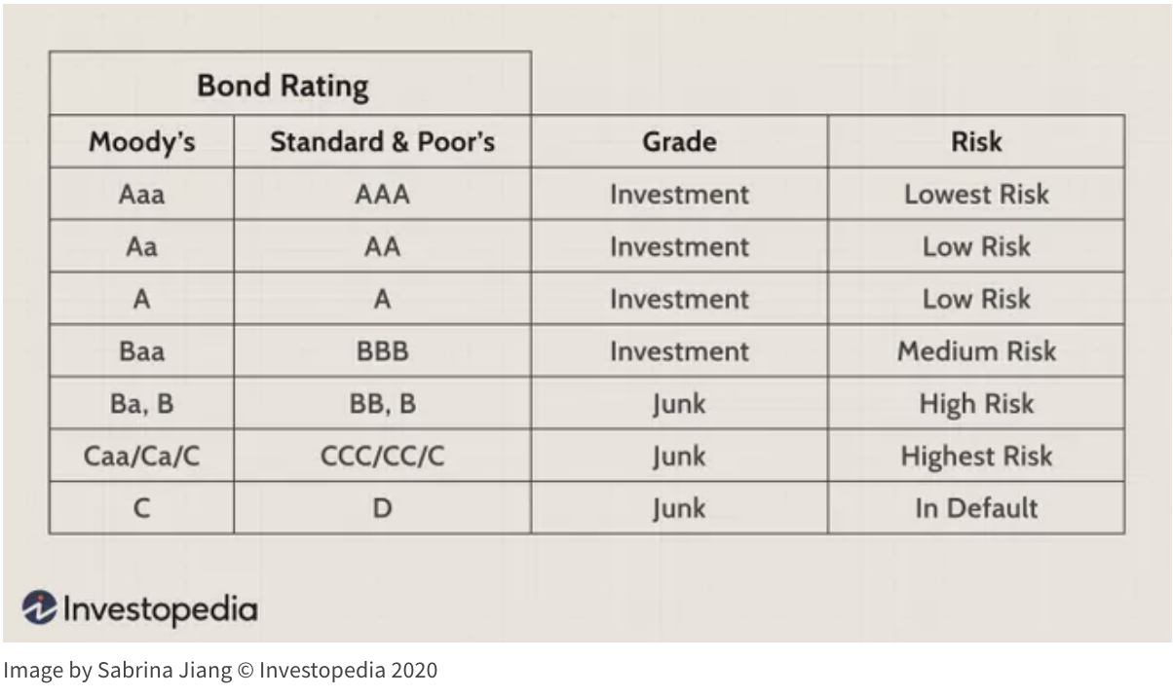
Bond ratings

Slide 4
Types of government bonds
Savings bonds: redeemable any time (issuer will take it back and pay principal plus interest)
Marketable bonds:
  Have a specific maturity date
  Usually not redeemable before maturity
  Bondholder can sell it to another investor
  Market price will depend on the characteristics of the bond as well as market conditions at time of sale

Slide 5
Terminology
Face value (par value) | Amount noted on front (face) of bond. Usually multiples of 100.
Maturity date | The date on which the loan is (normally) repaid.
Callable bond | A bond that can be redeemed before maturity at the discretion of the bond issuer, at specific dates, for specific amounts
Redemption date | A date on which the loan can be repaid
Redemption value | Amount payable at redemption date. “At par” means at face value.

Slide 6
Terminology, continued
Coupon rate (bond rate) | The rate at which the bond pays interest on its face value until the maturity date. Coupon payments are made at equal intervals (usually semiannually).
Yield rate (investment rate) | The rate of return realized by the bondholder on its investment.

Slide 7
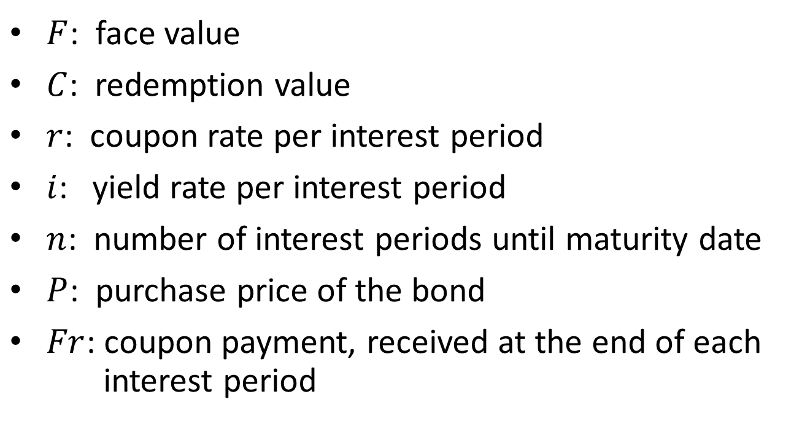
Notation
$F$: face value
$C$: redemption value
$r$: coupon rate per interest period
$i$: yield rate per interest period
$n$: number of interest periods until maturity date
$P$: purchase price of the bond
$Fr$: coupon payment, received at the end of each
interest period

Slide 8
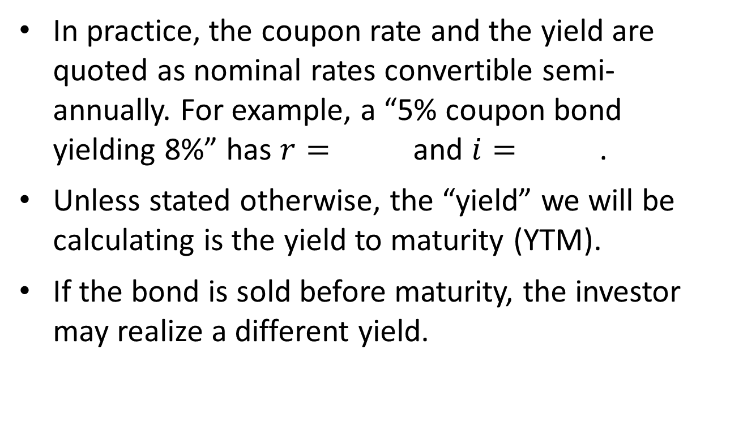
“Yield”
In practice, the coupon rate and the yield are quoted as nominal rates convertible semi-annually. For example, a “5% coupon bond yielding 8%” has $r=$ and $i=$ .
Unless stated otherwise, the “yield” we will be calculating is the yield to maturity (YTM).
If the bond is sold before maturity, the investor may realize a different yield.

Slide 9
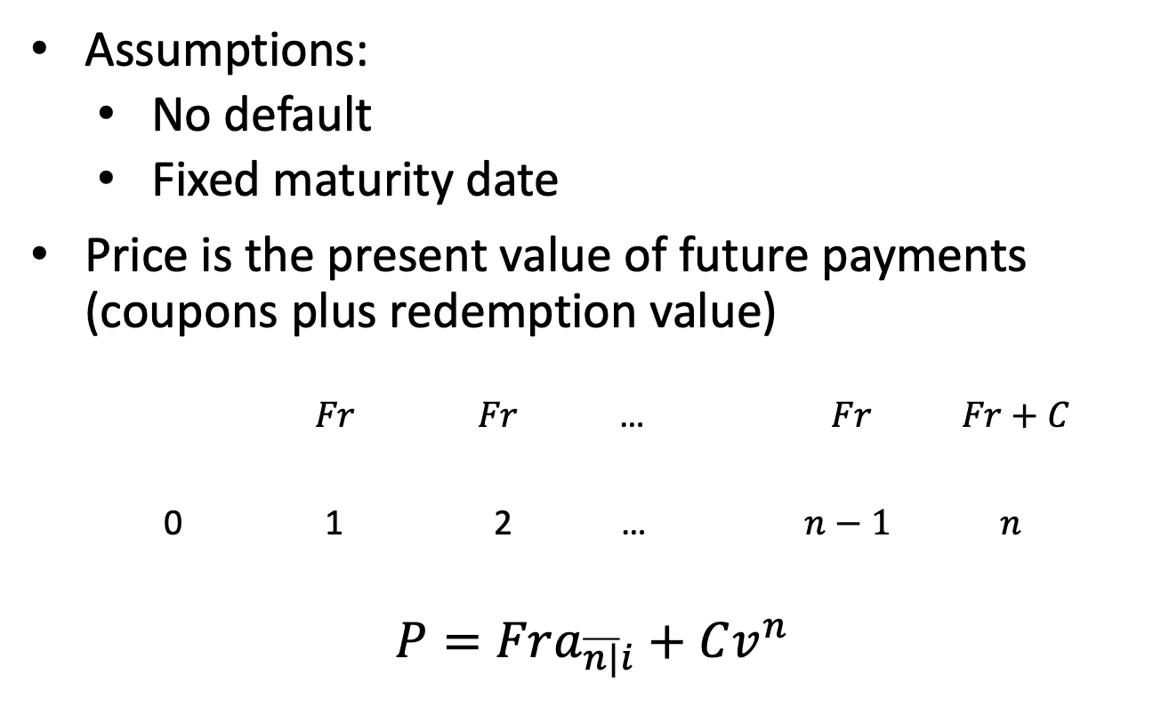
6.2 Purchase price of a bond
Assumptions:
  No default
  Fixed maturity date
Price is the present value of future payments (coupons plus redemption value)
$Fr$ $Fr$ … $Fr Fr+C$
0 1 2 … $n−1$ $n$
$$P=Fra_{\overline{n|}i}+Cv^{n}$$

Slide 10
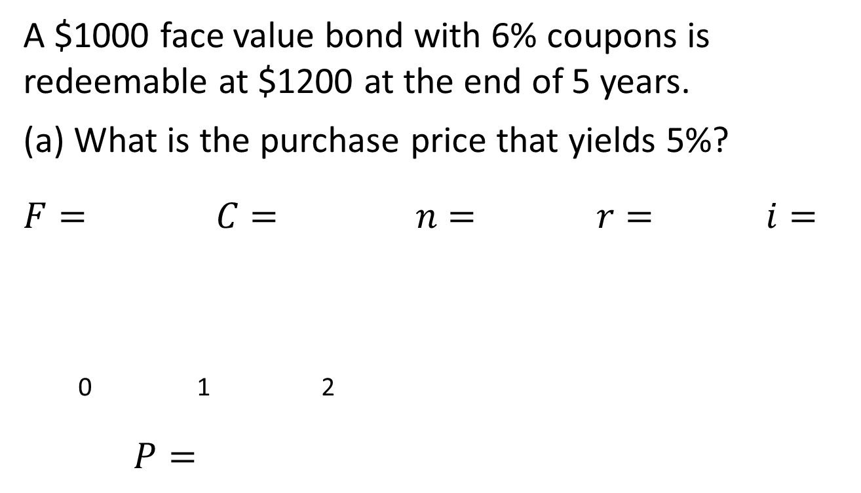
Example 6.1
A $1000 face value bond with 6% coupons is redeemable at $1200 at the end of 5 years.
(a) What is the purchase price that yields 5%?
$$F= C= n= r= i=$$
0 1 2
$$P=$$

Slide 11
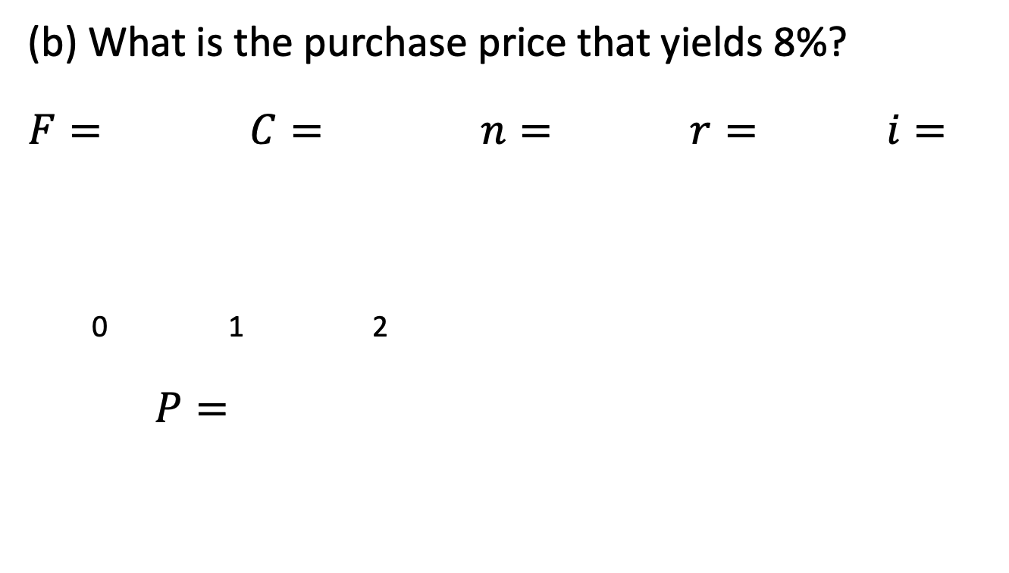
Example 6.1, continued
(b) What is the purchase price that yields 8%?
$$F= C= n= r= i=$$
0 1 2
$$P=$$

Slide 12
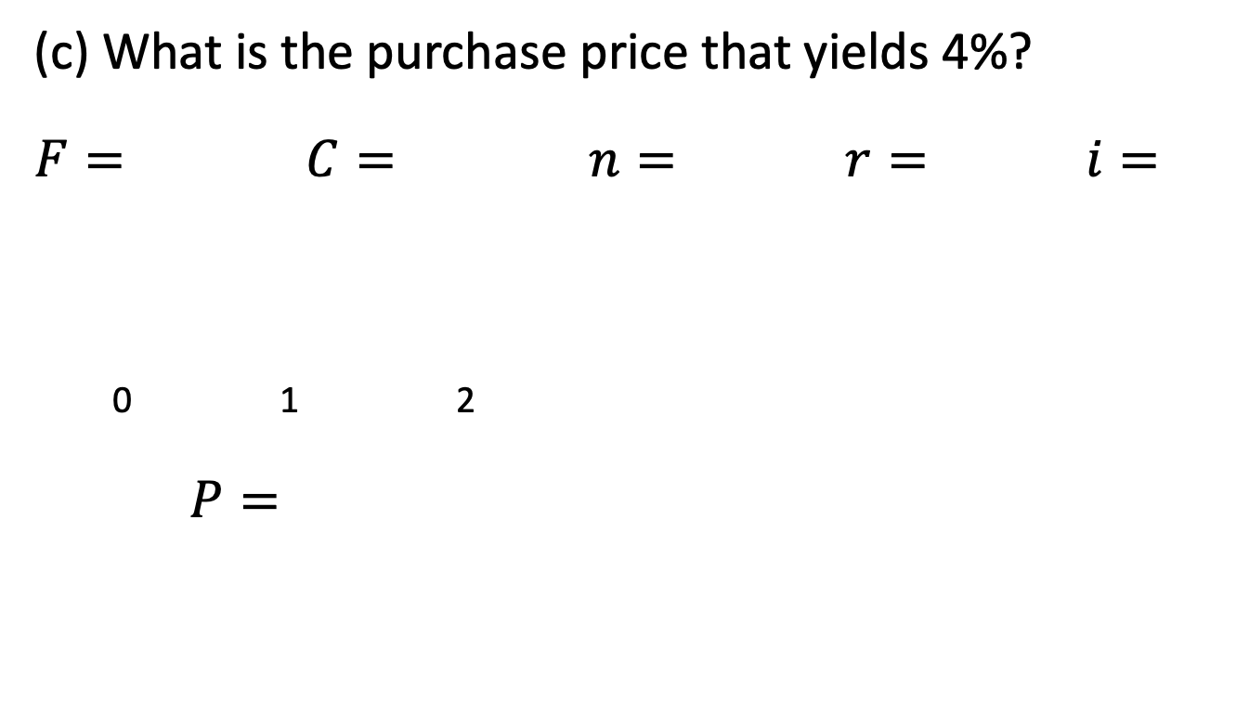
Example 6.1, continued
(c) What is the purchase price that yields 4%?
$$F= C= n= r= i=$$
0 1 2
$$P=$$

Slide 13
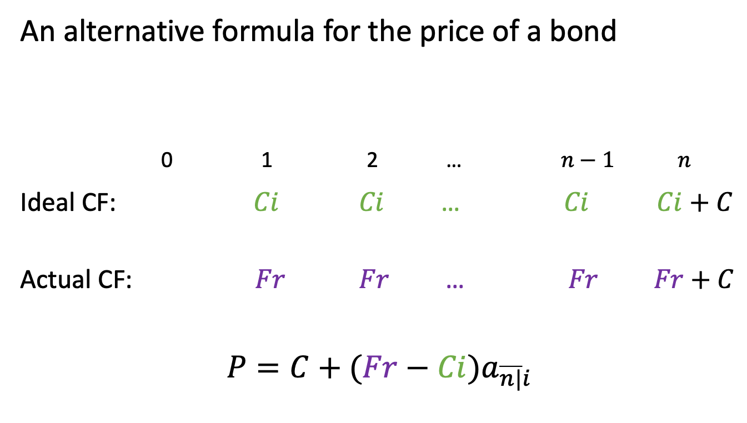
Premium/discount formula
An alternative formula for the price of a bond
0 1 2 … $n−1$ $n$
Ideal CF: $Ci$ $Ci$ … $Ci Ci+C$
Actual CF: $Fr$ $Fr$ … $Fr Fr+C$
$$P=C+(Fr−Ci)a_{\overline{n|}i}$$

Slide 14
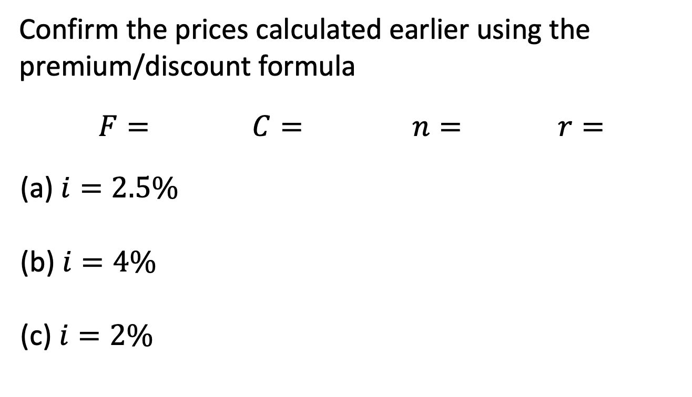
Example 6.1, continued
Confirm the prices calculated earlier using the premium/discount formula
$$F= C= n= r=$$
(a) $i=2.5\%$
(b) $i=4\%$
(c) $i=2\%$

Slide 15
Auction process for GoC bonds
Gov’t decides on face amount, term, coupon rate
Invites bids from investors for the yield they are willing to accept (to 3 decimals), and the amount of face value they are willing to buy
Yield is converted to price (5 decimals accuracy)
“First price sealed bid” auction:
  bids ranked from lowest to highest in terms of yield
  bids accepted in rank-order until desired amount is raised
  bids lower than threshold not accepted
  all accepted bids get the yield they proposed

Slide 16
Auction process, continued
Different from Dutch auction
Who can bid, and for what quantity, is limited
Competitive vs. non-competitive bids
Notes:
Process for issuing corporate bonds is different
After issue, bonds are traded in a dealer resale market

