Slide 1
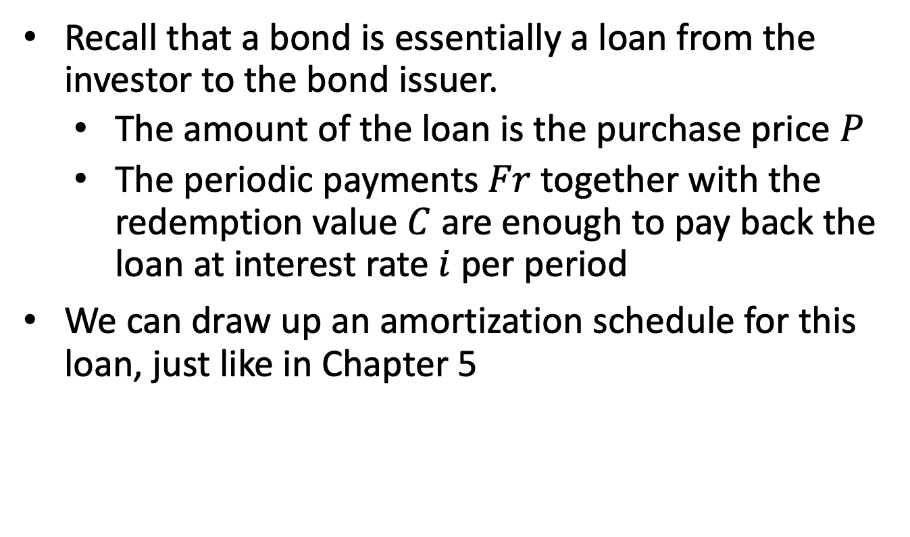
6.3 Premium and Discount
Recall that a bond is essentially a loan from the investor to the bond issuer.
  The amount of the loan is the purchase price $P$
  The periodic payments $Fr$ together with the redemption value $C$ are enough to pay back the loan at interest rate $i$ per period
We can draw up an amortization schedule for this loan, just like in Chapter 5

Slide 2
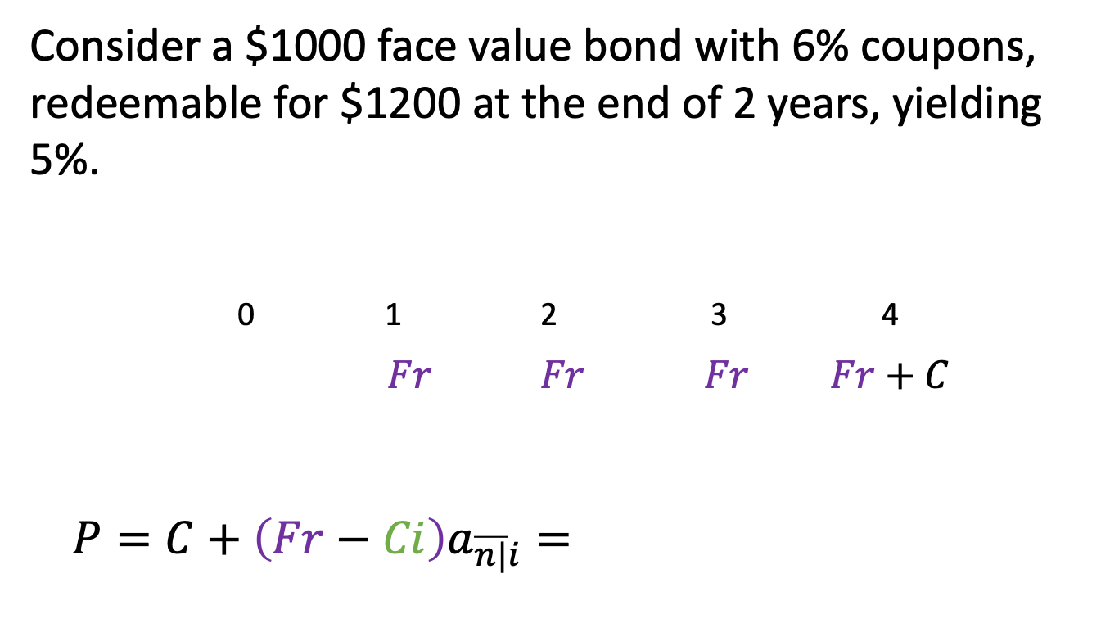
Example 6.2
Consider a $1000 face value bond with 6% coupons, redeemable for $1200 at the end of 2 years, yielding 5%.
0 1 2 3 4
$Fr$ $Fr$ $Fr Fr+C$
$$P=C+\left(Fr−Ci\right)a_{\overline{n|}i}=$$

Slide 3
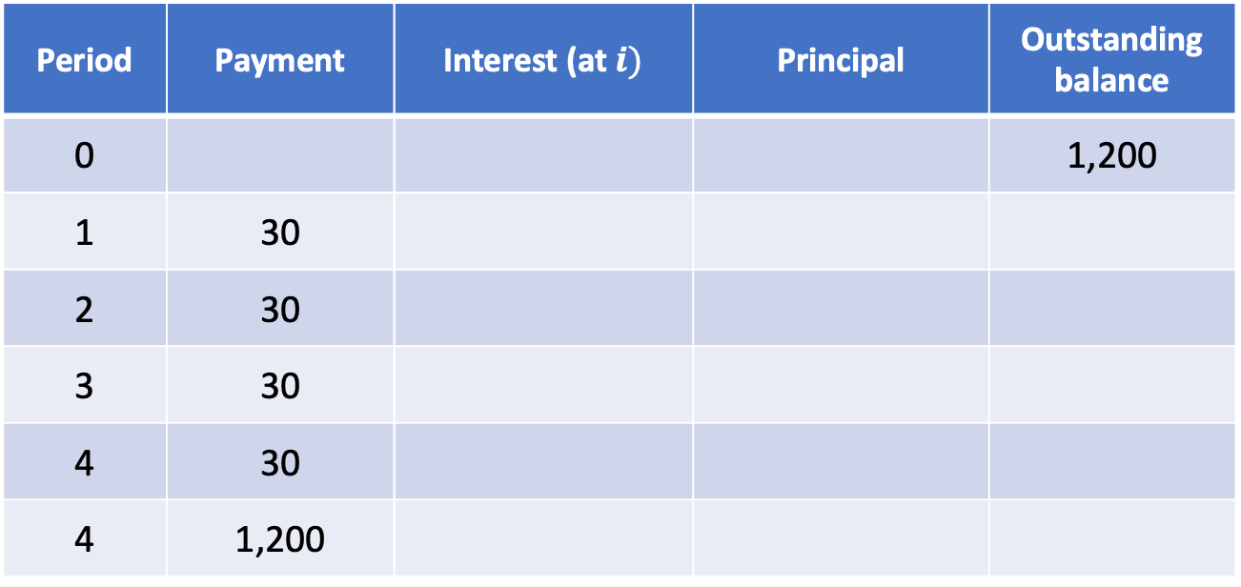
Example 6.2, continued
Period | Payment | Interest (at $i)$ | Principal | Outstanding balance
0 |  |  |  | 1,200
1 | 30
2 | 30
3 | 30
4 | 30
4 | 1,200

Slide 4
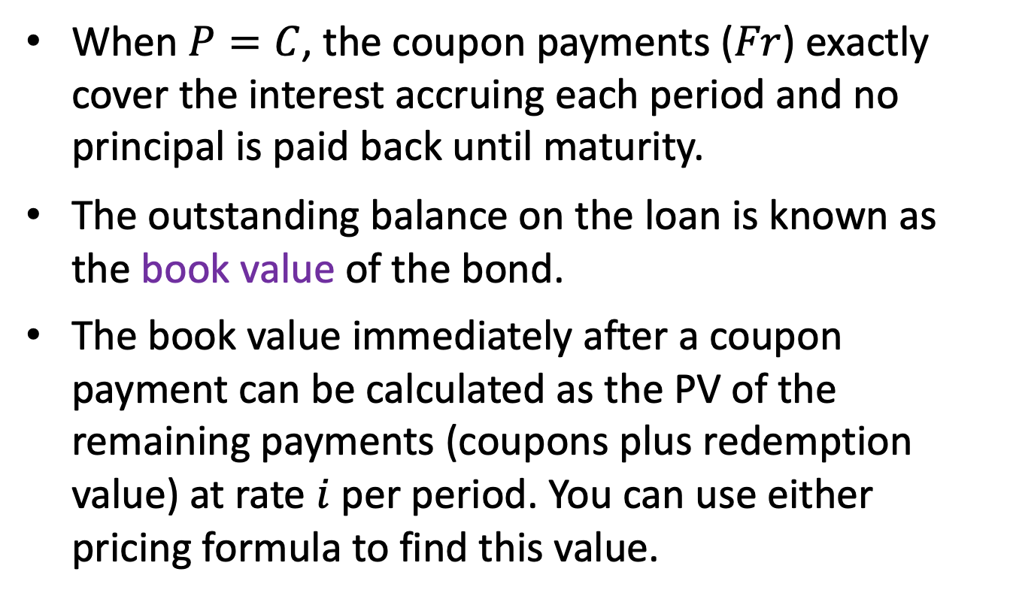
Observations
When $P=C$, the coupon payments ($Fr$) exactly cover the interest accruing each period and no principal is paid back until maturity.
The outstanding balance on the loan is known as the book value of the bond.
The book value immediately after a coupon payment can be calculated as the PV of the remaining payments (coupons plus redemption value) at rate $i$ per period. You can use either pricing formula to find this value.

Slide 5
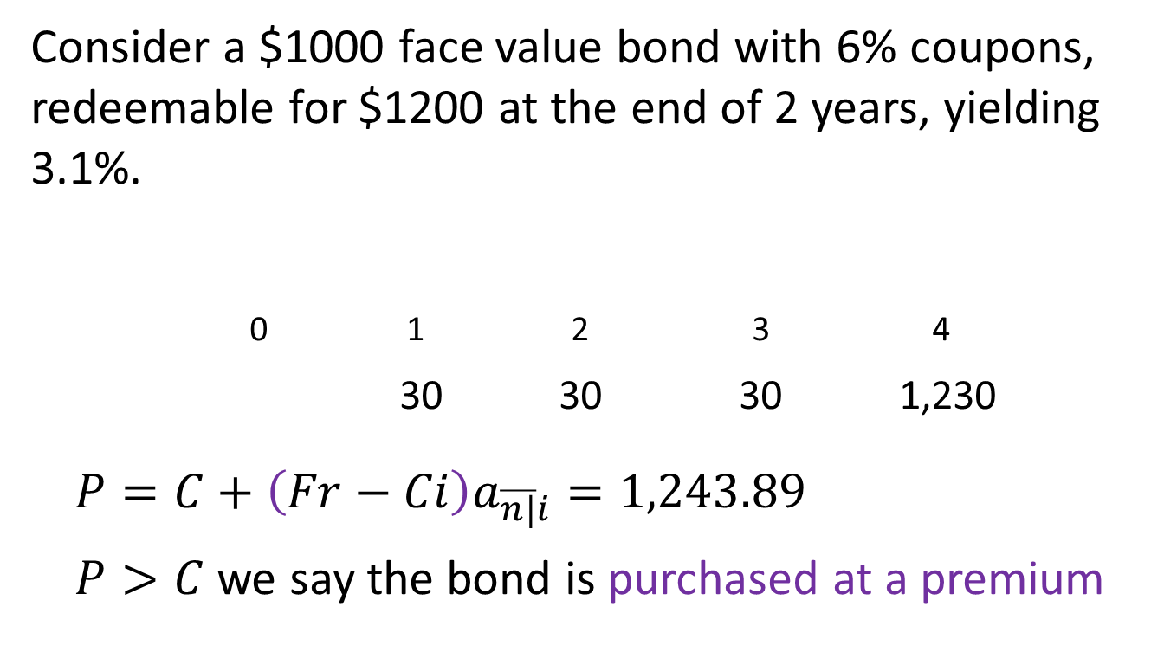
Example 6.3
Consider a $1000 face value bond with 6% coupons, redeemable for $1200 at the end of 2 years, yielding 3.1%.
0 1 2 3 4
30 30 30 1,230
$$P=C+\left(Fr−Ci\right)a_{\overline{n|}i}=1,243.89$$
$P>C$ we say the bond is purchased at a premium

Slide 6
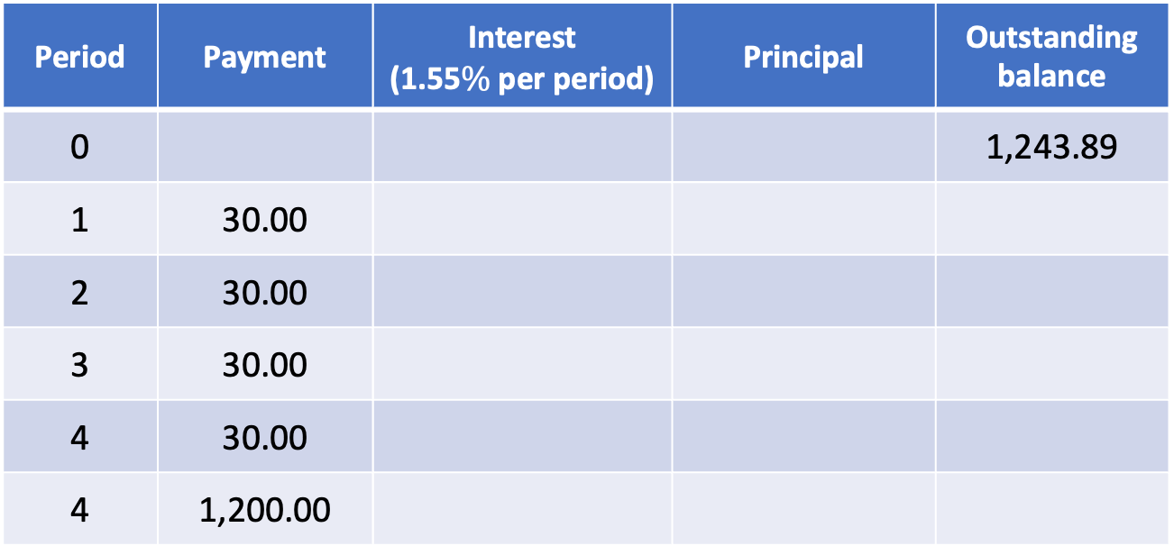
Example 6.3, continued
Period | Payment | Interest (1.55$\%$ per period) | Principal | Outstanding balance
0 |  |  |  | 1,243.89
1 | 30.00
2 | 30.00
3 | 30.00
4 | 30.00
4 | 1,200.00

Slide 7
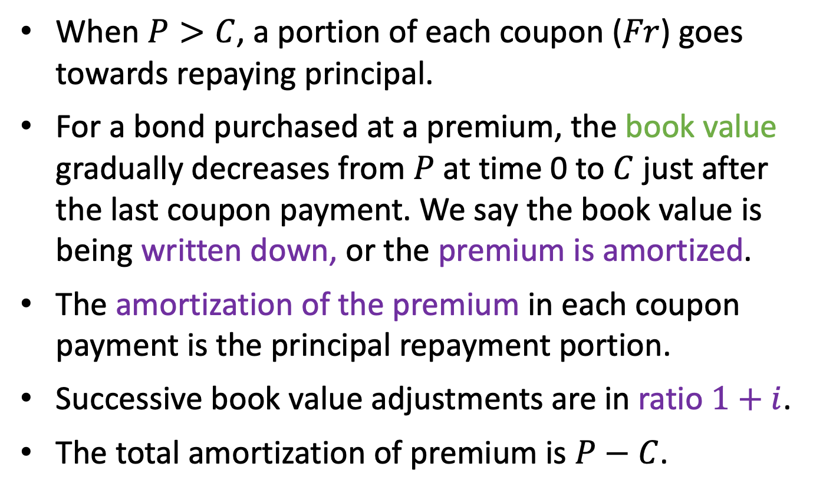
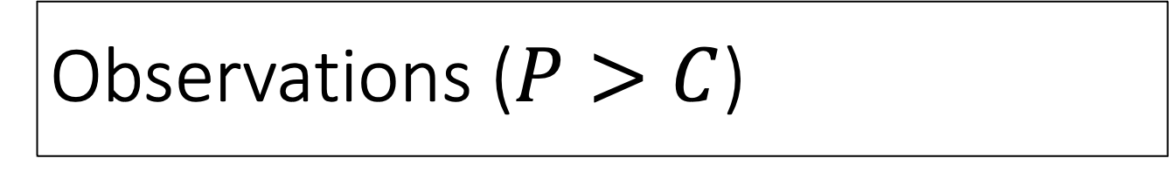
Observations ($P>C$)
When $P>C$, a portion of each coupon ($Fr$) goes towards repaying principal.
For a bond purchased at a premium, the book value gradually decreases from $P$ at time 0 to $C$ just after the last coupon payment. We say the book value is being written down, or the premium is amortized.
The amortization of the premium in each coupon payment is the principal repayment portion.
Successive book value adjustments are in ratio $1+i$.
The total amortization of premium is $P−C$.

Slide 8
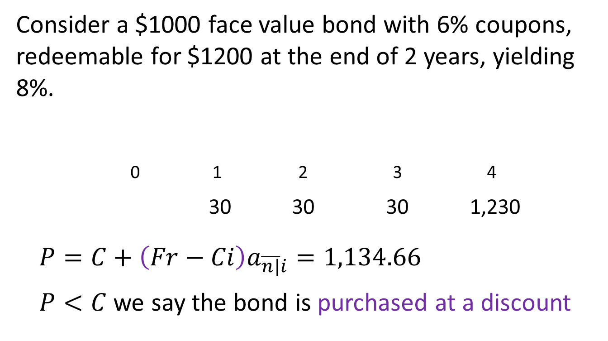
Example 6.4
Consider a $1000 face value bond with 6% coupons, redeemable for $1200 at the end of 2 years, yielding 8%.
0 1 2 3 4
30 30 30 1,230
$$P=C+\left(Fr−Ci\right)a_{\overline{n|}i}=1,134.66$$
$P<C$ we say the bond is purchased at a discount

Slide 9
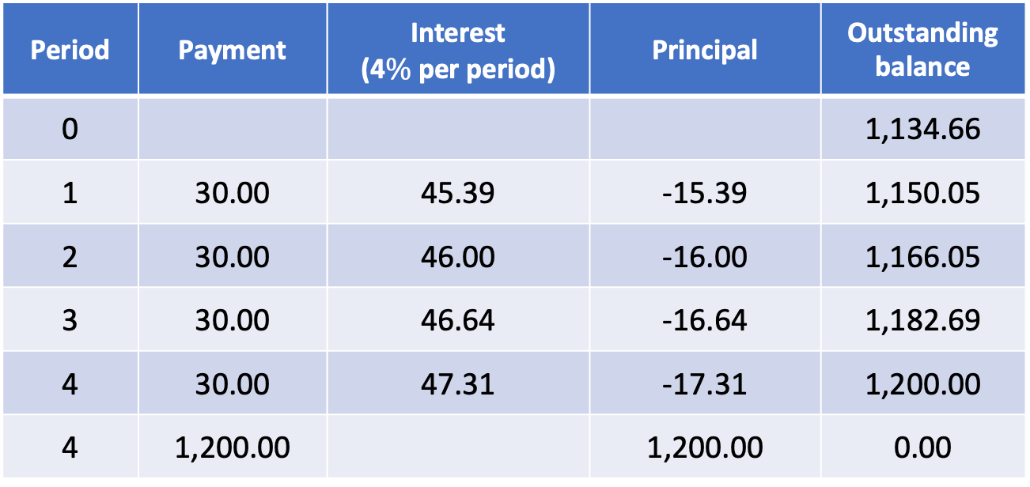
Example 6.4, continued
Period | Payment | Interest (4$\%$ per period) | Principal | Outstanding balance
0 |  |  |  | 1,134.66
1 | 30.00 | 45.39 | -15.39 | 1,150.05
2 | 30.00 | 46.00 | -16.00 | 1,166.05
3 | 30.00 | 46.64 | -16.64 | 1,182.69
4 | 30.00 | 47.31 | -17.31 | 1,200.00
4 | 1,200.00 |  | 1,200.00 | 0.00

Slide 10
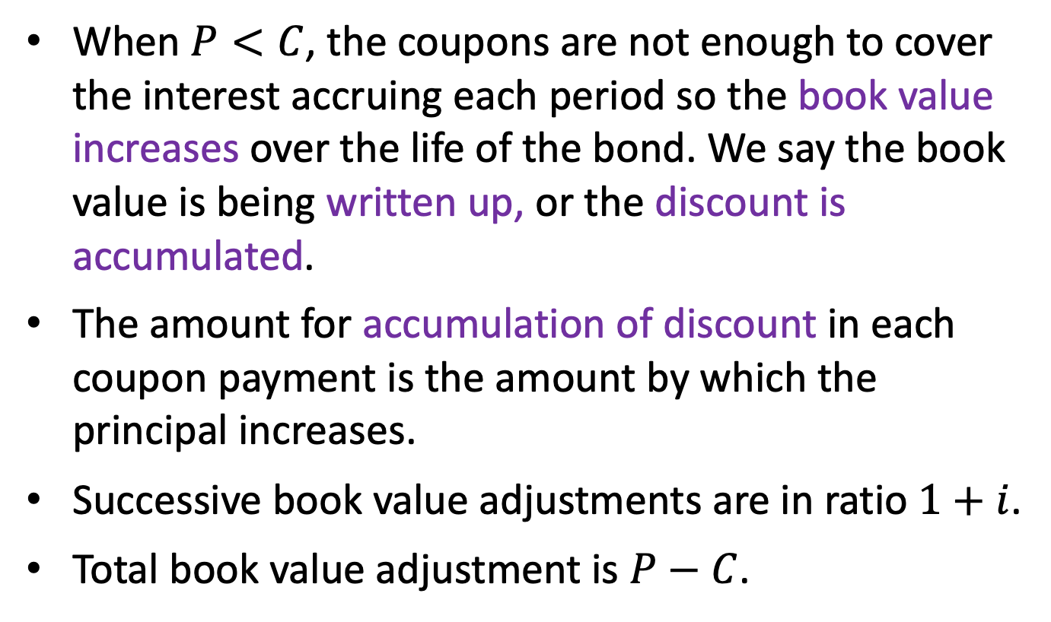
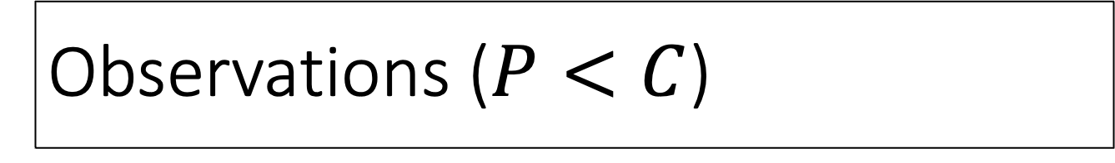
Observations ($P<C$)
When $P<C$, the coupons are not enough to cover the interest accruing each period so the book value increases over the life of the bond. We say the book value is being written up, or the discount is accumulated.
The amount for accumulation of discount in each coupon payment is the amount by which the principal increases.
Successive book value adjustments are in ratio $1+i$.
Total book value adjustment is $P−C$.

Slide 11
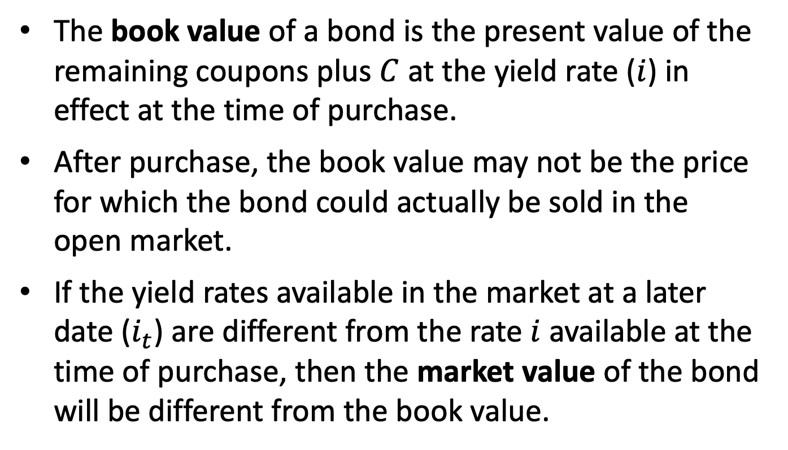
Book value vs. market value
The book value of a bond is the present value of the remaining coupons plus $C$ at the yield rate ($i$) in effect at the time of purchase.
After purchase, the book value may not be the price for which the bond could actually be sold in the open market.
If the yield rates available in the market at a later date ($i_{t}$) are different from the rate $i$ available at the time of purchase, then the market value of the bond will be different from the book value.

Slide 12
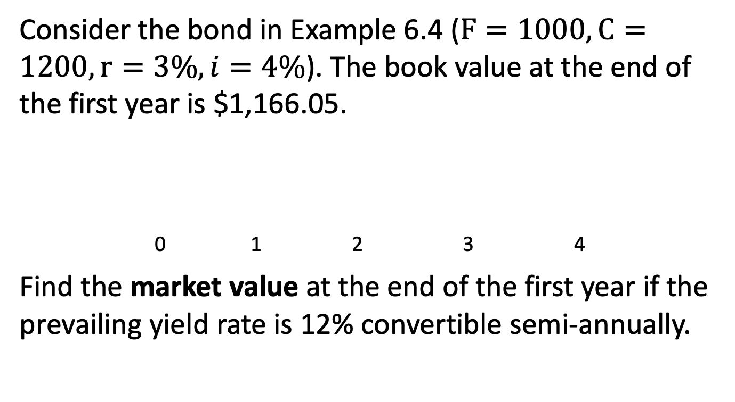
Example 6.5
Consider the bond in Example 6.4 ($F=1000, C=1200, r=3\%, i=4\%$). The book value at the end of the first year is $1,166.05.
0 1 2 3 4
Find the market value at the end of the first year if the prevailing yield rate is 12% convertible semi-annually.

Slide 13
Example 6.5, continued
If the investor bought the bond for $1,134.66 at issue and sold it at market value at the end of the first year, what is the realized yield over the 1-year holding period?
0 1 2 3 4

Slide 14
6.4 Price between coupon dates
Purchase price formulas from 6.2 only work when the bond is issued or immediately after a coupon payment, so the remaining coupons are equally spaced.
If a bond is purchased between coupon payment dates, we need to adjust the price.
The book value of the bond increases as we get closer to each coupon payment date, and then drops when the coupon is actually paid.

Slide 15
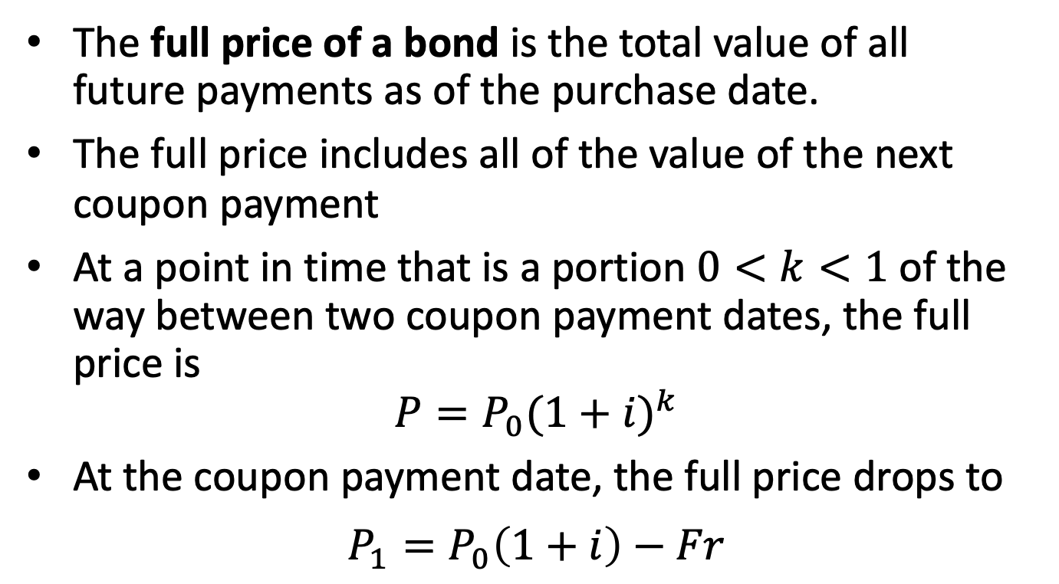
Full price of a bond
The full price of a bond is the total value of all
future payments as of the purchase date.
The full price includes all of the value of the next coupon payment
At a point in time that is a portion $0<k<1$ of the way between two coupon payment dates, the full price is
$$P=P_{0}{(1+i)}^{k}$$
At the coupon payment date, the full price drops to
$$P_{1}=P_{0}\left(1+i\right)−Fr$$

Slide 16
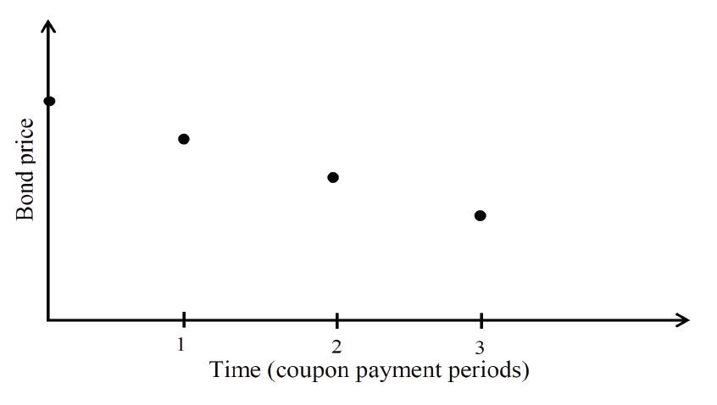
Evolution of full price

