Slide 1
6.6 Determining the yield rate
To determine the yield on a bond:
Use a financial calculator
Use Excel (YIELD)
Use interpolation between integer values
  Needs a starting point
  Consider the “method of averages” which approximates the true yield

Slide 2
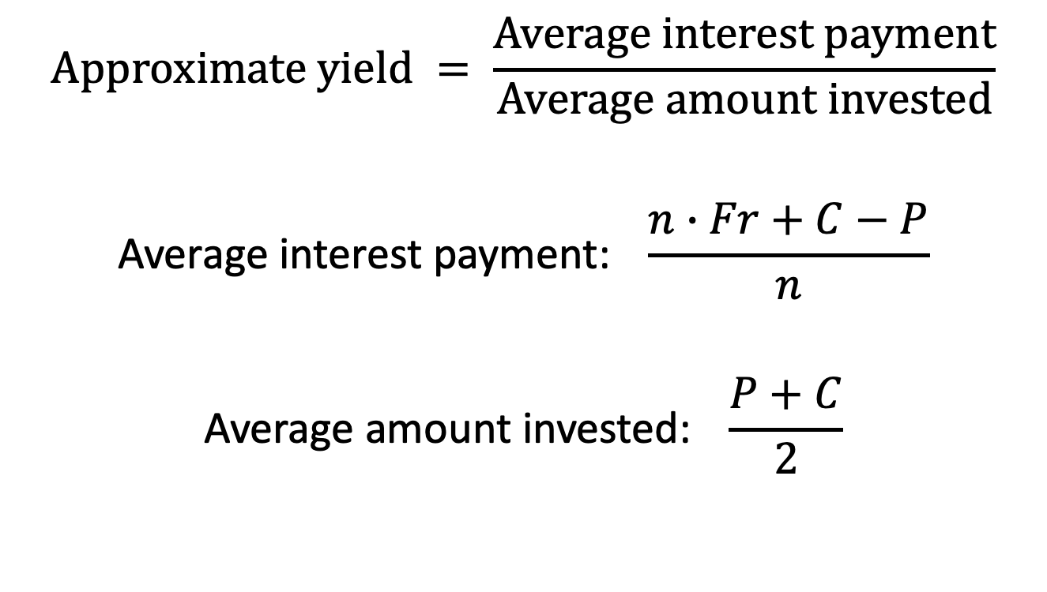
The method of averages
$$Approximate yield = \frac{Average interest payment}{Average amount invested}$$
$$\text{Average} \text{interest} \text{payment}\text{:} \frac{n∙Fr+C−P}{n}$$
$$\text{Average} \text{amount} \text{invested}\text{:} \frac{P+C}{2}$$

Slide 3
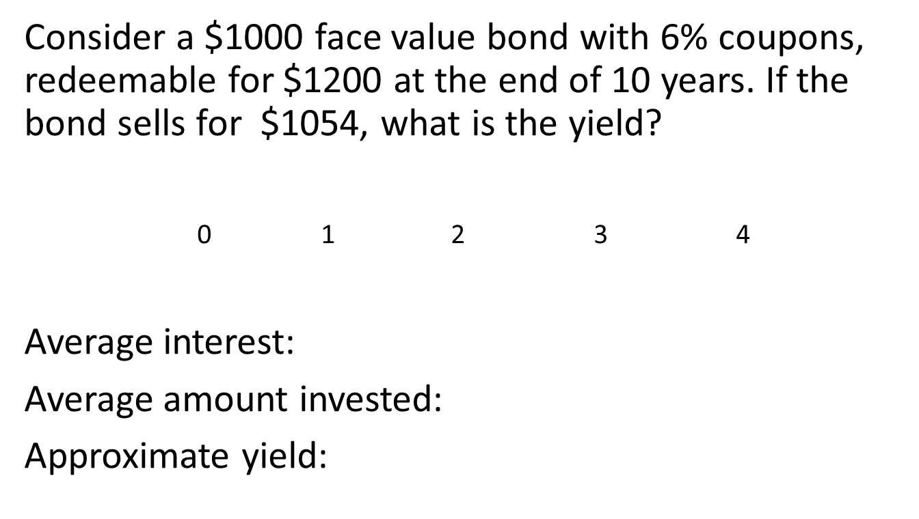
Example 6.7
Consider a $1000 face value bond with 6% coupons, redeemable for $1200 at the end of 10 years. If the bond sells for $1054, what is the yield?
0 1 2 3 4
Average interest:
Average amount invested:
Approximate yield:

Slide 4
6.7 Other types of bonds
A zero-coupon bond (aka zero)
Makes no coupon payments
Pays the face value at maturity
Sold at a discount relative to face value
  Aka discount bond or pure discount bond
Price is PV of face value, discounted at yield rate
Examples:
  T-bills (short term, maturity < 1 year)
  T-notes (intermediate term, less than 5 years)
  Stripped bonds (longer term)

Slide 5
Stripped bonds
An investor could:
  Buy a regular bond with coupons
  Resell the coupon payments and the redemption value separately
The “redemption only” part is known as a strip bond
Coupon payments could be sold individually or in groups

Slide 6
Stripped bonds, continued
In the US, the Separate Trading of Registered Interest and Principal of Securities (STRIPS) program started in 1985.
In Canada, Canadian Depository Services Ltd. (CDS) has been stripping bonds electronically since 1987.

Slide 7
Observed US Treasury yields (Feb 21)

