Slide 1
6.8 Callable Bonds
A callable bond is a bond which gives the issuer (not the bondholder) the right to redeem prior to its maturity date, under certain conditions.
When issued, the call provisions explain when the bond can be redeemed and what the price will be.
In most cases, there is some period of time during which the bond cannot be called. This period of time is named the call protection period.

Slide 2
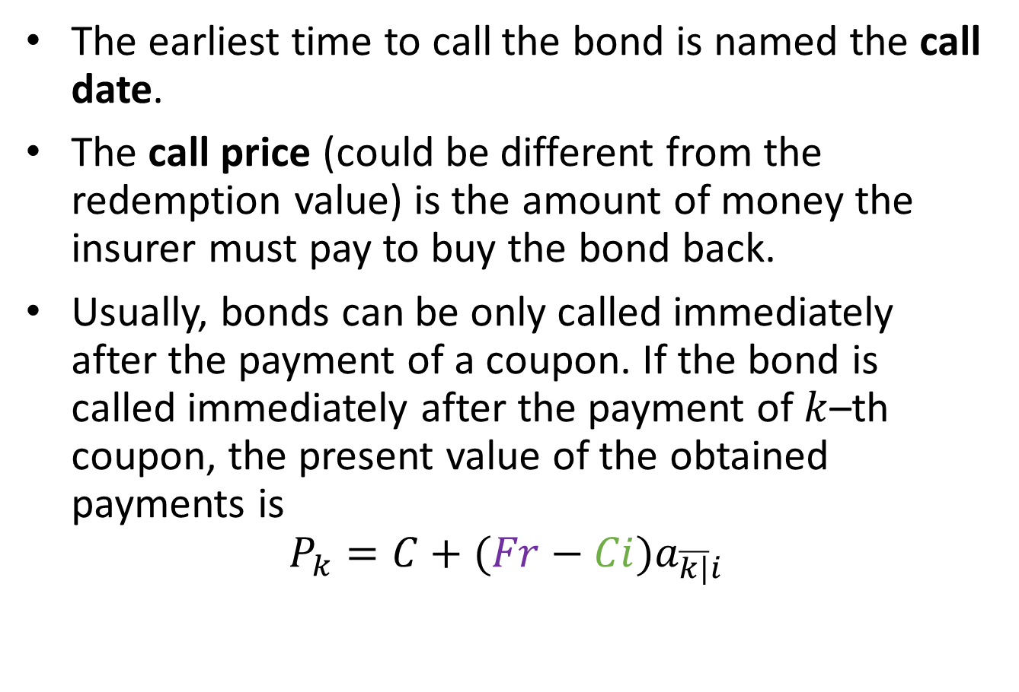
The earliest time to call the bond is named the call date.
The call price (could be different from the redemption value) is the amount of money the insurer must pay to buy the bond back.
Usually, bonds can be only called immediately after the payment of a coupon. If the bond is called immediately after the payment of $k$–th coupon, the present value of the obtained payments is
$$P_{k}=C+(Fr−Ci)a_{\overline{k|}i}$$

Slide 3
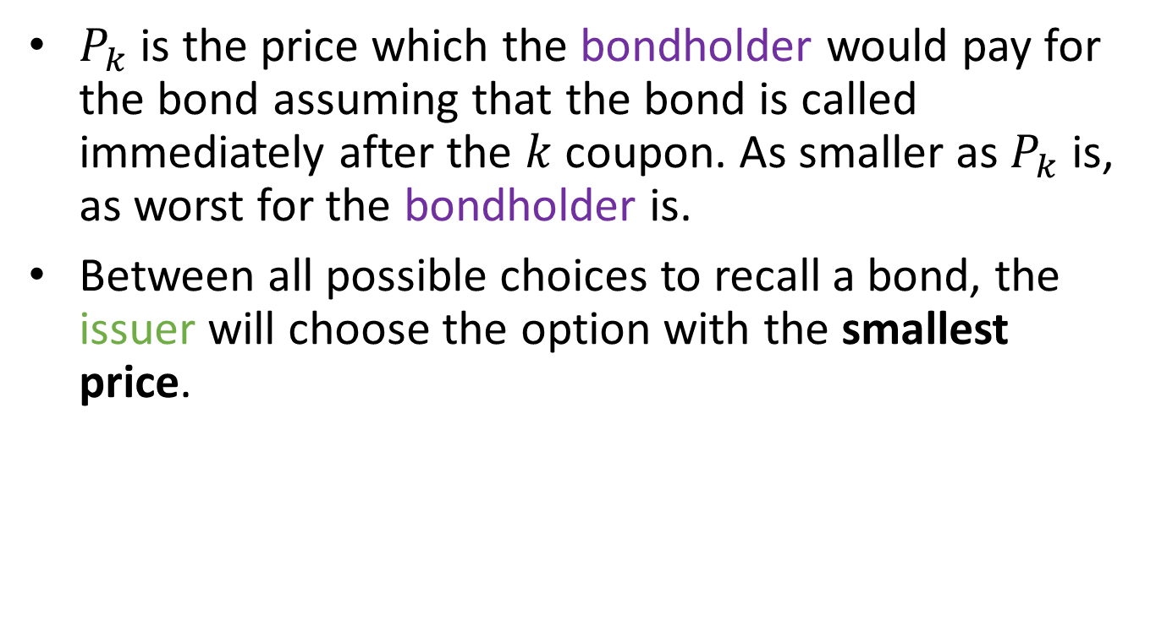
Callable bond pricing
$P_{k}$ is the price which the bondholder would pay for the bond assuming that the bond is called immediately after the $k$ coupon. As smaller as $P_{k}$ is, as worst for the bondholder is.
Between all possible choices to recall a bond, the issuer will choose the option with the smallest price.

Slide 4
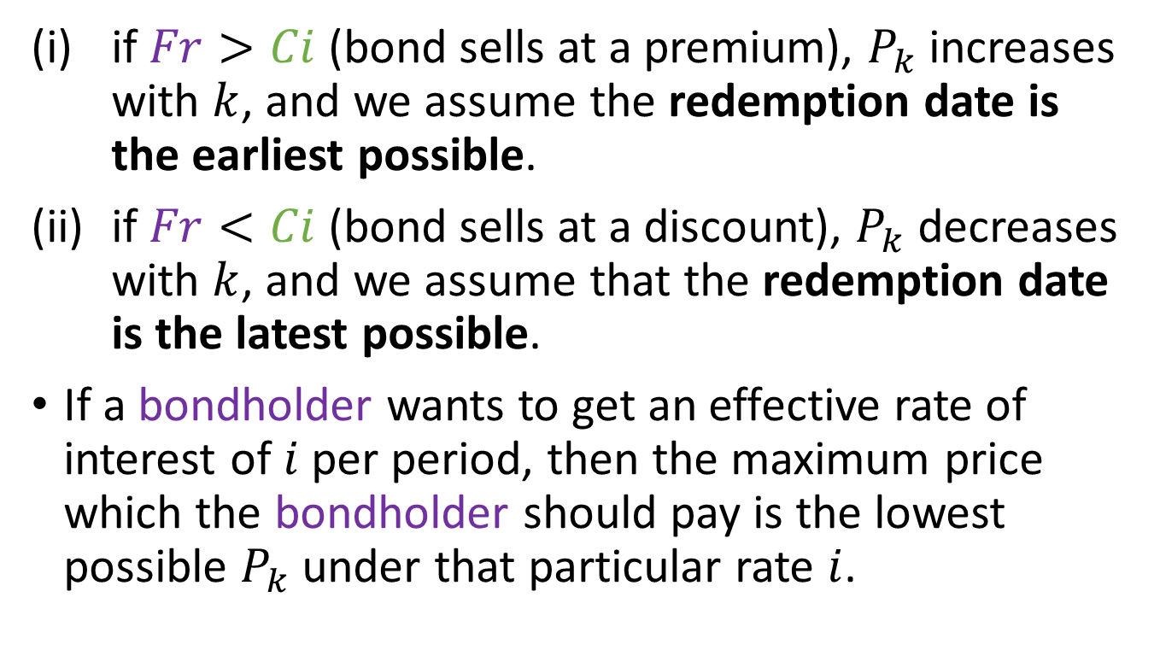
Callable bond pricing
if $Fr>Ci$ (bond sells at a premium), $P_{k}$increases with $k$, and we assume the redemption date is the earliest possible.
if $Fr<Ci$ (bond sells at a discount), $P_{k}$ decreases with $k$, and we assume that the redemption date is the latest possible.
If a bondholder wants to get an effective rate of interest of $i$ per period, then the maximum price which the bondholder should pay is the lowest possible $P_{k}$ under that particular rate $i$.

Slide 5
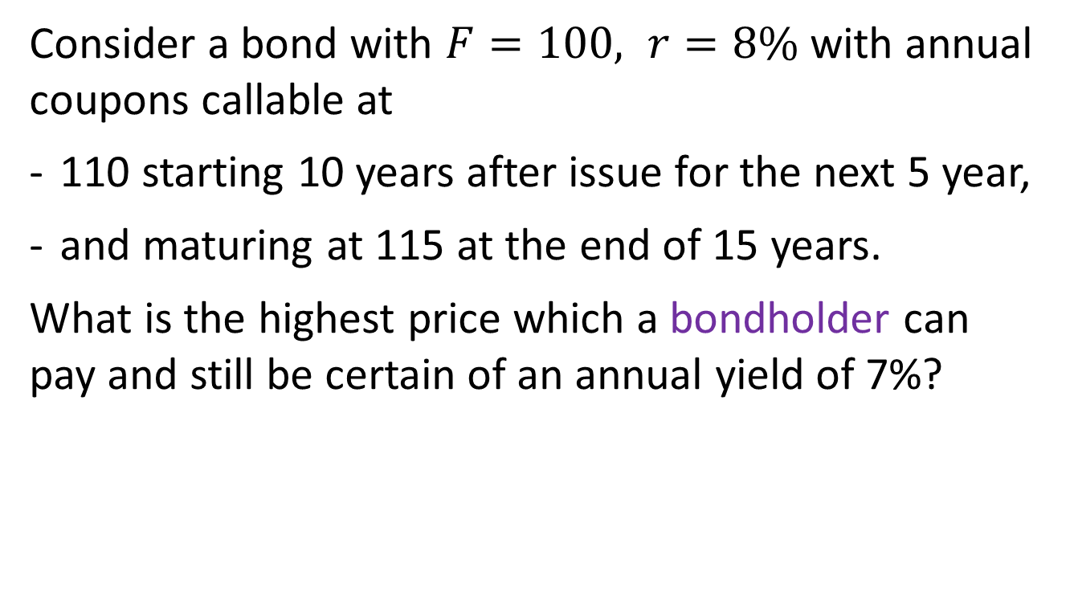
Example 6.6
Consider a bond with $F=100, r=8\%$ with annual coupons callable at
110 starting 10 years after issue for the next 5 year,
and maturing at 115 at the end of 15 years.
What is the highest price which a bondholder can pay and still be certain of an annual yield of 7%?

Slide 6
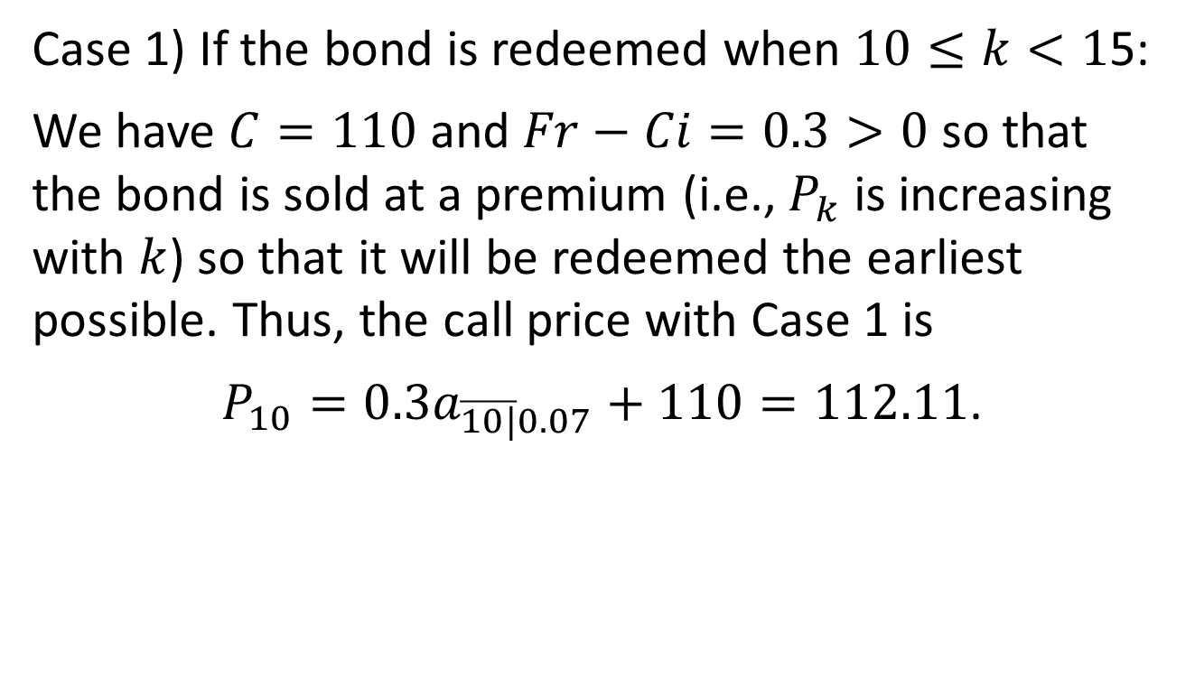
Example 6.6, continued
Case 1) If the bond is redeemed when $10≤k<1$5:
We have $C=110$ and $Fr−Ci=0.3>0$ so that the bond is sold at a premium (i.e., $P_{k}$ is increasing with $k$) so that it will be redeemed the earliest possible. Thus, the call price with Case 1 is
$P_{10}=0.3a_{\overline{10|}0.07}+110=112.11$.

Slide 7
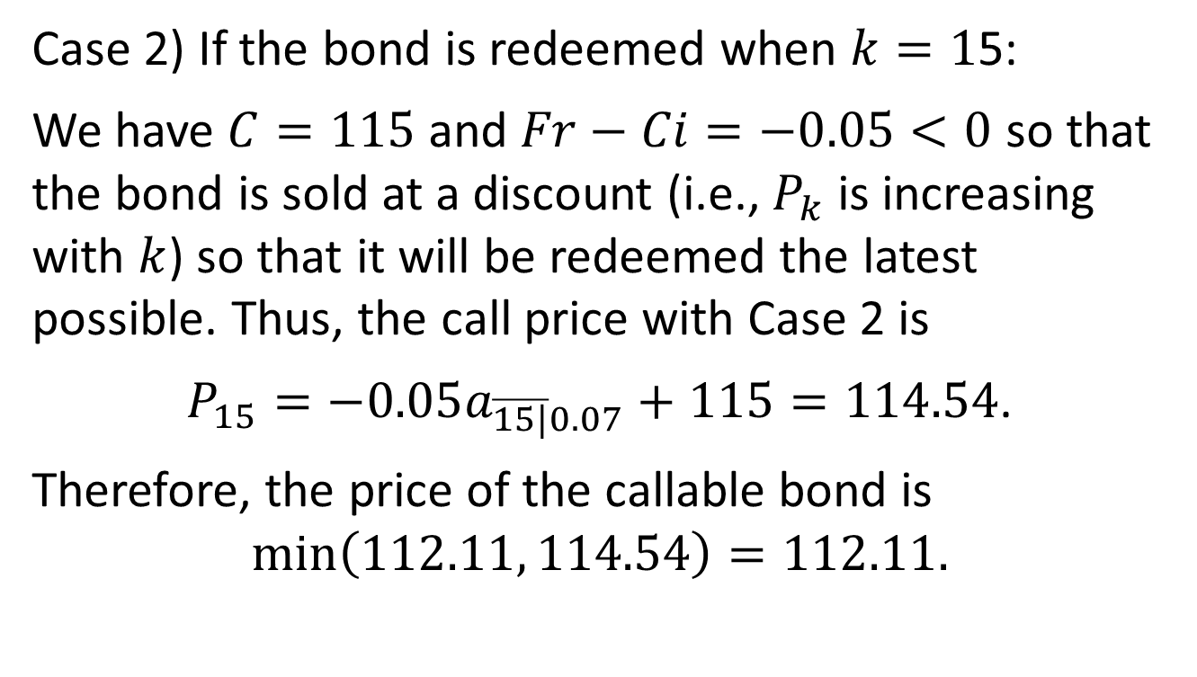
Example 6.6, continued
Case 2) If the bond is redeemed when $k=1$5:
We have $C=115$ and $Fr−Ci=−0.05<0$ so that the bond is sold at a discount (i.e., $P_{k}$ is increasing with $k$) so that it will be redeemed the latest possible. Thus, the call price with Case 2 is
$P_{15}=−0.05a_{\overline{15|}0.07}+115=114.54$.
Therefore, the price of the callable bond is
$$\min\left(112.11, 114.54\right)=112.11.$$

Slide 8
SOA FM Samples
https://www.soa.org/4a5549/globalassets/assets/files/edu/2018/2018-10-exam-fm-sample-questions.pdf
72, 135, 136, 139, 142, 198, 292, 301, 378, 381

