Slide 1
CHAPTER 7
Rates of Return

Slide 2
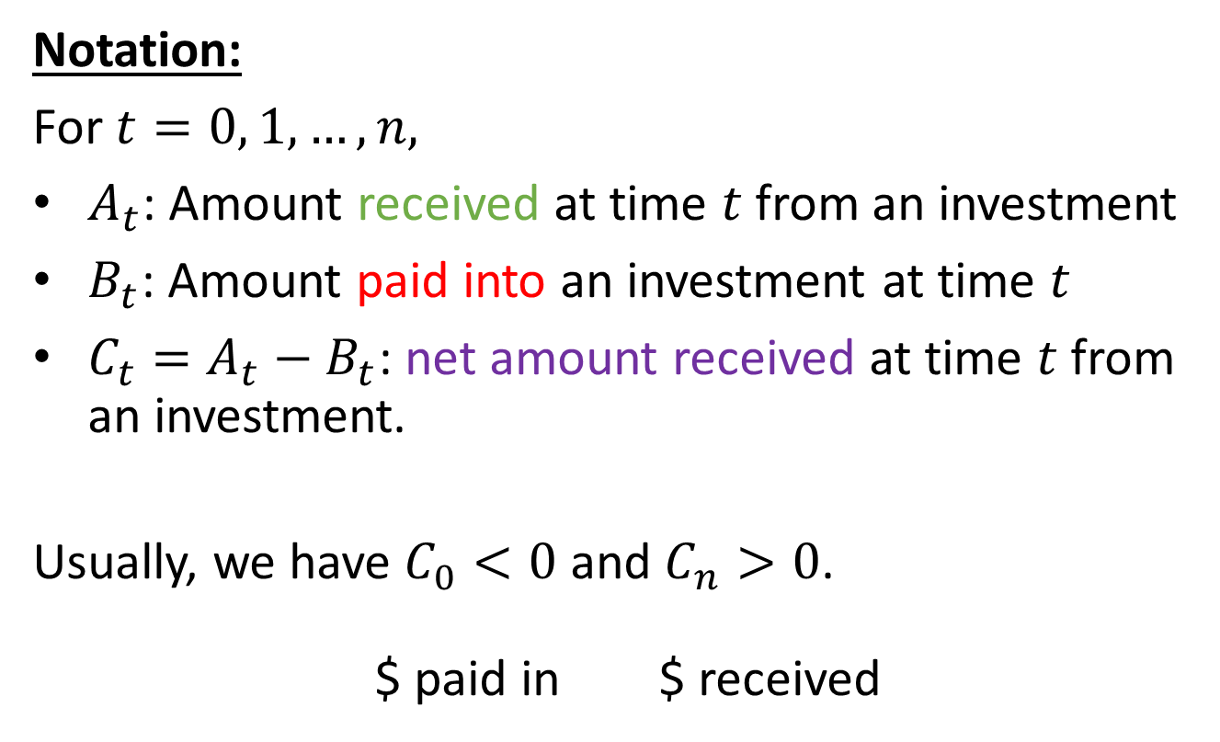
7.1 Net present value
Notation:
For $t=0, 1, …, n,$
$A_{t}$: Amount received at time $t$from an investment
$B_{t}$: Amount paid into an investment at time $t$
$C_{t}=A_{t}−B_{t}$: net amount received at time $t$from an investment.
Usually, we have $C_{0}<0$ and $C_{n}>0$.
$ paid in $ received

Slide 3
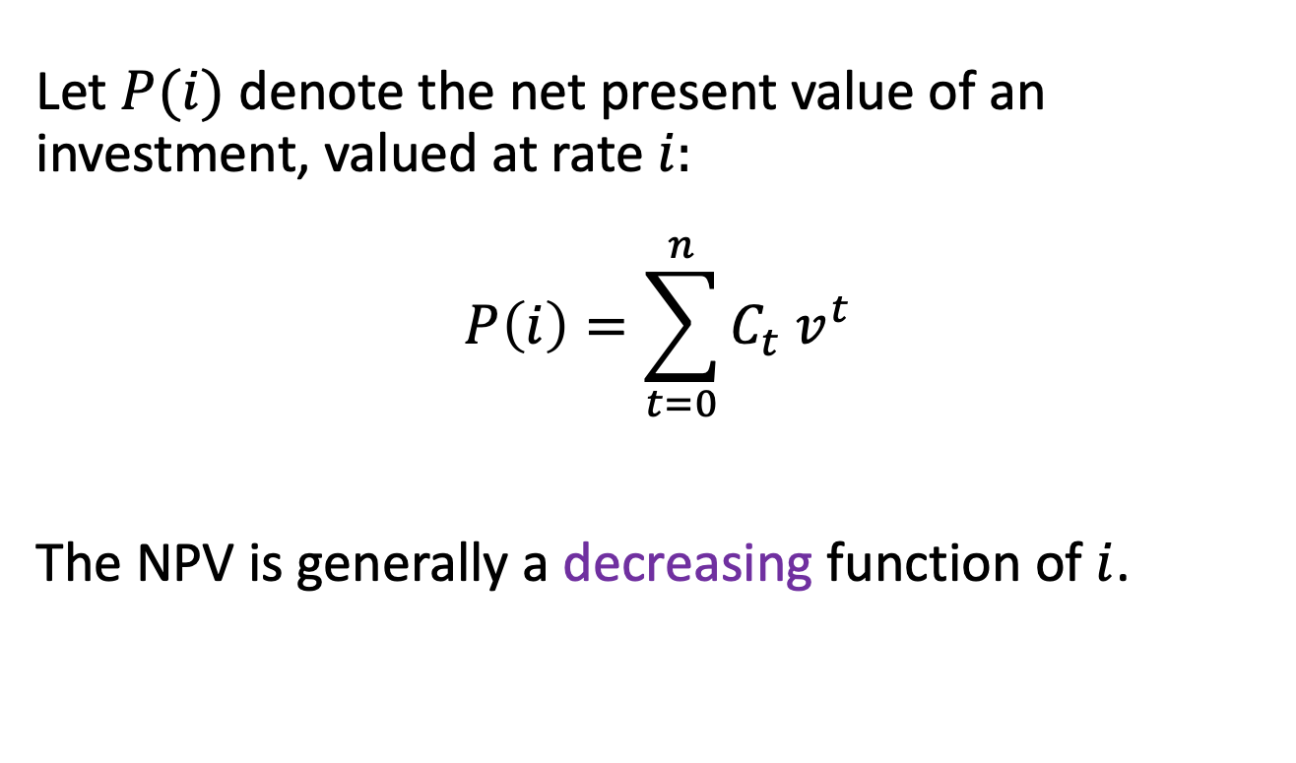
Net present value (NPV)
Let $P(i)$ denote the net present value of an investment, valued at rate $i:$
$$P\left(i\right)=\sum_{t=0}^{n}{C_{t}{ v}^{t}}$$
The NPV is generally a decreasing function of $i$.

Slide 4
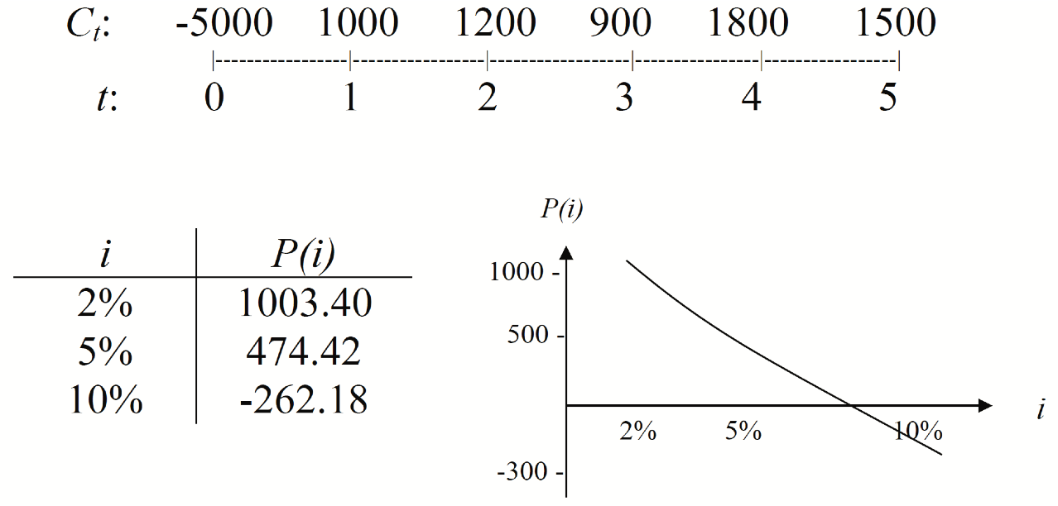
Example 7.1
Consider the following series of cash flows:

Slide 5
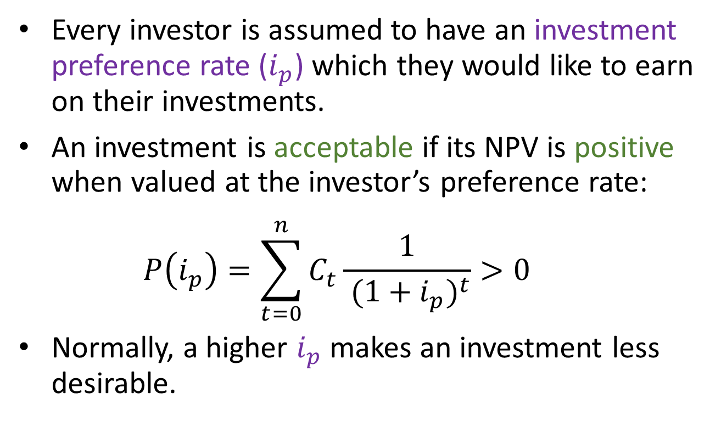
Discounted cash flow analysis
Every investor is assumed to have an investment preference rate ($i_{p}$) which they would like to earn on their investments.
An investment is acceptable if its NPV is positive when valued at the investor’s preference rate:
$$P\left(i_{p}\right)=\sum_{t=0}^{n}{C_{t}\frac{1}{{ (1+i_{p})}^{t}}}>0$$
Normally, a higher $i_{p}$ makes an investment less desirable.

Slide 6
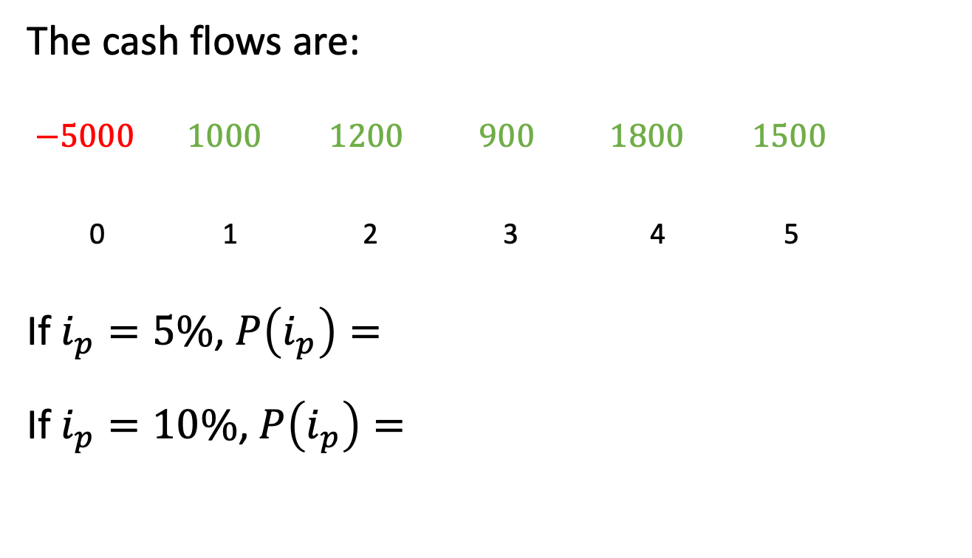
Example 7.1, continued
The cash flows are:
$−5000 1000 1200 900 1800 1500$
0 1 2 3 4 5
If $i_{p}=5\%$, $P\left(i_{p}\right)=$
If $i_{p}=10\%$, $P\left(i_{p}\right)=$

Slide 7
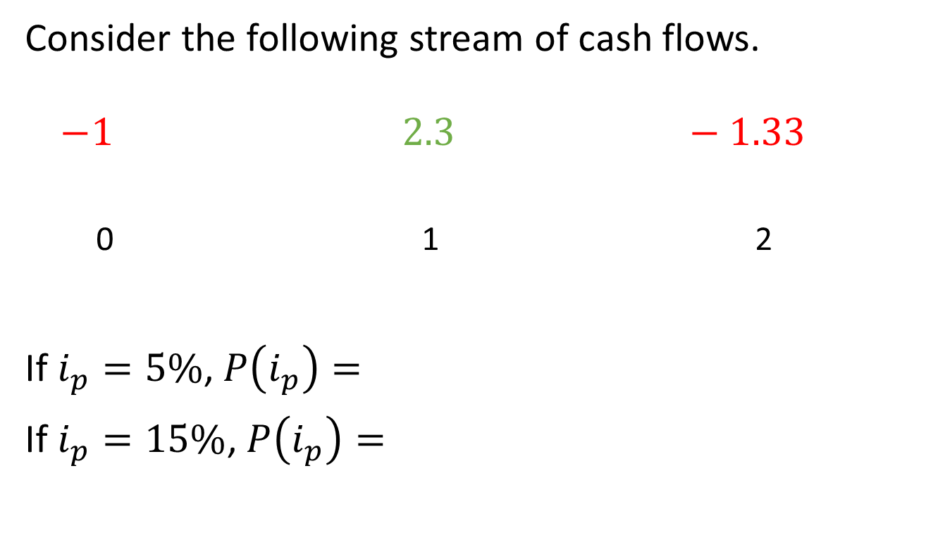
Example 7.2
Consider the following stream of cash flows.
$−1 2.3 −1.33$
0 1 2
If $i_{p}=5\%$, $P\left(i_{p}\right)=$
If $i_{p}=15\%$, $P\left(i_{p}\right)=$

Slide 8
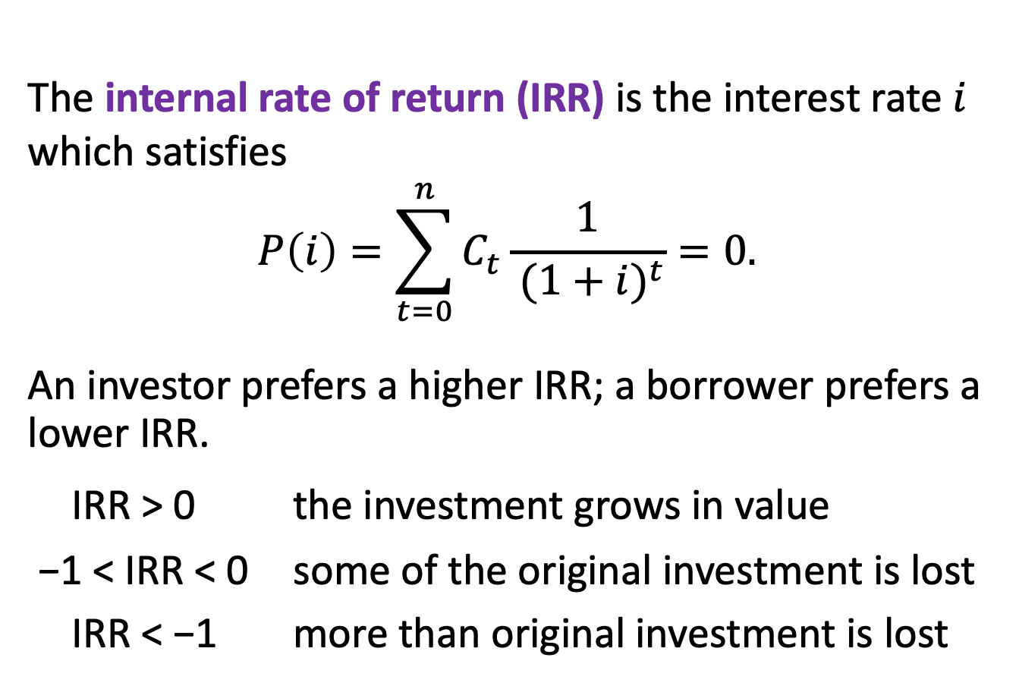
7.2 Internal rate of return
The internal rate of return (IRR) is the interest rate $i$ which satisfies
$$P\left(i\right)=\sum_{t=0}^{n}{C_{t}\frac{1}{{ (1+i)}^{t}}}=0.$$
An investor prefers a higher IRR; a borrower prefers a lower IRR.
IRR > 0 the investment grows in value
−1 < IRR < 0 some of the original investment is lost
IRR < −1 more than original investment is lost

Slide 9
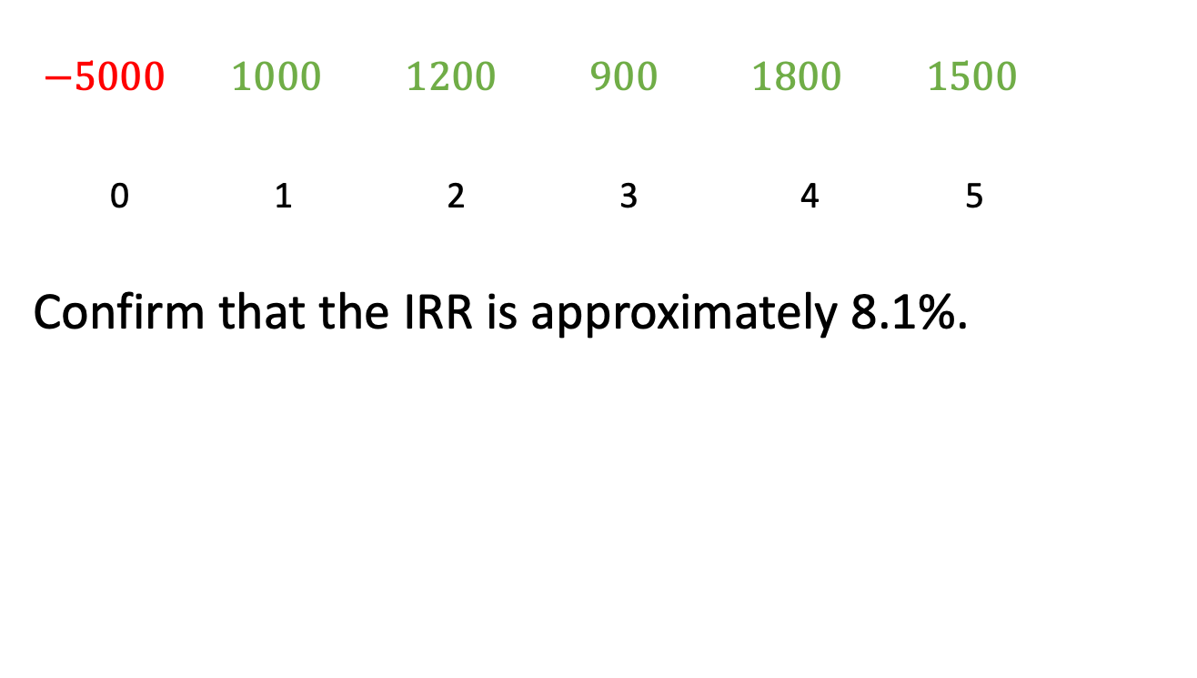
Example 7.1, continued
$−5000 1000 1200 900 1800 1500$
0 1 2 3 4 5
Confirm that the IRR is approximately 8.1%.

Slide 10
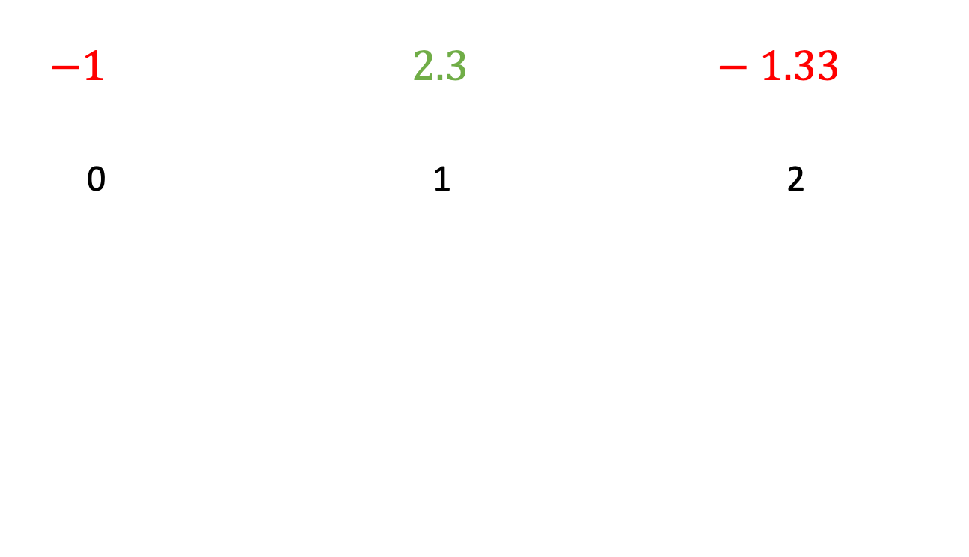
Example 7.2, continued
$−1 2.3 −1.33$
0 1 2

Slide 11
Uniqueness of IRR
The IRR need not be positive, exist or be unique.
Descartes’ rule of signs:
  The maximum number of positive roots of an nth degree polynomial is equal to the number of sign changes in the coefficients.
  If all the cash flows in one direction (i.e., + or −) are made before the cash flows in the other direction, then the IRR is unique (because in this case, the number of sign changes = 1).

Slide 12
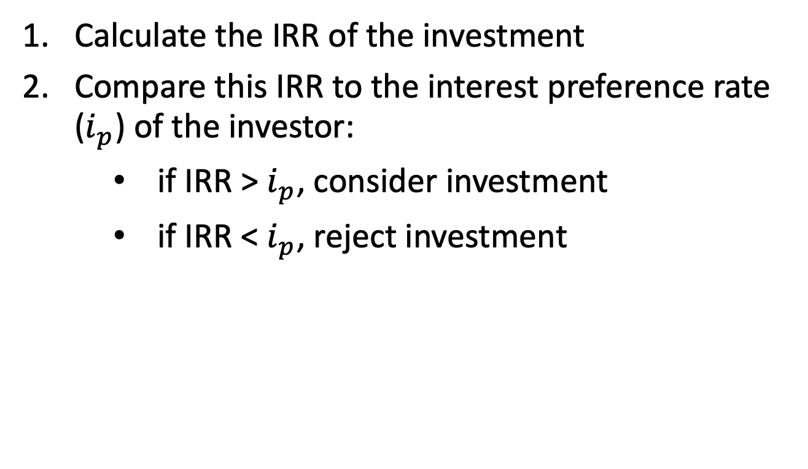
IRR method of capital budgeting
Calculate the IRR of the investment
Compare this IRR to the interest preference rate ($i_{p}$) of the investor:
if IRR > $i_{p}$, consider investment
if IRR < $i_{p}$, reject investment

Slide 13
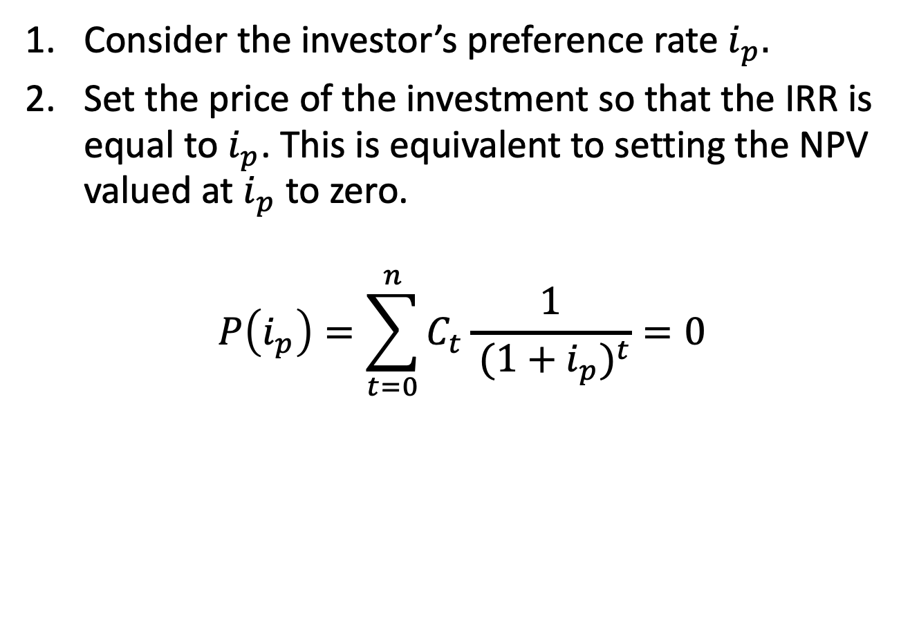
IRR method of pricing
Consider the investor’s preference rate $i_{p}.$
Set the price of the investment so that the IRR is equal to $i_{p}$. This is equivalent to setting the NPV valued at $i_{p}$ to zero.
$$P\left(i_{p}\right)=\sum_{t=0}^{n}{C_{t}\frac{1}{{ (1+i_{p})}^{t}}}=0$$

Slide 14
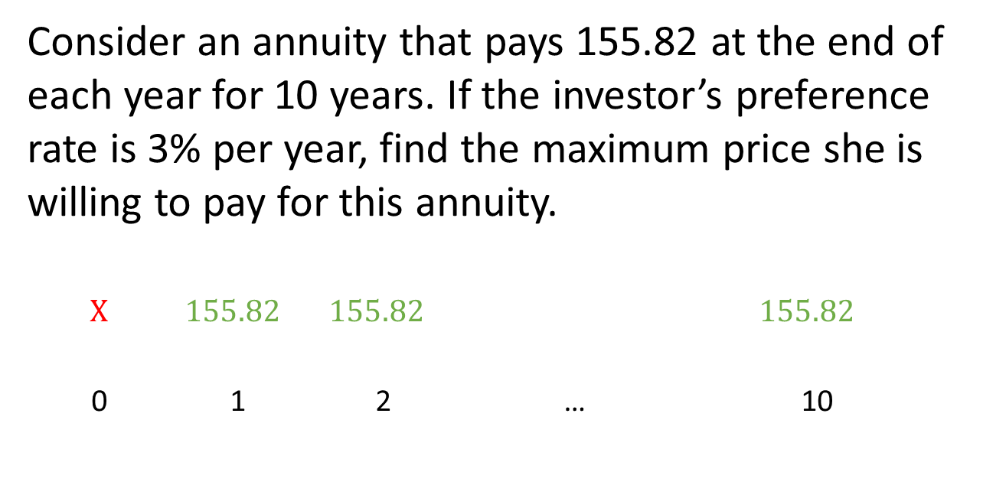
Example 7.3
Consider an annuity that pays 155.82 at the end of each year for 10 years. If the investor’s preference rate is 3% per year, find the maximum price she is willing to pay for this annuity.
$$X 155.82 155.82 155.82$$
0 1 2 … 10

