Slide 1
Borrowing to invest
Suppose you are considering an investment opportunity but you don’t actually have funds to invest → you can borrow money.
The loan you receive should have the same term (length) as the investment.
You would only consider an investment if you could make a profit after taking into account the cost of the loan (i.e., interest on the amount you borrowed).

Slide 2
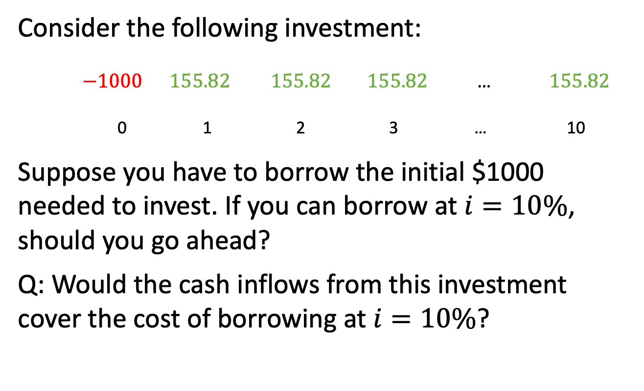
Example 7.4
Consider the following investment:
$−1000 155.82 155.82 155.82 \text{…} 155.82$
0 1 2 3 … 10
Suppose you have to borrow the initial $1000 needed to invest. If you can borrow at $i=10\%$, should you go ahead?
Q: Would the cash inflows from this investment cover the cost of borrowing at $i=10\%$?

Slide 3
Example 7.4, continued
Period | Payments | Interest | Principal | Loan balance
0 |  |  |  | 1,000.00
1 | 155.82 | 100.00 | 55.82 | 844.16
2 | 155.82 | 94.42 | 61.40 | 882.78
3 | 155.82 | 88.28 | 67.54 | 815.24
.. | … | … | … | …
10 | 155.82 | 24.20 | 131.62 | 110.37

Slide 4
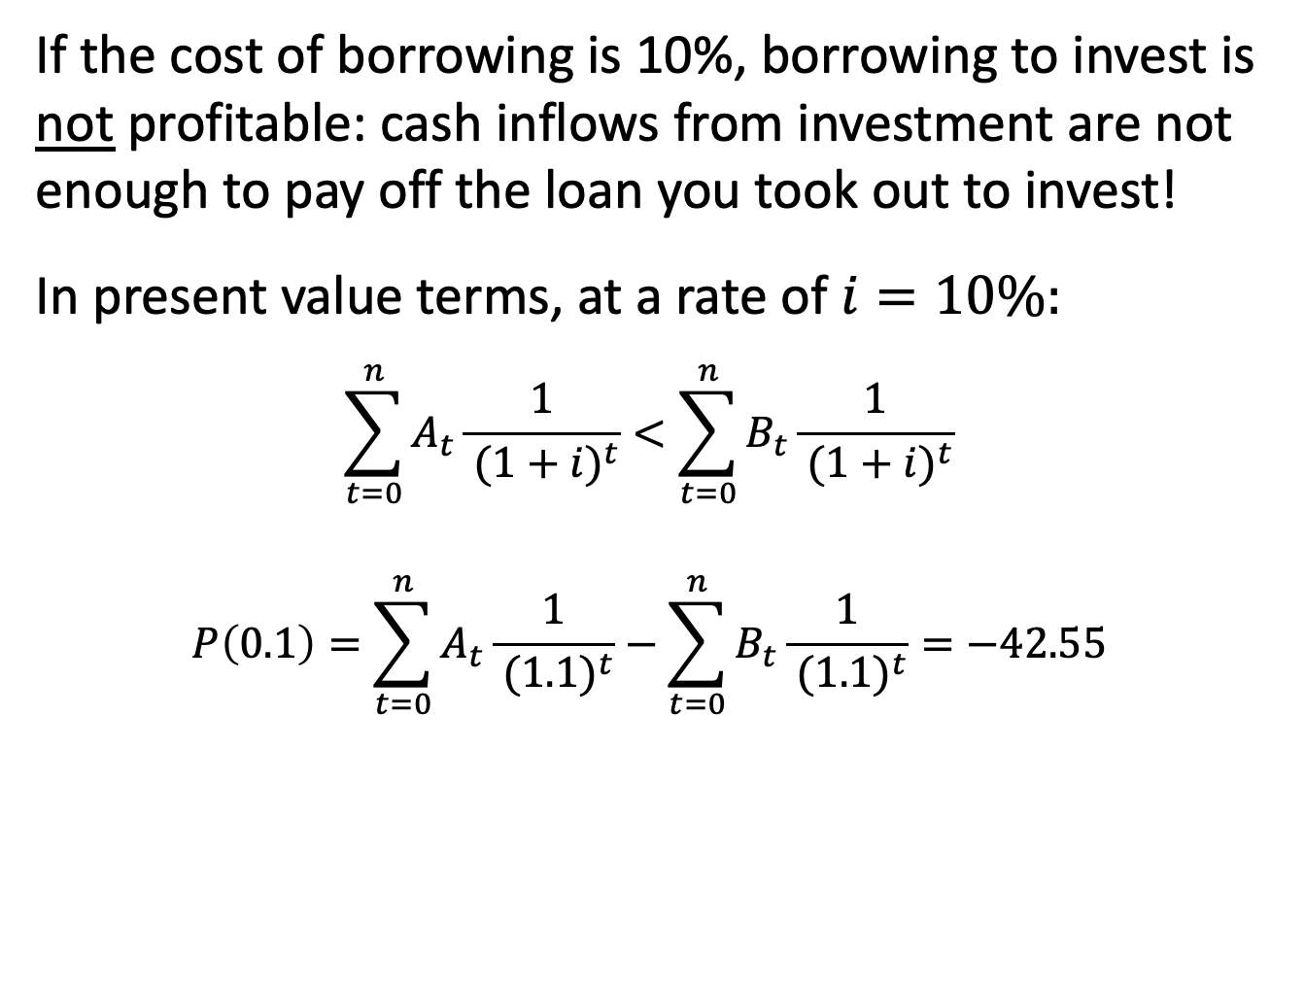
Example 7.4, continued
If the cost of borrowing is 10%, borrowing to invest is not profitable: cash inflows from investment are not enough to pay off the loan you took out to invest!
In present value terms, at a rate of $i=10\%:$
$$\sum_{t=0}^{n}{A_{t}\frac{1}{{ (1+i)}^{t}}}<\sum_{t=0}^{n}{B_{t}\frac{1}{{ (1+i)}^{t}}}$$
$$P\left(0.1\right)=\sum_{t=0}^{n}{A_{t}\frac{1}{{ (1.1)}^{t}}}−\sum_{t=0}^{n}{B_{t}\frac{1}{{ (1.1)}^{t}}=−42.55}$$

Slide 5
Example 7.4, continued
Would the cash inflows from this investment cover the cost of borrowing if you could borrow at 5%?
Period | Payments | Interest | Principal | Loan balance
0 |  |  |  | 1,000.00
1 | 155.82 | 50.00 | 105.82 | 894.18
2 | 155.82 | 44.71 | 111.11 | 783.07
3 | 155.82 | 39.15 | 116.67 | 666.40
.. | … | … | … | …
10 | 155.82 | -8.43 | 164.16 | -330.99

Slide 6
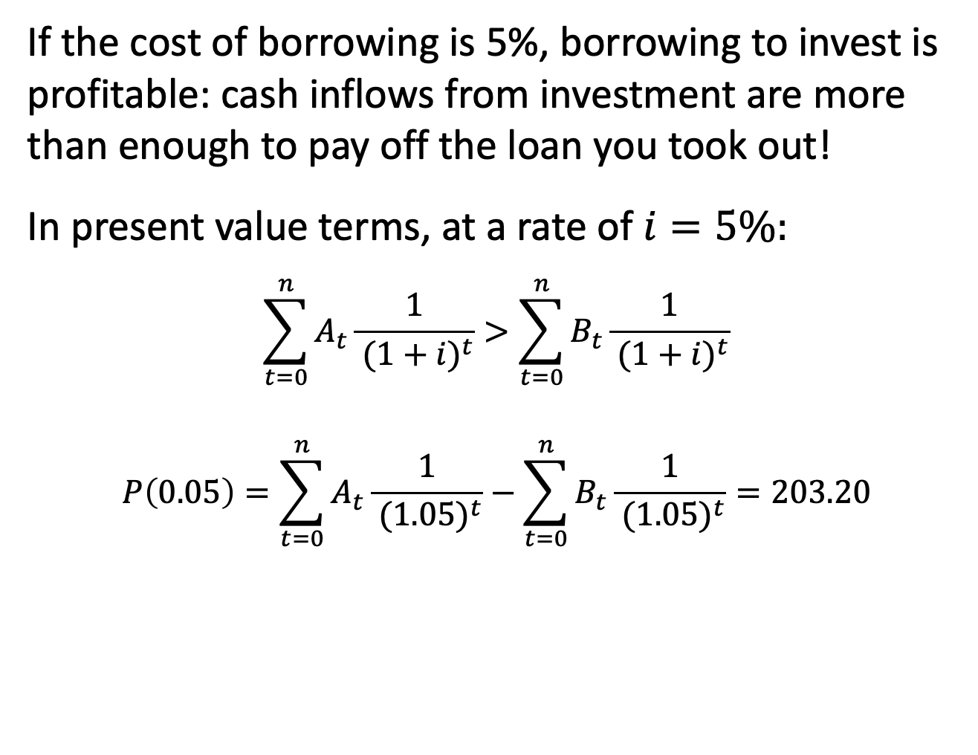
Example 7.4, continued
If the cost of borrowing is 5%, borrowing to invest is profitable: cash inflows from investment are more than enough to pay off the loan you took out!
In present value terms, at a rate of $i=5\%:$
$$\sum_{t=0}^{n}{A_{t}\frac{1}{{ (1+i)}^{t}}}>\sum_{t=0}^{n}{B_{t}\frac{1}{{ (1+i)}^{t}}}$$
$$P\left(0.05\right)=\sum_{t=0}^{n}{A_{t}\frac{1}{{ (1.05)}^{t}}}−\sum_{t=0}^{n}{B_{t}\frac{1}{{ (1.05)}^{t}}=203.20}$$

Slide 7
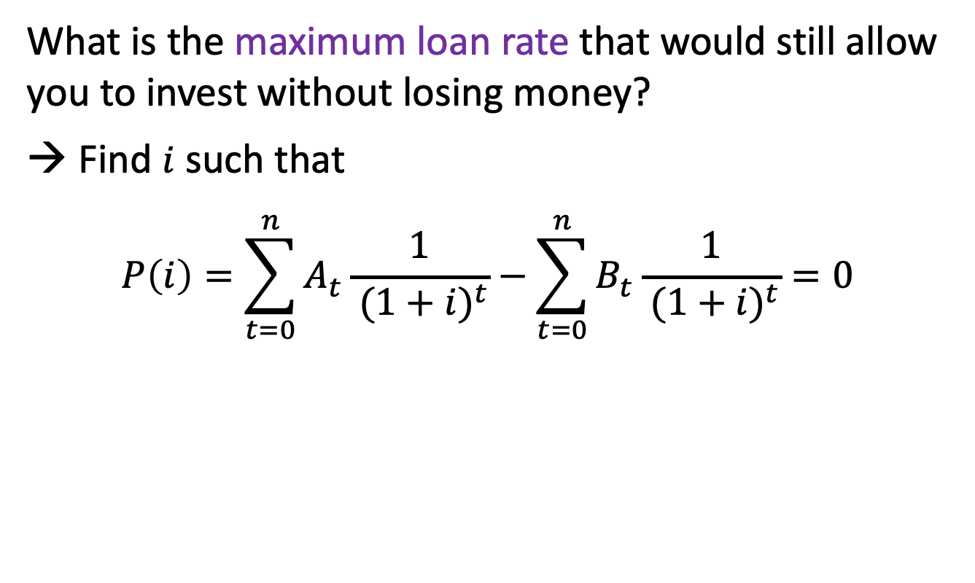
Example 7.4, continued
What is the maximum loan rate that would still allow you to invest without losing money?
→ Find $i$ such that
$$P\left(i\right)=\sum_{t=0}^{n}{A_{t}\frac{1}{{ (1+i)}^{t}}}−\sum_{t=0}^{n}{B_{t}\frac{1}{{ (1+i)}^{t}}=0}$$

Slide 8
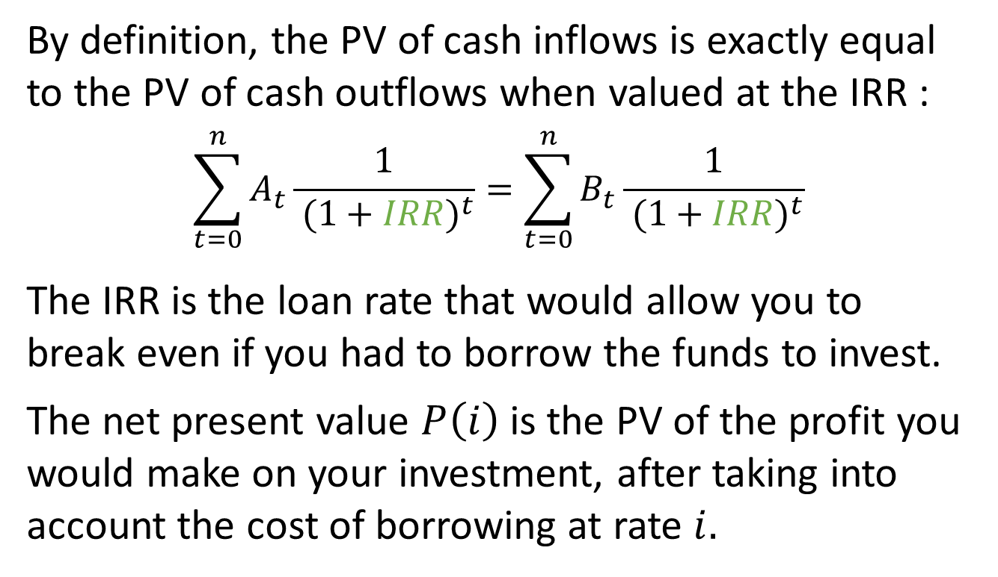
IRR, NPV, and the borrowing criterion
By definition, the PV of cash inflows is exactly equal to the PV of cash outflows when valued at the IRR :
$$\sum_{t=0}^{n}{A_{t}\frac{1}{{ (1+IRR)}^{t}}}=\sum_{t=0}^{n}{B_{t}\frac{1}{{ (1+IRR)}^{t}}}$$
The IRR is the loan rate that would allow you to break even if you had to borrow the funds to invest.
The net present value $P\left(i\right)$is the PV of the profit you would make on your investment, after taking into account the cost of borrowing at rate $i.$

Slide 9
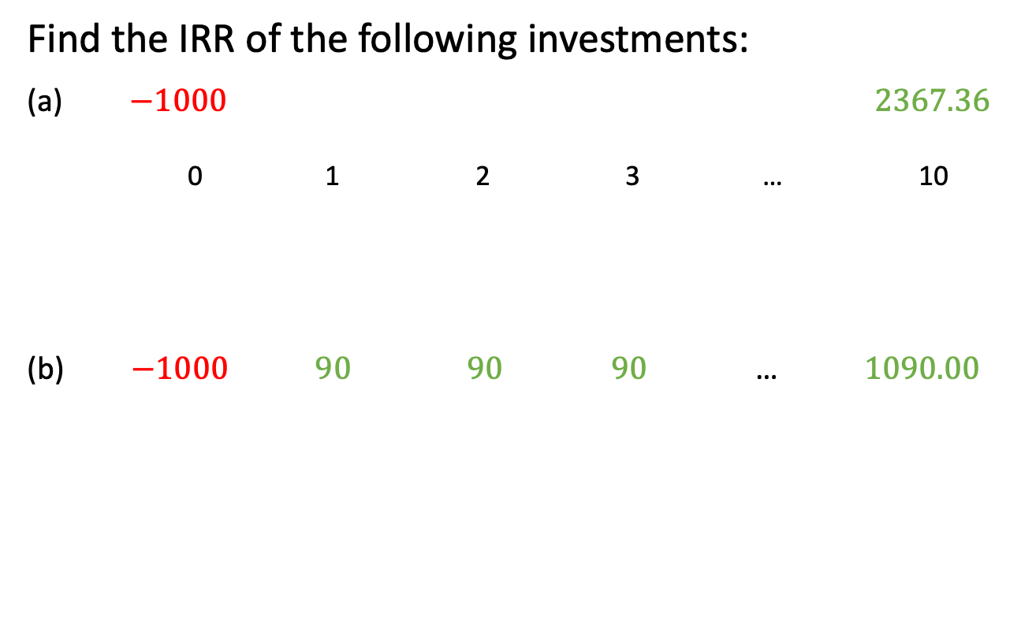
Example 7.5
Find the IRR of the following investments:
(a) $−1000 2367.36$
0 1 2 3 … 10
(b) $−1000 90 90 90 \text{…} 1090.00$

Slide 10
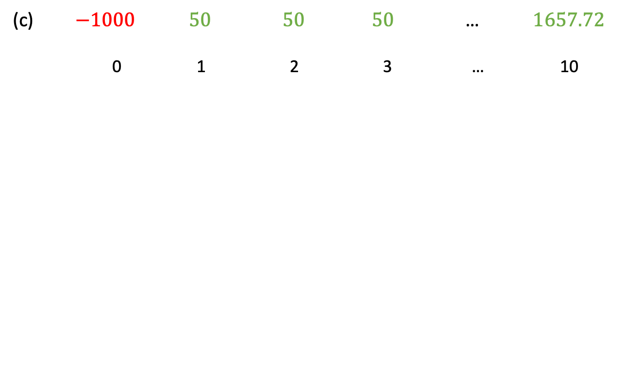
Example 7.5, continued
(c) $−1000 50 50 50 \text{…} 1657.72$
0 1 2 3 … 10

Slide 11
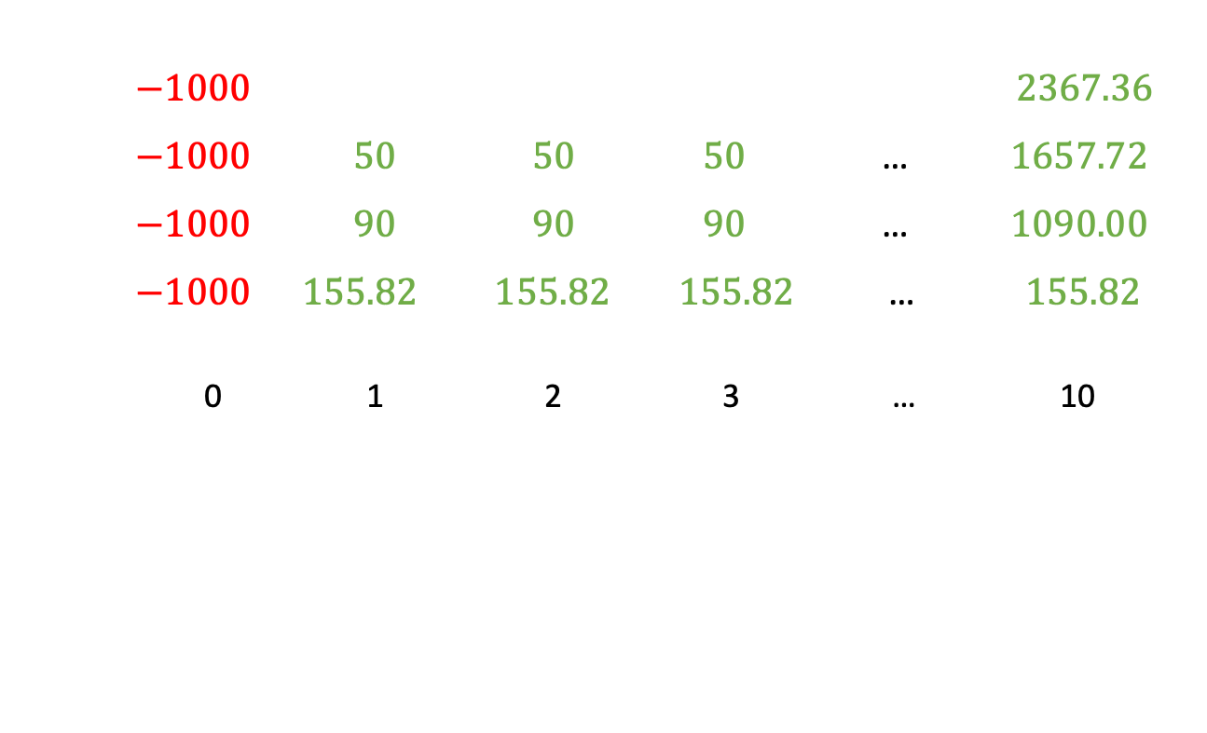
Example 7.5, continued
$−1000 2367.36$
$−1000 50 50 50 \text{…} 1657.72$
$−1000 90 90 90 \text{…} 1090.00$
$−1000 155.82 155.82 155.82 \text{…} 155.82$
0 1 2 3 … 10

Slide 12
Taking into account reinvestment
A reinvestment rate is the rate at which a payment received from an original investment can be reinvested.
When the proceeds of an investment are reinvested, the appropriate focal date for the valuation of cash inflows and outflows is at the end of the investment horizon.
➔ compare AVs instead of PVs

Slide 13
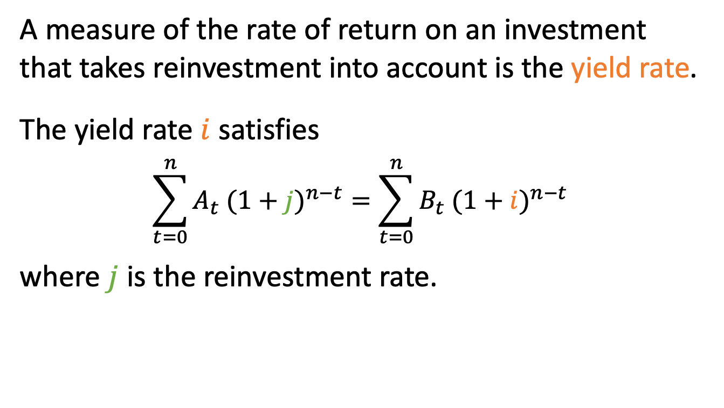
Yield rate
A measure of the rate of return on an investment that takes reinvestment into account is the yield rate.
The yield rate $i$ satisfies
$$\sum_{t=0}^{n}{A_{t}{ (1+j)}^{n−t}}=\sum_{t=0}^{n}{B_{t}{ (1+i)}^{n−t}}$$
where $j$ is the reinvestment rate.

Slide 14
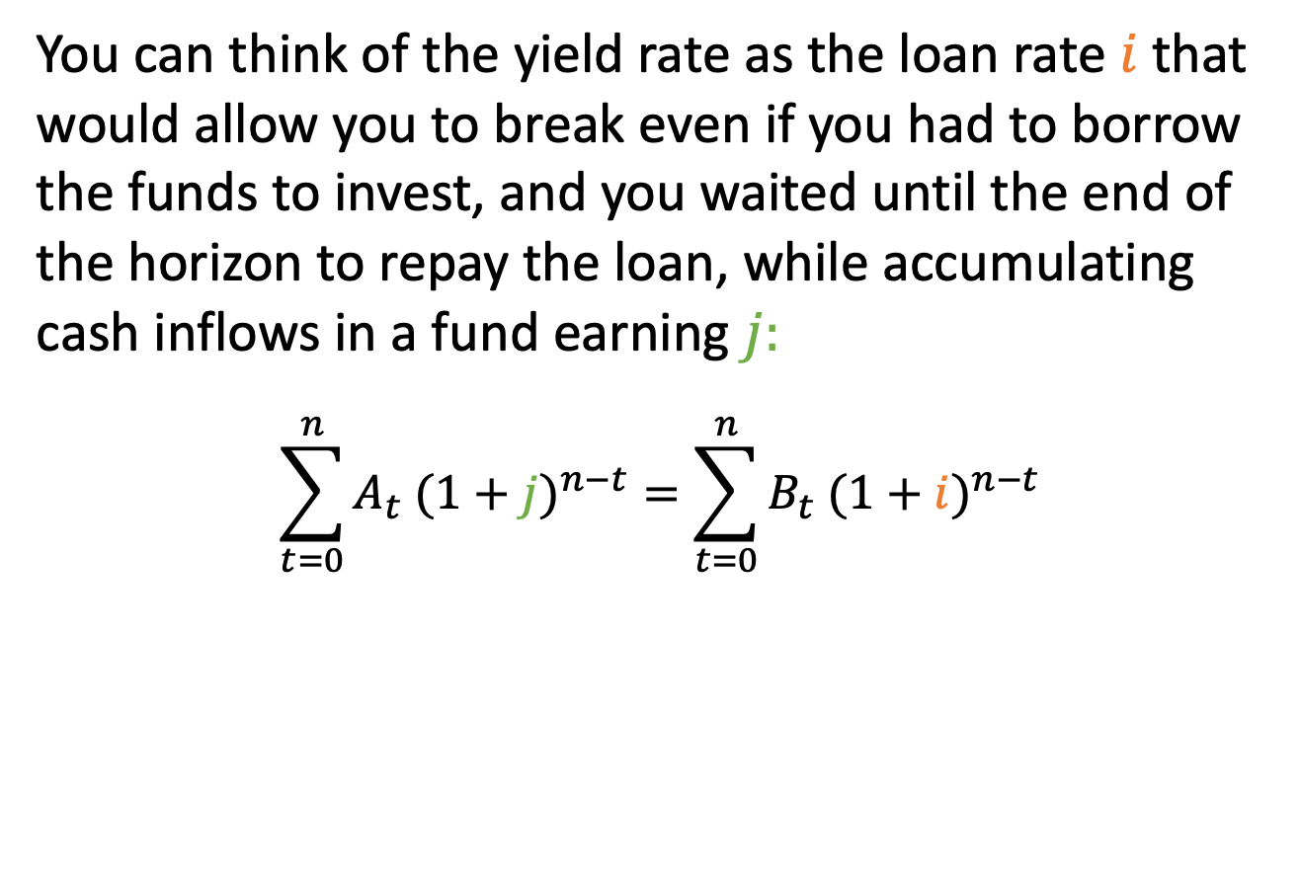
Yield rate and the borrowing criterion
You can think of the yield rate as the loan rate $i$that would allow you to break even if you had to borrow the funds to invest, and you waited until the end of the horizon to repay the loan, while accumulating cash inflows in a fund earning $j:$
$$\sum_{t=0}^{n}{A_{t}{ (1+j)}^{n−t}}=\sum_{t=0}^{n}{B_{t}{ (1+i)}^{n−t}}$$

Slide 15
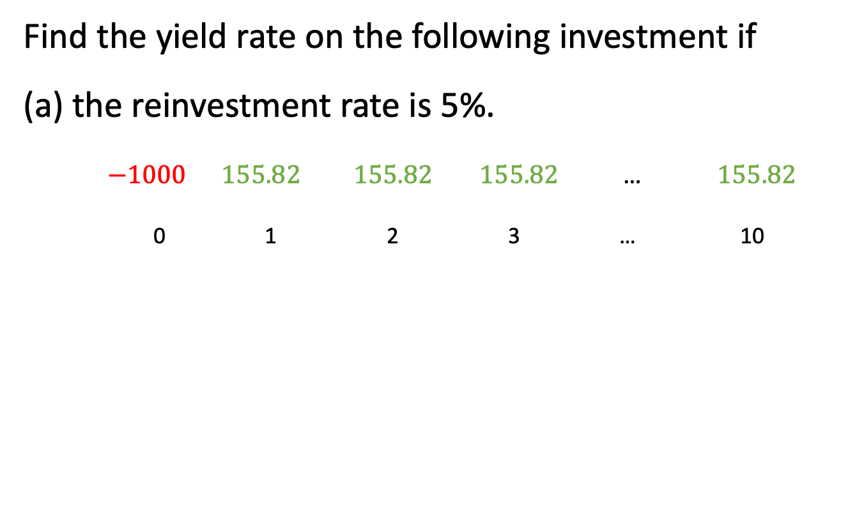
Example 7.6
Find the yield rate on the following investment if
(a) the reinvestment rate is 5%.
$−1000 155.82 155.82 155.82 \text{…} 155.82$
0 1 2 3 … 10

Slide 16
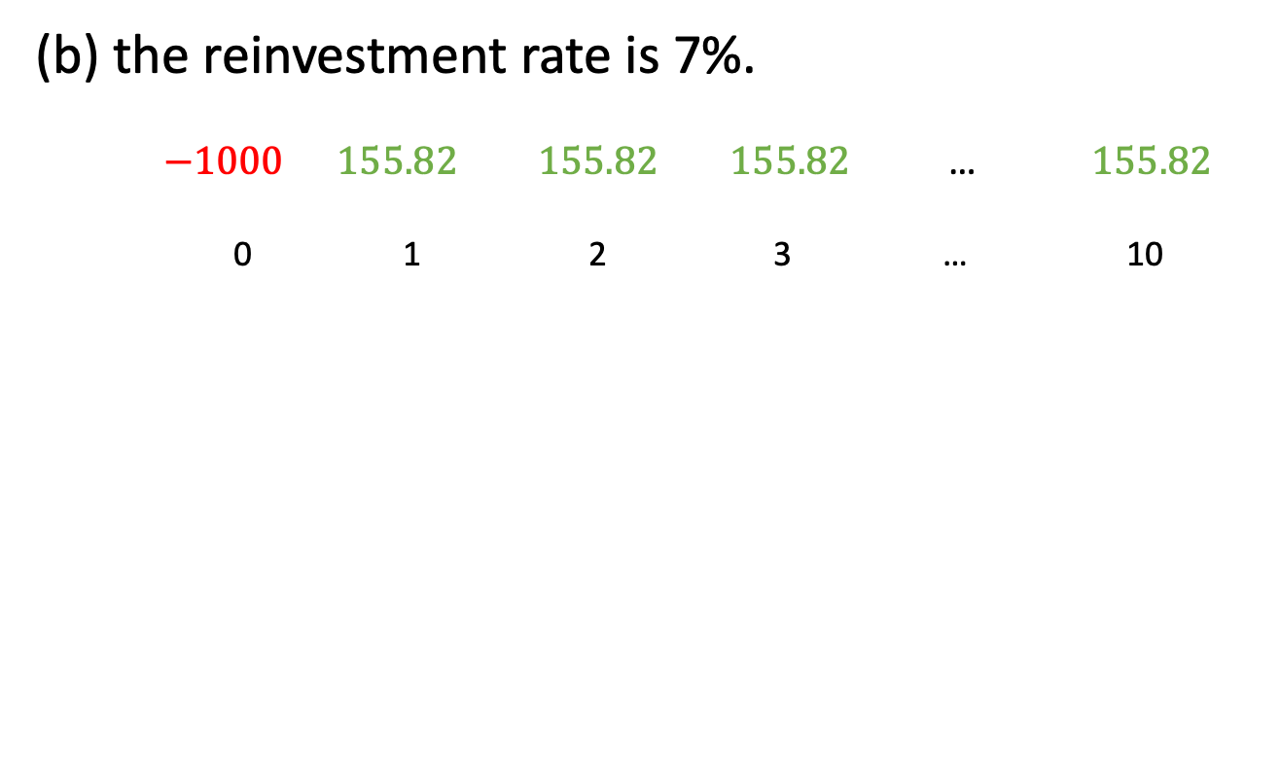
Example 7.6, continued
(b) the reinvestment rate is 7%.
$−1000 155.82 155.82 155.82 \text{…} 155.82$
0 1 2 3 … 10

Slide 17

Example 7.6, continued
(c) the reinvestment rate is 9%.
$−1000 155.82 155.82 155.82 \text{…} 155.82$
0 1 2 3 … 10

