Slide 1
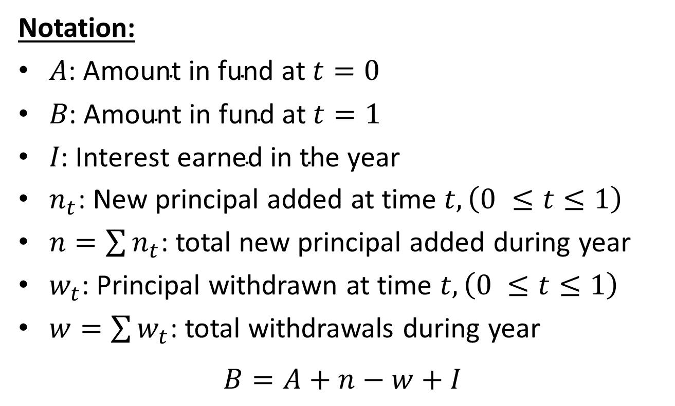
7.3 Dollar-weighted rates
Notation:
$A\text{: }\text{Amount} \text{in} \text{fund} \text{at} t=0$
$B\text{: }\text{Amount} \text{in} \text{fund} \text{at} t=1$
$I\text{: }\text{Interest} \text{earned} \text{in} \text{the} \text{year}$
$n_{t}$: New principal added at time $t, \left(0 ≤t≤1\right)$
$n=\sum{n_{t}}$: total new principal added during year
$w_{t}$: Principal withdrawn at time $t, \left(0 ≤t≤1\right)$
$w=\sum{w_{t}}$: total withdrawals during year
$$B=A+n−w+I$$

Slide 2
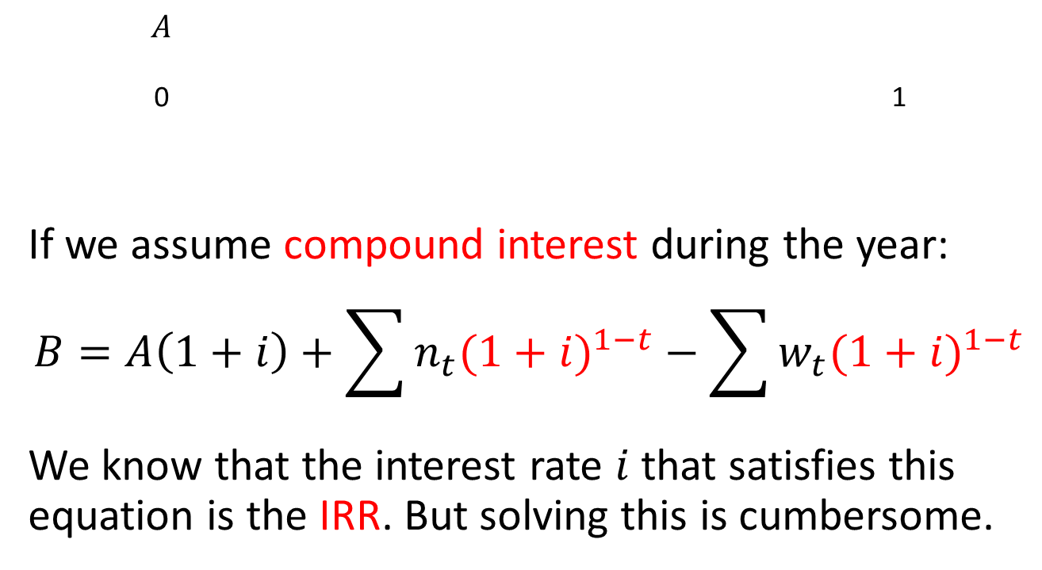
Equation of value
$$A$$
0 1
If we assume compound interest during the year:
$$B=A\left(1+i\right)+\sum{n_{t}{(1+i)}^{1−t}}−\sum{w_{t}{(1+i)}^{1−t}}$$
We know that the interest rate $i$that satisfies this equation is the IRR. But solving this is cumbersome.

Slide 3
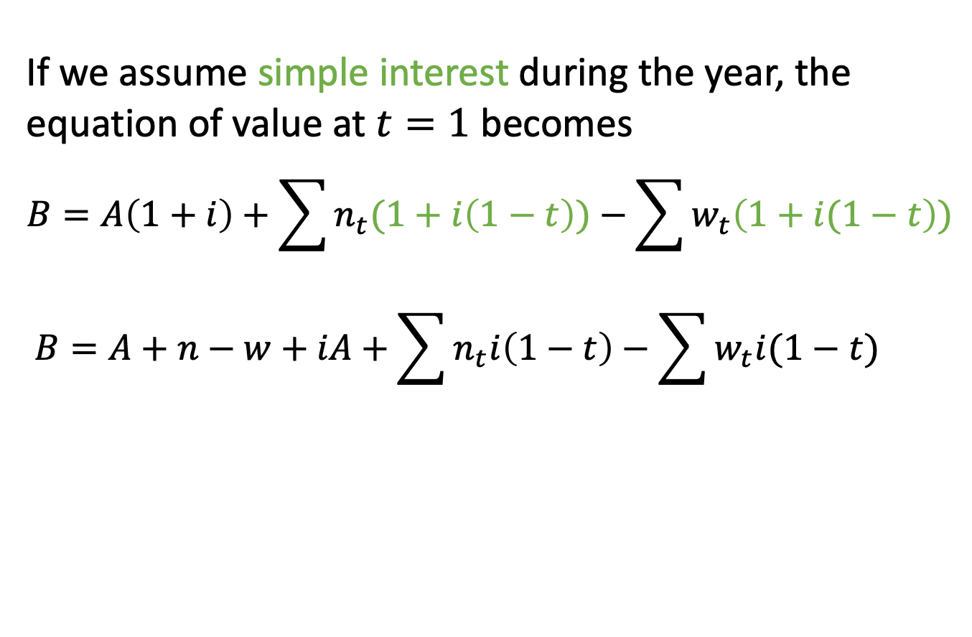
A simple approximation
If we assume simple interest during the year, the equation of value at $t=1$ becomes
$$B=A\left(1+i\right)+\sum{n_{t}(1+i\left(1−t\right))}−\sum{w_{t}\left(1+i(1−t\right))}$$
$$B=A+n−w+iA+\sum{n_{t}i\left(1−t\right)−\sum{w_{t}i(1−t)}}$$

Slide 4
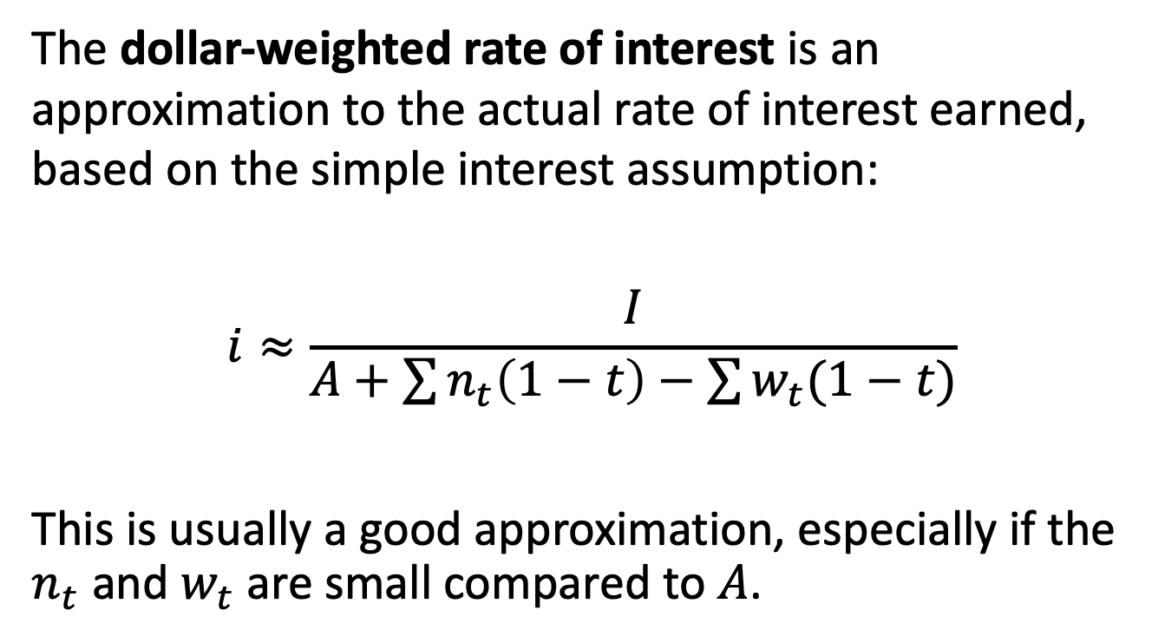
Dollar-weighted rate of interest
The dollar-weighted rate of interest is an approximation to the actual rate of interest earned, based on the simple interest assumption:
$$i≈\frac{I}{A+\sum{n_{t}\left(1−t\right)−\sum{w_{t}(1−t)}}}$$
This is usually a good approximation, especially if the $n_{t}$ and $w_{t}$are small compared to $A$.

Slide 5
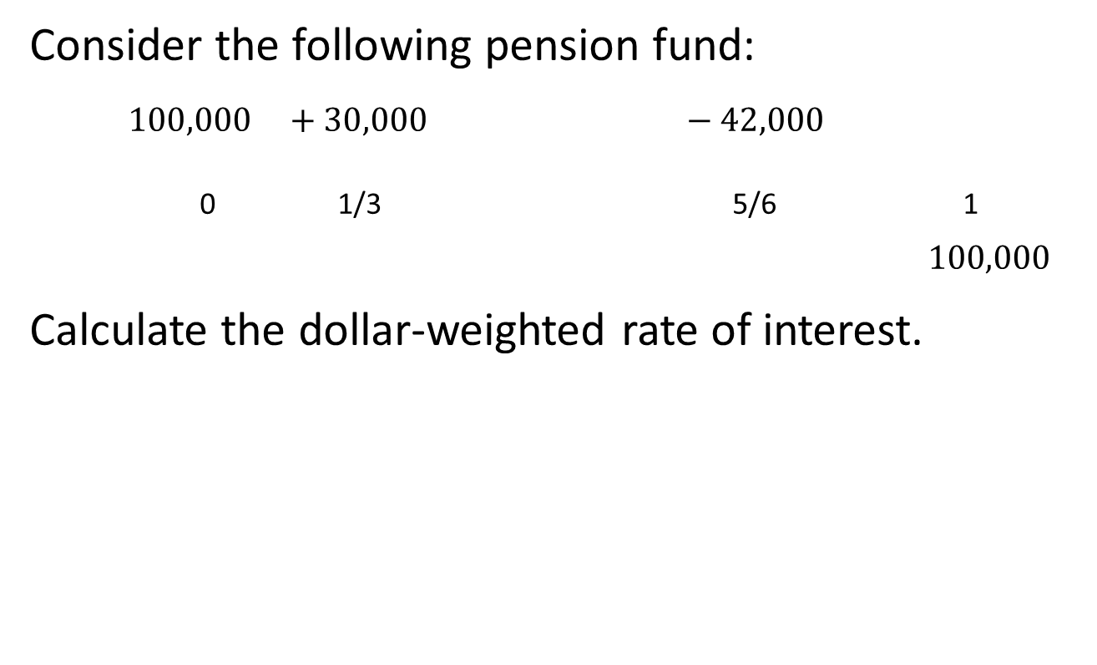
Example 7.7
Consider the following pension fund:
$$100,000 +30,000 −42,000$$
0 1/3 5/6 1
$$100,000$$
Calculate the dollar-weighted rate of interest.
Fund Value: 100,000 112,000 125,000

Slide 6
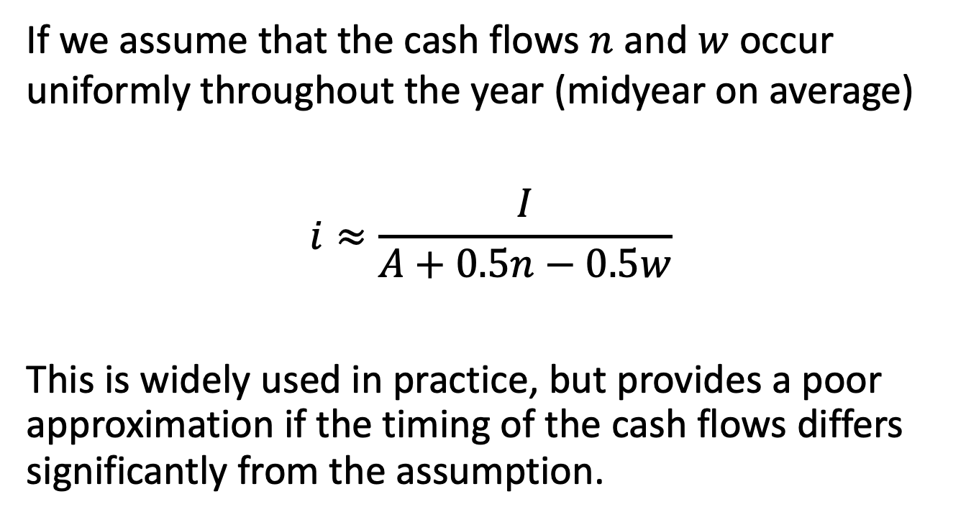
A further simplification
If we assume that the cash flows $n$ and $w$ occur uniformly throughout the year (midyear on average)
$$i≈\frac{I}{A+0.5n−0.5w}$$
This is widely used in practice, but provides a poor approximation if the timing of the cash flows differs significantly from the assumption.

Slide 7
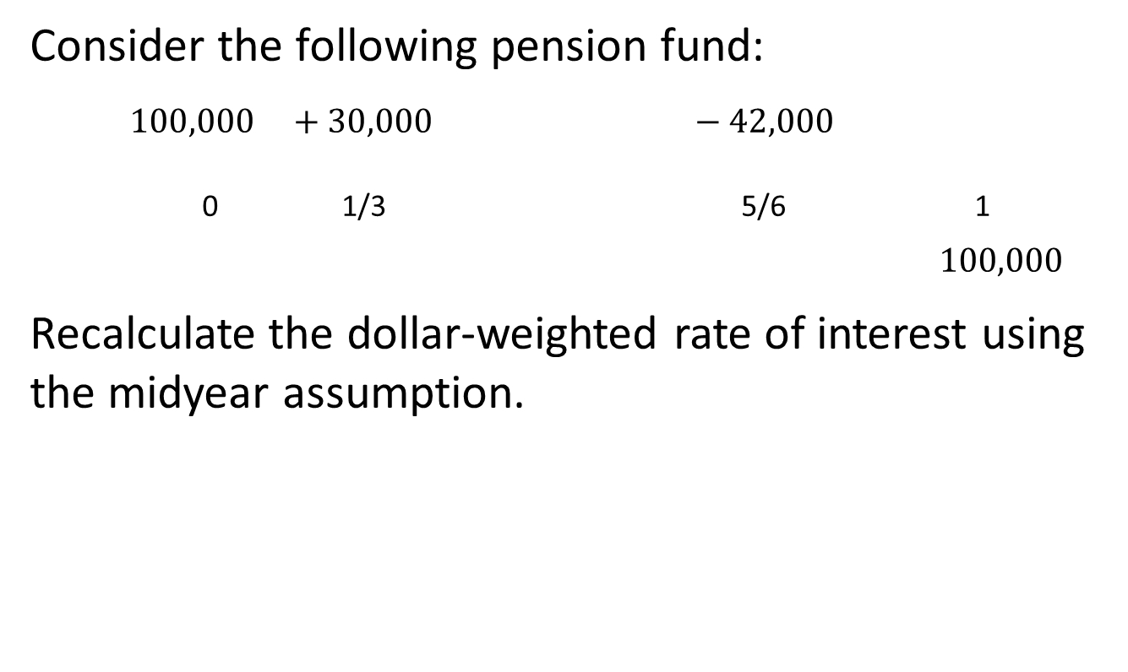
Example 7.7, continued
Consider the following pension fund:
$$100,000 +30,000 −42,000$$
0 1/3 5/6 1
$$100,000$$
Recalculate the dollar-weighted rate of interest using the midyear assumption.
Fund Value: 100,000 112,000 125,000

Slide 8
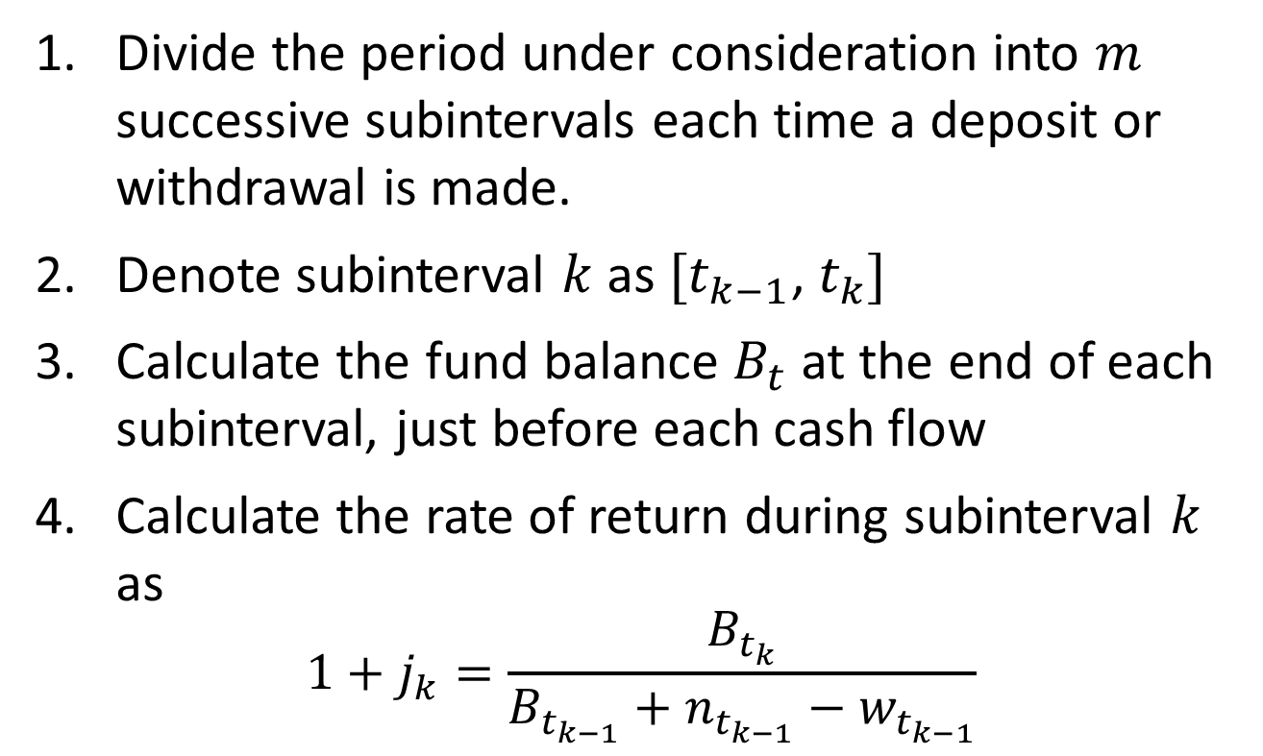
7.4 Time-weighted rates
Divide the period under consideration into $m$ successive subintervals each time a deposit or withdrawal is made.
Denote subinterval $k$ as $[t_{k−1}$, $t_{k}]$
Calculate the fund balance $B_{t}$at the end of each subinterval, just before each cash flow
Calculate the rate of return during subinterval $k$ as
$$1+j_{k}=\frac{B_{t_{k}}}{B_{t_{k−1}}+n_{t_{k−1}}−w_{t_{k−1}}}$$

Slide 9
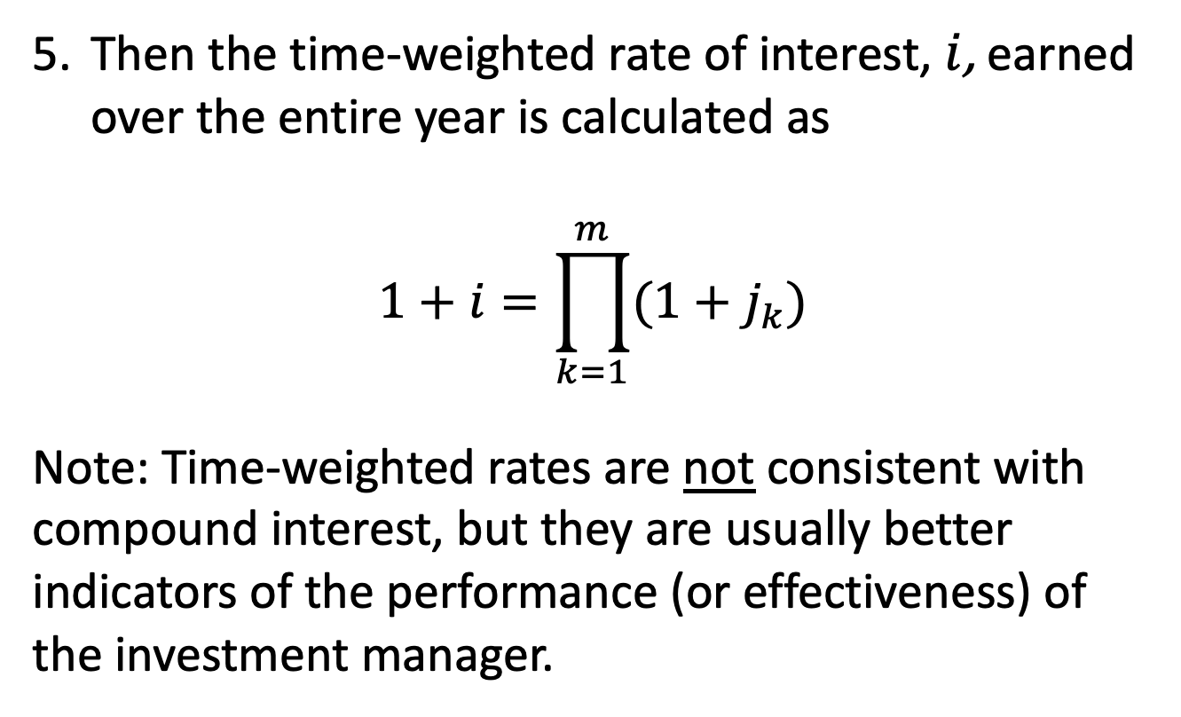
Time-weighted rates
Then the time-weighted rate of interest, $i$, earned over the entire year is calculated as
$$1+i=\prod_{k=1}^{m}{(1+j_{k})}$$
Note: Time-weighted rates are not consistent with compound interest, but they are usually better indicators of the performance (or effectiveness) of the investment manager.

Slide 10
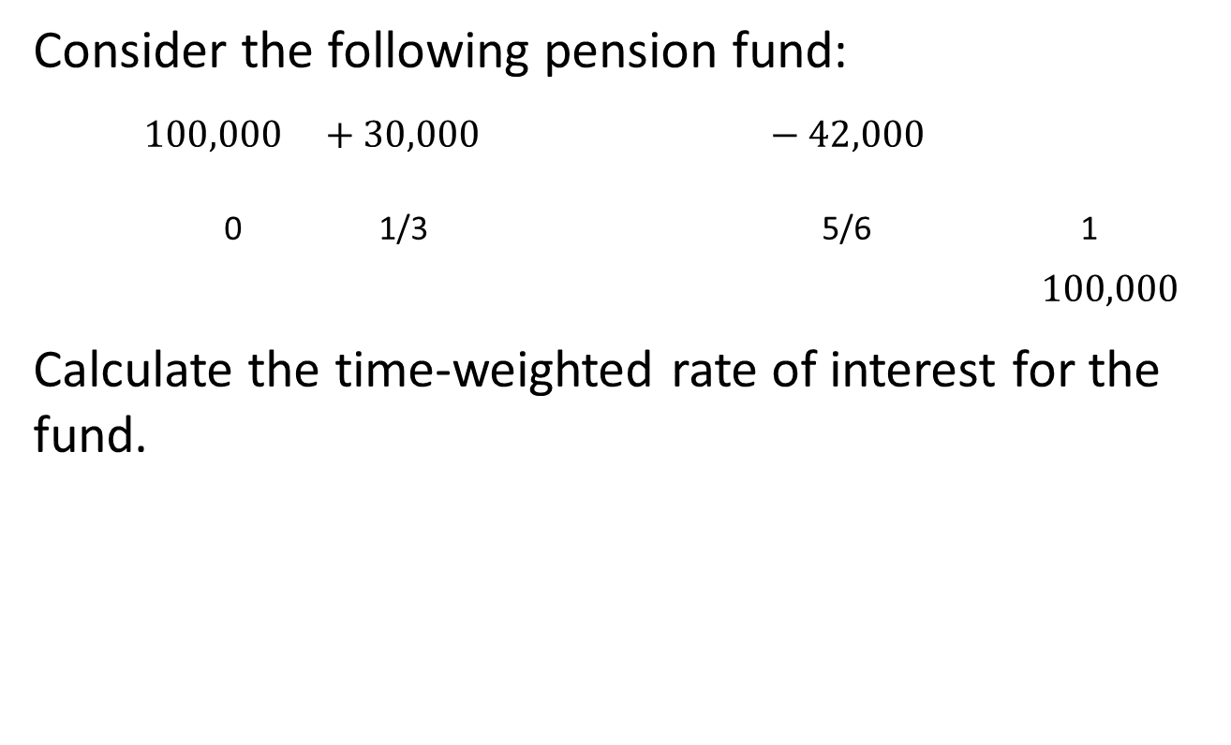
Example 7.7, continued
Consider the following pension fund:
$$100,000 +30,000 −42,000$$
0 1/3 5/6 1
$$100,000$$
Calculate the time-weighted rate of interest for the fund.
Fund Value: 100,000 112,000 125,000

Slide 11
7.5 Other securities
Debt versus equity in the corporate structure:
Debt holders are called creditors; they always get paid unless the borrower defaults on the loan
  Secured creditors (have lien on assets)
  Unsecured creditors (no lien)
Equity holders (aka shareholders) are entitled to residual profits, after everyone else is paid
  Periodic disbursements of profits to shareholders are called dividends

Slide 12
Different types of securities
Equity securities:
  Preferred stock: fixed dividends, paid before common stock dividends
  Common stock: dividend varies with profits
Debt securities
  Bonds (Chapter 6)

Slide 13
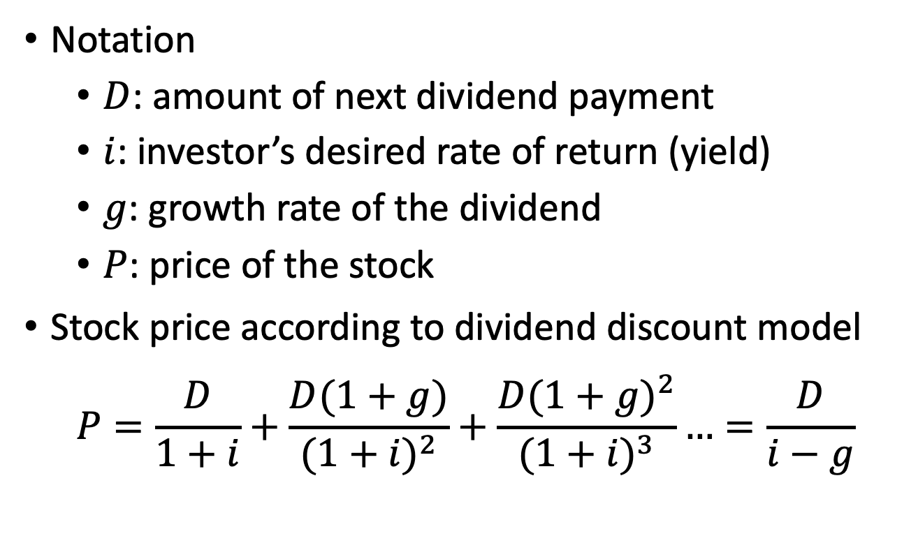
Dividend discount model
Notation
  $D$: amount of next dividend payment
  $i$: investor’s desired rate of return (yield)
  $g$: growth rate of the dividend
  $P$: price of the stock
Stock price according to dividend discount model
$$P=\frac{D}{1+i}+\frac{D(1+g)}{{(1+i)}^{2}}+\frac{D{(1+g)}^{2}}{{(1+i)}^{3}}…=\frac{D}{i−g}$$

Slide 14
Example 7.9
The earnings of a corporation are expected to increase 3% per year. The current earnings on a common stock are $5 per share. The corporation pays 60% of its earnings as dividends. Find the price per share that will yield 4.5%.

