Slide 1
CHAPTER 8
Yield Curves

Slide 2
8.1 Term structure of interest rates
The observed yields on zero-coupon bonds of different maturities is referred to collectively as the yield curve. It is also known as the term structure of interest rates.
The yield curve is usually increasing, meaning that zero-coupon bonds of longer maturities command a higher yield than zero-coupon bonds of shorter maturities.
Occasionally, the yield curve could be flat or decreasing (inverted).

Slide 3
Why is the yield curve upward sloping?
Expectations Theory
  Investors expect interest rates to rise in the future
Liquidity Preference Theory
  Investors need an incentive (higher yield) to tie up their money in the long term (as opposed to staying in more liquid, shorter-term investments)
Inflation Risk Premium Theory
  The fixed income provided by bonds is eroded by inflation. Since future inflation is uncertain and may rise, investors need incentive to invest over longer term.

Slide 4
Changes in the yield curve
Parallel shifts:
  All yields change by the same amount (e.g., 1% up)
Non-parallel shifts (twists):
  Different parts of the yield curve (short, medium and long maturities) shift by different amounts → slope and curvature changes
Inversion:
  Short-term yields exceed long-term yields. Relatively rare; usually taken as a signal of an impending recession or other weakness.

Slide 5
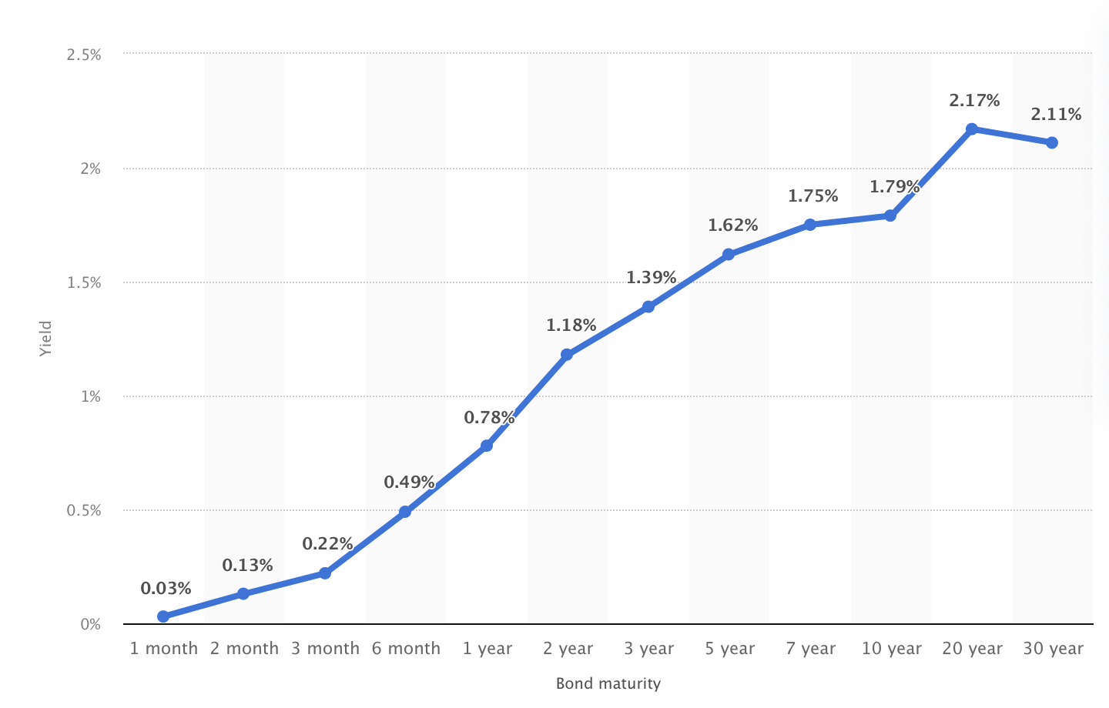
Observed US Treasury yields (Jan 31)

Slide 6
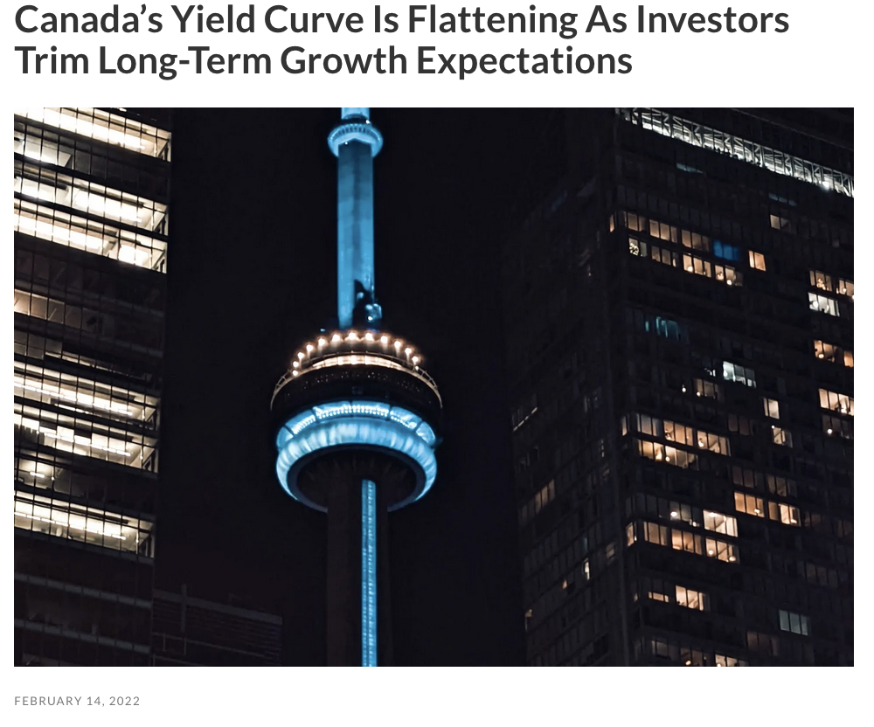

Slide 7
Riding the yield curve
Consider the following strategy:
Invest in a longer term (e.g., 10 year) bond
Instead of holding the bond to maturity, sell it before maturity (e.g., after 3 years).
If the yield curve is upward sloping and hasn’t shifted, the YTM of the remaining bond (now with 7 years to maturity) is lower than the YTM of the original bond purchased.
Investor will get a higher price → enhanced yield

Slide 8
Example 8.1
Using the data for US Treasuries as of Jan 31:
Determine the purchase price of a 10-year zero-coupon bond with $1000 face value.
Determine the sale price of the same zero-coupon bond 3 years later (now 7 years to maturity) assuming the yield curve has not changed.

Slide 9
Example 8.1, continued
Determine the overall yield to the investor.

Slide 10
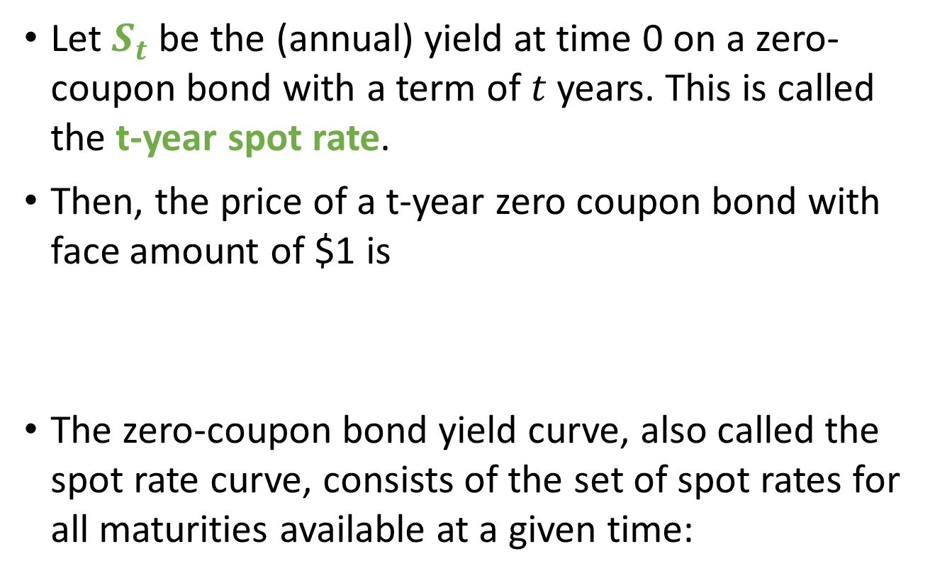
8.2 Spot rates
Let $S_{t}$ be the (annual) yield at time 0 on a zero-coupon bond with a term of $t$ years. This is called the t-year spot rate.
Then, the price of a t-year zero coupon bond with face amount of $1 is
The zero-coupon bond yield curve, also called the spot rate curve, consists of the set of spot rates for all maturities available at a given time:

Slide 11
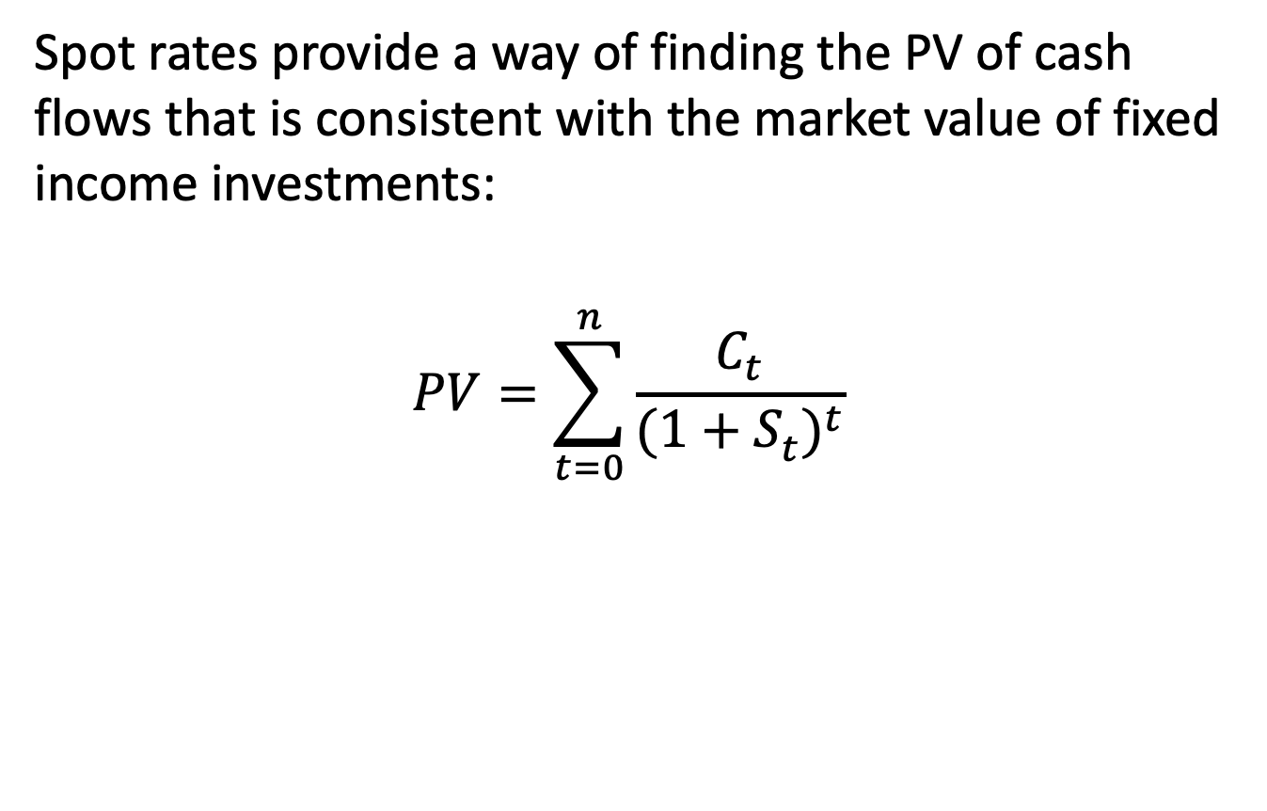
Pricing cash flows with spot rates
Spot rates provide a way of finding the PV of cash flows that is consistent with the market value of fixed income investments:
$$PV=\sum_{t=0}^{n}{\frac{C_{t}}{{(1+S_{t}^{ })}^{t}}}$$

Slide 12
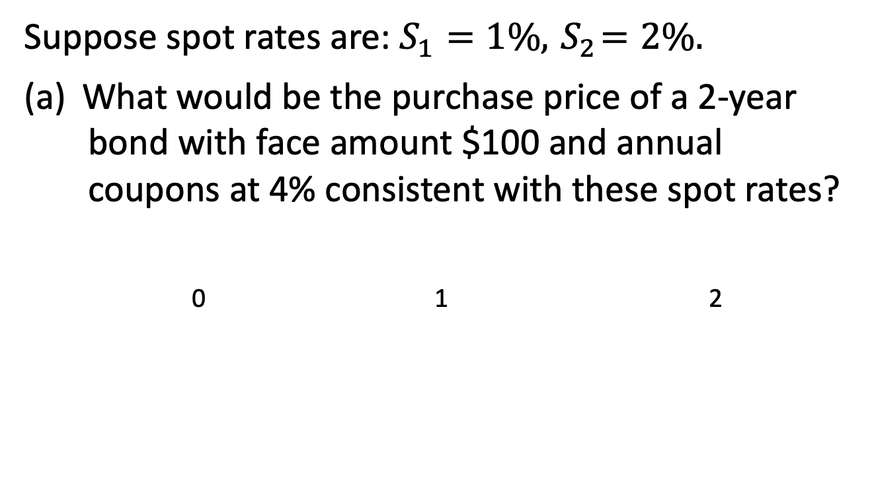
Example 8.2
Suppose spot rates are: $S_{1}=1\%, { S}_{2}=2\%.$
(a) What would be the purchase price of a 2-year bond with face amount $100 and annual coupons at 4% consistent with these spot rates?
0 1 2

Slide 13
Example 8.2, continued
(b) What is the corresponding YTM?

Slide 14
Replicating portfolio
We have essentially built a replicating portfolio whose cash flows exactly match the cash flows of the asset we are trying to price.
The Law of One Price states that, in an efficient market, all securities with the same cash flows must have the same price. Imbalances and inefficiencies can only exist for a short time.

Slide 15
Example 8.2, continued
What would happen if we could buy the 2-year bond for $102 instead?
Buy the 2-year bond for $102 today and, at the same time, sell $3.96 of one-year zeros and $98.04 of two-year zeros.
0 1 2
2-year bond:
1-year zero:
2-year zero:

Slide 16
Arbitrage
Arbitrage refers to the simultaneous purchase and sale of securities which generate a sure profit from zero net investment.
Our assumptions in Example 8.2:
no transaction costs on buying and selling
anyone can buy/sell bonds at rates in the yield curve
anyone can buy/sell zero-coupon bonds at prices indicated by the spot rates

Slide 17
Constructing the spot rate curve
Two methods:
From actual observed yield on zero coupon bonds
From actual observed prices on coupon bonds
  Consider bonds in order of increasing maturity
  On the one hand, price is PV of all cash flows discounted at YTM
  Price is also the PV of each cash flow discounted at the corresponding spot rate.

Slide 18
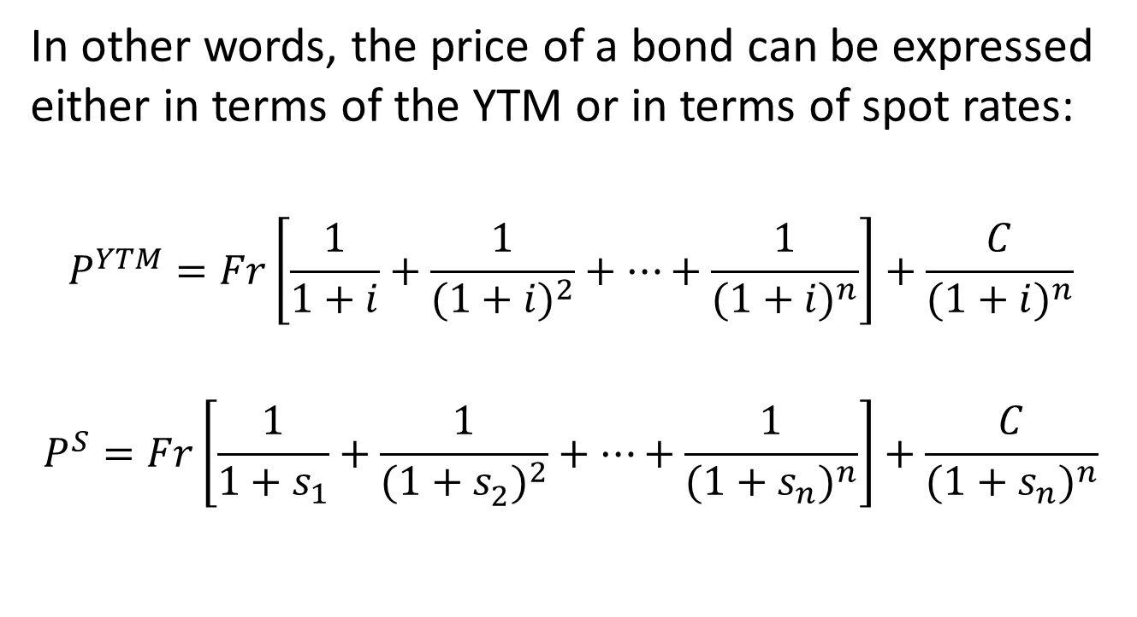
Bond pricing with Spot rates/YTM
In other words, the price of a bond can be expressed either in terms of the YTM or in terms of spot rates:
$$P^{YTM}=Fr\left[\frac{1}{1+i}+\frac{1}{{(1+i)}^{2}}+…+\frac{1}{{(1+i)}^{n}}\right]+\frac{C}{{(1+i)}^{n}}$$
$$P^{S}=Fr\left[\frac{1}{1+s_{1}}+\frac{1}{{(1+s_{2}^{ })}^{2}}+…+\frac{1}{{(1+s_{n}^{ })}^{n}}\right]+\frac{C}{{(1+s_{n})}^{n}}$$

Slide 19
Example 8.3
Find the 1-, 2-, and 3-year spot rates from the following information regarding coupon bonds redeemable at par:
Term | Annual coupon rate | Annual yield rate
1 | 2.000% | 5.000%
2 | 5.000% | 5.487%
3 | 5.961% | 5.961%

Slide 20
Example 8.3, continued
Price of 1-year bond:
Price of 2-year bond:

Slide 21
Example 8.3, continued
Price of 3-year bond:

