Slide 1
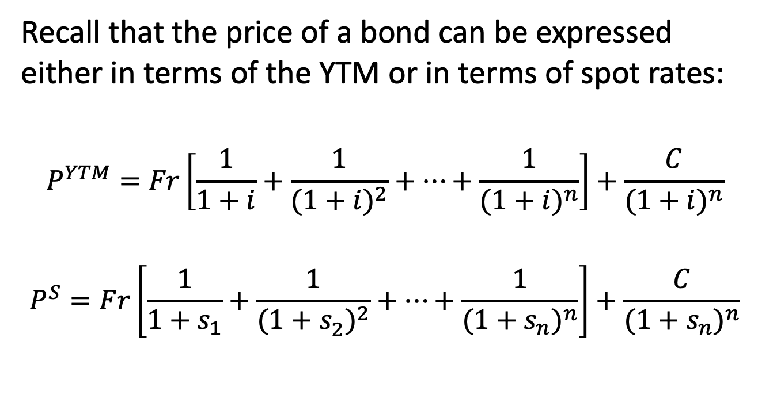
Spot rates vs. YTM
Recall that the price of a bond can be expressed either in terms of the YTM or in terms of spot rates:
$$P^{YTM}=Fr\left[\frac{1}{1+i}+\frac{1}{{(1+i)}^{2}}+…+\frac{1}{{(1+i)}^{n}}\right]+\frac{C}{{(1+i)}^{n}}$$
$$P^{S}=Fr\left[\frac{1}{1+s_{1}}+\frac{1}{{(1+s_{2}^{ })}^{2}}+…+\frac{1}{{(1+s_{n}^{ })}^{n}}\right]+\frac{C}{{(1+s_{n})}^{n}}$$

Slide 2
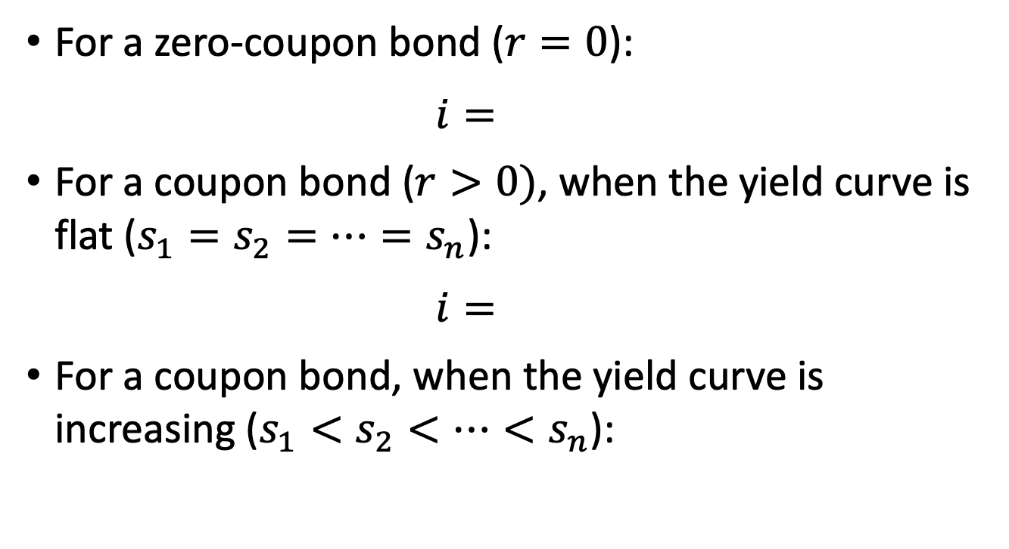
Spot rates vs. YTM
For a zero-coupon bond ($r=0$):
$$i=$$
For a coupon bond ($r>0)$, when the yield curve is flat ($s_{1}=s_{2}=…=s_{n}$):
$$i=$$
For a coupon bond, when the yield curve is increasing ($s_{1}<s_{2}<…<s_{n}$):

Slide 3
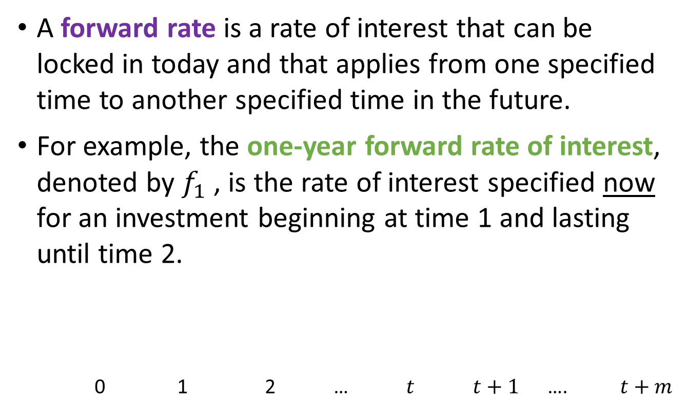
8.3 Forward rates
A forward rate is a rate of interest that can be locked in today and that applies from one specified time to another specified time in the future.
For example, the one-year forward rate of interest, denoted by $f_{1}$ , is the rate of interest specified now for an investment beginning at time 1 and lasting until time 2.
0 1 2 … $t$ $t+1$ …. $t+m$

Slide 4
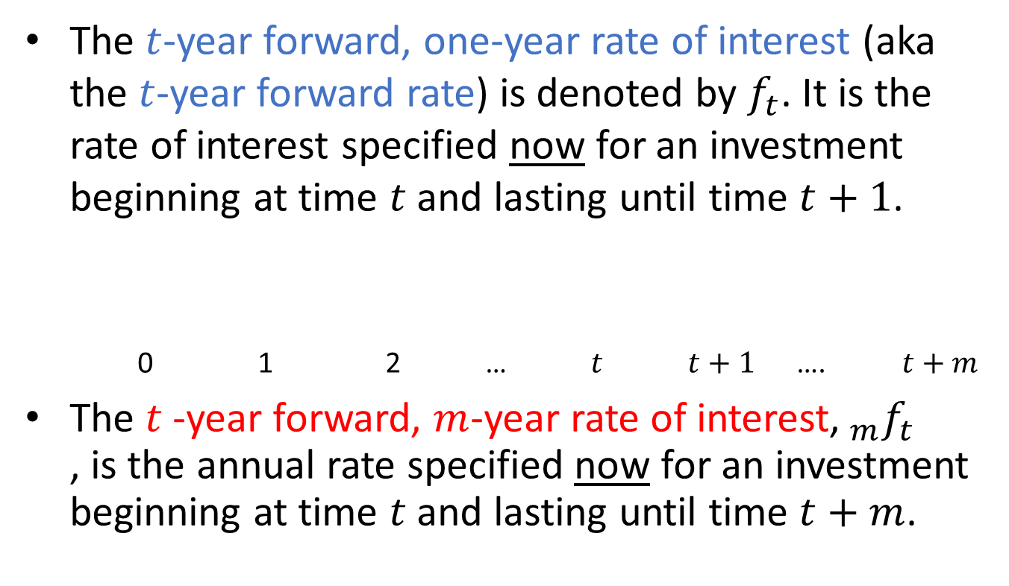
Forward rates
The $t$-year forward, one-year rate of interest (aka the $t$-year forward rate) is denoted by $f_{t}$. It is the rate of interest specified now for an investment beginning at time $t$ and lasting until time $t+1$.
0 1 2 … $t$ $t+1$ …. $t+m$
The $t$-year forward, $m$-year rate of interest,${ _{m}f}_{t}$ , is the annual rate specified now for an investment beginning at time $t$ and lasting until time $t+m$.

Slide 5
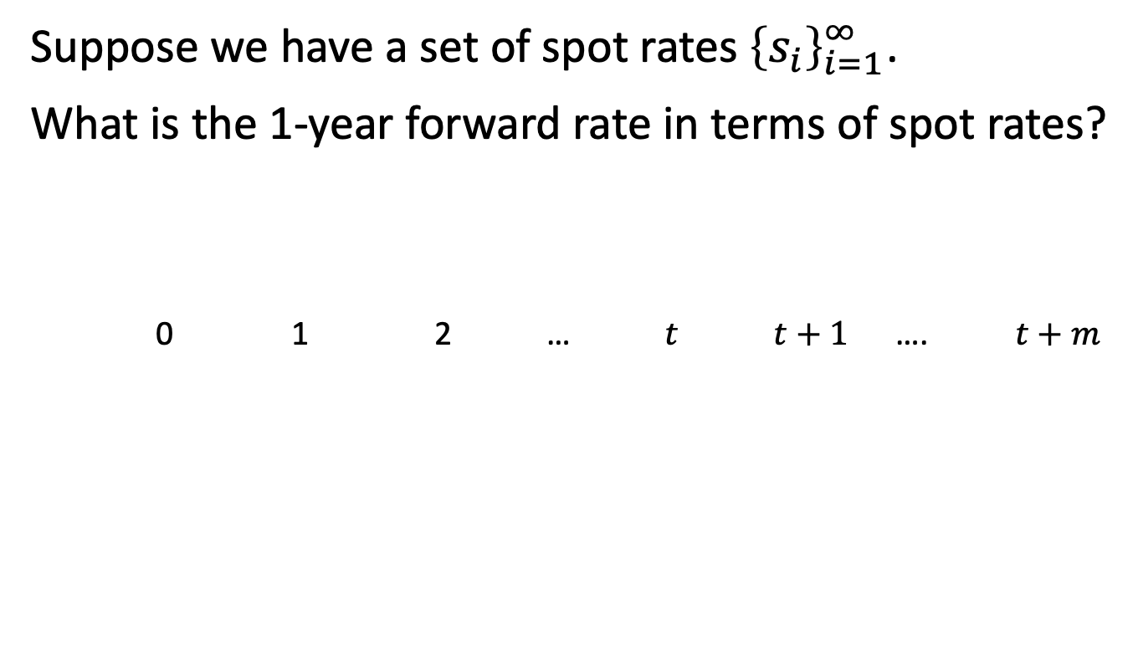
Spots and forwards
Suppose we have a set of spot rates ${\left\{s_{i}\right\}}_{i=1}^{∞}$.
What is the 1-year forward rate in terms of spot rates?
0 1 2 … $t$ $t+1$ …. $t+m$

Slide 6
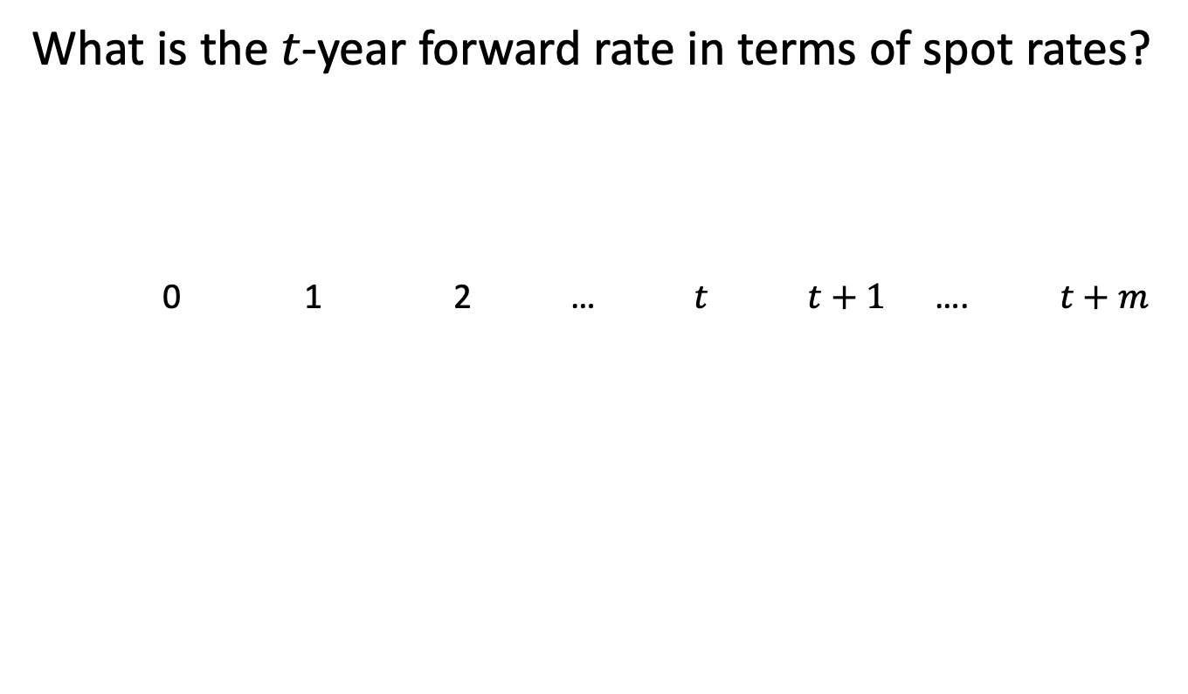
Spots and forwards, continued
What is the $t$-year forward rate in terms of spot rates?
0 1 2 … $t$ $t+1$ …. $t+m$

Slide 7
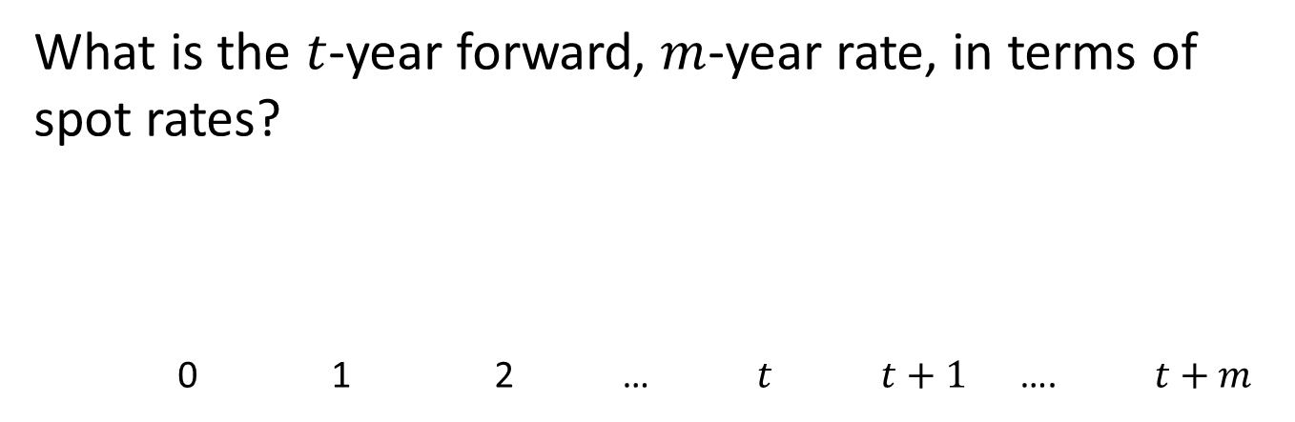
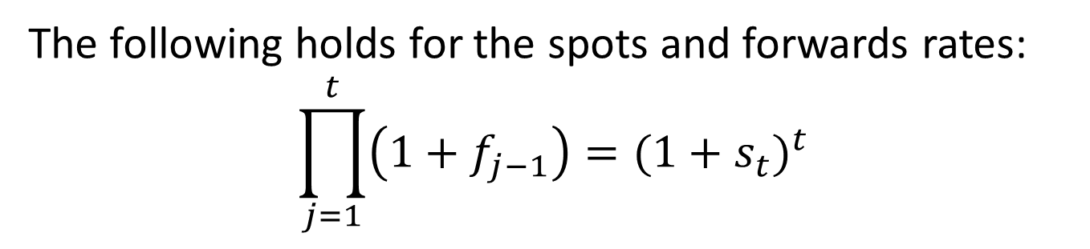
Spots and forwards, continued
What is the $t$-year forward, $m$-year rate, in terms of spot rates?
0 1 2 … $t$ $t+1$ …. $t+m$
The following holds for the spots and forwards rates:
$$\prod_{j=1}^{t}{\left(1+f_{j−1}\right)}=(1+s_{t})^{t}$$

Slide 8
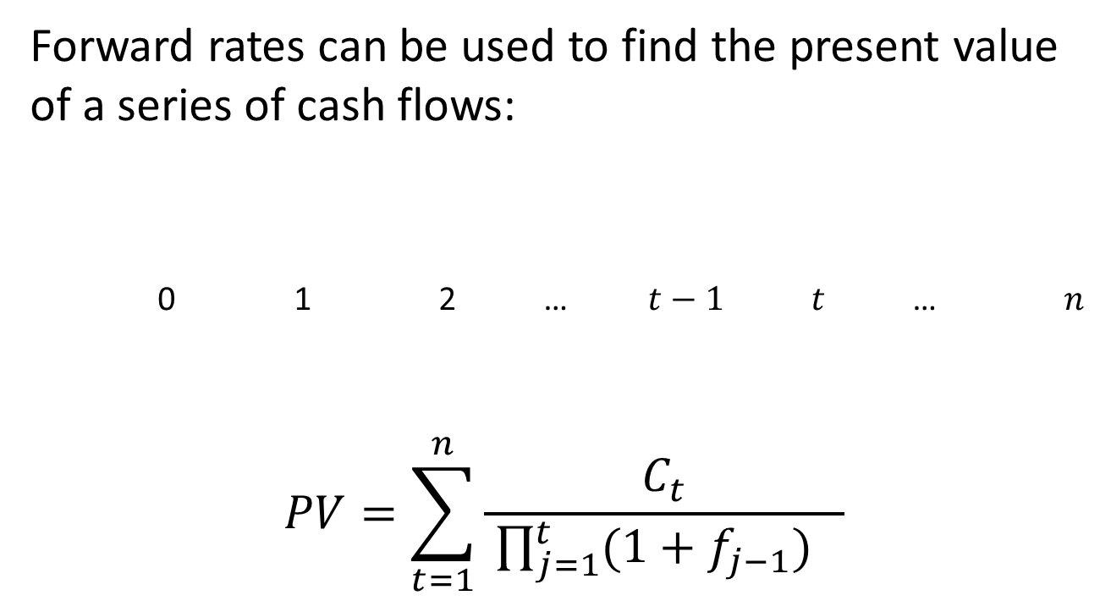
Pricing with forward rates
Forward rates can be used to find the present value of a series of cash flows:
0 1 2 … $t−1$ $t$ … $n$
$$PV=\sum_{t=1}^{n}{\frac{C_{t}}{ \prod_{j=1}^{t}{(1+f_{j−1})} }}$$

Slide 9
Example 8.4
The 1-year spot rate is 4.8%. The 1-year forward rate is 5.1%. The 2-year forward rate is 5.3%. Calculate the price of 3-year bond with face amount 100 redeemable at par paying 8% annual coupons.

Slide 10
Extracting forward rates from YTM
Forward rates can be extracted from the YTM on coupon bonds:
Consider bonds in order of increasing maturity
On the one hand, price is PV of all cash flows discounted at YTM
Price is also the PV of each cash flow discounted using the appropriate forward rates

Slide 11
Example 8.5
Find the 0-, 1-, and 2-year forward rates from the following information regarding coupon bonds redeemable at par:
Term | Annual coupon rate | Annual yield rate
1 | 2.000% | 5.000%
2 | 5.000% | 5.487%
3 | 5.961% | 5.961%

Slide 12
Example 8.5, continued
Price of 1-year bond:
Price of 2-year bond:

Slide 13
Example 8.5, continued
Price of 3-year bond:

Slide 14
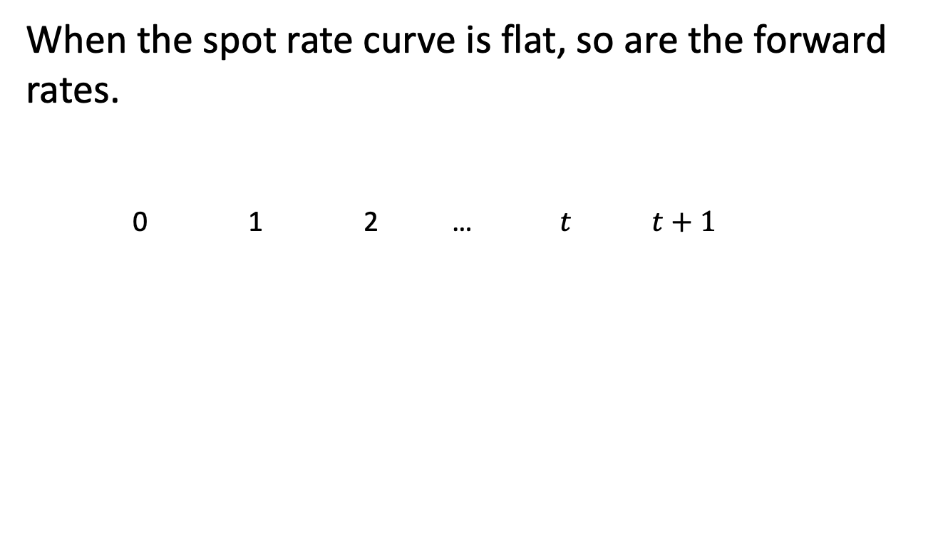
Patterns of forward rates
When the spot rate curve is flat, so are the forward rates.
0 1 2 … $t$ $t+1$

Slide 15
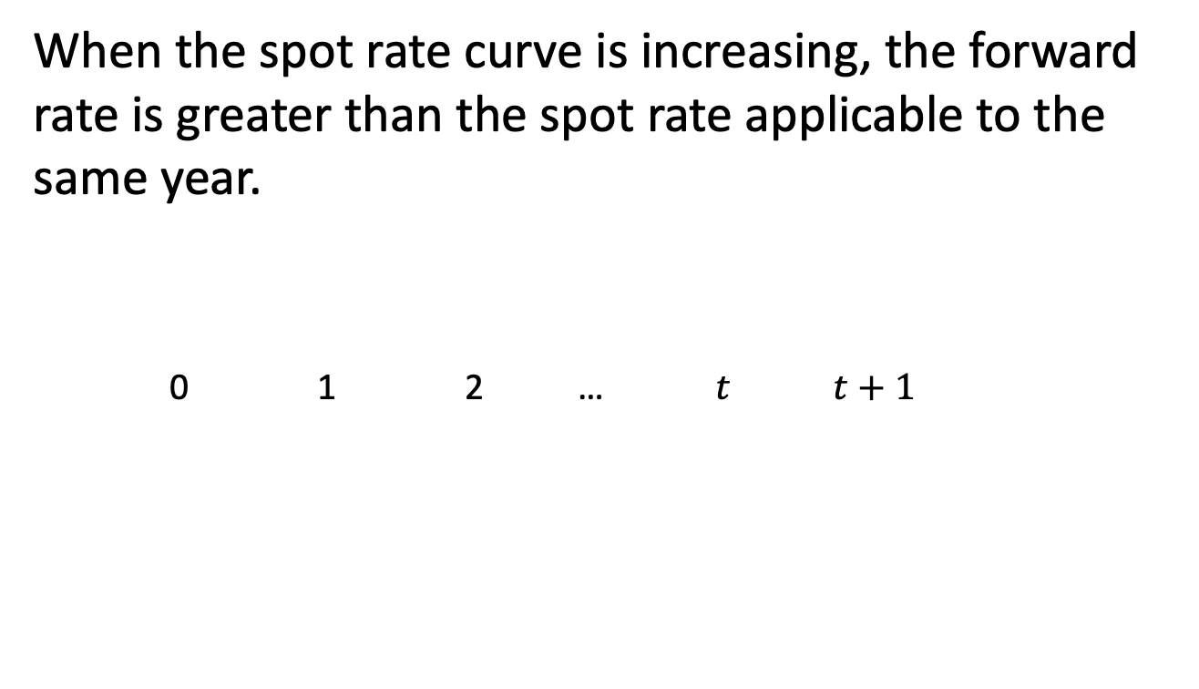
Patterns of forward rates, cont’d
When the spot rate curve is increasing, the forward rate is greater than the spot rate applicable to the same year.
0 1 2 … $t$ $t+1$

