Slide 1
CHAPTER 9
Asset-Liability Management

Slide 2
Assets and liabilities
Insurance company liabilities consist of future cash flows promised to policyholders (e.g., annuity or pension payments, payouts on settlements after an injury, etc.).
These liabilities must be backed by assets.
The best assets to back a liability stream are ones that produce cash flows with the same timing and in the same amount as the liabilities. This is called exact cash flow matching or dedication.

Slide 3
Exact cash flow matching
Creating a dedicated portfolio using zero-coupon bonds is easy → buy bonds to match CFs one by one
When using bonds with coupons:
  Consider the final liability cash flow first.
  Find the amount of the asset needed to match the last liability cash flow.
  Determine the liability cash flows that are left over after the first matching asset is chosen.
  Consider the longest remaining cash flow; repeat steps 2-4 until all liability cash flows are matched.

Slide 4
Example 9.1
A company has an obligation to pay $10,000 at the end of each year for 3 years. Spot rates are 4%, 5%, and 5.8% for terms of 1, 2 and 3 years, respectively.
Construct a dedicated portfolio to match the cash flows using 1-, 2- and 3-year zero coupon bonds.
0 1 2 3
1-year zero:
2-year zero:
3-year zero:

Slide 5
Example 9.1, continued
Construct a dedicated portfolio using the following:
  Bond 1: 3-year bond with 5% annual coupons
  Bond 2: 2-year bond with 2% annual coupons
  Bond 3: 1-year zero-coupon bond
0 1 2 3
3-year bond:
2-year bond:
1-year zero:

Slide 6
Interest rate sensitivity
Creating dedicated portfolios is not always possible; assets and liabilities might not be perfectly matched.
Even if we pick assets whose PV matches the PV of the liabilities, the PVs might drift apart when interest rates change and
  the value of fixed-income assets, like bonds, changes
  the (market-consistent) value of the liabilities changes
Goal: choose assets so that the PV of the assets moves in unison with the PV of the liabilities
→ protect surplus from changes in interest rates

Slide 7
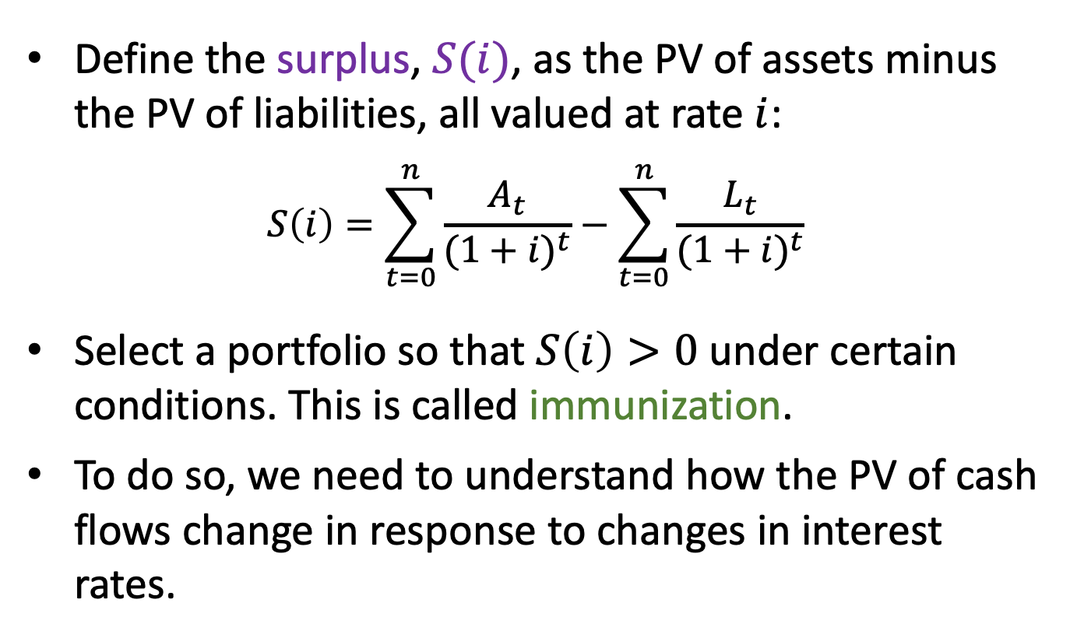
Surplus
Define the surplus, $S(i)$, as the PV of assets minus the PV of liabilities, all valued at rate $i$:
$$S\left(i\right)=\sum_{t=0}^{n}{\frac{A_{t}}{{(1+i)}^{t}}}−\sum_{t=0}^{n}{\frac{L_{t}}{{(1+i)}^{t}}}$$
Select a portfolio so that $S\left(i\right)>0$ under certain conditions. This is called immunization.
To do so, we need to understand how the PV of cash flows change in response to changes in interest rates.

Slide 8
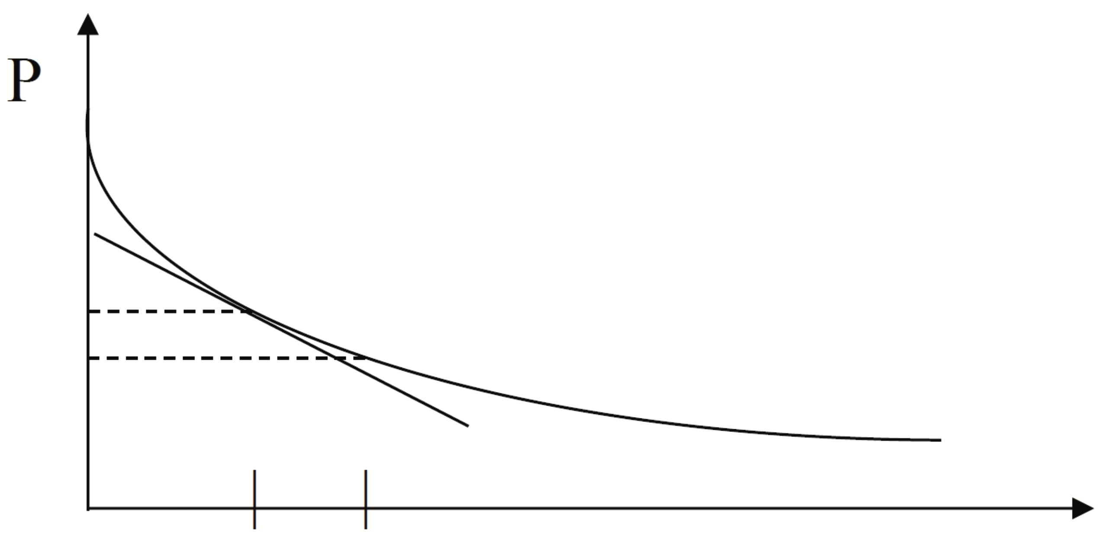
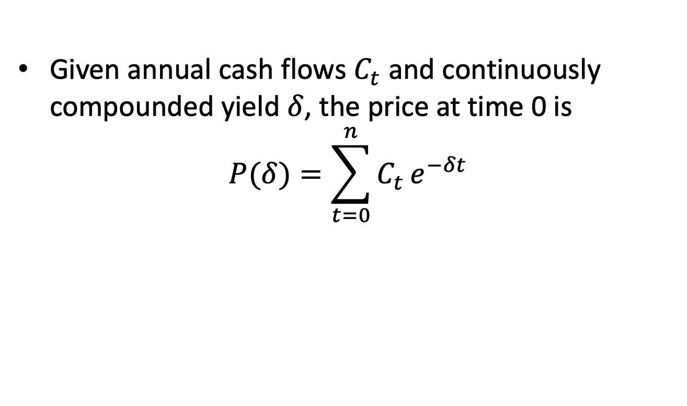
9.1 Duration
Given annual cash flows $C_{t}$ and continuously compounded yield $δ$, the price at time 0 is
$$P(δ)=\sum_{t=0}^{n}{C_{t}}e^{−δt}$$
Price curve is usually decreasing and convex.

Slide 9
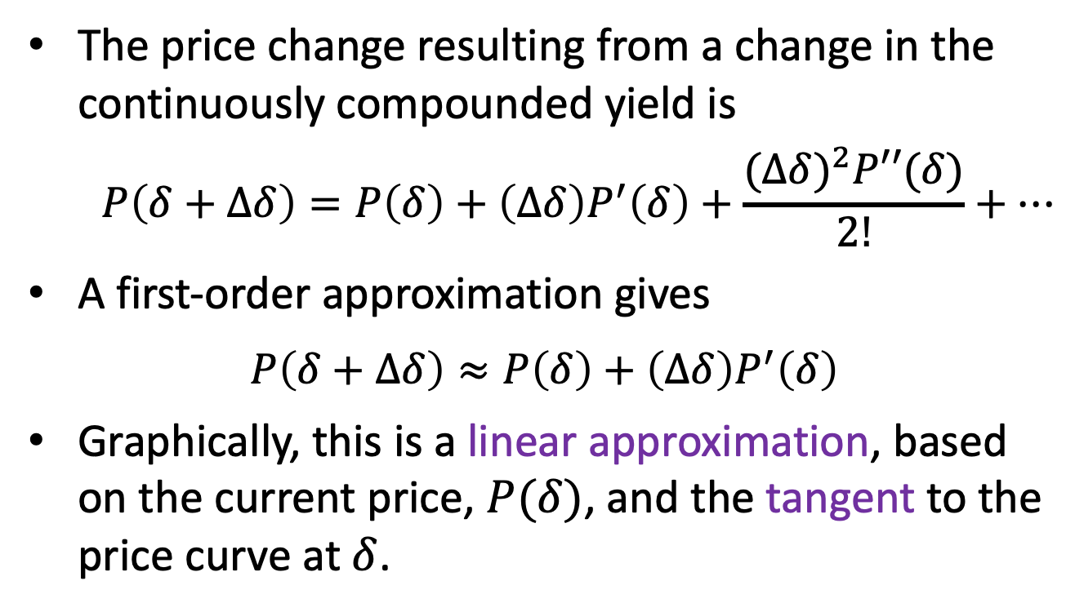
Approximating the price change
The price change resulting from a change in the continuously compounded yield is
$$P\left(δ+∆δ\right)=P\left(δ\right)+\left(∆δ\right)P^{′}\left(δ\right)+\frac{{(∆δ)}^{2}P′′(δ)}{2!}+…$$
A first-order approximation gives
$$P\left(δ+∆δ\right)≈P\left(δ\right)+\left(∆δ\right)P^{′}\left(δ\right)$$
Graphically, this is a linear approximation, based on the current price, $P(δ)$, and the tangent to the price curve at $δ$.

Slide 10
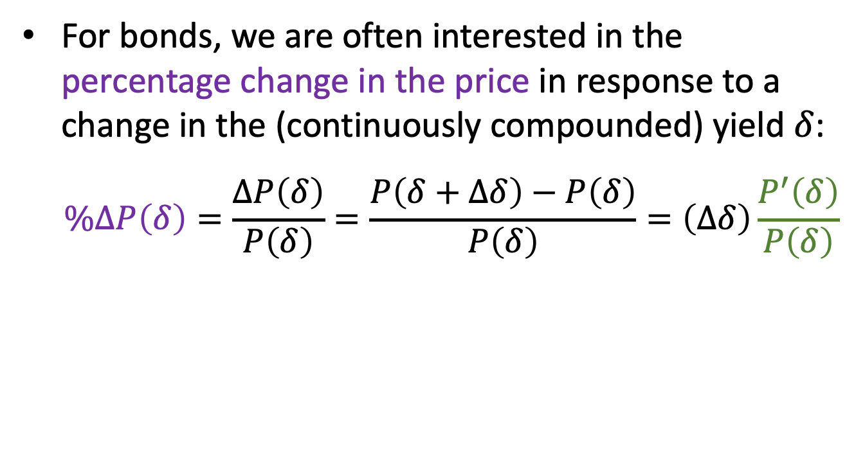
Percentage change in price
For bonds, we are often interested in the percentage change in the price in response to a change in the (continuously compounded) yield $δ$:
$$\%∆P\left(δ\right)=\frac{∆P\left(δ\right)}{P\left(δ\right)}=\frac{P\left(δ+∆δ\right)−P\left(δ\right)}{P\left(δ\right)}=\left(∆δ\right)\frac{P^{′}\left(δ\right)}{P\left(δ\right)}$$

Slide 11
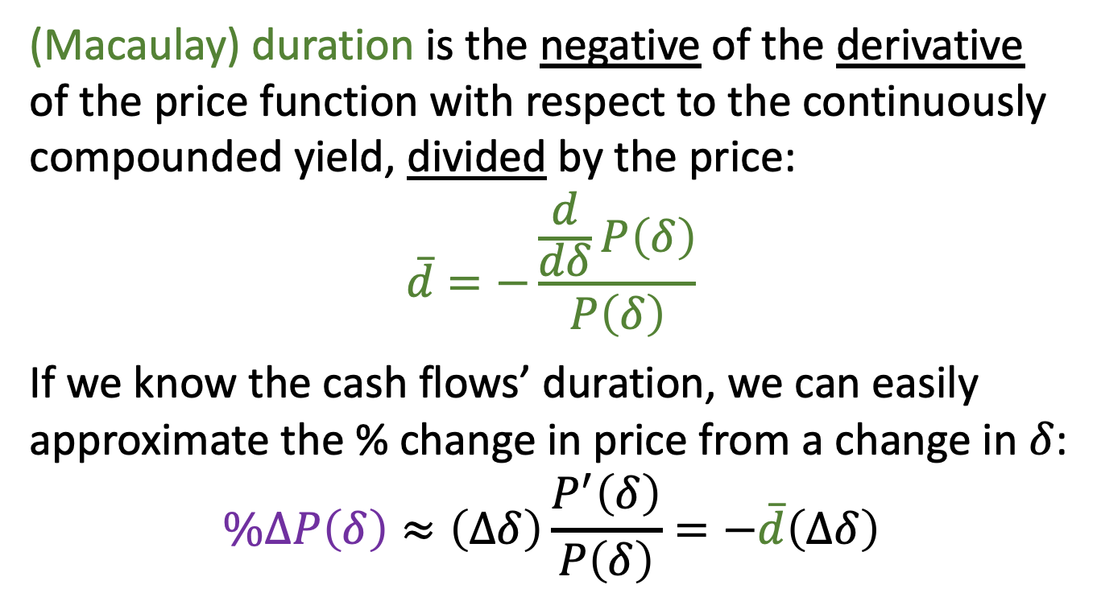
Duration
(Macaulay) duration is the negative of the derivative of the price function with respect to the continuously compounded yield, divided by the price:
$$\overline{d}=−\frac{\frac{d}{dδ}P\left(δ\right)}{P\left(δ\right)}$$
If we know the cash flows’ duration, we can easily approximate the % change in price from a change in $δ$:
$$\%∆P\left(δ\right)≈\left(∆δ\right)\frac{P^{′}\left(δ\right)}{P\left(δ\right)}=−\overline{d}\left(∆δ\right)$$

Slide 12
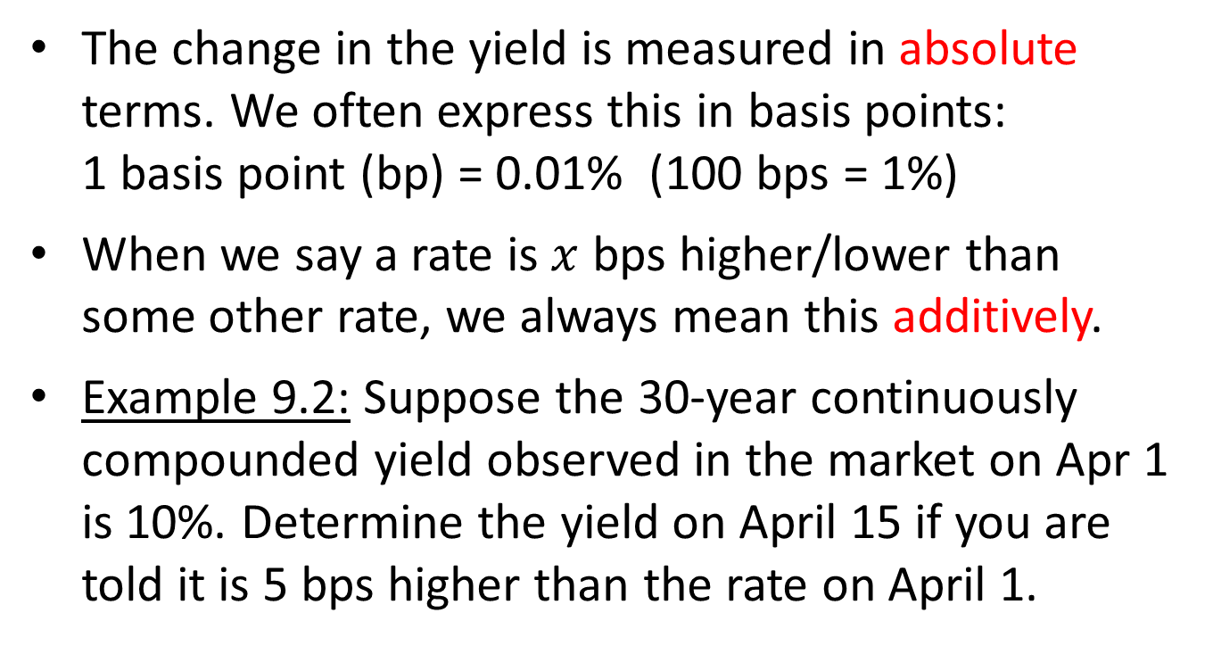
Measuring the change in yield
The change in the yield is measured in absolute terms. We often express this in basis points:
1 basis point (bp) = 0.01% (100 bps = 1%)
When we say a rate is $x$ bps higher/lower than some other rate, we always mean this additively.
Example 9.2: Suppose the 30-year continuously compounded yield observed in the market on Apr 1 is 10%. Determine the yield on April 15 if you are told it is 5 bps higher than the rate on April 1.

Slide 13
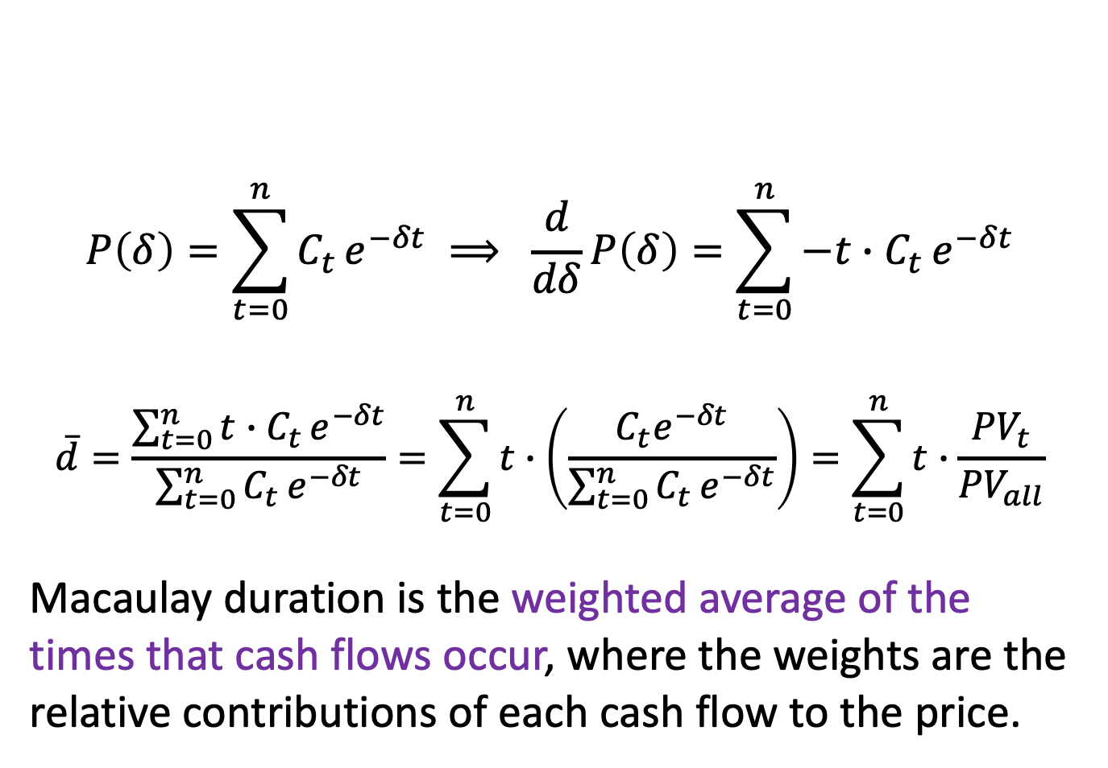
Interpreting (Macaulay) duration
$$P\left(δ\right)=\sum_{t=0}^{n}{C_{t}}e^{−δt} ⟹ \frac{d}{dδ}P\left(δ\right)=\sum_{t=0}^{n}{{−t∙C}_{t}}e^{−δt}$$
$$\overline{d}=\frac{\sum_{t=0}^{n}{{t∙C}_{t}}e^{−δt}}{\sum_{t=0}^{n}{C_{t}}e^{−δt}}=\sum_{t=0}^{n}{t∙\left(\frac{C_{t}e^{−δt}}{\sum_{t=0}^{n}{C_{t}}e^{−δt}}\right)}=\sum_{t=0}^{n}{t∙\frac{{PV}_{t}}{{PV}_{all}}}$$
Macaulay duration is the weighted average of the times that cash flows occur, where the weights are the relative contributions of each cash flow to the price.

Slide 14
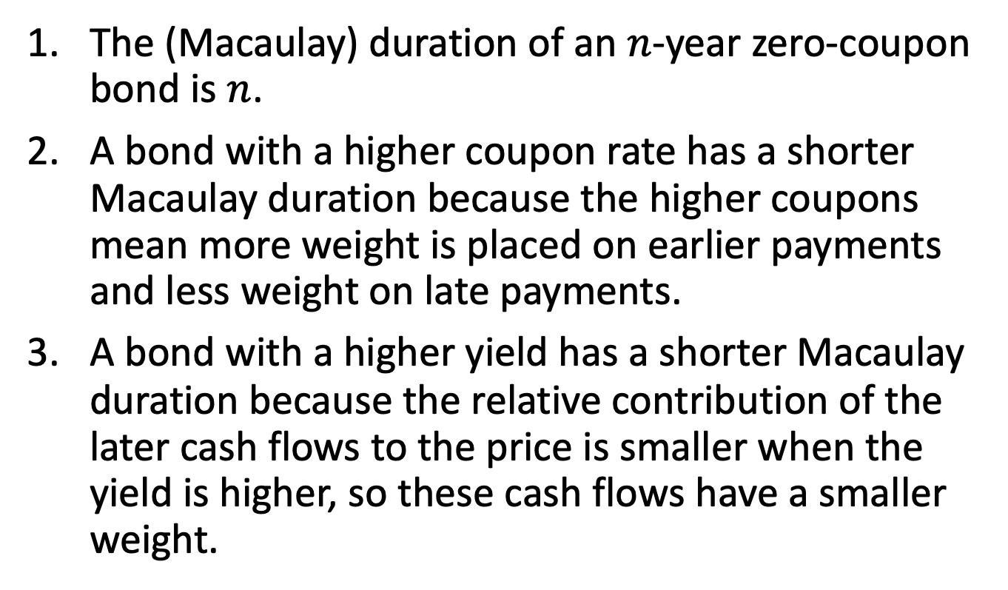
Observations
The (Macaulay) duration of an $n$-year zero-coupon bond is $n$.
A bond with a higher coupon rate has a shorter Macaulay duration because the higher coupons mean more weight is placed on earlier payments and less weight on late payments.
A bond with a higher yield has a shorter Macaulay duration because the relative contribution of the later cash flows to the price is smaller when the yield is higher, so these cash flows have a smaller weight.

Slide 15
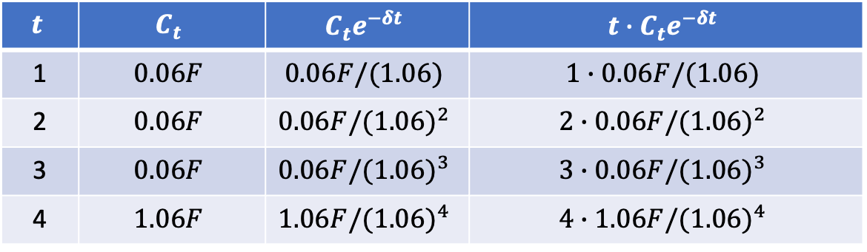
Example 9.3
A 4-year bond has 6% annual coupons and is priced at par.
Find the duration of this bond.
$$t$$ | $$C_{t}$$ | $$C_{t}e^{−δt}$$ | $$t∙C_{t}e^{−δt}$$
1 | $$0.06F$$ | $$0.06F/(1.06)$$ | $$1∙0.06F/(1.06)$$
2 | $$0.06F$$ | $$0.06F/{(1.06)}^{2}$$ | $$2∙0.06F/{(1.06)}^{2}$$
3 | $$0.06F$$ | $$0.06F/{(1.06)}^{3}$$ | $$3∙0.06F/{(1.06)}^{3}$$
4 | $$1.06F$$ | $$1.06F/{(1.06)}^{4}$$ | $$4∙1.06F/{(1.06)}^{4}$$

Slide 16
Example 9.3, continued
Approximate the percentage change in price resulting from a 10 bps increase in the continuously compounded yield.

Slide 17
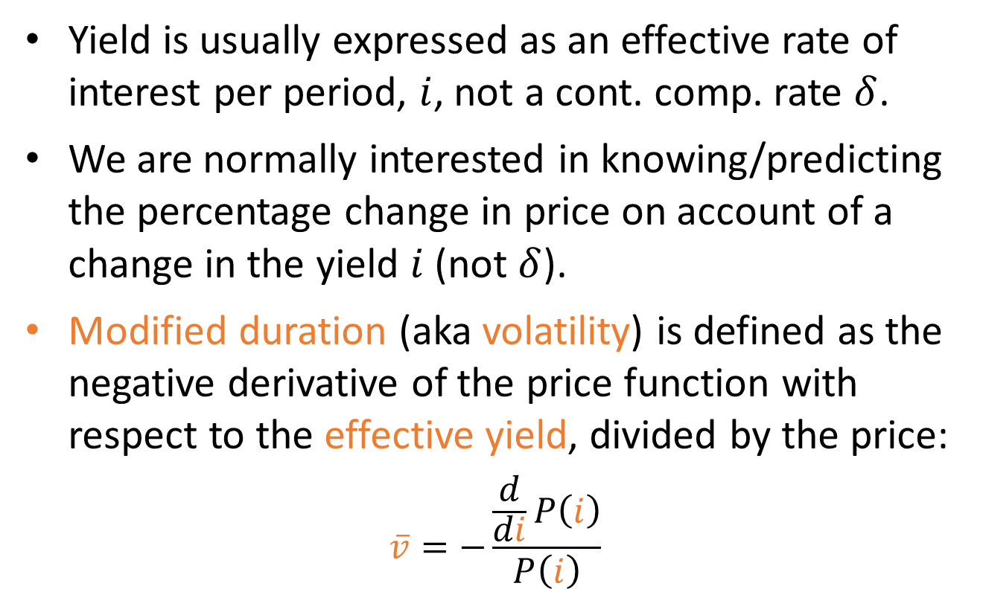
9.2 Modified duration (volatility)
Yield is usually expressed as an effective rate of interest per period, $i$, not a cont. comp. rate $δ$.
We are normally interested in knowing/predicting the percentage change in price on account of a change in the yield $i$ (not $δ$).
Modified duration (aka volatility) is defined as the negative derivative of the price function with respect to the effective yield, divided by the price:
$$\overline{v}=−\frac{\frac{d}{di}P\left(i\right)}{P\left(i\right)}$$

Slide 18
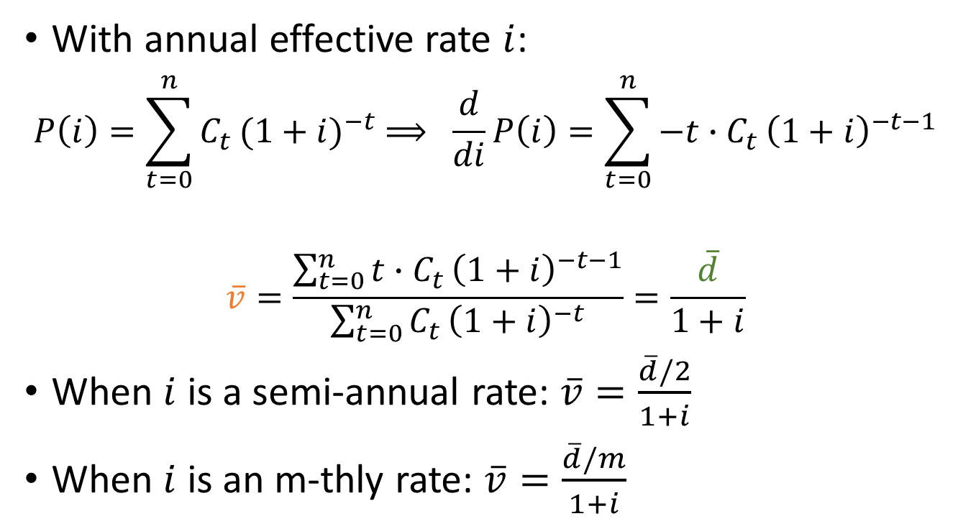
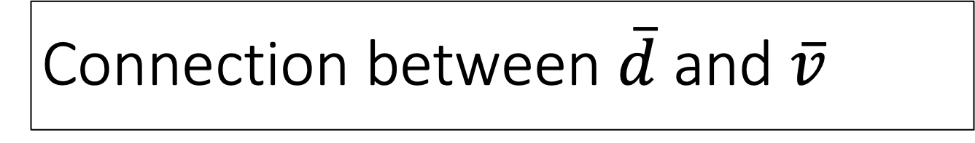
Connection between $\overline{d}$ and $\overline{v}$
With annual effective rate $i$:
$$P\left(i\right)=\sum_{t=0}^{n}{C_{t}}{(1+i)}^{−t} ⟹ \frac{d}{di}P\left(i\right)=\sum_{t=0}^{n}{{−t∙C}_{t}}{\left(1+i\right)}^{−t−1}$$
$$\overline{v}=\frac{\sum_{t=0}^{n}{{t∙C}_{t}}{\left(1+i\right)}^{−t−1}}{\sum_{t=0}^{n}{C_{t}}{\left(1+i\right)}^{−t}}=\frac{\overline{d}}{1+i}$$
When $i$ is a semi-annual rate: $\overline{v}=\frac{\overline{d}/2}{1+i}$
When $i$ is an m-thly rate: $\overline{v}=\frac{\overline{d}/m}{1+i}$

Slide 19
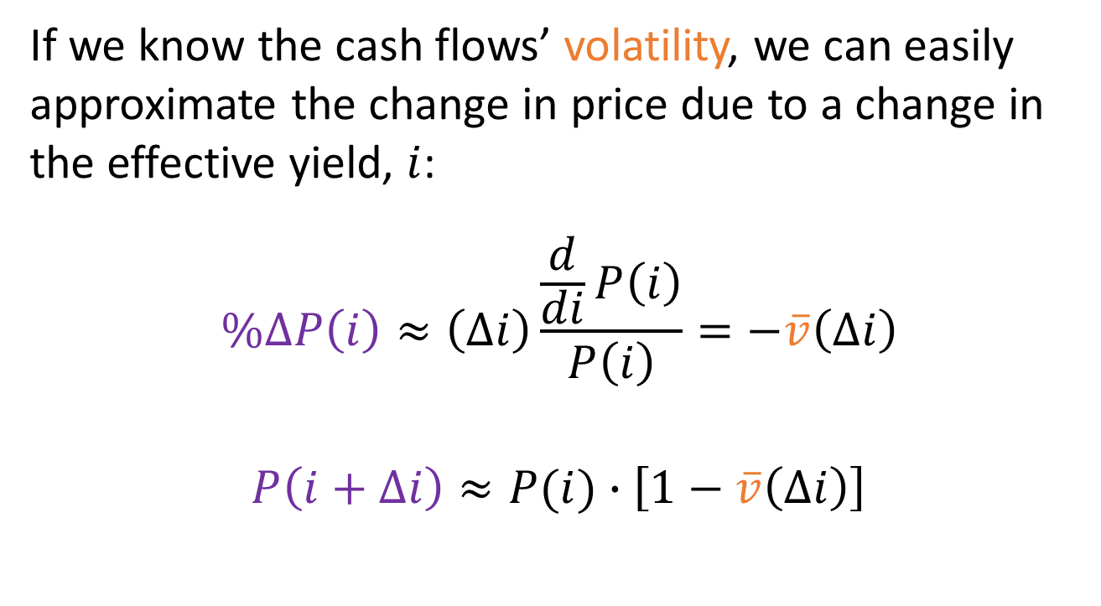
Approximating the change in price
If we know the cash flows’ volatility, we can easily approximate the change in price due to a change in the effective yield, $i$:
$$\%∆P\left(i\right)≈\left(∆i\right)\frac{\frac{d}{di}P\left(i\right)}{P\left(i\right)}=−\overline{v}\left(∆i\right)$$
$$P\left(i+∆i\right)≈P(i)∙\left[1−\overline{v}\left(∆i\right)\right]$$

Slide 20
Example 9.4
Consider the same bond as in Example 9.3: a 4-year bond with 6% annual coupons priced at par.
Find the modified duration (volatility) of this bond.
What is the approximate percentage change in the price of this bond is response to a 75 bps increase in the effective yield?

Slide 21
Example 9.4, continued
What is the exact percentage change in the price of this bond is response to a 75 bps increase in the effective yield?
How good was the approximation in part (b)?

Slide 22
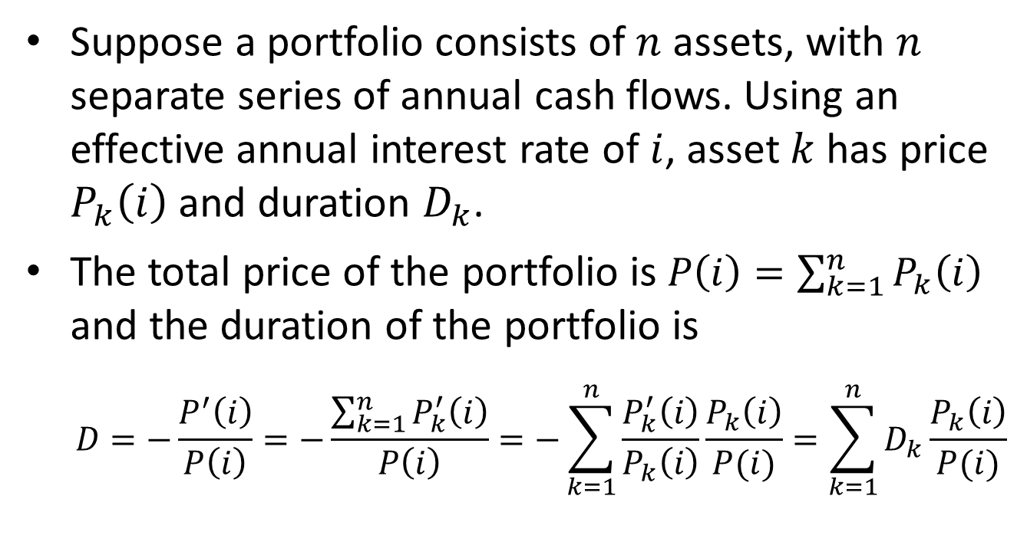
Portfolio duration
Suppose a portfolio consists of $n$ assets, with $n$ separate series of annual cash flows. Using an effective annual interest rate of $i$, asset $k$ has price $P_{k}\left(i\right)$ and duration $D_{k}$.
The total price of the portfolio is $P\left(i\right)=\sum_{k=1}^{n}{P_{k}\left(i\right)}$ and the duration of the portfolio is
$$D=−\frac{P^{′}\left(i\right)}{P\left(i\right)}=−\frac{\sum_{k=1}^{n}{P_{k}^{′}\left(i\right)}}{P\left(i\right)}=−\sum_{k=1}^{n}{\frac{P_{k}^{′}\left(i\right)}{P_{k}\left(i\right)}\frac{P_{k}\left(i\right)}{P(i)}}=\sum_{k=1}^{n}{D_{k}}\frac{P_{k}\left(i\right)}{P(i)}$$

Slide 23
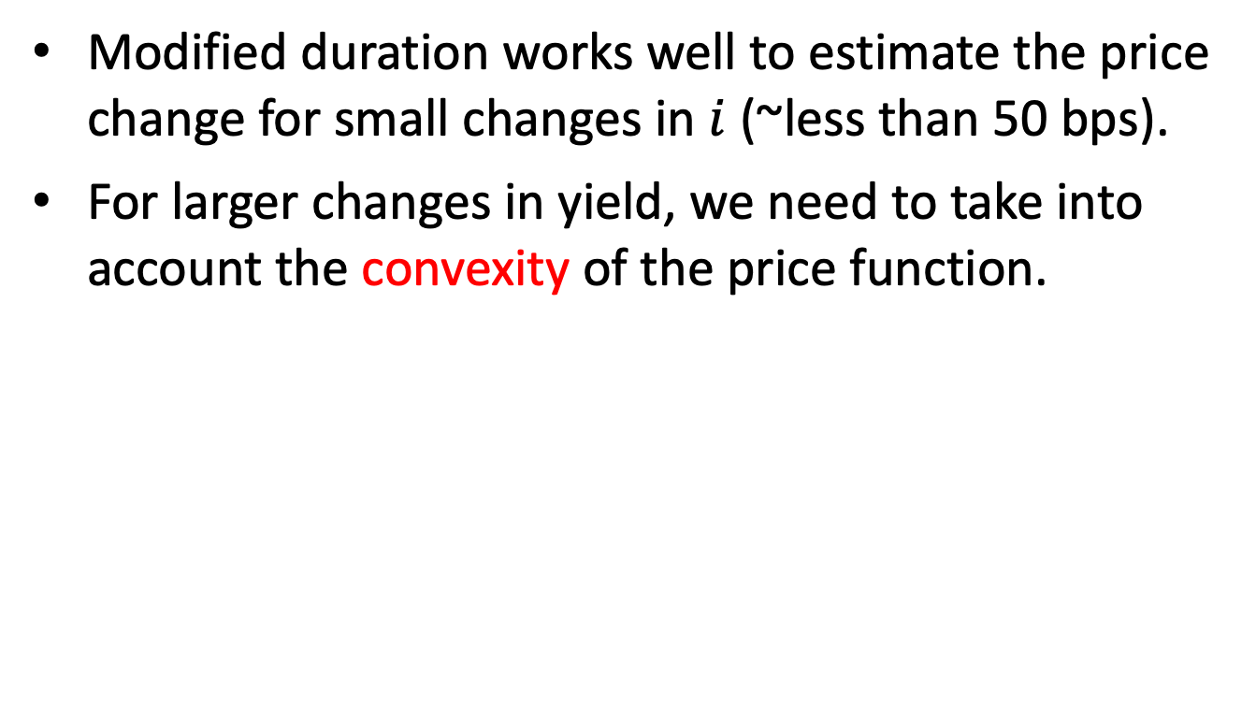
9.3 Convexity
Modified duration works well to estimate the price change for small changes in $i$ (~less than 50 bps).
For larger changes in yield, we need to take into account the convexity of the price function.

Slide 24
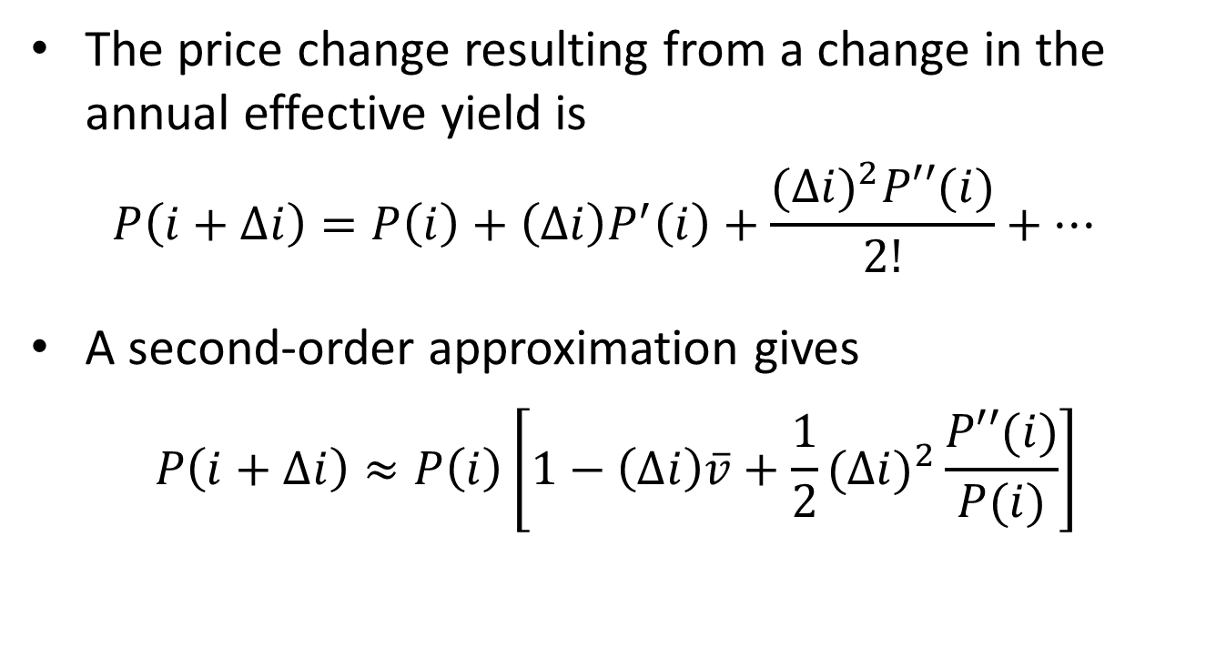
Second-order approximation
The price change resulting from a change in the annual effective yield is
$$P\left(i+∆i\right)=P\left(i\right)+\left(∆i\right)P^{′}\left(i\right)+\frac{{(∆i)}^{2}P′′(i)}{2!}+…$$
A second-order approximation gives
$$P\left(i+∆i\right)≈P\left(i\right)\left[1−\left(∆i\right)\overline{v}+{\frac{1}{2}(∆i)}^{2}\frac{P′′(i)}{P(i)}\right]$$

Slide 25
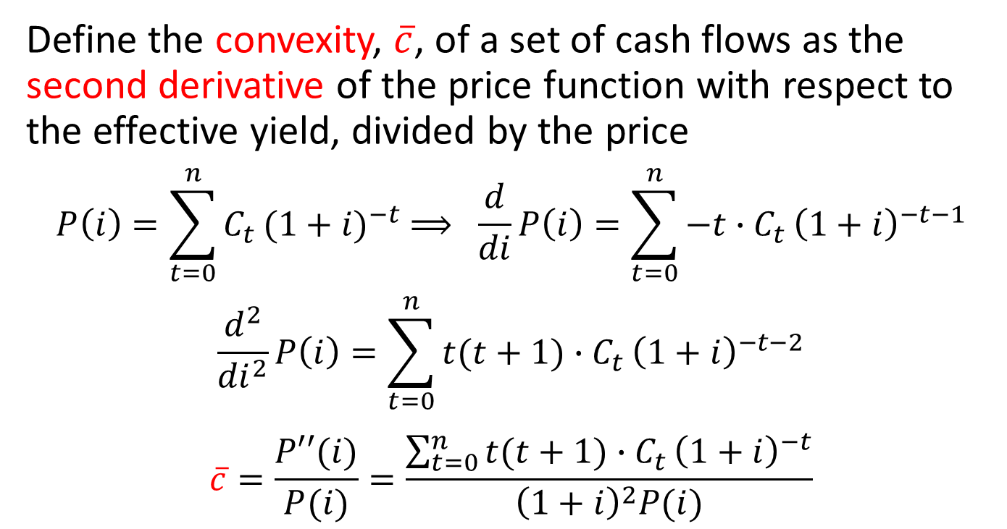
Convexity
Define the convexity, $\overline{c}$, of a set of cash flows as the second derivative of the price function with respect to the effective yield, divided by the price
$$P\left(i\right)=\sum_{t=0}^{n}{C_{t}}{(1+i)}^{−t} ⟹ \frac{d}{di}P\left(i\right)=\sum_{t=0}^{n}{{−t∙C}_{t}}{\left(1+i\right)}^{−t−1}$$
$$\frac{d^{2}}{{di}^{2}}P\left(i\right)=\sum_{t=0}^{n}{{t(t+1)∙C}_{t}}{\left(1+i\right)}^{−t−2}$$
$$\overline{c}=\frac{P′′(i)}{P(i)}=\frac{\sum_{t=0}^{n}{{t(t+1)∙C}_{t}}{\left(1+i\right)}^{−t}}{{\left(1+i\right)}^{2}P(i)}$$

Slide 26
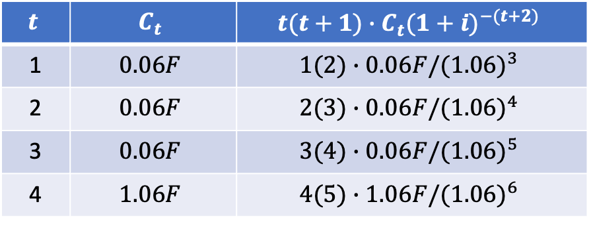
Example 9.5
Consider the same bond as in Example 9.4: a 4-year bond with 6% annual coupons, priced at par.
Find the convexity of this bond.
$$t$$ | $$C_{t}$$ | $$t(t+1)∙C_{t}{(1+i)}^{−(t+2)}$$
1 | $$0.06F$$ | $$1(2)∙0.06F/{(1.06)}^{3}$$
2 | $$0.06F$$ | $$2(3)∙0.06F/{(1.06)}^{4}$$
3 | $$0.06F$$ | $$3(4)∙0.06F/{(1.06)}^{5}$$
4 | $$1.06F$$ | $$4(5)∙1.06F/{(1.06)}^{6}$$

Slide 27
Example 9.5, continued
What is the approximate percentage change in the price of this bond is response to a 75 bps increase in the effective yield, using convexity?
How good is this approximation?

Slide 28
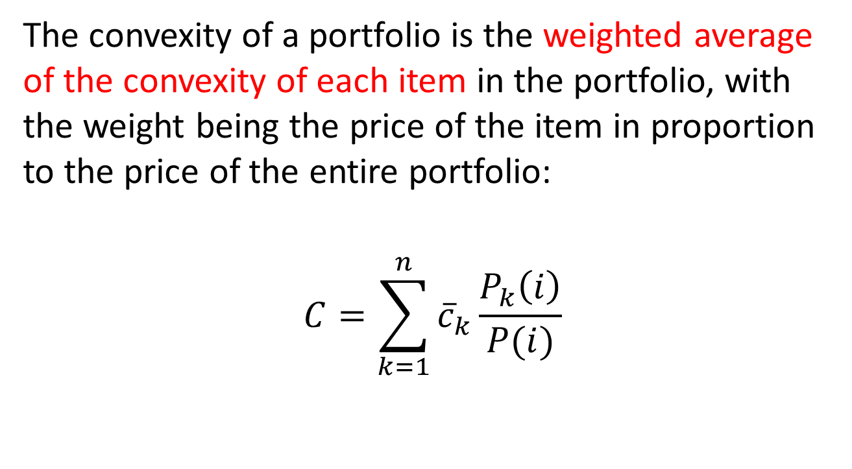
Portfolio convexity
The convexity of a portfolio is the weighted average of the convexity of each item in the portfolio, with the weight being the price of the item in proportion to the price of the entire portfolio:
$$C=\sum_{k=1}^{n}{{\overline{c}}_{k}}\frac{P_{k}\left(i\right)}{P(i)}$$

