Slide 1
9.4 Immunization
Suppose we have a series of liability cashflows and we are trying to construct an asset portfolio so that the surplus (PV of assets - PV of liabilities) does not become negative when interest rates change
Two choices:
  Redington immunization
  Full immunization

Slide 2
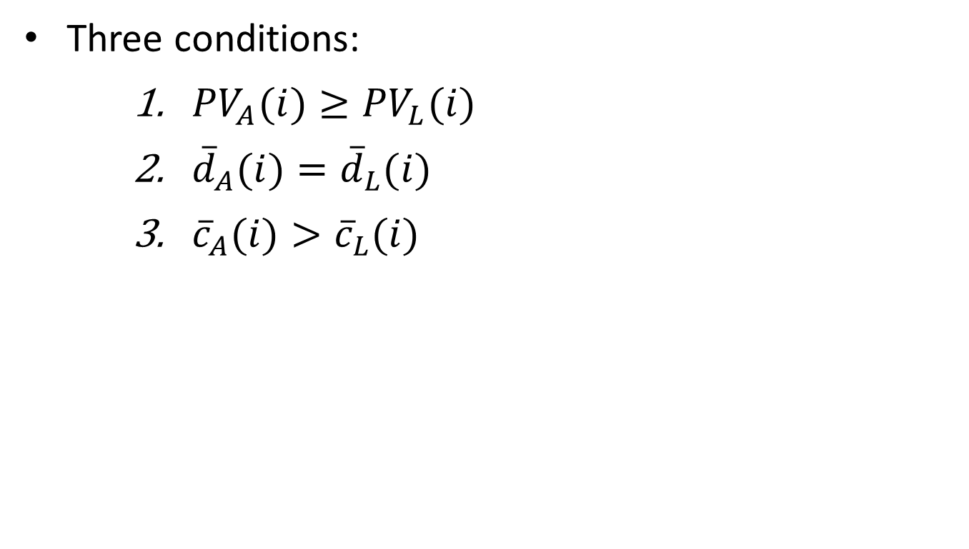
Redington immunization
Three conditions:
${PV}_{A}(i)≥{PV}_{L}(i)$
${\overline{d}}_{A}(i)={\overline{d}}_{L}(i)$
${\overline{c}}_{A}(i)>{\overline{c}}_{L}(i)$

Slide 3
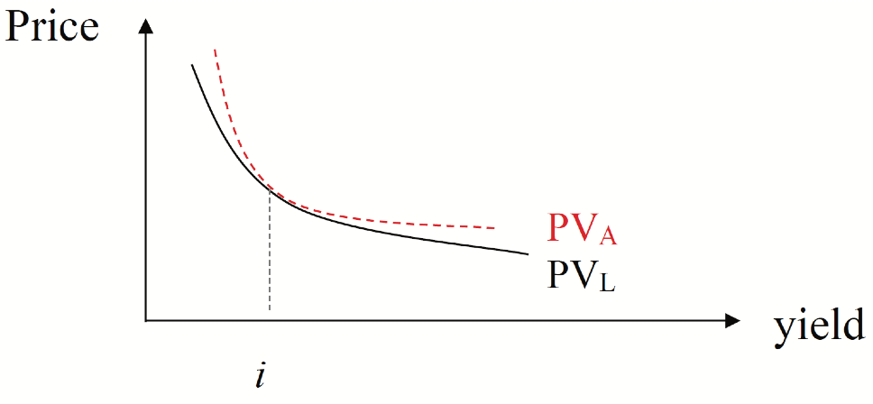
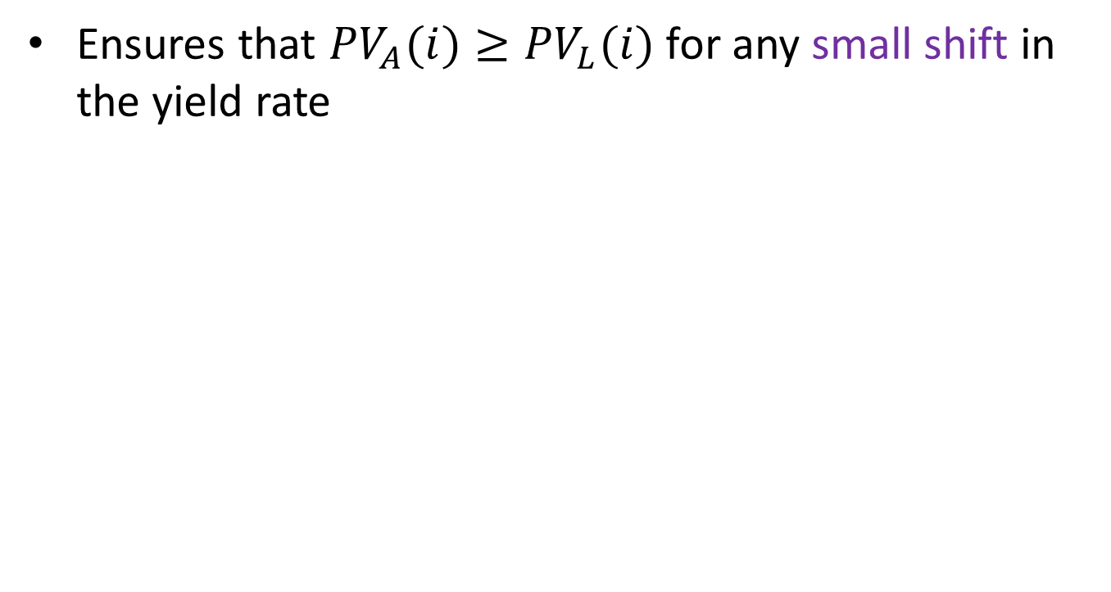
Redington immunization, cont’d
Ensures that ${PV}_{A}(i)≥{PV}_{L}(i)$ for any small shift in the yield rate

Slide 4
Assumptions (Redington imm’n)
Flat yield curve
Parallel shifts in the yield curve (yields change by the same amount for all maturities)

Slide 5
Example 9.6
An insurance company has committed to making a payment of $100,000 in 10 years.
In order to fund its liability, the company has invested $27,919.74 in a 5-year zero-coupon bond and $27,919.74 in a 15-year zero-coupon bond.
The annual effective yield is 6%.
Determine whether the company’s position is immunized.

Slide 6
Example 9.6, continued
Liability CF:
0 5 10 15
Asset CF:

Slide 7
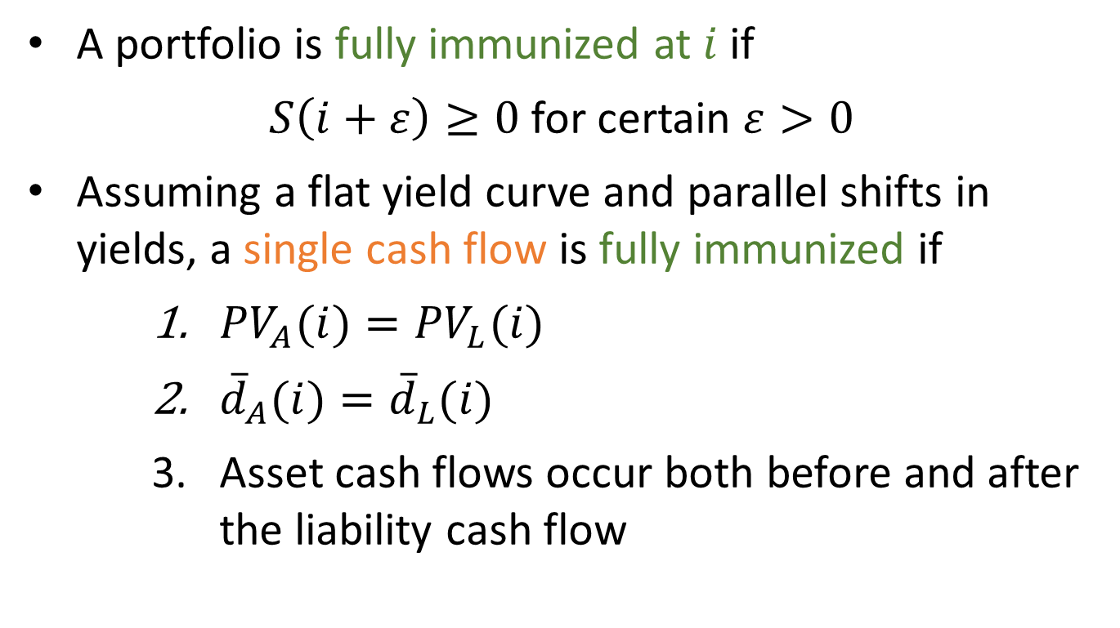
Full immunization
A portfolio is fully immunized at $i$ if
$S\left(i+ε\right)≥0$ for certain $ε>0$
Assuming a flat yield curve and parallel shifts in yields, a single cash flow is fully immunized if
${PV}_{A}(i)={PV}_{L}(i)$
${\overline{d}}_{A}(i)={\overline{d}}_{L}(i)$
Asset cash flows occur both before and after the liability cash flow

Slide 8
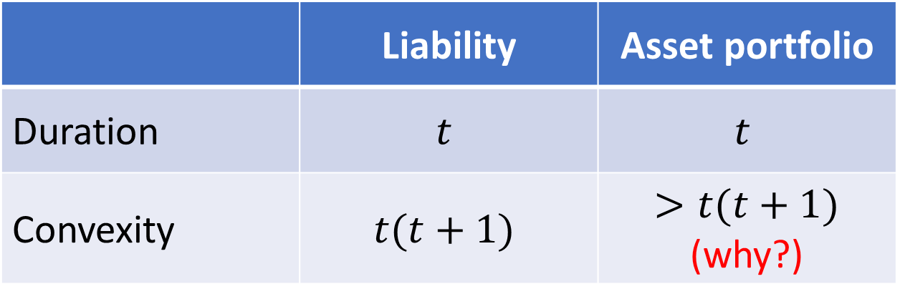
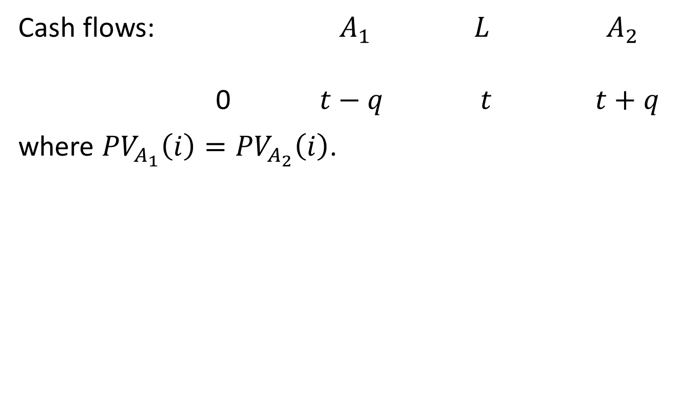
Full immunization, continued
Cash flows: $A_{1}$ $L$ $A_{2}$
0 $t−q$ $t$ $t+q$
where ${PV}_{A_{1}}\left(i\right)={PV}_{A_{2}}\left(i\right)$.
 | Liability | Asset portfolio
Duration | $$t$$ | $$t$$
Convexity | $$t(t+1)$$ | $>t(t+1)$ (why?)

Slide 9
Full immunization, continued
To fully immunize a series of liability cash flows, choose assets to fully immunize each liability cash flow separately.
Some practical issues:
  Yield curves are usually not flat
  Changes in yield curve are not parallel
  Asset cash flows contain risk
  Uncertainty in liability cash flows

Slide 10
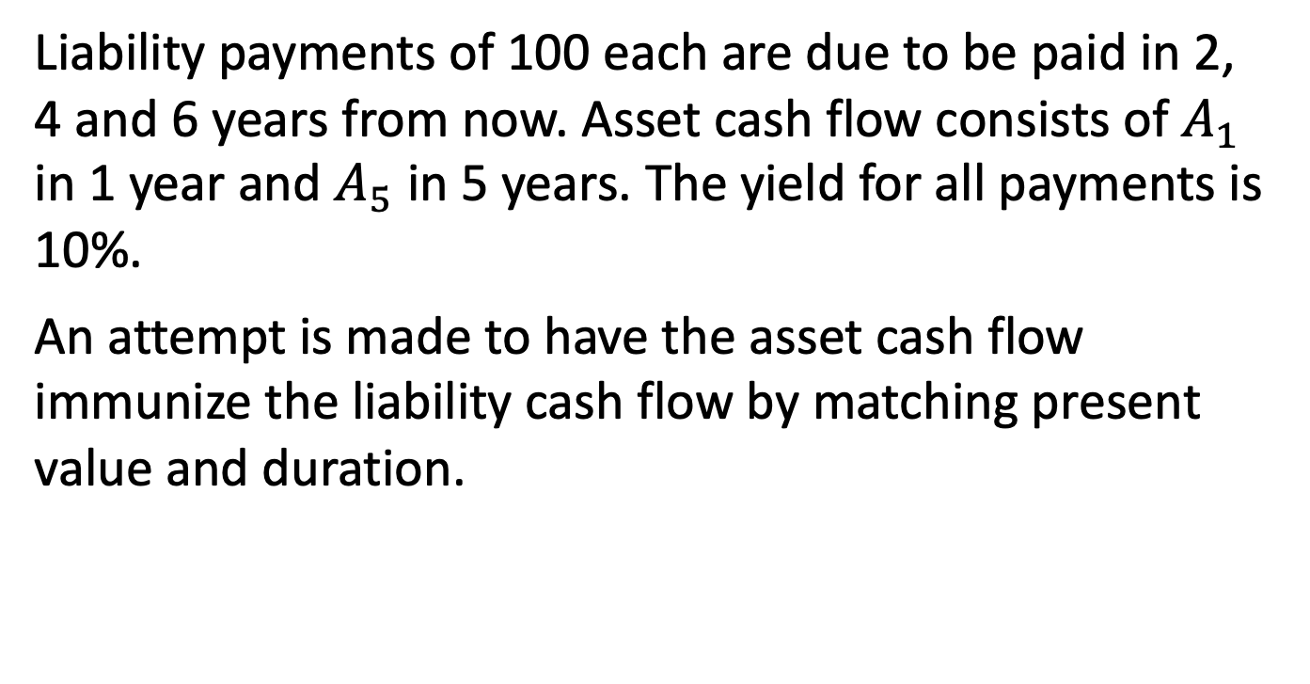
Example 9.7
Liability payments of 100 each are due to be paid in 2, 4 and 6 years from now. Asset cash flow consists of $A_{1}$ in 1 year and $A_{5}$ in 5 years. The yield for all payments is 10%.
An attempt is made to have the asset cash flow immunize the liability cash flow by matching present value and duration.

Slide 11
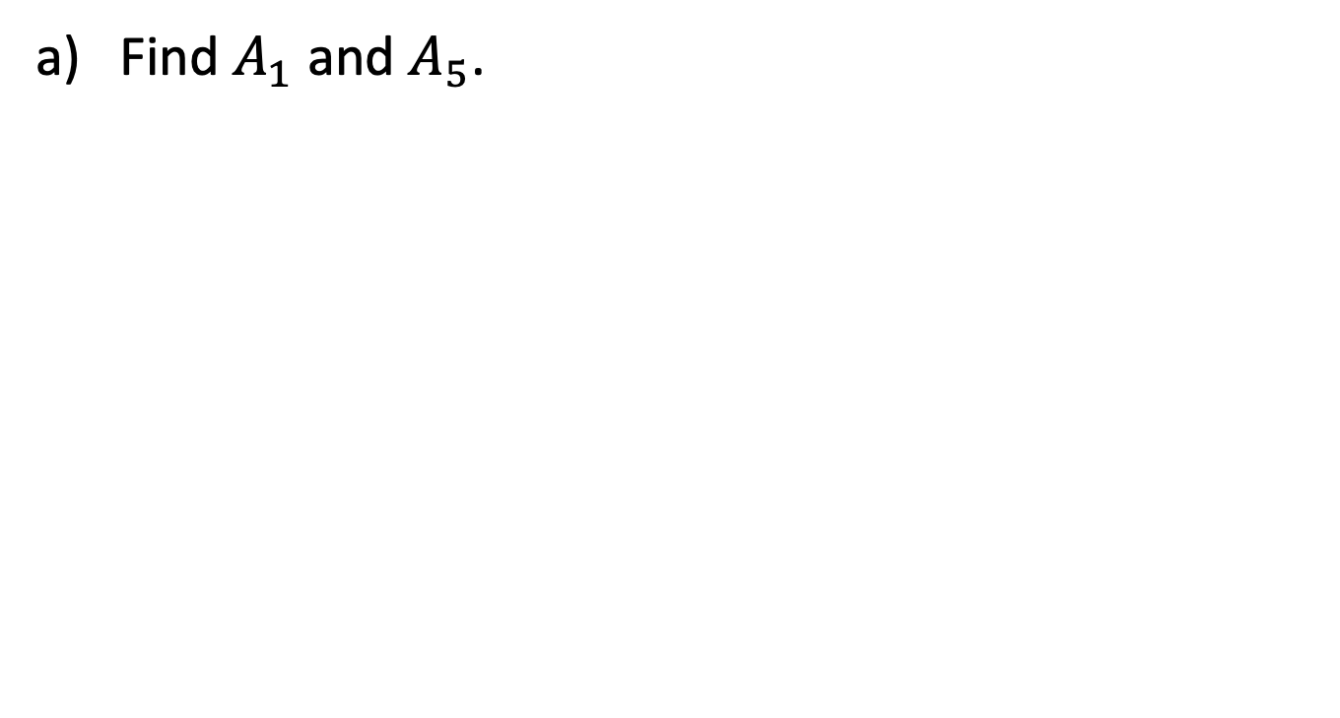
Example 9.7, continued
Find $A_{1}$ and $A_{5}$.

Slide 12
Example 9.7, continued
Determine whether the conditions for Redington immunization are satisfied.

