Slide 1
PIZZA PLACE RECOMMENDER
By
Saurabh Singh

Slide 2

Introduction:
Toronto is the capital city of the Canadian province of Ontario. With a recorded population of 2,731,571 in 2016,it is the most populous city in Canada and the fourth most populous city in North America. The city is the anchor of the Golden Horseshoe, an urban agglomeration of 9,245,438 people (as of 2016) surrounding the western end of Lake Ontario, while the Greater Toronto Area (GTA) proper had a 2016 population of 6,417,516. Toronto is an international centre of business, finance, arts, and culture, and is recognized as one of the most multicultural and cosmopolitan cities in the world.
Toronto is a prominent centre for music, theatre, motion picture production, and television production, and is home to the headquarters of Canada's major national broadcast networks and media outlets. Its varied cultural institutions, which include numerous museums and galleries, festivals and public events, entertainment districts, national historic sites, and sports activities, attract over 43 million tourists each year. Toronto is known for its many skyscrapers and high-rise buildings, in particular the tallest free-standing structure in the Western Hemisphere, the CN Tower.
The city is home to the Toronto Stock Exchange, the headquarters of Canada's five largest banks, and the headquarters of many large Canadian and multinational corporations. Its economy is highly diversified with strengths in technology, design, financial services, life sciences, education, arts, fashion, aerospace, environmental innovation, food services, and tourism.
Restaurant industry is one of the major industries in Canada. Canada's restaurants and bars collectively add up to a large industry, with more than $60 billion in annual sales.
Notes:
Insert a map of your country.

Slide 3
Problem:
To find the answers to the following questions:
1) List and visualize all the neighbourhoods in Toronto and their top 10 most common venues.
2) What is density of Pizza Places in the neighbourhoods?
3) Which all areas have low density of Pizza Places but are not overcrowded by other types of Restaurant?
Notes:
Insert a picture of one of the geographic features of your country.

Slide 4
Data Section:
For this project we need the following data:
Toronto City data that contains list Boroughs, Neighbourhoods along with their latitude and longitude.
Data source : https://en.wikipedia.org/wiki/List_of_postal_codes_of_Canada:_M
Description: This data set contains the required information. And we will use this data set to explore various neighbourhoods of Toronto.
Restaurants in each neighbourhood of Toronto City.
Data source : Foursquare API
Description: By using this API we will get all the venues in each neighbourhood. We can filter these venues as per our requirement.
GeoSpatial data
Data source : https://cocl.us/Geospatial_data
Description: By using this geo space data we will get the Latitude and Longitude values of different neighbourhoods in Toronto
Notes:
Insert a picture illustrating a season in your country.

Slide 5
Methodology:
We begin by scraping the borough and neighbourhood data the Toronto city using the following Wikipedia page “https://en.wikipedia.org/wiki/List_of_postal_codes_of_Canada:_M“
Then we find all venues for each neighbourhood using Foursquare API.
We will then filter out data in such a way that only restaurant venues are returned,using Foursquare API.
We will then use K means clustering algorithm to group neighbourhood based on common type of venue category.
Finally,we will find out neighbourhoods that have low density of pizza places but have great potential for growth.
Steps that we are going to follow are mentioned below:
We will, analyze the density of the Pizza Places for each neighborhood.
Then we need to find out places that have density of pizza places greater than 30 percentile and density of restaurants greater than 60%.
Then we will provide recommendation to the stakeholder based on the result.
Notes:
Insert a picture of an animal and or plant found in your country.

Slide 6
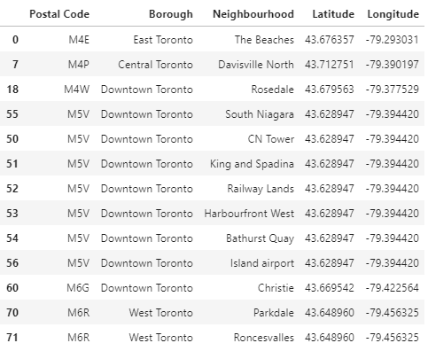
Conclusion:
Our analysis shows that there are 4 boroughs and 13 neighborhoods in Toronto, Canada that are ideal for opening a pizza place.
Five clusters were obtained, each having a unique collection of restaurants. Since, we were focused on finding optimal neighborhoods for opening Pizza places, we selected cluster 1,3 and 4 which had the highest number of Indian restaurants. The above actions left us with the only those neighborhoods that had high demand for Pizza Places.
After finding out the neighbourhoods with high demand for pizza places, we plotted a heat map for analyzing the density of restaurants in them. Then we found out the neighbourhoods that had few Pizza Places and were not too crowded by other type of restaurants so that business for the stakeholders is not affected due to overcrowding.
Notes:
Add key points in the history of your country to the timeline.

