Slide 1
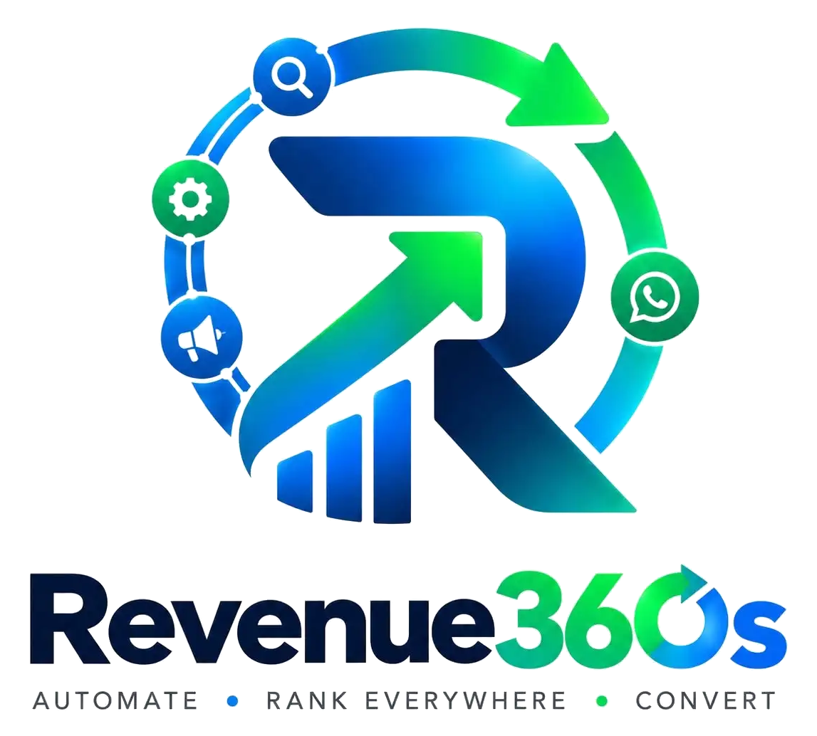
Five sales tools, collapsed into one workflow
INVESTOR PITCH · ₹60 LAKH SEED
Scored leads, personal emails and voice notes, ads that fill WhatsApp, and a single CRM, built for Indian founders and small teams.
MISSION Replace the five tools solo founders stitch together today.
Raising ₹60 Lakh · 15% equity

Slide 2




Five disconnected tools, and leads slip through
02
Manual lead research
80%
Apollo, LinkedIn, Reddit and Maps. Most leads get no real follow-up.
Generic outreach
of Indian small businesses use WhatsApp to talk to customers. Email is opened far less.
The same email to everyone, no voice notes, low reply rates.
Disconnected ads and CRM
Meta WhatsApp leads never enter the right sequence.
Five tools stitched together
Source: industry reports on WhatsApp Business adoption
No single view of what is actually working.

Slide 3

India’s MSMEs live on WhatsApp, not CRMs
03
63 M+
80%
98% vs 20%
MSMEs in India (Ministry of MSME, Udyam)
of small businesses use WhatsApp for customer communication
WhatsApp vs email open rates (vendor-reported)
THE GAP
Most tools are pure CRM, pure email or pure ads. Few combine the full motion for Indian founders.
Sources: Ministry of MSME and Udyam portal data; Meta and industry reports on WhatsApp Business adoption; 2024–2026 open-rate studies.

Slide 4
Year-3 goal: 1,000 accounts, a ₹12 Cr run-rate
04
TAM
SAM
SOM
63 M+ MSMEs
Founder-led B2B teams
₹12 Cr ARR
India’s MSME base that could use sales automation (Ministry of MSME, Udyam)
Teams of 1–15 people that need outbound plus WhatsApp today
1,000 accounts × ₹10,000 × 12 months in Year 3, under 0.002% of MSMEs
SOM is taken from the Year-3 plan on slide 8 and is deliberately conservative.

Slide 5





One workflow replaces five stitched tools
05
ICP engine
Lead discovery
Personal outreach
Define your ideal customer and keep refining it.
Scored leads from Apollo, LinkedIn, Reddit and Maps.
Unique email sequences, plus optional voice notes.
Ads with CAPI
WhatsApp to CRM
Full or modular
Meta, Google, X and YouTube ads that feed WhatsApp.
Qualify on WhatsApp; every lead lands in one CRM.
Take the full package or only the modules you need.
Not a generic LLM wrapper: sequences come from historical datasets with strong open and reply rates, plus Meta Ads Library data on which ad categories work.

Slide 6

Product defined, ready for first customers
06
ICP, lead scoring, email and voice, ads view and WhatsApp-to-CRM flow designed
NEXT
20–40
Modular packaging ready
paying accounts is the next milestone
Two testers allocated (₹30,000 each) for final validation
TODAY
2
Pricing and cost structure modeled
testers allocated for final validation

Slide 7
₹60 Lakh to win the first 40 accounts
07
Paid acquisition
₹18 L
Meta and Google ads
Team (core)
₹25 L
₹60 L
Sales, developers and support
Testing and setup
₹7 L
₹0.6 L for 2 testers, ₹6.4 L for testing tools and setup
Tools, APIs and cloud
₹10 L
12 months of runway
Resend, LLM, WhatsApp and infrastructure

Slide 8
From 40 to 1,000 accounts in three years
08
Exit MRR by year (₹ Lakh). Blended ARPU ₹10,000 a month.
YEAR 1
40 accounts
₹4 L MRR · First customers
YEAR 2
400 accounts
₹40 L MRR · Refine sequences
YEAR 3
1,000 accounts
₹1 Cr MRR (≈ ₹12 Cr ARR) · Modular and retention
Assumptions: strong retention and modular upsell. Gross margin about 65–75% after variable LLM, email, WhatsApp and API costs. Fixed team burn is covered at roughly 35–55 full accounts, so contribution margin turns positive at scale.

Slide 9
₹60 Lakh for 15% at a ₹3.4 Cr pre-money
09
THE ASK
PRE-MONEY
INVESTMENT
POST-MONEY
₹60 Lakh
₹3.4 Cr
₹0.6 Cr
₹4.0 Cr
before the round
new capital in
after the round
for 15% equity
Existing holders 85%
Investor 15%
Valuation is illustrative for an early-stage company. Capital proves the unit economics and reaches the first 40 accounts.

Slide 10


Founder-led, building three connected products
10
SS
Stock360s
Trading intelligence for India’s active F&O traders
Shailendra Saurav
Revenue360s
This pitch
Founder & CEO
One sales and marketing workflow for Indian founders
Hands-on with AI sales agents, WhatsApp and Hinglish workflows, Meta ads and full-stack automation. Focused on low-overhead tools that replace several SaaS subscriptions.
Carbon360s
Early stage. Direction locked; capital wins the first customers.
Agricultural carbon-credit projects, starting in Jharkhand

Slide 11


Five risks we are planning around
11
RISK
HOW WE HANDLE IT
High variable API, LLM and WhatsApp costs
Per-user token limits and modular pricing
Low reply rates or weak sequences
Historical datasets and fast iteration on real data
CAC higher than modeled
Referrals and content; modular entry points
Customer ad ROAS is outside our control
We provide tools and tracking, not guarantees
The 24–48 h setup promise slips
Clear checklist; start with modular offers

Slide 12
One workflow for leads, outreach, ads and CRM
THANK YOU
Let’s talk.
Shailendra Saurav, Founder & CEO
ssaurav9572@gmail.com
+91 93805 83202

