Slide 1

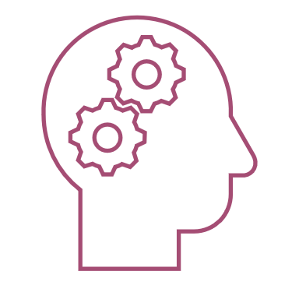
Drone Footage Object Detection
AI/ML-012
Leader: Siddhi Borase
Team: Shriya Deo, Aarushi Pandey, Tanishka Sihara
Mentor: Bhavya Shah

Slide 2

CONCEPTS LEARNT & APPLIED:
1. Working on Google Collaboratory.
2. Supervised and Unsupervised learning.
3. Use of Numpy, Pandas, Matplotlib, sklearn:
These are extensively used libraries, which find use in almost every python-based project.
Numpy library allows scientific computing and commendable data analysis. It provides efficient numerical computations and array operations.
Pandas is a powerful Python library for data manipulation and analysis, especially designed for working with structured (tabular) data- mainly, series(1D) & DataFrame(2D).
Matplotlib is the most popular Python library for creating static, interactive, and animated visualizations.
The library is built on top of foundational Python libraries such as NumPy, SciPy, and Matplotlib, ensuring seamless integration with these tools.
4. The basic workflow of any Machine Learning project:
Data collection Data analysis Data preprocessing Train-test split Choose & train a suitable model
Deployment Evaluation

Slide 3
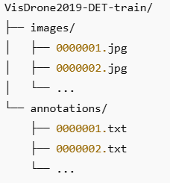
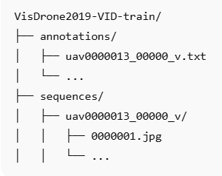
5. Data handling/ Analyzing:
Collected data from open source VisDrone, which had a very structured and organized data. Understanding the data structure was an essential step, to begin with.
Same data structure for IMAGES test, val. Same data structure for VIDEOS test, val.
6. Data preprocessing:
The process of transforming raw, messy, and often inconsistent data into a clean and structured format, removing noises and making it suitable for analysis, machine learning.
Basically, it is a step to “preprocess” the data, or make it ready to train a model. This step can include opening an image, reading videos frame-by-frame, rescaling, converting the RGB images to grayscale, black&white, canny edged, adding hues, etc.

Slide 4
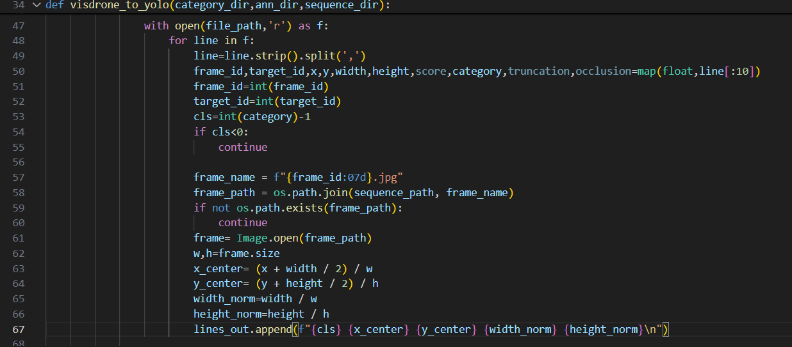
In our case, a very important part of preprocessing was- to convert the annotations .txt files to yolo format, as we planned to implement the yolo model. The code snippet below (for video preprocessing) shows how we created a new directory by appending the tuples (containing required values, extracted from the annotation file lines) to an empty list, declared earlier in the function. These were stored in a new ‘labels’ directory, when the function was called.
VisDrone format
Yolo format

Slide 5
7 . Train-test split:
Let suppose, we have a huge dataset. Training the model on the whole dataset and testing it on some part of the same dataset will give incorrect estimate of the accuracy and correctness of our model. Hence a train-test split (generally, in a ratio of 80- 20) is a must, so as to ensure that the training data does not overlap with the testing data.
In case of our VisDrone dataset, it was available in already-structured and separated manner, so this step was not necessary.
8. How to choose a model:
A good model selection is an essential step.
This can be done on the basis of data available (if images and videos-- deep learning models; text or speech data-- deep learning models; numerical data-- decision trees/ logistic regression, etc.)
Based on the task we need to carry out (classification, regression, clustering, etc).
9. Small factors, like:
parameters (weights, biases), hyperparameters (epochs, learning rate), concept of overfitting, underfitting, bias-variance tradeoffs, gradient descent, loss function, etc.
10. PyTorch basics
11. Basics of YOLO Models :
-Basic architecture – backbone, neck, head
-Yolo annotations
-Different variants of yolo
-Training yolo model
(We referred to ultralytics official GitHub repo to understand these things)

Slide 6
Our Procedure
We collected dataset, that was most suited for our project.
Next, Data Preprocessing involved-
1)Image dataset preprocessing
2)Video footage preprocessing
Video Preprocessing steps, that we implemented:
Conversion of VisDrone annotations to yolo format
VisDrone annotations (images)-
Yolo labels (images) –
VisDrone annotations (videos) –
Yolo labels(videos) –
Resizing images to 928 x 928 pixels using OpenCV as yolo needs images with this size as input.
Validating the dataset
Check image label correspondence for resized images and yolo converted labels
Check class counts to verify that the data is balanced
Data collection
Model selection, Data Preprocessing
Model Training
Evaluation

Slide 7
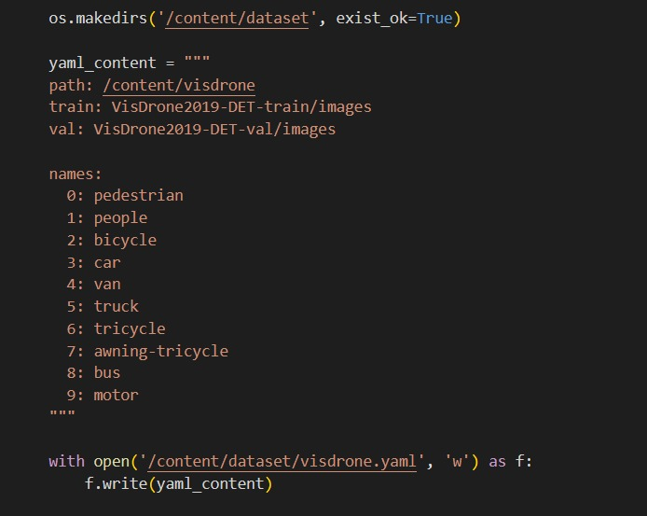
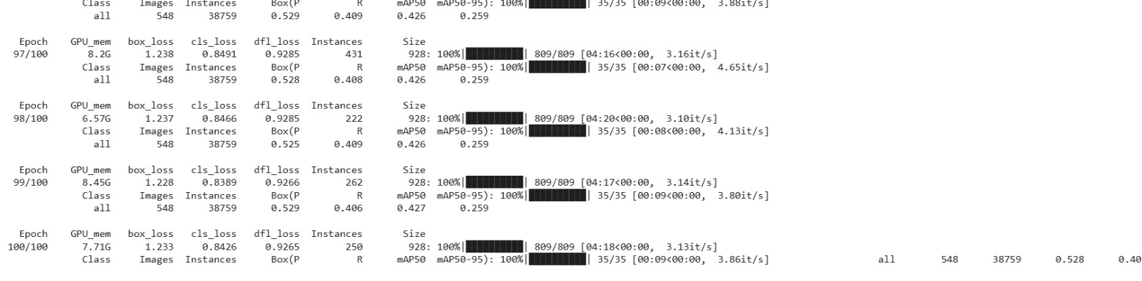
TRAINING
We created a yaml file
And trained the model.
Result after running 100 epochs during training the model for images

Slide 8

ERRORS/ ISSUES FACED & THEIR SOLUTIONS
Using perplexity for entire code:
Initially, we assumed that this is our first project so undoubtedly, we have to use Perplexity or ChatGPT for everything, because we’re beginners. So, we used to copy the code from perplexity and understand every line of the code in-depth.
But after our first meet with our mentor, we completely switched our workflow. We started observing the dataset and then writing codes on ourselves. This actually boosted me, when we started writing ‘video annotation to yolo conversion function’ by ourselves, helping each other but not using perplexity at all.

Slide 9
Annotations: We tried grouping the annotations using the target ids which would be beneficial in future for object tracking as well. For converting VisDrone annotations to yolo annotations for video part ,we actually tried a lot of ways to do it and finally figured out a much sorted way…
1st attempt
First, we converted every line of visdrone ann to yolo labels ann. Then, we converted it into an array and tried splitting the array using 2nd index(i.e. target id) of annotations.
2nd attempt
This time, we first created an array of all annotations, then tried splitting the array using 2nd index of annotations(i.e. target_id) and then processed every target file. But another error arose, because target files were not linked to their particular frames. No specified path was there, like any target file can be linked to any frame.
3rd attempt
But the logic behind the code in our 2nd attempt was wrong, because target ids were not globally unique. For two categories we can have same target ids (red and black cars example).
But here was the problem. Since, we had already converted visdrone ann to yolo ann, so accessing 2nd index(target id) of visdrone ann was not possible.
So we again tried to resolve this, by specifying the path, this time the code was right, and ran successfully. (code is given below)
So, we discussed this issue with our mentor and figured out that we have to work with a 2 dimensional tuple, grouping object category with target ids.

Slide 10
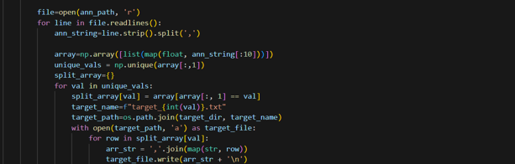
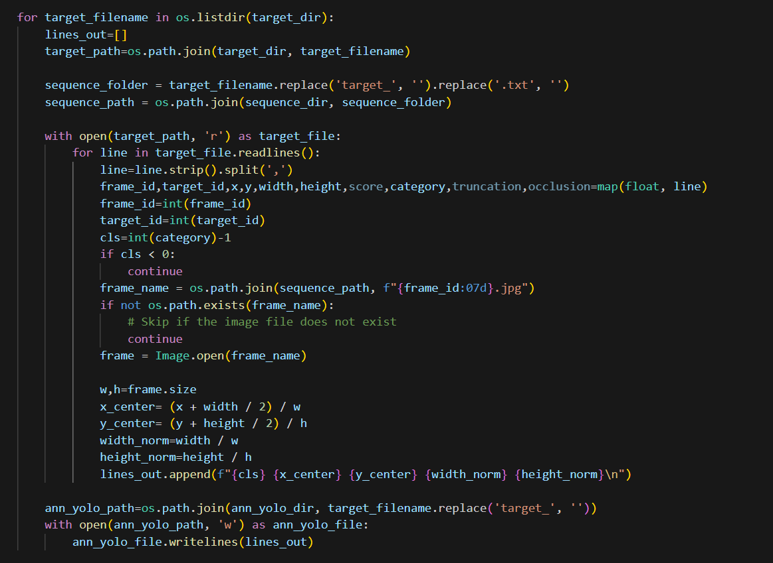
1st and 2nd attempt related code

Slide 11
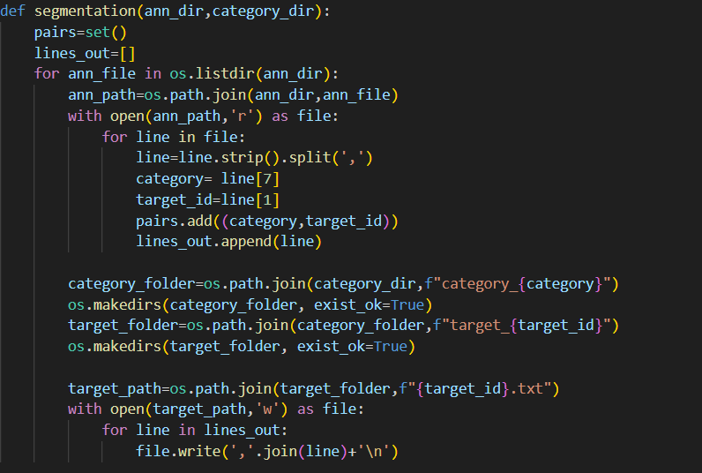
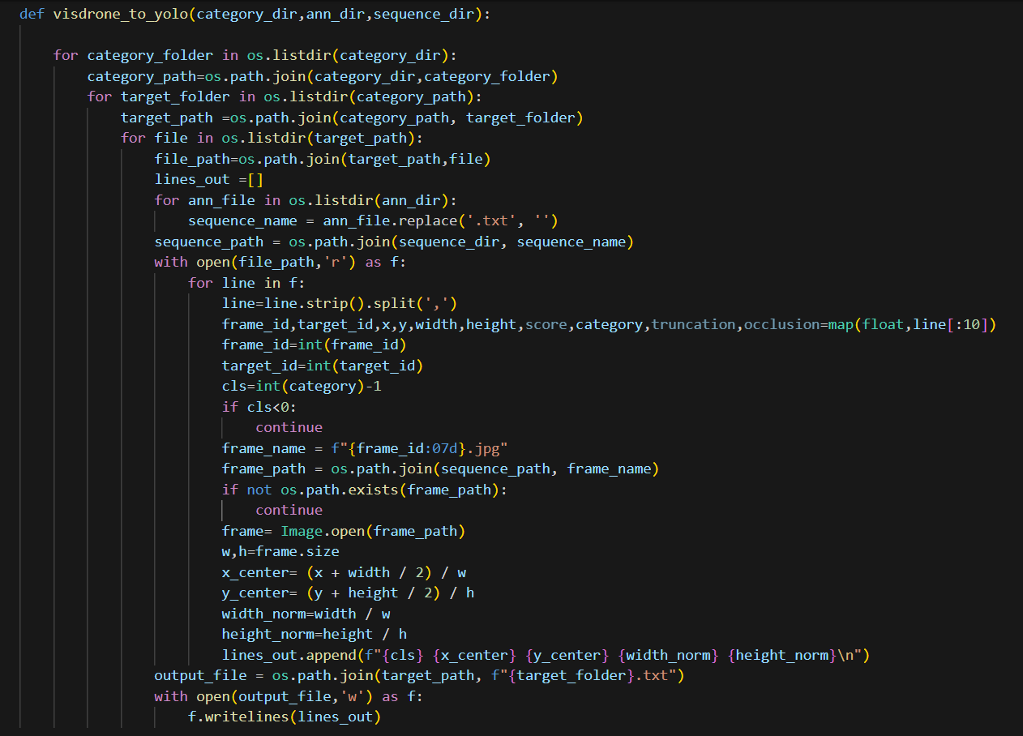
From this function we obtained all the annotation lines, according to the corresponding object category and target ids.
And then we converted this data to yolo

Slide 12
Structure after 3rd attempt..
Categories
Category_1
Target_1
Target_2
Target_3
Category_2
Target_1
Target_2
Target_3

Slide 13
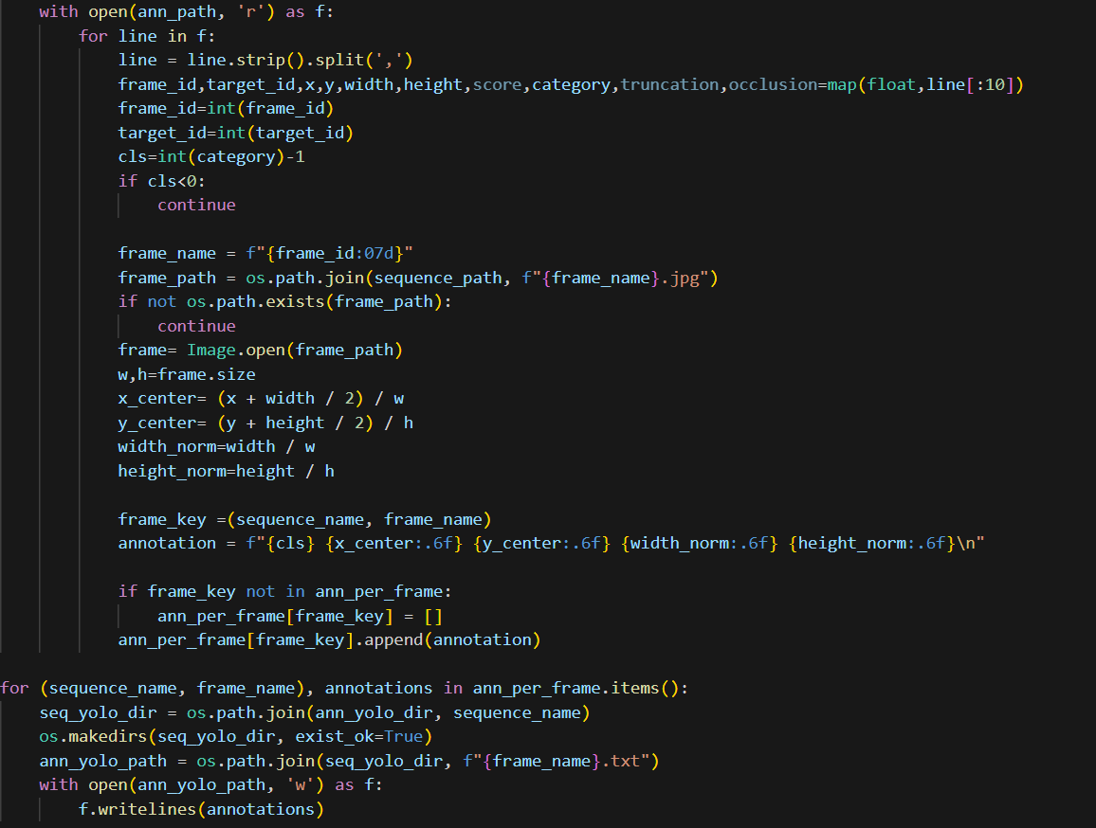
Final code
Final structure

Slide 14
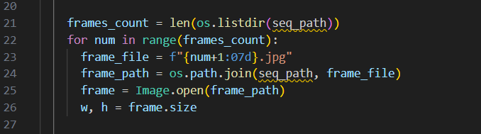
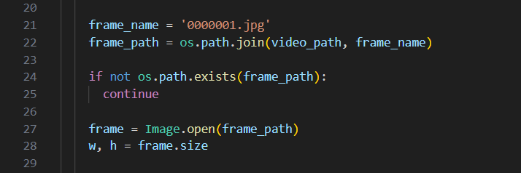
Code logic:
The preprocessing setup required a function to convert annotations to yolo format, as we planned to implement yolo model. It required the us to obtain image size, which was initially confusing, as we were trying to find path for each frame and iterate:
This was the modified code snippet:
This was one step at which I was stuck for too long. But, after analysing the dataset more carefully, we figured out that each frame in a video had the same size, so we could randomly take any frame as reference and obtain its width and height. This way obtaining dimensions proved to be a lot easier and convenient.

Slide 15
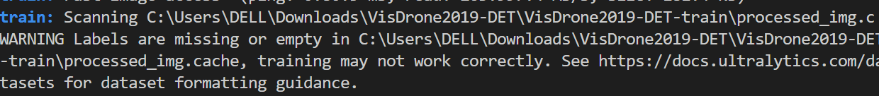
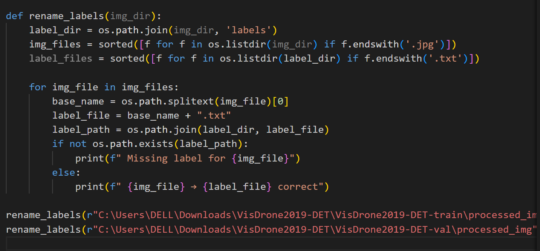
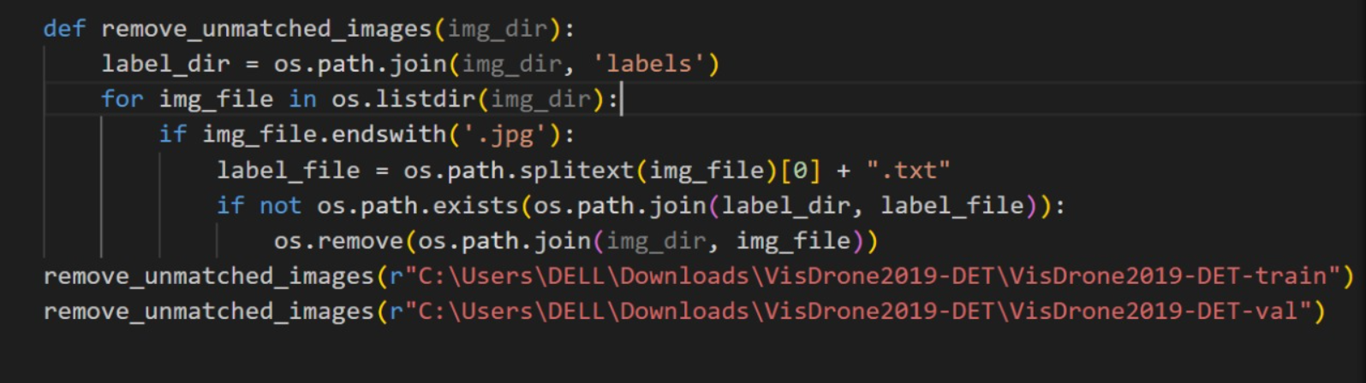
Labels not found error (while training):
We were getting ‘Labels not found’ error while training the model with yaml configuration.
After checking, we found that this happened because some label file names did not match the corresponding image file names.
The mismatch may have occurred during preprocessing, while saving resized images and labels in yolo format. As a result, the model could not find the labels for those images during training.
We fixed the error by writing a code at the end of preprocessing, which renames the label files.
Renames the label files , and remove images for which labels were
not found.

Slide 16
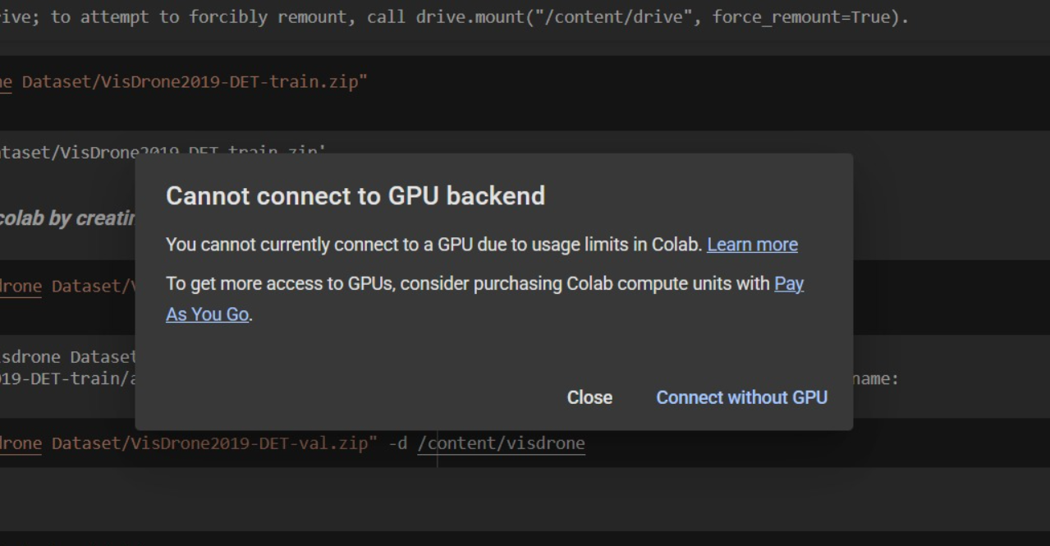
Aspect Ratio Distortion in Resizing:
Initially, we resized all video frames directly to 928x928 using cv2.resize(), thinking it would match YOLO's input size. But later, we realised that this method distorted the images if the original frame wasn’t square. Objects started looking stretched, which could affect the model’s accuracy.
We mentioned resizing values while model training, which resized and also added padding to the images, this helped us preserve the true object proportions.
GPU connection lost
During training, we required to run the code for 100 epochs. So we switched to colab for a better GPU. After running for about 4 hours, the runtime got disconnected. We again setup the environment and started the code to run, some ‘file not found’ errors arose, which were then sorted. Retrying for the 3rd time, the following error message started to display:
so we added checkpoints while training and resumed the epochs on another account.

Slide 17
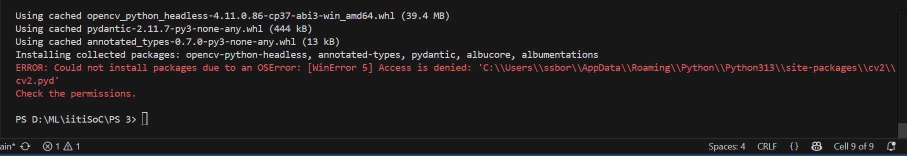
Using Google Colaboratory :
Initially we were using google Colab but it was taking way too long for running every single cell. So we shifted to local system and started using vs code, where our code could run smoothly.
Permission errors:
Solution—run vs code as administrator
Dealing with large dataset:
The Google Drive account, that was connected and mounted, had a 15GB limit. The colab stopped saving changes and didn’t run any further codes as the data limit exceeded.
Then we had to switch to Vscode.

Slide 18
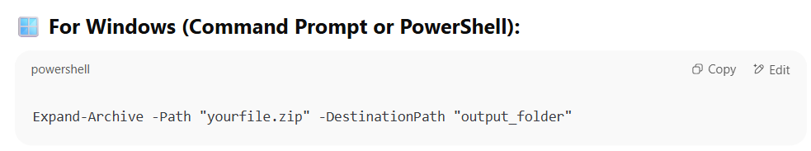
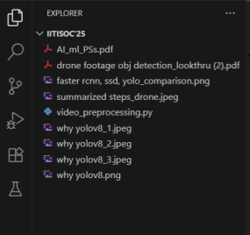
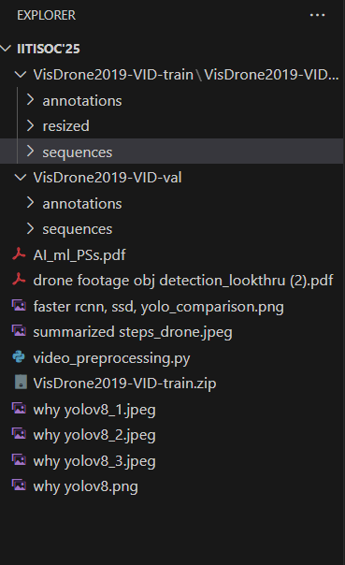
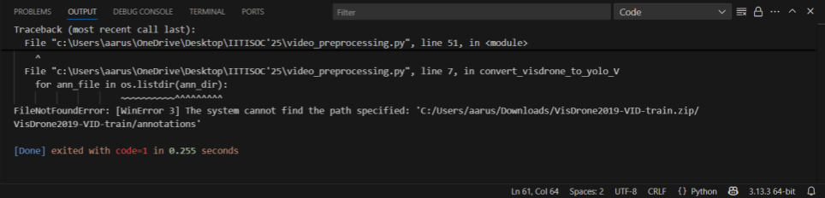

FileNotFoundError:
The training and validation directories were stored in C: drive of the laptop. When the directory path was copied and entered in the code (when coding on vscode), it displayed file not found error. Then I tried uploading the folders to the main folder which contained my .py code. Since the training file was too large (7.53GB), unzipping it was another problem. I asked a command prompt from perplexity, to unzip:
After unzipping, it showed multiple errors and the subdirectories ‘annotations’ and ‘sequences’ from the 7.53GB folder got wiped out from the folder. Then I removed the training directory completely, from that location, and re-uploaded it to my working directory. Again unzipped it, and the code finally ran successfully.

Slide 19
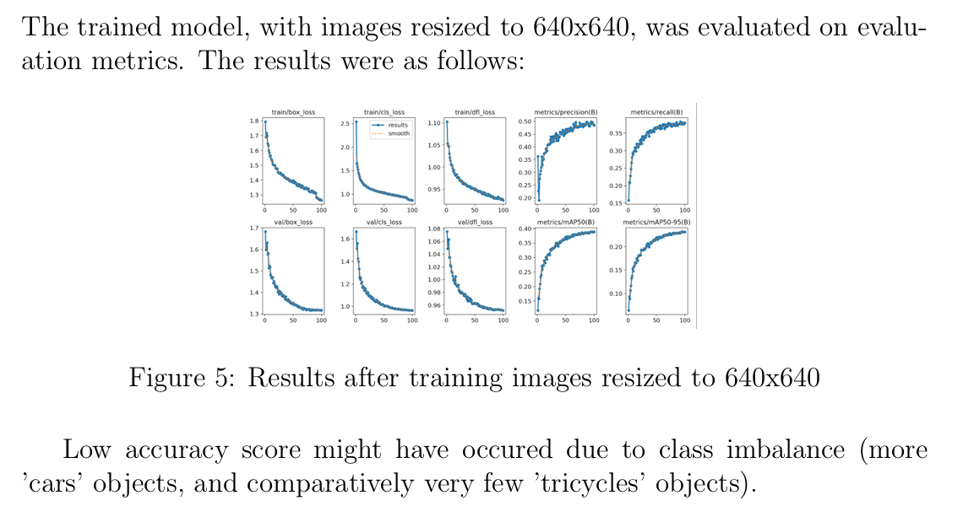

Conclusion

Slide 20
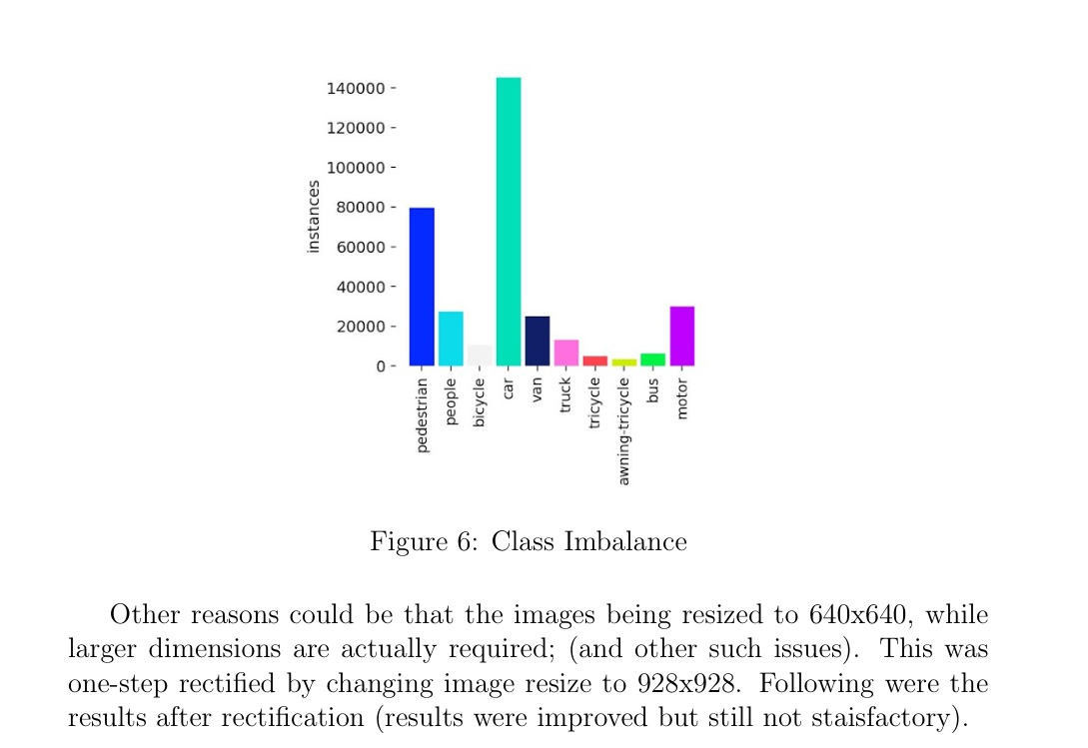





Slide 21
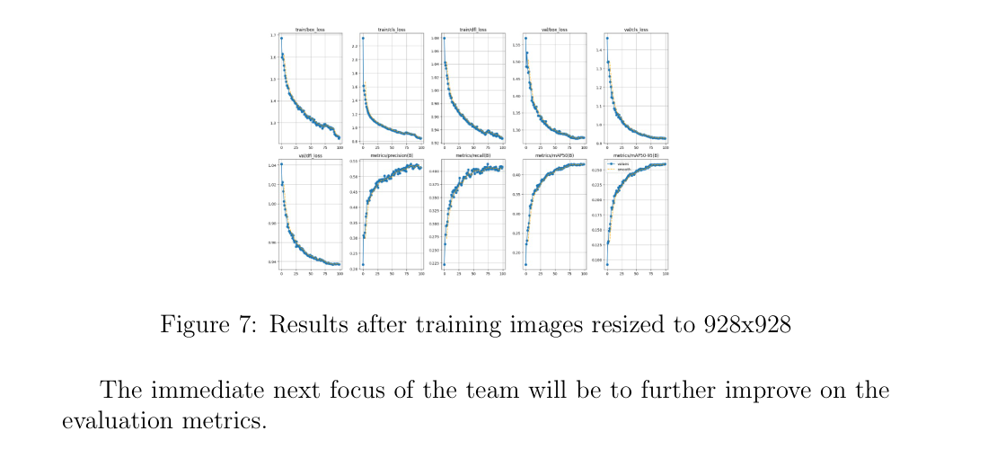


Slide 22
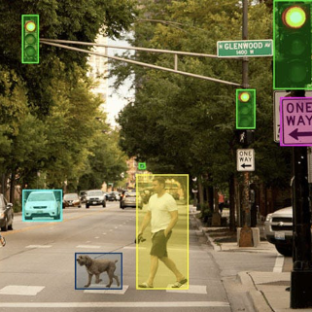
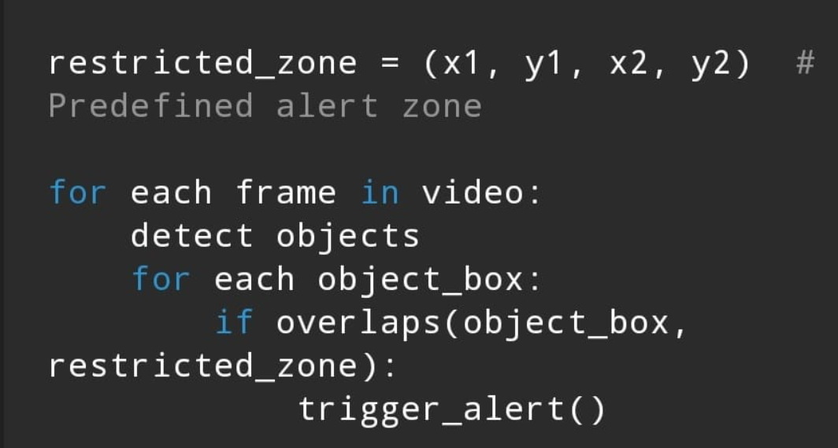
Ideas to implement and enhance further
SMART ALARMING SYSTEM, using object detection:
Suppose an object (person or a vehicle) is found to be entering a pre-defined restricted zone, it can be detected on the footage on real-time, and an immediate alert can be generated.
For this we have planned to define coordinates of the bounding box, and if it is found to be within the range limits of the restricted zone, a buzzer/ notification can be generated.
This feature can be extensively helpful for security and surveillance applications—Examples include: Monitoring at No-entry zones in banks, jails; School or building boundaries; Drone surveillance for danger zones, etc.
Basic Logic:
1. Read video frame-by-frame
2. Detect objects in each frame
(using YOLO model)
3. Define a restricted zone (fixed coordinates)
4. Check for overlap between detected objects
and the zone
5. If overlap found → Trigger alert

Slide 23
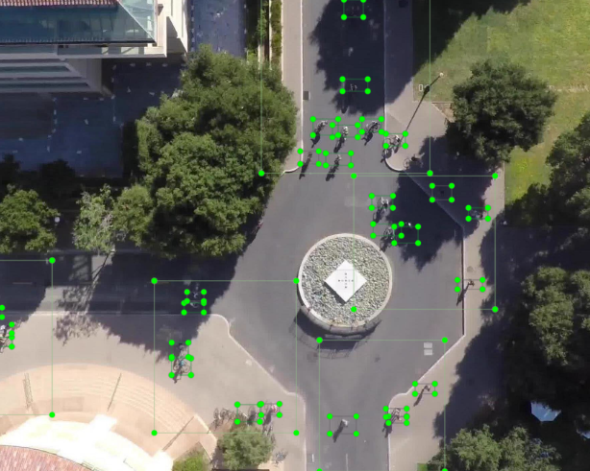
Key learnings:
The entire brainstorming and hard work has made the project more interesting for us.
We learned to deal with such huge real world dataset.
Through this, we understood how object detection models actually “see” and process objects.
This project taught us how important data preprocessing is for model performance. Even before training, the way we prepare the data can affect how well the model learns.
We also became familiar with the basic structure of a Machine Learning pipeline.
…And innumerable other learnings.
So we are eagerly looking forward to another month of such brainstorming and debugging..
THANK YOU

