Slide 1

Hello,
KDT 웹 개발자 양성 프로젝트
5기!
with

Slide 2


Slide 3
https://engineering.linecorp.com/ko/blog/uit-survey2022-report

Slide 4


Slide 5
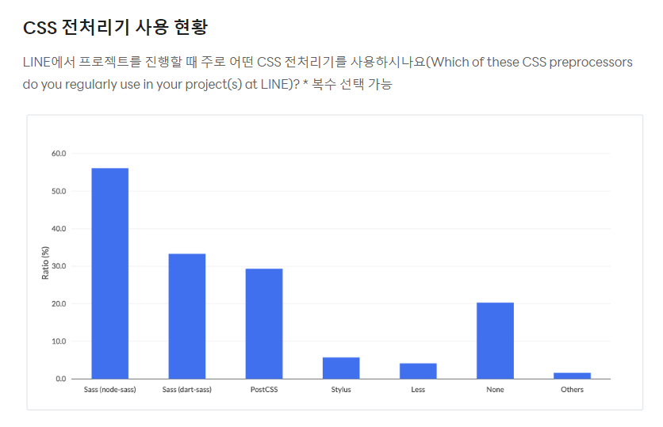

Slide 6
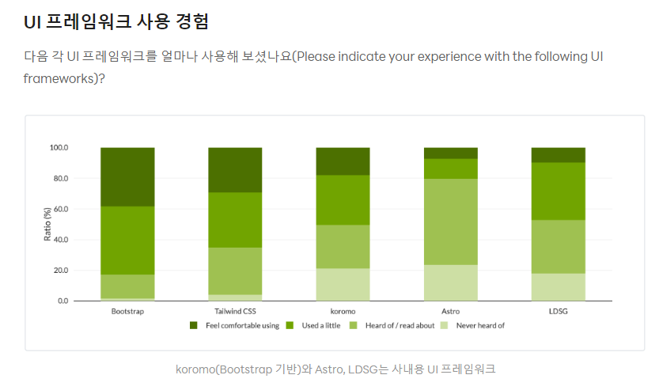

Slide 7
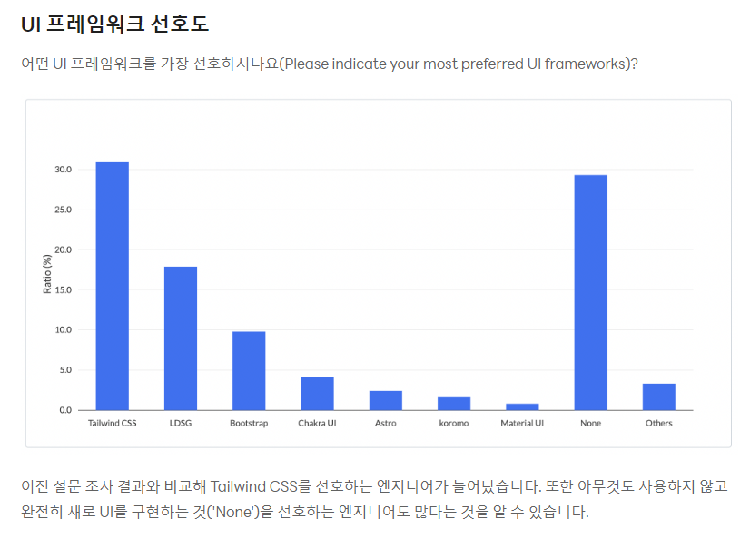

Slide 8
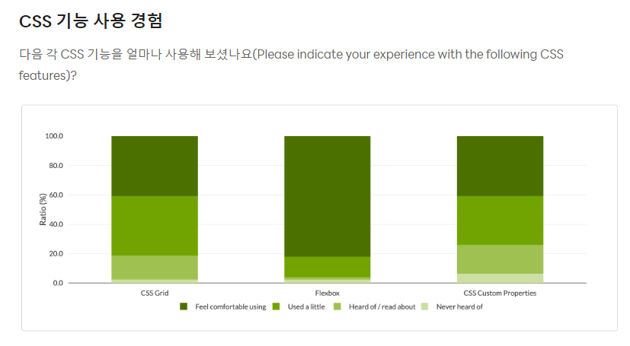

Slide 9
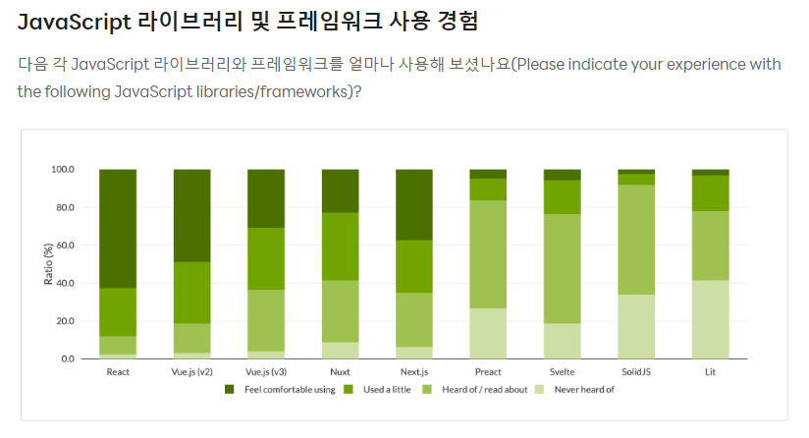

Slide 10
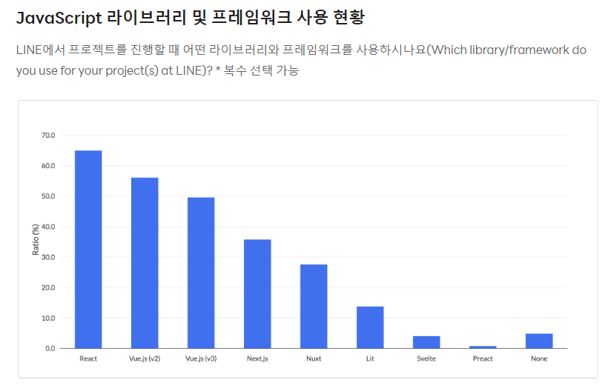

Slide 11
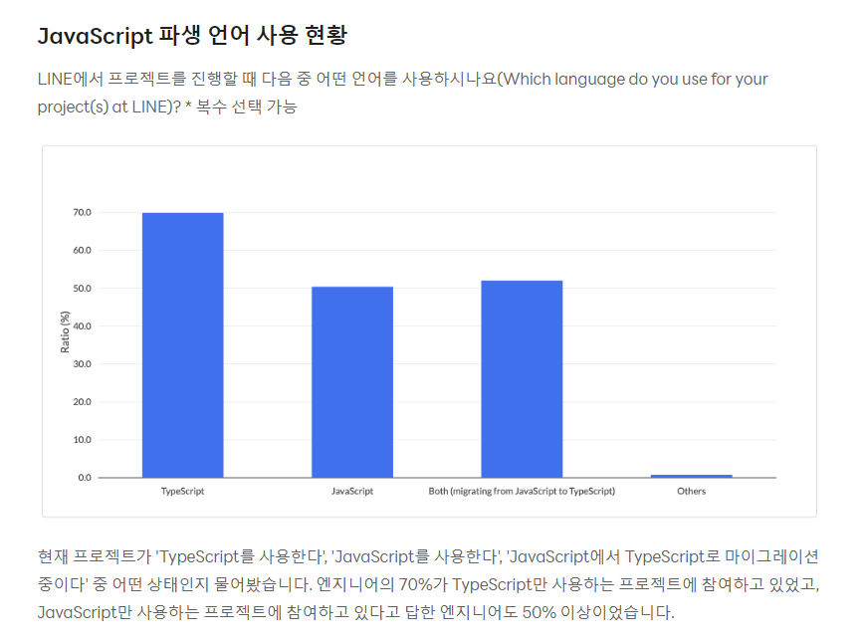

Slide 12
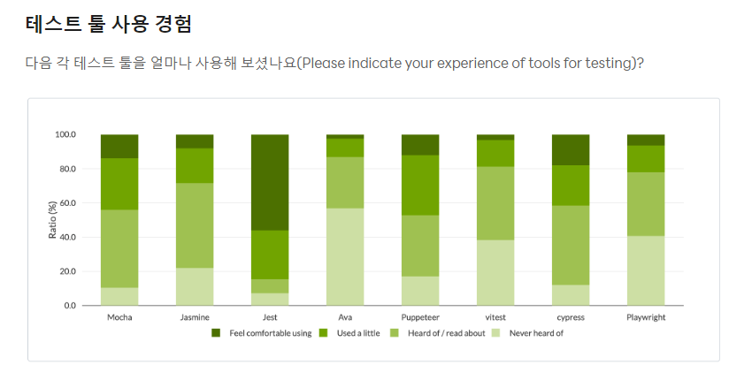

Slide 13
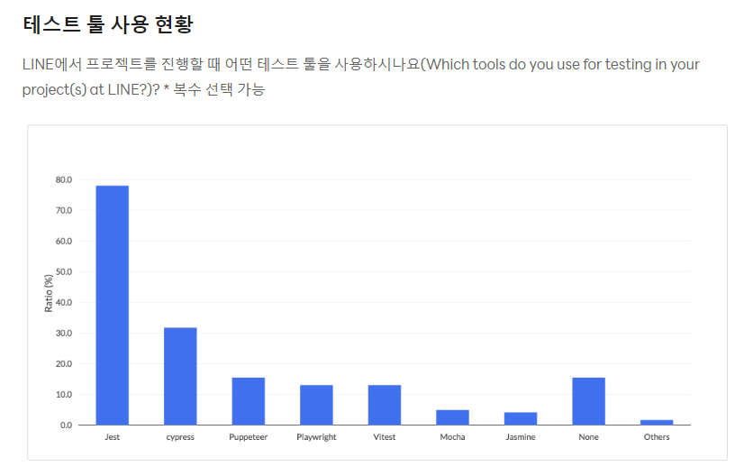

Slide 14
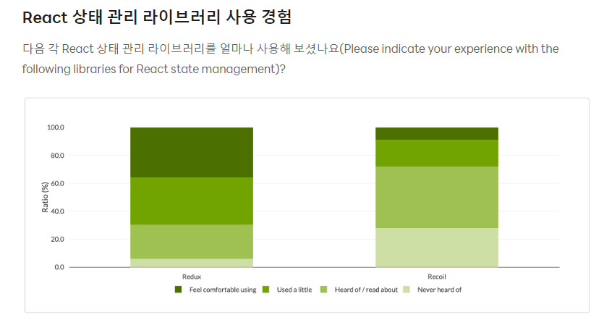

Slide 15
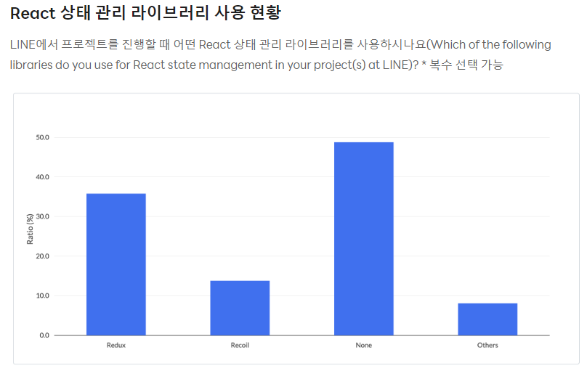

Slide 16
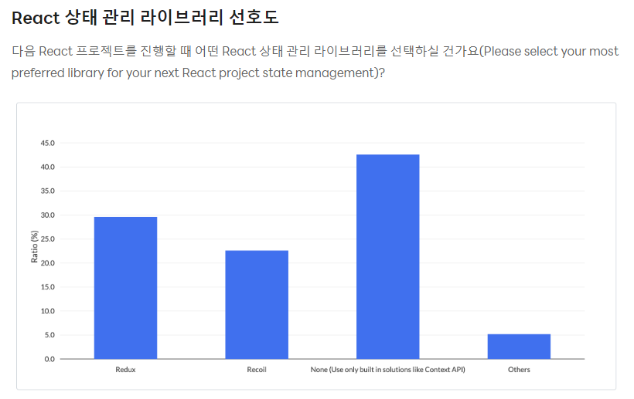

Slide 17
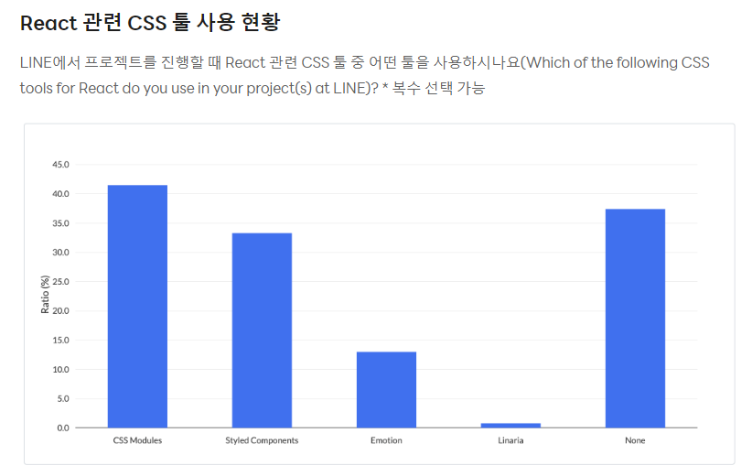

Slide 18
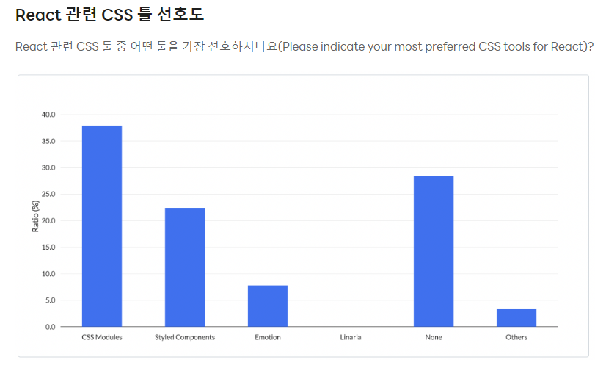

Slide 19
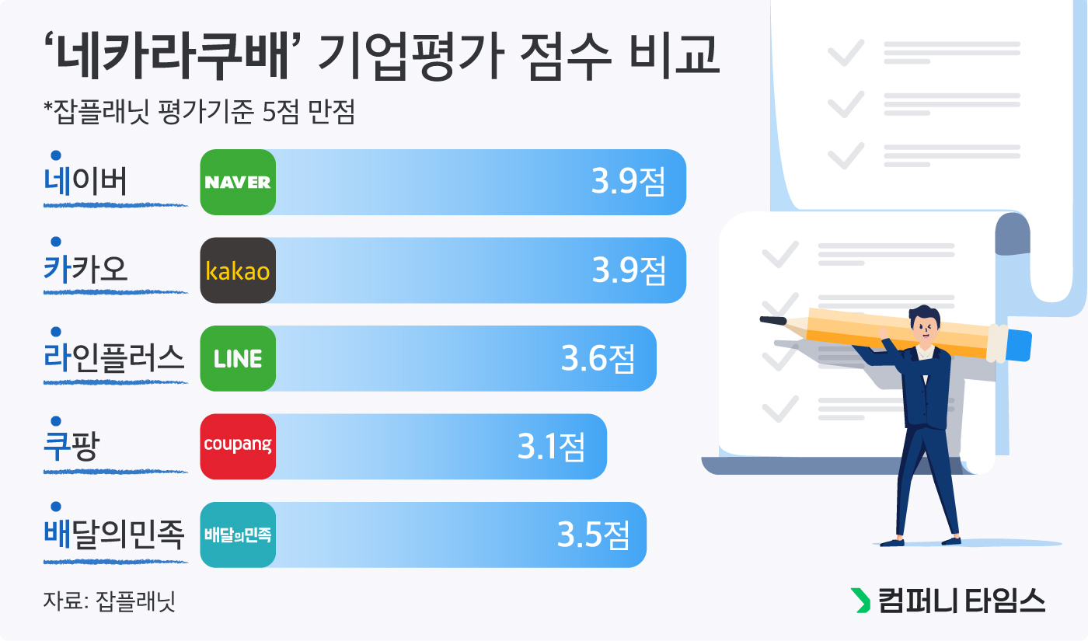

Slide 20
https://d2.naver.com/home
https://tech.kakao.com/blog/
https://engineering.linecorp.com/ko/blog
https://medium.com/coupang-engineering
https://techblog.woowahan.com/

Slide 21


