Slide 1
Codeathon01 Presentation
By Sidhardh Burre

Slide 2
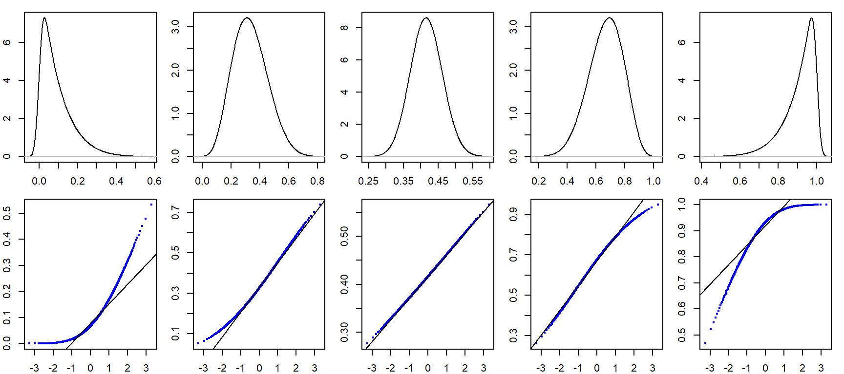

Slide 3
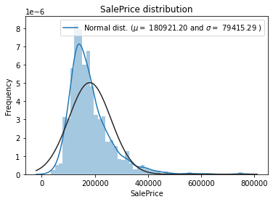
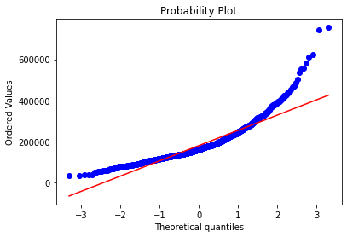
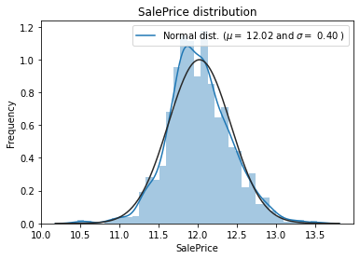
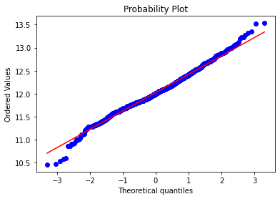
1. Used the log of SalePrice
Why Log SalePrice?
Improve performance significantly
ML algorithms in general are not good with non-linear data
By artificially linearizing the sale price, we can improve perf.
Potential Drawbacks?
Some built-in functions may not work
Must implement some custom functions

Slide 4
2. Had a highly complex pipeline
A prior presenter said this but splitting data
Applying custom pipelines only to data partitions
ORDERING CATEGORICAL DATA
All Data
Unordered Categorical data
Ordered Categorical Data (num)
Ordered Categorical Data (non-num)
#’s

Slide 5
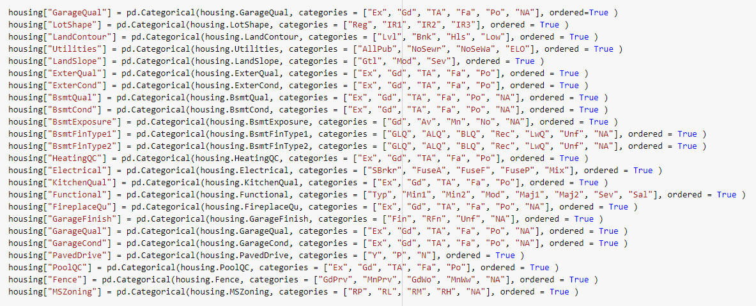

Slide 6
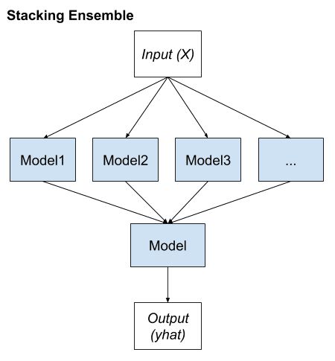
3. Ensemble Learning
(Pipeline(steps=[('robustscaler', RobustScaler()), ('elasticnet', ElasticNet(alpha=0.0005, l1_ratio=0.9))]),
Pipeline(steps=[('robustscaler', RobustScaler()), ('elasticnet', ElasticNet(alpha=0.0005, l1_ratio=0.9))]),
GradientBoostingRegressor(learning_rate=0.05, loss='huber', max_depth=4, max_features='sqrt', min_samples_leaf=15, min_samples_split=10, n_estimators=1000),
LGBMRegressor(bagging_fraction=0.8, bagging_freq=5, feature_fraction=0.2319, learning_rate=0.05, max_bin=55, min_data_in_leaf=6, min_sum_hessian_in_leaf=11, n_estimators=1000, num_leaves=5, objective='regression'))

