Slide 1
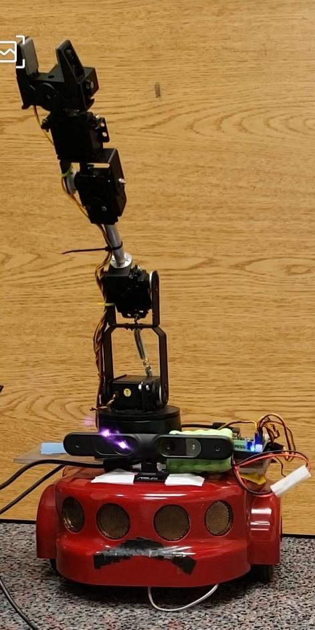
Autonomous Mobile Manipulator
Deep Saran
Jaji
Sriparvathi Shaji Bhatttathiri

Slide 2
Introduction
Compute in real-time the camera trajectory and a sparse 3D reconstruction of the scene
It is able to close large loops and perform global relocalisation in real-time

Slide 3
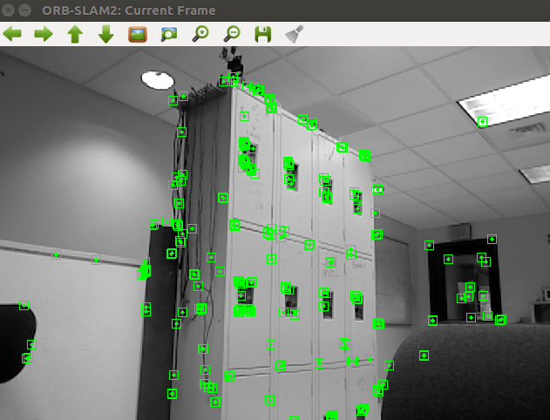
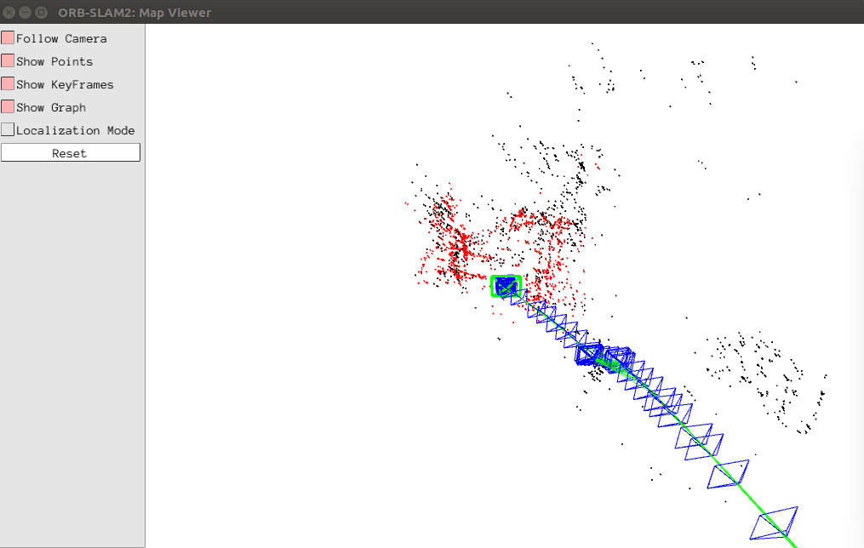
ORB SLAM2
The algorithm gets a new frame from the camera, it first performs keypoint detection
ORB-SLAM tries to improve the estimated camera pose.
New map points are created by triangulating matching keypoints from connected frames.
ORB-SLAM checks if keypoints in a frame match with previously detected keypoints from a different location [1]
Notes:
green squares in camera image = tracked keypoints.
Blue boxes in lower map view: keyframes. Red box = current camera view. Red points = visible local map points

Slide 4
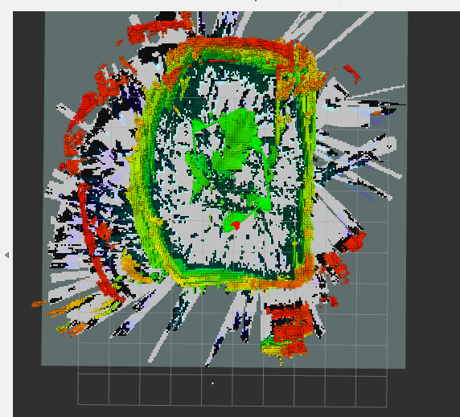
OCTOMAP
3D occupancy grid mapping approach
It explicitly represents not only occupied space, but also free and unknown areas [2]

Slide 5
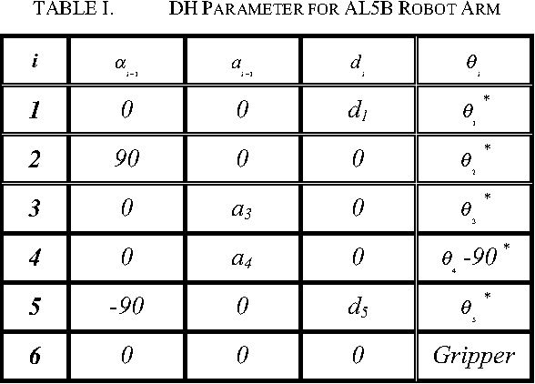
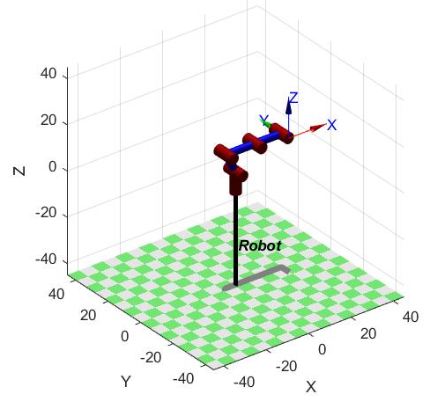
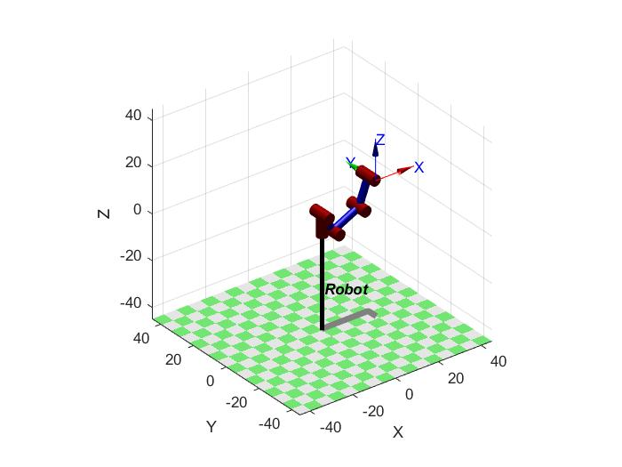
MANIPULATOR (ALB5)
Uses Inverse Kinematics
DH table
Ikcon -inverse kinematics using optimisation with joint limits
Works by minimizing the error between the forward kinematics of the joint angle solution and the end-effector frame as an optimisation.
Error = sumsqr( (inv(T)*robot.fkine(q) - eye(4)) * omega )
Uses fmincon() for the optimisation
Qreachservogoal = qreachgoal*10*180/3.14
Gripper /End effector has only open and close
Goal coordinates
  X = 8 cm
  Z = 13 cm
Map real world coordinates to the arms frame
Notes:
omega = diag([1 1 1 3/reach]);

Slide 6
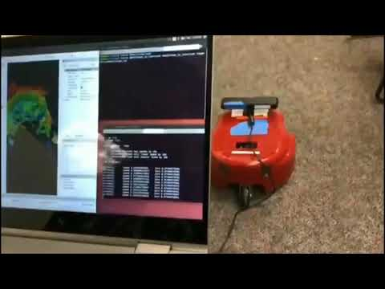
Video

Slide 7
Thank you
Questions
References:
https://www.andreasjakl.com/basics-of-ar-slam-simultaneous-localization-and-mapping/
Hornung, A., Wurm, K.M., Bennewitz, M. et al. Auton Robot (2013) 34: 189. https://doi.org/10.1007/s10514-012-9321-0-”OctoMap: an efficient probabilistic 3D mapping framework based on octrees”

