Slide 1



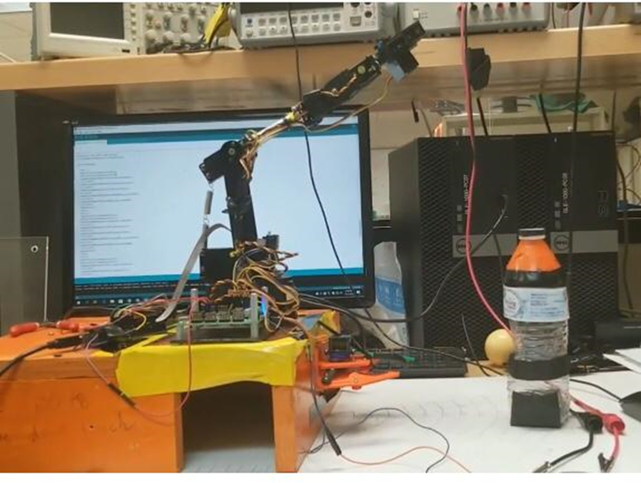
Flair Bot
Flair Bot is our very own bartender. It is an Arm Robot with a custom gripper and a Pixy Camera attached to it. Just like a bartender it can identify a bottle pick it up, open it and pour it out.
HARDWARE
Flow Chart
SOFTWARE
Two Arduino Uno Microcontroller
PIXY2 Camera
Custom Gripper
AL5B Robot
The robot scans the area for a bottle with orange colour sticker. After identifying the bottle, the bot detects its distance from the bottle using the pixie cam input. Then then arms goes and picks up the bottle from the determined location. It places the bottle into its custom gripper. Gripper grips the bottle while the native AL5B gripper twists and upon the cap. After removing the cap from the bottle, the bot picks it up and does the pouring motion to pour its contents out.

