Slide 1






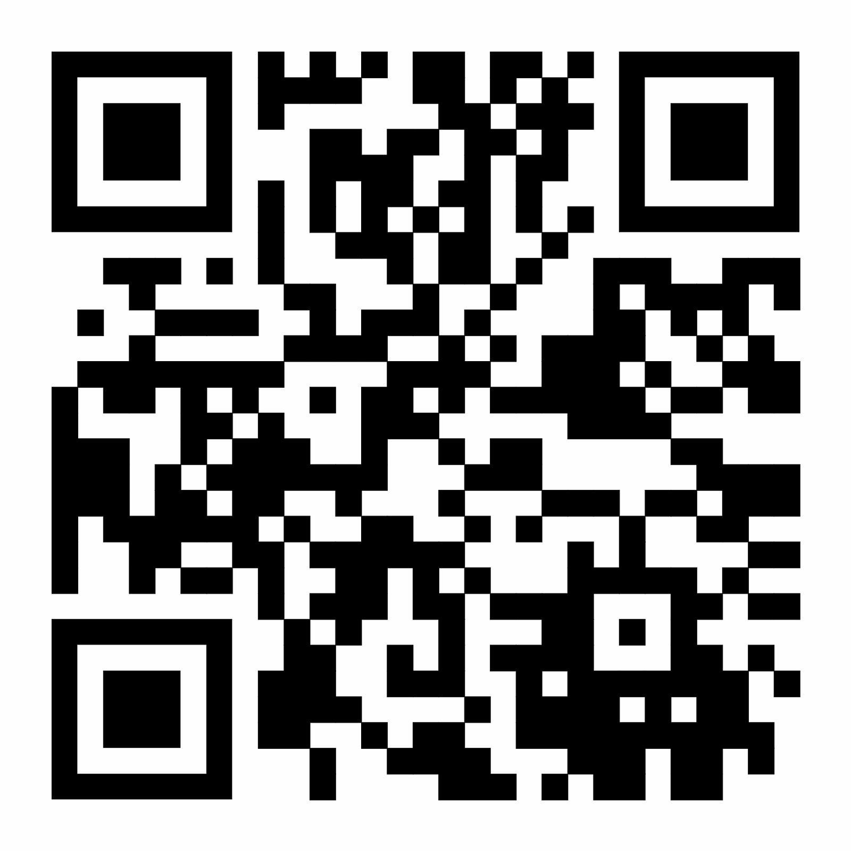
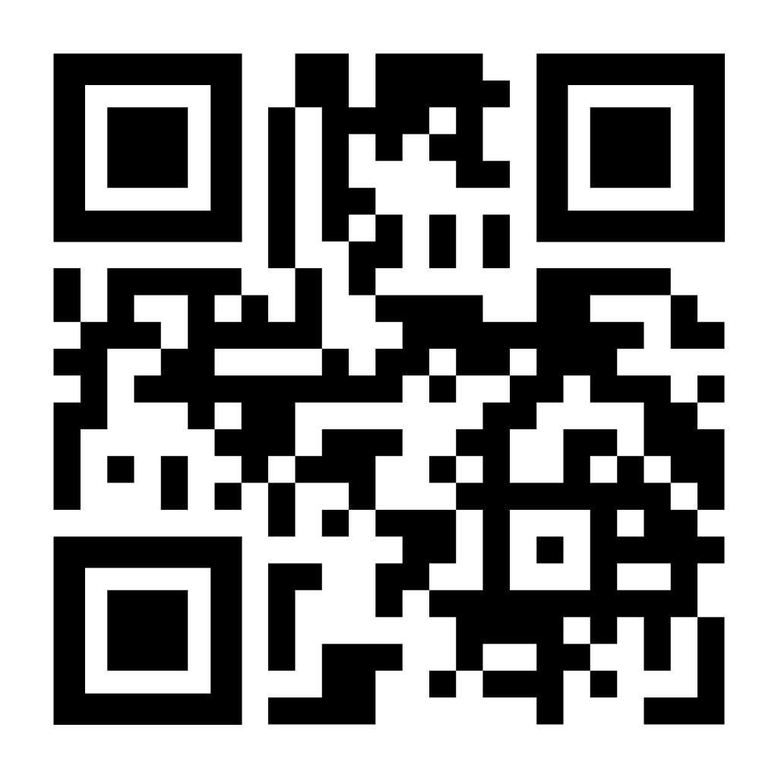
TESTBUDGET
GROUP 9
Every PR earns its test budget.
Vedantt Koul • Saanvi Bajjuri
Namrata Joshi • Sakshi Shelar
Risk-calibrated test selection for long CI suites
MISSION
WHY
WHAT
SO WHAT
Long CI suites force teams to choose between 20+ minute pull requests and weak smoke subsets. E2E tests are often moved to nightly runs, leaving PRs under-tested.
TestBudget is a GitHub Action + CLI that uses a repository’s own CI history to decide which existing tests run on each PR, in what order, and for how long.
Teams get faster feedback, safer merges, and reproducible decisions. TestBudget explains selections, tracks skip debt, and needs no ML, coverage instrumentation, or hosted service.
PROJECT 2 TARGET • ≥85% failing runs caught • ≤30% average full-suite time
HOW TESTBUDGET DECIDES
PROPOSED PR CHECK
1
2
3
4
5
✓
TestBudget / PR #142
CHANGE
RISK
LINK
RANK
BUDGET
Risk level: HIGH
Analyze changed files
Use CI failure history
Map to tests via routes + co-failures
Prioritize by uncovered risk / second
Select tests within time budget
Budget: 12m
Selected: 14 / 52 tests
Skipped: profile.spec.ts (debt 4/7)
$ /testbudget full # reviewer override
PROPOSED CLI
STAKEHOLDERS
STACK
$ testbudget plan --base main
Developers
Python
SQLite
Risk: MEDIUM Budget: 08:40
Reviewers
Selected: 14 / 52 tests
QA / Test owners
Actions
pytest
Estimated time: 29% of full suite
Release / On-call
Security / Compliance
Playwright
Next.js
MILESTONES
BEFORE · Project 1a
NOW · Project 2
FUTURE · Project 3
Reverse-engineered MealSlot into 20 use cases
CI history ingestion and adapters
Fork pull-request support
109 tests across 5 suites, all traced
Risk map + route / co-failure links
Automatic drift correction after nightly misses
30 defects exposed that shipped tests missed
PR check + reviewer override
Adapter expansion for more test frameworks
MealSlot CI history becomes first replay dataset
Calibrated budgets + static dashboard
Uncovered-risk + test-retirement reporting
REPOSITORY
DISCUSSION FORUM
github.com/ssbajjur-ncstate/SE-CSC-510-Group-9.git
discord.gg/X47fDBE6x
CSC 510 • NC State • Fall 2026

