Slide 1
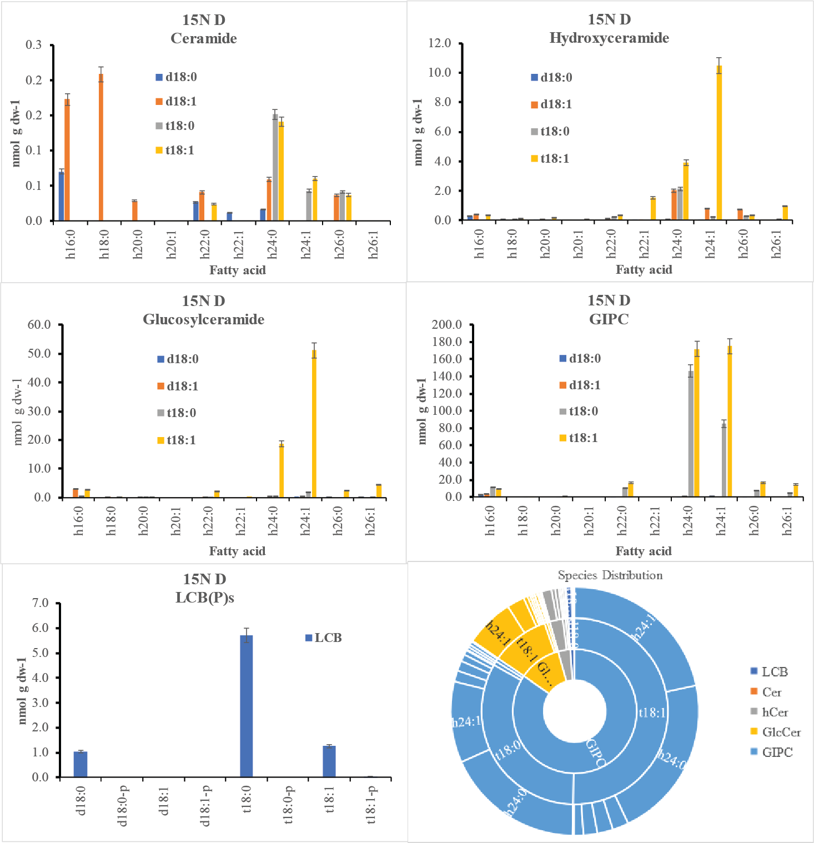
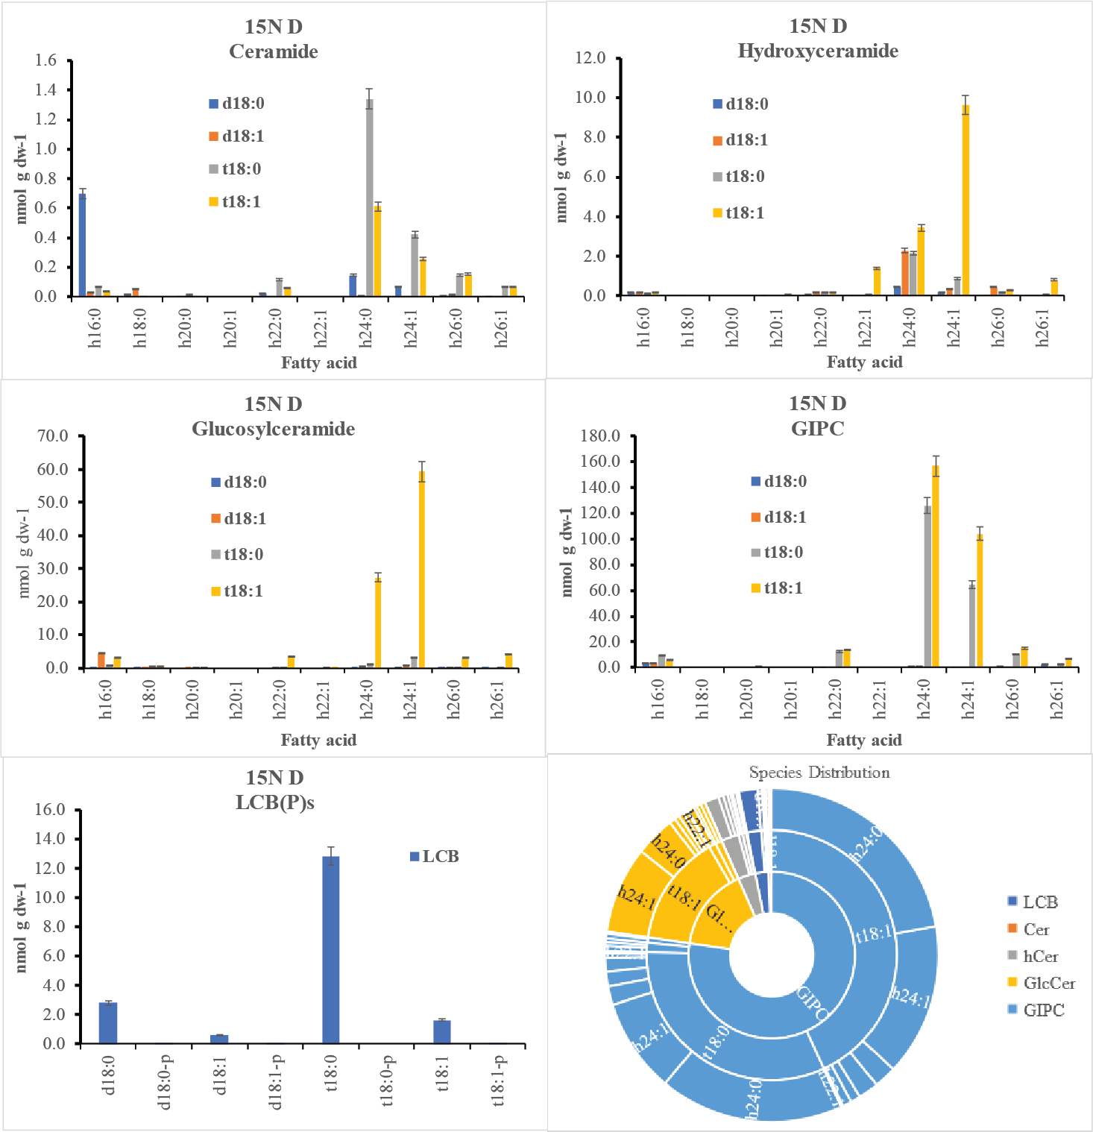
T0 - 15N Davg (N14 + N15)
T1 - 15N Davg (N14 + N15)

Slide 2
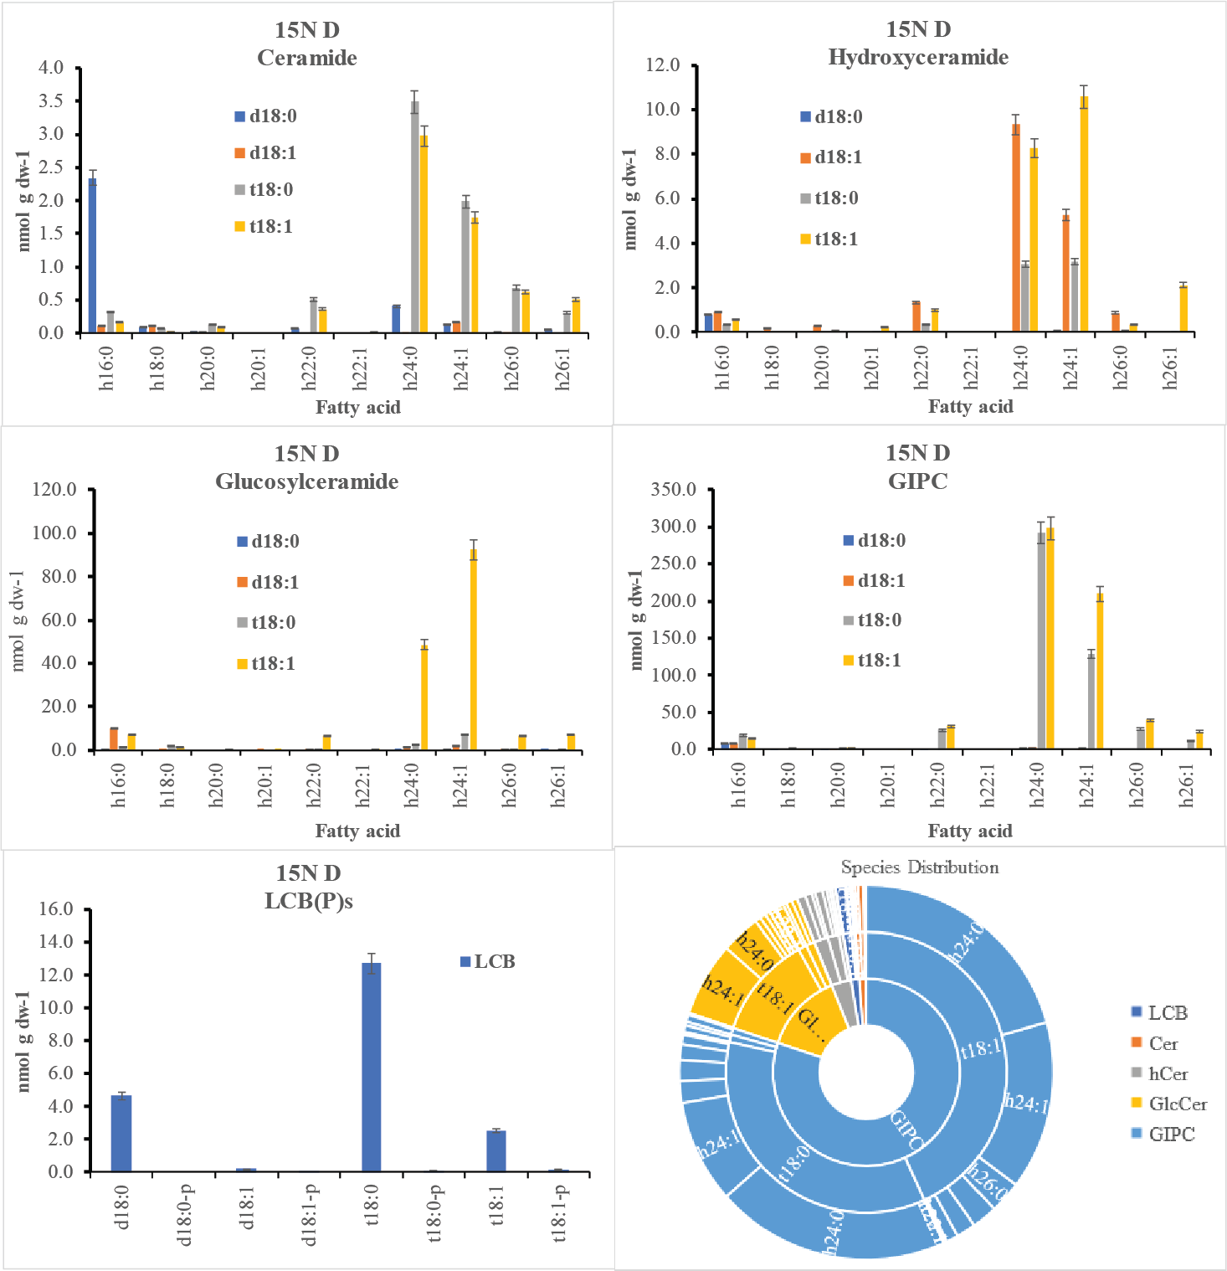
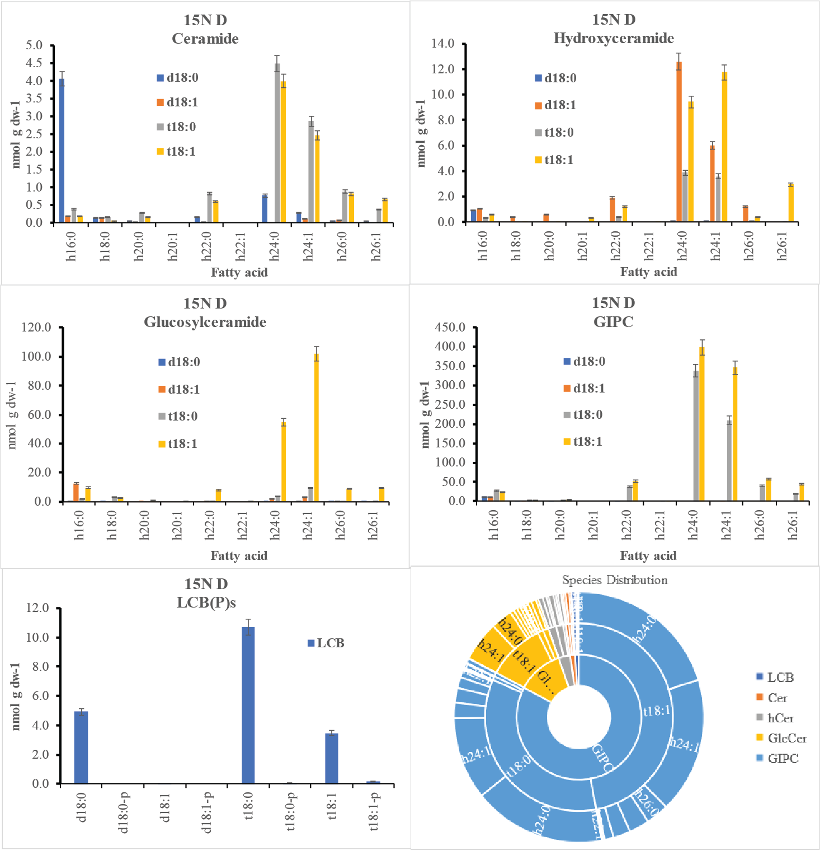
T2 - 15N Davg (N14 + N15)
T3 - 15N Davg (N14 + N15)

Slide 3

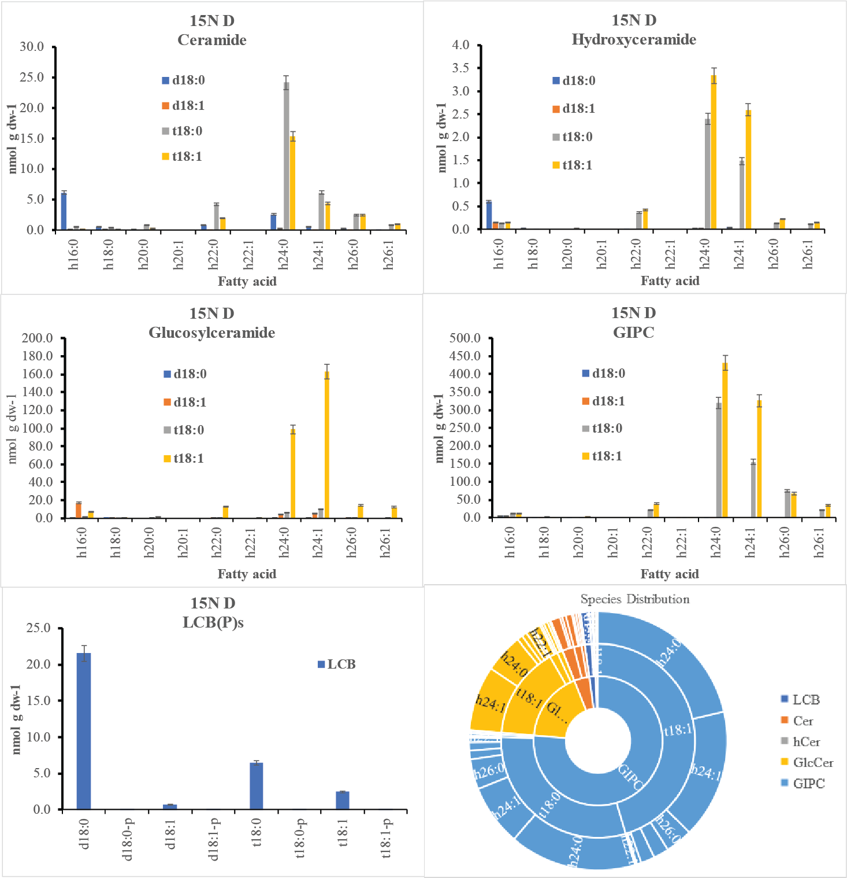
T4 - 15N Davg (N14 + N15)
T5 - 15N Davg (N14 + N15)

Slide 4

T6 - 15N Davg (N14 + N15)

