Slide 1
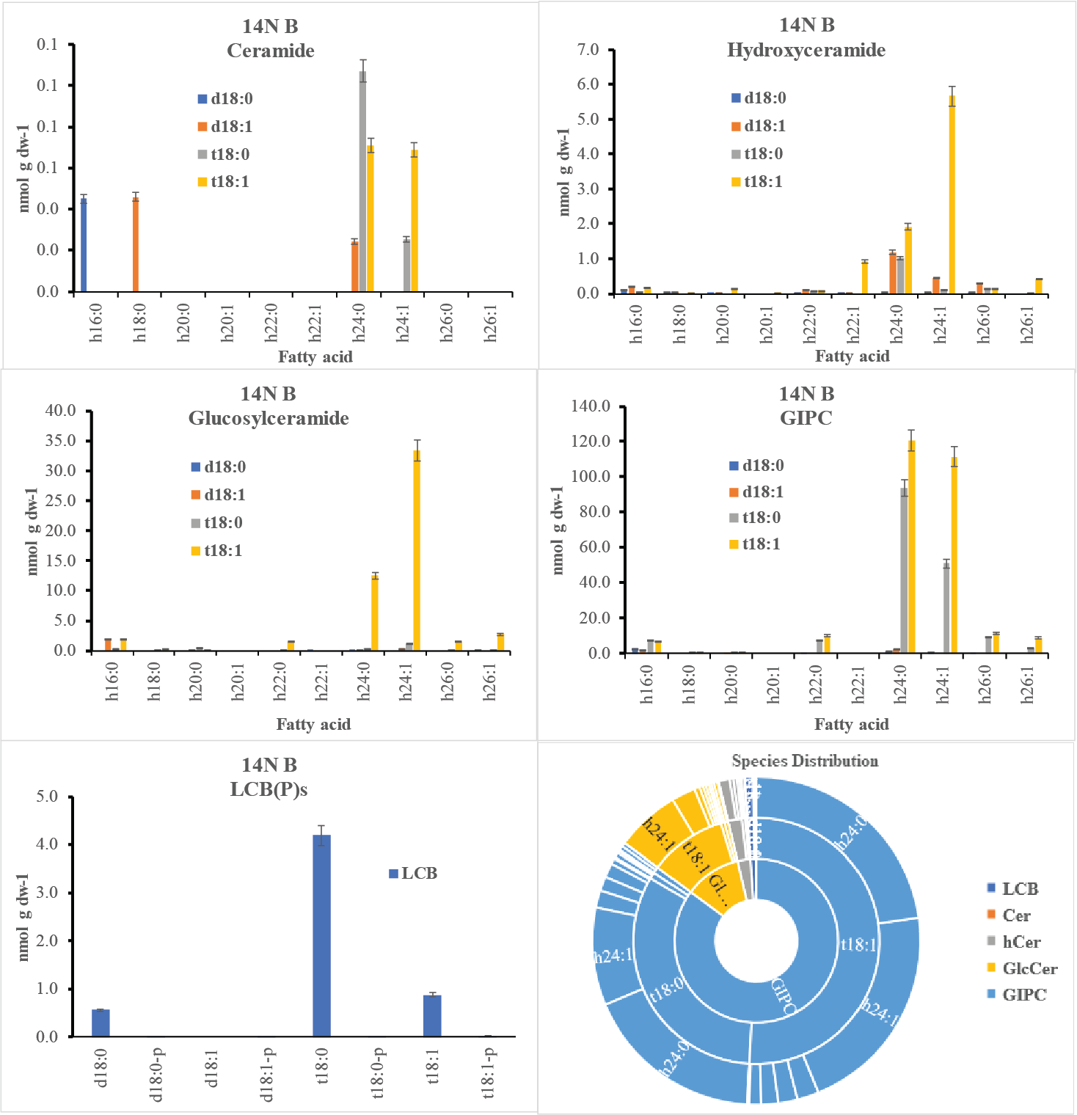
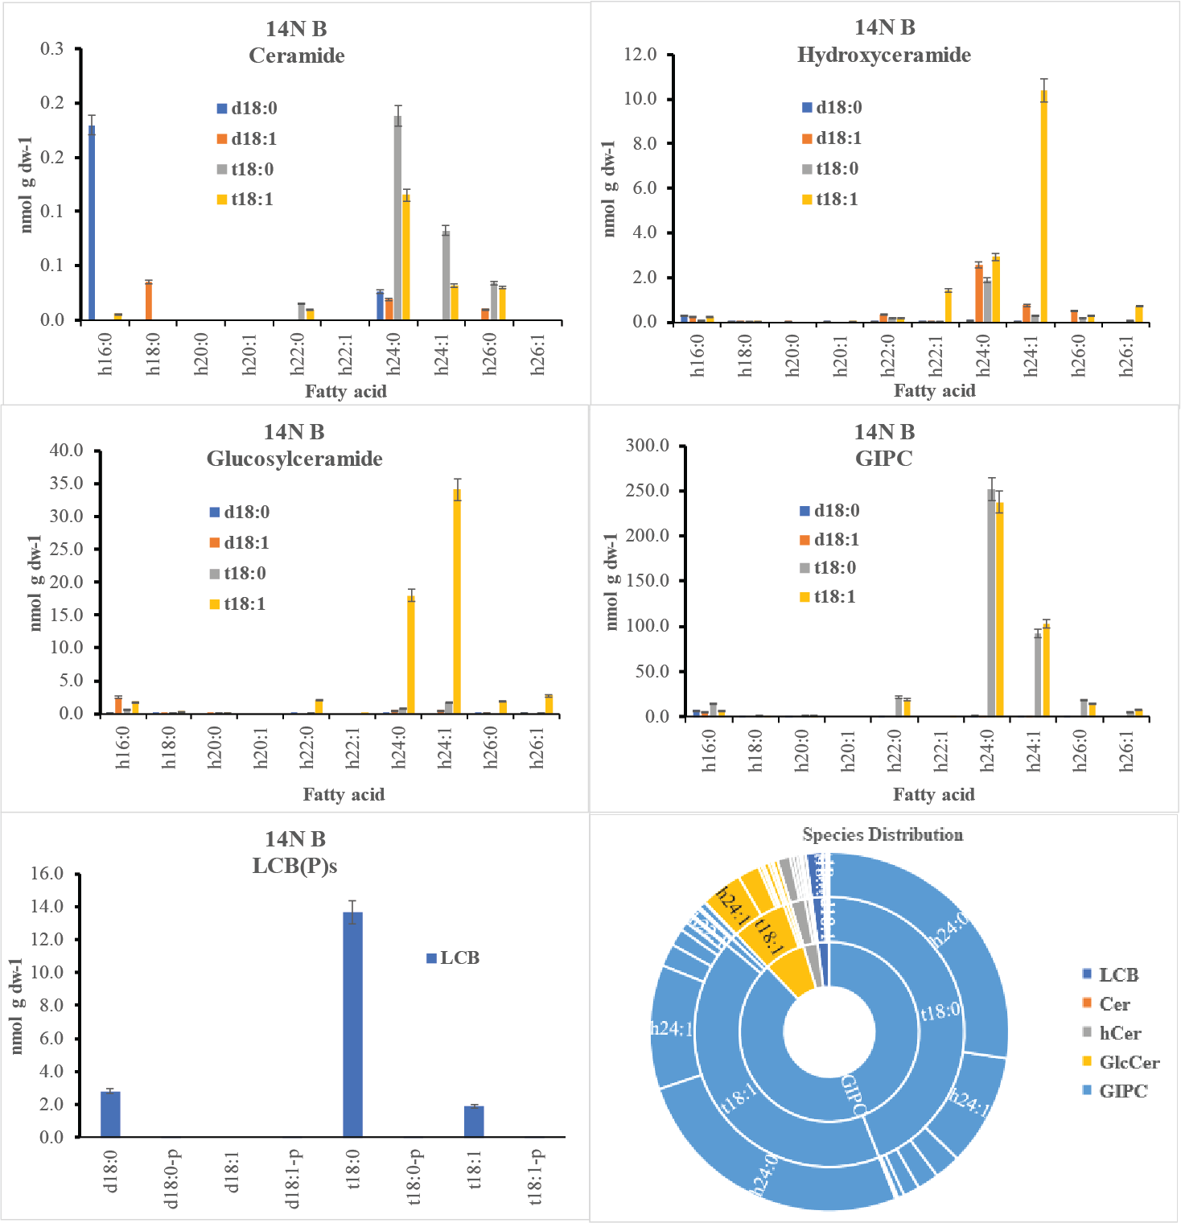
T0 - 14N Bavg (N14 + N15)
T1 - 14N Bavg (N14 + N15)

Slide 2
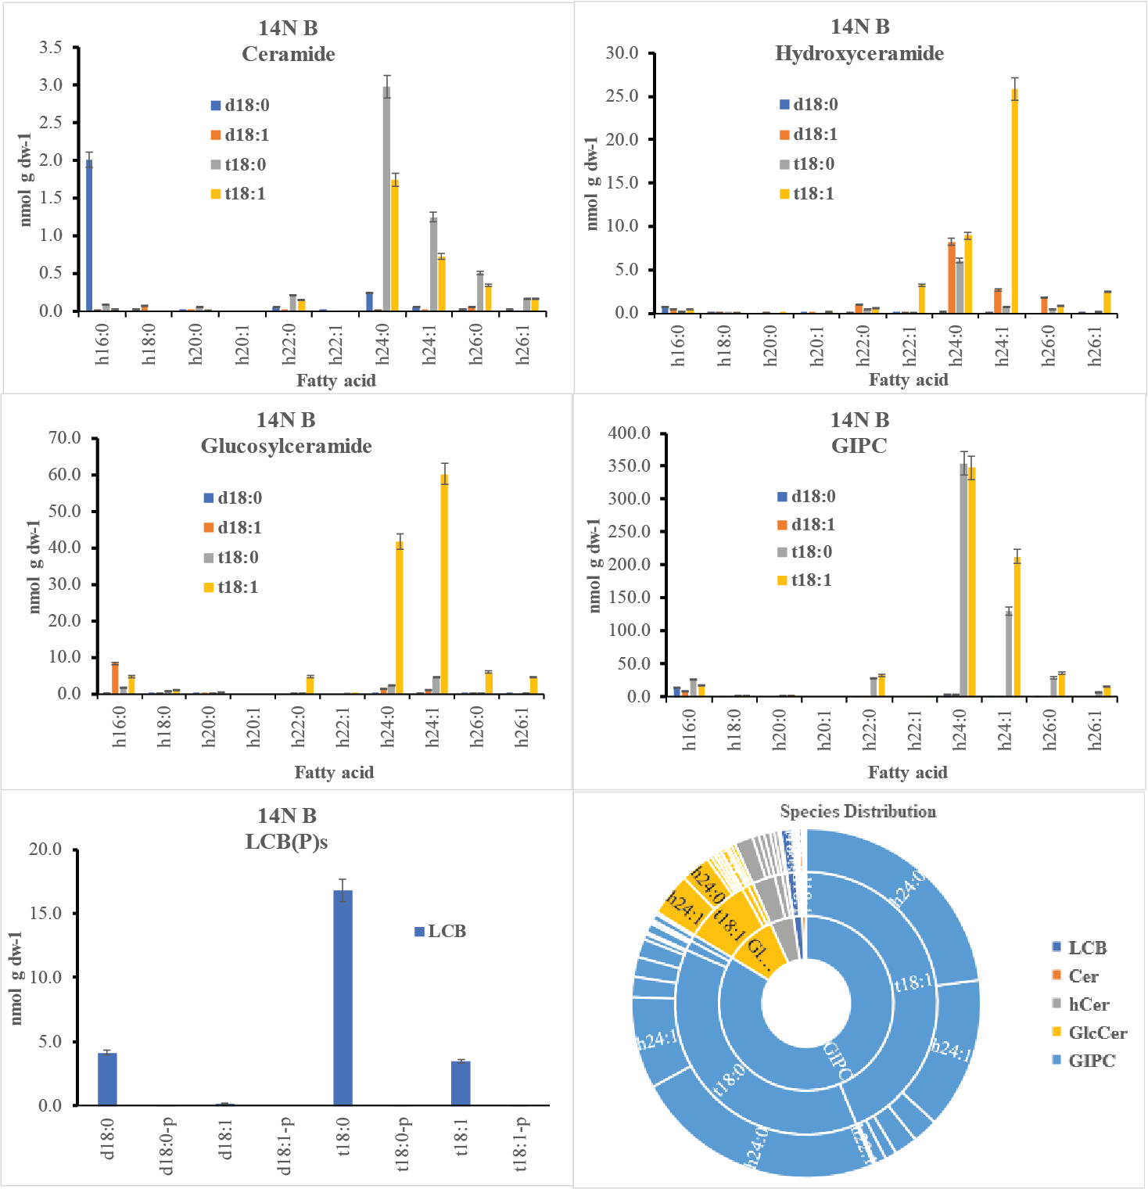
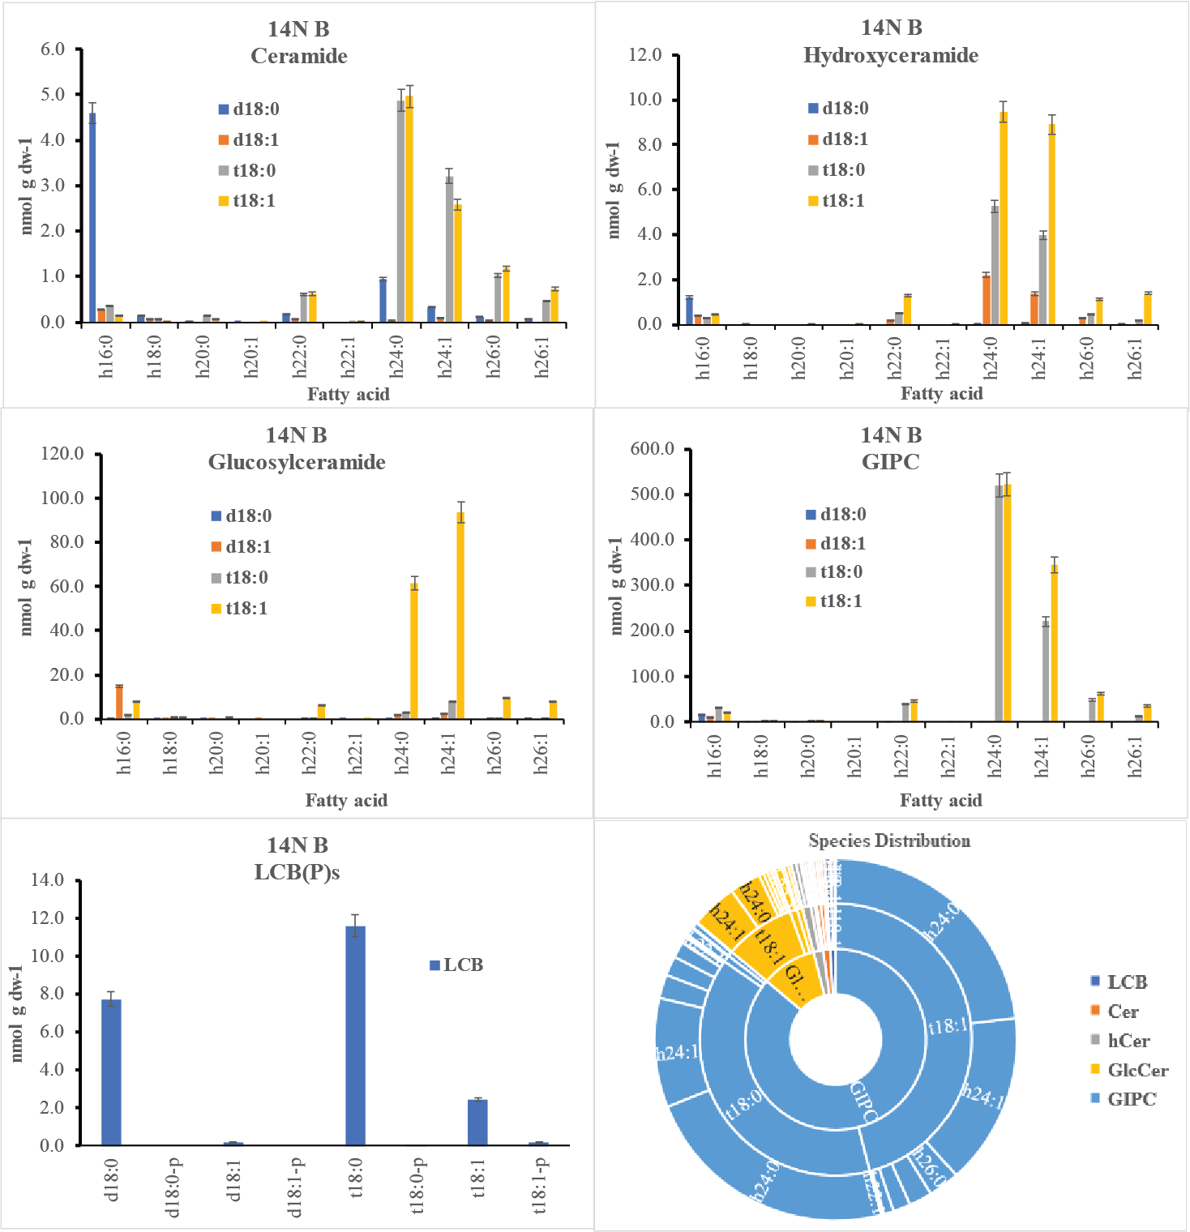
T2 - 14N Bavg (N14 + N15)
T3 - 14N Bavg (N14 + N15)

Slide 3
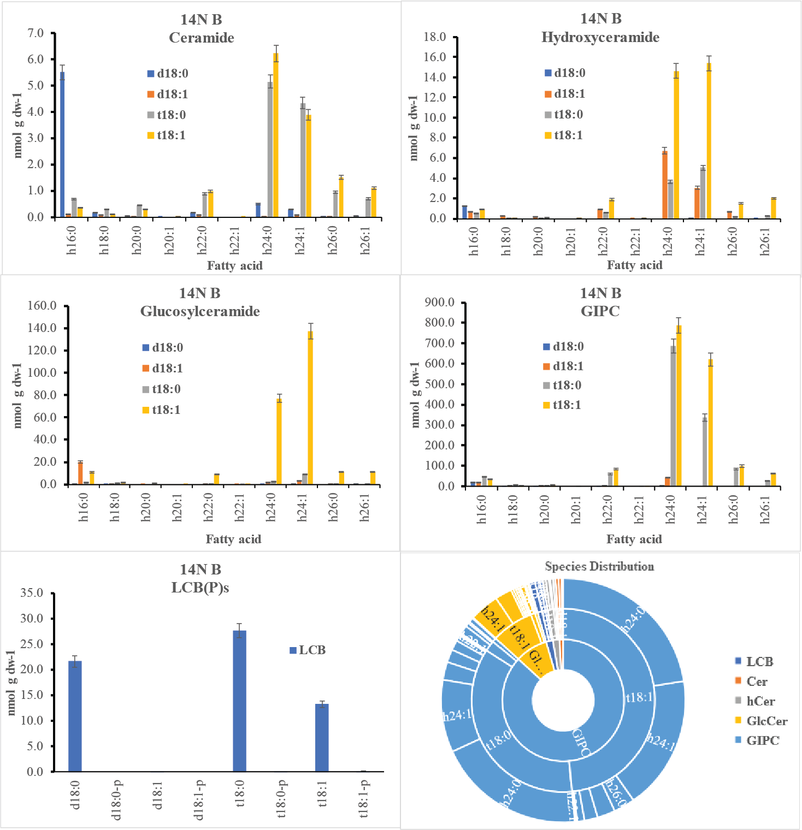
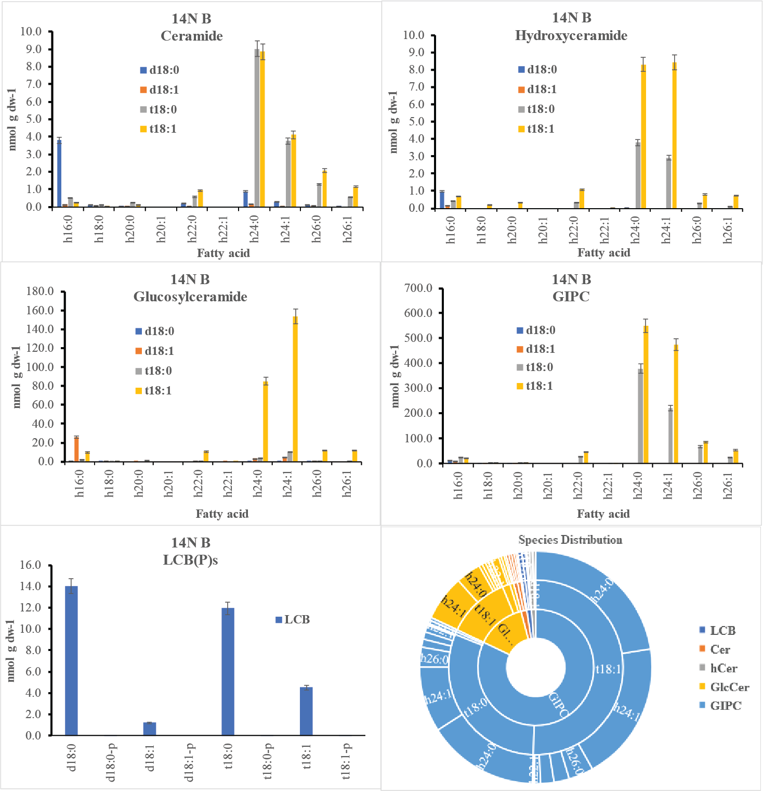
T4 - 14N Bavg (N14 + N15)
T5 - 14N Bavg (N14 + N15)

Slide 4
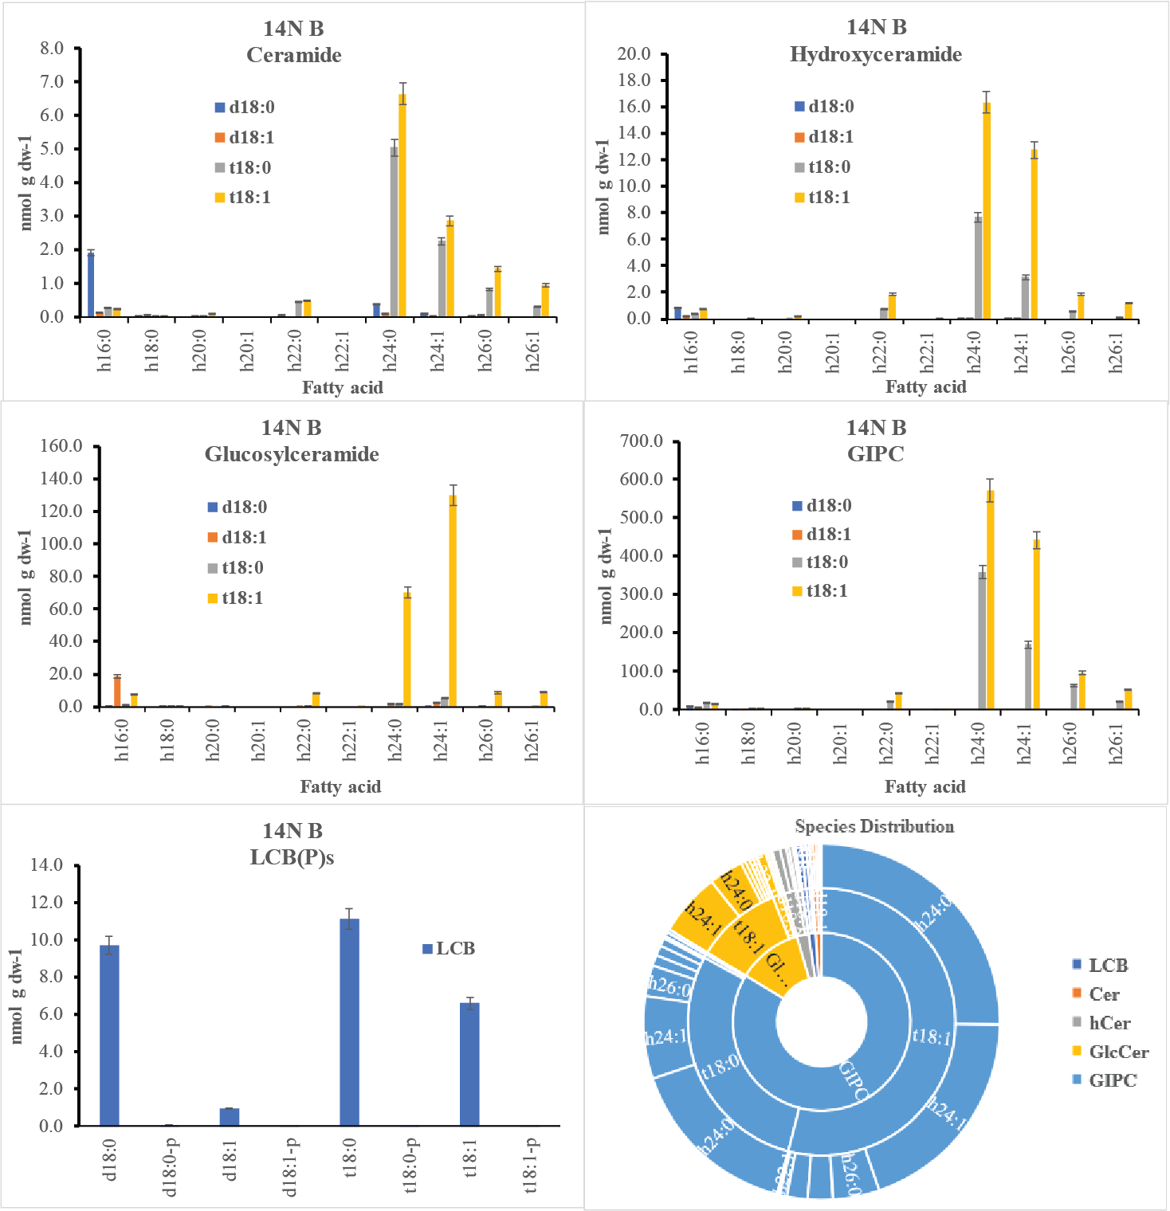

T6 - 14N Bavg (N14 + N15)
T7 - 14N Bavg (N14 + N15)

Slide 5

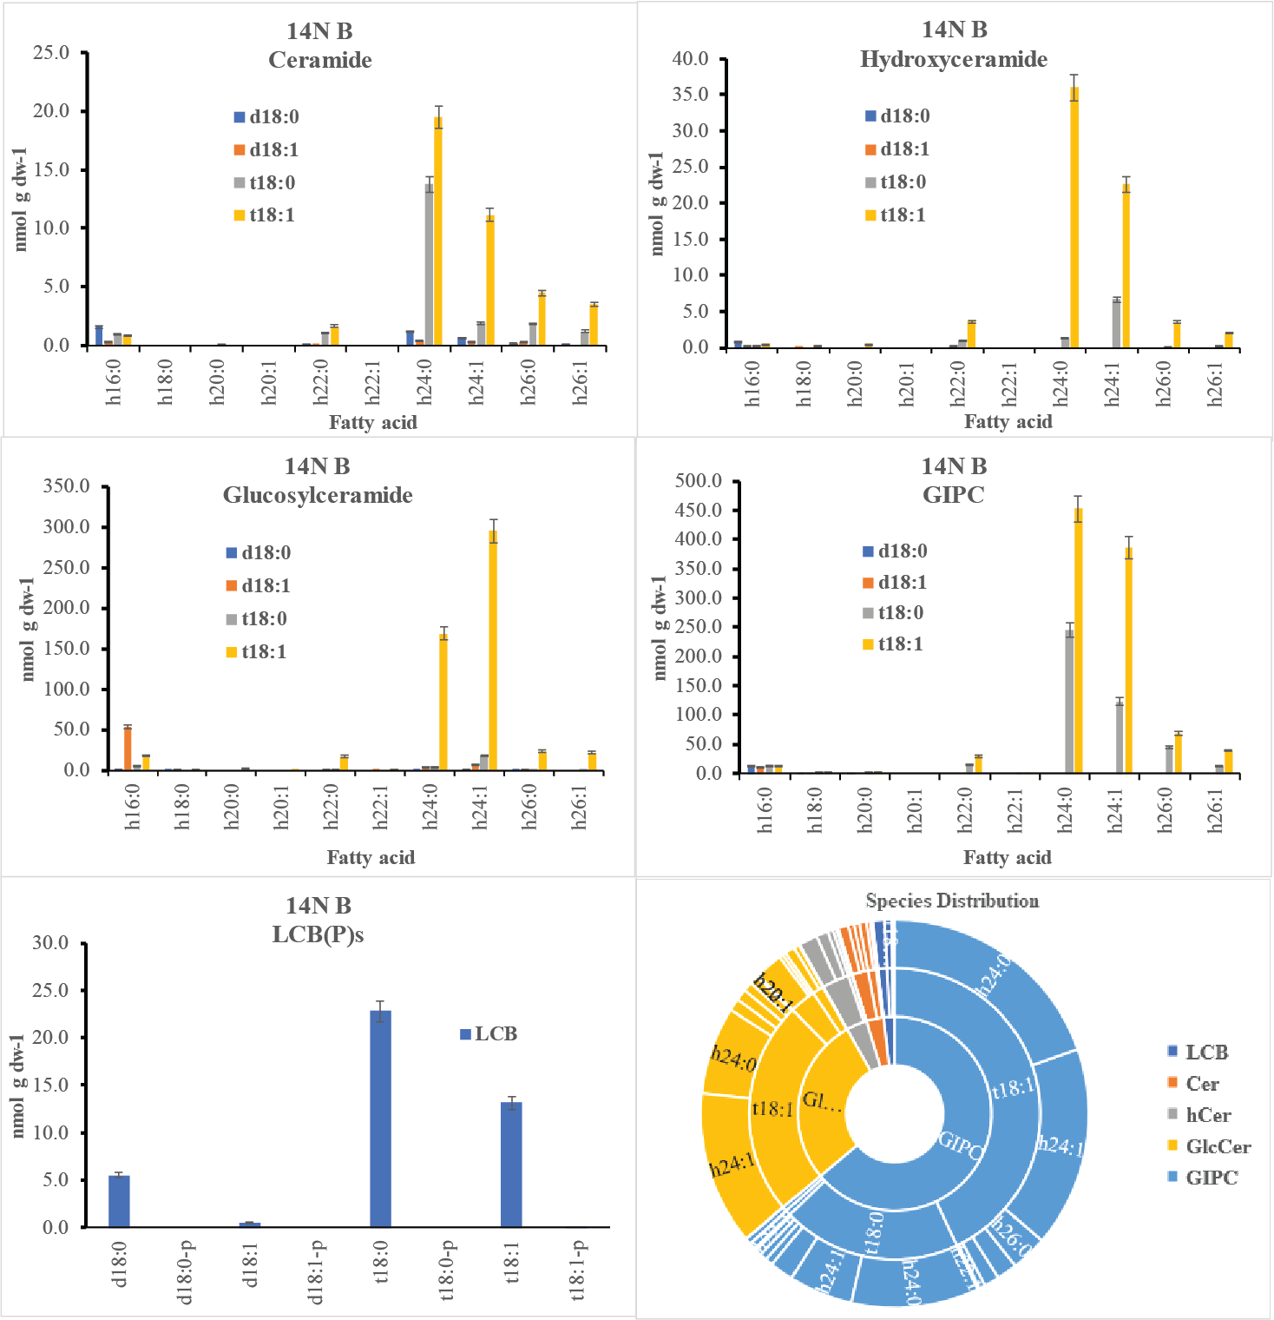
T8 - 14N Bavg (N14 + N15)
T9 - 14N Bavg (N14 + N15)

