Slide 1
Development of an Integrated Database for Historical Business Requests
August 30, 2024
Notes:
Business Requests Parsing and how the parsed data can be integrated into Open WebUI

Slide 2
Project Overview
Part 1: Business Requirements Document Parsing
Part 2: Retrieval Augmented Generation with Open WebUI
Part 3: ePET Pricing Extraction (Under development)
Notes:
There are 3 main components to the work that I have done, and I will talk about each individually.
All the work that I have done with their documentations can be found on the SSC repository on Github

Slide 3
Background
Analyze historical Business Requests
Overcome unstructured and loosely structured data
Generate insightful findings from organized data
Why a client may have cancelled a business request
Objective
Consolidate all relevant information into a searchable datastore.
Automate the process of data extraction
Predict the costs of business requests
Notes:
To begin, I will just give a brief background about the project that I am working on and some of the objectives that I was aiming to achieve.
So within Share Services Canada, all the work done with internal and external clients are recorded as business requests, specifically in these files called Business Requirements Document and ePET, and my task is basically to build an automated pipeline that takes these raw data and consolidate them into some type of searchable datastore. With these parsed data, I can then do data analysis and try find useful insights from them, like predicting the cost of a business request, or finding out why a client may have cancelled a business request. The data that we have is very messed up and unstructured, and that is one of the biggest challenge that I had to account for while working on this.

Slide 4
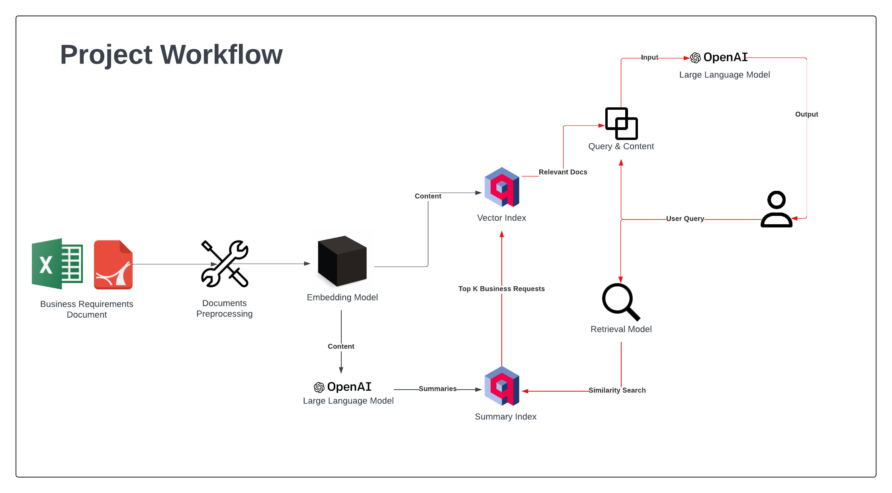
Notes:
Here is a diagram that shows the overall workflow for my first two components. The first component is the business requirements document parsing pipeline, shown on the left with black lines, and the second component is using Retrieval Augmented Generation to do Q&A on the data, which is shown on the right with red lines. And I will break down these steps individually in the next couple of slides,

Slide 5
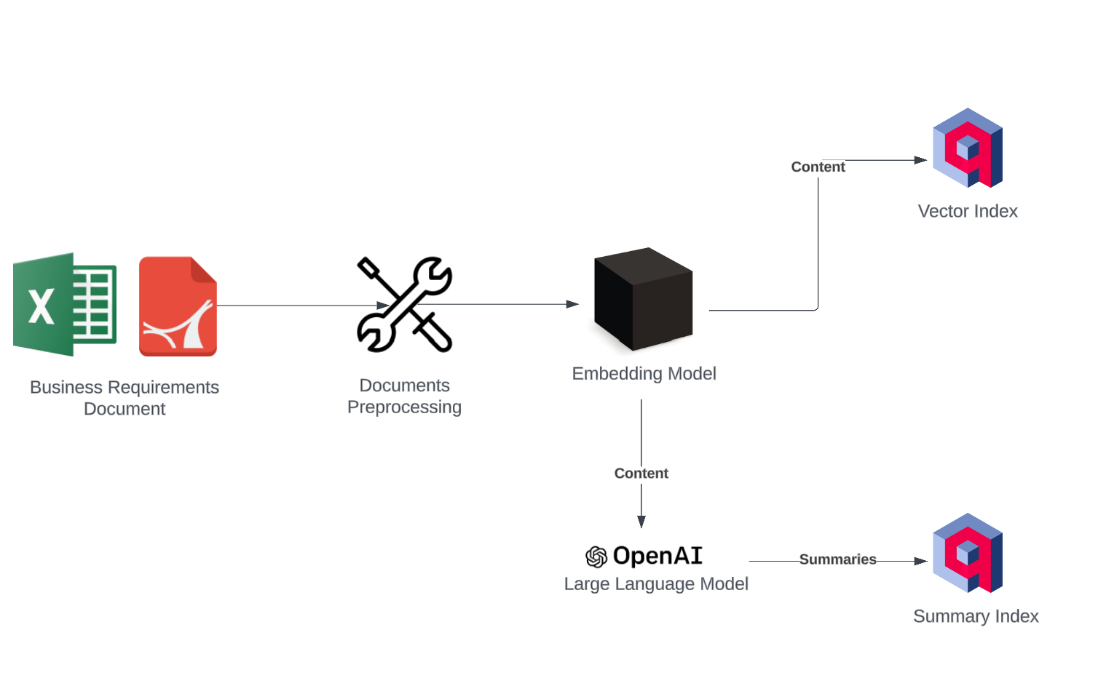
Part 1: Business Requirements Document Parsing

Slide 6
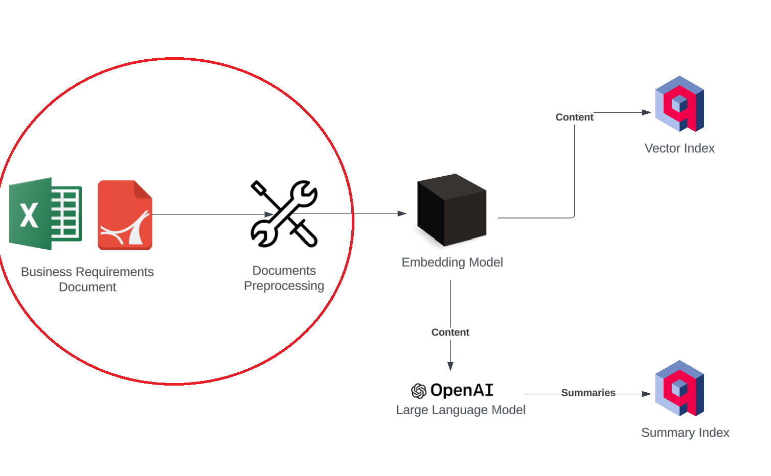
Data Extraction
Notes:
And I will first talk about the data extraction process of this pipeline

Slide 7
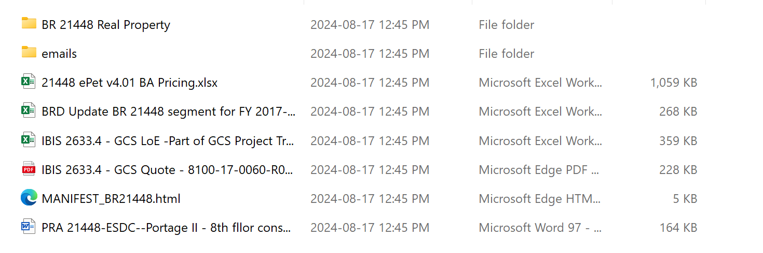
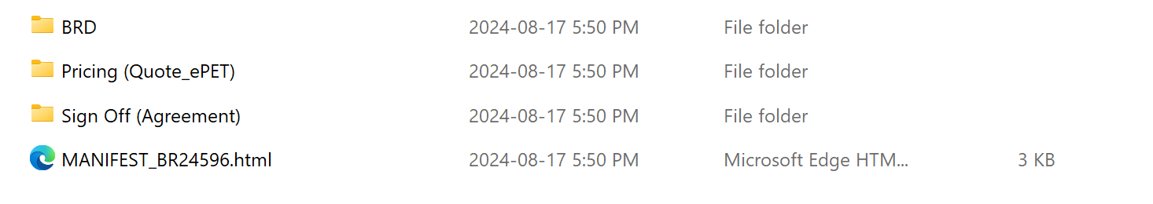
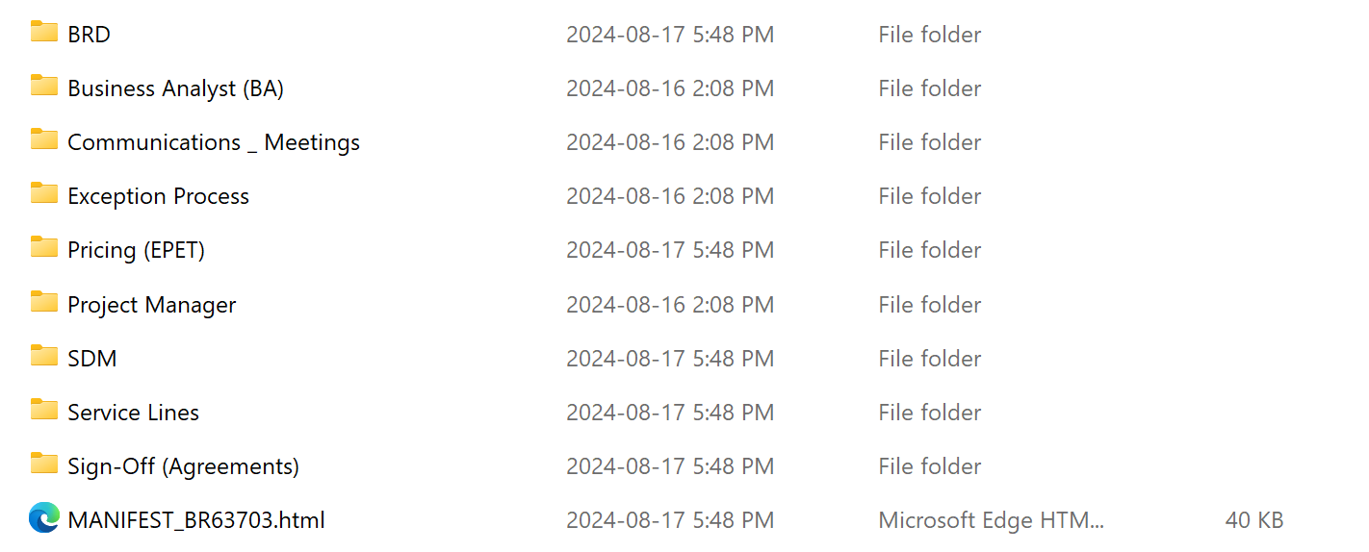
Problem: Inconsistent Data Structure
Notes:
The biggest problem that I have encountered while working on data extraction was the inconsistent data structure. Here are three different directories for three business requests, and you can see within them, the contents are very different. One is just all files, and another one is like all folders, and it was difficult to produce a single generalized algorithm that can deal with all these different structures elegantly.

Slide 8
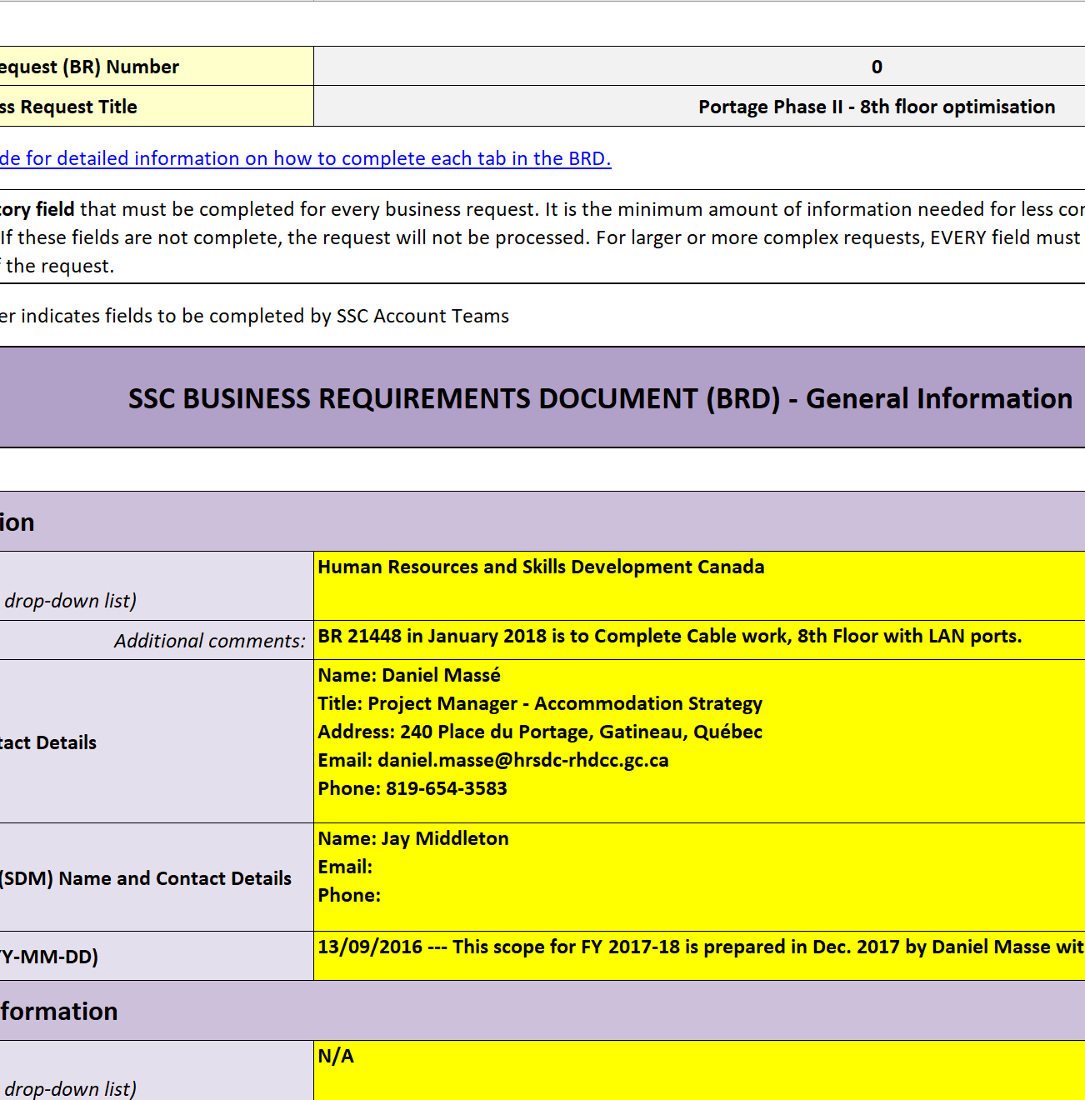
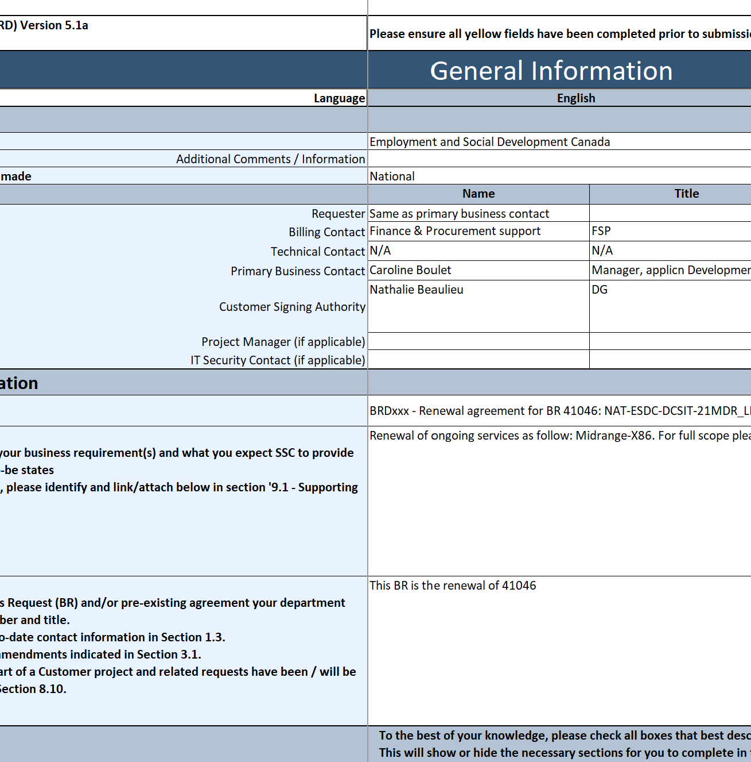
Notes:
And even within files, the data looks very different, especially between the older BRDs and the newer BRDs. And here is two different BRDs.

Slide 9
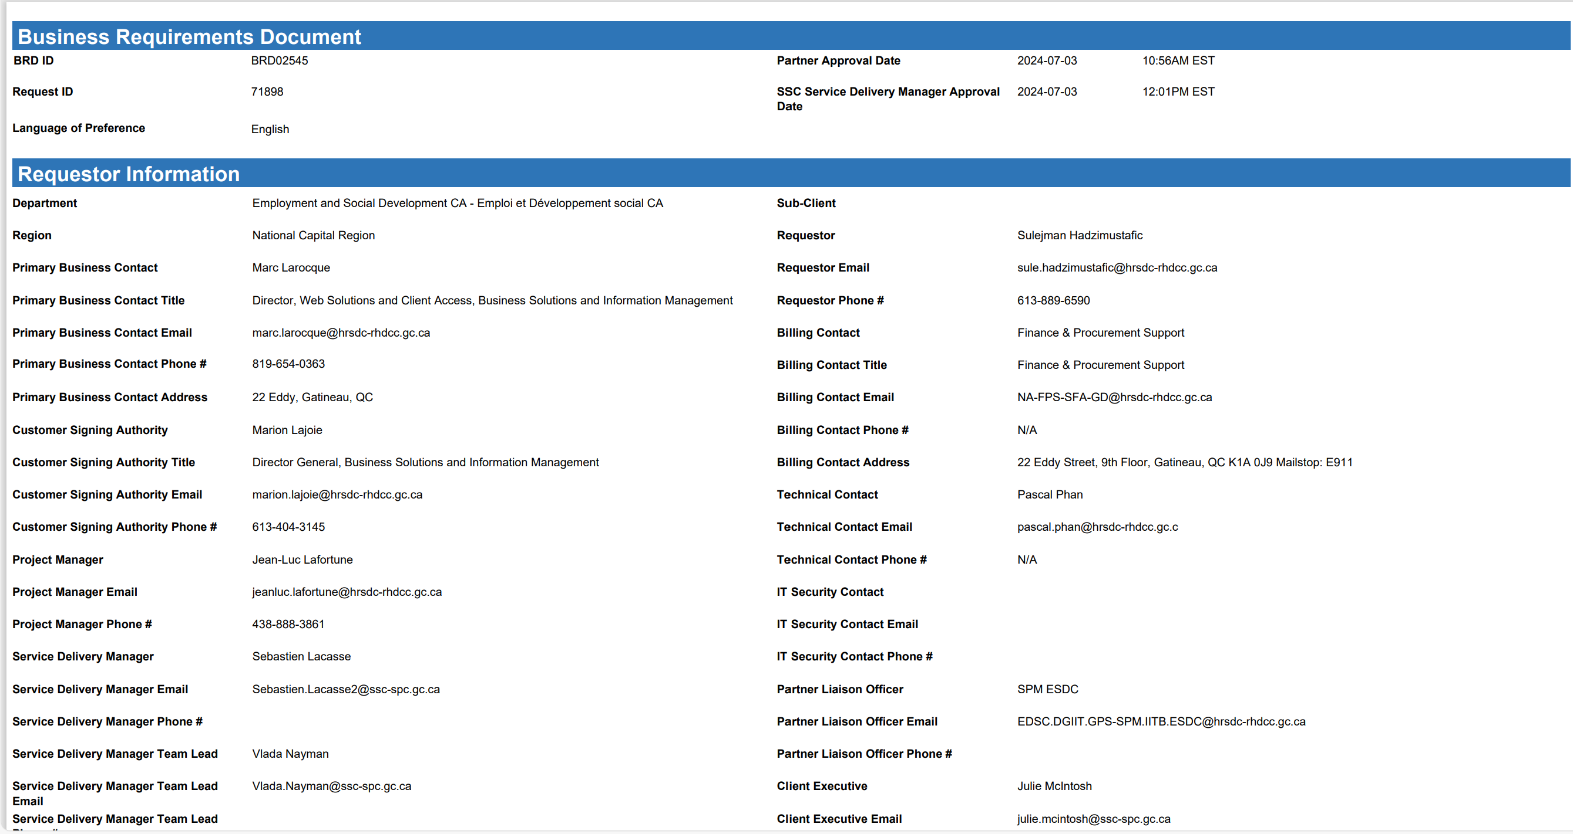
Notes:
Here is another BRD in PDF format. So you can see that there is already three different versions of BRDs that look very different to each other.

Slide 10
My Approach
Assumptions about the structure of the data
Every Business Request contains no more than 1 BRD folder, 1 ePET, and 1 Agreement Approval Folder
All business requests directories are named as BR##### (useful information for metadata)
Every BRD contains certain keywords like “Business Requirements Document”
Regular Expression to identify patterns
Pandas to extract data from BRDs in Excel format
PyMuPDF to extract data from BRDs in PDF format
Notes:
So one of the most important things that I did was making assumptions about the structure of the data, and without these assumptions it would be very hard to make a generalized algorithm that can deal with these different structures. I derived these assumptions by looking at lots of BRDs from different business requests and trying to find common patterns among them. There are three main assumptions that I made in my algorithm; the first one being the fact that every business request contains no more than 1 BRD folder, 1 ePET folder, and 1 agreement approval folder (there are other data in the directory, but these three folders are the primary ones that I was dealing with). The second assumption I made was that all business requests directories are named as BR followed by a bunch of digits, and this was very useful as metadata especially in the RAG part of my project which I will take about later. And lastly, I made the assumption that every BRD contains certain keywords like “Business requirements Document” to make sure that the algorithm picks out BRDs only.
When I was making the algorithm, I used regular expressions to identify patterns in the extracted data so that I can filter out irrelevant data and also do metadata extraction.
Earlier, I showed that BRDs come in different formats as Excel files or PDF files, if it was an Excel file, then I would use Pandas to extract the data. If it was a PDF file, then I would use PyMuPDF to extract the data.

Slide 11
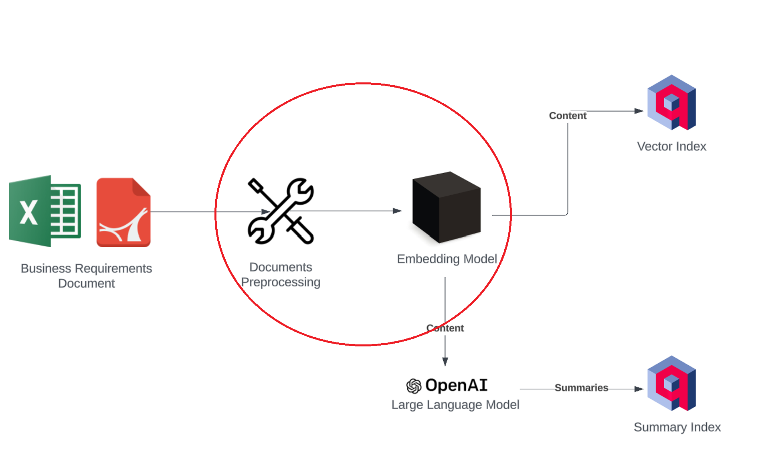
Data Transformation
Notes:
Now I will talk about data transformation, which is what I did after I extracted my data.

Slide 12
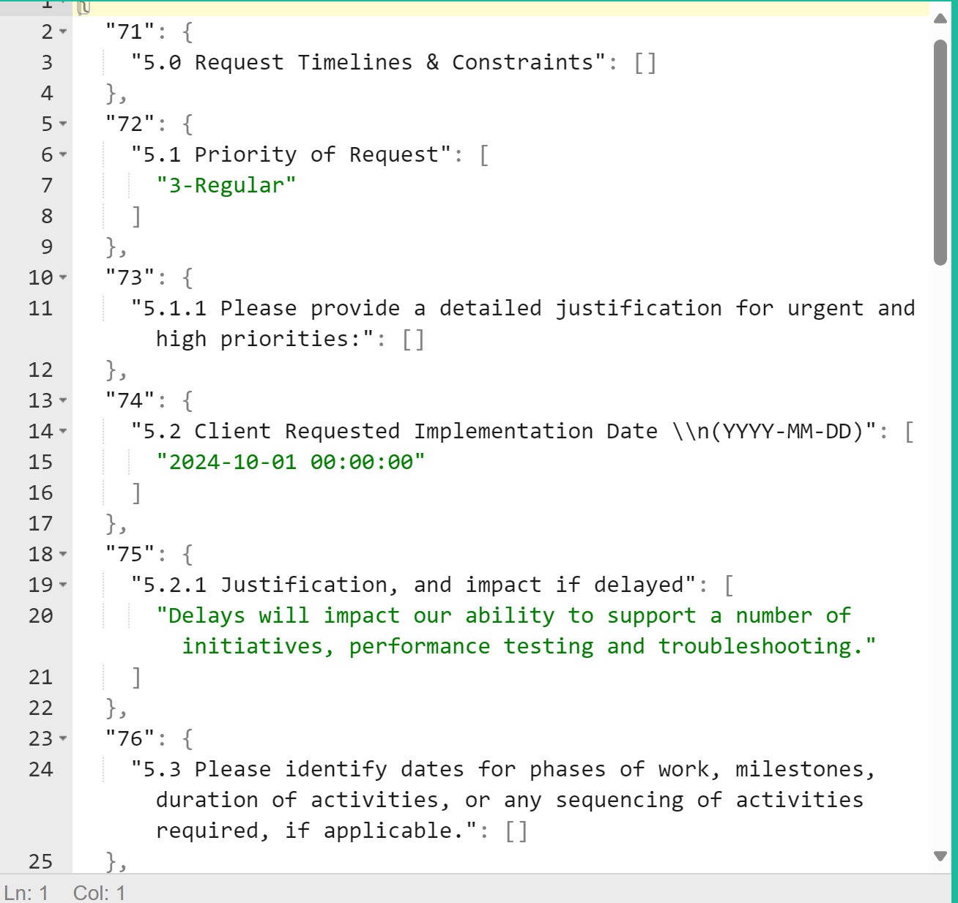
My Approach
JSON
Standard cleaning techniques using Pandas
Replacing NaN values
Convert all cell values to strings
Data division by section for contextual understanding
Llamaindex TextNodes for data storage
FastEmbeddings with Mxbai-embed-large-v1 model
Maybe compare Raw text with JSON response
Notes:
I tried to keep the data as original as possible, so I didn’t do too much on the natural language processing side. One thing that I thought about was the fact that these raw data came from Excel spreadsheets, which means that they are semi-structured, and by converting them into JSON format, I can maybe retain that tabular structure when I feed them into some large language model. To do that, I had to read the data using Pandas and store it in a Dataframe so that it can be converted into JSON easily. Every BRD was also very lengthy, and since large language models are bad at dealing with very long context, I divided my data up by sections so that I can feed them into the large language model by smaller chunks. When I have these processed data, I applied embeddings on them using the Mxbai large model, and I stored them in this data structure called Llamaindex Textnode so that I can load them into a database.

Slide 13
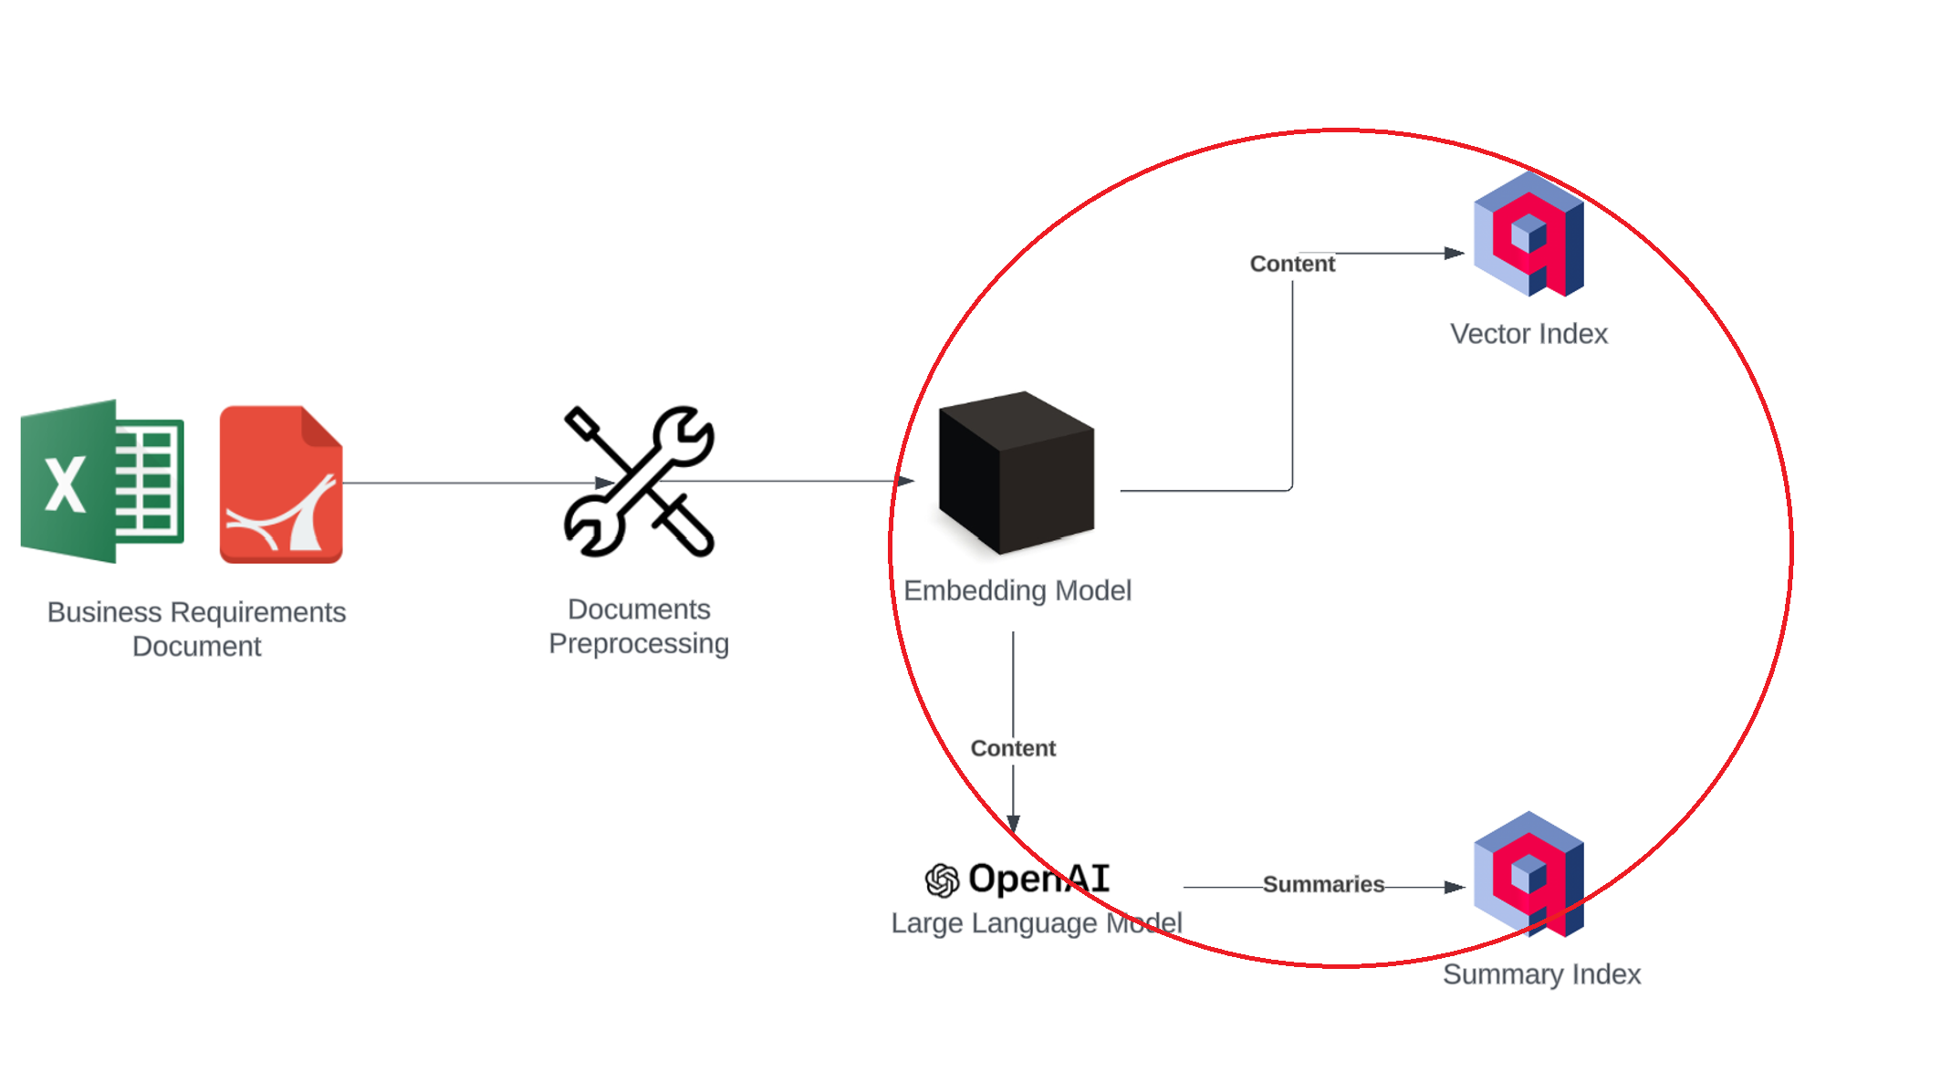
Data Loading
Notes:
And that leads to the next part of the pipeline, which is data loading.

Slide 14

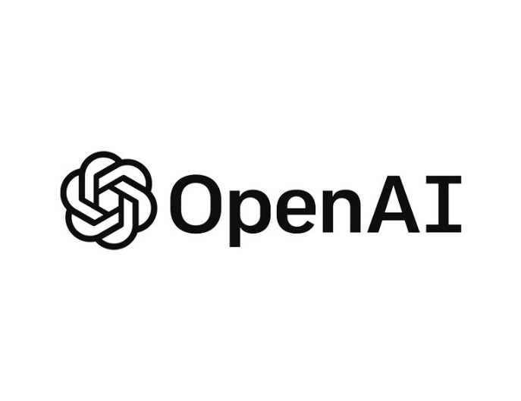
My Approach
Qdrant vector database
Data stored along with their respective metadata (for RAG purposes)
Source of information, the file type, business request number
Summary generation using OpenAI (for RAG purposes)
GPT 3.5 V.S GPT4o-mini
Minimal hyperparameter tuning (context length, temperature)
Separate context index and summary index
Takes approximately 1 hour and costs 1.6 million tokens to store 100 business requests
Notes:
Using LlamaIndex’s built in functions, I loaded my data onto Qdrant so that I can interact with them using LLMs or other tools.
Along with the JSON data from the BRDs, each node in the database also contains their respective metadata, such as the source of where the data came from, the file type that stored the data, and the business request number for the data. And this data is very useful during retrieval augmented Generation.
To improve my retrieval accuracy during RAG, I also summarized each business request using GPT4o-mini and stored them in a separate database to the JSON data. I tried generating summaries using GPT 3.5, GPT4o, llama3 8b, but it turns out that GPT4o-mini worked the best in terms of pricing and output quality. I did little on tuning hyperparameters like context length or model temperature because I couldn’t really see the effects of it too well, and this could be a future area of improvement
It takes approximately 1 hour and costs 1.6 million tokens to extract like 100 business requests, and I think 1.6 million tokens is like around 50 cents usd.

Slide 15
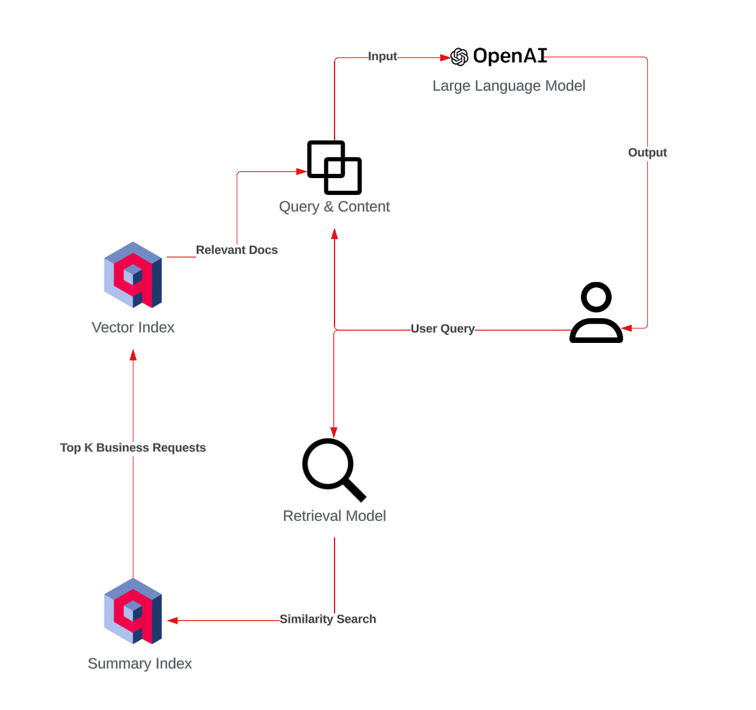
Part 2: Retrieval Augmented Generation with Open WebUI
Notes:
Here comes part 2 of my project, which is retrieval augmented generation with Open WebUI

Slide 16

Retrieval Augmented Generation
Goal
Interaction with parsed data using Generative AI
Integration with a chat interface (Open WebUI)
Problem
Poor retrieval accuracy
Hyperparameter tuning
Top k documents
Notes:
My goal for this component is to basically enable interactions between generative models and my parsed data in the database, and to integration these interactions into a chat interface which in this case is Open WebUI.
Some of the problems that I have encountered while building this component was poor retrieval accuracy, so given a query from the user, the retrieved nodes from the database were not very relevant to the query, and I also had trouble finding the right hyperparameters like the number of relevant nodes to retrieve based on the given query, and this was something that had a significant impact on the quality of the model’s output and the cost of the queries.

Slide 17
Query & Retrieval Process
User query is vectorized into numerical representations
The vectorized query is used to retrieve top K nodes from the summary index using cosine similarity
Each node is associated with a business request number
With these numbers, retrieve top K nodes from the context index
The query and retrieved context is synthesized as inputs to a LLM
Output is generated by the LLM
Everything is done with LlamaIndex and Open WebUI’s pipeline feature
Notes:
To overcome these challenges, I came up with a custom workflow. I will go back to the diagram so that you can understand this process visually.

Slide 18
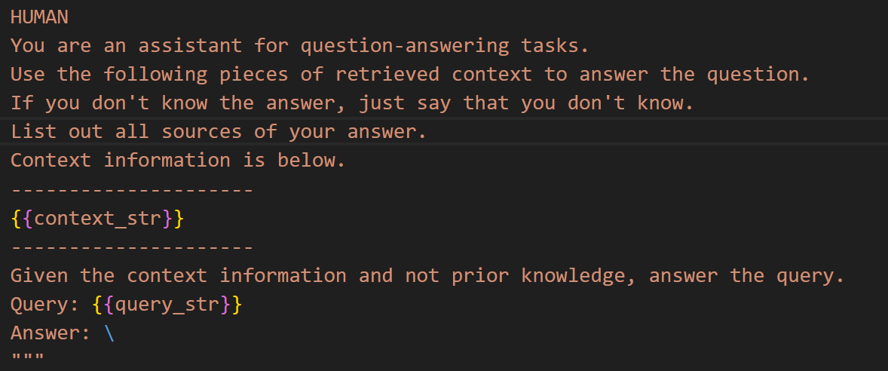
Other Details
Keyword Extraction(BR#####) from user query using regular expression
Prompt Engineering to prevent hallucination
Hybrid retriever (bm25 + cosine similarity)
Notes:
Some other things that I added in my workflow includes keyword extraction. So if the user mentions a business request number in the query, then that business request number will be used to directly retrieve the relevant nodes from the database.
I also did prompt engineering to deal with hallucination problems in the output of the model. As you can see in the picture, I asked the LLM to give the source of the nodes that it retrieved, and also made sure that it doesn’t make up stuff when it doesn’t know the answer
Lastly, I implemented a Hybrid Retriever (which is a combination of keyword search and cosine similarity).

Slide 19
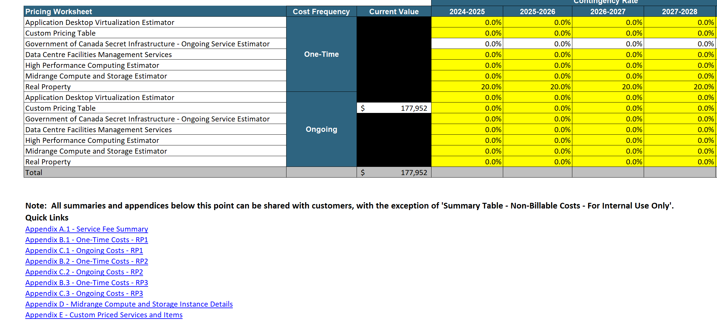
Part 3: ePET Feature Extraction (Under development)
Notes:
This component is not finalized, but I will talk about what I have done so far.

Slide 20

Feature Extraction for Data Analysis
Problems
Duplicated ePETs with different dates
Loosely structured file
Chosen libraries don’t work for Excel files with filters turned on
Solution
Convert all Excel files from xlsb, xlsm, xlsx format to xlsx
Use custom script to turn off Excel filters (Microsoft Windows)
Read tabular data using Unstructured IO
Notes:
The problems that I encounter while working on this component include duplicated Epets each with different dates, meaning that It was really hard to tell which Epet had the most up to date costing when there are multiple of them under the same directory. The structure of the Epets were also messed up, so it was very difficult to retain the tabular structure of the data after extracting it. Another thing that came up was these Excel Files each had like some type of filters turned on, and that wasn’t compatible with the library that I was using.
To solve these problems, I first converted all Excel files with extensions of xlsb, xlsm, or xlsx all into xlsx, and I wrote a custom script to turn off the filters in these files so that my chosen library can be used to read the data that are stored in them. The library that I used was Unstructured IO.

Slide 21
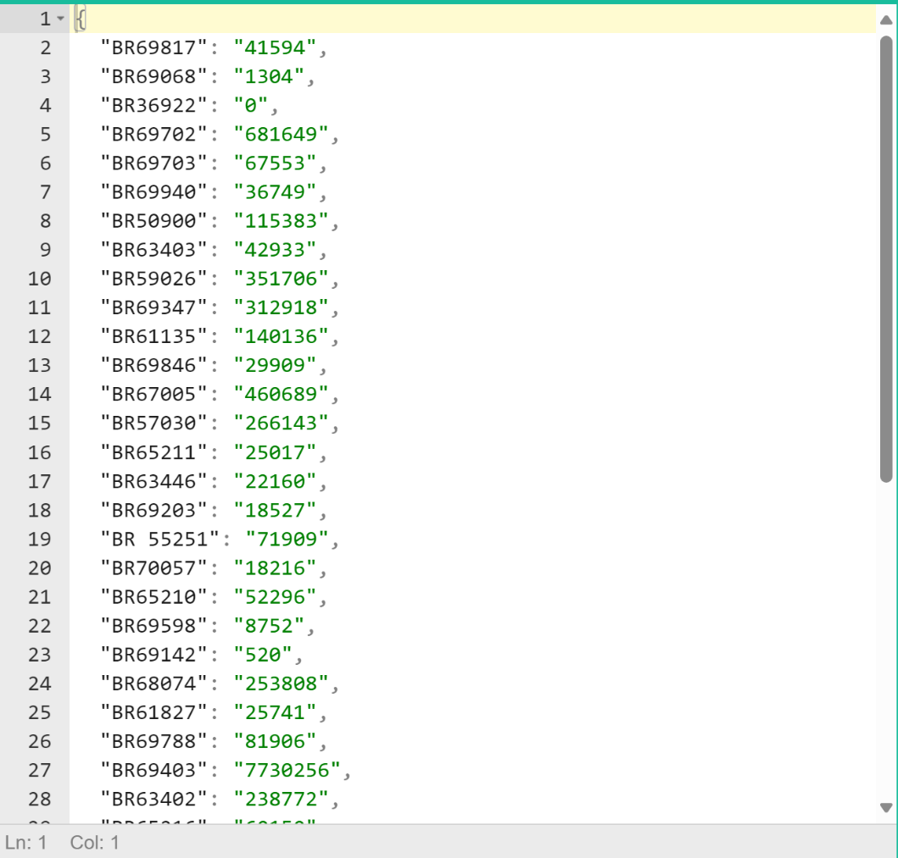

My Approach
Assumptions about the structure of the data
Total cost of the business request always shows up following the first “Total”
Keyword extraction using regular expressions
AutoGluon
Notes:
When I was reading that data, I had to make assumptions again due to the inconsistent structures of the data. And one of the assumptions that I made was that the total cost of the business request always shows up following the first “Total” (Show the picture in slide 19). On the right, you can see that I have all the extracted prices with their respective business request number in JSON format.
One thing that I want to mention is that I tried building a costing prediction model based on some of the features that I have using a very powerful library called AutoGluon that can automatically build machine learning models if you feed data into it. I had no good results when I used but I think it was mainly because of the data that I fed into it and not the model itself.

Slide 22

Future Directions
Support for bilingual data (Can easily be done by changing a few lines of code)
Use AI agents to look at document similarity and deal with inconsistent directory structure
Part 1
Better PDF parser
Part 2
Hyperparameter tuning
Chat engine
Reranking
Part 3
In depth data analysis for model construction and feature extraction
Notes:
Finally, I will just talk about some of the future directions of this project.
The first thing is support for French data. I only parsed English data for simplicity, but if I wanted to parse French data, I could just change a few lines in my code, and it shouldn’t be a difficult process.
I think the biggest future improvement that could be made is incorporating AI agents into my workflow. This is something that I found while learning about RAG, and I think they have great potentials as they become more powerful. For example, you can use them to identify duplicated data by actually going into these documents and look at their similarity, and they can also classify documents by dates or deal with inconsistent directory structure.
For part 1 of my project, I could use a better PDF parser. The PDF files also had a tabular structure, and the open-source tools that I found do not identify that structure too well, so if a better extraction tool is used, then the extracted data can also be more meaningful.
For part 2 of my project, I can improve on hyperparameter selection, which I have already mentioned earlier.
I could’ve also made a chat engine. Right now I only have a query engine that the user can ask questions on. The problem that I saw with chat engine was that the number of tokens could grow exponentially as the chat history becomes longer, because every time the user makes a query, the entire chat history is sent back to the model along with the BRDs, and the pricing can go really high quickly.
I also tried simple reranking to improve document retrieval accuracy during RAG but I didn’t find it too helpful, and this could be something to look at in depth in the future.
And lastly for part 3, I could probably do more on extracting meaningful features from the data and maybe build a custom model instead of using an automatic engine.

Slide 23
Demo

Slide 24
Name your files consistently!

