Slide 1
Curation and Refactoring of Legacy Software
Walton Macey
June 2018

Slide 2
Agenda
Motivation and overview of research
Over decades massive amounts of legacy softwares have been developed at huge costs
Even if functionality exists one cannot find it
Even if the software exists it may not run on the latest architecture
Approach to curating legacy software collection
Discover current issues
Validate existing metadata
Deliver final audit
Deep dive into refactoring an active legacy software development
Develop tools for refactoring ease
Define effort refactoring model
Notes:
In the past 50 years multitudes of expensive and costly legacy softwares have been developm0pkom

Slide 3
Introduction and Goals
Legacy Software
Goals
ESTSC:
Explore the current state of the Department of Energy’s Software Center and what was done to improve and validate existing software collection
Assess flaws and inconsistencies
Curate, audit and correct entire inventory
ACME:
Demonstrate an approach to contributing to one such software package still undergoing active development
Data restructuring of user-derived data types in the Land Model component
What is it?
Difficult to utilize, learn from or contribute to legacy software
Challenges arise due to
Outdated media & instructions/documentation
Missing documentation
Unknown current status of software
Note:
Source:
Notes:
Legacy software is way to categorize software projects which may be outdate or untouched for years
But in this case, due to the nature of these being research and scientific softwares, there is a large potential for learning
And continued contribution for these older software packages

Slide 4
Agenda
Overview of research
Approach to curating legacy software collection
Deep dive into refactoring an active legacy software development

Slide 5
The OSTI Software center needs an update to match modern advances
Overview of the center
History: At OSTI in Oakridge, TN is the Energy Science and Technology Software Center (ESTSC) originally founded at Argonne National Laboratory by Margaret Butler.
Description: Serves as the software distribution center for requests of federally-funded software developed by DOE national laboratories.
Inventory: Responsible for 3300+ Software Packages from 50+ national labs over 55 years
Issues with the current center
Current method of distribution is very outdated
The center has changed locations, management and methodologies countless times, causing inconsistencies in what is known about the software collection
General lack of knowledge about accuracy of information for these packages
Existing Solutions
DOE code - What is it? What issues does it solve?
Improved software submission process
= does not impact past projects, not a valid solution for programs in past 5 decades
Note:
Source:
Notes:
Update with the modern world
1966-2018

Slide 6
Approached the problem in four steps
35_85
End Goal
Add value to legacy research software by efficiently providing an accurate and complete inventory of the state of the DOE software collection.
Create informed understanding of the landscape of the software collection and create optimized approach for eventual digitalization of the software packages
1
2
3
4
Random Sampling
Metadata Cleaning
Auditing Inventory
Open Source Verification
Methodical approach to the existing problems allowed for streamlined problem solving and application of knowledge base
Note:
Source:
Notes:
Random Sampling
Metadata Cleaning
Auditing the entire collection – physical presence, duplicates, etc etc…
Open Source Validation –majority of work

Slide 7
Random sampling allowed for efficient diagnosis
1
Important findings and implications
Approach
We initially sampled 10 random software packages to gain an educated understanding, then expanded that sampling to 50 then 100, for a best representation.
Random sampling consisted of cross validating each individual software with metadata, physical folder and online research of each package.
Key Findings:
Within the random sample, over 30% of files were misclassified
Unknown quantity of software packages physically present.
Many important data fields are empty for the majority of packages
Implications:
Limits ability to utilize legacy software
Can’t trust data for each package or Open Source classification
The database was not only missing important classification information for 30% of files, but also included flawed and erroneous data classifications throughout the database
Note:
Source:
Notes:
This is a huge problem with a ton of files
I wanted to understand the problem at a high level first
Random sampling
Really alarmed at the number of issues
Due to inconsistency in the method and manner of documenting and accumulating software over 5 decades, we sampled initially sample 10 SW packages to gain an educated understanding.
Random sampling consisted of cross validating each individual software folder with its metadate in the center’s database, and then extensive research to search for further open source information from other sources

Slide 8
Random sampling allowed for efficient diagnosis of the ESTSC
1
Total Files | 3309
Total Classified Correctly | ~1777
Total Classified Incorrectly | ~580
Total Missing Classifications | 952
When extrapolating the random sample to the full population we estimate a large percentage of files incorrectly classified or missing
Note:
Source:
Notes:
Within our 100 random samples
When classified as Not Open Source, found to be incorrect for ~28% of the samples
When classified as Open Source, found to be incorrect for 15% of the samples
Approximately 30% of the samples were not classified at all.

Slide 9
Metadata cleaning allowed for database to be validated and completed
2
Example issues
Methodology
Incorrect data (wrong date, etc.)
Missing & incomplete data fields
Convoluted metadata parameters
Ex: One parameter holds information for 4 other variables
Script to extract missing data fields from software description
Ex: Programming Language, OS, Subject
Extract overcrowded parameters and populate correct data field
Manual confirmation often required for the script extraction results, and any incomplete or missing fields were cleaned and made NULL when applicable
Note:
Source:

Slide 10
Auditing inventory
3
Physical Status
Full physical inventory and tracking methodology
Cross validation to software center’s database
Findings:
~1000 software packages not present in the room [Open Source Note]
22 packages have more than one folder
At least 10 packages have physical media in the form of tape drive
Open Source Status
Develop method to scour online repositories like Github, Bitbucket, SourceForge and others for any trace of an open source version of each software
CustomSearch.py
Reduced results
Removed false positives
Verified final possible open source locations
Note:
Source:
Notes:
About 800 open source projects, do not need to have a folder in the room. Majority do have a folder as a placeholder

Slide 11
Open Source Verification
4
Process
Created customer search engine in Python to identify potential open source repositories
Google custom search API
Common source code hosting sites - github, bitbucket, codebase and gitlab
Utilized keywords from each software package’s metadata to search for potential matches in a websites header and description
Keywords mapped to respective software package and OSTI Id number
Created methodologies for eliminated false positives
Removed items relating to parsing libraries
‘word2vec’, ‘keywords’, ‘english’,
Urls ending in ‘.txt’, ‘.md’, ‘.bib’
NJOY related bibliography info
Ex: For 1200 software packages, 5784 possible urls are returned, after reduction 461 remain
Note:
Source:
Notes:
5784 urls returned for 1200 software packages
apply rules and scan
reduce to 461 urls
sed -i '/english/d' ./archive.csv
sed -i '/.txt\s*$/d' archive.csv
Look for identicaiul matches
with title - contains all or part of the title exactly
Look for consecutive urls with same first couple of levels of /asdf/qwerty/
Indicating multiple hits from the same directory
For example:
Software package: "Pyomo v5.0"
https://github.com/Pyomo/pyomo/blob/master/pyomo/repn/tests/ampl/small12.pyomo.nl
https://github.com/Pyomo/pyomo-model-libraries/blob/master/cute/aug2d_cute.py
https://github.com/Pyomo/pyomo/blob/master/examples/pyomo/draft/morphEpanet3.mod
https://github.com/google/or-tools/blob/master/examples/python/linear_programming.py
https://github.com/vmware/pyvmomi
The first 3 all begin with https://github.com/Pyomo/pyomo

Slide 12
Agenda
Overview of research
Approach to curating legacy software collection
Deep dive into refactoring an active legacy software development

Slide 13

Overview of ACME
Accelerated Climate Modeling for Energy
designed to accelerate the development and application of fully coupled, state-of-the-science Earth system modeling, simulation and prediction for scientific and energy applications.
Large scale earth simulation project to poject global climate under a wide variety of conditions
Data restructuring initiative within the ACME land model - the terrestrial land component
Note:
Source:
Notes:
Large scale earth simulation to project global climate
Large-scale earth system simulation codes
Accelerated Climate Model for Energy (ACME) has been designed to accelerate the development and application of fully coupled, state-of-the-science Earth system modeling, simulation and prediction for scientific and energy applications. With an early emphasis on improving software design and practice, development has included maintaining build, test, and performance tools for the relevant computer platforms, and providing rapid development and debugging capabilities to the team.
Designed to represent the interactions of atmosphere, ocean, land, ice and biosphere to project global climate under a wide variety of conditions

Slide 14
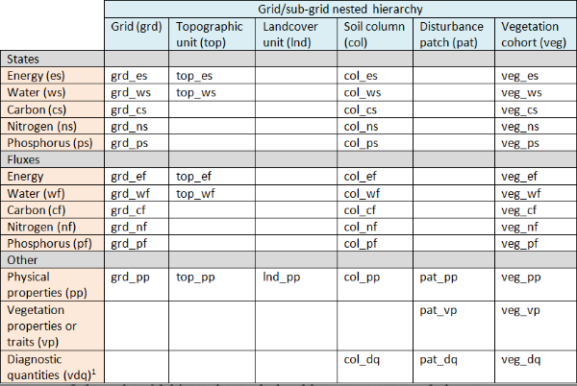
ACME was interested in simplifying their data architecture
Today
Future-state
Complex user-derived data types
Last release ACME 4.3 – convert fully to modern version of Fortran
New datatype requirements
From 50 to 8 primary data-types
Simplify implementation of submodels to allow for ease of understanding for other non-programming scientists.
Alleviate effort of future codebase restructuring
Note:
Source:
Notes:
Inside ACME, the scientists/modelers have developed a terrestrial land model,called the ACME Land Model (ALM). ALM is a process-based model with a collection of key biogeophysical and biogeochemical functions that represent the energy-water-biogeochemical interactions between the atmosphere and the terrestrial landscape. ALM contains hundreds of energy, water and ecosystem variables which may be used or modified by many terrestrial ecosystem functions/modules. Designing data types to contain variables in a more modular fashion can facilitate scientific model development and unit testing [6]. In our previous work [3] we have described quantitative ways to evaluate such data modularity and a search algorithm that finds the optimal assignment of variables to modules. Based on the prior analysis and ongoing and future requirements of ALM development, the fundamental data types of ALM needs to be “re-modularized”

Slide 15
There are 4 components that influenced our approach
32_84 38_84 41_84 59_84
Repeatable model
Ongoing assistance tools
Make it iterative
Automation
Separate the task into small pieces
Allows for rapid implementation and Testing
Learn from early iterations to design assistance tools
Increasing automation use with experience from early iterations
Identify work which could most benefit from automation
Automation tools can reduce effort spent on repetitive tasks
Focus on methods which would benefit any future restructuring efforts
Utilize scripting tools
Develop a model to approximate effort
1
Summary Script
Preview Script
Replacement Script
2
3
Explored on the following pages
Note:
Source:
Notes:
Why effort estimation needed
We want to refactor is it affordable, can we do it

Slide 16
Example
Variable Use Types:
Definition
Association
Assignment
Summary
Preview
Replace
Input:
Variable name of interest
Parent directory
Output:
Summary of the extent to which this variable is used throughout the code.
Locations of files
Number of files
Total Variable occurrences
Distribution of use of variable
Input:
Original variable + replacement variable
Parent directory
Output:
Full output of each original line containing the variable and what the new line of code would look like with the replacement variable
See replacement preview according to variable use
Includes filename, location and line number
Input:
Original variable + replacement variable
Parent directory
Output:
Executes the replacement as seen in the preview script
Can execute replacement according to variable use or simply replace all

Slide 17
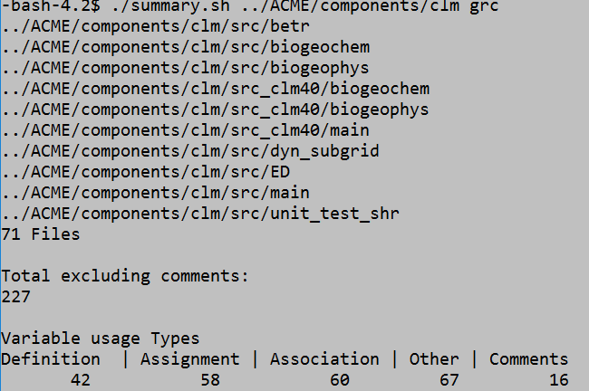
Example
Summary

Slide 18
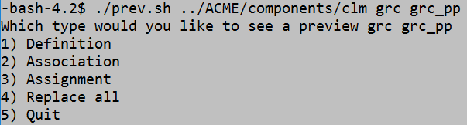
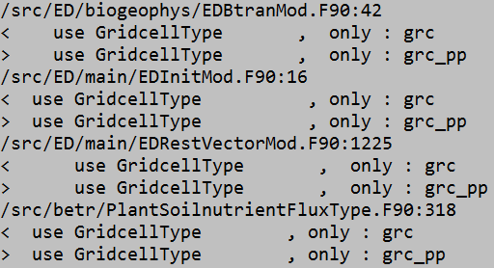
Example
Preview
Original line
Replacement line

Slide 19
Summary of findings
EQUATION:
Difficulty ~= -1.025(Insertions) + 5.72(Automation Difficulty) + 3.124(UserIssueDependency Flag) + 1.011 (Files Added)
Key Variables Analysis:
‘Insertions’ & ‘Files Added’ are both easily determined for any variable, utilizing the Summary script previously mentioned
‘User or Dependency Issue Flag’ & ‘Automation Difficulty’ as user created predictors aren’t as simple to determine
As flag type variables it’s a simple yes/no situation
Automation Difficulty can hopefully be ascertained by utilizing the Summary and Preview scripts previously mentioned combined with data restructuring experience.
User or Dependency Issues may be able to be predicted by looking at repository history to see if a variable has been previously changed or modified

Slide 20
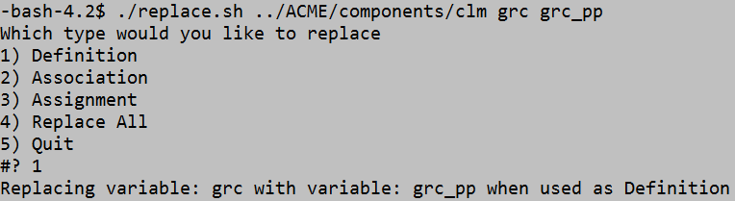
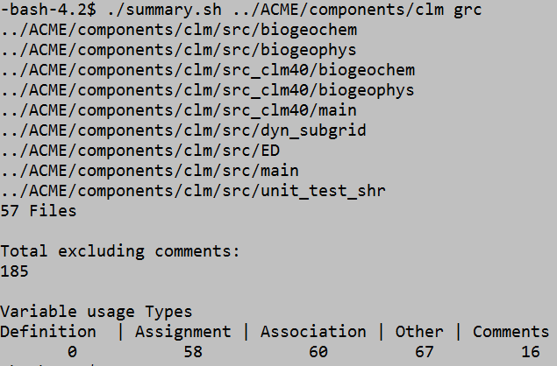
Example
Replace
Summary Script

Slide 21
How much effort will full refactoring take?
Approach
Statistics
Want to know if refactoring is an affordable option
Have implementation engineer assign level of difficulty associated with each of the 12 phases
Create additional variables to reflect missing or intangible aspects of the data reconstruction process
12 iterations of data reconstruction
Simple Parameters:
Sequence of Ordinality
Insertions
Deletions
Files Modified, Added or Deleted
Files Added
Number of Actions Performed
Number of Commits
Number of Automations Performed
To summarize, for each of the 12 major changes to the repository, we extracted all possible associated data in an effort to identify key factors contributing to the difficulty of making that major change
Note:
Source:
Notes:
Wanted to learn from and make it easier for the next round of restructuring
Summary findings of Data Reconstruction
12 branches
Analysis was performed through extensive diff comparissons between each commit
Why effort estimation needed
We want to refactor is it affordable, can we do it

Slide 22
User Defined Variables
Variables | Brief Description
Automation Difficulty | Flag variable of whether an aliasing difficulty occurred when trying to change variables automatically
Manual Addition Difficulty | Estimation of amount of non automated code required per phase
Dependency/User Issue | Flag variable of whether a user issue occurred or dependency issue with variable naming. Harder to predict.
Difficulty | Determined by the engineer (Dr. Wang) for each of the 12 sprints to best assign a difficulty and amount effort required

Slide 23
Determination of predictors for Model of Development Effort
1
Log Transform Data
Analyze Correlations
Perform Principal Component Analysis
2
3
Initial data had parameters only in the single digits and others with a range up to 3500
Normalizes data to range from 0-8
Utilized statistical functions in R to help identify which parameters may best explain difficulty/effort
Examples: spearman correlation, correlation plot
Full clustered correlation plot
Combined with correlation analysis to narrow down a subset of predictors to create a linear model to estimate difficulty.
Established 6 or 7 possible predictors to be utilized in determining the strongest linear model to predict difficulty
Explored on the following page
Note: Detail for how we analyzed correlation between parameters and performed Principal Component Analysis can be found in the Appendix
Notes:
After fiting all observed data to the input from the implementation engineer

Slide 24
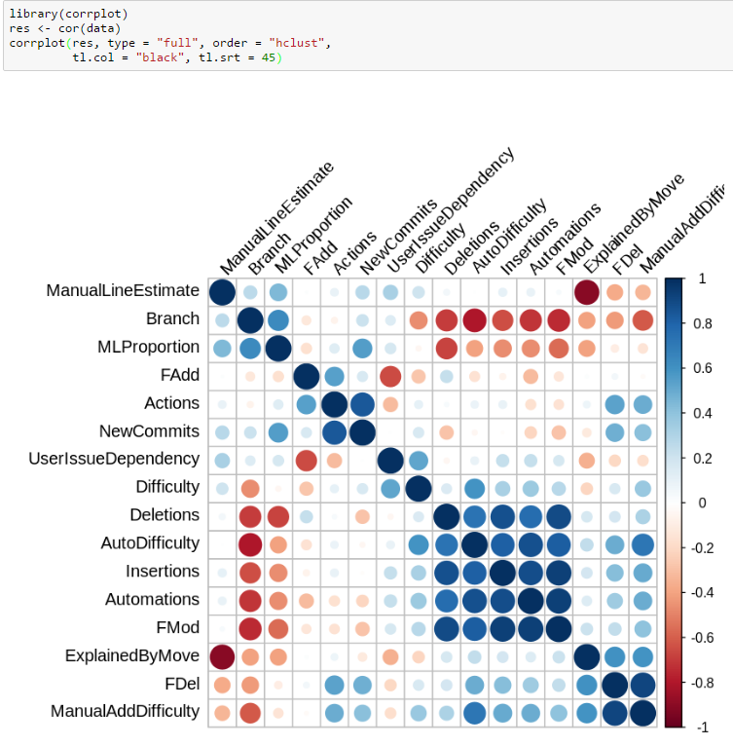
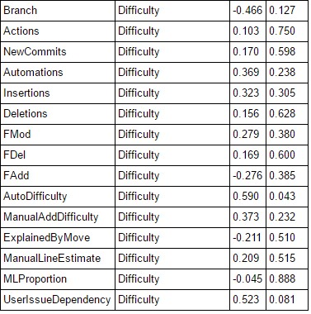
Overview of the variables
Notes:
Show the pretty slide you walked me through here. Could add a highlight of the variables that matter and talk through implications for making changes to the software
Establish which variables could have the largest impact and influence on determining difficulty
With that narrowed down list, perform PCA operations in R, in efforts to find a subset of predicotrs which can be used to model difficulty
Fraction of variance explained by PC1, PC2, PC3
P value shows which terms show significance
Adjusted r squared values
And a summary of overall goodness of fit
Indicate the fraction of overall variance the model accounts for

Slide 25
Impact
ESTSC
ACME
Utilizing updated and complete software collection metadata to determine associations and connections between the software packages.
Establish an efficient and informed method to begin digitalization of each legacy software not already available via open source means.
Predict difficulty of any further work for current data restructuring work
Quantify the benefits of restructuring the data architecture for the ACME Land Component
Notes:
Digitalization
can approach the brute force method of manually copying each software to DOE code or whatever repository storage media with the knowledge of what is actually
Any further work can move forward with assurances that work being done is not redundant or a waste of time/effort

Slide 26
Concluding Remarks
Aim - Manage legacy software
Curation
Uncovered issues
Corrected and validated results
Summarized content
Refactoring
Developed tools for refactoring ease
Defined effort refactoring model

Slide 27
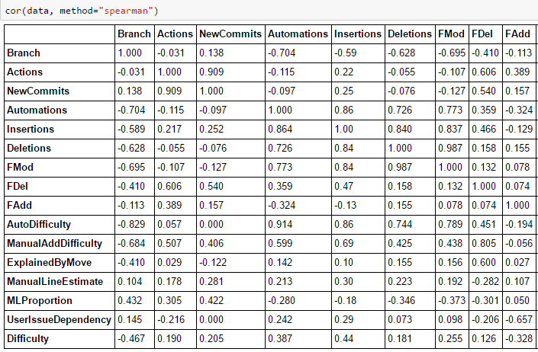
Appendix
Correlation data using R

Slide 28
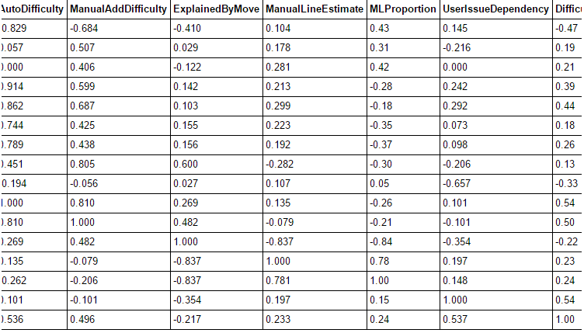
Appendix
Correlation data using R continued

Slide 29
Appendix
Correlation data using R refined and ordered

Slide 30
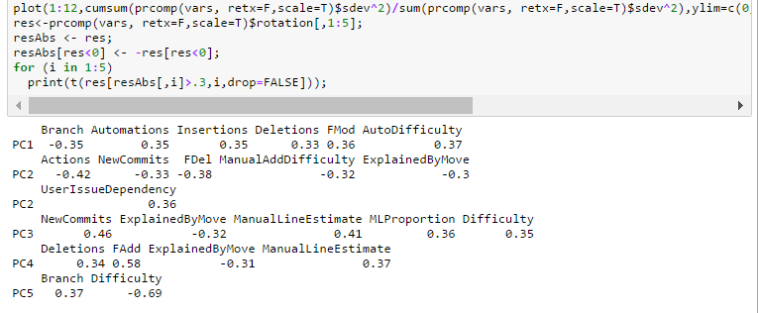
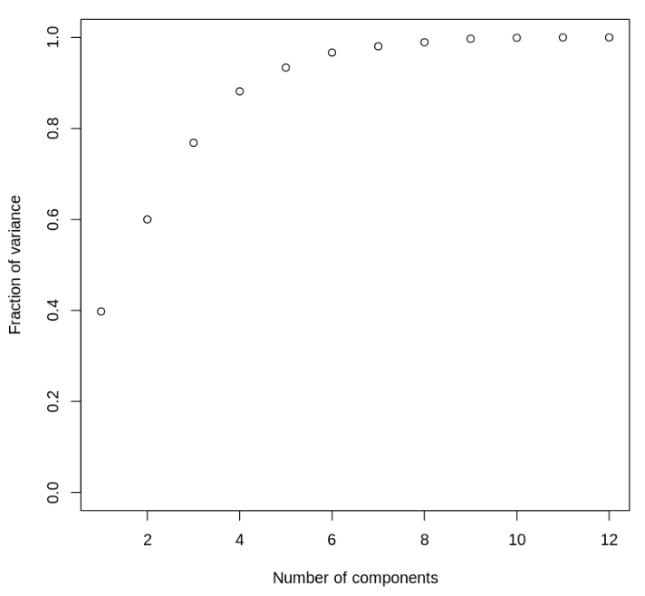
Appendix
Principle Component Analysis using R

Slide 31
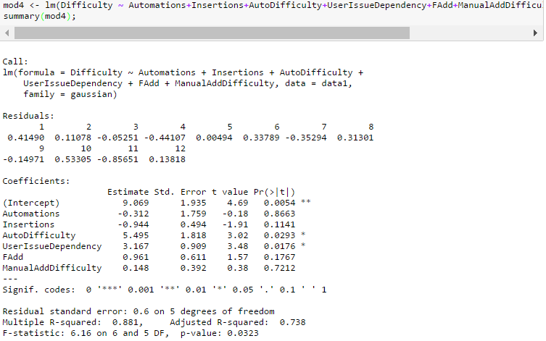
Appendix
Initial linear model calculations using R

Slide 32
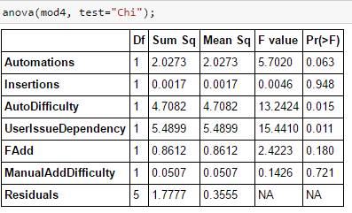
Appendix
Anova results using R : p value indicates which terms show significance for this linear model

Slide 33
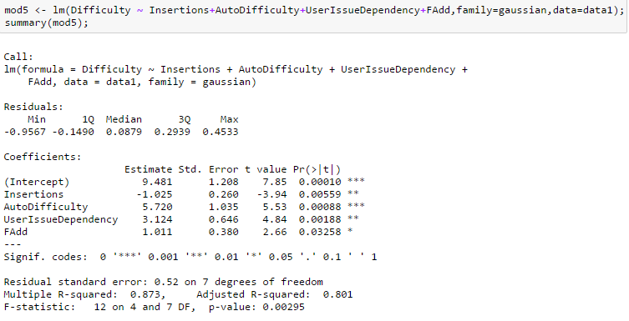
Appendix
Final linear model calculations using R

Slide 34
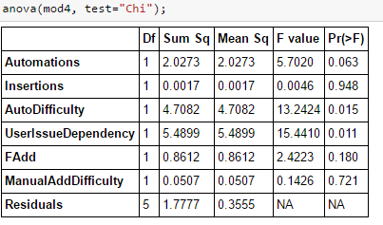
Appendix
Final Anova results using R : p value indicates which terms show significance for this linear model

Slide 35
The research consisted of two components
10_84 17_84
Optimization of DOE Software Center
“deep dive” into an example Legacy software
Understanding and diagnosing current legacy software problems
Recognize key learning opportunities from legacy software curation
Create high-value verification processes of existing collection of legacy software
Determine issues in utilization of legacy software, and define a future state
Looking at one such software package managed by OSTI, assessed the methodology for proper contribution
Demonstrated methodology for contribution to project that is still undergoing active development 20+ years later
Tested and validated contribution approaches that can be implemented efficiently in all future endeavors.
Note:
Source:
Notes:
What is legacy software
One of the critical challenges to improving DOE’s software capabilities (and, therefore, accomplish its mission goals efficiently and effectively) is the general lack of understanding of the current DOE capabilities and resources that are distributed over numerous projects implemented over at least half a century

Slide 36
Other unexpected issues did arise
VARIABLE DEPENDENCY ISSUE
Change in Testing Framework
Caused by individual’s different style of programming
Aliasing issue - changed but not everywhere
Ex: “pft” in 4.0 change “patch” in 4.5;
not a clean change for this variable
Issues merging restructuring work with the master branch
Solution:
Rebase the fork and exclude 2 problem commits which were causing issues
Patch the problem commits and identify & remove lines of code causing issue

