Slide 1



PRELIMINARY DESIGN REVIEW Code Optimization of GSM – AMR Speech Codec
ECE 6277 Fall 2010
November 18, 2010
Group Number 7
Group Members:
Pratik Chatterjee
Shubhojit Chattopadhyay
Manas Choksi
Vaibhav Desai
Ashwin Shivani

Slide 2

Introduction
Overview
It is a Narrow Band Speech Codec specified by 3GPP.
Uses link adaptation to select from eight different bit rates based on link conditions.
It uses Algebraic Code Excited Linear Prediction (ACELP) as speech codec.
It utilizes Discontinuous Transmission (DTX), Voice Activity Detection (VAD) and Comfort Noise Generation (CNG) to reduce bandwidth usage during silence periods.
Specifications
Input: 8 kHz sampling rate, 13-bit PCM
20 ms frames, no overlap
8 modes + Comfort noise
Output bitrate from 4.75 – 12.2 kbps
Modes | MR122 | MR102 | MR795 | MR74 | MR67 | MR59 | MR515 | MR475
Bit Rate (Kbps) | 12.2 | 10.2 | 7.95 | 7.4 | 6.7 | 5.9 | 5.15 | 4.75

Slide 3
Encoder Explanation
Preprocessing
Does high pass filtering of input speech with cut off frequency at 80 Hz.
Linear Predictive Coding(LPC) Analysis
Represents spectral envelope of input digital speech in compressed form with help of linear predictive model.
Autocorrelation and Levinson- Durbin algorithm are used in computing speech in compressed form. (A(z) and A^(z)).
Here frames are split in 4 sub frames.
It performs 10th order of linear prediction.
For 12.2 kbits/s mode, this is performed twice per frame with no look ahead.
For other modes, performed once per frame with 5ms look ahead.
Open Loop Pitch Analysis
Filters the preprocessed speech signal with perceptual weighting filter and finds the pitch lag T0.
Open loop pitch search function is selected based on state of VAD and DTX modules.

Slide 4
Encoder Explanation
Adaptive Codebook Search
It is performed on sub frame basis.
It computes adaptive excitation vector by performing closed loop pitch search and then interpolating past excitation at fractional pitch lag so obtained.
Innovative(Fixed) Codebook Search
It is performed on sub frame basis.
Minimizes error between weighted input speech and synthesized or reconstructed speech.
Encodes the random part of excitation signal since the periodic part is removed.
It computes the fixed codebook vector.
Filter Memory Update
Updates the filter memory for adding entries in the codebook for current excitation signal.
Impulse Response Computation
Computes h(n) impulse response which is used for codebook searching.

Slide 5
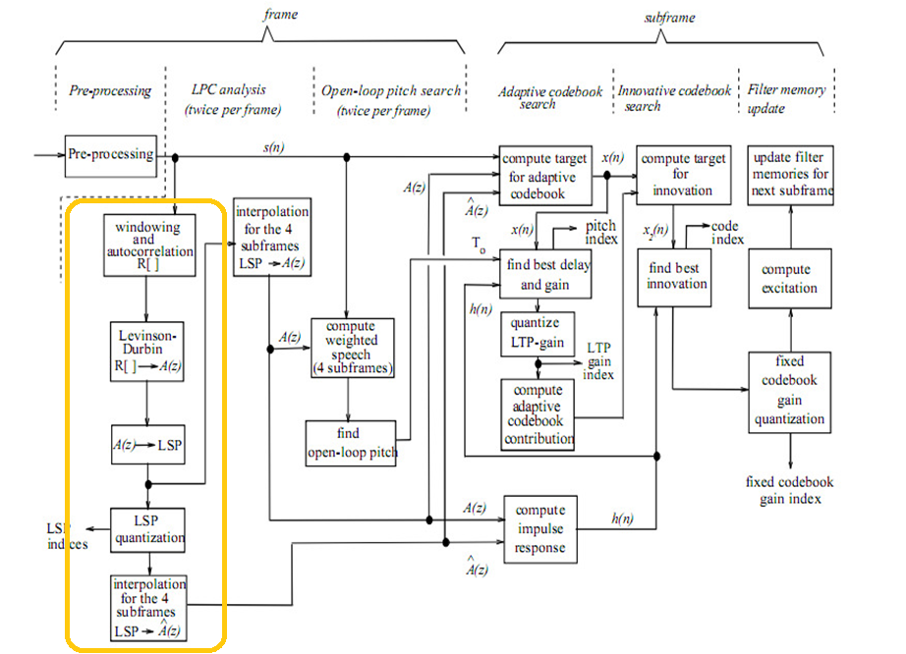
Encoder Block Diagram

Slide 6
Decoder Explanation
For each frame LSP coefficients are interpolated and converted to Linear Predictive coefficients(A^(z).
The codebook parameters provided by encoder are decoded by table lookup.
For each sub frame adaptive and fixed code book vectors are interpolated with help of above parameters.
For each sub frame, adaptive and fixed codebook vectors are added and the n multiplied with their gain indices to obtain the excitation signal.
This signal is passed to the synthesizing filter which gives output as a speech.
This speech is further passed for post processing were with help of adaptive post filtering and high pass filter, the speech quality is improved.

Slide 7
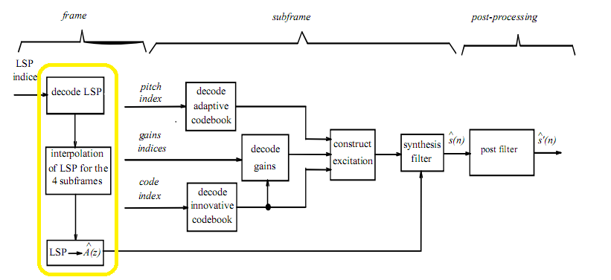
Decoder Block Diagram

Slide 8
Modules Optimized
Encoder
Autocorrelation
LSP
Levinson
Decoder
LSP

Slide 9
Autocorrelation
Functions Optimized
Autocorr()
Scope for Optimization
Large Iteration Loops
Multiple mathematical function calls
Misaligned Data

Slide 10
LSP
Functions Optimized
lsp()
Az_lsp()
lsp_az()
lsp_avg()
Get_lsp_pol()
Lsp_lsf()
Scope for Optimization
Multiple mathematical function calls
Multiple calls to single-line counter functions
Redefinition of loop variables
Large references to global variables
Switching loop types

Slide 11
Levinson
Functions Optimized
Levinson()
Scope for Optimization
Multiple mathematical function calls
Multiple loop Iterations
Calls to single-line counter functions

Slide 12
Optimization Techniques
Function Inlining
Use of Intrinsics
Loop Unrolling
Loop Checking
Loop Inversion
Avoid holes caused By Data Misalignment
Use of Registers for loop counters
Use of #Pragma Compiler Directive
Minimize the use of Global Variable Access
Removal of “Return” from Void functions
Conversion of Complex Loops to Simpler Loops
Modifying the Build Properties

Slide 13
Optimization Techniques
Function Inlining
Inlining removes the overhead of function call and return. The function calls for small and frequently occurring functions are replaced by the function definition itself .
Use of Intrinsics
C55x provides special functions which substitutes a sequence of automatically generated instructions for the original function call (similar to inlining).
List of Intrinsics Used:
Function | Intrinsic
add(x,y) | _sadd(x,y)
L_add(x,y) | _lsadd(x,y)
sub(x,y) | _ssub(x,y)
L_add(x,y) | _lssub(x,y)
mult(x,y) | _smpy(x,y)
L_mac(x,y) | _smac(x,y)
shr(x,y) | _shrs(x,y)

Slide 14
Optimization Techniques
Loop Unrolling
It increases the program execution speed by reducing/eliminating the instructions that control a loop at the expense of increased code size .
Normal loop | After loop unrolling
int i; for( i = 0 ; i < 100 ; i++) { x[i] = 1; } | int i; for( i = 0; i<100; i=i+5) { x[i]=1; x[i+1] =1; x[i+2] =1; x[i+3] =1; x[i+4] =1; }

Slide 15
Optimization Techniques
Loop Checking
Converting the ++ (increment) to --(decrement) in loops.
Loop Inversion
Replace a while loop by an if block containing a do…. while loop . This reduces the number of jumps by 2 for the cases when the loop is executed.
Normal loop | After loop checking
for( j = 0; j < 240; j++) { …………… } | for( j=239; j >= 0; j--) { ………….. }
Normal loop | After loop inversion
int i, a[100]; i = 0; while (i < 100) { a[i] = 0; i++; } | int i, a[100]; i = 0; if (i < 100) { do { a[i] = 0; i++; }while (i < 100); }

Slide 16
Optimization Techniques
Avoid holes caused by data misalignment
Use Registers for loop counters
Use of # Pragma Compiler directive
Normal Code | After data allignment
int i; long x; Int k; | long x; int i; int k;
Original Code | Revised Code
for( j = 0; j < 240; j++) { …………… } | #pragma MUST_ITERATE(240) #pragma UNROLL(240) for( j = 0; j < 240; j++) { …………… }

Slide 17
Optimization Techniques
Minimizing the Use of Global Variable Access
Declare a loop variable for a loop locally rather than globally to reduce the number of memory accesses.
Remove “Return” from Void Functions
Convert a complex loop containing multiple loop variables into a simple loop containing lesser number of loop variables
Modifying the Build Properties
Set the compiler optimization level while building to either 0,1, 2 or 3.
( -o0, -o1, -o2 , -o3).
-o3 represents the highest level of optimization available for improving the performance which includes register, local , global and interprocedural optimizations.

Slide 18
Testing Methodology
Selecting optimization techniques
Zeroing down on a single profiling techniques and implementing in all the modules by different team members.
Profiling results for selected number of frames
Profiled results for selected number of frames which served as the benchmark for comparison (5 Frames for encoder and 10 Frames for decoder)
Comparison of accuracy in hex format
Output files were compared in notepad++ to give us a hexadecimal view of the files. Original and modified outputs were compared for hex format similarities.

Slide 19
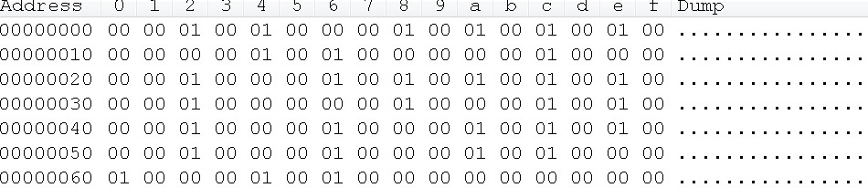
Testing Methodology

Slide 20
Profiling Results
Function Name | No. of Calls | Original Cycle Count | Optimized Cycle Count (-O3) | Percentage Improvement
Autocorr | 457 | 191,816,870 | 1,860,792 | 91.3
Lsp | 426 | 655,702,136 | 273,266,385 | 60.34
Az_lsp | 457 | 254,849,286 | 63,328,581 | 75.15
Lsp_az | 2215 | 46,993,689 | 13,097,529 | 72.12
lsp_avg | 427 | 1,771,011 | 681,734 | 61.50
Lsp_lsf | 627 | 9,933,078 | 5,030,012 | 49.33
Get_lsp_pol | 4430 | 40,064,528 | 10,206,717 | 74.54
Levinson | 457 | 70,374,393 | 19,884,150 | 71.74
Total |  | 1,271,504,991 | 387355900 | 69.53

Slide 21
Work Distribution
No. | Tasks | Members
1. | GSM AMR Document Review and Information Research | All (Main: Manas Choksi)
2. | GSM AMR Speech Codec Source code Review and Identifying modules | All
3 | Porting of Code to CCS | All
4. | Identifying compiler optimization and build optimization techniques | Shubhojit Chattopadhyay, Pratik Chatterjee
5. | Identifying intrinsic functions | Manas Choksi
6. | Identifying programmable code optimization techniques | Vaibhav Desai, Ashwin Shivani
7. | Testing and verification | All
8. | Identifying functions and optimization (Autocorrelation) | Shubhojit Chattopadhyay, Pratik Chatterjee
9. | Identifying functions and optimization (Levinson) | Manas Choksi
10. | Identifying functions and optimization (LSP functions in encoder) | Vaibhav Desai
11. | Identifying functions and optimization (LSP functions in decoder) | Ashwin Shivani
12. | Profiling of results | Vaibhav Desai and Ashwin Shivani
13. | PDR preparation | All

Slide 22
Milestone Chart
Week 0.5 | Week 1 | Week 2 | Week 3 | Week 4 | Week 5
Team Meeting
Research and Analysis of modules and functions
Initial Optimization
Code Optimizations and information collection
Final Profiling and PDR
Hand Coding in Assembly
Review and CDR

Slide 23
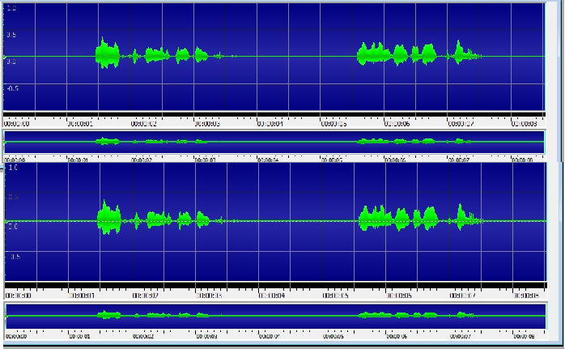
Output Waveform

Slide 24

Thank You

Slide 25
Appendix
Function inlining (AutoCorr):
move32():
#if WMOPS
multiCounter[currCounter].DataMove32++;
#endif
Intrinsics (oper32_b):
L_32 = _lsmpy (hi1, hi2);
L_16 = _smpy (hi1, lo2);
L_32 = _smac (L_32, L_16, 1);
L_16 = _smpy (lo1, hi2);
L_32 = _smac (L_32, L_16, 1);

Slide 26
Appendix
Loop Unrolling(Levinson):
A[0] = 4096; move16 ();
for (i = 1; i <= M; i = i + 2)
{
t0 = L_Comp (Ah[i], Al[i]);
st->old_A[i] = A[i] = round (L_shl (t0, 1));move16 (); move16 ();
t0 = L_Comp (Ah[i+1], Al[i+1]);
st->old_A[i+1] = A[i+1] = round (L_shl (t0, 1));move16 (); move16 ();
}

Slide 27
Appendix
Loop Inversion (lsp_lsf):
if(sub (table[ind], lsp[i]) < 0)
{
do
{
ind--;
//test ();
#if WMOPS
multiCounter[currCounter].Test++;
#endif
}while(sub (table[ind], lsp[i]) < 0);
}
/* acos(lsp[i])= ind*256 + ( ( lsp[i]-table[ind] ) *
slope[ind] )/4096 */

Slide 28
Appendix
//L_tmp = L_mult (sub (lsp[i], table[ind]), slope[ind]);
L_tmp = _lsmpy (sub (lsp[i], table[ind]), slope[ind]);
/*(lsp[i]-table[ind])*slope[ind])>>12*/
lsf[i] = round (L_shl (L_tmp, 3));
#if WMOPS
multiCounter[currCounter].DataMove16++;
#endif //move16 ();
//lsf[i] = add (lsf[i], shl (ind, 8));
lsf[i] = _sadd (lsf[i], shl (ind, 8));
#if WMOPS
multiCounter[currCounter].DataMove16++;
#endif//move16 ();
}

