Slide 1
Implementation and Evaluation of Pseudo LRU cache eviction policy
Shubhojit Chattopadhyay
CS7290, Spring 2012

Slide 2
Why cache eviction?
Caches have limited capacity
Set Associative caches have have conflict misses (Index is same but Tag is different)
How to decide which way to evict?
Memory access address
Cache
Tag A
Way A
Tag B
Way B
Tag C
Way C
Tag D
Way D
Index
Each way = one cache line (64B)

Slide 3
Commonly used policies
Random
Most Recently used (keep track of which way was the one last used)
FIFO
Least Recently used
Not Recently Used

Slide 4

Random Policy
Initial State
Way A
Way B
Way C
Way D
Access B
No effect
Way A
Way B
Way C
Way D
Access E
Pseudo Random generates 01
Evict Way B
Way A
Way E
Way C
Way D
Access L
Pseudo Random generates 10
Evict Way C
Way A
Way E
Way L
Way D
1
0
0
0
Linear Feedback shift register

Slide 5
FIFO Policy
Last In
First In
Initial State
Way A
Way B
Way C
Way D
Access B
No effect
Way A
Way B
Way C
Way D
Access E
Evict Way D
Way E
Way A
Way B
Way C
Access L
Evict Way C
Way L
Way E
Way A
Way B

Slide 6
LRU Policy
Most recently used
Least recently used
Initial State
Way A
Way B
Way C
Way D
Access B
Update location of B
Way B
Way A
Way C
Way D
Access E
Evict Way D
Way E
Way B
Way A
Way C
Access L
Evict Way C
Way L
Way E
Way B
Way A

Slide 7
Need for a new policy
Primary disadvantage of above policies
Some have high eviction rate
Some have Hardware and latency concerns
Some have higher Energy Concerns
How to maintain small latencies for closest caches if we have to update so much?
Problems with True LRU
Expensive in terms of speed and hardware
Need to remember the order in which all N lines were last accessed
N! scenarios ≈ O(N log N) LRU bits
2-ways → AB BA = 2 = 2!
3-ways → ABC ACB BAC BCA CAB CBA = 6 = 3!

Slide 8
Pseudo – LRU policy
Tree based tracking
Not exactly LRU, but not far from it either
O(N) number of bits
Faster than LRU

Slide 9
Pseudo LRU
Tree-based
O(N): 3 bits for 4-way
Cache ways are the leaves of the tree
Combine ways as we proceed towards the root of the tree
AB/CD bit (L0)
A/B bit (L1)
C/D bit (L2)
Way A
Way B
Way C
Way D
Way3
Way2
Way1
Way0
A
B
C
D

Slide 10
How it works
AB/CD bit (L0)
0
1
A/B bit (L1)
C/D bit (L2)
0
1
0
1
Way A
Way B
Way C
Way D
L2L1L0 = 001,
a way needs to be replaced, which way would be chosen?
L2L1L0 = 000,
there is a hit in Way B, what is the new updated L2L1L0?
LRU update algorithm
Replacement Decision
CD
AB
AB/CD
CD
AB
AB/CD
Way hit | L2 | L1 | L0
Way A | --- | 1 | 1
Way B | --- | 0 | 1
Way C | 1 | --- | 0
Way D | 0 | --- | 0
L2 | L1 | L0 | Way to replace
X | 0 | 0 | Way A
X | 1 | 0 | Way B
0 | X | 1 | Way C
1 | X | 1 | Way D

Slide 11
Implementation in Simplescalar
All cache policies are a case in cache.c. Caches are a set of structs that are chained in a queue
Create another case for plru. Each cache set has it’s own plru vector
For each access, check if it is a hit or a miss
If Hit,
Update the plru vector based on the tree (vector = L2L1L0)
Getvector (current_vector, num_of_ways, hit_way)
If Miss,
Find the Least recently used way using the current plru vector
Evictway(current_way, num_of_ways)
Getvector() to update the plru vector now since this is most recently used way now

Slide 12
Performance Evaluation
Baseline Cache configuration for evaluation (unless otherwise specified):
Intel Clarkdale Microarchitecture (1st gen Core i3)
Split L1 Instruction and Data Cache (32KB, 8 ways)
Unified L2 cache (256KB, 8 ways)
Testing methodology
Modify config file to activate different policies
Run the simulator through SPEC2000 benchmarks for 10 million instructions
Performance Metrics:
Replacement/Eviction Rate
IPC
Power Consumption
Storage/Hardware update requirements per cache access

Slide 13
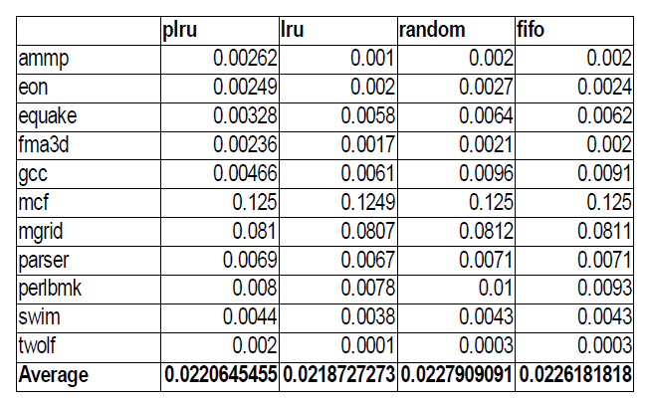
Performance Evaluation(Replacement Rate)
Replacement Rate for policies in L1 cache:
LRU only slightly better than plru
Plru, however, performs better than random or FIFO

Slide 14
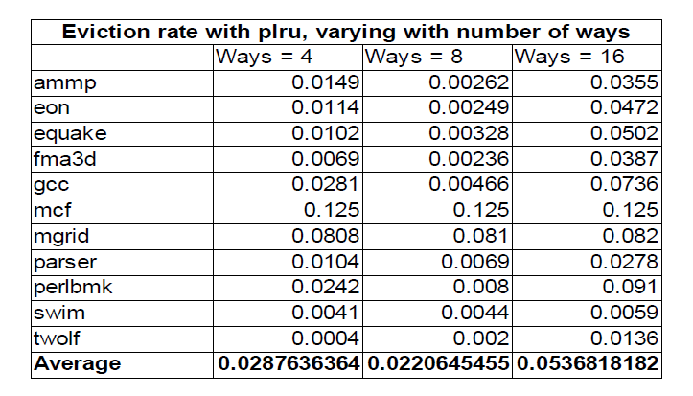
Performance evaluation (Replacement Rate)
Replacement rate for pLRU with increasing number of ways (overall L1 cache size =32KB const)

Slide 15
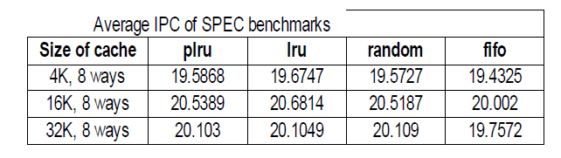
Performance evaluation (IPC)
IPC with increasing L1 cache size
IPC of pLRU is only slightly worse than LRU in all cases, with Random in 3rd and FIFO is the worst

Slide 16
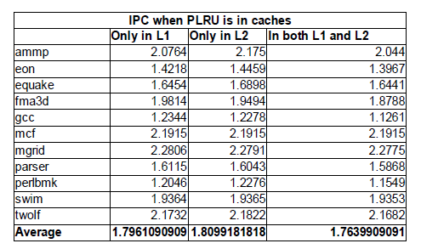
Performance Evaluation (IPC)
IPC when plru is used in both L1 and L2 as opposed to using only in one level
Higher IPC when used only in L2 (because L1 has LRU)
Using in both levels makes IPC performance even worse

Slide 17
Performance Evaluation (Power)
Power Consumption is calculated using CACTI simulator (provided by HP)
Takes various cache configurations as input and the computes Dynamic Read energy consumption, area and complexity
Inputs like Cache line size, technology node etc.
Has a web interface, but for most purposes you need to download the source

Slide 18
Energy consumption calculation
For the clarkdale configuration (L1 32KB and 8 ways, L2 256KB and 8 ways)
Total energy consumption = Total Energy consumed in all accesses in L1 + Total energy consumed in all accesses in L2
In the above formula, Energy consumed in each level of cache = Dynamic read energy per access*Total number of accesses in that cache level
where Dynamic read energy/access = Dynamic read energy of Data array/per access + Dynamic read energy of Tag/access

Slide 19
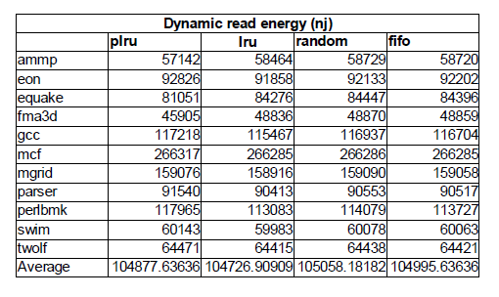
Performance Evaluation (Energy)
So, we can see that plru overall consumes slightly more energy as compared to lru on account of more replacements. However the difference in energy consumption for 10 million cycles is very little.

Slide 20
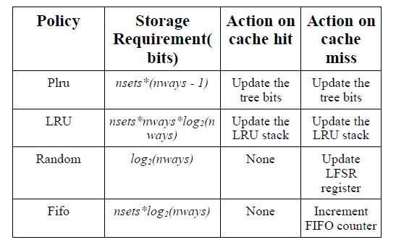
Performance Evaluation (Storage)
On every cache access, we need to update the tracking bits based on eviction policy

Slide 21
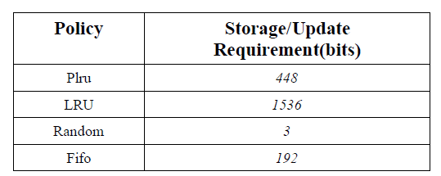
Performance Evaluation (Storage)
For the same Intel clarkdale configuration

Slide 22
Conclusion
pLRU is almost equivalent to LRU in terms of Eviction Rate, IPC and hit based energy consumption
The storage/update requirements for pLRU is lesser than LRU for almost the same IPC performance
Ideal for L1 caches

Slide 23
References
[1] Ackland B., Anesko D., Brinthaupt D., DaubertS.J, Kalavade A.., Knoblock J., Micca E., Moturi M.,Nicol C.J., O’Neill J.H., Othmer J., Sackinger E.,Singh K. J., Sweet J., Terman C. J., and Williams J.,“A Single-Chip, 1.6 Billion, 16-b MAC/s Multiprocessor DSP,” IEEE Journal of Solid-state circuits, Vol. 35, No. 3, March 2000, pp. 412-423.
[2] Belady, L.A., “A study of replacement algorithms for a virtual storage computer,” IBM Systems Journal, 5(2):79- 101, 1966.
[3] Burger D., Austin T., “The SimpleScalar Tool Set, Version 2.0,” University of Wisconsin-Madison Technical Report #1342, June 1997.
[4] Cantin J. F, Hill M. D., Cache Performance of the SPEC CPU2000 Benchmarks, http://www.cs.wisc.edu/multifacet/misc/spec2000cach e- data/
[5]Hennessy J. L., Patterson D., Computer Architecture: A Quantitative Approach, Third Edition, Morgan Kaufmann Publishers, 2003.
[6] Henning J. L., SPEC CPU2000: Measuring CPU Performance in the New Millennium, IEEE Computer, vol. 33, no. 7, July 2000, pp. 28-35, http://www.spec.org/osg/cpu2000/papers/COMPUTE R_20 0007- bstract.JLH.html
[7] Wong W., Baer J-L., “Modified LRU Policies for Improving Second-level Cache Behavior,” Proceedings of the 6th International Symposium on High-Performance Computer Architecture, Toulouse, France, January 2000
[8] Hussein Al-zoubi, Ar Milenkovic, Milena Milenkovic, “Performance Evaluation of Cache Replacement Policies for the SPEC CPU2000 Benchmark Suite ”
[9] Hsin-Hsien Lee, class notes ECE 6100, Georgia Institute of Technology
[10] http://etd.nd.edu/ETD-db/theses/available/etd- 07122008-005947/unrestricted/ThoziyoorS072008.pdf for computation of dynamic power using CACTI
[11] http://www.hpl.hp.com/research/cacti/ HP Cacti simulator

