Slide 1


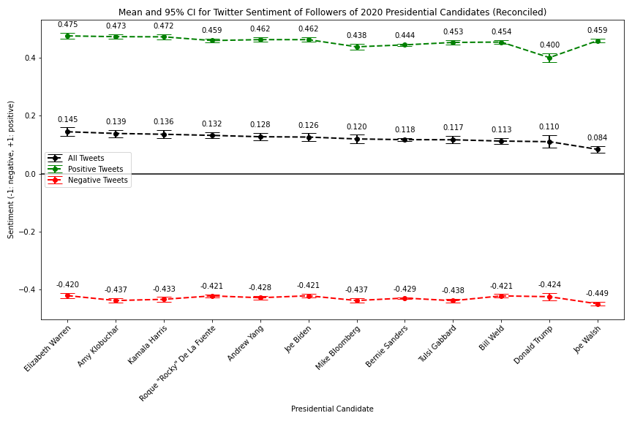
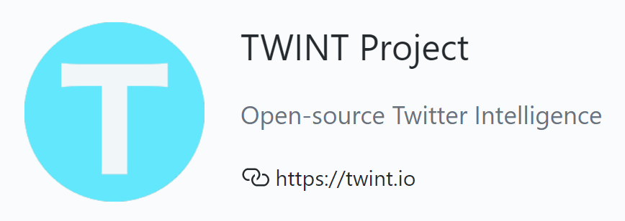
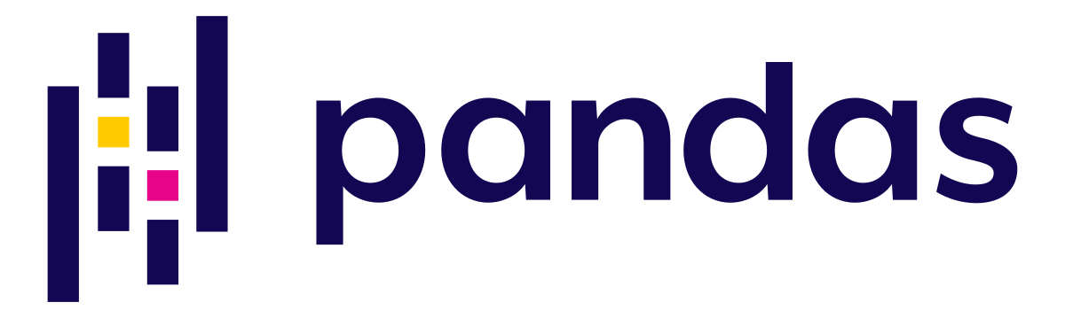
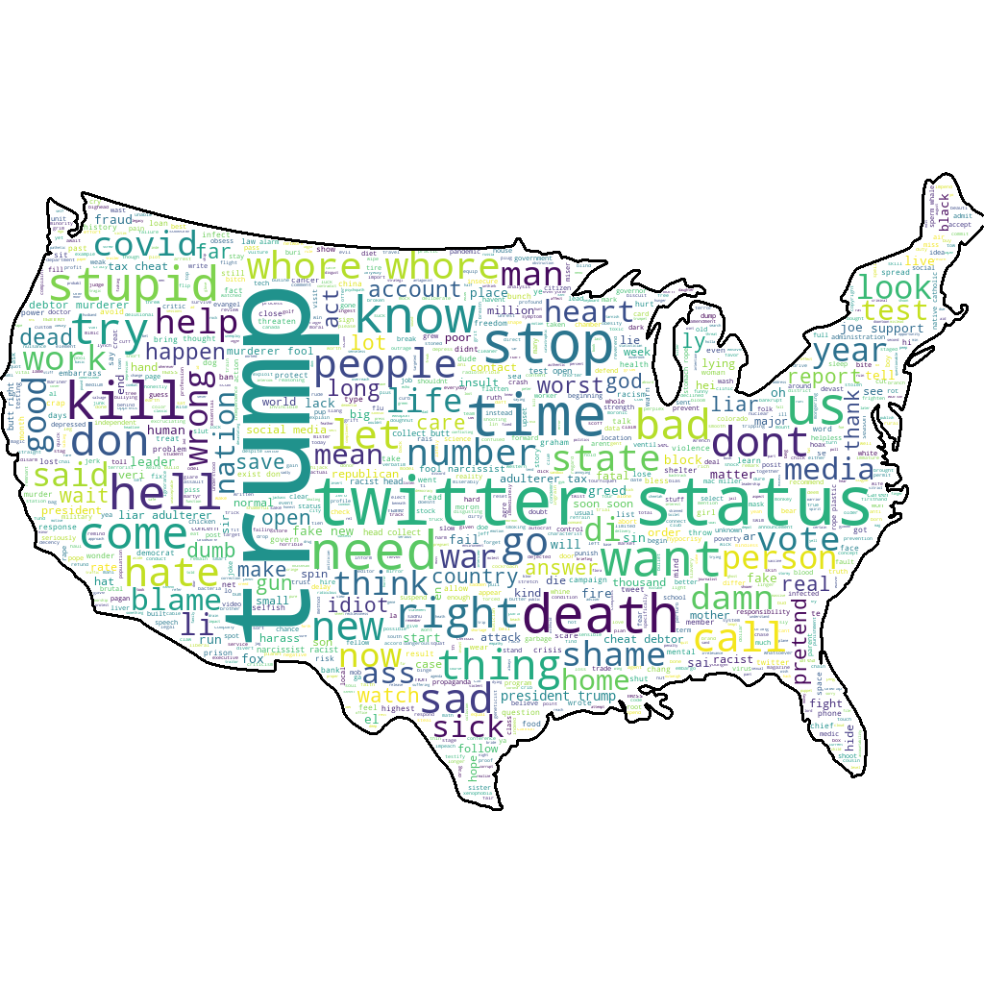
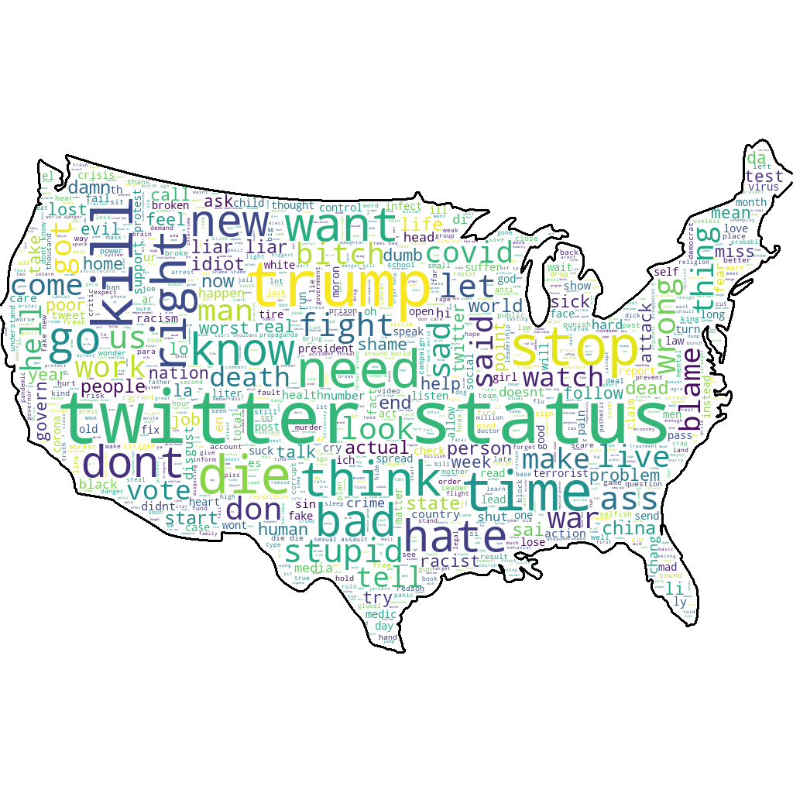
Digital Vitriol in the 2020 US Presidential Election
Shawn Chao, Sam Chinnery, Frank Gonzalez, Nyle Sykes, Evan Vogelbaum
17.835 Machine Learning and Data Science in Politics
Problem and Approach
Descriptive Analysis
Sentiment Analysis Results
Social media has created a place for political influencers to interact with their society. It drastically lowered the barrier for individuals to express their political opinions and past researchers proved capable of using individuals’ online activity to estimate political ideologies. These tactics were used in conjunction with sentiment analysis to assign levels of vitriol to the followers of various presidential candidates.
Specifically, the vitriol of Bernie Sanders individuals was expected to be higher than normal due to two factors:
Cognitive dissonance
Far-from-center ideologies
Tweets were scrapped from twitter from supporters of various candidates to test this hypothesis.
Collected top hashtags per party (GOP omitted below)
Sanders supporters used less aggressive hashtags than supporters of other Democratic candidates
Average sentiment for all tweets, negative tweets, and positive tweets by followers of candidates shown below
Combination of Vader and TextBlob results
Affiliation Matrix
Data
Matrices describe overlap between the sets of supporters of candidate pairs
The “incumbency effect” is clearly visible: Trump has a significantly larger follower base and thus has considerable overlap with most other candidates
While Sanders’ supporters are more negative than other Democratic candidates, we cannot attribute this to material differences in the negative vocabulary used
We collected Twitter data using the TWINT API with simple integration to the Python pandas package.
Data Collected from TWINT:
14 usernames of political candidates
Over 5000 usernames of followers per candidate
Over 165000 total tweets from those followers
5000 usernames of who these followers followed
Find between-candidate overlap/affiliation
Sentiment Analysis Methods
Elizabeth Warren
Bernie Sanders
Naïve Bayes Models
Scale Priors by probability of class given input
Assumes Independence of Features
NLTK: Twitter Data, Stopwords, Noise Reduction
TextBlob: ”Vanilla” Model, IMBD Data
Limitations and Future Work
“Affiliation matrix” between candidates: shows the number of users that follow both (row) and (column). Blue cells indicate higher overlap.
Data collection: Tweets were collected following the outbreak of COVID-19. Future work would limit the data to tweets posted prior to the outbreak
Overlap between candidates: Future work would consider alternate data sources (e.g. Reddit) where political affiliation may be more easily distinguishable
Sample bias: The ideological distribution of Twitter users is not uniform. Future work would cross-reference election contribution databases to determine ideology
VADER
Specialized to Social Media
Defines heuristics from many datasets
Accounts for Sentiment Laden Emojis
😍 = smiling face with heart-eyes
😱 = face screaming in fear
Understands Trigram Sentiment Switches
“The food here isn’t really all that great
References
Bond, Robert, and Solomon Messing. "Quantifying social media’s political space: Estimating ideology from publicly revealed preferences on Facebook." American Political Science Review 109.1 (2015): 62-78.
“Agreement matrix” between candidates: shows the probability that a follower of (row) also follows (column). Red cells indicate higher overlap.
May 10, 2020

