Slide 1


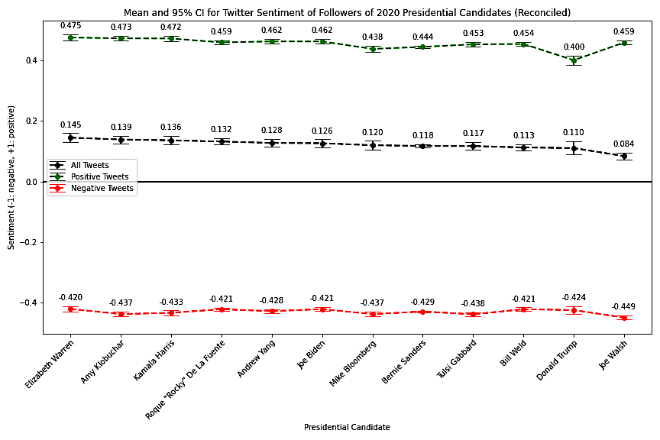

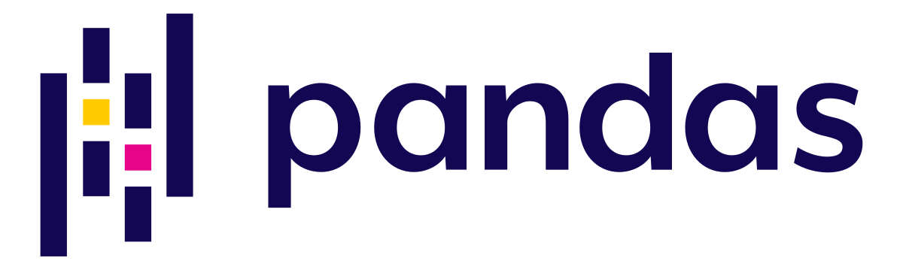
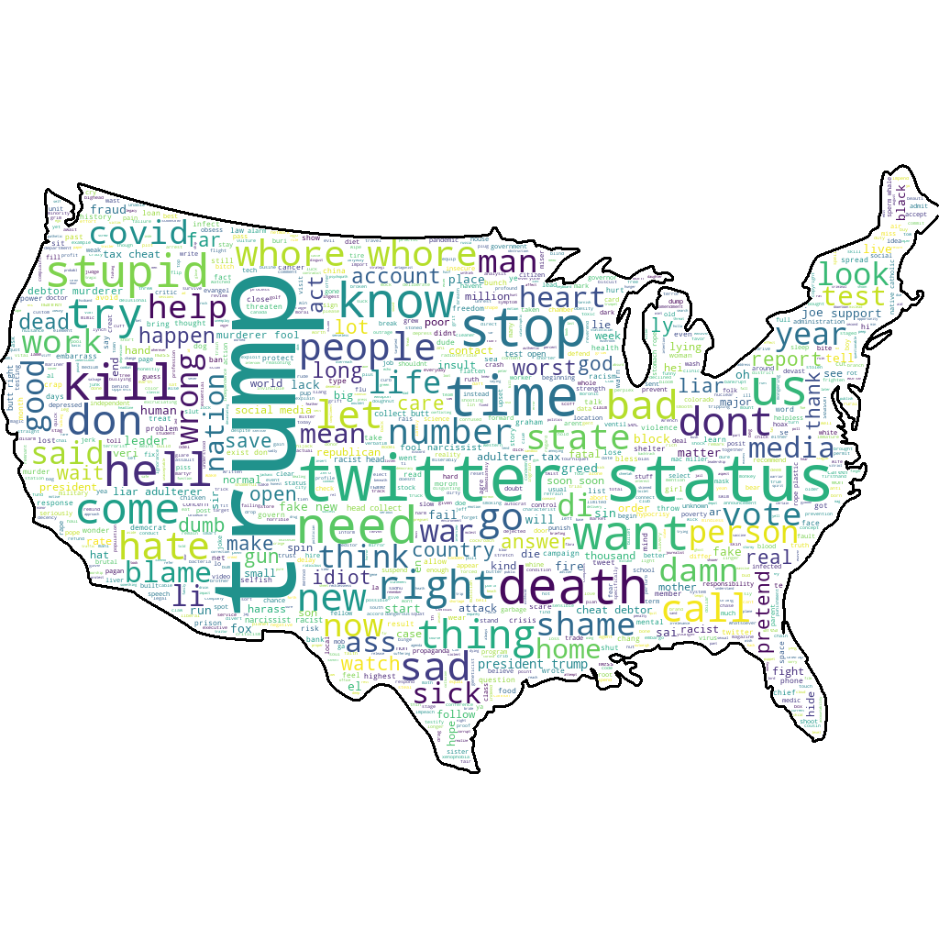
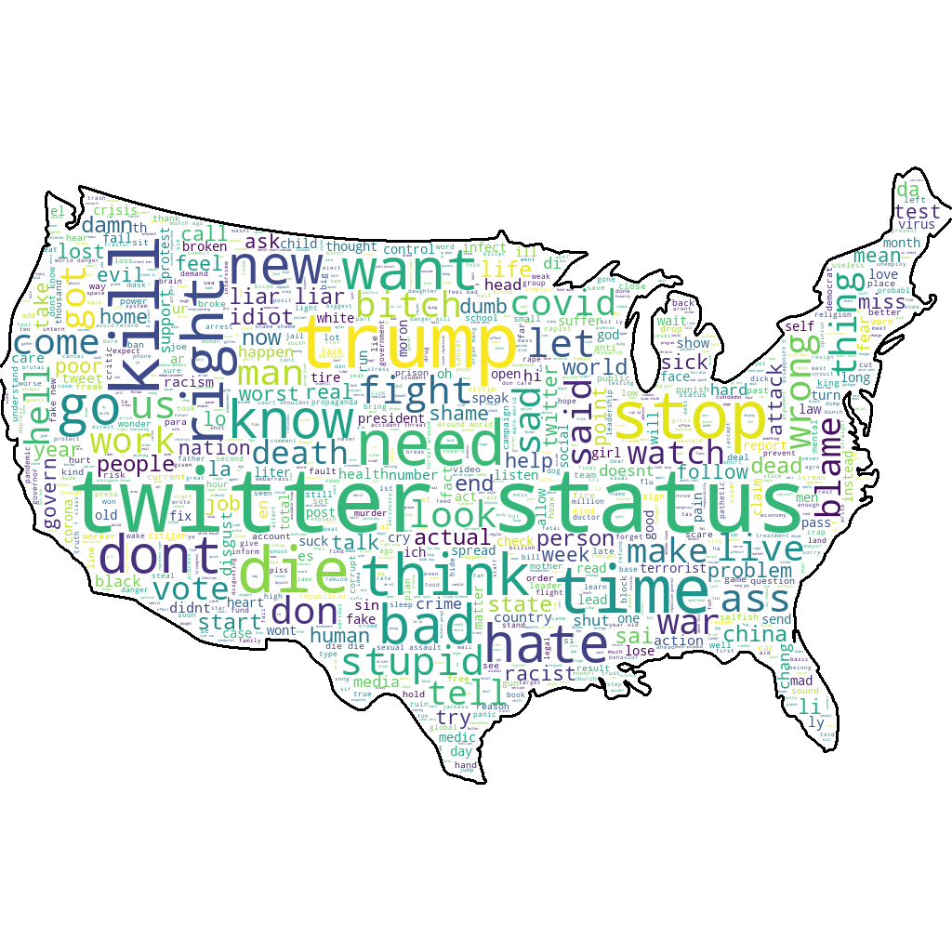
Digital Vitriol in the 2020 US Presidential Election
Shawn Chao, Sam Chinnery, Frank Gonzalez, Nyle Sykes, Evan Vogelbaum
17.835 Machine Learning and Data Science in Politics
Abstract
Descriptive Analysis
Sentiment Analysis Results
Are supporters of Bernie Sanders more vitriolic online than supporters of other presidential candidates? We believe this may be the case for two reasons:
Cognitive dissonance: Individuals who voted for Sanders in 2016 may feel the need to validate their past “investment” in voting
Far-from-center ideology: Sanders is on the left extreme of the ideological spectrum
Previous work has shown that social media can be reliable in determining political affiliation. We seek to determine individuals' political ideologies using Twitter posts and to quantify their vitriol using sentiment analysis.
Collected top hashtags per party (GOP omitted below)
Sanders supporters used less aggressive hashtags than supporters of other Democratic candidates
Average sentiment for all tweets, negative tweets, and positive tweets by followers of candidates shown below
Combination of Vader and TextBlob results
Affiliation Matrix
Data
Matrices describe overlap between the sets of supporters of candidate pairs
The “incumbency effect” is clearly visible: Trump has a significantly larger follower base and thus has considerable overlap with most other candidates
While Sanders’ supporters are more negative than other Democratic candidates, we cannot attribute this to material differences in the negative vocabulary used
We collected Twitter data using the TWINT API with simple integration to the Python pandas package.
Data Collected from TWINT:
14 usernames of political candidates
Over 5,000 usernames of followers per candidate
Over 165,000 total tweets from those followers
5,000 usernames of who these followers followed
Find between-candidate overlap/affiliation
Sentiment Analysis Methods
Elizabeth Warren
Bernie Sanders
Naïve Bayes Models
Scale Priors by probability of class given input
Assumes Independence of Features
NLTK: Twitter Data, Stopwords, Noise Reduction
TextBlob: ”Vanilla” Model, IMDB Data
Limitations and Future Work
“Affiliation matrix” between candidates: shows the number of users that follow both (row) and (column). Blue cells indicate higher overlap.
Data collection: Tweets were collected following the outbreak of COVID-19. Future work would limit the data to tweets posted prior to the outbreak
Overlap between candidates: Future work would consider alternate data sources (e.g. Reddit) where political affiliation may be more easily distinguishable
Sample bias: The ideological distribution of Twitter users is not uniform. Future work would cross-reference election contribution databases to determine ideology
VADER
Specialized to Social Media
Defines heuristics from many datasets
Accounts for Sentiment Laden Emojis
😍 = smiling face with heart-eyes
😱 = face screaming in fear
Understands Trigram Sentiment Switches
“The food here isn’t really all that great
References
Bond, Robert, and Solomon Messing. "Quantifying social media’s political space: Estimating ideology from publicly revealed preferences on Facebook." American Political Science Review 109.1 (2015): 62-78.
“Agreement matrix” between candidates: shows the probability that a follower of (row) also follows (column). Red cells indicate higher overlap.
May 10, 2020

