Slide 1
Seek Your Home in Chicago
Instructor:
Mjumbe Poe
Developed by:
Sisun Cheng (sisunc@upenn.edu)
Shimin Tu (tushimin@upenn.edu)

Slide 2

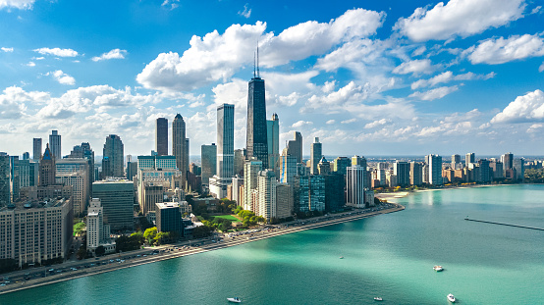
Background
The City of Chicago,
is the most populous city in the U.S. state of Illinois, and the third most populous city in the United States, following New York City and Los Angeles.
Attracted by the beautiful scenery as well as amazing cultural landscapes. millions of tourists visit Chicago each year. Chicago's 58 million tourist visitors in 2018 set a new world record, and Chicago has been voted the best large city in the U.S. for four years in a row by Condé Nast Traveler.

Slide 3


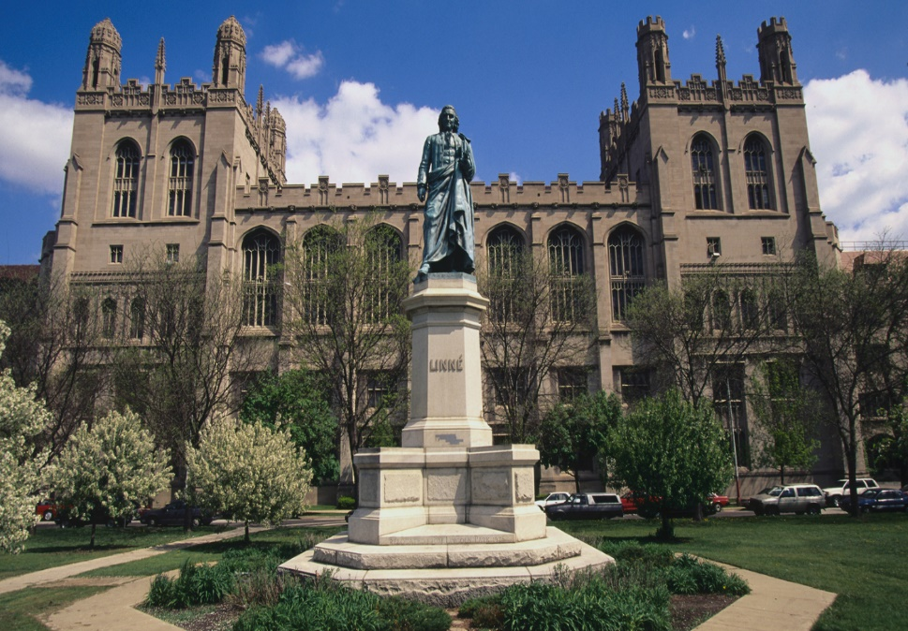
Background
Chicago has the third-largest gross metropolitan product in the United States—about $670.5 billion according to September 2017 estimates. The city has also been rated as having the most balanced economy in the United States, due to its high level of diversification.
Since the 1850s, Chicago has been a world center of higher education and research with several universities. Many of them are among the top "National Universities" in the United States. (University of Chicago, etc.)
From all perspectives, Chicago is really attractive to both tourists and residents.

Slide 4
Background
However, …
Life in Chicago is also deeply influenced by local crimes, and Chicago is recognized as one of the most dangerous cities in the United States.
The violent crime rate in Chicago is 164% higher than the national average, while the property crime rate is 45% higher than the national average.
A Chinese student Dennis who just graduated from University of Chicago, was shot dead near the campus On Nov 9th. Shocked by Dennis’s misfortune, we wonder how people can find a suitable place in Chicago to live. Thus, we’d like to design an application which aims to provide recommendations for people who plan to stay, no matter a long stay or a short one, in Chicago.

Slide 5
Data
Crime data one month prior to present
Renew with time
Public transit stations
Grocery stores data
Restaurants data
Chicago neighborhood data
Our primary spatial unit
* Data Source: Chicago Data Portal (https://data.cityofchicago.org/)

Slide 6

How to define a good neighborhood
Normalize
A process to convert values with different ranges to range (0, 1).
We apply normalization to crime cases, number of bus stops, number of groceries, and number of restaurants in each neighborhood.
$$Value_{norm}=\frac{Value−min⁡(Values)}{\max\left(Values\right)−min⁡(Values)}$$
Calculate the “Index”
$$Index=0.5∗\left(1−crime_{norm}\right)+0.3∗busstop_{norm}+0.1∗grocery_{norm}+0.1∗restaurant_{norm}$$
We give the coefficient according to our own experiences and users may define their weights.
The higher the index is, the more livable the neighborhood is.

Slide 7
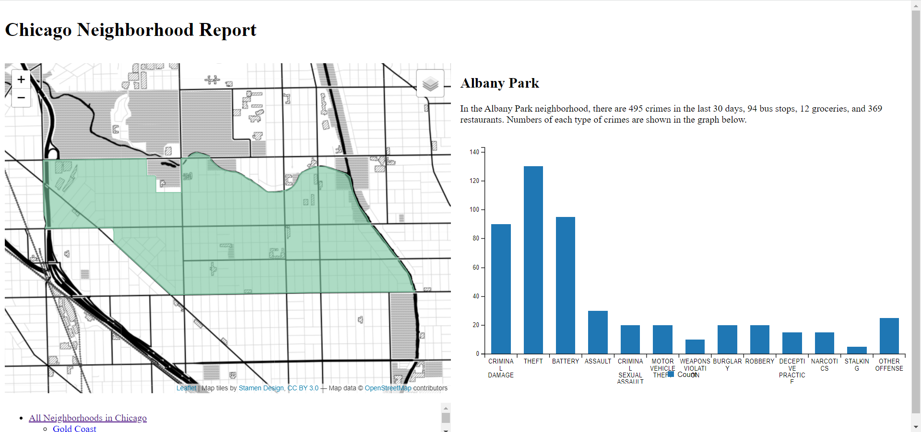

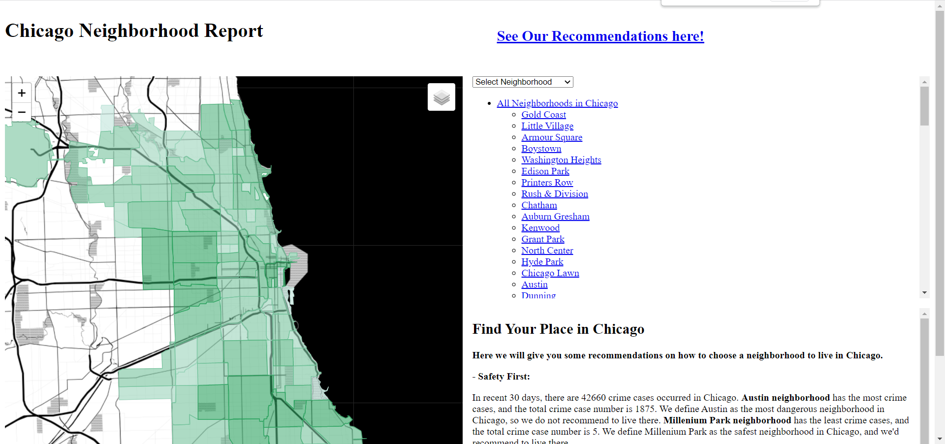
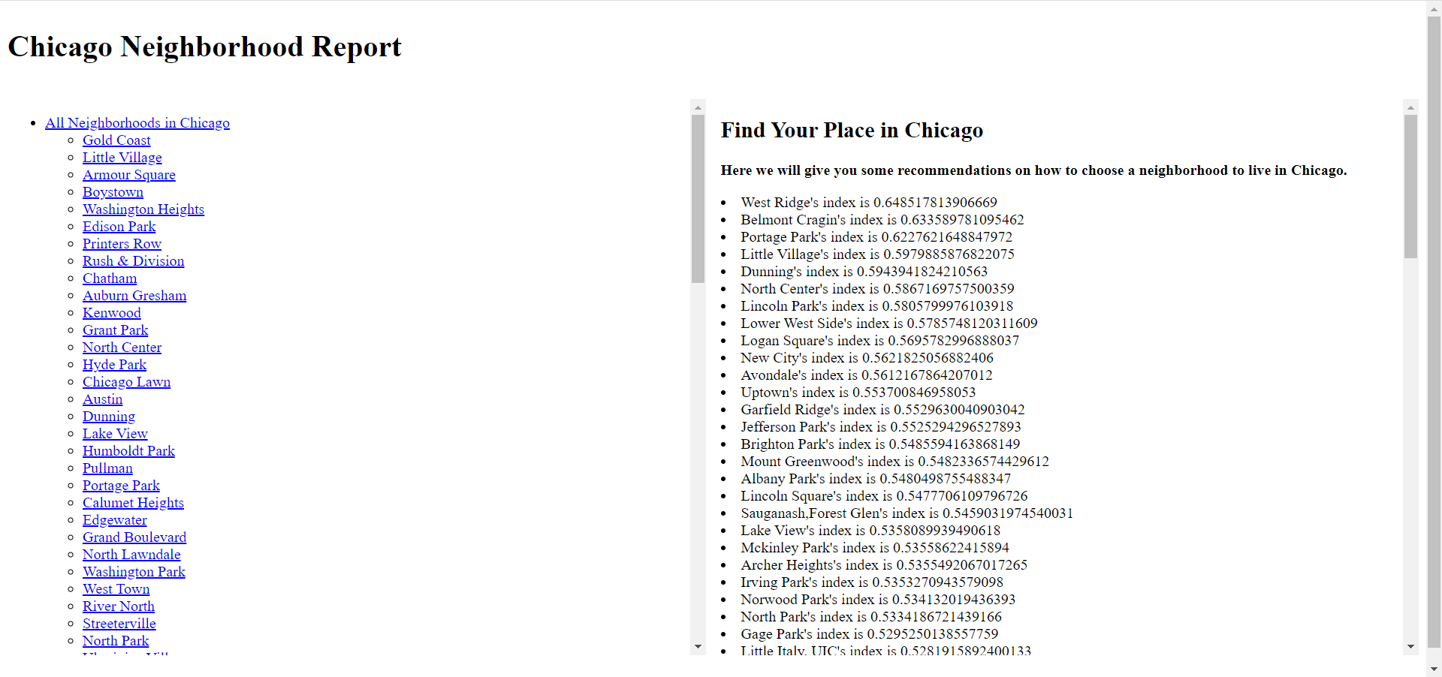
Web-based Report
Neighborhood page
Cover page
Overview page
Recommendation page
* Link

Slide 8
THANK YOU FOR WATICHING
Instructor:
Mjumbe Poe
Developed by:
Sisun Cheng (sisunc@upenn.edu)
Shimin Tu (tushimin@upenn.edu)

