Slide 1


RISK & RESILIENCY INTERACTIVE DASHBOARD
CAPSTONE PROJECT 2024

Slide 2
TABLE OF CONTENTS
Problem Statement
Business Value
Risk and Resiliency Dashboard
4. Dashboard Demonstration
Notes:
Divide the part
1. Introduce

Slide 3
1
Problem statement

Slide 4
PROBLEM STATEMENT
Why?
Enhance Supply chain management capabilities
Utilize data to predict and mitigate potential supply chain disruptions
Empower decision-makers with advanced, data-driven insights
Notes:
“To design and implement a Supply Chain Risk & Resiliency Tool aimed at significantly enhancing supply chain management capabilities.
The Risk & Resiliency Tool will utilize data to predict and mitigate potential supply chain disruptions by analyzing historical trends, current data, and external factors.
Our project's goal is to empower decision-makers with advanced, data-driven insights for improving supply chain resilience and responsiveness in a dynamic and often unpredictable business environment.”

Slide 5
2
Business value

Slide 6
1. Improved Risk Management 2. Enhanced Decision-Making 3. Supply Chain Optimization 4. Customer Satisfaction 5. Cost Reduction 6. Competitive Advantage
BUSINESS VALUE
Notes:
Divide the part
1. Introduce

Slide 7
3
RISK & RESILIENCY DASHBOARD

Slide 8
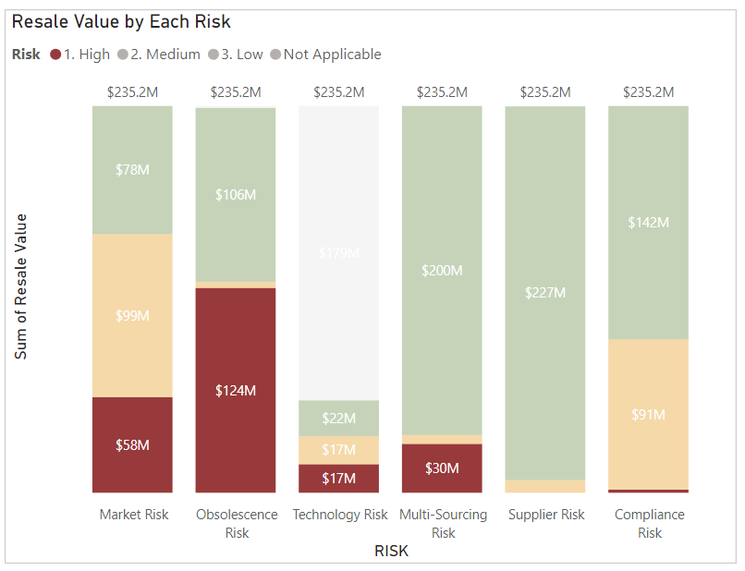
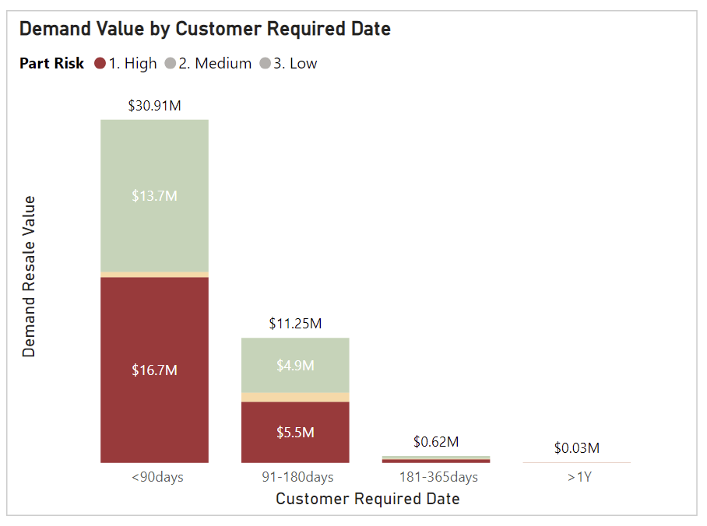
RISK & RESILIENCY DASHBOARD
DEMAND
How much is High Risk in our Demand?
Is there any Risk in our Critical Demand?
Demand Value by Each risk
Demand Value by Customer Required Date
Top 2 influential Risks are
Obsolescence Risk ($124, 53%)
Market Risk ($58, 25%)
In Critical Demand,
High Risk takes 54% of Value ($16.7M Value, 115K Quantity)

Slide 9
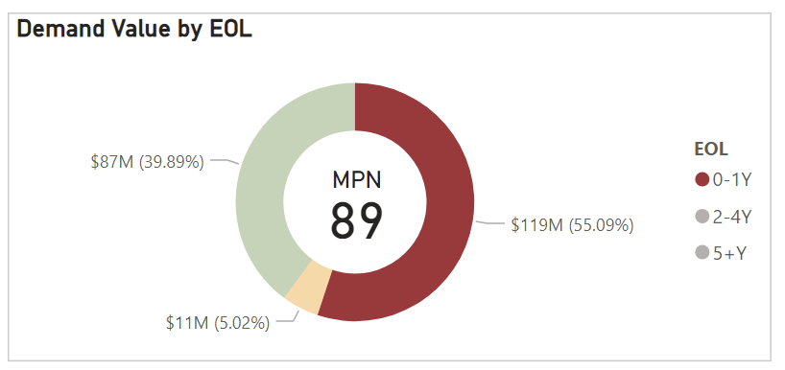
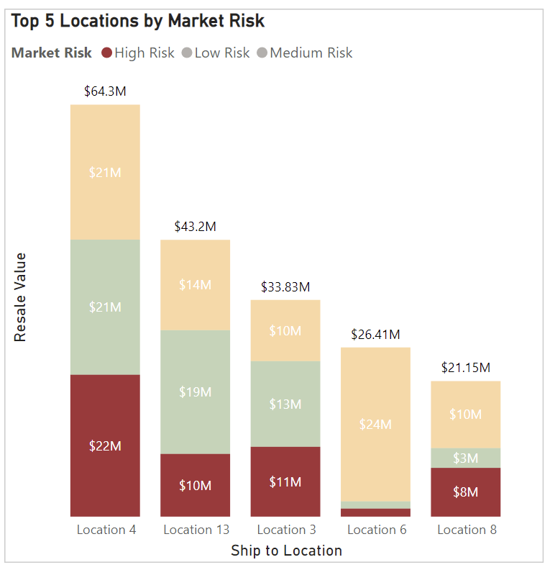
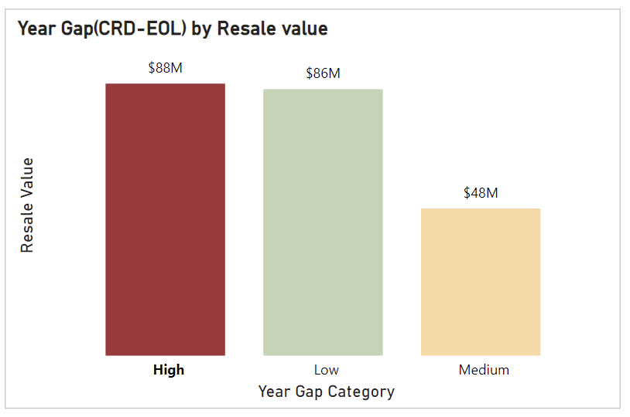
Risk & Resiliency Dashboard
DEMAND
Obsolescence Risk in Demand
Market Risk in Demand

Slide 10
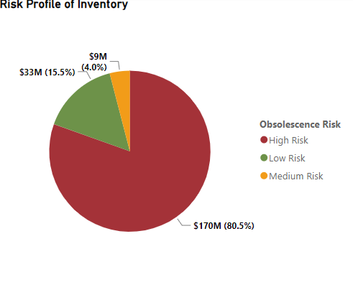
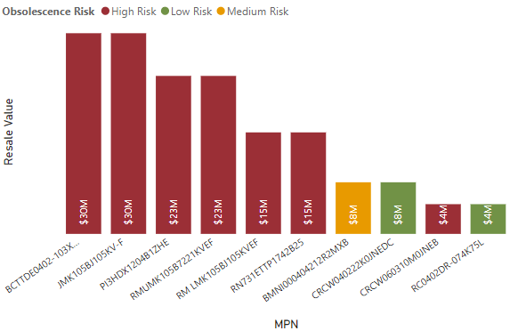
RISK & RESILIENCY DASHBOARD
INVENTORY
Obsolescence Risk of Inventory
Top 10 Inventory by Quantity On Hand

Slide 11
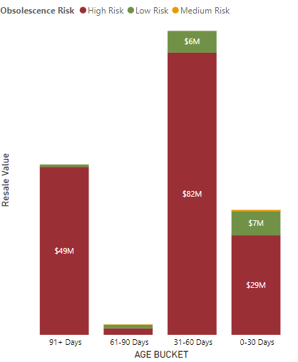
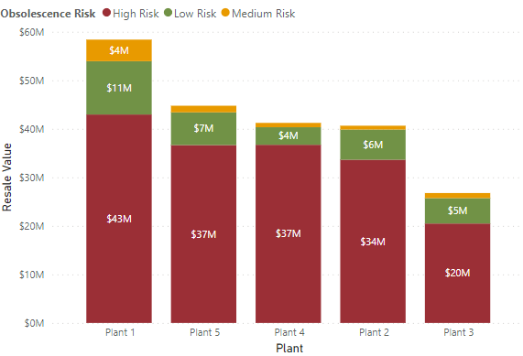
RISK & RESILIENCY DASHBOARD
INVENTORY
Obsolescence Risk By Aging
Plant wise Obsolescence risk

Slide 12
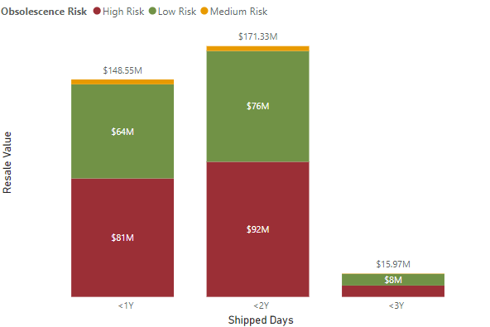
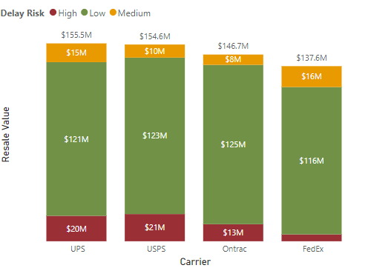
RISK & RESILIENCY DASHBOARD
SHIPPING
Obsolescence Risk by Shipped days
Carrier Performance Risk
Delay Risk: High(10 to 15 Days), Medium(5 to 9 Days), Low(-3 to 4 Days)

Slide 13
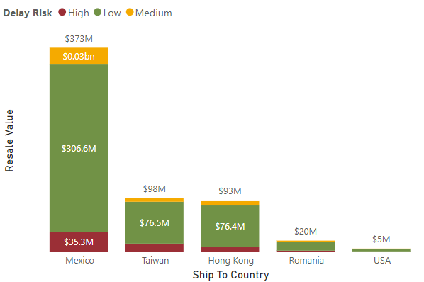
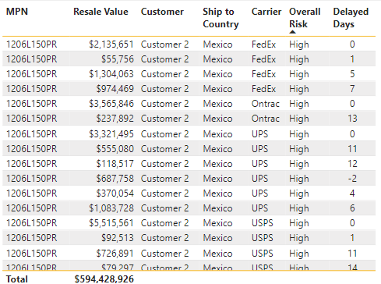
RISK & RESILIENCY DASHBOARD
SHIPPING
Top 5 Countries with Delay Risk
Additional Insights

Slide 14
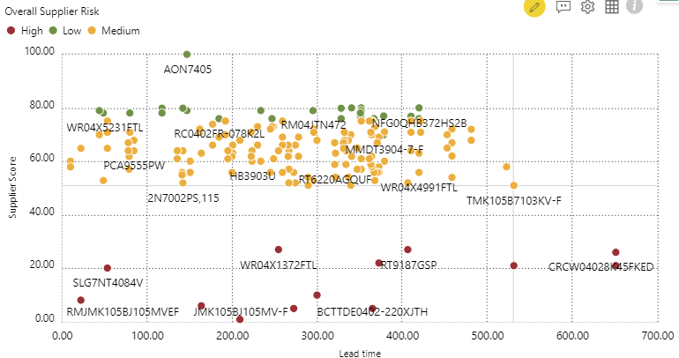
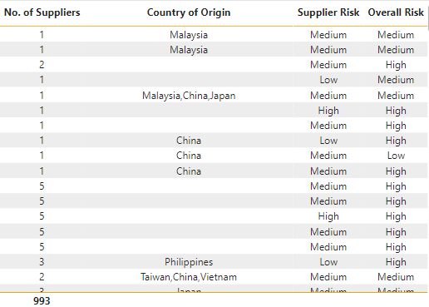
RISK & RESILIENCY DASHBOARD
PURCHASE ORDERS
Supplier Risk In Purchase Orders
Additional Insights

Slide 15
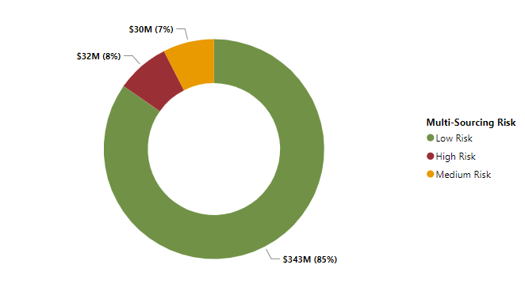
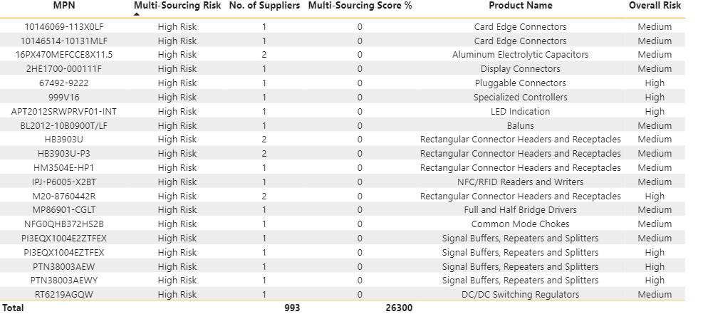
RISK & RESILIENCY DASHBOARD
PURCHASE ORDERS
Multi-Sourcing Risk in Purchase Orders
Additional Insights

Slide 16
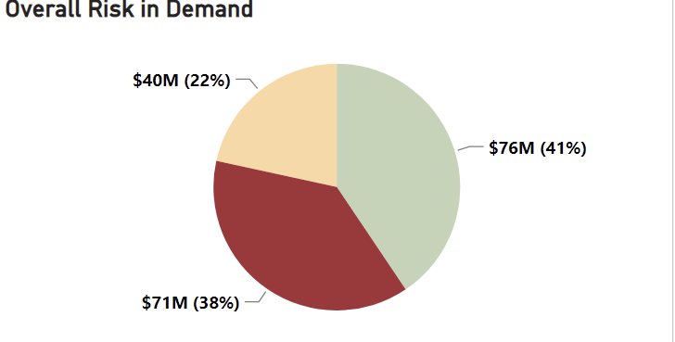
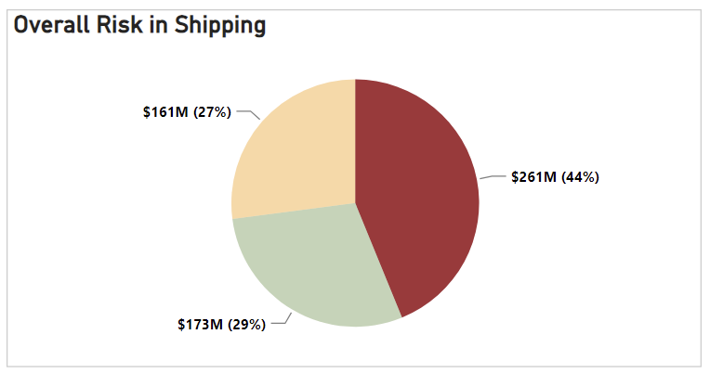
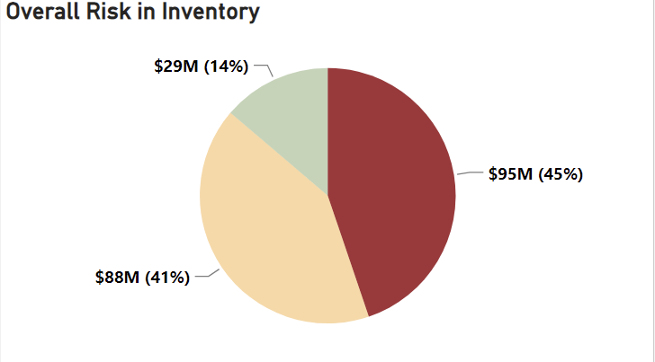
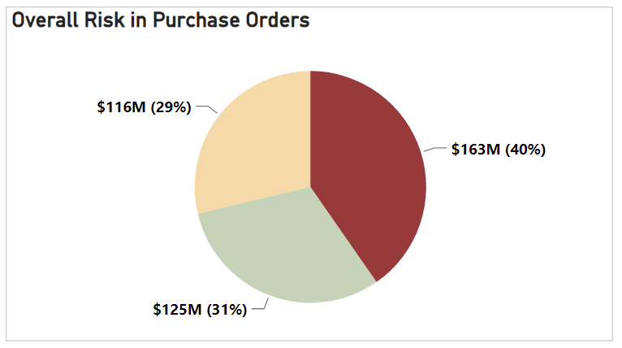
RISK & RESILIENCY DASHBOARD
OVERALL

Slide 17
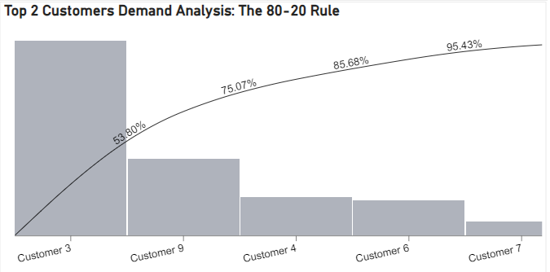
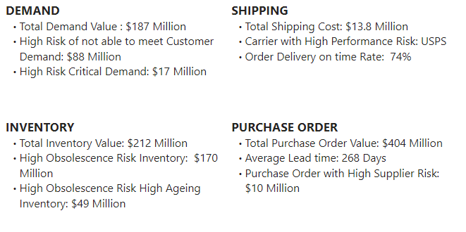
RISK & RESILIENCY DASHBOARD
OVERALL
75% of Demand coming from 18% Customers
Key Performance Indicators

Slide 18
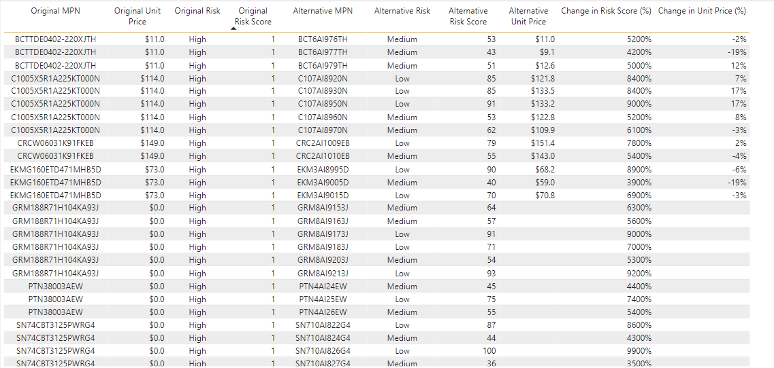
What-if analysis

Slide 19
4
Dashboard demonstration

