Slide 1

STRATEGIC INSIGHTS AND COMPETITIVE EDGE: A COMPREHENSIVE EXTERNSHIP JOURNEY
Project by
Satya Sandeep Chintu
Notes:
3 seconds
In alignment with the Pyramid Principle, start your presentation by letting the audience know upfront what is your investment decision for the company. The rest of the presentation will build upon this decision.

Slide 2

Agenda
Overview of Pricing Models and Prices Charged
Key Differences in Pricing Models
Ad Placement and Format Effectiveness
Return On Ad Spend
Value Proposition
Concluding Insights
Notes:
7 seconds
The agenda slide is important for a couple of reasons. Not only are you letting your audience know what to expect from this presentation, but in the event that they would come back to this presentation and look for certain parts that they wanted to check out, this should serve as a guide for them to do that.

Slide 3
Overview of Pricing Models and Prices Charged
Competitor | Product | Pricing Model | Ad Price
Write the competitor’s name | Write the name of the digital advertising product | What pricing models (CPC, CPM and/or CPA) are used for this product’s pricing? | What is the price charged?
UBER | UberX | CPA | $1.50 per ride
 | Uber Eats | CPC, CPA | $0.50 per click, $5 per order
 | Uber Pool | CPA | $1.00 per ride
CTRIP | Flight Booking | CPC, CPA | $0.75 per click, $10 per booking
 | Hotel Booking | CPC, CPA | $0.60 per click, $8 per booking
 | Package Tours | CPA | $20 per package booked
Notes:
15-20 seconds
While presenting this slide, you’re expected to highlight some important data points. Here are some questions to guide you: 1. What are the key differences in pricing models used by Company X and Company Y for their digital advertising products?
2. How do the CPC, CPM, and CPA prices compare between Company X ‘s and Company Y the differ for different types of digital ads?
3. What patterns or unique strategies can you identify from the pricing models of these competitors?

Slide 4
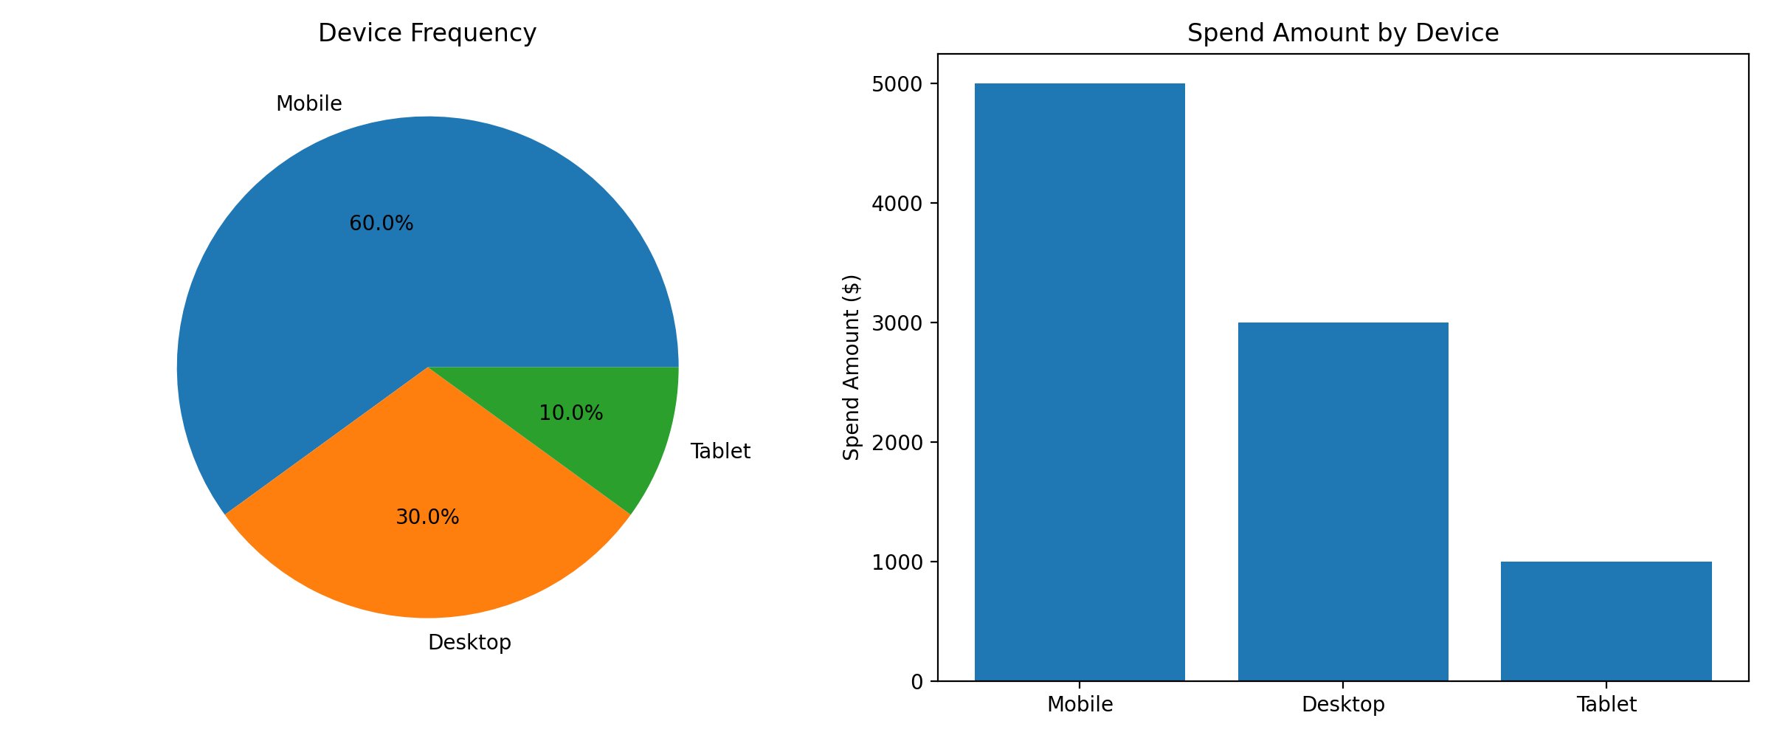
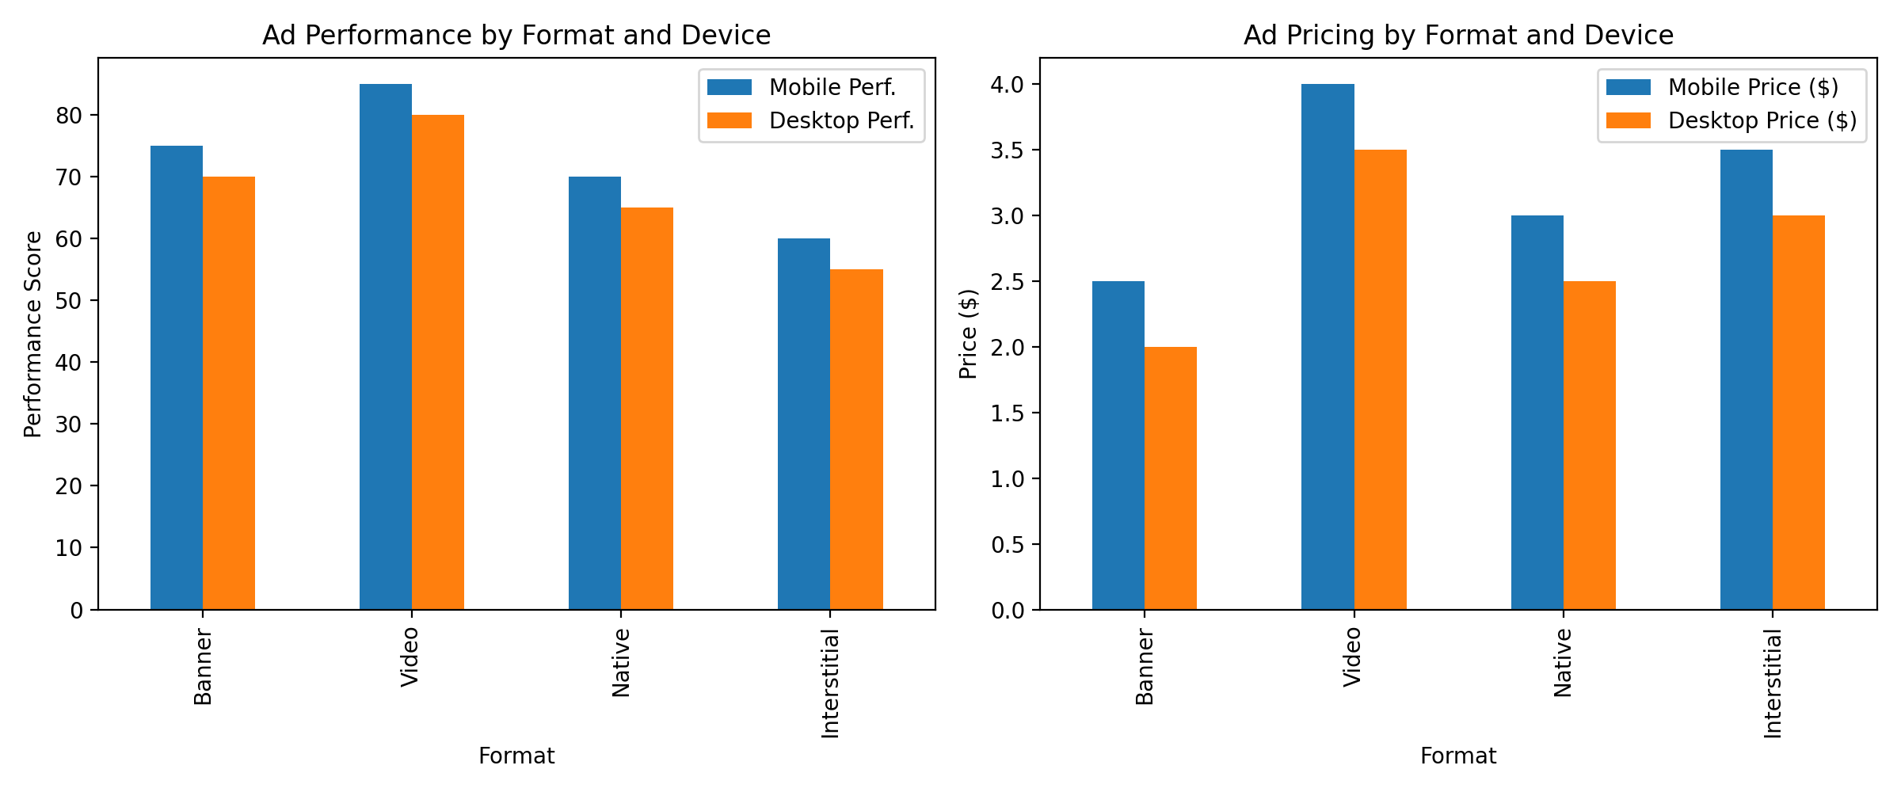
Ad Placement and Format Effectiveness
Device Frequency and Spend Amount
Results by Format
Summarize the common ad placements and formats used by each competitor.
Highlight the most effective and commonly used placements and formats.
[Use diagrams, bar graphs, pie charts or line charts to visually represent the data]
[Use diagrams, bar graphs, pie charts or line charts to visually represent the data]
Identify the most commonly utilized ad placements.
Compare ad performance and pricing between mobile and desktop devices for each competitor.
Discuss how device type influences ad effectiveness and pricing.
Notes:
20-25 seconds

Slide 5
Return On Ad Spend
Competitor | Ad Format | ROAS | Conversion Performance or Additional Metrics
UBER | Mobile App Ads | 2.1 | High conversion, strong user acquisition
UBER | Social Media Ads | 1.8 | Good engagement, moderate conversion
UBER | Search Engine Marketing | 1.5 | Moderate conversion, high intent traffic
CTRIP | Display Ads | 1.7 | Moderate conversion, broad reach
CTRIP | Email Marketing | 2.0 | High conversion, excellent for retention
Provide a brief overview of the overall impact of different ad types and placements on the ROAS for each competitor. Identify areas of strength and opportunities for improvement based on the findings.
Notes:
15 - 20 seconds
For the last two columns, make sure you:
Present the ROAS figures for different ad formats and placements for each competitor.
Analyze how different ad types convert to sales or leads.
Discuss the patterns and effectiveness of various ad types in driving conversions.
Example: Competitor Ad Format ROAS Conversion Performance
A Video Ads 1.5x High conversion, strong engagement

Slide 6
Value Proposition
Compare these value propositions to understand how each competitor positions themselves in the market, and provide a brief summary of your findings.
 | Key Value Points | Unique Selling Points
UBER | Convenient on-demand transportation | Flexible work opportunities for drivers
CTRIP | One-stop travel booking platform | Competitive pricing
Notes:
15-20 seconds
Compare these value propositions to understand how each competitor positions themselves in the market. Provide a brief summary highlighting the key value points and unique selling points (USPs) for advertisers. Here is what each of these terms means:
Value points are the specific benefits and advantages that an advertiser gains by using a competitor’s ad products, such as better targeting, higher engagement rates, or cost-effectiveness. Unique selling points (USPs) are distinctive features or benefits that set one competitor's offerings apart from others, like exclusive audience insights, innovative ad formats, or superior customer support.
In the note on the side, explain how these value points and USPs influence the overall market positioning of each competitor, and why advertisers might choose one over another based on these factors.

Slide 7
[Concluding Insights]
Context
Recommendation
Next-steps
Conduct in-depth user experience research to identify areas for improvement in the mobile app.
Explore partnerships with local transportation providers to offer more integrated travel solutions.
Develop a comprehensive loyalty program to increase customer retention and lifetime value.
.
Analysis of UBER (indirect competitor) and CTRIP (direct competitor) value propositions and ad effectiveness.
Focus on enhancing mobile app advertising and expanding integrated travel services to compete effectively.
Notes:
5 seconds
You can craft this by answering the question, what is the most important thing that you want the audience to take away from this presentation? And that answer would help you in creating this concluding statement. Here is the content you can reference while thinking of talking points for this slide:
What can Expedia’s Media Solutions team learn from their competitors?
How can the insights from the pricing comparison inform Expedia's decisions on ad placements and formats?
How can they use it to improve their digital advertisement strategy?
How can they use it to increase their value proposition for the advertisers?

Slide 8
Reference Links:
UBER Official Website: https://www.uber.com/
CTRIP Official Website (Trip.com Group): https://www.trip.com/
Statista - Ride-Hailing & Taxi Market Report: https://www.statista.com/outlook/mmo/mobility-services/ride-hailing-taxi/worldwide
Phocuswright - Online Travel Agencies Report: https://www.phocuswright.com/Travel-Research/Market-Overview-Sizing/Online-Travel-Agencies
McKinsey & Company - The Future of Mobility: https://www.mckinsey.com/industries/automotive-and-assembly/our-insights/the-future-of-mobility-is-at-our-doorstep

