Slide 1
SNPs - GWAS - eQTLs
Sebastian Schmeier
s.schmeier@gmail.com
http://sschmeier.github.io/bioinf-workshop/
17.08.2015

Slide 2
Overview
Single nucleotide polymorphism (refresh)
SNPs effect on genes (refresh)
Genome-wide association studies (refresh)
Quantitative trait loci (QTL)
SNPs effect outside of the genic region
Expression quantitative trait loci (eQTL)
Sebastian Schmeier

Slide 3
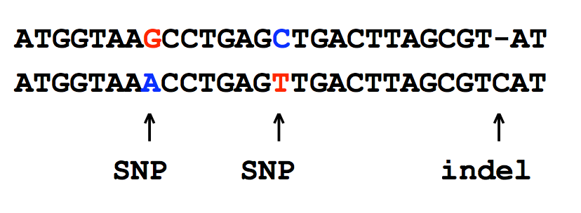
Single nucleotide polymorphism (SNP)
A SNP is defined as a single base change in a DNA sequence that occurs in a significant proportion (more than 1 percent) of a large population.
SNPs result from replication errors and DNA damage
Sebastian Schmeier

Slide 4
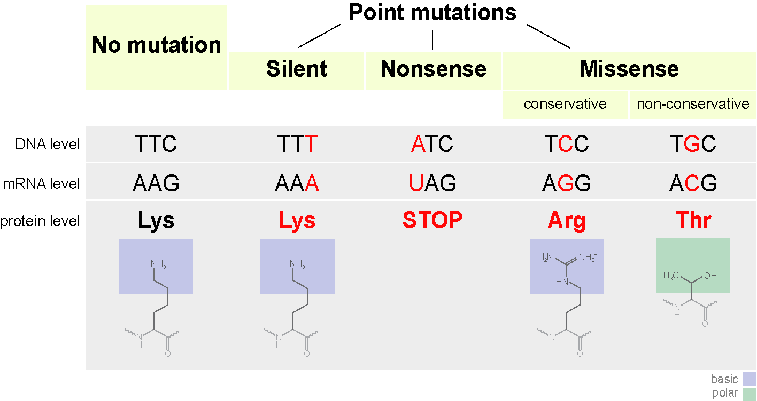
SNPs effects in coding regions
https://en.wikipedia.org/wiki/Point_mutation
Sebastian Schmeier

Slide 5
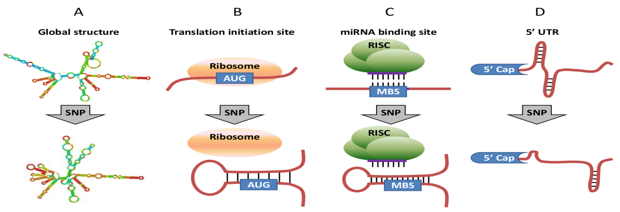
Structural effect caused by exonic SNPs
Exonic SNPs that cause substantial change in mRNA global structure and stability.
Exonic SNPs that change the mRNA local structure around translation initiation sites.
Exonic SNPs that change the structural accessibility of miRNA binding sites (MBSs).
Exonic SNPs in 5’ UTR that may change mRNA local structure near 5’ cap and thus affect miRNA-mediated translation inhibition.
Int J Respir Pulm Med, ijrpm-1-002e (Vol 1, Issue 1),
Sebastian Schmeier

Slide 6
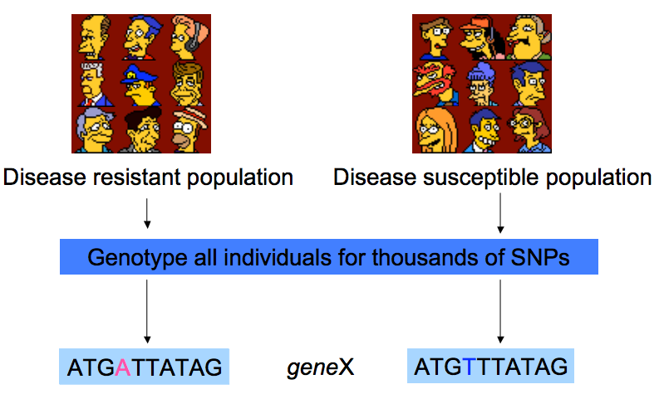
Why are SNPs useful?
Example: Resistant people all have an ‘A’ at position 4 in gene X, while susceptible people have a ‘T’ (A/T are the SNP
http://elc.fhda.edu/bioinfo/attachments/snp_haplotype_slides.pdf

Slide 7
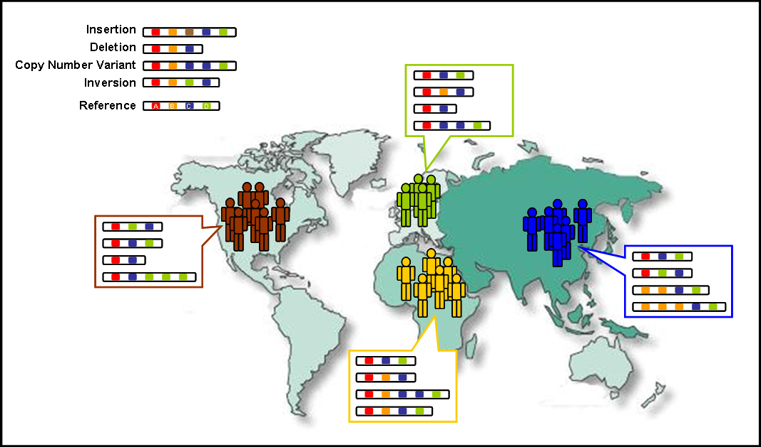
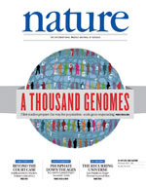
1000 Genome project
First project to sequence the genomes of a large number of people, to provide a comprehensive resource on human genetic variation (2008-2010)
Aim was to find most genetic variants that have frequencies of at least 1% in the populations
http://www.1000genomes.org/
Sebastian Schmeier

Slide 8
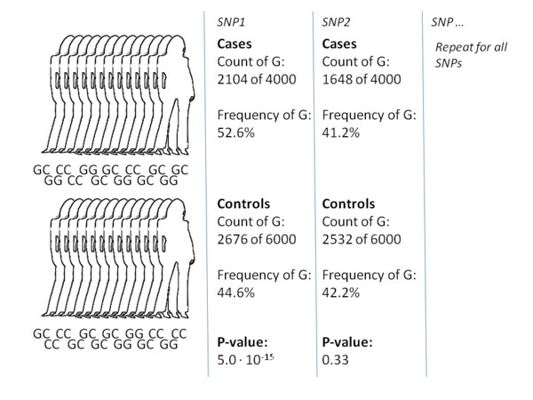
Genome-wide association study (GWAS)
The aim is to identify genes involved in human disease/traits
This method searches the genome for SNPs that occur more frequently in people with a particular trait/disease than in people without the trait/disease.
GWAS scans many SNPs at the same time using SNP arrays or NGS-based methods
https://en.wikipedia.org/wiki/Genome-wide_association_study
Sebastian Schmeier

Slide 9
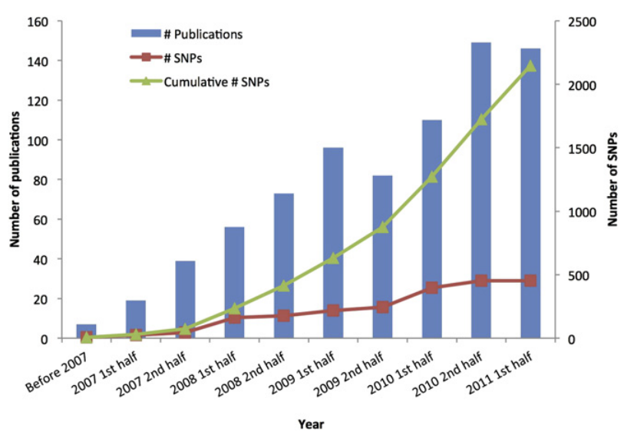
Genome-wide association study (GWAS)
Five Years of GWAS Discovery. Visscher et al. Am J Hum Genet. 2012 Jan 13; 90(1): 7–24.
Sebastian Schmeier

Slide 10
Genome-wide association study (GWAS)
“To date, genome-wide association studies (GWAS) have published hundreds of common variants whose allele frequencies are statistically correlated with various illnesses and traits. However, the vast majority of such variants have no established biological relevance to disease or clinical utility for prognosis or treatment.”
Genetic heterogeneity in human disease. McClellan J1, King MC.
Cell. 2010 Apr 16;141(2):210-7. doi: 10.1016/j.cell.2010.03.032.
Sebastian Schmeier

Slide 11
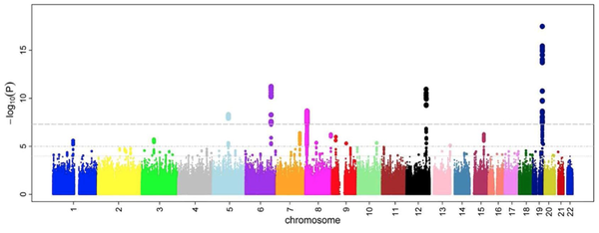
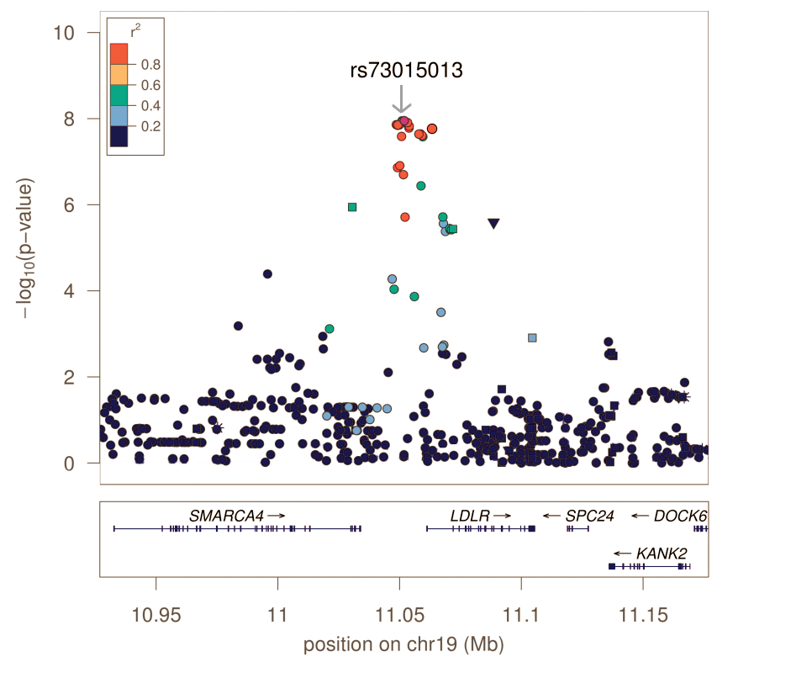
Genome-wide association study (GWAS)
GWAS identify SNPs and other variants in DNA which are associated with a disease or trait, but cannot on their own specify which genes are causal
The molecular mechanisms by which genetic variation predisposes individuals to diseases are still poorly characterized
The majority of GWAS SNPs are non-coding!!!!
https://en.wikipedia.org/wiki/Genome-wide_association_study
Sebastian Schmeier

Slide 12
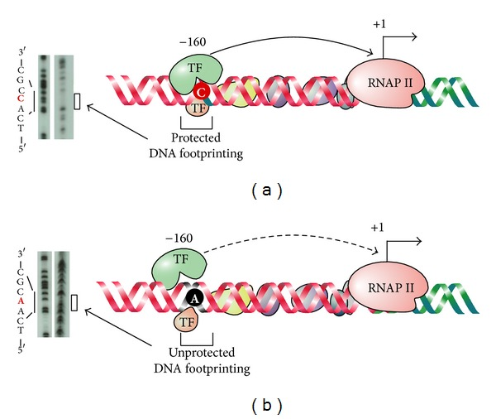
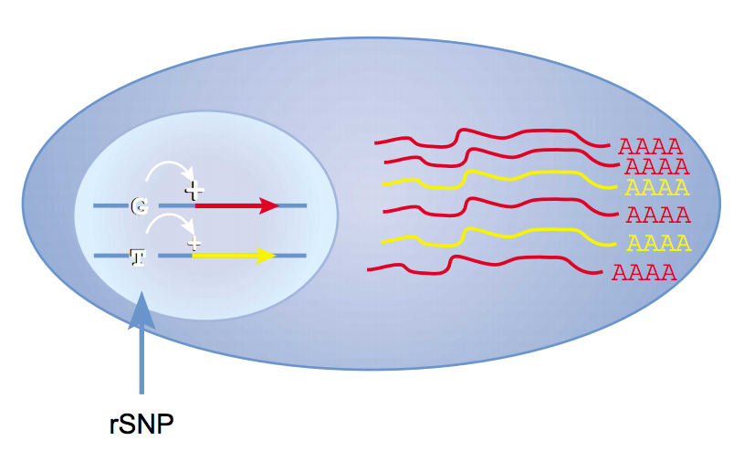
SNP effect in non-coding regions
doi:10.1155/2014/967565
Regulatory SNPs (rSNPs)
SNPs regulate gene transcription by affecting transcription factor (TF) binding
Sebastian Schmeier
http://www.nature.com/ng/journal/v33/n4/full/ng0403-439.html

Slide 13
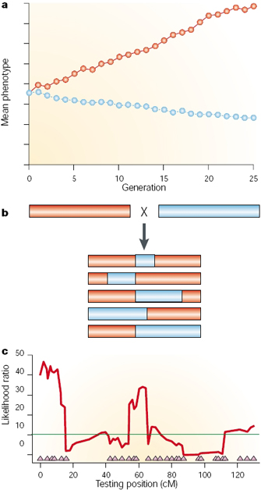
Quantitative trait locus (QTL)
A QTL is a section of DNA (the locus) that correlates with variation in a phenotype (the quantitative trait)
Requires parental strains (A) with genetic differences in the trait
Parental lines get crossed to create F1 offspring, which are crossed among themselves to create F2 that contain diff. fractions of the parental genomes (B)
Statistics to test regions association to trait (C), highest likelihood at 60cM
http://www.nature.com/scitable/topicpage/quantitative-trait-locus-qtl-analysis-53904
Sebastian Schmeier

Slide 14
expression QTL (eQTL)
A genetic locus where the genotype of a variant is significantly associated with gene expression levels of one or more genes.
An eQTL usually contains multiple DNA variants, i.e. supposedly regulatory SNPs (rSNPs)
Mapping eQTLs is done using standard QTL mapping methods that test the linkage between variation in expression and genetic polymorphisms.
Sebastian Schmeier

Slide 15
expression QTL (eQTL)
Cis-eQTL: A genetic variant that influences the expression levels of a proximal gene on the same chromosome in an allele-specific manner.
Trans-eQTL: A genetic variants that affects gene expression through an intermediate trans factor, such as a protein or RNA regulator. Trans-eQTLs usually lie far away from the target gene or on a separate chromosome.
Sebastian Schmeier

Slide 16
Genotype-tissue expression (GTEx)
Large-scale project to discover eQTLs in human tissues
Pilot study data published in 2015 (Science 348:6235 348)
The study uses SNPs as markers for eQTLs
~6.8 million SNPs with minor allele frequency (MAF) >= 5% were tested
The ultimate goal is to provide a framework fir biological interpretation of disease-related variants (→what is missing from GWAS)
Sebastian Schmeier

Slide 17
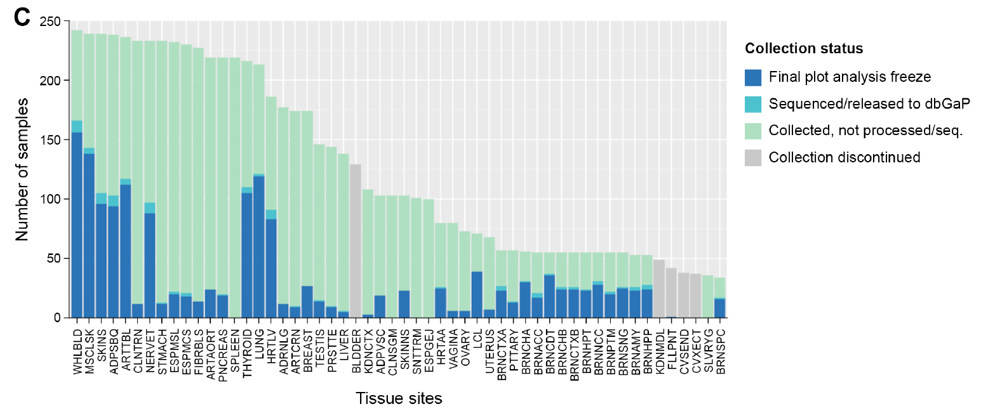
Genotype-tissue expression (GTEx)
237 postmortem donors
28 tissues per donor
54 distinct body sites
Science 348:6235 648
Sebastian Schmeier

Slide 18
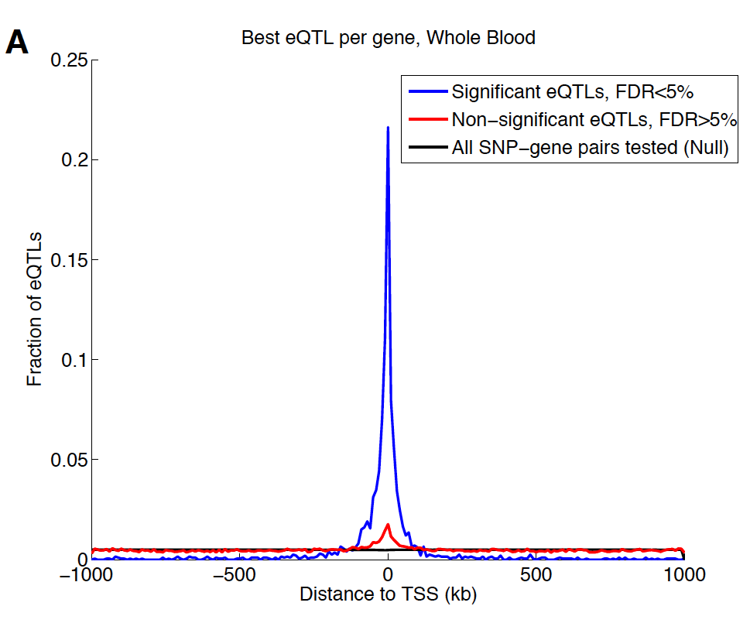
Genotype-tissue expression (GTEx)
Focuses on cis-eQTLs → here 1Mbp surrounding TSS of each gene
The eQTL signal shows an upstream bias (~60% of all eQTL are upstream)
Science 348:6235 648
Sebastian Schmeier

Slide 19
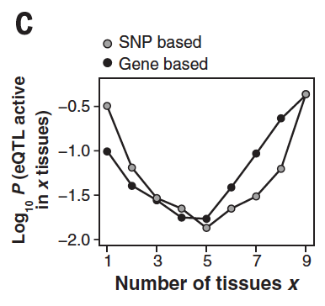
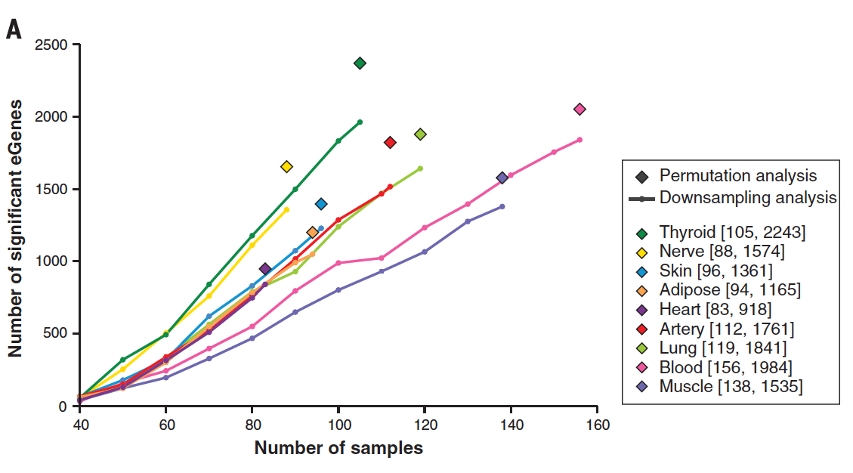
Genotype-tissue expression (GTEx)
Single tissue analysis revealed different number of eQTL genes per tissue
Multitissue analysis reveals the most likely configurations are for active eQTLs in few or many tissues
Science 348:6235 648
Sebastian Schmeier

Slide 20
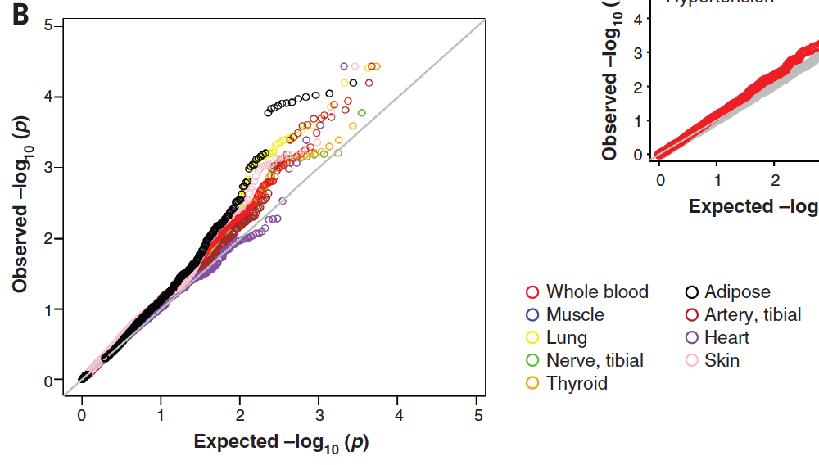
Genotype-tissue expression (GTEx)
Enrichment for eQTLs for disease associations is tissue-dependent →the example shows hypertension
Science 348:6235 648
Sebastian Schmeier

Slide 21
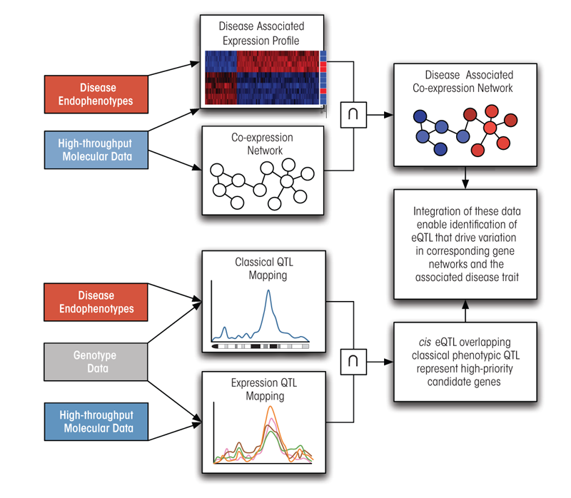
Integration of expression and eQTLs to identify gene networks and candidate genes for complex traits
Example of how such an approach might look like.
Sebastian Schmeier
http://pubs.niaaa.nih.gov/publications/arcr343/306-317.htm

Slide 22
Integration of expression and eQTLs to identify gene networks and candidate genes for complex traits
Example of how such an approach might look like.
Variation to trait association
Importantly, eQTLs allow for associating known disease-related SNPs to be associated to regulated genes
Variation to gene association
Sebastian Schmeier
http://pubs.niaaa.nih.gov/publications/arcr343/306-317.htm

Slide 23
Questions?
Miles, C. & Wayne, M. (2008) Quantitative trait locus (QTL) analysis. Nature Education 1(1):208
The GTex consortium. (2015). The Genotype-Tissue Expression (GTex) pilot analysis: Multitissue gene regulation in humans. Science 348:6235 648
Sebastian Schmeier
s.schmeier@gmail.com
http://sschmeier.github.io/bioinf-workshop/

