Slide 1
Genome Assembly Introduction
Sebastian Schmeier
s.schmeier@gmail.com
http://sschmeier.github.io/bioinf-workshop/
10.08.2015

Slide 2
Topic overview
Genome assembly
Learning outcomes:
Being able to compute, investigate and evaluate the quality of sequence data from a sequencing experiment.
Be able to describe the concepts regarding genome assembly.
Be able to compute and investigate a whole genome assembly.
Being able to interpret and judge the quality of a genome assembly.

Slide 3
Overview
DNA sequencing technologies
Quality assessment of a sequencing run
Genome assemblies and de Bruijn graphs

Slide 4
Typical workflow of a genomics experiment
Scientific question
Experimental design
The essential part to make all downstream analysis work
Run the experiment
This is where the biological experiment happens
Assess data quality
This is the bottleneck of the whole experiment
Analyse the data
Biologically meaningful results

Slide 5
Genome versus transcriptome
Genome
The entirety of an organism's ancestral information. It is encoded either in DNA or, for many types of viruses, in RNA.
Transcriptome
The set of all RNA molecules, including messenger RNA, ribosomal RNA, transfer RNA, and other non-coding RNA produced in one or a population of cells
Name | Base Pairs
HIV | 9,749 | 9.7kb
E.Coli | 4,600,000 | 4.6MB
Yeast | 12,100,000 | 12.1Mb
Drosophila | 130,000,000 | 130MB
Homo sapiens | 3,200,000,000 | 3.2GB
marbled lungfish | 130,000,000,000 | 130Gb
"Amoeba" dubia | 670,000,000,000 | 670Gb
disputed

Slide 6
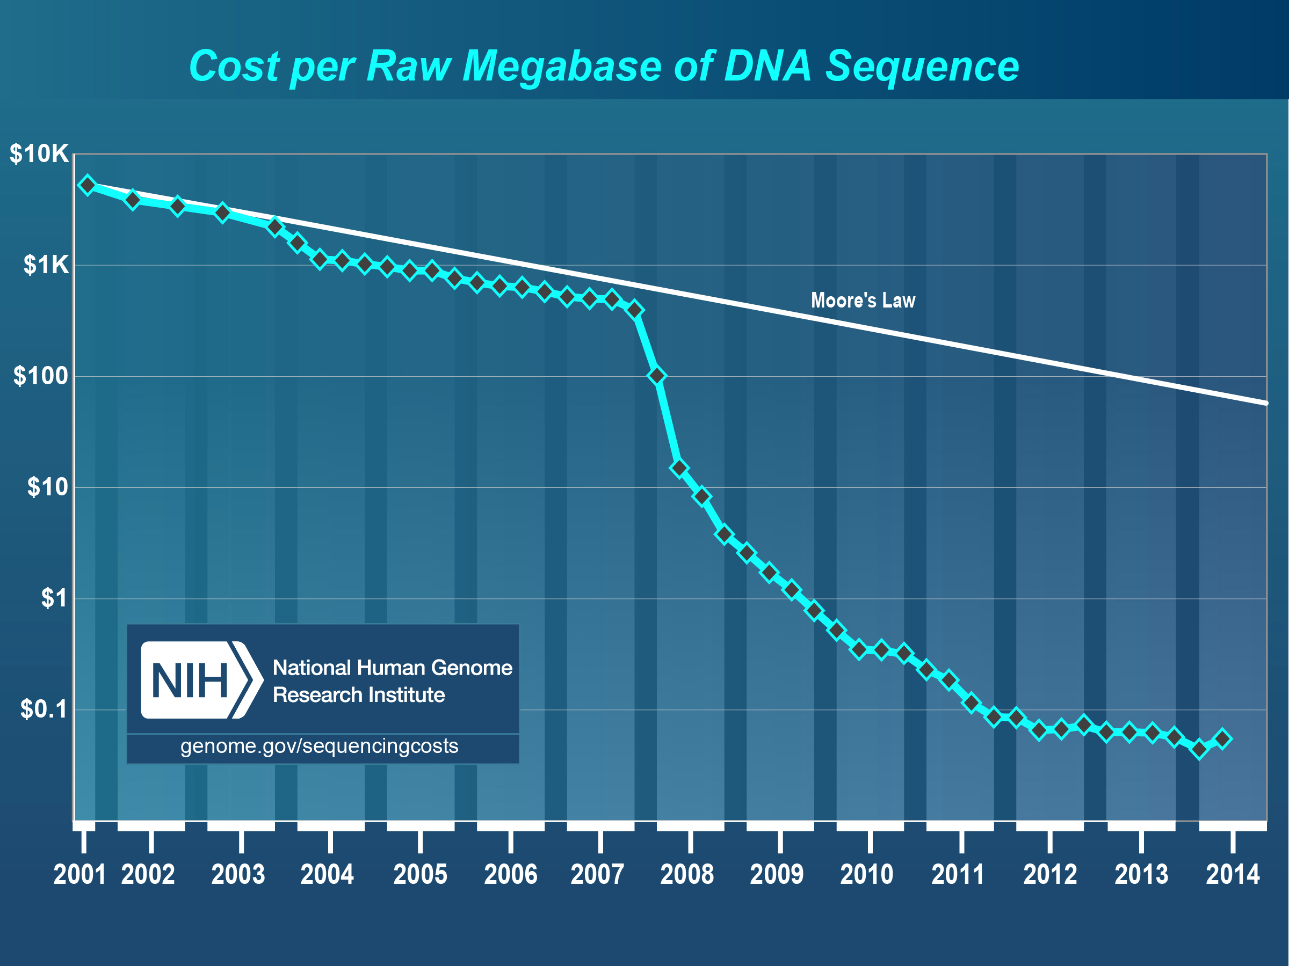
DNA sequencing
DNA sequencing is the process of determining the nucleotide order of a given DNA fragment.
First-generation sequencing:
1977 Sanger sequencing method development (chain-termination method)
2001, Sanger method produced a draft sequence of the human genome
Next-generation sequencing (NGS)
Demand for low-cost sequencing has driven the development of high-throughput sequencing (or NGS) technologies that parallelize the sequencing process, producing thousands or millions of sequences concurrently
2004 454 Life Sciences marketed a parallelized version of pyrosequencing

Slide 7
Result of a sequencing run
Short read sequences
The result of NGS technology are a collection of short nucleotide sequences (reads) of varying length (~40-400nt) depending on the technology used to generate the reads
Usually a reads quality is good at the beginning of the read and errors accumulate the longer the read gets → IMPORTANT

Slide 8
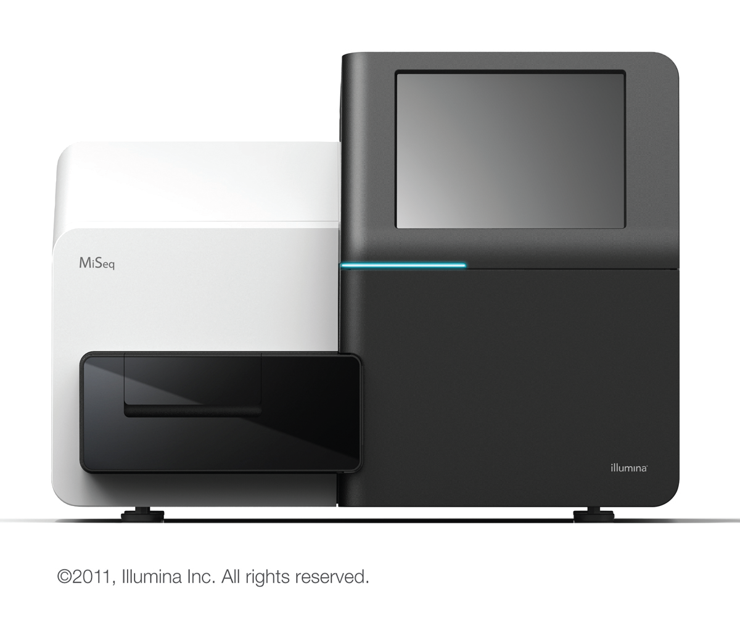
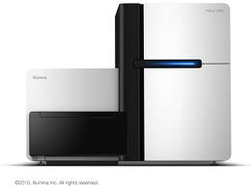
Illumina sequencing
MiSeq:
Bench-top sequencer
Produces around 30 million reads/run
Reads are up to 250nt
HiSeq:
Large-scale sequencer
4 billion reads/run
Reads up to 150nt
The Illumina systems accumulate errors towards the end of the read sequence.
MiSeq
HiSeq
http://www.illumina.com/

Slide 9

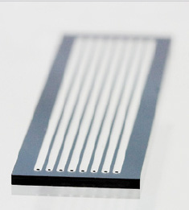
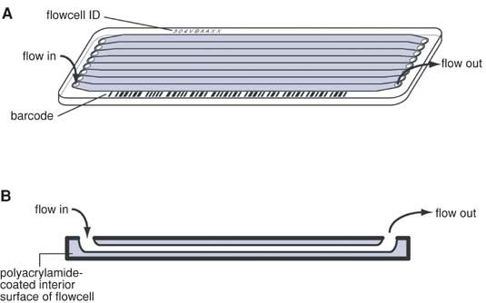
Illumina sequencing
An Illumina flowcell is a surface to which seq. adaptors are covalently attached.
DNA with complementary adaptors is attached, clonally amplified, and then sequenced by synthesis
Each flowcell is subdivided into hundreds of tiles
http://www.illumina.com/

Slide 10
How does the output look like?
The file-format that you will encounter soon is called FastQ
Sequence id
@EAS139:136:FC706VJ:2:2104:15343:197393 1:Y:18:ATCACG
GATTTGGGGTTCAAAGCAGTATCGATCAAATAGTAAATCCATTTGTTC
+
''*((((***+))%%%++)(%%%%).1***-+*''))**55CCF>>>>>>
Sequence
Phred quality of the corresponding nucleotide (ASCII code)

Slide 11
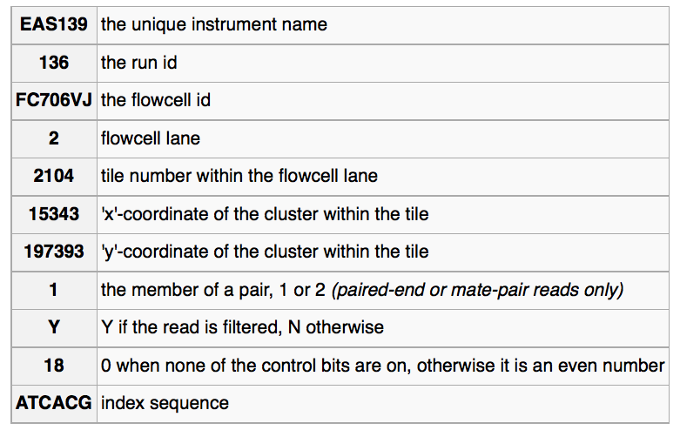
How does the output look like?
FastQ: Identifier
Sequence id
@EAS139:136:FC706VJ:2:2104:15343:197393 1:Y:18:ATCACG
GATTTGGGGTTCAAAGCAGTATCGATCAAATAGTAAATCCATTTGTTC
+
''*((((***+))%%%++)(%%%%).1***-+*''))**55CCF>>>>>>
Casava 1.8 the format

Slide 12
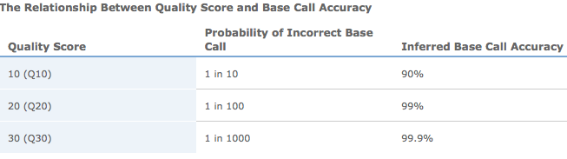
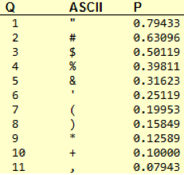
How does the output look like?
FastQ: Phred base quality
@EAS139:136:FC706VJ:2:2104:15343:197393 1:Y:18:ATCACG
GATTTGGGGTTCAAAGCAGTATCGATCAAATAGTAAATCCATTTGTTC
+
''*((((***+))%%%++)(%%%%).1***-+*''))**55CCF>>>>>>
Phred quality of the corresponding nucleotide (ASCII code)
One ASCII character per nucletide.
Encodes for a quality Q = -10*log₁₀(P), where P is the error probability
-10*log₁₀(0.1) =

Slide 13
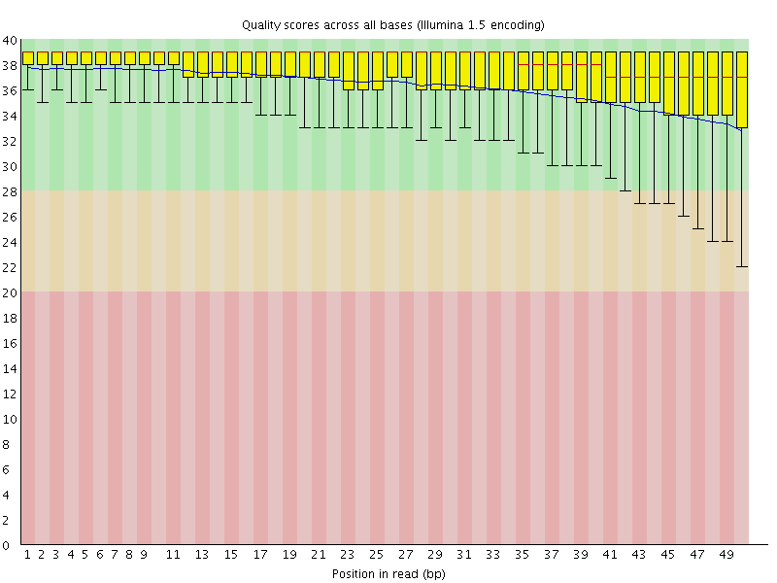
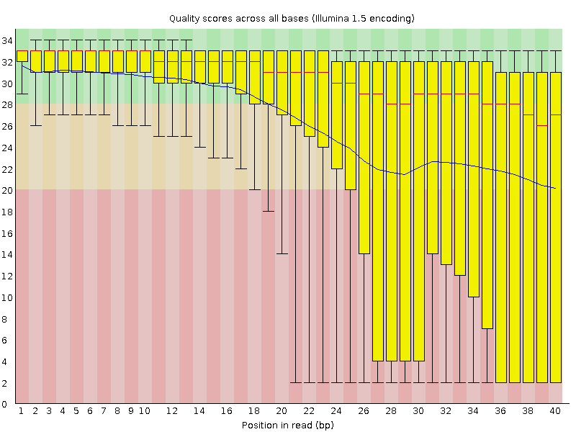
Assessing quality: Reads
http://www.bioinformatics.babraham.ac.uk/projects/fastqc/
Quality
Bad
Trimming needed
Good
Position in read
Position in read
If the quality of the reads is bad we can trim the nucleotides that are bad of the end of the reads
Not trimming the end has a huge influence on downstream processes, e.g. assemblies
Sebastian Schmeier
Notes:
Bad
Trimming needed

Slide 14
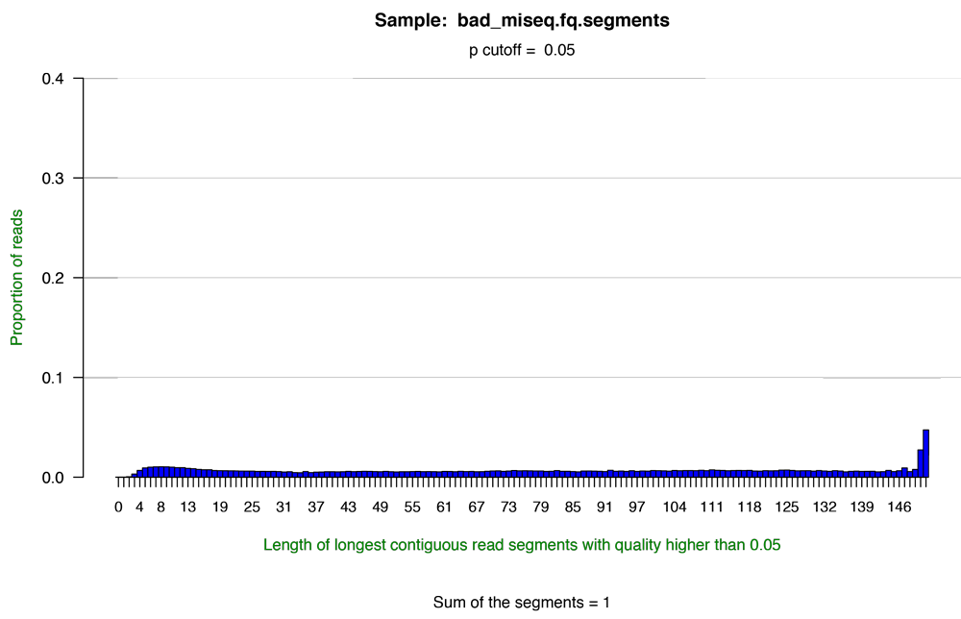
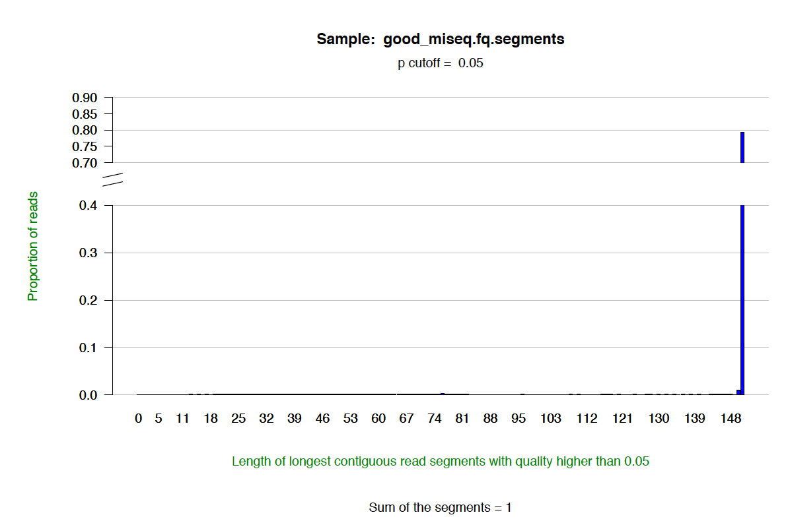
Assessing quality: Reads
Bad run
good run
http://solexaqa.sourceforge.net/
Notes:
Bad
Trimming needed

Slide 15
Assessing quality: Tiles
One can assess also the quality of a run based on the tiles of a lane of a flowcell
→ spot problems with a particular tile on a lane, e.g. Bubbles in the reagents
The homogeneity of the Illumina process ensures that the relative frequencies are similar from tile to tile and distributed uniformly across each tile
→ when the machine is functioning properly
Major discrepancies in these conditions can be discerned by sight
Many such discrepancies are small and their effects are limited to one, or a few, tiles.

Slide 16
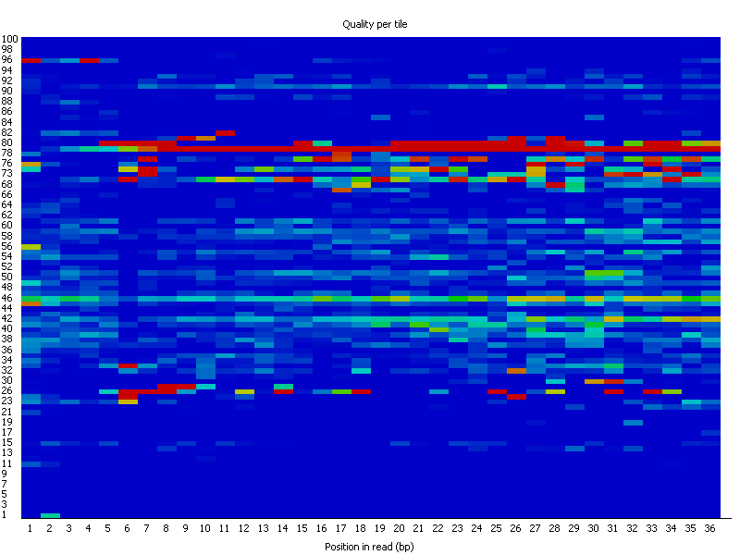
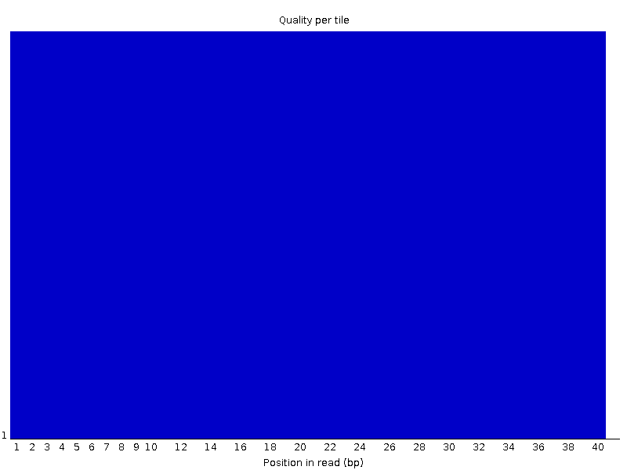
Assessing quality: Tiles
Encoded in these is the flowcell tile from which each read came.
The graph allows you to look at the quality scores from each tile across all of your bases to see if there was a loss in quality associated with only one part of the flowcell.
Bad run
Good run
The plot shows the deviation from the average quality for each tile.
The colours are on a cold to hot scale
Cold colours being positions where the quality was at or below the average for that base in the run
Hotter colours indicate that a tile had worse qualities than other tiles for that base.
http://www.bioinformatics.babraham.ac.uk/projects/fastqc/

Slide 17
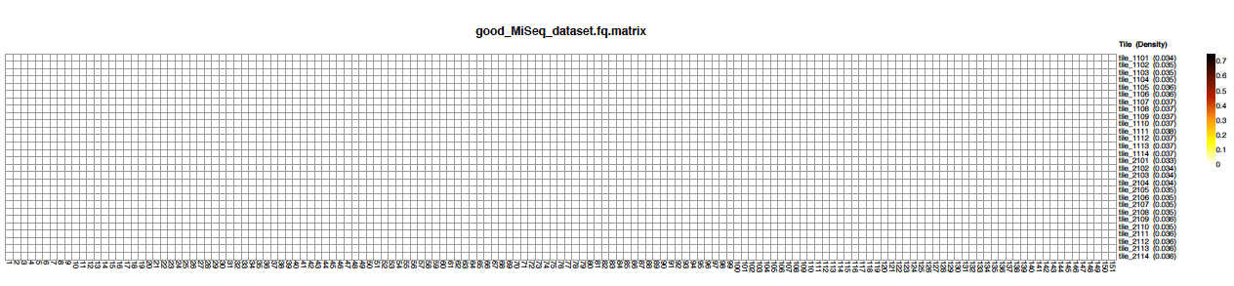
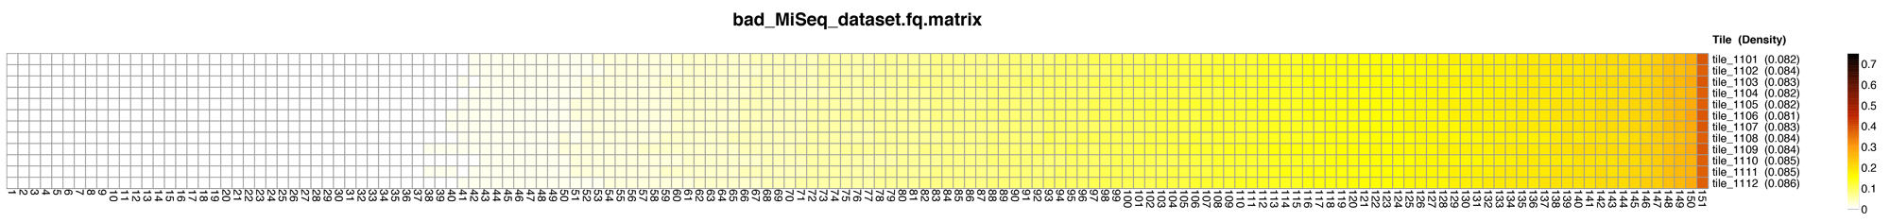
Assessing quality: Tiles
http://www.bioinformatics.babraham.ac.uk/projects/fastqc/
Good run
Bad run
Position in read

Slide 18
Assessing quality: Final
After assessing the quality we would try to remove all bp from the ends that do not fulfil a certain quality
Thus, we work with a adjusted set of sequencing reads for which we are more certain that they represent correct nt sequences from the genome

Slide 19
De novo genome assembly
The process of generating a new genome sequence from NGS genome sequence reads based on assembly algorithms
Assembly involves joining short sequence fragments together into long pieces – contigs
genome
sequencing
reads

Slide 20
ATGCG
GTGGC
GCGTG
TGGCA

Slide 21
Vertex
ATGCG
GTGGC
GCGTG
TGGCA

Slide 22
Vertex
ATGCG
Edge
GTGGC
GCGTG
TGGCA

Slide 23
Vertex
ATGCG
Edge
GTGGC
GCGTG
TGGCA

Slide 24
Vertex
ATGCG
Edge
GTGGC
GCGTG
TGGCA

Slide 25
Vertex
ATGCG
ATGCG
GCGTG
Edge
GTGGC
GTGGC
TGGCA
GCGTG
ATGCGTGGCA
TGGCA
genome

Slide 26
The fragment assembly problem
Given: A set of reads (strings) {s1, s2, … , sn }
Do: Determine a large string s that “best explains” the reads
What do we mean by “best explains”?
What assumptions might we require?

Slide 27
Shortest superstring problem
Objective: Find a string s such that
all reads s₁, s₂, … , s_{n} are substrings of s
s is as short as possible
Assumptions:
Reads are 100% accurate
Identical reads must come from the same location on the genome
“best” = “simplest”

Slide 28
ATGCG
ATGCG
GCGTG
GTGGC
GTGGC
1
2
TGGCA
GCGTG
3
ATGCGTGGCA
TGGCA
The assumption is that all substrings are represented
Even modern sequencers that generate 100nt reads do not cover all possible 100-mers

Slide 29
ATGCG
GTGGC
ATG, TGC, GCG,
GCG, CGT, GTG
GTG, TGG GGC
TGG, GGC, GCA
GCGTG
TGGCA
3-mers
Thus, people generally use k-mers of certain length
Here we use 3-mers by cutting the original reads into reads of length 3

Slide 30
ATGCG
GTGGC
ATG, TGC, GCG,
GCG, CGT, GTG
GTG, TGG GGC
TGG, GGC, GCA
GCGTG
TGGCA
3-mers
make them unique
Thus, people generally use k-mers of certain length
Here we use 3-mers by cutting the original reads into reads of length 3

Slide 31
ATGCG
GTGGC
ATG, TGC, GCG,
GCG, CGT, GTG
GTG, TGG GGC
TGG, GGC, GCA
GCGTG
TGGCA
3-mers
GCG
CGT
GTG
TGC
GCA
Draw edge from x to y
where
suffix from x overlaps prefix from y
ATG
TGG
GGC
Thus, people generally use k-mers of certain length
Here we use 3-mers by cutting the original reads into reads of length 3

Slide 32
ATGCG
GTGGC
ATG, TGC, GCG,
GCG, CGT, GTG
GTG, TGG GGC
TGG, GGC, GCA
GCGTG
TGGCA
3-mers
GCG
CGT
GTG
TGC
GCA
Draw edge from x to y
where
suffix from x overlaps prefix from y
ATG
TGG
GGC
Thus, people generally use k-mers of certain length
Here we use 3-mers by cutting the original reads into reads of length 3

Slide 33
ATGCG
GTGGC
ATG, TGC, GCG,
GCG, CGT, GTG
GTG, TGG GGC
TGG, GGC, GCA
GCGTG
TGGCA
3-mers
GCG
CGT
GTG
TGC
GCA
Draw edge from x to y
where
suffix from x overlaps prefix from y
ATG
TGG
GGC
Thus, people generally use k-mers of certain length
Here we use 3-mers by cutting the original reads into reads of length 3

Slide 34
ATGCG
GTGGC
ATG, TGC, GCG,
GCG, CGT, GTG
GTG, TGG GGC
TGG, GGC, GCA
GCGTG
TGGCA
3-mers
GCG
CGT
GTG
TGC
GCA
Draw edge from x to y
where
suffix from x overlaps prefix from y
ATG
TGG
GGC
Thus, people generally use k-mers of certain length
Here we use 3-mers by cutting the original reads into reads of length 3

Slide 35
ATGCG
GTGGC
ATG, TGC, GCG,
GCG, CGT, GTG
GTG, TGG GGC
TGG, GGC, GCA
GCGTG
TGGCA
3-mers
GCG
CGT
GTG
Find Hamiltonian path, that is, a
path that visits every vertex exactly once
Record the First letter of each vertex +
All letters of last vertex
TGC
GCA
ATG
TGG
GGC
Thus, people generally use k-mers of certain length
Here we use 3-mers by cutting the original reads into reads of length 3

Slide 36
ATGCG
GTGGC
ATG, TGC, GCG,
GCG, CGT, GTG
GTG, TGG GGC
TGG, GGC, GCA
GCGTG
TGGCA
3-mers
GCG
CGT
GTG
Find Hamiltonian path, that is, a
path that visits every vertex exactly once
Record the First letter of each vertex +
All letters of last vertex
TGC
GCA
ATG
ATGCGTGGCA
TGG
GGC
Thus, people generally use k-mers of certain length
Here we use 3-mers by cutting the original reads into reads of length 3
UNFORTUNATELY: The Hamiltonian path problem is very difficult to solve (np-complete)

Slide 37
ATGCG
GTGGC
ATG, TGC, GCG,
GCG, CGT, GTG
GTG, TGG GGC
TGG, GGC, GCA
GCGTG
TGGCA
3-mers
GCG
CGT
GTG
Find Hamiltonian path, that is, a
path that visits every vertex exactly once
Record the First letter of each vertex +
All letters of last vertex
TGC
GCA
ATG
ATGCGTGGCA
TGG
GGC
ATGGCGTGCA
Thus, people generally use k-mers of certain length
Here we use 3-mers by cutting the original reads into reads of length 3
UNFORTUNATELY: The Hamiltonian path problem is very difficult to solve (np-complete)

Slide 38
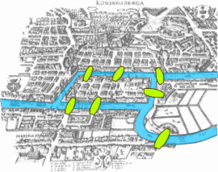
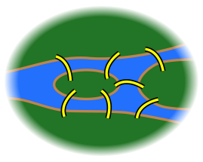
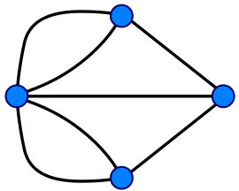
Seven bridges of Königsberg
In 1735 Leonhard Euler was presented with the following problem:
find a walk through the city that would cross each bridge once and only once
He proved that a connected graph with undirected edges contains an Eulerian cycle exactly when every node in the graph has an even number of edges touching it.
For the Königsberg Bridge graph, this is not the case because each of the four nodes has an odd number of edges touching it and so the desired stroll through the city does not exist.
https://en.wikipedia.org/wiki/Leonhard_Euler

Slide 39
Assembly as a graph theoretical problem
The degree of a vertex: # of edges connected to it
outdegree: # of outgoing edges
indegree: # of ingoing edges
degree(B)?
outdegree(B)?
indegree(D)?
A
B
Directed edge
C
D
Vertex

Slide 40
Seven bridges of Königsberg II
The case of directed graphs is similar:
A graph in which indegrees are equal to outdegrees for all nodes is called 'balanced'.
Euler's theorem states that a connected directed graph has an Eulerian cycle if and only if it is balanced.
Mathematically/computationally finding Eulerian path is much easier than Hamiltonian
→ we need to reformulate our assembly problem

Slide 41
We construct a de Bruijn graph:
edges represent k-mers
vertices correspond to (k-1)-mers
Form a node for every distinct prefix or suffix of a k-mer
Connect vertex x to vertex y with a directed edge if some k-mer (e.g., ATG) has prefix x (e.g., AT) and suffix y (e.g., TG), and label the edge with this k-mer.
k-mers: ATG, TGG, TGC, GTG, GGC, GCA, GCG, CGT
Distinct (k-1)-mers:

Slide 42
We construct a de Bruijn graph:
edges represent k-mers
vertices correspond to (k-1)-mers
Form a node for every distinct prefix or suffix of a k-mer
Connect vertex x to vertex y with a directed edge if some k-mer (e.g., ATG) has prefix x (e.g., AT) and suffix y (e.g., TG), and label the edge with this k-mer.
k-mers: ATG, TGG, TGC, GTG, GGC, GCA, GCG, CGT
Distinct (k-1)-mers:
AT

Slide 43
We construct a de Bruijn graph:
edges represent k-mers
vertices correspond to (k-1)-mers
Form a node for every distinct prefix or suffix of a k-mer
Connect vertex x to vertex y with a directed edge if some k-mer (e.g., ATG) has prefix x (e.g., AT) and suffix y (e.g., TG), and label the edge with this k-mer.
k-mers: ATG, TGG, TGC, GTG, GGC, GCA, GCG, CGT
Distinct (k-1)-mers:
AT
TG

Slide 44
We construct a de Bruijn graph:
edges represent k-mers
vertices correspond to (k-1)-mers
Form a node for every distinct prefix or suffix of a k-mer
Connect vertex x to vertex y with a directed edge if some k-mer (e.g., ATG) has prefix x (e.g., AT) and suffix y (e.g., TG), and label the edge with this k-mer.
k-mers: ATG, TGG, TGC, GTG, GGC, GCA, GCG, CGT
Distinct (k-1)-mers:
AT
TG
GG

Slide 45
We construct a de Bruijn graph:
edges represent k-mers
vertices correspond to (k-1)-mers
Form a node for every distinct prefix or suffix of a k-mer
Connect vertex x to vertex y with a directed edge if some k-mer (e.g., ATG) has prefix x (e.g., AT) and suffix y (e.g., TG), and label the edge with this k-mer.
k-mers: ATG, TGG, TGC, GTG, GGC, GCA, GCG, CGT
GT
CG
Distinct (k-1)-mers:
AT
TG
GC
CA
GG

Slide 46
We construct a de Bruijn graph:
edges represent k-mers
vertices correspond to (k-1)-mers
Form a node for every distinct prefix or suffix of a k-mer
Connect vertex x to vertex y with a directed edge if some k-mer (e.g., ATG) has prefix x (e.g., AT) and suffix y (e.g., TG), and label the edge with this k-mer.
k-mers: ATG, TGG, TGC, GTG, GGC, GCA, GCG, CGT
GT
CG
Distinct (k-1)-mers:
AT
ATG
TG
GC
CA
GG

Slide 47
We construct a de Bruijn graph:
edges represent k-mers
vertices correspond to (k-1)-mers
Form a node for every distinct prefix or suffix of a k-mer
Connect vertex x to vertex y with a directed edge if some k-mer (e.g., ATG) has prefix x (e.g., AT) and suffix y (e.g., TG), and label the edge with this k-mer.
k-mers: ATG, TGG, TGC, GTG, GGC, GCA, GCG, CGT
GT
CG
Distinct (k-1)-mers:
AT
ATG
TG
GC
CA
TGG
GG

Slide 48
We construct a de Bruijn graph:
edges represent k-mers
vertices correspond to (k-1)-mers
Form a node for every distinct prefix or suffix of a k-mer
Connect vertex x to vertex y with a directed edge if some k-mer (e.g., ATG) has prefix x (e.g., AT) and suffix y (e.g., TG), and label the edge with this k-mer.
k-mers: ATG, TGG, TGC, GTG, GGC, GCA, GCG, CGT
GT
CG
Distinct (k-1)-mers:
CGT
GTG
GCG
AT
ATG
TG
TGC
GC
GCA
CA
TGG
GGC
GG

Slide 49
Can we find a DNA sequence containing all k-mers?
In a de Bruijn graph, can we find a path that visits every edge of the graph exactly once?
Eulerian path
a vertex v is semibalanced if |indegree(v) – outdegree(v)| = 1
a connected graph has an Eulerian path if and only if it contains at most two semibalanced vertices
k-mers: ATG, TGG, TGC, GTG, GGC, GCA, GCG, CGT
GT
CG
Distinct (k-1)-mers:
CGT
GTG
GCG
AT
ATG
TG
TGC
GC
GCA
CA
TGG
GGC
GG

Slide 50
Can we find a DNA sequence containing all k-mers?
In a de Bruijn graph, can we find a path that visits every edge of the graph exactly once?
Eulerian path
a vertex v is semibalanced if |indegree(v) – outdegree(v)| = 1
a connected graph has an Eulerian path if and only if it contains at most two semibalanced vertices
k-mers: ATG, TGG, TGC, GTG, GGC, GCA, GCG, CGT
GT
CG
Distinct (k-1)-mers:
CGT
GTG
GCG
AT
ATG
TG
TGC
GC
GCA
CA
TGG
GGC
GG

Slide 51
Can we find a DNA sequence containing all k-mers?
In a de Bruijn graph, can we find a path that visits every edge of the graph exactly once?
Eulerian path
k-mers: ATG, TGG, TGC, GTG, GGC, GCA, GCG, CGT
GT
CG
Distinct (k-1)-mers:
CGT
GTG
GCG
AT
ATG
TG
TGC
GC
GCA
CA
TGG
GGC
ATGGCGTGCA
GG

Slide 52
Can we find a DNA sequence containing all k-mers?
In a de Bruijn graph, can we find a path that visits every edge of the graph exactly once?
Eulerian path
k-mers: ATG, TGG, TGC, GTG, GGC, GCA, GCG, CGT
GT
CG
Distinct (k-1)-mers:
CGT
GTG
GCG
AT
ATG
TG
TGC
GC
GCA
CA
TGG
GGC
ATGGCGTGCA
GG
ATGCGTGGCA

Slide 53
Underlying assumptions
Four hidden assumptions that do not hold for next-generation sequencing We took for granted that:
we can generate all k-mers present in the genome
all k-mers are error free
each k-mer appears at most once in the genome
the genome consists of a single chromosome

Slide 54
Underlying assumptions
Four hidden assumptions that do not hold for next-generation sequencing We took for granted that:
we can generate all k-mers present in the genome
all k-mers are error free
That is the reason that we do not choose the longest possible k-mer
The smaller the k-mer the higher the possibility that we see all k-mers
Errors:
K=3
ATG TGG GGC GCG CGT GTG TGC GCA
ATGGCGTGCA
Mostly unaffected k-mers
K=10
ATGGCGTGCA
100% affected k-mers

Slide 55
Each k-mer appears at most once in the genome → repeats
This is most often not true
This is known as k-mer multiplicity
k-mers:
ATG, GCA,
TGC, TGC, GTG, GTG, GCG, GCG, CGT, CGT
GT
CG
Distinct (k-1)-mers:
CGT
GTG
GCG
AT
ATG
TG
TGC
GC
GCA
CA
ATGCGTGCGTGCA

Slide 56
Questions?
References
How to apply de Bruijn graphs to genome assembly. Phillip E C Compeau, Pavel A Pevzner & Glenn Tesler. Nature Biotechnology 29, 987–991 (2011) doi:10.1038/nbt.2023 Published online 08 November 2011
Sequence Assembly. Lecture by Mark Craven (craven@biostat.wisc.edu). BMI/CS 576 (www.biostat.wisc.edu/bmi576/), Fall 2011
Sebastian Schmeier
s.schmeier@gmail.com
http://sschmeier.github.io/bioinf-workshop/

