Slide 1
MVVM Presentation
Controllers

Slide 2
What is a Controller?
Non-visual singleton object that stays alive in memory for the duration of the application’s lifetime
Typically, created in app startup (directly or through a bootstrapper class or module initialization)
At a minimum, it usually handles View/ViewModel construction and opening views (just like the IAppDialogService in sample app)
Many names: Conductor, Orchestrator, ViewManager, (can also be similar to the “Presenter” in an MVP design pattern), but “Controller” is most common
Generally conforms to an interface such as IController
Can be communicated with through an interface that is injected into ViewModels
Can also subscribe to events/messages in a mediator pattern (eventaggregator, messenger, messagebus, etc.) and ViewModels can just publish the message through the mediator object without needing to reference the Controller’s interface
Not quite 1 to 1 with views/viewmodels it opens
Simple apps might only have one “ApplicationController” that opens all the Views.
Larger apps might split controllers out by use case scenarios (eg “ProductController” that opens ProductSearch, CreateProduct, ProductsReport Views, “Customercontroller” handles all Customer-related views, etc.)

Slide 3
Other Potential Responsibilities
Opening the MainWindow
Instead of the app startup creating the main application window, the controller handles this (Main Window is just another “view” after all, so why should it get special treatment?)
Merging the model with the ViewModel
The Controller handles all business logic/data access and the ViewModel is just a dumb container for shaping the data for databinding with zero knowledge or dependencies on the Model layer
ViewModel forwards all requests to Controller (all CRUD operations)
Controller can either “push” data to ViewModel or ViewModel can “pull” or “ask” for data through the IController interface injected through constructor
Controller forwards calls to data/business layers
Application “Flow,” navigation, and business logic. The Controller IS the application. It’s the “glue” that ties all the pieces together.
When the Controller is used in this way, it can be called MVCVM or MVVM#
Further reading: http://www.codeproject.com/Articles/173618/MVVM-sharp-Episode-1

Slide 4
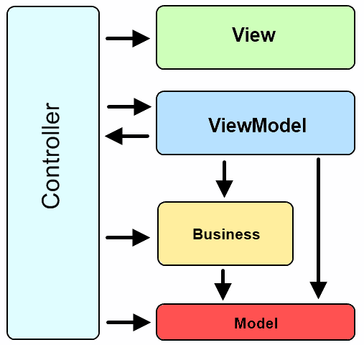
Controller conducts the Orchestra

Slide 5
Advantages
Simplifies ViewModel responsibility (SRP)
Loosely-coupled/separation of concerns
Much like a ViewModel is an abstraction of the view, the controller can act as an abstraction of the Application flow/logic
Totally agnostic of the UI
Can lead to more testable and flexible code
Particularly useful in modular applications
Controller is instantiated in Module’s initialization, subscribes to events/messages from Mediator/EventAggregator and sits in memory waiting…just waiting…

Slide 6
Disadvantages
More code to write (linking ViewModel and Model, forwarding calls to intermediary methods on controller, etc.)
Yet another concept on top of MVVM to teach new developers
Code can be slightly more unintuitive with extra layer of indirection between ViewModel and Model
Some benefits (such as narrowing responsibilities of ViewModels) can be achieved with alternatives
Break up Responsibilities of ViewModel by composing into child ViewModels
Separate Commands from data properties with ViewData class as subproperty of ViewModel

