Slide 1
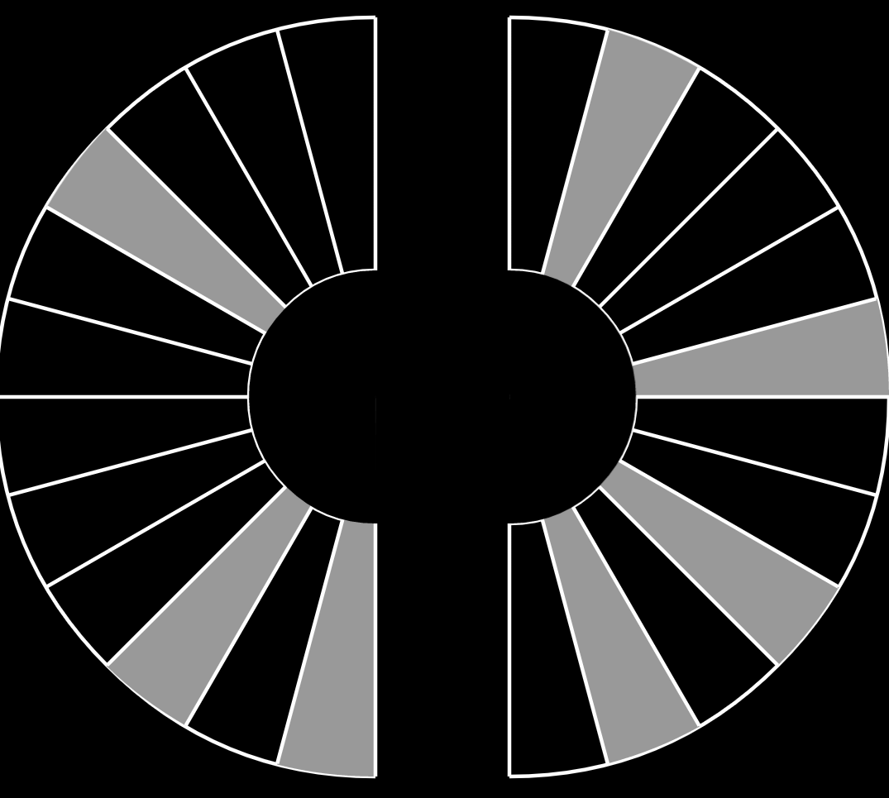


Maquina Home
Pattern:
Maunal
You have control
Send
Refreshed July 17, 2014 at 10:51pm

