Slide 1
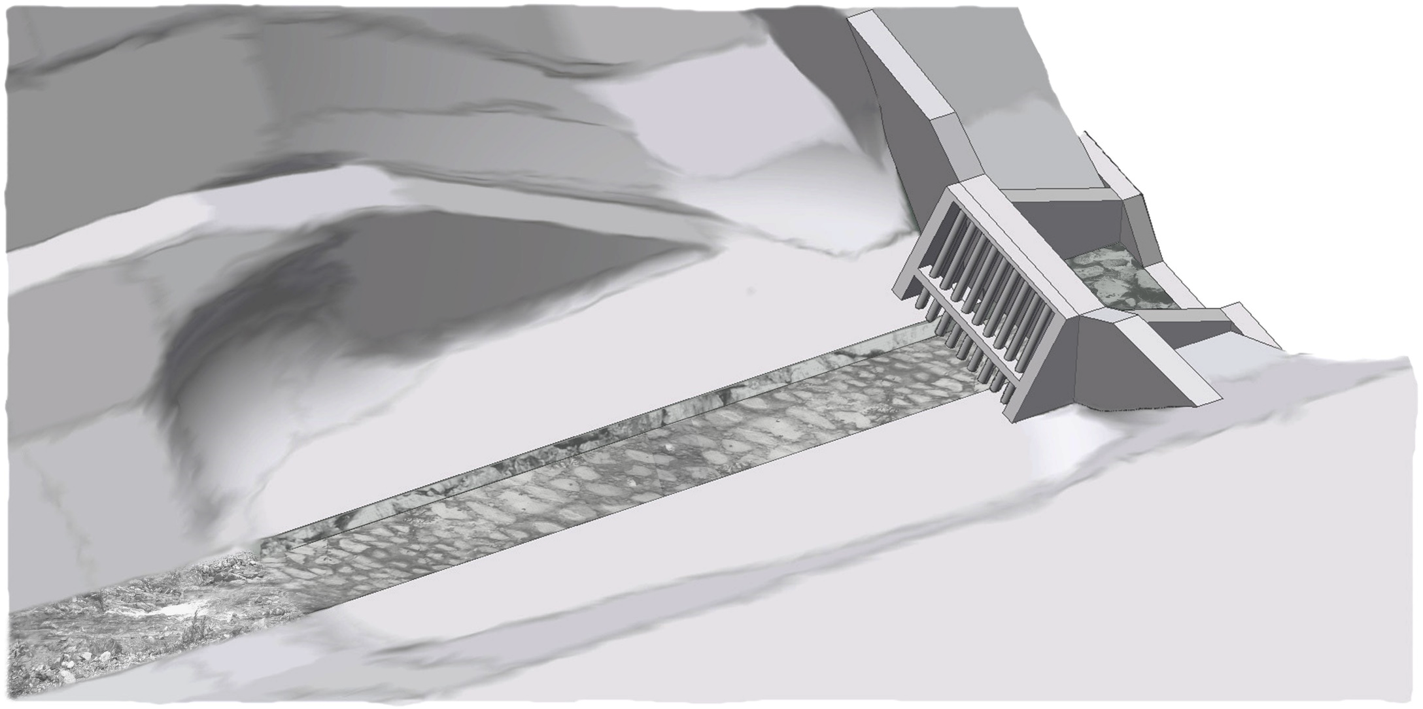
Maintenance access
Mechanical-hydraulic barrier
Scour
protection
Deposition -
Inlet structure
Guiding channel
area
Lateral dykes
Q

