Slide 1
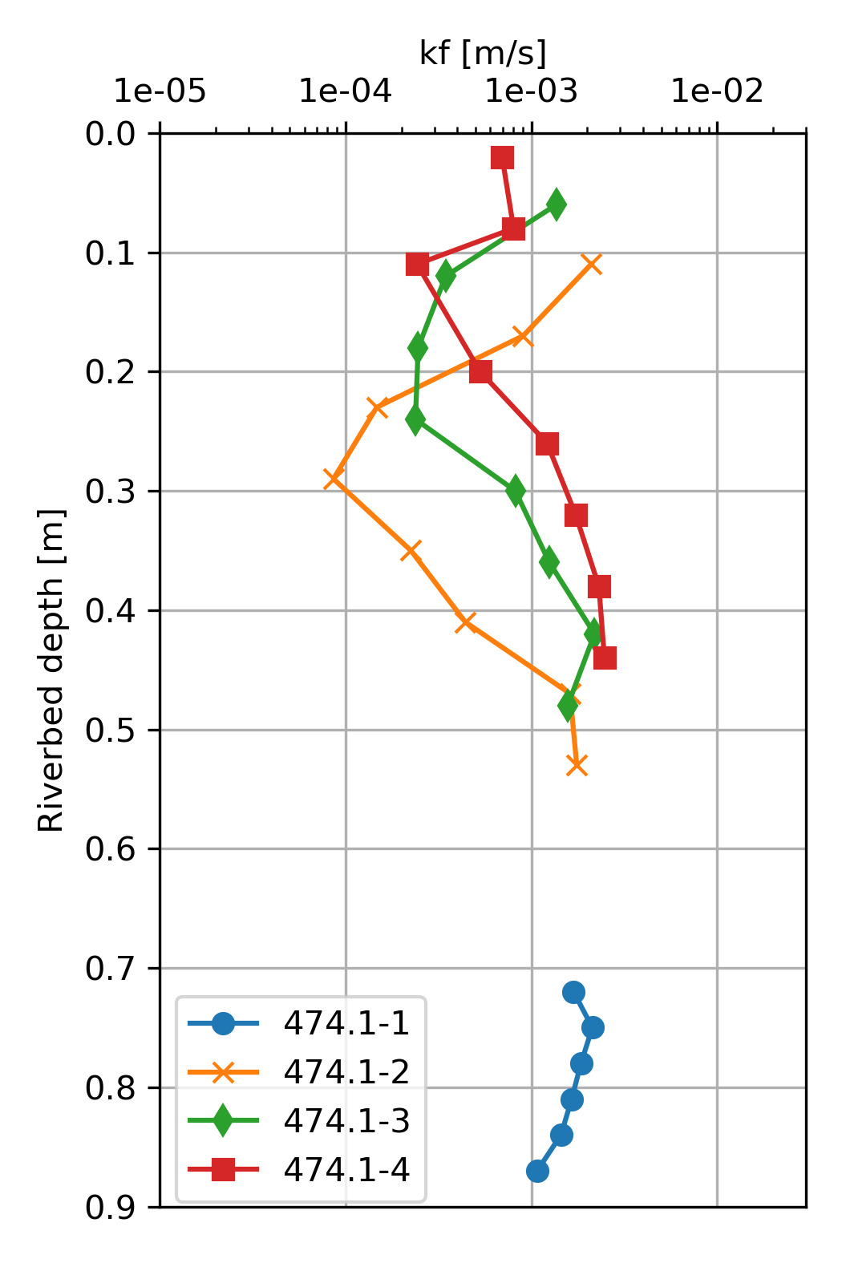
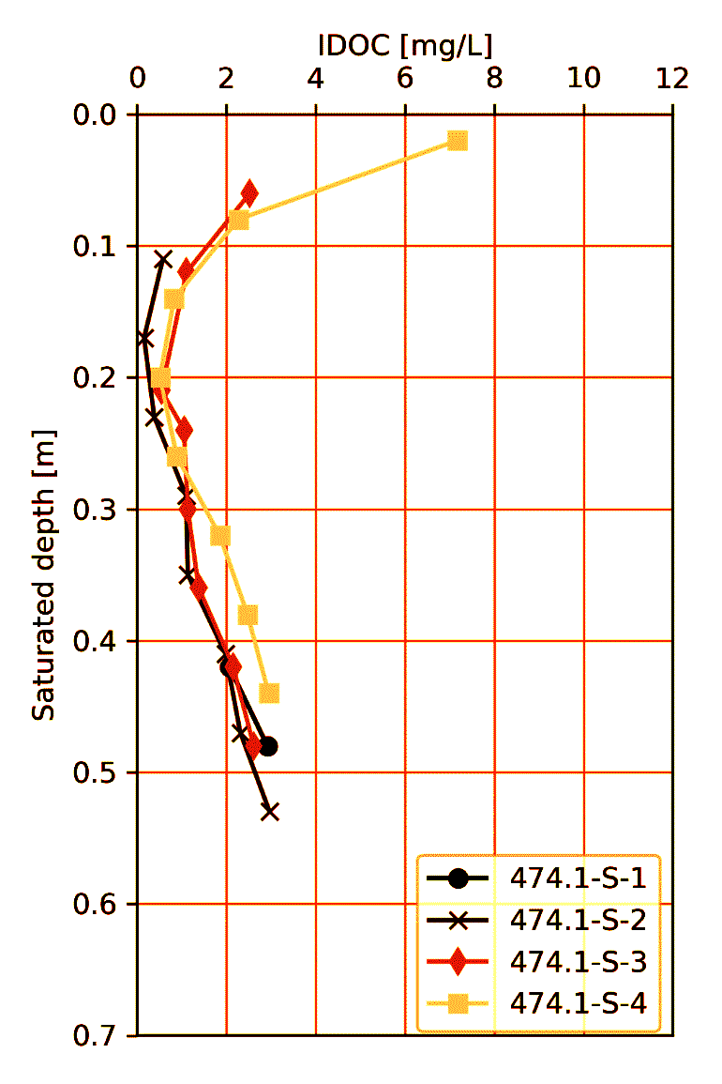
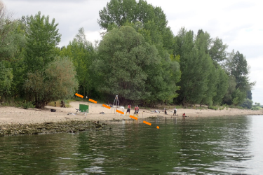
kf : hydraulic conductivity
IDOC : Interstitial Dissolved Oxygen Concentration

Slide 2
