Slide 1
C++ Benchmarking
Liam Keegan, SSC
Notes:
https://forms.gle/vcsJpEmTBMBj8zMb8
https://ssciwr.github.io/cpp-benchmarking/

Slide 2
Course Outline
Performance
  How to get good performance
  Why benchmarking is important
Micro-benchmarks
  Run a tiny snippet of code many times, see how long it takes
  Non-deterministic, real hardware
Profiling
  Run the entire code, occasionally check what it’s doing
  Non-deterministic statistical sampling of events, real hardware
Simulation
  Run entire code on a virtual machine & measure every single operation
  Deterministic measurement of all events, but not real hardware

Slide 3
Performance

Slide 4
Motivation
We use c++ because we need performance
  Otherwise we could (should?) use a higher-level language, e.g. Python
Writing fast code is simple
  Need to use good algorithms for efficiency (do less work)
  Need to use good data structures for speed (do work faster)
Writing fast code is difficult
  Often these two needs are in conflict with each other
  So the answer to “what is the fastest way to do this?” is “it depends”
Benchmarking can help
  With the question “which method is fastest?”
  With the question “where and why is my code slow?”

Slide 5
Algorithms
A finite sequence of operations
Complexity
  Count operations required to process N items
    E.g. 2 N + 5 N log(N)
  For large N, term with highest power of N dominates
  “Big-O” algorithmic complexity is the highest power of N
    E.g. O(N log(N))
Memory
  Required memory is also counted and expressed in Big-O notation

Slide 6
Algorithm goal: reduce complexity
Generally we want the most efficient algorithm
  I.e. the one with the smallest Big-O complexity
Often there a multiple “optimal” algorithms
  Different pros and cons depending on your data and your hardware
Although sometimes a less efficient algorithm can be better
  if memory is a constraint, and there is a less efficient algorithm that requires less memory
  if the big-O coefficient is much smaller
    E.g. unless N is very large, 1e9 * log(N) is larger than N
  if it allows for a much faster implementation on your hardware
    E.g. more fast operations can be better than a few slow operations
  if it allows for parallelization over threads / cores / nodes
  etc

Slide 7
Hardware
CPU gets some data, operates on it:
Get the data from
  L1 cache (32kb): 1 ns
  L2 cache (256kb): 3 ns
  L3 cache (32mb): 20 ns
  RAM (32gb): 100 ns
  SSD (1tb): 10000 ns
Do the operation
  CPU core cycle: 1 ns
  SIMD: apply same instruction to multiple data in the same operation
  Multi-core: a CPU typically has several cores
CPU spends a lot of time idle, waiting for data

Slide 8
Hardware goal: avoid cache misses
Spatial locality of data
  Store data contiguously, and in the order in which it will be accessed
  Also known as “Data-oriented design”
    or old-fashioned C-style arrays of data
    or SoA (struct-of-arrays) vs AoS (arrays-of-struct)
  Why? So that it is more likely to already be in the cache
  Also
    allows pre-fetcher to load data into cache before it is needed
    enables the use of SIMD cpu instructions
Temporal locality of algorithms
  When accessing the same data again, do it sooner rather than later
  Why? So that it is more likely to still be in the cache

Slide 9
General Performance strategy
For large problems
  We care about the efficiency of our algorithms
  We want to do less work
For small problems
  We care about cache friendly data structures
  We want to do our work fast
Sometimes a large problem can also be many small problems
  Use an efficient algorithm to reduce a large problem to many small problems
  Use a fast cache-friendly method to solve each small problem
Algorithms and data structures are interconnected
  But helpful to consider their impact separately
  Helps to understand the tradeoffs you are making with your choices
  Benchmarks are the key to making an informed choice!

Slide 10
Micro-benchmarks

Slide 11
Micro-benchmarks
Run a tiny snippet of code on real hardware
Do it many times & see how long it takes
Pros
  Good to get accurate results for specific functions
  Similar to a unit test suite but for performance: monitor regressions
Cons
  May not be so close to “real world” scenarios
  Have to take care compiler doesn’t optimize away the supposed work!
  Not deterministic: but can repeat many times & measure statistical significance
Different possible metrics
  Average time: most common and most relevant for many use cases
  Median time: less noisy than the average, not affected by outliers
  Fastest time: e.g. if investigating peak performance
  Slowest time: e.g. if latency / worst-case scenario is important

Slide 12
Micro-benchmarking tools
Google benchmark
  Widely used and actively maintained
  See also Quick-bench (online version a bit like compiler explorer)
Celero
  Actively maintained
Nonius
  Older, less/not actively maintained
Catch2
  Some integration of nonius to add benchmarks to unit tests
Do it yourself solution
  E.g. using std::chrono::high_resolution_clock
  Not recommended

Slide 13
Google benchmark minimal example
#include <benchmark/benchmark.h>
static void bench_map(benchmark::State &state) {
Map map; // initialize data
for (auto _ : state) {
map.find(keys[0]); // code to benchmark
}
}
BENCHMARK(bench_map);
BENCHMARK_MAIN();

Slide 14
Map implementation performance
Binary Tree: O(log(N)) to find an item
  Good algorithmic efficiency
  Terrible cache locality
  Use case: large N
Unsorted Vector: O(N) linear traversal to find an item
  Terrible algorithmic efficiency
  Good cache locality
  Use case: small N
Hash table: O(1)
  Excellent algorithmic efficiency
    Although not guaranteed - need a good hash function
  Cache locality depends on implementation
  Use case: large N

Slide 15
Coding time
git clone --recursive https://github.com/ssciwr/cpp-benchmarking.git
cd cpp-benchmarking
mkdir build
cd build
cmake -DCMAKE_BUILD_TYPE=Release ..
cmake --build .
ctest
./bench/bench1

Slide 16
Benchmark 1
for (auto _ : state) {
map.find(keys[0]);
}
bench_small_map/1 0.000 ns 0.000 ns 1000000000
bench_small_map/2 0.000 ns 0.000 ns 1000000000
bench_small_map/4 0.000 ns 0.000 ns 1000000000
Looks bogus: Zero run-time, no N-dependence
Why? Compiler optimizes away the entire statement

Slide 17
Benchmark 2
for (auto _ : state) {
benchmark::DoNotOptimize(map.find(keys[0]));
}
bench_small_map/1 0.990 ns 0.990 ns 691986485
bench_small_map/2 1.00 ns 1.00 ns 705385115
bench_small_map/4 0.989 ns 0.989 ns 703257489
Force compiler to put result into register or memory
Non-zero runtime, but still no N-dependence
Why? Always looking for the first key!

Slide 18
Benchmark 3
for (auto _ : state) {
benchmark::DoNotOptimize(map.find(keys[n/2 + 1]));
}
bench_small_map/1 1.14 ns 1.14 ns 600298793
bench_small_map/2 1.38 ns 1.38 ns 507900144
bench_small_map/4 2.51 ns 2.51 ns 278833095
Force compiler to put result into register or memory
Ask for a key roughly in the middle of the vector
Get reasonable-looking N-dependence

Slide 19
Benchmark 4
for (auto _ : state){
for (auto key : keys) {
benchmark::DoNotOptimize(map.find(key));
}
}
bench_small_map/1 1.34 ns 1.34 ns 495155683
bench_small_map/2 3.21 ns 3.21 ns 218922642
bench_small_map/4 6.53 ns 6.53 ns 105903854
Force compiler to put result into register or memory
Loop over all keys: now doing N finds per benchmark iteration
Get average performance over all inputs

Slide 20
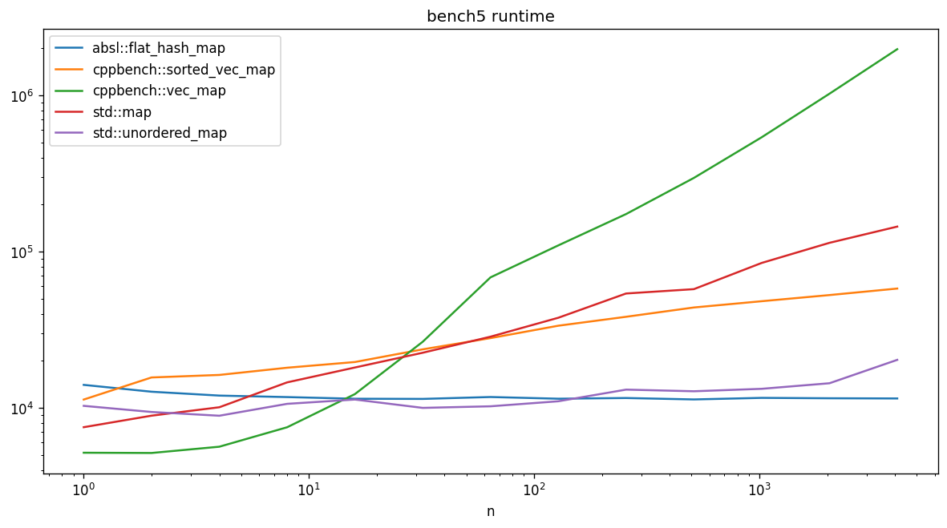
Benchmark 5
Compare with std::map, std::unordered_map implementations
Do the same number of find operations per benchmark iteration

Slide 21
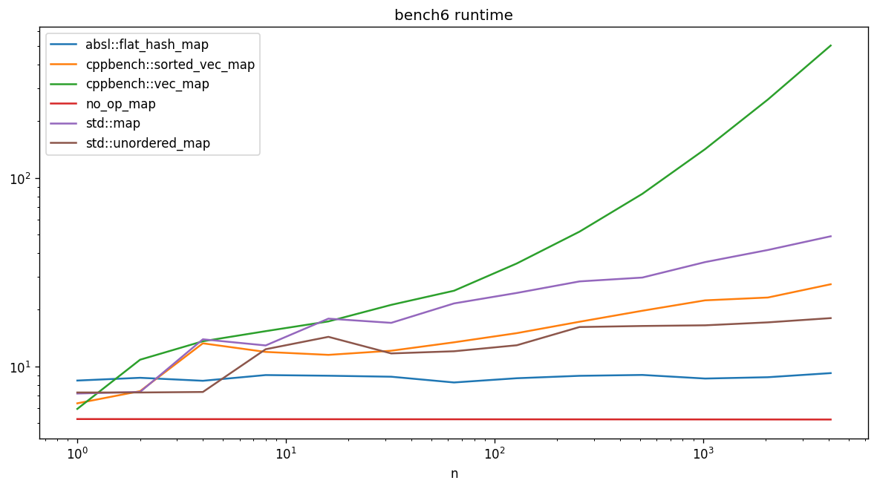
Benchmark 6
Pick a random key at each iteration (more realistic, but adds overhead)
Add a “no-op” Map to measure this overhead

Slide 22
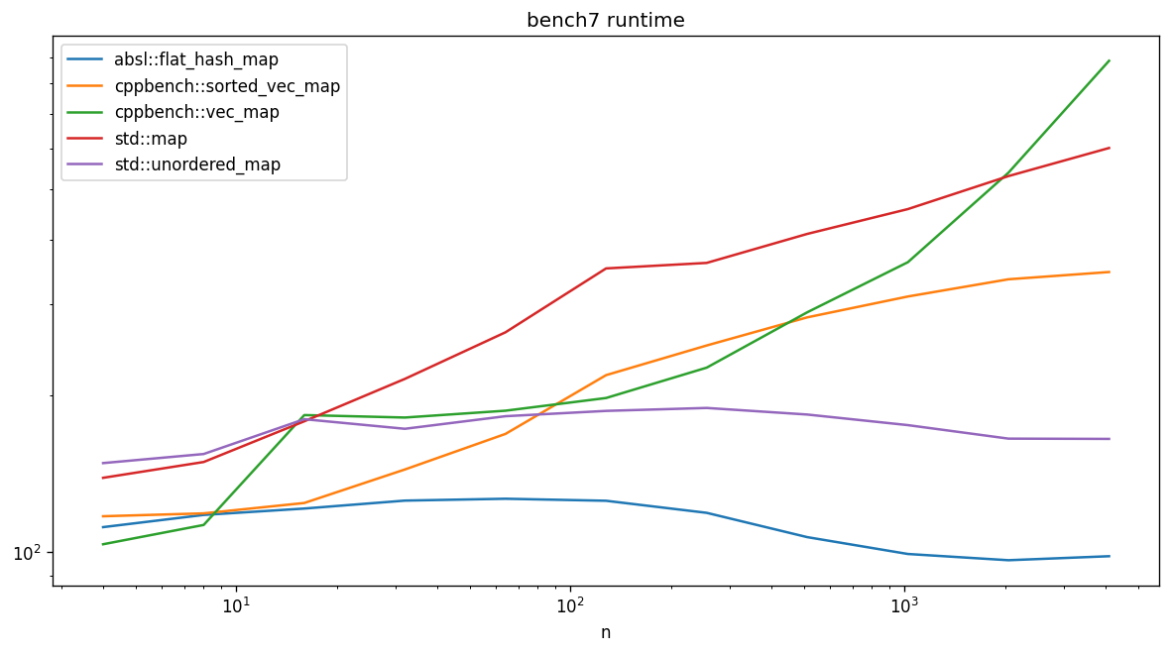
Benchmark 7
Try to simulate a “cold cache scenario”
  Generate millions of identical maps (a few gig of RAM)
  Pick a random map (probably not already in cache) for each benchmark iteration

Slide 23
Micro-benchmarking tips
Compile in release mode
Reduce the noise
  Disable CPU turbo-boost / frequency scaling
  Avoid running anything else at the same time
  Repeat benchmarks to estimate noise, statistical significance of differences
Try to be sure you’re measuring what you intend to
  Check the inputs and outputs are correct
  Check the compiler is not optimizing away the work
  Try to use or generate representative realistic input data
  Compare timings with a no-op version of your operation / function
  Look at the scaling as you vary the size of the input data
  Try varying the order of the input data
  Cold cache or hot cache scenario

Slide 24
Profiling

Slide 25
Profiling
Run real production code on real hardware
Not deterministic
Sampling
  Occasionally check what it’s doing
    Not too often to avoid interfering with execution / slowing it down!
  Good to get an overview of real-world bottlenecks
  Only sample a tiny fraction of events
    But likely to find hotspots this way
Instrumentation
  Instrument specific functions in your code to measure
  Good for keeping track of performance over time / identifying regressions
  More upfront work: typically need to add instrumentation code, have a separate build, etc

Slide 26
Profiler Information
Scheduler
  CPU use of each thread vs time
  Quick visual impression of multi-threading
Top-down
  Callgraph starting from main
  Inclusive %: time spent in function and children
  Exclusive %: time spent in function excluding children
  Go from the function to the child functions it calls
Bottom-up
  % time spent inside each function
  Go from the function to the parent functions that call it
  Default view in perf
  Note: inlined functions are not shown!

Slide 27
Profiling Tools
Perf
  No special instrumentation or re-compilation of code required
  Relatively simple to use, pre-installed on most linux distributions
  But linux only, and need sudo permissions: https://www.kernel.org/doc/html/latest/admin-guide/perf-security.html
Intel VTune
Likwid
Gperftools
Orbit
Tracy
Optick
and many more…

Slide 28
Compiling for profiling
Generally want to compile in Release mode
  Goal is to run your code exactly as in real-world setting
Additional flags to improve profile output at minimal cost:
  -g : include debugging symbols (e.g. function names)
    CMAKE_BUILD_TYPE = RelWithDebInfo
  -fno-omit-frame-pointer : don’t omit frame pointers (i.e. better stack traces)
Any additional requirements for your profiler
  Link to their library?
  Include their header?
  Instrument your code?
  Set environment variables?

Slide 29
Perf stat
perf stat ./app
  default performance counters
perf list
  show all available counters
perf stat -e L1-dcache-load-misses,L1-dcache-load ./app
  how often do we have a L1 data cache miss
perf stat -e branches,branch-misses ./app
  how often do we have a branch prediction miss

Slide 30
Perf stat example
perf stat -e L1-dcache-load-misses,L1-dcache-load \
./bench/bench6 \
--benchmark_filter=".*:vec_map.*/16\$" \
--benchmark_min_time=2
First line: Measure cache misses using perf stat
Others: run n=16 vec_map benchmark from bench6 for at least 2 secs
627,014 L1-dcache-load-misses # 0.01% of all L1-dcache accesses
8,377,940,732 L1-dcache-load

Slide 31
Branch prediction
CPU constructs a pipeline of instructions
  Often “out of order” i.e. not evaluated in the order you wrote them
  E.g. part of iteration n+1 in a loop may be calculated in iteration n
  You need to know what instructions are coming next to be able to do this
At every branch (e.g. if statement) in the code
  CPU doesn’t know where execution will jump to next until condition is evaluated
  This stalls the pipeline
So it tries to guess the most likely outcome (branch prediction)
  Constructs the pipeline based on guessing where the branch will jump to
Sometimes it guesses wrong
  This is called a “branch miss” (similar to a cache miss)
  CPU has to throw away / undo a lot of potentially incorrect operations
  Then find and execute the correct instructions from the correct branch
  This is expensive (also similar to a cache miss)

Slide 32
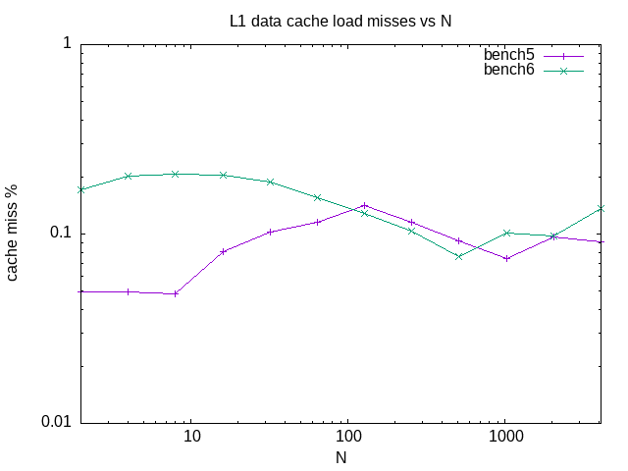
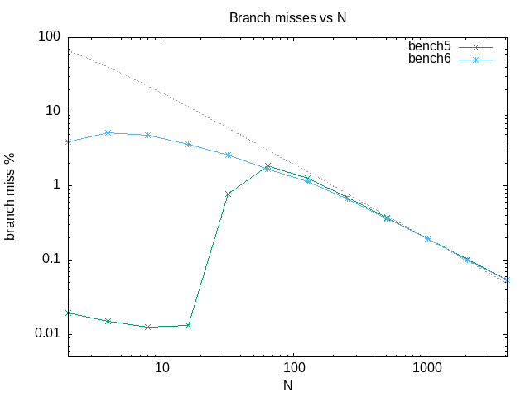
Perf branch prediction
Branch predictor is outsmarting our benchmark in bench5

Slide 33
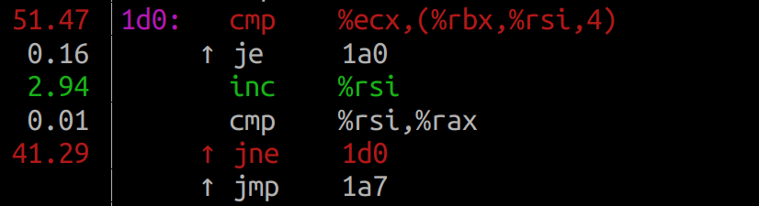
Perf record
perf record ./app && perf report
  see annotated assembly with % of time for each line
    h: show shortcuts
    H: go to hotspot
    Enter: go to function / follow jump
./bench/bench5 --benchmark_filter=".*:vec_map.*/1024\$" --benchmark_min_time=2

Slide 34
Perf visualization
Raw assembly can be overwhelming
Can be easier to interpret a call graph, flame graph, etc
Options (all inconvenient in different ways)
  https://github.com/KDAB/hotspot
    Works directly on perf.data, but output seems incomplete / wrong
  https://github.com/brendangregg/FlameGraph
    Use supplied perl script to convert trace data first
  https://github.com/google/pprof
    But also need https://github.com/google/perf_data_converter
  https://www.eclipse.org/tracecompass
    But you need to re-compile perf with CTF support

Slide 35
Google Orbit
GUI profilers can be more intuitive for complicated applications
Google orbit: https://github.com/google/orbit
Build (requires conan)
  ./bootstrap-orbit.sh --ignore-system-requirements
  ./build.sh gcc10_release
Start collector
  sudo ./build_gcc10_release/bin/OrbitService
Start frontend
  ./build_gcc10_release/bin/Orbit --local
Select your process, start capture

Slide 36
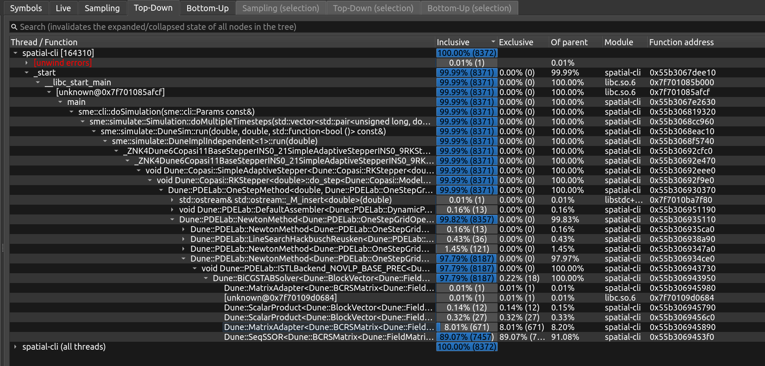
Top Down

Slide 37
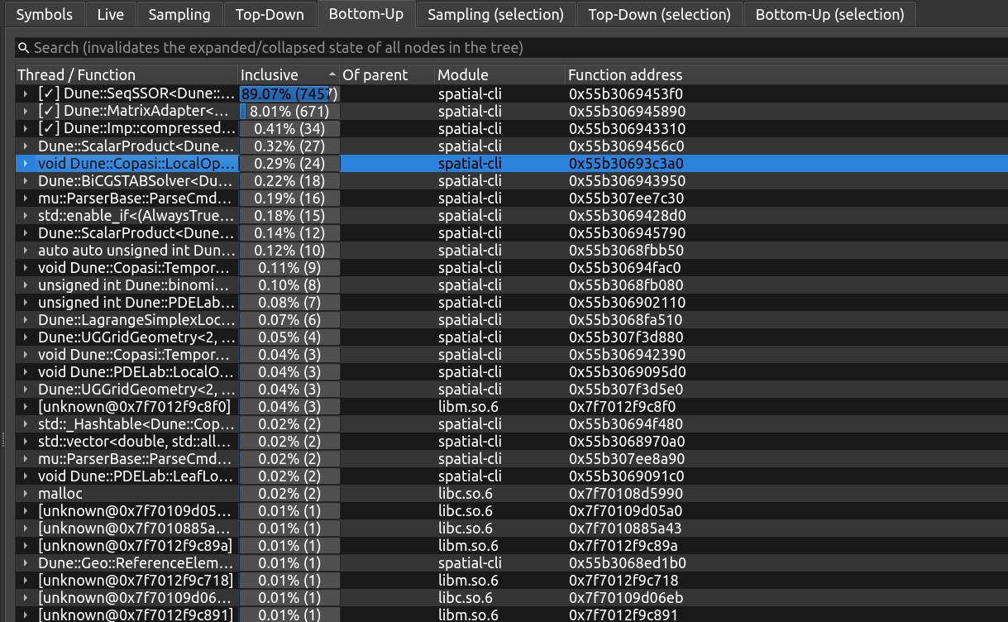
Bottom Up

Slide 38
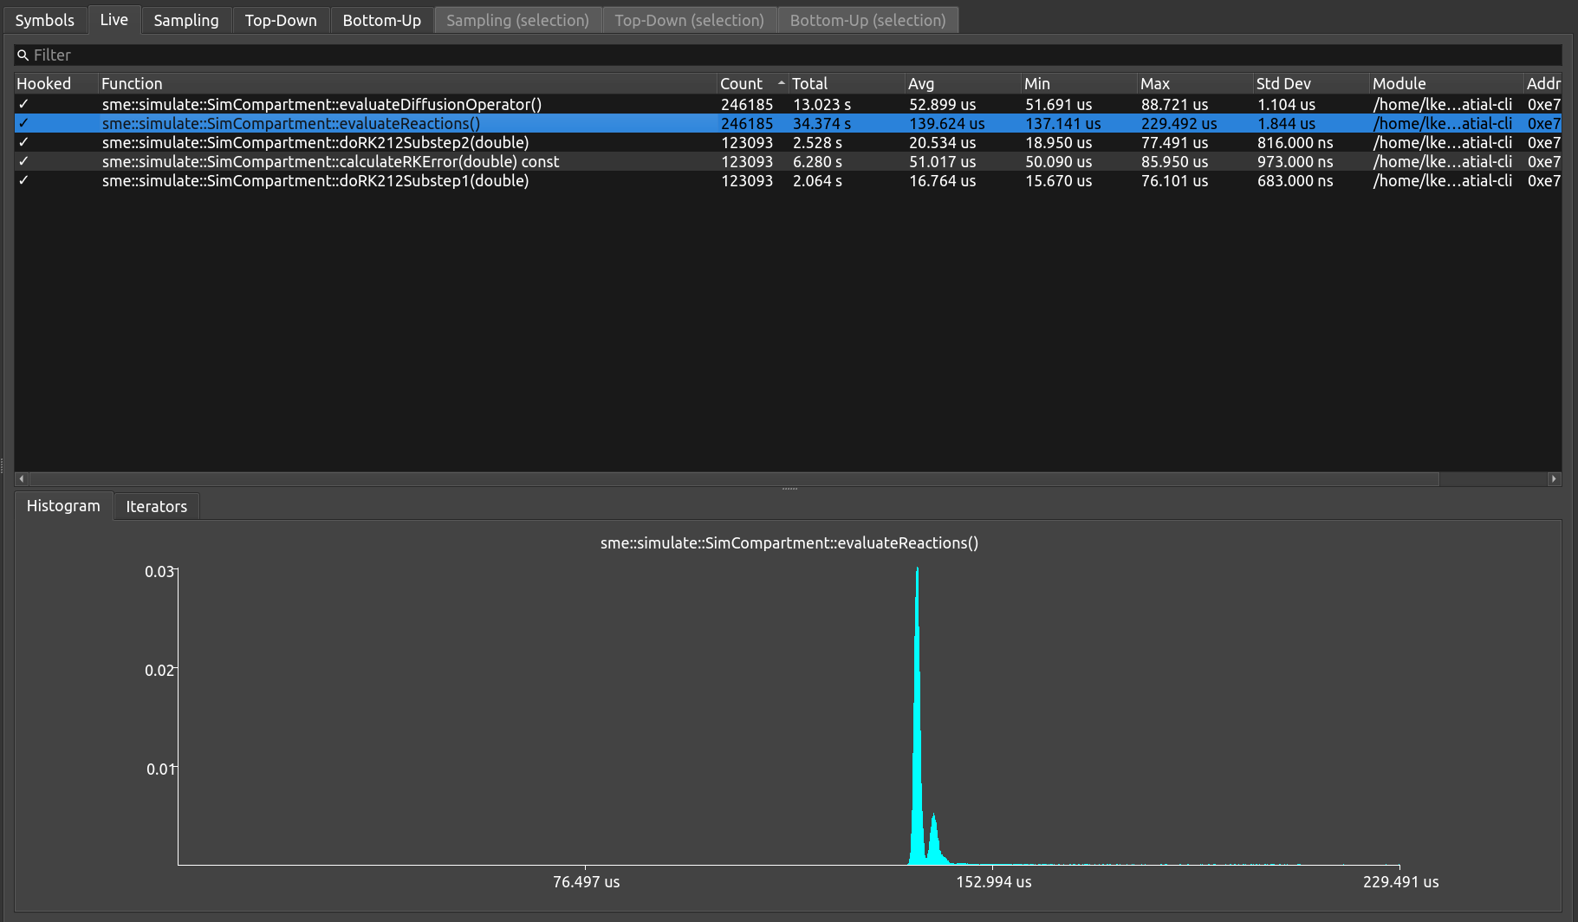
Instrumentation - 1 thread

Slide 39
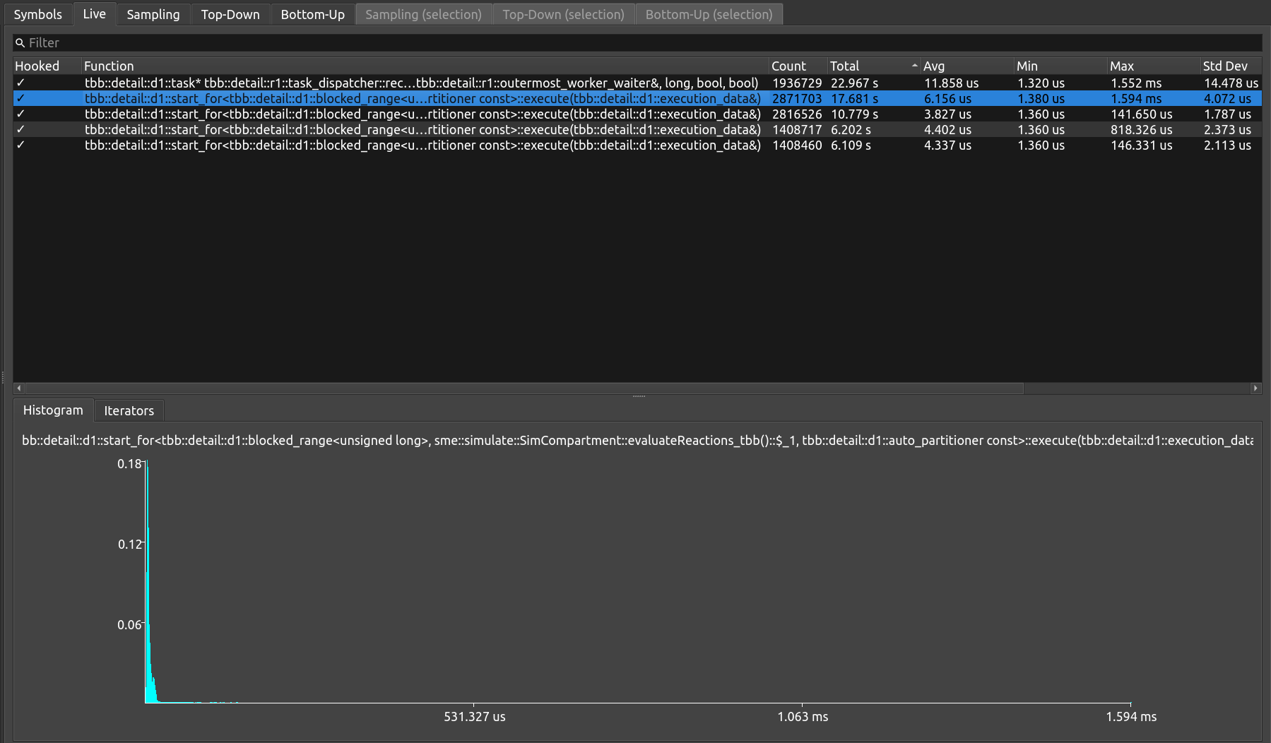
Instrumentation - 12 threads

Slide 40
Profiling tips
Reduce the noise
  Disable CPU turbo-boost / frequency scaling
  Avoid running anything else at the same time
First step: look at cache misses
  If there are a lot of these, nothing else matters much
Look at branch misses
  Sometimes Profile Guided Optimization (PGO) can help
  Very rarely you can improve them by hand (__builtin_expect, [[likely]], etc)
  But hard to do better than the CPU (and easy to make things worse!)
Look at hotspots
  Lines of code that are called a lot and/or slow
Profile your benchmarks
  Can help understand if they are testing what you want them to

Slide 41
Simulation

Slide 42
Simulation
Run real production code on a virtual machine
  Simulated CPU, simulated cache
Record every cpu operation, every cache read, etc
  Doesn’t affect (simulated) speed of operations
Deterministic
  No statistical variation, not affected by other running processes
But: not real hardware
  No guarantee performance implications are the same
Also: typically vastly slower than real-time (e.g. 50x slower)
  Can be inconvenient / impractical for certain applications

Slide 43
Callgrind/cachegrind
Part of valgrind set of tools
  Default tool is memcheck, but there are others!
valgrind --tool=cachegrind ./app
  Command line output of simulated cache hits/misses
valgrind --tool=callgrind --simulate-cache=yes ./app
  Generates call-graph data and cache hits/misses
kcachegrind
  GUI to visualize above data

Slide 44
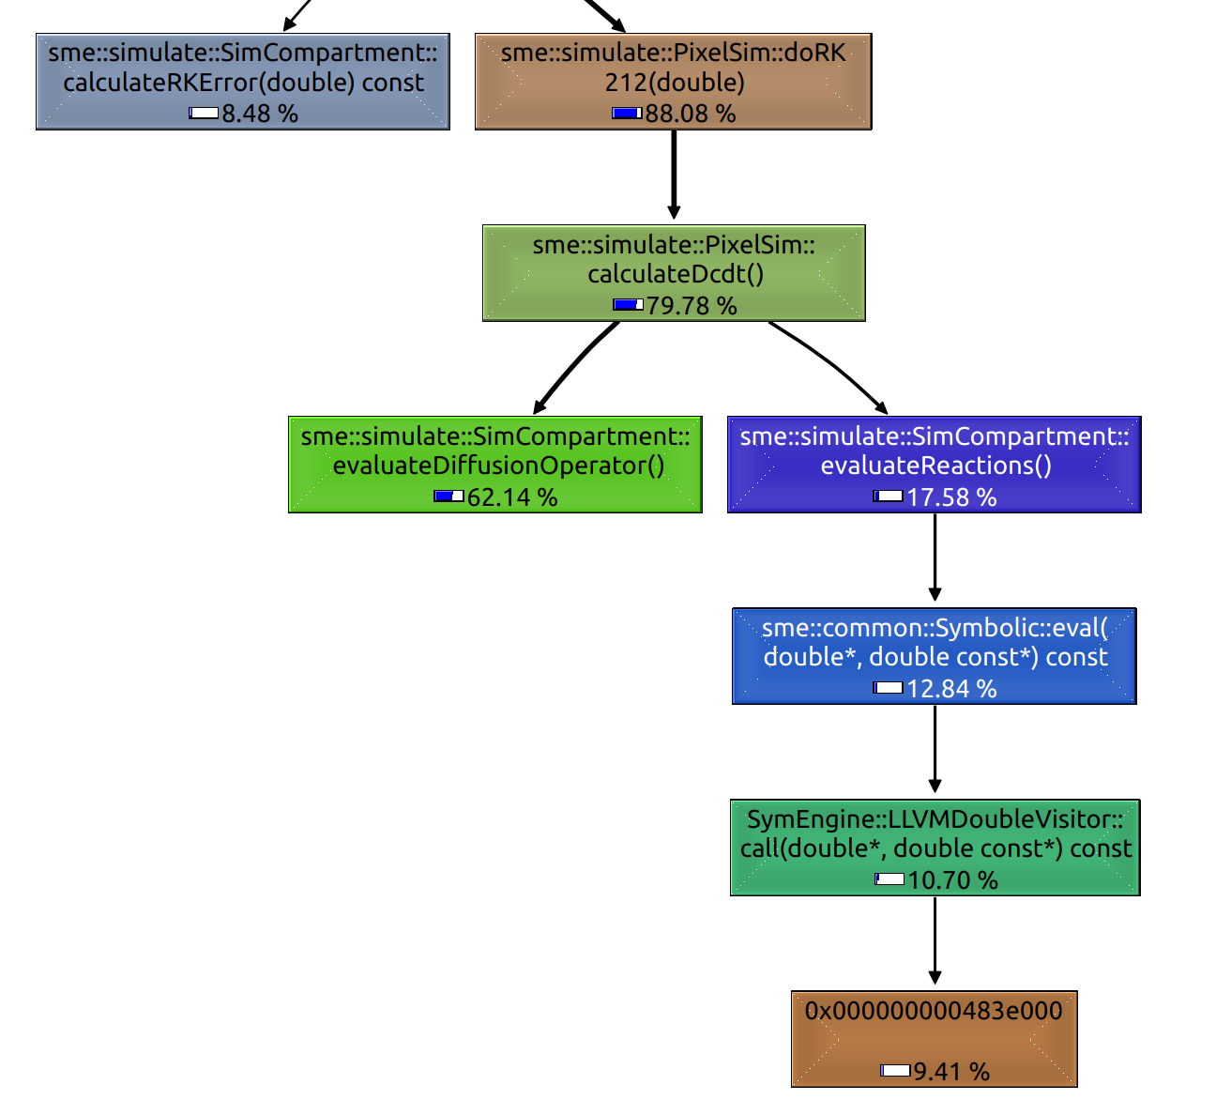
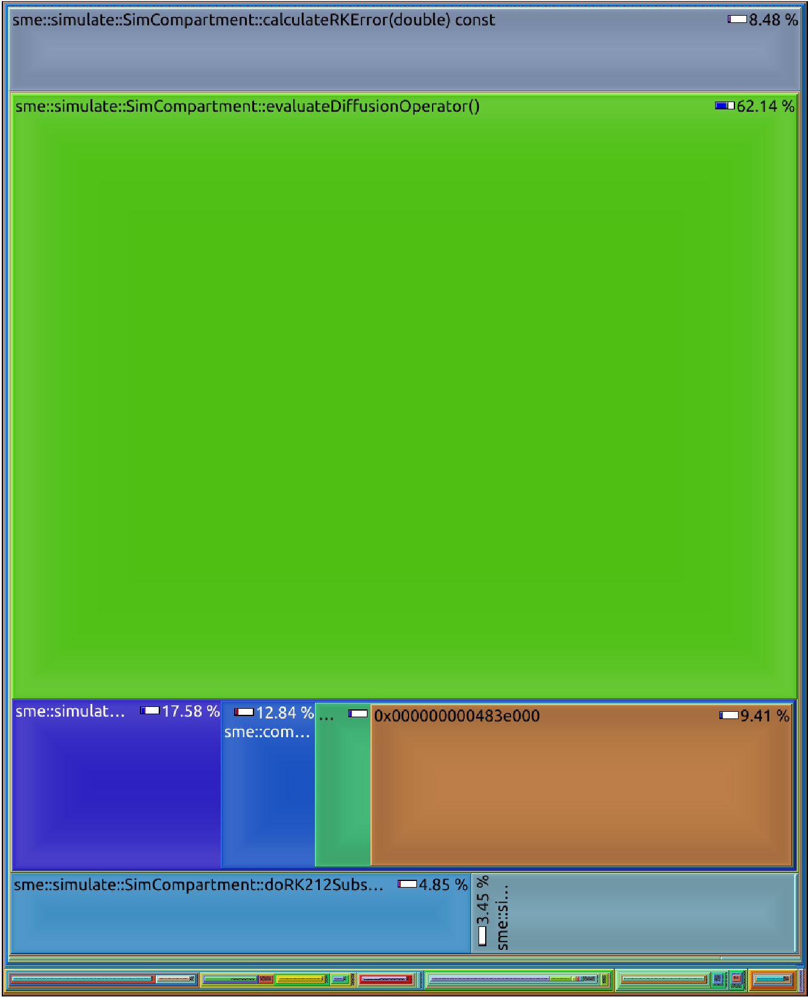
Example call graph (cycles)

Slide 45
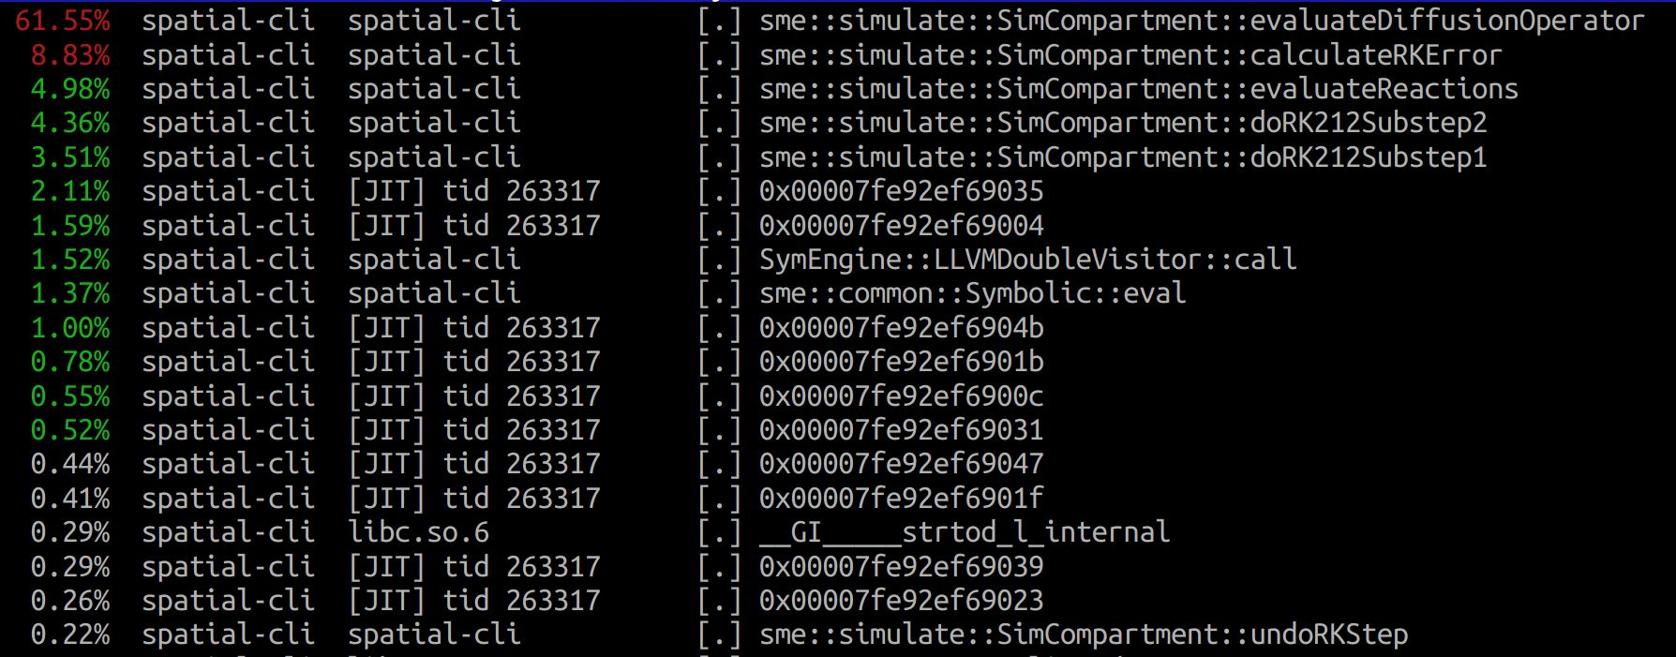
Perf report for same code

Slide 46
Simulation tips
Don’t worry about the noise!
  CPU turbo-boost, other running processes, etc are not relevant
Otherwise, same tips as profiling
  First step: look at cache misses
    If there are a lot of these, nothing else matters much
  Look at branch misses
    Sometimes Profile Guided Optimization (PGO) can help
    Very rarely you can improve them by hand (__builtin_expect, [[likely]], etc)
    But hard to do better than the CPU (and easy to make things worse!)
  Look at hotspots
    Lines of code that are called a lot and/or slow
  Profile your benchmarks
    Can help understand if they are testing what you want them to
Remember it’s a simulation - compare results with actual profiling data

Slide 47
Summary

Slide 48
Summary
Benchmarking is vital but also difficult to do reliably
Important not to blindly take one metric or benchmark as the “truth”
We covered three complementary approaches
  Micro-benchmarking
  Profiling
  Simulation
Each have their own strengths and weaknesses
Together they allow you to understand the performance of your code
Also where and how to improve the performance of your code

Slide 49
Recommended resources
Benchmarking
Chandler Carruth talks on benchmarking/performance
  Tuning C++: Benchmarks, and CPUs, and Compilers! Oh My!
  Efficiency with Algorithms, Performance with Data Structures
  Going Nowhere Faster
Fedor Pikus talk on branchless programming
  Branchless Programming in C++
Profiling
http://pramodkumbhar.com/2017/04/summary-of-profiling-tools/

Slide 50
Recommended resources
Performance
Mike Acton talk on data oriented design
  Data-Oriented Design and C++
Ulrich Drepper paper on memory and cache
  What Every Programmer Should Know About Memory
  Not for “every programmer” but excellent info on RAM / cache / performance
  From 2007 but still very relevant
A curated list of c++ performance-related resources
  AwesomePerfCpp

Slide 51
More recommended resources
Hash maps
Malte Skarupke talk on hash map implementations and performance
  You Can Do Better than std::unordered_map
Matt Kulukundis talks on Google’s hash map
  Designing a Fast, Efficient, Cache-friendly Hash Table, Step by Step
  Abseil's Open Source Hashtables: 2 Years In

