Slide 1
Chapter 2
Principle of Fourier Transform Spectrometry (傅里叶变换光谱测量原理)
2.1 Principle of the FTS
2.2 Resolution and Resolving power
2.2.1 Relation between the resolution and the maximum OPD
2.2.2 Relation between the resolution and the angle of divergence
2.3 Advantages of Fourier Transform Spectrometers
2.3.1 Throughput or Jacquinot advantage

Slide 2
Chapter 2
Principle of Fourier Transform Spectrometry
(傅里叶变换光谱测量原理)
2.3.2 Multiplex or Felgett advantage
2.3.3 Connes advantage
2.4 Interferogarm data processing
2.4.1 Sampling intervals of the interferogram and the spectrum
2.4.2 Apodization
2.4.3 Phase correction
2.4.4 Effects of ADC resolution on spectral SNR

Slide 3
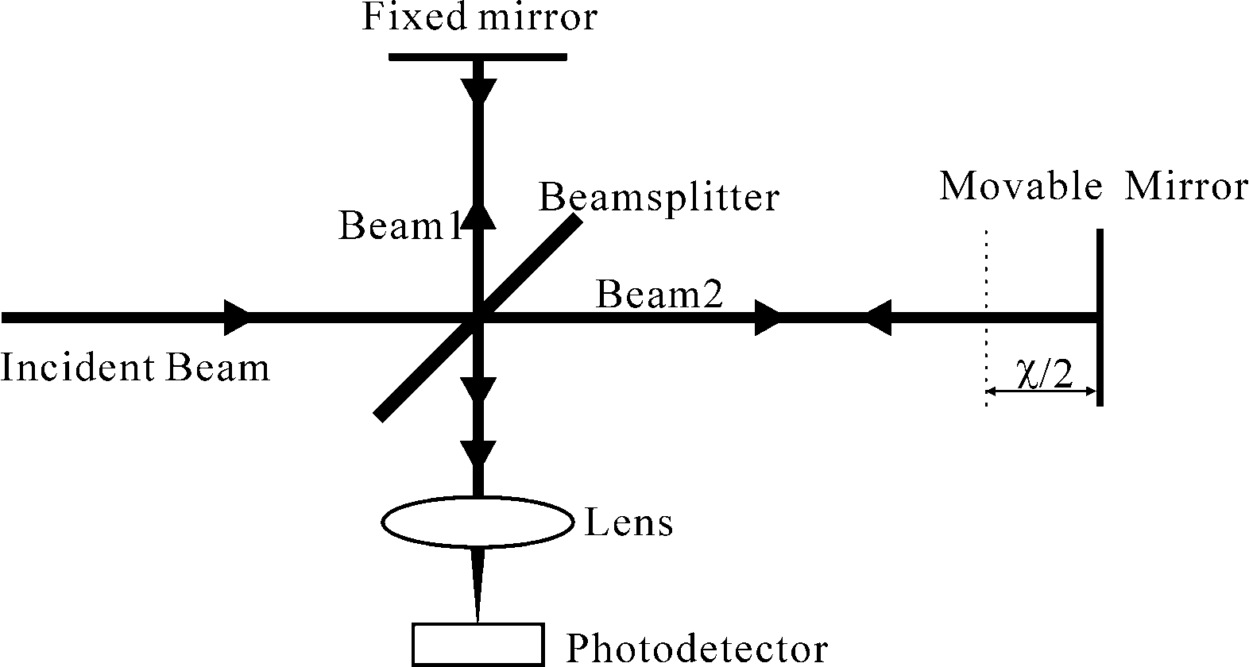
Chapter 2
Principle of Fourier Transform Spectrometry
(傅里叶变换光谱测量原理)
2.1 Principle of the FTS
Fig.2.1 Conventional Michelson interferometer

Slide 4
Chapter 2
Principle of Fourier Transform Spectrometry (傅里叶变换光谱测量原理)
Assuming that the intensity ratio of the two beams come from the beamsplitter is 1:1, for an incident beam of monochromatic light of wavenumber σ₀ , the intensity of the interferogram as a function of the optical path difference(OPD) between two beams is given by
an AC expression relation between the interferogram intensity and the OPD, x, can be obtained,

Slide 5
Chapter 2
Principle of Fourier Transform Spectrometry (傅里叶变换光谱测量原理)
For an incident beam of polychromatic light, the following result can be generalized:
(2.1)
(2.2)
(2.3)

Slide 6
Chapter 2
Principle of Fourier Transform Spectrometry (傅里叶变换光谱测量原理)
(2.4)
(2.5)
We can also construct an even function from
Then,

Slide 7
Chapter 2
Principle of Fourier Transform Spectrometry (傅里叶变换光谱测量原理)
i.e.
can be obtained by Fourier transforming the interferogram
(2-6)
(2-7)

Slide 8
Chapter 2
Principle of Fourier Transform Spectrometry (傅里叶变换光谱测量原理)
In fact, there is dispersion in the optical path; this dispersion introduces asymmetries into the interferogram.
(2.9)

Slide 9
Chapter 2
Principle of Fourier Transform Spectrometry (傅里叶变换光谱测量原理)
2.2 Resolution and resolving power
The spectral resolution of a spectrometer, , is a measure of its ability to qualitatively distinguish two spectral peaks that are very close to each other. Commonly the spectral resolution is represented by the Full Width at Half Maximum (FWHM) of the instrumental line shape (ILS), the output spectrum of the spectrometer with a purely monochromatic input radiation.
The spectral resolving power, R, is defined by
where is the maximum wavenumber for which the spectrometer is designed to operate.

Slide 10
Chapter 2
Principle of Fourier Transform Spectrometry (傅里叶变换光谱测量原理)
2.2.1 Relation between the resolution and the maximum OPD
(2.11)
(2.12)
where the rectangular function is defined as
(2.13)

Slide 11
Chapter 2
Principle of Fourier Transform Spectrometry (傅里叶变换光谱测量原理)
Therefore, theoretically the spectral resolution of an FTS depends on the scan range of the movable mirror
The interferogram of a perfect monochromatic line can be described by
Substituting this express into Eq.(2.12), considering that in reality,
the ILS is
(2.14)

Slide 12
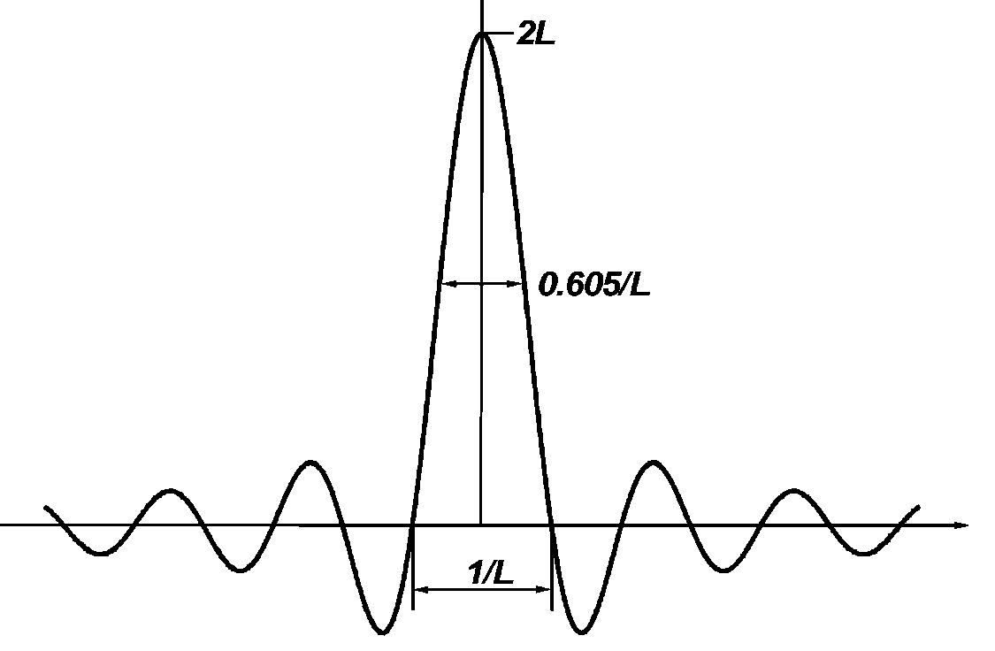
Chapter 2
Principle of Fourier Transform Spectrometry (傅里叶变换光谱测量原理)
As Fig2.2, the spectrum is broadened from one line (delta function) to a sinc function shape (instrumental line shape) .
Fig. 2.2 Plot of
versus

Slide 13
Chapter 2
Principle of Fourier Transform Spectrometry (傅里叶变换光谱测量原理)
(2.15)
Separation of resonances
The resolution can be described by the separation of two monochromatic lines (wavenumber and ) of equal intensity (or resonances) in a spectrum shown in Fig. 2.3. One can claim that two resonances are resolved if the amplitude of the dip between two line peaks is bigger than 20% of the line peak.
(2.16)

Slide 14
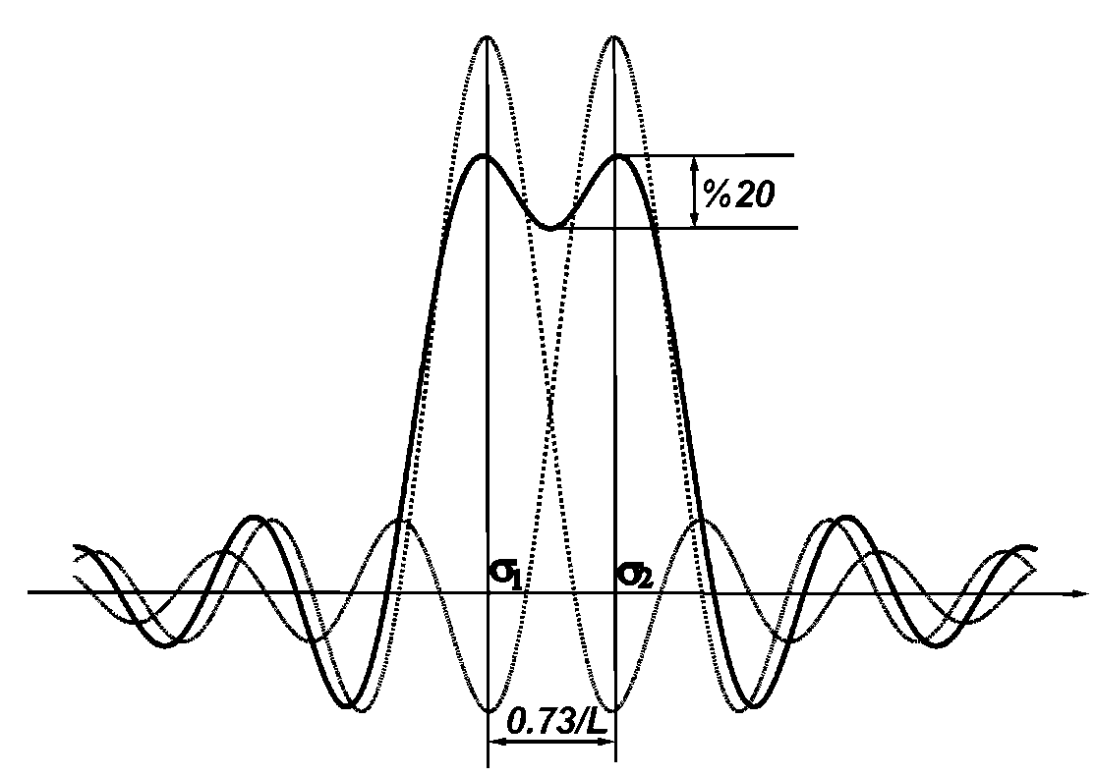
Chapter 2
Principle of Fourier Transform Spectrometry (傅里叶变换光谱测量原理)
Fig. 2.3 Resolved resonances and definition diagram

Slide 15
Chapter 2
Principle of Fourier Transform Spectrometry (傅里叶变换光谱测量原理)
Rayleigh criterion
Rayleigh criterion separates the peaks of two ILSs such that the maximum of one resonance falls at the zero of the other resonance, becomes , So the resolution as dictated by the instrumental line shape is
(2.17)

Slide 16
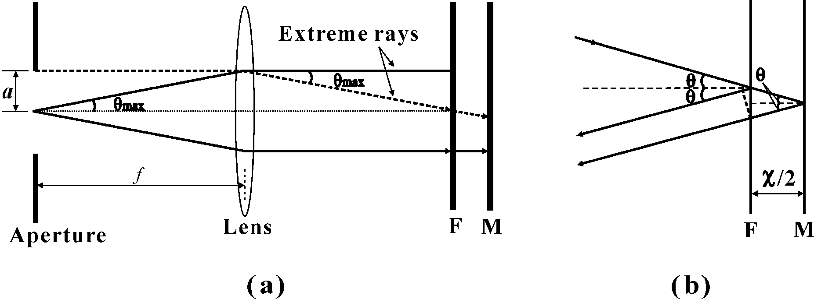
Chapter 2
Principle of Fourier Transform Spectrometry (傅里叶变换光谱测量原理)
2.2.2 Relation between the resolution and the angle of divergence
Fig. 2.4. Equivalent diagram of a Michelson interferometer. (a): Equivalent diagram; (b): Showed OPD between the rays reflected by the movable mirror and the fixed mirror at a divergence angle of θ; F: Image of the fixed mirror; M: Movable mirror.

Slide 17
Chapter 2
Principle of Fourier Transform Spectrometry (傅里叶变换光谱测量原理)
(2.18)
we can obtain the normalized interferogram of the extended source subtending a solid angle is
On substituting the solid angle in the above equation where is the azimuth angle, we have
(2.19)

Slide 18
Chapter 2
Principle of Fourier Transform Spectrometry (傅里叶变换光谱测量原理)
For a monochromatic light source ( ), then the instrumental line profile is
Considering

Slide 19
Chapter 2
Principle of Fourier Transform Spectrometry (傅里叶变换光谱测量原理)
We have
(2.20)
(2.21)
the total wavenumber spread or resolution is
(2.22)

Slide 20
Chapter 2
Principle of Fourier Transform Spectrometry (傅里叶变换光谱测量原理)
Considering a limited scan length of the movable mirror, the ILS of the practical FTS should be
(2.23)
where L is the maximum displacement of the movable mirror, “∗” is the convolution operator.

Slide 21
Chapter 2
Principle of Fourier Transform Spectrometry (傅里叶变换光谱测量原理)
The difference between the OPDs of two extreme rays in Fig.2.4(a) is
where a is the radius of the entrance aperture, f is the focal length of the collimator. The two rays are out of phase when ∆OPD is equal to λ/2, the destructive superposition will occur between them. For broadband radiation input, the shortest wavelength present determines the maximum effective value of ∆OPD of an FTS, as given by the following equation:

Slide 22
Chapter 2
Principle of Fourier Transform Spectrometry (傅里叶变换光谱测量原理)
Combining the above two equations, Eq.(2.10) and Eq.(2.17), we can obtain that the value of a should meet the following inequation in order to obtain the resolving power bigger than R.
(2.23)

Slide 23
Chapter 2
Principle of Fourier Transform Spectrometry (傅里叶变换光谱测量原理)
2.3 Advantages of Fourier Transform Spectrometers
There are a number of widely publicized advantages of FTSs when compared with the dispersive spectrometers. However, only throughput (Jacquinot) and multiplex (Felgett) advantages are inherent to FTSs’ operating principles rather than particular engineering designs.

Slide 24
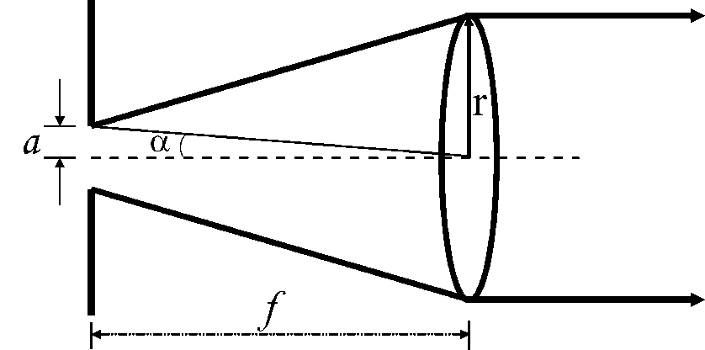
Chapter 2
Principle of Fourier Transform Spectrometry (傅里叶变换光谱测量原理)
2.3.1 Throughput or Jacquinot advantage
Throughput advantage is that the FTS can have a large circular entrance aperture, whose area is much bigger than that of the slit in the dispersive spectrometer for the same resolution. Throughput, T, is defined as where A is the area of the limiting aperture and is the solid angle subtended by the collimating or the focusing optics shown in Fig.2.5.
Fig.2.5 Diagram of the aperture and the solid angle

Slide 25
Chapter 2
Principle of Fourier Transform Spectrometry (傅里叶变换光谱测量原理)
The maximum throughput of FTSs is given by
Where is the projected area of the mirror.
For a grating spectrometer, the energy throughput to achieve a resolving power R is restricted by its slit area and collimating optics, and is given by
where is the focal length of the collimating optics, is the height of the slit, is the projected area of the grating. is smaller than 1/20 for grating spectrometers.

Slide 26
Chapter 2
Principle of Fourier Transform Spectrometry (傅里叶变换光谱测量原理)
Therefore, FTSs can have more than 60 times (20×π) higher energy-gathering capability than grating spectrometers for the same resolving power and similar instrument size. Thus, the Jacquinot advantage makes the FTS more suitable for weak signal measurements, where the detector noise is dominant, spectral signal-to-noise ratio (SNR) increases proportionally with throughput.

Slide 27
Chapter 2
Principle of Fourier Transform Spectrometry (傅里叶变换光谱测量原理)
2.3.2 Multiplex or Felgett advantage
The multiplex advantage is that an FTS simultaneously observes all the spectral information from the entire range of a given spectrum during a scan period.

Slide 28
Chapter 2
Principle of Fourier Transform Spectrometry (傅里叶变换光谱测量原理)
The ratio of the SNRs obtainable by using an FTS and by using a monochromator is thus
(2.24)
The multiplex advantage of an FTS only exists in the measurement of the infrared and far-infrared signal and is lost in the detection of the visible-ultraviolet signal because the detector noise which is independent of the signal level is dominant in the infrared detection, while the quantum noise is dominant in the visible-UV signal detection.

Slide 29
Chapter 2
Principle of Fourier Transform Spectrometry (傅里叶变换光谱测量原理)
2.3.3 Connes advantage
The wavenumber scale of an FTS is derived from a He-Ne laser fringe that acts as internal references for sampling positions in each scan. The wavenumber of this laser is known very accurately and is very stable. Therefore, the wavenumber calibration of interferometers is much more accurate and has much better long term stability than the calibration of dispersive instruments

Slide 30
Chapter 2
Principle of Fourier Transform Spectrometry (傅里叶变换光谱测量原理)
2.4 Interferogarm data processing
2.4.1 Sampling intervals of the interferogram and the spectrum
Sampling the interferogram
An interferogram must be digitized and recorded in order to be Fourier-transformed into the spectrum of the input light source by the computer. The Fourier transform of the sampled interferogram is the periodical extension of the Fourier transform of the corresponding continuous inteferogram in the sampling frequency. The following digital expression of the computed spectrum can be derived from Eq.(2.12).
(2.25)

Slide 31
Chapter 2
Principle of Fourier Transform Spectrometry (傅里叶变换光谱测量原理)
(2.26)
(2.27)
Sampling the spectrum
The spectrum computed according to Eq.(2.25) is still a continuous function of wavenumber . The computed spectrum of an N-sample interferogram can be completely represented by its samples at wavenumbers
(2.28)

Slide 32
Chapter 2
Principle of Fourier Transform Spectrometry (傅里叶变换光谱测量原理)
(2.29)
The corresponding complex spectrum are
(2.30)

Slide 33
Chapter 2
Principle of Fourier Transform Spectrometry (傅里叶变换光谱测量原理)
2.4.2 Apodization
Apodization is a mathematical method to remove the spurious “feet” or sidelobes around spectral features by gradually smoothing the interferogram points to zero intensity as the measurement comes to end
Typical apodization functions are Tophat function(i.e. no apodization), Cosine function, Triangular function, Bessel function and sinc² function, they broaden the spectral line of a monochromatic to the FWHMs 1.21/2L, 1.58/2L, 1.79/2L,1.91/2L and 2.17/2L respectively

Slide 34
Chapter 2
Principle of Fourier Transform Spectrometry (傅里叶变换光谱测量原理)
2.4.3 Phase correction
There are three methods used for phase correction: magnitude calculation, Mertz phase-correction technique and Forman phase-correction technique.

Slide 35
Chapter 2
Principle of Fourier Transform Spectrometry (傅里叶变换光谱测量原理)
Magnitude calculation
The popular and easy way of phase correction is to calculate the magnitude of the Fourier transform of the double-sided interferogram by using the Eq.(2.9). This method does not need a ZPD for all wavenumbers in the exact center of the interferogram, so it is convenient. But the resolution of the FTS using this method is half that of the FTS using one-sided interferogram for the same scan length, noise is always greater than zero.

Slide 36
Chapter 2
Principle of Fourier Transform Spectrometry (傅里叶变换光谱测量原理)
The phase correction methods due to Mertz and Forman are all based on single-sided interferogram. The resolution is higher than magnitude calculation method for the same scan length, thereby saving the measurement time for the same resolution. But the phase spectrum must be very accurately calculated in order to correct the phase errors properly; otherwise the distortion will occur in the resulting spectrum.

Slide 37
Chapter 2
Principle of Fourier Transform Spectrometry (傅里叶变换光谱测量原理)
2.4.4 Effects of ADC resolution on spectral SNR
(2.31)
where the is the measured signal level, and is usually denoted by the standard deviation of the measured signal

Slide 38
Chapter 2
Principle of Fourier Transform Spectrometry (傅里叶变换光谱测量原理)
where k is the used portion of the fully dynamic range (a value from zero to one)

Slide 39
Chapter 2
Principle of Fourier Transform Spectrometry (傅里叶变换光谱测量原理)

Slide 40
Chapter 2
Principle of Fourier Transform Spectrometry (傅里叶变换光谱测量原理)

