Slide 1
Chapter 3
FTS Based on the Prism Mirror Beam-folding Technique
(基于棱镜光束折叠技术的傅里叶变换光谱仪)
3.1 Beam-folding technique
3.2 UV-visible FTS based on the beam-folding technique
3.2.1 Optical measurement principle
3.2.2 Control and detecting electronics
3.2.3 Prototype FTSs
3.2.4 Computation of the spectrum
3.3 Test results
3.4 Discussion

Slide 2
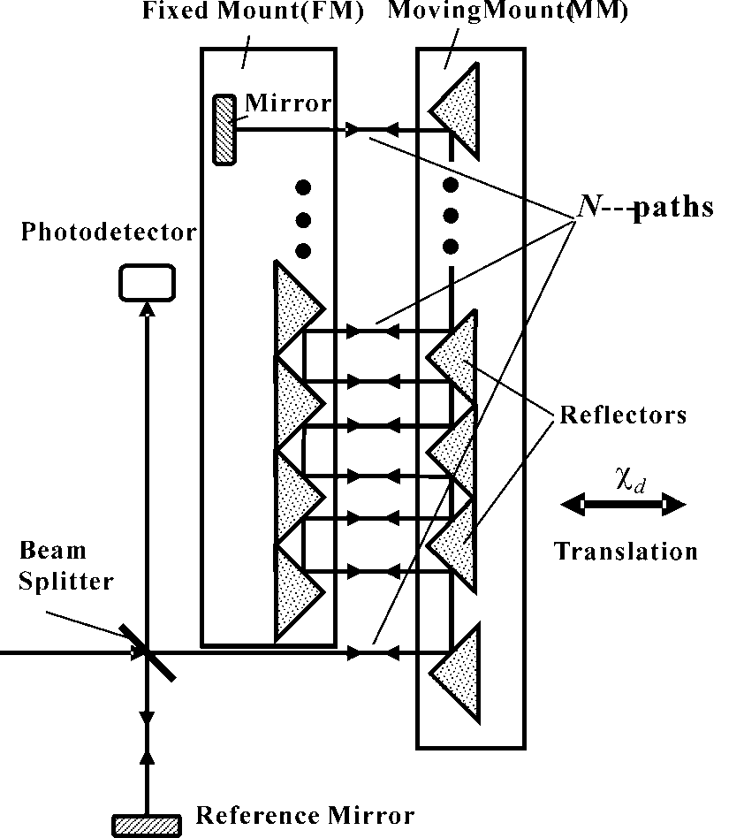
Chapter 3
FTS Based on the Prism Mirror Beam-folding Technique
(基于棱镜光束折叠技术的傅里叶变换光谱仪)
3.1 Beam-folding technique
Fig. 3.1 High-order-path ultra-sensitive interferometer

Slide 3
Chapter 3
FTS Based on the Prism Mirror Beam-folding Technique
(基于棱镜光束折叠技术的傅里叶变换光谱仪)
When the movable mirror scans a distance, the intensity, I, of the interference fringes at the detector, PD, varies as:
(3.1)
where is the maximum intensity of the fringes, is the displacement from the ZPD position of the mirror, and is the wavenumber of the monochromatic light source used in the interferometer. For the special beam-folding interferometer, the intensity will vary as:
(3.2)

Slide 4
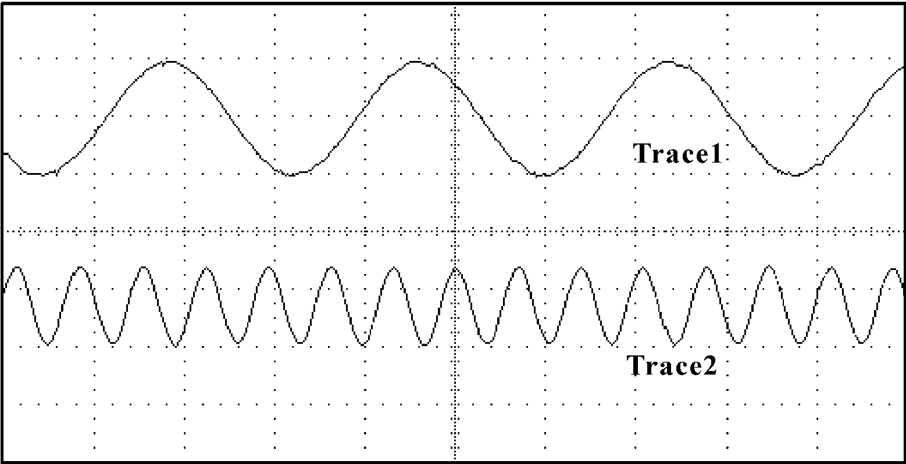
Chapter 3
FTS Based on the Prism Mirror Beam-folding Technique
(基于棱镜光束折叠技术的傅里叶变换光谱仪)
Fig. 3.2 Interference fringes of two interferometers. TRACE 2 obtained with a 4-path interferometer and TRACE 1 from a conventional Michelson interferometer

Slide 5
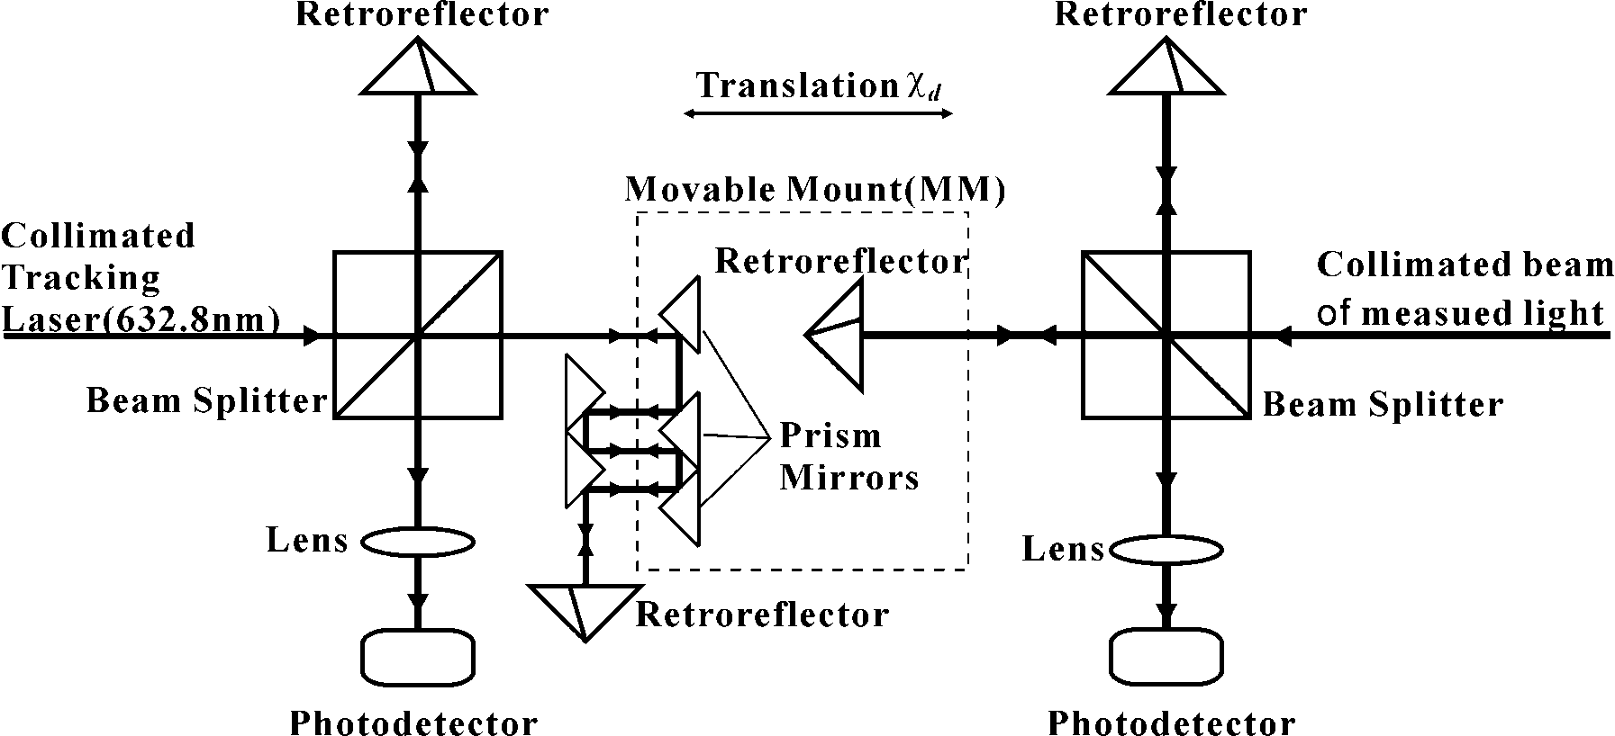
Chapter 3
FTS Based on the Prism Mirror Beam-folding Technique
(基于棱镜光束折叠技术的傅里叶变换光谱仪)
3.2 UV-visible FTS based on the beam-folding technique
3.2.1 Optical measurement principle
Fig.3.3. Setup of the FTS based on the beam-folding technique

Slide 6
Chapter 3
FTS Based on the Prism Mirror Beam-folding Technique
(基于棱镜光束折叠技术的傅里叶变换光谱仪)
The resultant optical path difference is in the tracking interferometer, the AC component of the interferogram is
(3.3)
Where is the maximum intensity of the tracking fringes, is the displacement of the mirror and is the wavenumber of the He-Ne laser. While the optical path difference is in the measurement interferometer, the AC component of the interferogram is:
(3.4)
Where, , a function of the wavenumber σ, is the spectrum of the measurement input beam that can be deduced by means of Fourier-transforming of .

Slide 7
Chapter 3
FTS Based on the Prism Mirror Beam-folding Technique
(基于棱镜光束折叠技术的傅里叶变换光谱仪)
For a HeNe laser wavelength at 632.8 nm, in our four-path beam-folding FTS, we apply two sampling points at zero-crossings per fringe, the optical path difference is 79.1 nm (= 632.8/8). According to the Nyquist sampling theorem, the shortest detectable wavelength is 158.2 nm, or wavenumber at 63211 cm⁻¹. However, the detectable spectral region is also limited by the optical components such as the beam splitter and photodetector in the FTS.

Slide 8
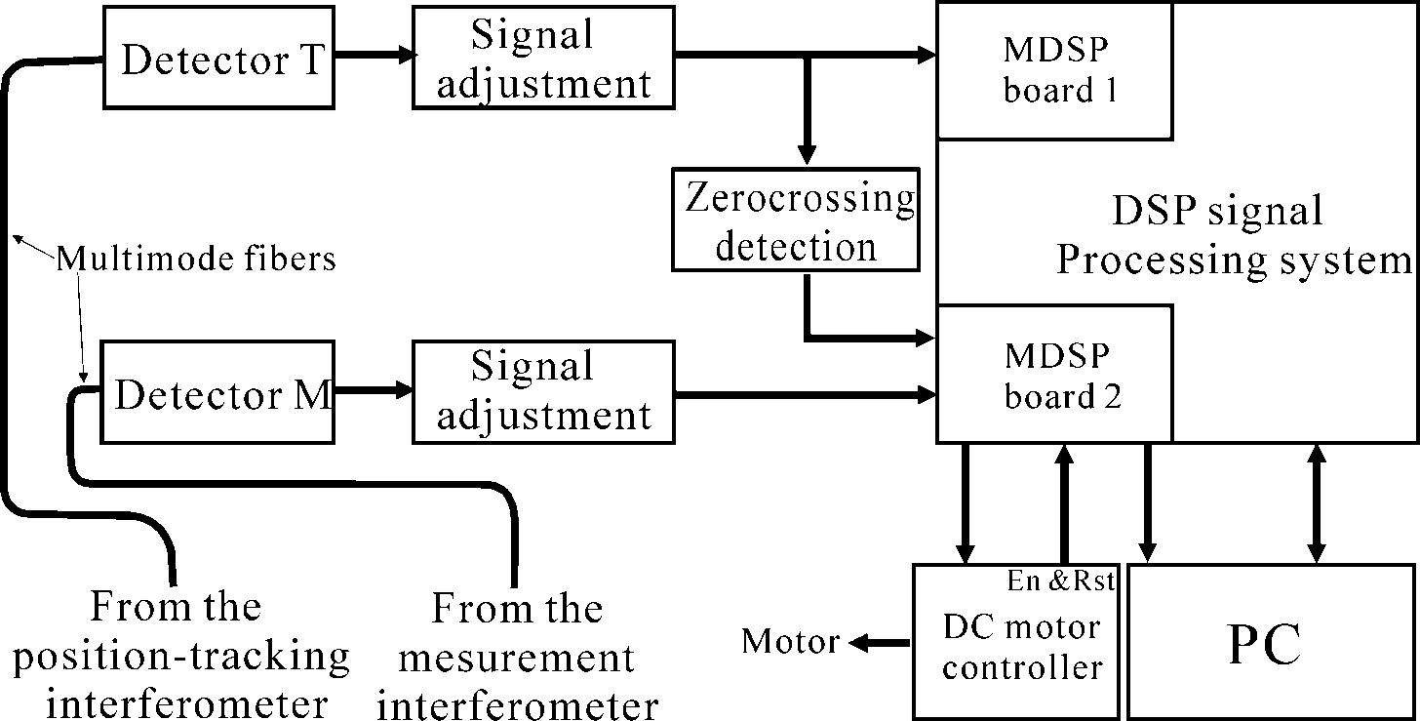
Chapter 3
FTS Based on the Prism Mirror Beam-folding Technique
(基于棱镜光束折叠技术的傅里叶变换光谱仪)
3.2.2 Control and detecting electronics
Fig.3.4. Control and detecting electronics

Slide 9
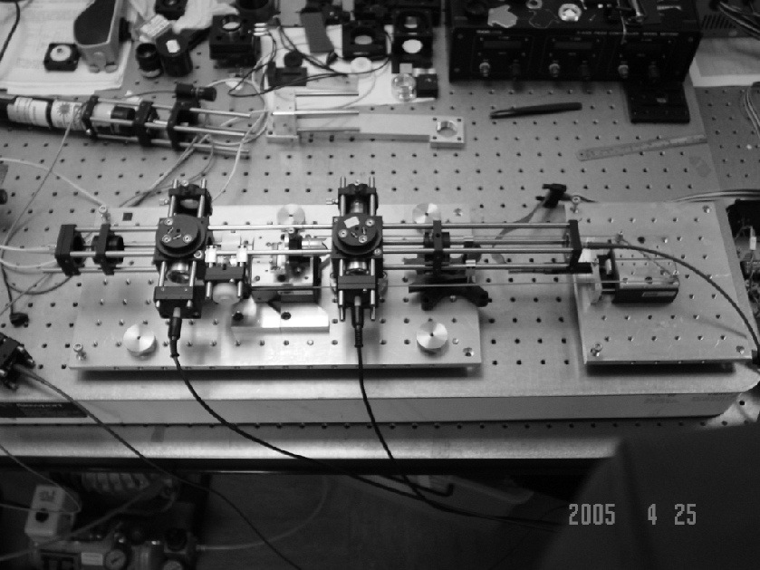
Chapter 3
FTS Based on the Prism Mirror Beam-folding Technique
(基于棱镜光束折叠技术的傅里叶变换光谱仪)
3.2.3 Prototype FTSs
Fig.3.5 Photo of FTS based on the beam-folding technique

Slide 10
Chapter 3
FTS Based on the Prism Mirror Beam-folding Technique
(基于棱镜光束折叠技术的傅里叶变换光谱仪)
3.2.5 Computation of the spectrum
The easy and popular magnitude calculation method (see section 2.4.3) is used as the phase-correction way of the prototype FTSs. Several apodization methods and the zero-padding operation can be chosen in the software panel. The test results given in Section 3.3 were obtained under no apodization and no zero-padding so that no effect from these operations on the resolutions of the FTSs occurred, that is in order to analyze individually the influence of the beam-folding technique on the performance of the FTSs.

Slide 11
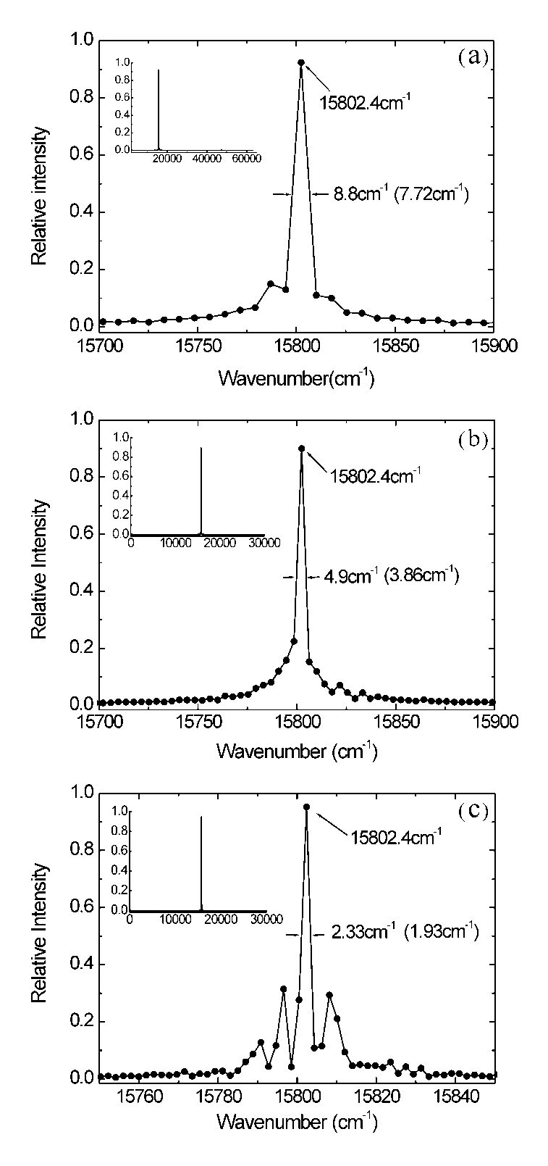
Chapter 3
FTS Based on the Prism Mirror Beam-folding Technique
(基于棱镜光束折叠技术的傅里叶变换光谱仪)
3.3 Test results
Fig.3.6 Test spectra of the He-Ne laser detected by the FTS based on the beam-folding technique. The scan distances are (a) 0.625mm, (b) 1.3 mm; (c) 2.6 mm respectively. The values in the brackets indicate the calculated FWHMs (spectral resolutions).

Slide 12
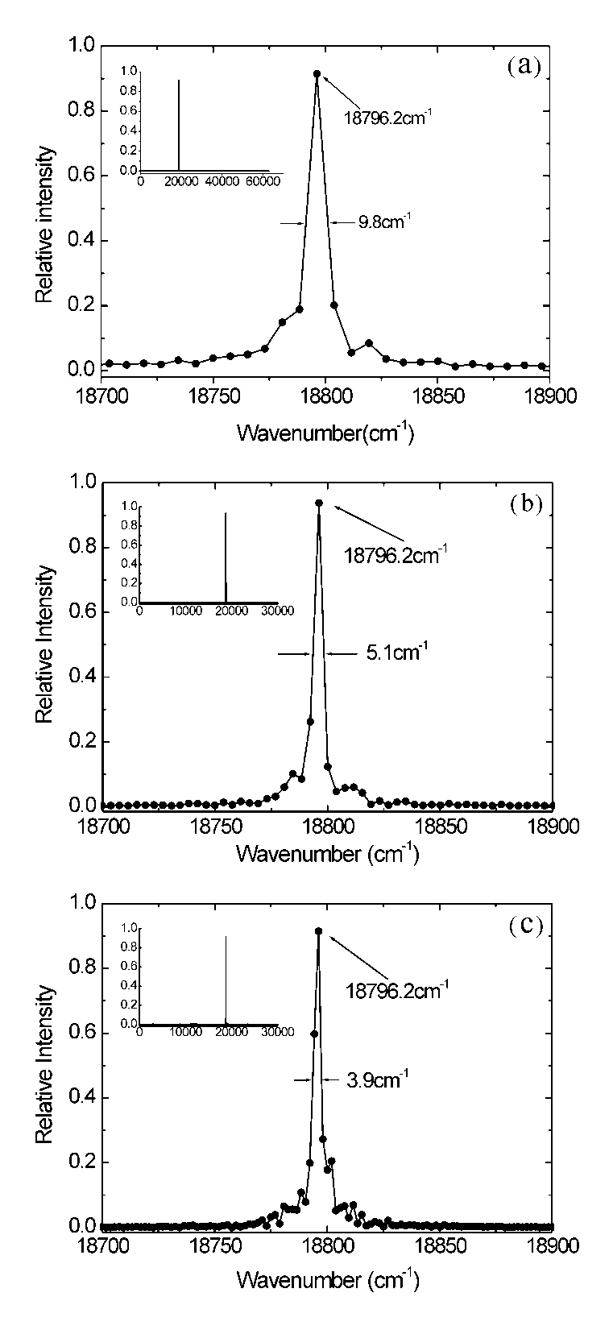
Chapter 3
FTS Based on the Prism Mirror Beam-folding Technique
(基于棱镜光束折叠技术的傅里叶变换光谱仪)
Fig.3.7 Test spectra of the YAG laser detected by the FTS based on the beam-folding technique. The scan distances are (a) 0.625mm, (b) 1.3 mm; (c) 2.6 mm respectively. The values in the brackets indicate the calculated spectral resolutions.

Slide 13
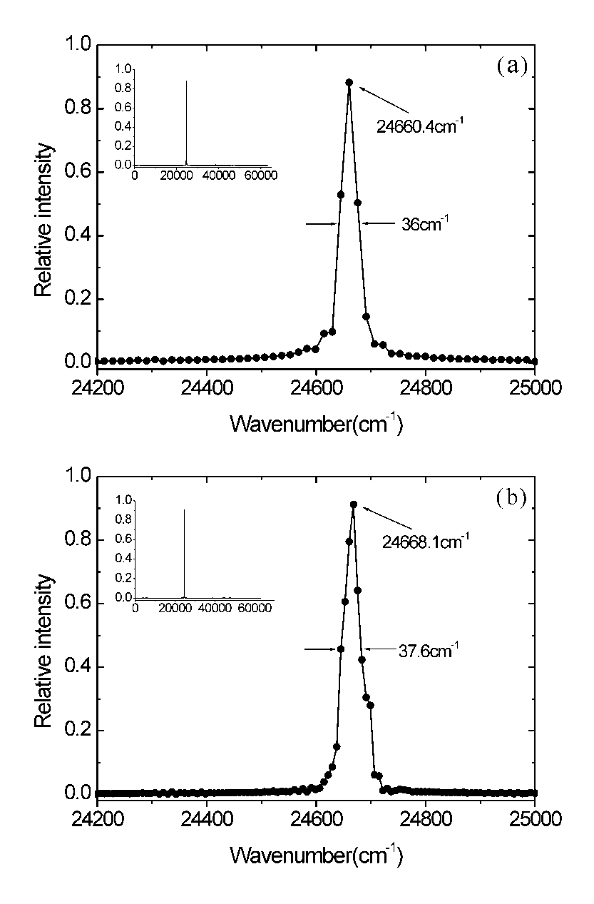
Chapter 3
FTS Based on the Prism Mirror Beam-folding Technique
(基于棱镜光束折叠技术的傅里叶变换光谱仪)
Fig.3.8 Test spectra of the diode-pumped solid-state violet (405nm) laser. The numbers of the interferogram data sampled are (a) 8k and (b) 16k respectively; the corresponding scan lengths are roughly (a) 0.3mm; (b) 0.625mm.

Slide 14
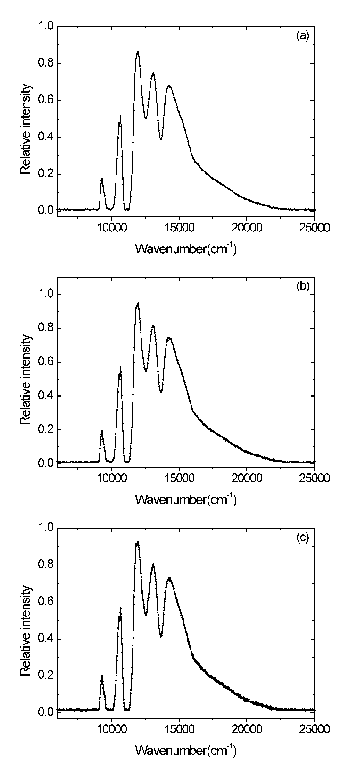
Chapter 3
FTS Based on the Prism Mirror Beam-folding Technique
(基于棱镜光束折叠技术的傅里叶变换光谱仪)
Fig.3.9 Test spectra of lamp S60. The numbers (or scan length) of the sampled interferogram data during a scan are (a) 2k (0.08mm), (b) 4k (0.16mm), and (c) 8k (0.31mm).

Slide 15
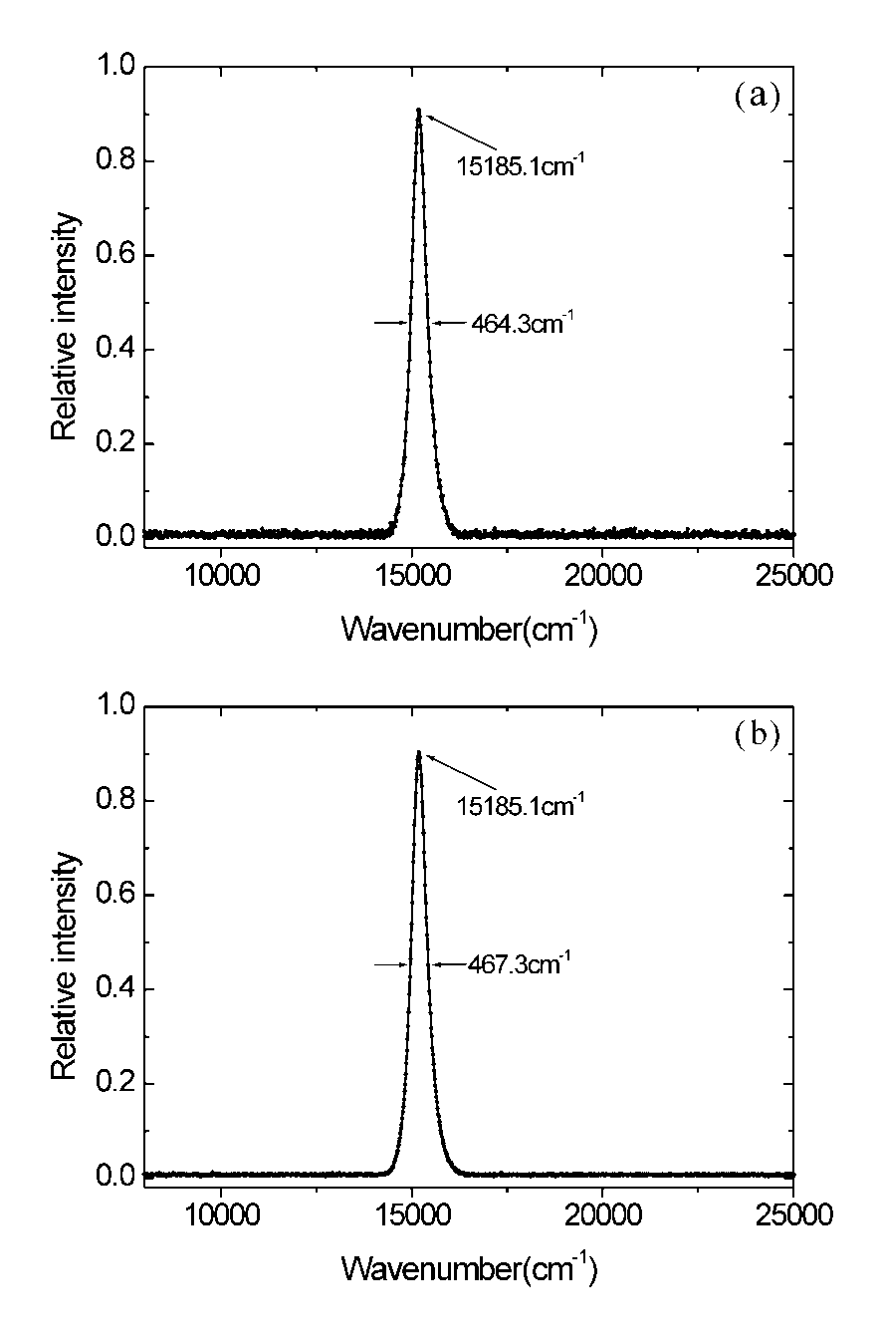
Chapter 3
FTS Based on the Prism Mirror Beam-folding Technique
(基于棱镜光束折叠技术的傅里叶变换光谱仪)
Fig.3.10 Test spectra of a red LED. The scan length is roughly 0.31mm (8k data). (a) Spectrum without average smoothing, (b) A 10-time averaging spectrum

Slide 16
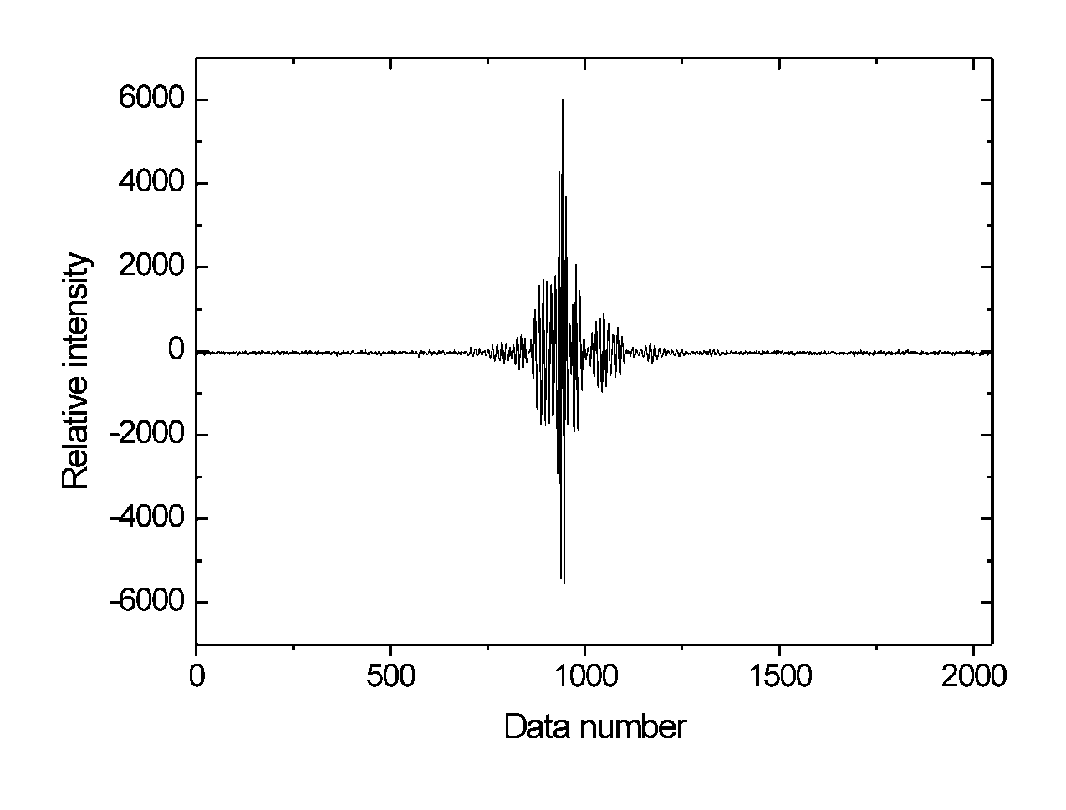
Chapter 3
FTS Based on the Prism Mirror Beam-folding Technique
(基于棱镜光束折叠技术的傅里叶变换光谱仪)
3.4 Discussion
Fig.3.12. Interferogram of lamp S60. Datum length is 2k

Slide 17
Chapter 4
FTS based on the improved beam-folding technique (基于改进光束折叠技术的傅里叶变换光谱仪)
4.1 Improved beam-folding technique
4.2 FTS based on the improved beam-folding technique
4.3 Results of new FTS
4.3.1 Comparison of spectra measured by different beam-folding FTSs
4.3.2 Spectra measured by the improved FTS
4.4 Discussion

Slide 18
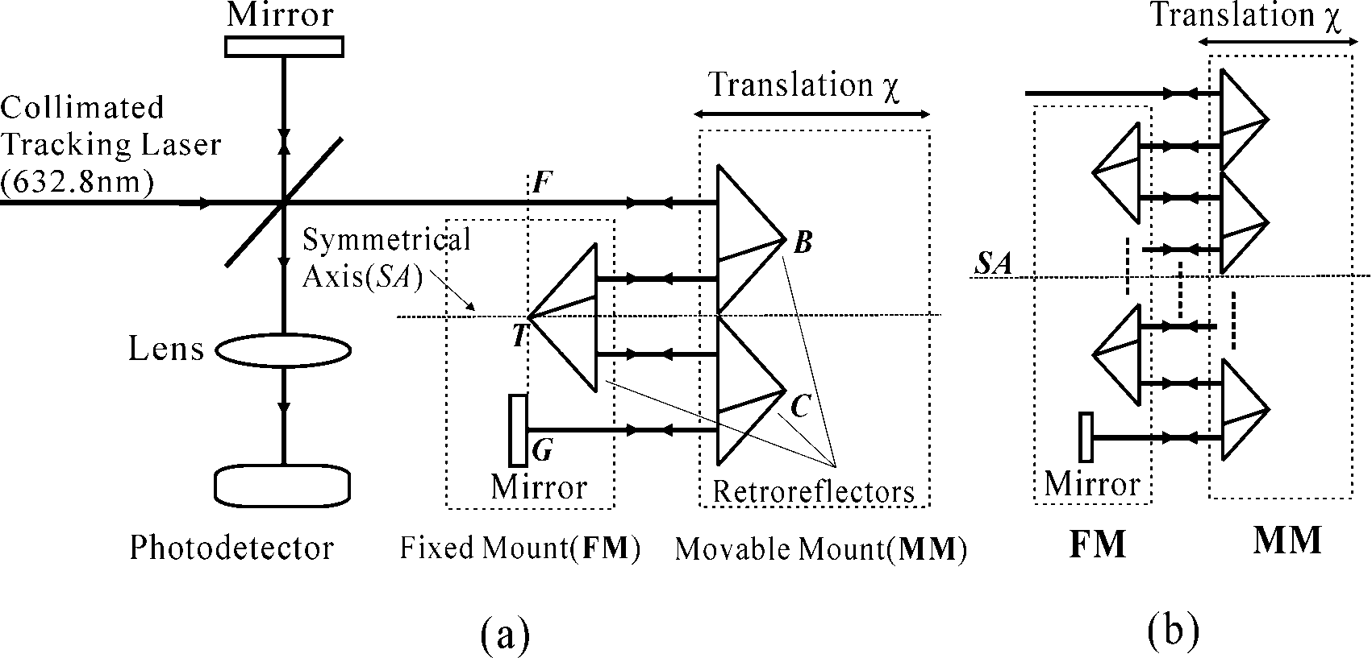
Chapter 4
FTS based on the improved beam-folding technique (基于改进光束折叠技术的傅里叶变换光谱仪)
4.1 Improved beam-folding technique
4.1. Improved beam-folding interferometer realized by retroreflectors. (a) 4-path interferometer, (b) fixed mount FM and movable mount MM for high-order beam-folding interferometer.

Slide 19
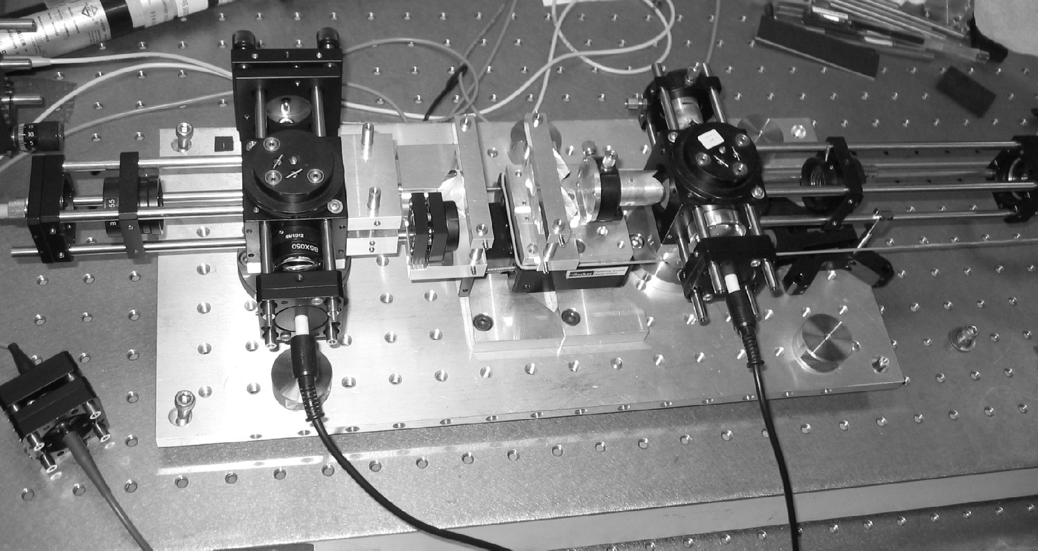
Chapter 4
FTS based on the improved beam-folding technique (基于改进光束折叠技术的傅里叶变换光谱仪)
4.2 FTS based on the improved beam-folding technique
Fig.4.2 Photo of the FTS based on the improved beam-folding technique.

Slide 20
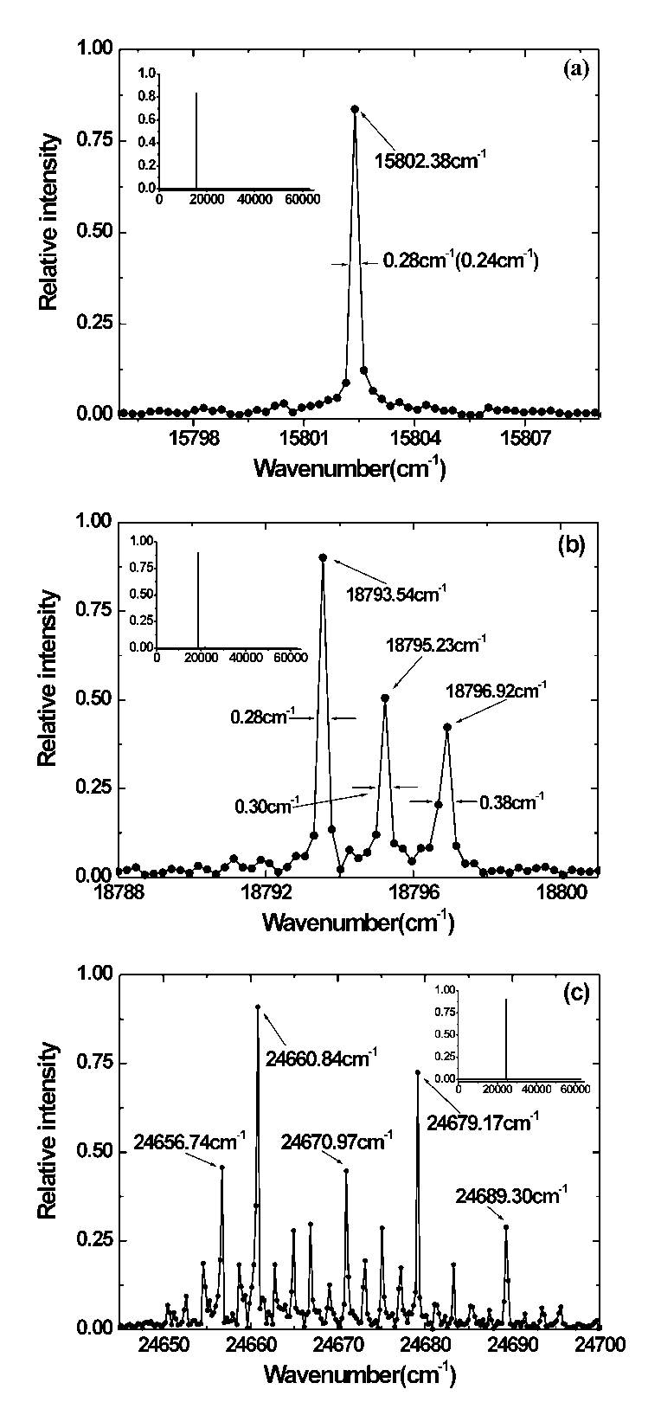
Chapter 4
FTS based on the improved beam-folding technique (基于改进光束折叠技术的傅里叶变换光谱仪)
4.3 Results of new FTS
4.3.1 Comparison of spectra measured by different beam-folding FTSs
Fig.4.3. Spectra detected by the FTS based on the improved beam-folding technique. The scan distance is 20.74 mm; the light sources are (a) He-Ne laser, (b) YAG laser and (c) diode violet laser. The value in the bracket in Fig.4.6 (a) indicates the calculated spectral resolution at the He-Ne laser wavelength.

Slide 21
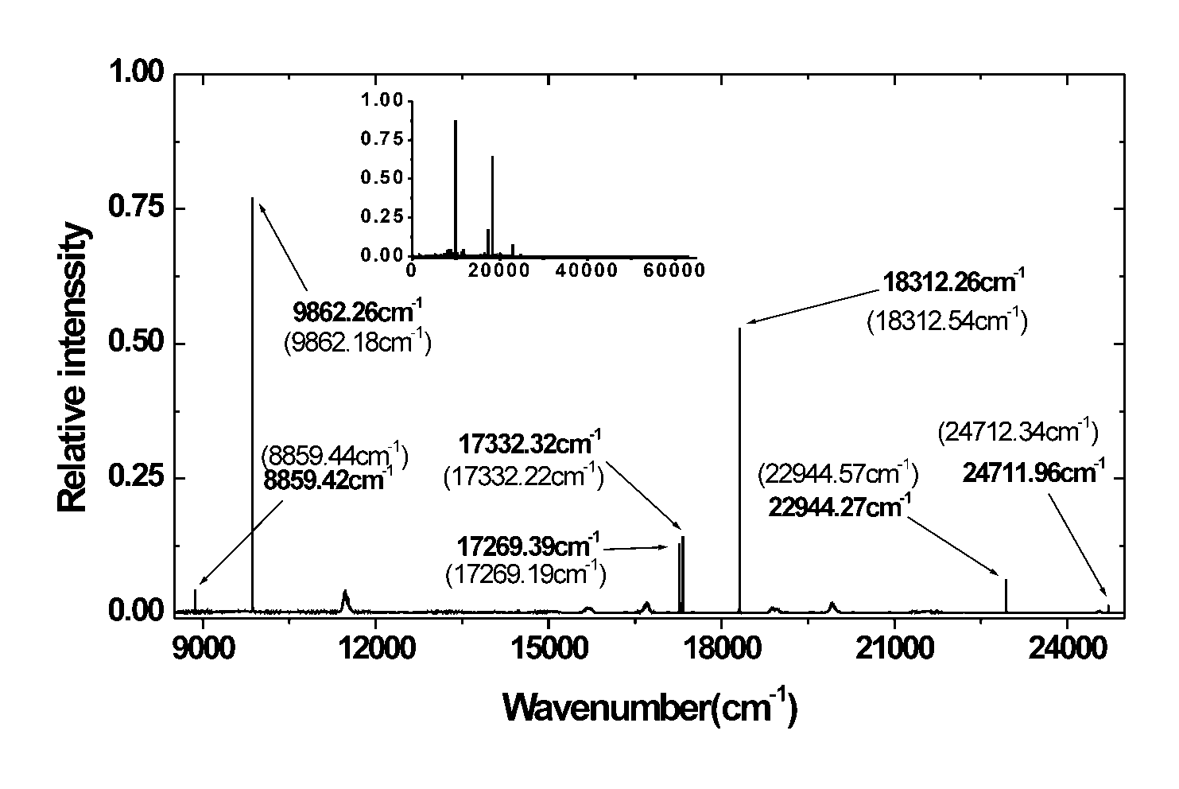
Chapter 4
FTS based on the improved beam-folding technique (基于改进光束折叠技术的傅里叶变换光谱仪)
Fig.4.4 Spectrum of mercury (Hg) lamp with a scan length of 20.74mm. The values in the brackets indicate the specification values of the spectral line wavenumbers.

Slide 22
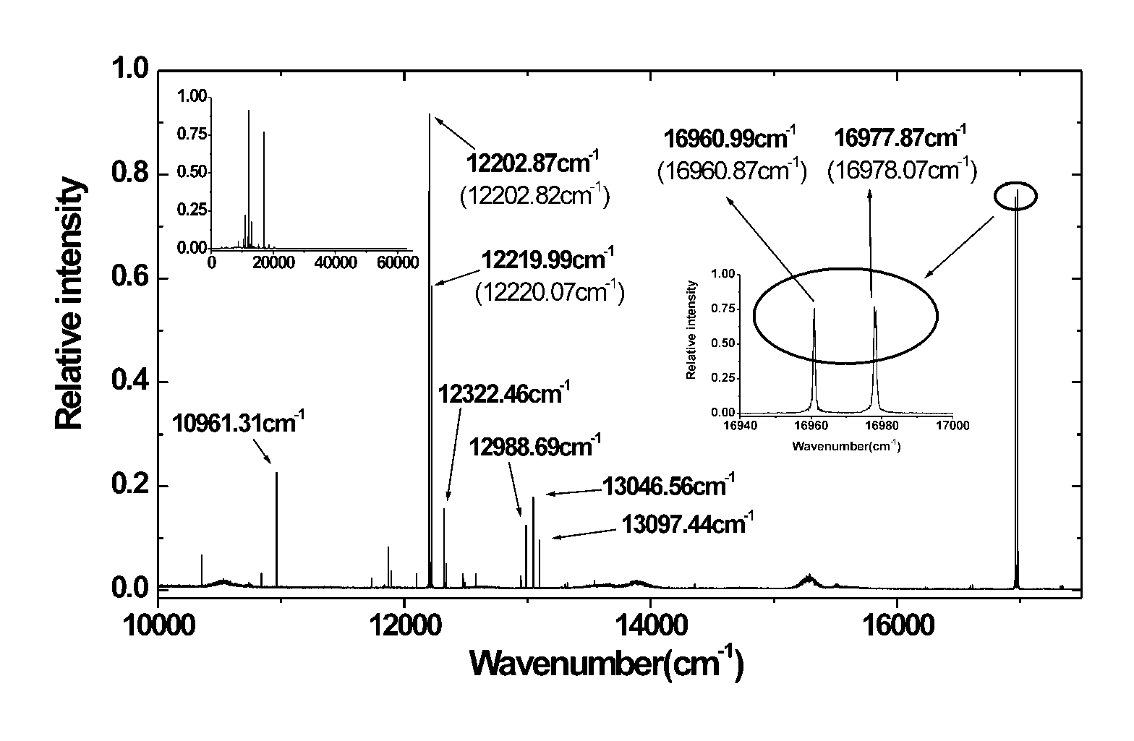
Chapter 4
FTS based on the improved beam-folding technique (基于改进光束折叠技术的傅里叶变换光谱仪)
Fig.4.8 Spectrum of sodium (Na) lamp measured with a scan length of 20.74mm. The values in the brackets indicate the specification values of the spectral line wavenumbers.

Slide 23
Chapter 4
FTS based on the improved beam-folding technique (基于改进光束折叠技术的傅里叶变换光谱仪)
4.4 Discussion

Slide 24
Chapter 3
FTS Based on the Prism Mirror Beam-folding Technique
(基于棱镜光速折叠技术的傅里叶变换光谱仪)

Slide 25
Chapter 3
FTS Based on the Prism Mirror Beam-folding Technique
(基于棱镜光速折叠技术的傅里叶变换光谱仪)

Slide 26
Chapter 3
FTS Based on the Prism Mirror Beam-folding Technique
(基于棱镜光速折叠技术的傅里叶变换光谱仪)

Slide 27
Chapter 3
FTS Based on the Prism Mirror Beam-folding Technique
(基于棱镜光速折叠技术的傅里叶变换光谱仪)

Slide 28
Chapter 3
FTS Based on the Prism Mirror Beam-folding Technique
(基于棱镜光速折叠技术的傅里叶变换光谱仪)

Slide 29
Chapter 3
FTS Based on the Prism Mirror Beam-folding Technique
(基于棱镜光速折叠技术的傅里叶变换光谱仪)
(2.25)

Slide 30
Chapter 3
FTS Based on the Prism Mirror Beam-folding Technique
(基于棱镜光速折叠技术的傅里叶变换光谱仪)

Slide 31
Chapter 3
FTS Based on the Prism Mirror Beam-folding Technique
(基于棱镜光速折叠技术的傅里叶变换光谱仪)

Slide 32
Chapter 3
FTS Based on the Prism Mirror Beam-folding Technique
(基于棱镜光速折叠技术的傅里叶变换光谱仪)

Slide 33
Chapter 3
FTS Based on the Prism Mirror Beam-folding Technique
(基于棱镜光速折叠技术的傅里叶变换光谱仪)

Slide 34
Chapter 3
FTS Based on the Prism Mirror Beam-folding Technique
(基于棱镜光速折叠技术的傅里叶变换光谱仪)

Slide 35
Chapter 3
FTS Based on the Prism Mirror Beam-folding Technique
(基于棱镜光速折叠技术的傅里叶变换光谱仪)

Slide 36
Chapter 3
FTS Based on the Prism Mirror Beam-folding Technique
(基于棱镜光速折叠技术的傅里叶变换光谱仪)

Slide 37
Chapter 3
FTS Based on the Prism Mirror Beam-folding Technique
(基于棱镜光速折叠技术的傅里叶变换光谱仪)

Slide 38
Chapter 3
FTS Based on the Prism Mirror Beam-folding Technique
(基于棱镜光速折叠技术的傅里叶变换光谱仪)

Slide 39
Chapter 3
FTS Based on the Prism Mirror Beam-folding Technique
(基于棱镜光速折叠技术的傅里叶变换光谱仪)

