Slide 1
2017 1st Homework of Fourier transform spectroscopy
Presented by
kangkai chen,song shang

Slide 2
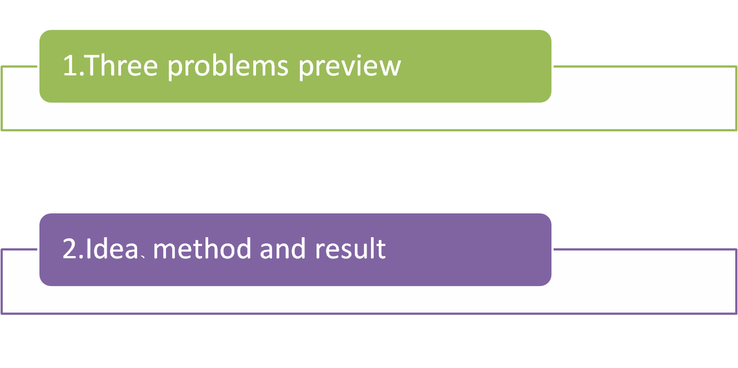
CONTENTS

Slide 3
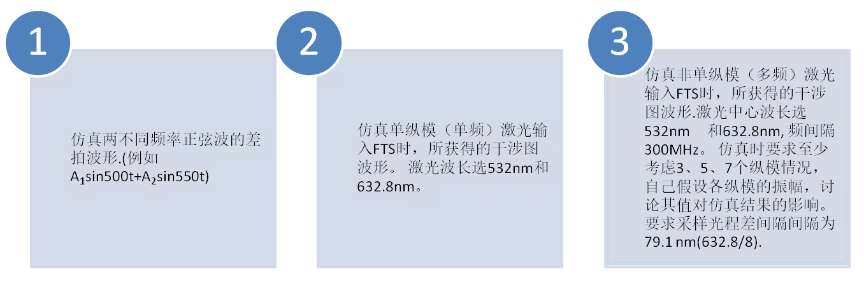
Work preview
U(t)=A1sin(500t)+A2sin(550t)
I(x)=I0cos(4pi*x/lambda)
I(x)=∑Ii

Slide 4
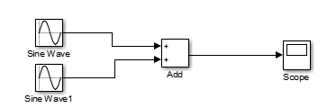
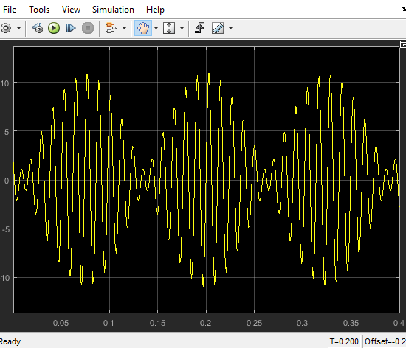
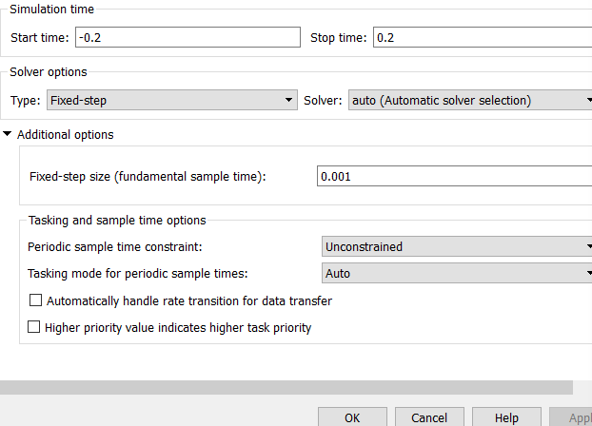
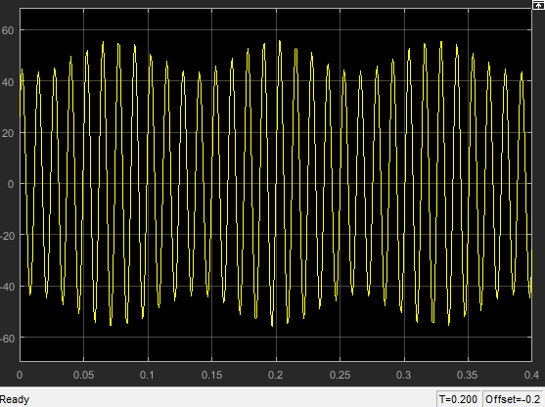
Data and result of HW1
Module
Results
A1:A2=5:6
A1:A2=50:6

Slide 5
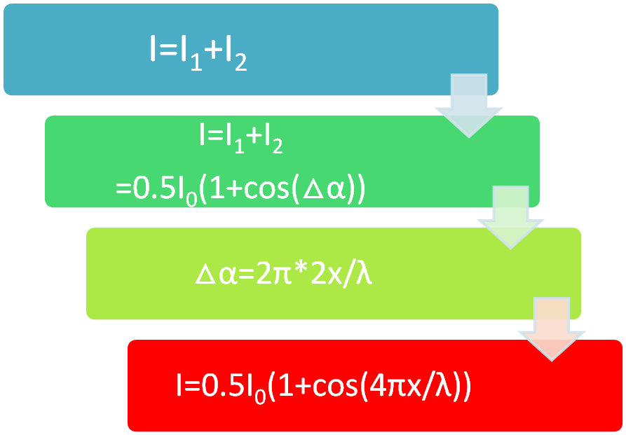
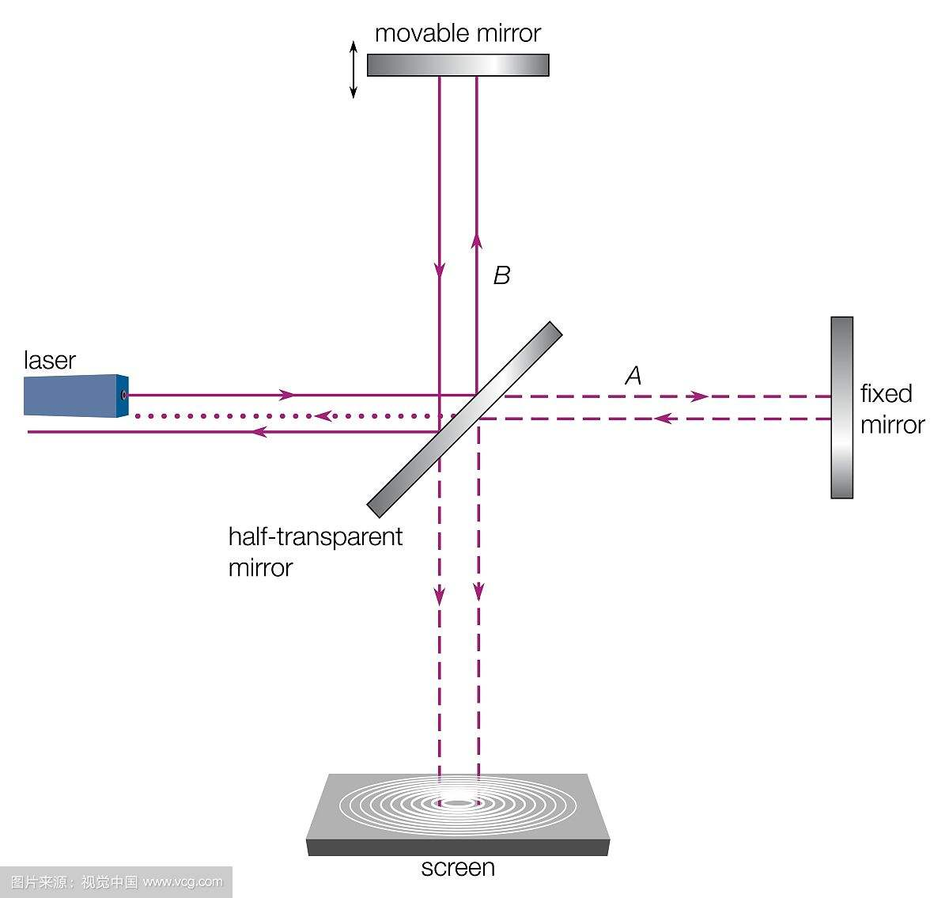
Data and result of HW2
Module
x
I0
I1
I2

Slide 6
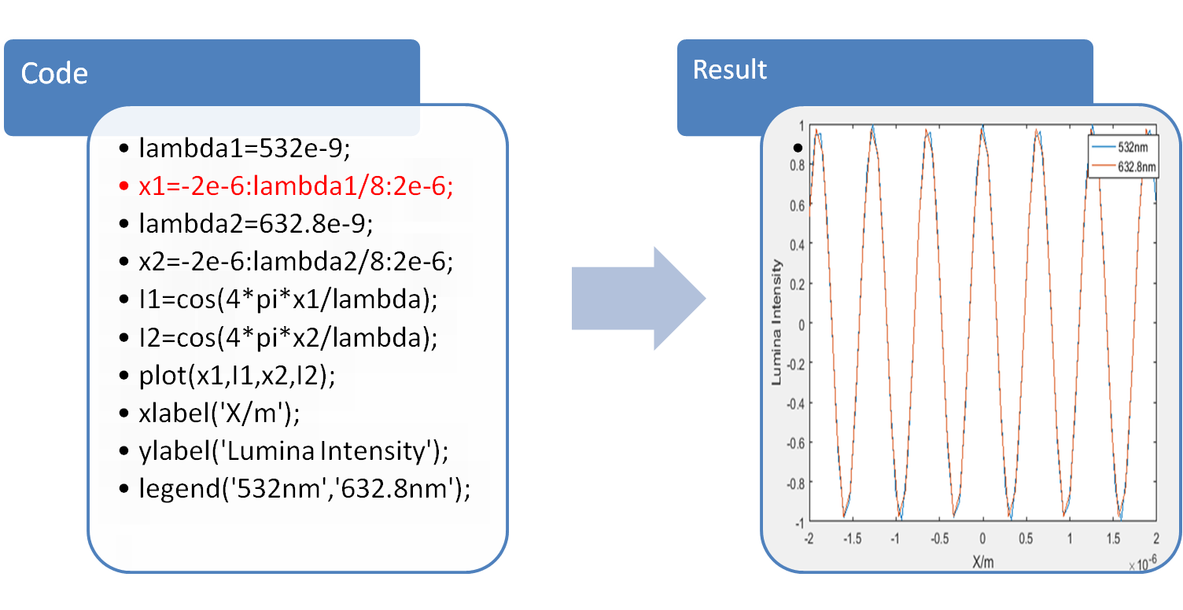
Data and result of HW2

Slide 7
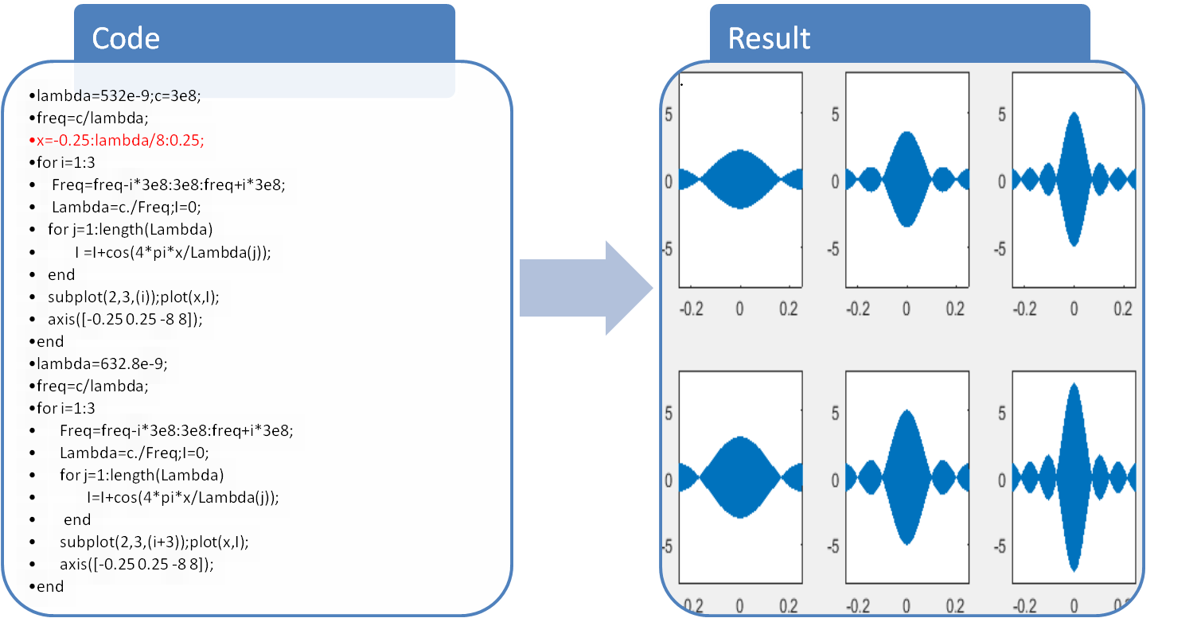
Data and result of HW3
532nm
I_{i}=1
Scan distance=±0.25m
632.8nm

Slide 8
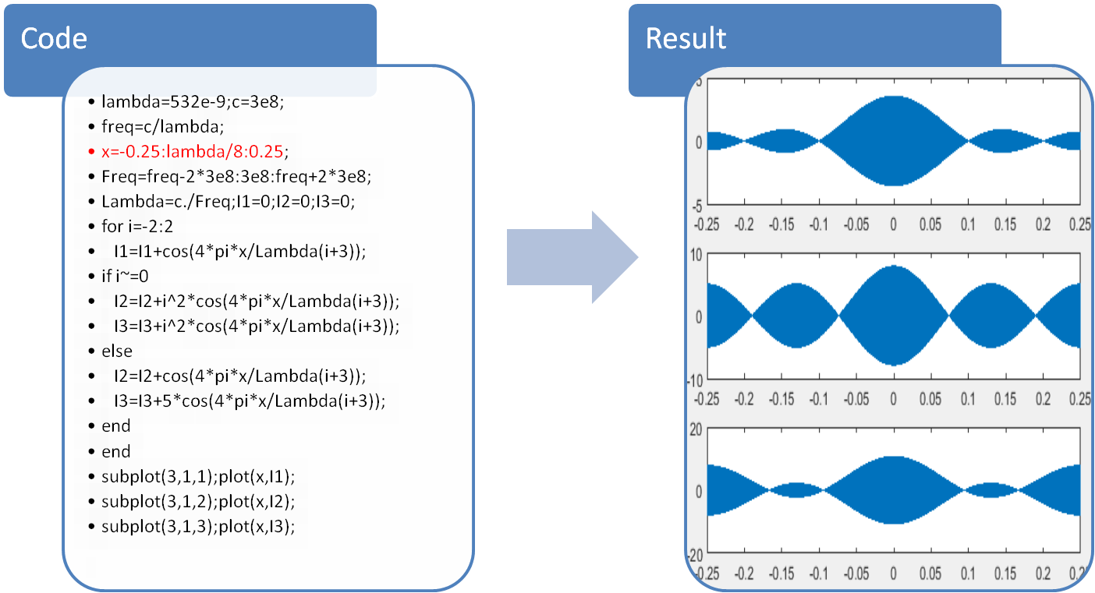
Data and result of HW3
I₁:I₂:I₃:I₄:I₅=1:1:1:1:1
I₁:I₂:I₃:I₄:I₅=4:1:1:1:4
I₁:I₂:I₃:I₄:I₅=4:1:5:1:4

