Slide 1
2017 2nd Homework of Fourier transform spectroscopy
Presented by
kangkai chen,song shang

Slide 2
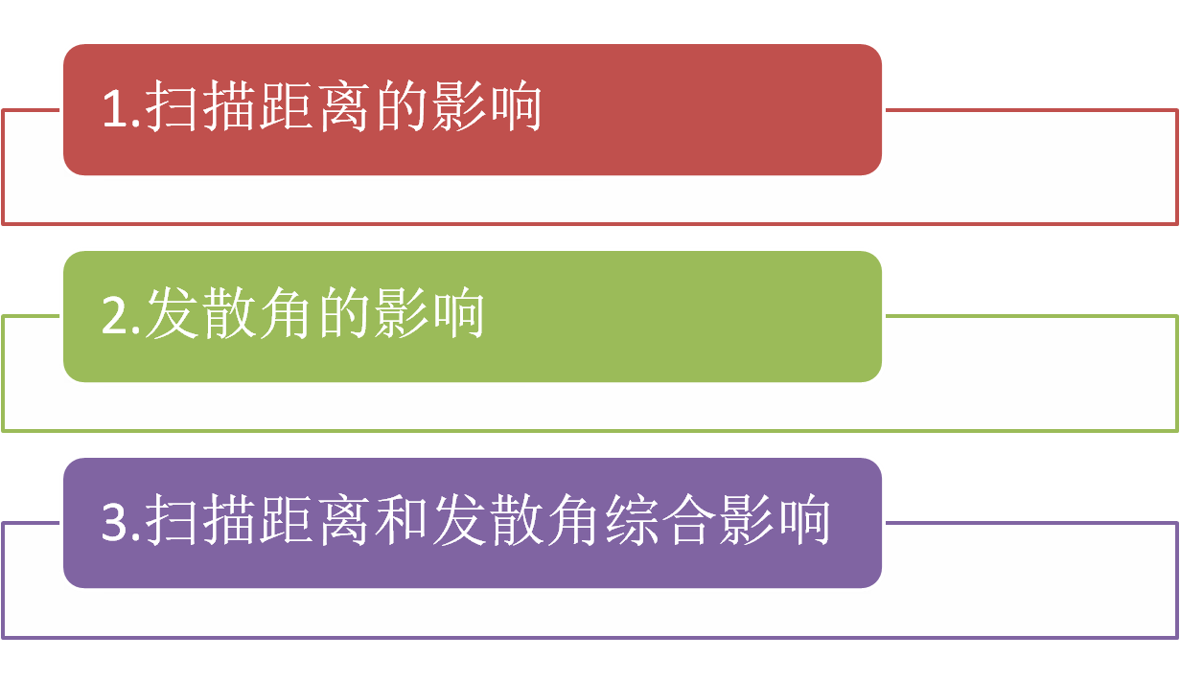
CONTENTS

Slide 3

整体思路
*

Slide 4
扫描距离的影响
lambda1=532e-7;lambda2=632.8e-7;
theta1=1/lambda1;theta2=1/lambda2;
x=-25:lambda2/8:25;
N=length(x);
nfft=2^nextpow2(N);
theta=linspace(0,8*theta2,nfft);
linecolor=['r','b','k'];
c=cell(1,3);
B=zeros(3,nfft);
for i=1:3;
I=2*(cos(2*pi*x*theta1)+
cos(2*pi*x*theta2)).*(rectpuls(x,i));
B(i,1:nfft)=2*fft(I,nfft)/N;
figure(1)
plot(theta(1:nfft/2),abs(B(i,1:nfft/2)),linecolor(i));
hold on
figure(2)
plot(theta(1:nfft/2),abs(B(i,1:nfft/2)),linecolor(i));
hold on
axis([0.9998*theta2 1.0002*theta2 0 0.2]);
c{i}=sprintf('扫描距离=±%2.1fcm',i/2);
end
figure(1)
title('扫描距离对光谱测量的影响');
xlabel('σ/cm-1');
text(1.9e4,0.06,'\leftarrow532nm','color','r');
text(0.5e4,0.06,'632.8nm\rightarrow','color','r');
figure(2)
title('扫描距离对光谱测量的影响');
xlabel('σ/cm-1');
legend(c{1},c{2},c{3});
控制不同扫描距离（cm）

Slide 5
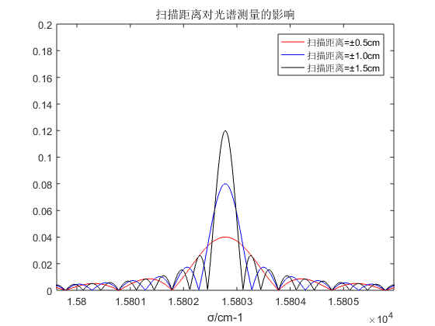
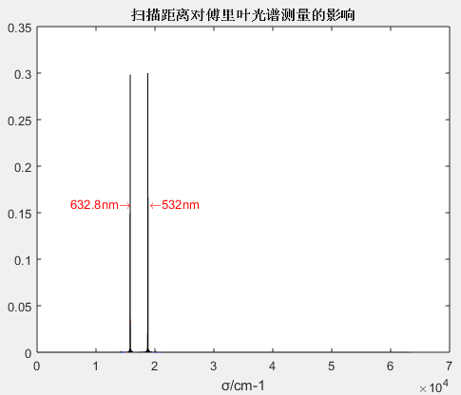
扫描距离的影响

Slide 6
发散角的影响
lambda1=532e-7;lambda2=632.8e-7;
theta1=1/lambda1;theta2=1/lambda2;
x=-25:lambda2/8:25;
N=length(x);
nfft=2^nextpow2(N);
theta=linspace(0,8*theta2,nfft);
linecolor=['r','b','k'];
c=cell(1,3);
B=zeros(3,nfft);
for i=1:3
f=[50 75 100];
a=0.3;
omiga=2*pi*(1-cos(atan(a/f(i))));
dtheta1=theta1*omiga/(2*pi);
dtheta2=theta2*omiga/(2*pi);
E1=pi/(omiga*theta1);
E2=pi/(omiga*theta2);
B(i,1:nfft)=E1*rectpuls(theta-theta1*(1-(omiga/(4*pi))),dtheta1)+E2*rectpuls(theta-theta2*(1-(omiga/(4*pi))),dtheta2);
figure(1)
plot(theta(1:nfft/2),abs(B(i,1:nfft/2)),linecolor(i));
hold on
figure(2)
plot(theta(1:nfft/2),abs(B(i,1:nfft/2)),linecolor(i));
hold on
axis([0.9998*theta2 1.0002*theta2 -0.1 8]);
c{i}=sprintf('f=%dmm a=600um',f(i));
end
figure(1)
title('发散角对光谱测量的影响');
xlabel('σ/cm-1');
figure(2)
title('发散角对光谱测量的影响');
xlabel('σ/cm-1');
legend(c{1},c{2},c{3});

Slide 7
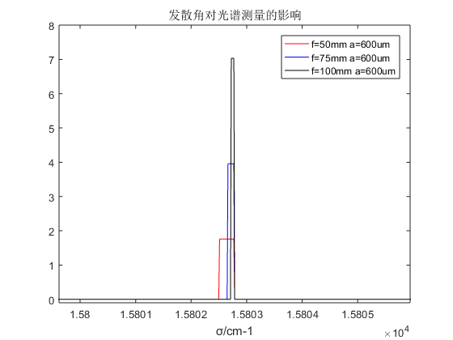
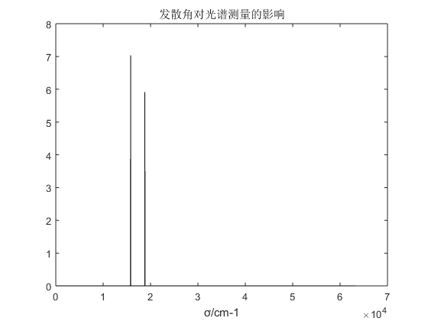
发散角的影响

Slide 8
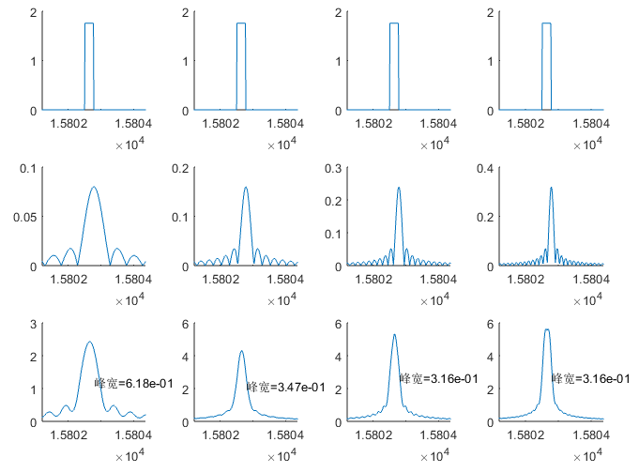
扫描距离和发散角综合影响
固定发散角a/f=0.6/50（mm） 扫描距离x=±1~±4（cm）
结论—当光源发散角为a/f=0.6/50时：
若扫描距离小于3cm，增大扫描距离光谱曲线可以明显改善。
若超过3cm，无论如何增大扫描距离，对结果几乎没有影响。。
固定发散角
不同距离
卷积后

Slide 9
扫描距离和发散角综合影响
lambda=632.8e-7;theta=1/lambda;f=50;a=0.3;
x=-25:lambda/8:25;N=length(x);nfft=2^nextpow2(N);
Theta=linspace(0,8*theta,nfft);B=zeros(4,nfft);
ax=[];n1=floor(0.9998*nfft/8);n2=ceil(1.0002*nfft/8);
omiga=2*pi*(1-cos(atan(a/f)));dtheta=theta*omiga/(2*pi);
E=pi/(omiga*theta);
Bdiv=E*rectpuls(Theta(n1:n2)-theta*(1-(omiga/(4*pi))),dtheta);
ax(1)=subplot(341);plot(Theta(n1:n2),Bdiv);set(gca,'box','off');
ax(2)=subplot(342);plot(Theta(n1:n2),Bdiv);set(gca,'box','off');
ax(3)=subplot(343);plot(Theta(n1:n2),Bdiv);set(gca,'box','off');
ax(4)=subplot(344);plot(Theta(n1:n2),Bdiv);set(gca,'box','off');
for i=1:4;
I=2*cos(2*pi*x*theta).*(rectpuls(x,i*2));
B(i,1:nfft)=2*fft(I,nfft)/N;
BILS=conv(Bdiv,abs(B(i,n1:n2)),'same');
[temp,wdind]=sort(abs(BILS-max(BILS)/2));
width=abs(wdind(1)-wdind(2))*theta*8/nfft;
ax(i+4)=subplot(3,4,i+4);plot(Theta(n1:n2),abs(B(i,n1:n2)));
set(gca,'box','off');
ax(i+8)=subplot(3,4,i+8);
plot(Theta(n1:n2),BILS);
set(gca,'box','off');
text(theta,BILS(wdind(1)),
sprintf('峰宽=%0.2e',width));
end
linkaxes(ax,'x');
xlim([0.9999*theta 1.0001*theta]);

Slide 10
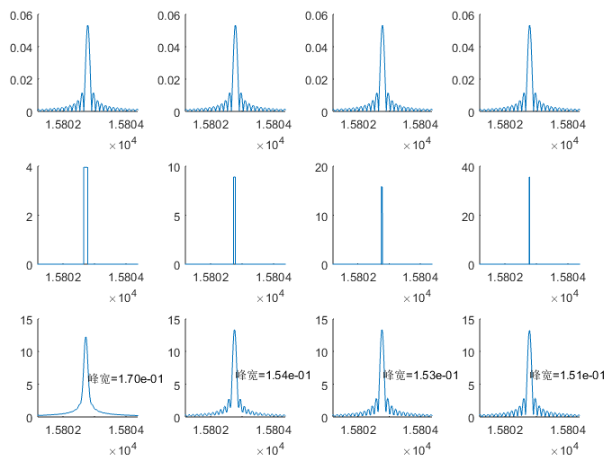
扫描距离和发散角综合影响
结论—当扫描距离x=4cm，光源直径a=0.4mm时：
在50~75mm焦距内，增大焦距可以改善光谱曲线。
若焦距超过75mm时，无论如何增大焦距，对结果几乎没有影响。。
固定扫描距离x=±4cm
光源直径a=0.4mm
f=50
f=75
f=100
f=150

Slide 11
扫描距离和发散角综合影响
lambda=632.8e-7;theta=1/lambda;x=-150:lambda/8:150;
N=length(x);nfft=2^nextpow2(N);Theta=linspace(0,8*theta,nfft);
ax=[];n1=floor(0.9998*nfft/8);n2=ceil(1.0002*nfft/8);B=zeros(4,n2-n1+1);
I=2*cos(2*pi*x*theta).*(rectpuls(x,8));BL=abs(2*fft(I,nfft)/N);
ax(1)=subplot(341);plot(Theta(n1:n2),BL(n1:n2));set(gca,'box','off');
ax(2)=subplot(342);plot(Theta(n1:n2),BL(n1:n2));set(gca,'box','off');
ax(3)=subplot(343);plot(Theta(n1:n2),BL(n1:n2));set(gca,'box','off');
ax(4)=subplot(344);plot(Theta(n1:n2),BL(n1:n2));set(gca,'box','off');
for i=1:4;
f=[50 75 100 150];a=0.2;
omiga=2*pi*(1-cos(atan(a/f(i))));
dtheta=theta*omiga/(2*pi);
E=pi/(omiga*theta);
B(i,n1:n2)=E*rectpuls(Theta(n1:n2)-theta*(1-(omiga/(4*pi))),dtheta);
BILS=conv(BL(n1:n2),B(i,n1:n2),'same');
[temp,wdind]=sort(abs(BILS-max(BILS)/2));
width=abs(wdind(1)-wdind(2))*theta*8/nfft;
ax(i+4)=subplot(3,4,i+4);plot(Theta(n1:n2),B(i,n1:n2));
set(gca,'box','off');
ax(i+8)=subplot(3,4,i+8);plot(Theta(n1:n2),BILS);
set(gca,'box','off');
text(theta,BILS(wdind(1)),sprintf('峰宽=%0.2e',width));
end
linkaxes(ax,'x');
xlim([0.9999*theta 1.0001*theta]);

