Slide 1
2017 4th Homework of Fourier transform spectroscopy
Presented by
kangkai chen,song shang

Slide 2
代码
lambda=632.8e-7;
sigma=1/lambda;
x0=-1024*256*lambda/8:lambda/8:(1024*256-1)*lambda/8;
n=length(x0);
nfft=2^(nextpow2(n)+4);
Sigma=linspace(0,8*sigma,nfft);
n1=floor(0.9998*nfft/8);
n2=ceil(1.0002*nfft/8);
I=2*cos(2*pi*x0*sigma);
B=2*abs(fft(I,nfft))/n;
figure
subplot(1,2,1),plot(x0(10:40),I(10:40));
subplot(1,2,2),plot(Sigma(n1:n2),B(n1:n2));
[temp,wd]=sort(abs(B(n1:n2)-max(B(n1:n2))/2));
peakwd=abs(wd(1)-wd(2))*sigma*8/nfft;
text(sigma,1,sprintf('峰宽=%0.3f',peakwd));
text(sigma,1.8,sprintf('峰高=%0.3f',max(B)));
noise=[2*rand(size(x0))-1;sin(2e12*pi*sigma*x0);randn(size(x0))];

Slide 3
代码
figure;
for i=1:3
x=x0+lambda/16*noise(i,:);
I=2*cos(2*pi*x*sigma);
B=2*abs(fft(I,nfft))/n;
subplot(3,3,3*i-2),plot(x0(10:40),I(10:40));
subplot(3,3,3*i-1),hist(noise(i,:),100);
subplot(3,3,3*i),plot(Sigma(n1:n2),B(n1:n2));
[temp,wd]=sort(abs(B(n1:n2)-max(B(n1:n2))/2));
peakwd=abs(wd(1)-wd(2))*sigma*8/nfft;
text(sigma,1,sprintf('峰宽=%0.3f',peakwd));
text(sigma,1.8,sprintf('峰高=%0.3f',max(B)));
xlabel('σ/cm-1');
end

Slide 4
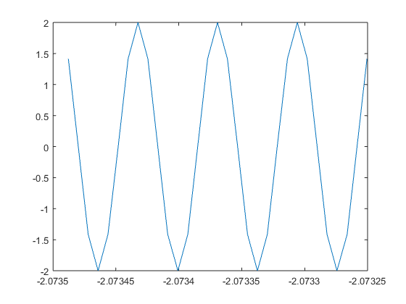
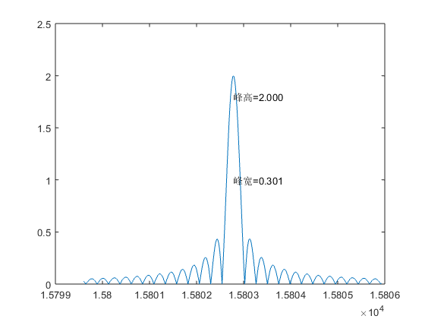
无噪声

Slide 5
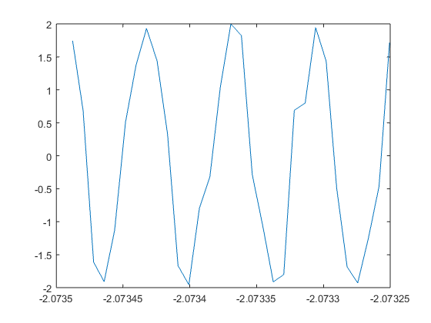
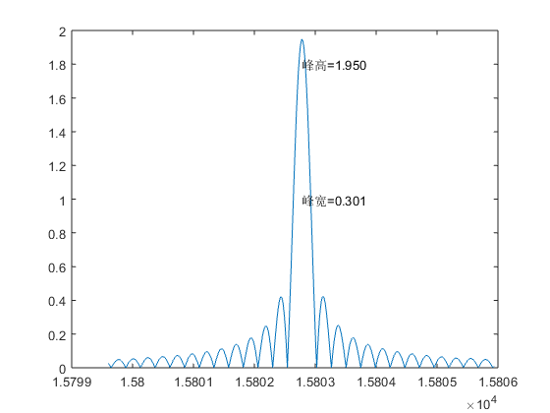
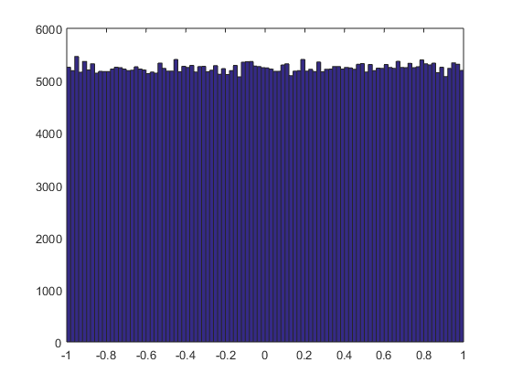
均匀随机噪声

Slide 6
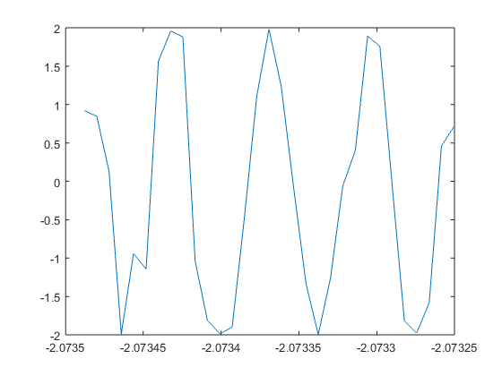
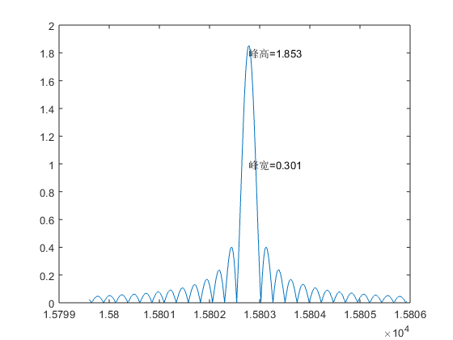
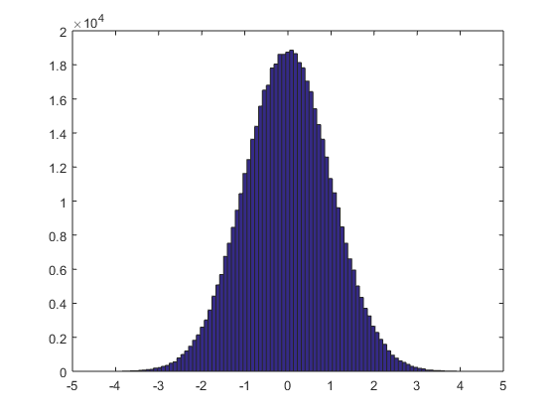
高斯随机噪声

Slide 7
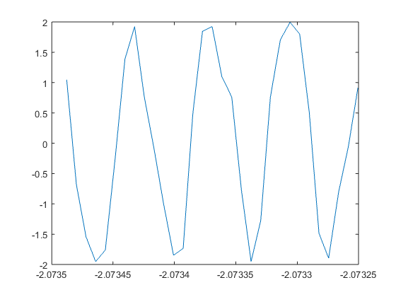

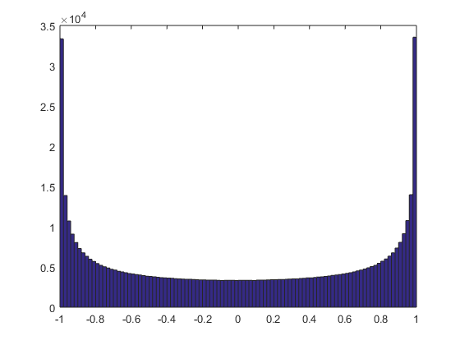
正弦周期噪声

